Slide 1
From modelling to McStas and more
A short guide
E. Farhi, ILL

Slide 2

Data formats

Slide 3
McStas Data formats
McStas uses a number of input data formats, all text based.
Lau (Single_crystal, PowderN, Isotropic_Sqw)
Laz (PowderN, Isotropic_Sqw)
Sqw (Isotropic_Sqw)
qSq (Isotropic_Sqw) – mostly for liquids
nxs (Sample_nxs) – this is not a NeXus/HDF
PDB (SANSPDB)
The question is how to generate these files…
By hand ?

Slide 4
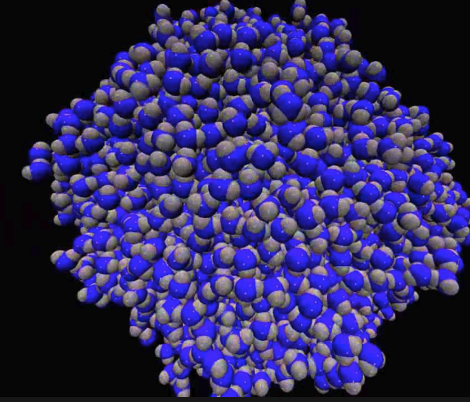
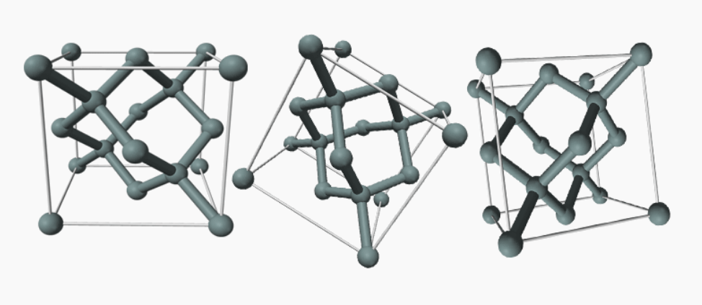
Material modelling formats
MD (classical or DFT)
  trajectories, many data formats
Lattice dynamics:
  PhonoPy FORCE_SETS
  ...

Slide 5
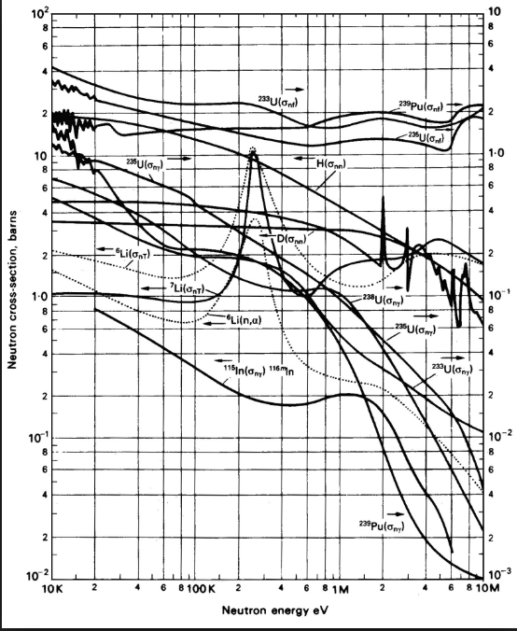
Nuclear data base formats
ENDF, JEFF, JENDL, …
  all use a standard format for a set of materials. Most are monoatomic / incoherent
ACE
  Same as ENDF, but in binary for MCNP
Ncrystal (2.5)
  NCMAT,NXS,LAU

Slide 6
Experiments
Intensity(d) → F(Q) → S(Q) and Laz
Intensity(HKL) → F2(HKL) → Lau
Intensity(theta,ToF) → S(q,w)
Often saved as text and/or NeXus

Slide 7

Tools
iFit
Mantid
Python/ASE (IO)
MDANSE/nMoldyn (converters)
Scripts of all kinds
  OpenBABEL, ...
cif2hkl
bash

Slide 8
Material DataBases
ICSD <http://icsd.ill.fr/icsd/index.html>
COD <http://crystallography.net>
<https://www.materialsproject.org/>
PhononDB <http://phonondb.mtl.kyoto-u.ac.jp/>
Nomad <https://repository.nomad-coe.eu/>
Mostly provide structures...

Slide 9
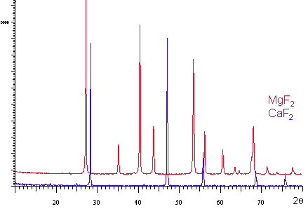
McStas: structure: powder
For powders, the pure elastic diffraction is easy to prepare: LAZ
  PowderN
  Single_crystal(powder=1, ...)
  Isotropic_Sqw
Terminal:
cif2hkl --powder file.cif
CIF file
FullProf/ShelX
McStas Laz file
iFit:
cif2hkl(‘file.cif’,’’,’p’)
CIF file
FullProf/ShelX
McStas Laz file

Slide 10
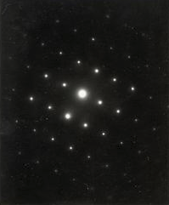
McStas: structure: SX
For single crystals, the pure elastic diffraction is easy to prepare: LAU
  PowderN
  Single_crystal
  Isotropic_Sqw
Terminal:
cif2hkl --xtal file.cif
CIF file
FullProf/ShelX
McStas Lau file
iFit:
cif2hkl(‘file.cif’,’’,’x’)
CIF file
FullProf/ShelX
McStas Lau file

Slide 11
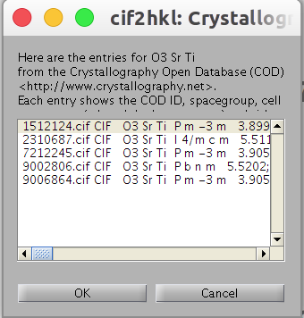
McStas: structure: COD
cif2hkl from iFit can input chemical formula
Requires internet connection to COD
Hill notation: C H then alpha order
iFit:
cif2hkl(‘cod: La Mn O3’,’’,’p’)
Chemical formula
McStas Laz file
iFit:
cif2hkl(‘cod: O3 Sr Ti’,’’,’x’)
Chemical formula
McStas Lau file

Slide 12
McStas: structure: others
Other McStas structure file formats
  SANSPDB and similars: get from Data Bases
  Sample_nxs: manual edit only (nxs, text)
  Isotropic_Sqw: manual edit only (qSq, text)
  NCrystal_sample*: (ncmat,nxs,lau)
*in McStas from v. 2.5
Terminal:
babel -iFMT -oOUT file.cif
FMT file
OUT file
Terminal:
babel -icif -opdb file.cif
CIF file
PDB
OpenBabel supports many data files

Slide 13
McStas: dyn from ToF spec
Import and correct data with e.g. LAMP, Mantid
Integrate radially (|q|) and compute S(q,w)
Export to e.g. HDF/NeXus or other
Import then export with iFit:
  sqw=iData_Sqw2D(‘file’)
  sqw.saveas(‘file.sqw’,’mcstas’)
Can/should always edit manually (text)
# weight 4.002 in [g/mol]
# density 0.4784 in [g/cm^3]
# sigma_abs 0.00747 absorption scattering cross section in [barn]
# sigma_coh 1.34 coherent scattering cross section in [barn]
# sigma_inc 0 incoherent scattering cross section in [barn]
# Temperature 2 in [K]
# classical 0 experimental, contains Bose factor

Slide 14
McStas: dyn from exp. DOS
Import and correct data with e.g. LAMP, Mantid
Estimate g(w) with e.g. LAMP, Mantid, MUPHOCOR
Export to e.g. HDF/NeXus or other
Import then export with iFit:
  g=iData_vDOS(‘file’)
  inc=g.incoherent;
  inc.saveas(‘inc.sqw’,’mcstas’)
Can/should always edit manually (text)

Slide 15
McStas: dyn from nuclear DB
Import and export with iFit:
  sqw=iData_Sqw2D(‘tsl.endf’)
  saveas(sqw(1), ‘inc.sqw’,’mcstas’)
Ncrystal (2.5) will provide an alternate solution
Can/should always edit manually (text)
# weight 4.002 in [g/mol]
# density 0.4784 in [g/cm^3]
# sigma_abs 0.00747 absorption scattering cross section in [barn]
# sigma_coh 1.34 coherent scattering cross section in [barn]
# sigma_inc 0 incoherent scattering cross section in [barn]
# Temperature 2 in [K]
# classical 0 experimental, contains Bose factor

Slide 16
McStas: dyn from MD
Import trajectory into MDANSE (converters)
Double click the trajectory to allow analysis
Use Plugins:
  Analysis/Scattering/DCSF and DISF
  Analysis/Scattering/Structure Factor
  Analysis/Dynamics/Density of States
Import then export with iFit:
  sqw=iData_Sqw2D(‘DCSF.nc’)
  sqw.saveas(‘coh.sqw’,’mcstas’)
Can/should always edit manually (text)

Slide 17
McStas: dyn from Lattice Dynamics
Using PhonoPy:
  iFit: s4d=sqw_phonons(‘phonopy_directory’)
Computing on the fly:
  iFit: s4d=sqw_phonons(‘cod: La Mn O3’)
  p=powder(s4d)
  d=iData_Sqw2D(iData(p, [], 0:10, 0:100))
  d.saveas(‘coh.sqw’,’mcstas’)
Other:
  Import in iFit, convert to Sqw2D, export.

Slide 18

Neutron events
McStas handle ‘rays’ as packets of neutron events.
Summing-up builds intensity and distributions.
McStas can read/write ‘events’ from other software:
  MCNP TRAC and SSW
  TRIPOLI
  MCPL*
McStas can generate events as well for Mantid via NeXus/HDF files.
*Allows interchange with many other MC codes: MCNP, Geant4, SIMRES, Vitess, ...

Slide 19
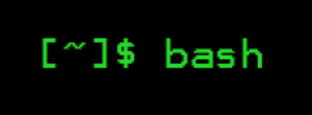
McStas automation: bash
Can use cif2hkl and mcrun commands:
  cif2hkl ‘file’ --out ‘file.laz’ --powder
  mcrun –dir=test instr Powder=file.laz
  mcplot.pl -psc test

Slide 20

McStas automation: iFit
iFit is a generic infrastructure which gathers data sets handling, fitting, S(q,w) models, and McStas hooks.

Slide 21
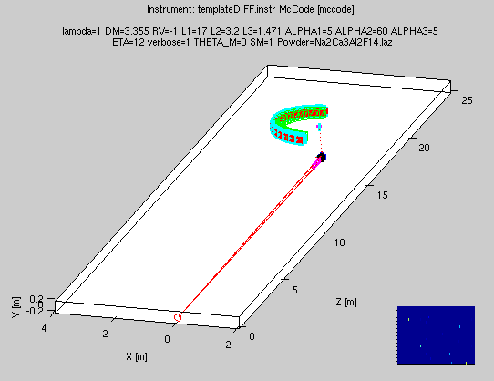
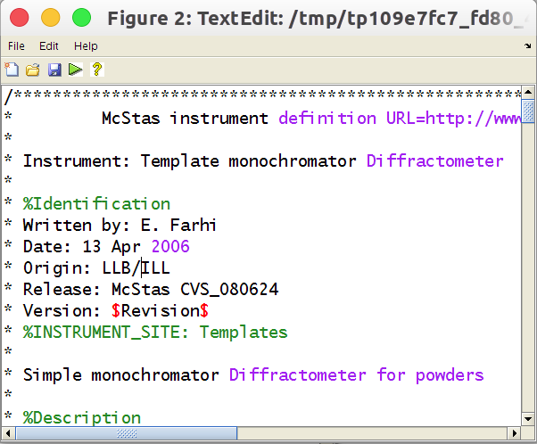
McStas iFit: build
McStas can be controlled from within iFit.
Open Matlab/iFit
Create the McStas model with:
  model = mccode(‘instr’)
Plot the geometry with:
  plot(model) % has contextual menus
Edit the instrument and re-compile
  edit(model)

Slide 22
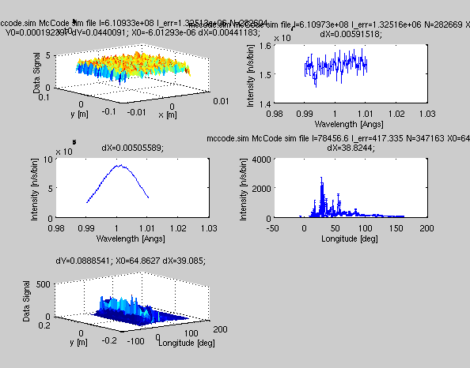
McStas iFit: eval
Run with (default 1e6 event and pars)
  data = iData(model, [], nan);
  subplot(model) % plot monitors, contextual menus
Specify parameters
  data = iData(model, ‘lambda=2.36; coh=Cu.laz’)
Do a scan:
  data = iData(model, ‘lambda=[1.2 2.4 3.6]’)
Change neutron events #
  model.UserData.options.ncount = 1e7;

Slide 23
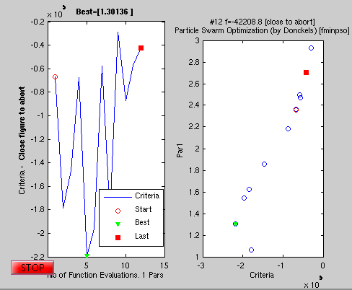
McStas iFit: optim
Fix all parameters but lambda, Maximize model value:
  mlock(model, ‘all’); munlock(model, ‘lambda’)
  xlim(model, ‘lambda’, [1 3]); % bounds
  fmax(model, ‘lambda=2.36’, ‘’, nan)
  fmax(model, ‘lambda=2.36’, ‘OutputFcn=fminplot’, nan)

Slide 24
McStas iFit: advanced
You can add McStas models:
  model=mccode(‘instr1’)+mccode(‘instr2’) + ...
For instance:
  Instr1: structure
  Instr2: spin-wave
  Instr3: phonons
  Instr4: incoherent
The different models can also be assembled as a set of samples chosen at execution in a single McStas instrument.

Slide 25
Links to software
McStas http://www.mcstas.org (includes cif2hkl)
iFit http://ifit.mccode.org (includes cif2hkl)
Mantid http://www.mantidproject.org
MDANSE http://www.mdanse.org
ASE https://wiki.fysik.dtu.dk/ase/
Ncrystal https://github.com/mctools/ncrystal

