Slide 1
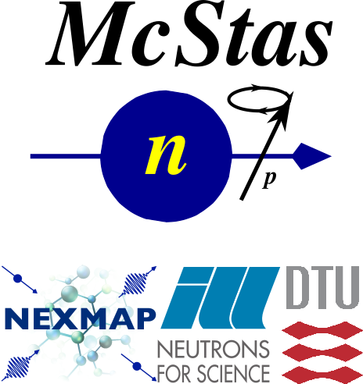
Simulating Polarized Neutron Scattering Experiments and Equipment with McStas
Emmanuel Farhi, ILL (Slides from Erik Bergbäck Knudsen, DTU Physics)

Slide 2
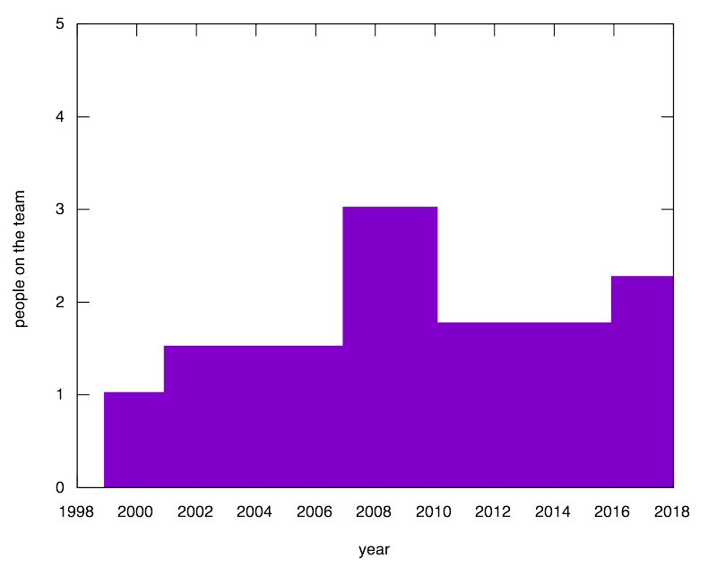
Workforce
Work starts on polarization
Release 2.4
Release 1.0
Work starts on McXtrace

Slide 3
Mcstas “particle” model
Neutron ray/package:
Weight: (p) # neutrons left in the package Position: (x, y, z)
Velocity: (v_{x}, v_{y}, v_{z})
Polarization: (p_{x}, p_{y}, p_{z})
Time: (t)
Neutron ray/package:
Weight: (p) # neutrons left in the package Position: (x, y, z)
Velocity: (v_{x}, v_{y}, v_{z})
Polarization: (p_{x}, p_{y}, p_{z})
Time: (t)
Neutron ray/package:
Weight: (p) # neutrons left in the package Position: (x, y, z)
Velocity: (v_{x}, v_{y}, v_{z})
Polarization: (s_{x}, s_{y}, s_{z})
Time: (t)
$$P_{n}=\frac{1}{p}\sum_{i}^{p}{P_{i}}, n=raynumber$$
$$P_{n}$$
n
$$P$$
$$P_{i}=2\left(\left\langle {\hat{s}}_{x,i}\right\rangle {\hat{i}}_{x,i}+\left\langle {\hat{s}}_{y,i}\right\rangle {\hat{i}}_{y,i}+\left\langle {\hat{s}}_{z,i}\right\rangle {\hat{i}}_{z,i}\right)$$
$$P=\frac{1}{N}\sum_{n=0}^{N}{P_{n}}$$
From G. Williams: “Polarized neutrons”, Oxford Science Publ., 1988

Slide 4
McStas detectors/monitors
Monitoring: How and What do we monitor?
n
n
$$P_{\hat{h}}=\frac{\sum_{n=0}^{N}{p_{n}}P_{n}⋅\hat{h}}{\sum_{n}^{N}{p_{n}}}$$
n
n
n
n
$$P$$
$$\hat{h}$$

Slide 5
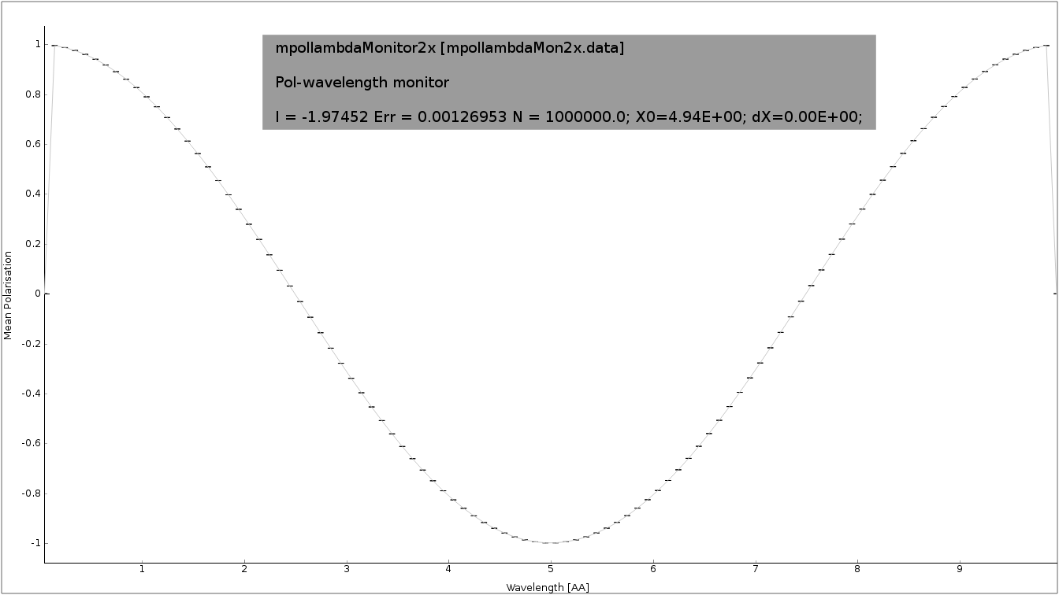
McStas detectors/monitors
Monitoring: How and What do we monitor?
n
n
n
n
n
n
$$P$$
$$\hat{h}$$

Slide 6
McStas detectors/monitors
Monitoring: How and What do we monitor?
n
n
n
n
n
n
$$P$$
$$\hat{h}$$

Slide 7
Polarization monitors
Available monitors:
Pol_monitor.comp: 0D
PolLambda_monitor.comp: 2D
MeanPolLambda_monitor.comp: 1D

Slide 8
McStas precession algorithm
Magnetic fields in McStas
The challenge:
Fast beam/ray transport: #
Unknown magnetic field and field strength
>1 Magnet → nested fields.
$$rays>{10}^{6}$$

Slide 9
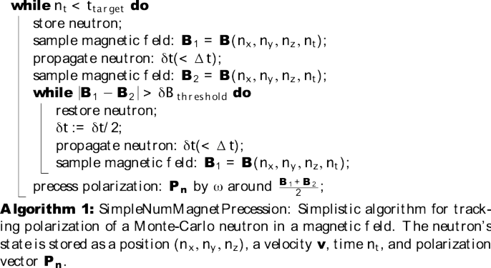
McStas precession algorithm
From: Knudsen et.al., J. Neutron Research, 2014

Slide 10
McStas precession algorithm
B₂
B₁
n
$$δt$$

Slide 11
McStas precession algorithm
B₂
B₁
n
$$δ\hat{t}=δt/2$$

Slide 12
McStas precession algorithm
From: Knudsen et.al., J. Neutron Research, 2014

Slide 13
McStas precession algorithm
From: Knudsen et.al., J. Neutron Research, 2014

Slide 14
McStas precession algorithm
void mc_pol_set_timestep(double dt);
void mc_pol_set_angular_accuracy(double domega);
From: Knudsen et.al., J. Neutron Research, 2014

Slide 15
McStas polarization components
Magnetic fields:
Pol_FieldBox.comp
Pol_constBfield.comp
Pol_simpleBfield.comp
Pol_simpleBfield_stop.comp
Pol_triafield.comp
Optics:
Monochromator_pol.comp
Pol_bender.comp
Pol_guide_vmirror.comp
Pol_mirror.comp
Pol_pi_2_rotator.comp
Transmission_polarisatorABSnT.comp
Pol_bender_tapering.comp
Monitors:
Pol_monitor.comp
MeanPolLambda_monitor.comp
PolLambda_monitor.comp
Idealized components:
PolAnalyser_ideal.comp
Set_pol.comp
Contrib:
Foil_flipper_magnet.comp

Slide 16
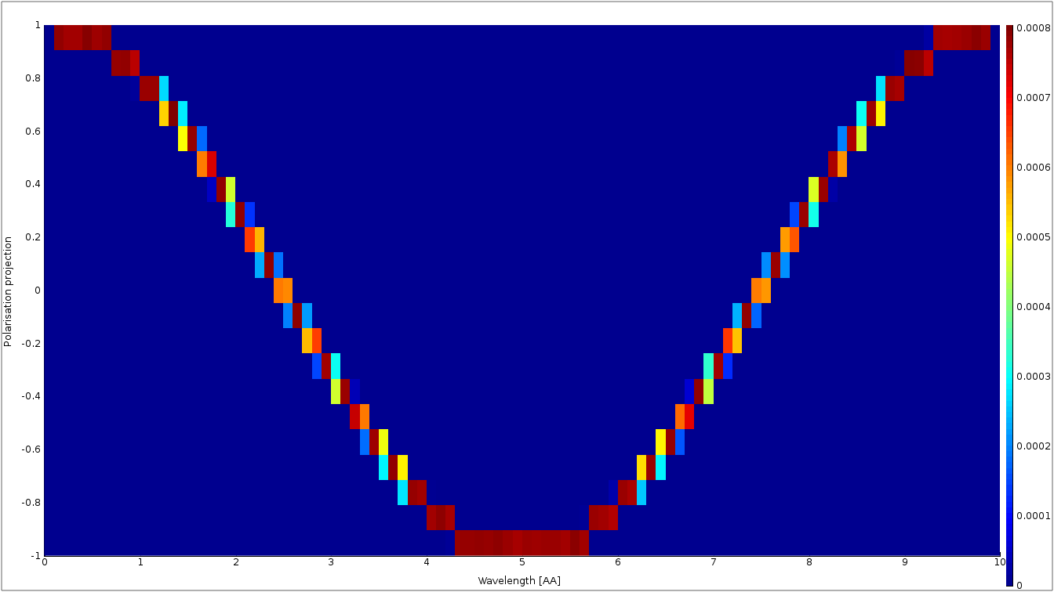
McStas polarization monitors
PolLambda_monitor
Monitors
MeanPolLambda_monitor
n
n
n
n
n
n
$$P$$
Pol_monitor
$$P∥\left(m_{x},m_{y},m_{z}\right)=0.87$$

Slide 17
McStas magnetic fields
Pol_constBfield.comp
Single constant Magnetic field in a “box”.
- user may specify a wavelength to flip. - blocking walls

Slide 18
McStas magnetic fields
Pol_FieldBox.comp
Single Magnetic field in a “box”
- optional user supplied field c-function

Slide 19
McStas magnetic fields
Pol_simpleBfield.comp
Pol_simpleBfield_stop.comp
- Entry/Exit contruction allows for nested magnetic field descriptions. - Any magnetic fields through user supplied c-function - Tabled magnetic fields

Slide 20
McStas Polarization Capabilities IV
Pol_simpleBfield.comp
Pol_simpleBfield_stop.comp
- Entry/Exit contruction allows for nested magnetic field descriptions. - Any magnetic fields through user supplied c-function - Tabled magnetic fields

Slide 21
Pol_monitors along the way...

Slide 22
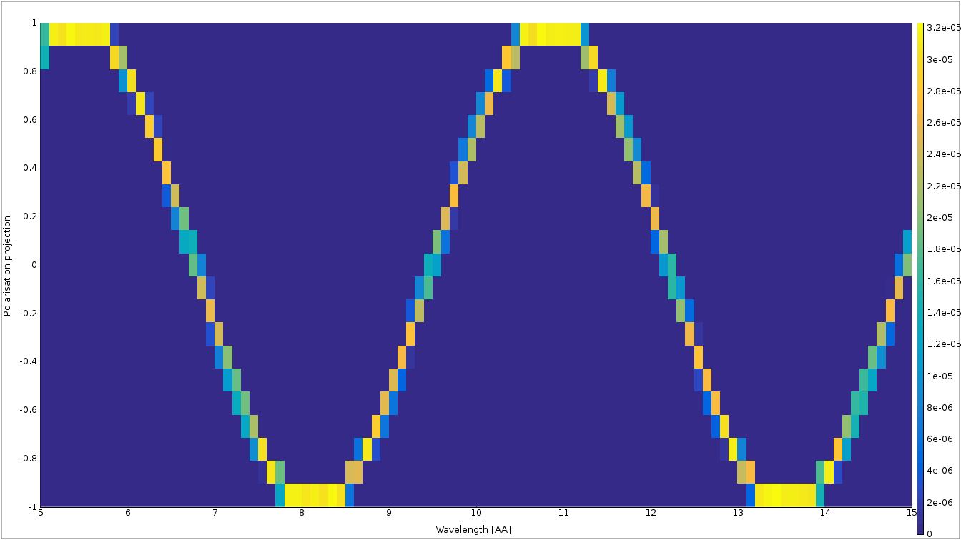
Pol_monitors along the way...
Pol_lambda_mon 1 placeholder

Slide 23
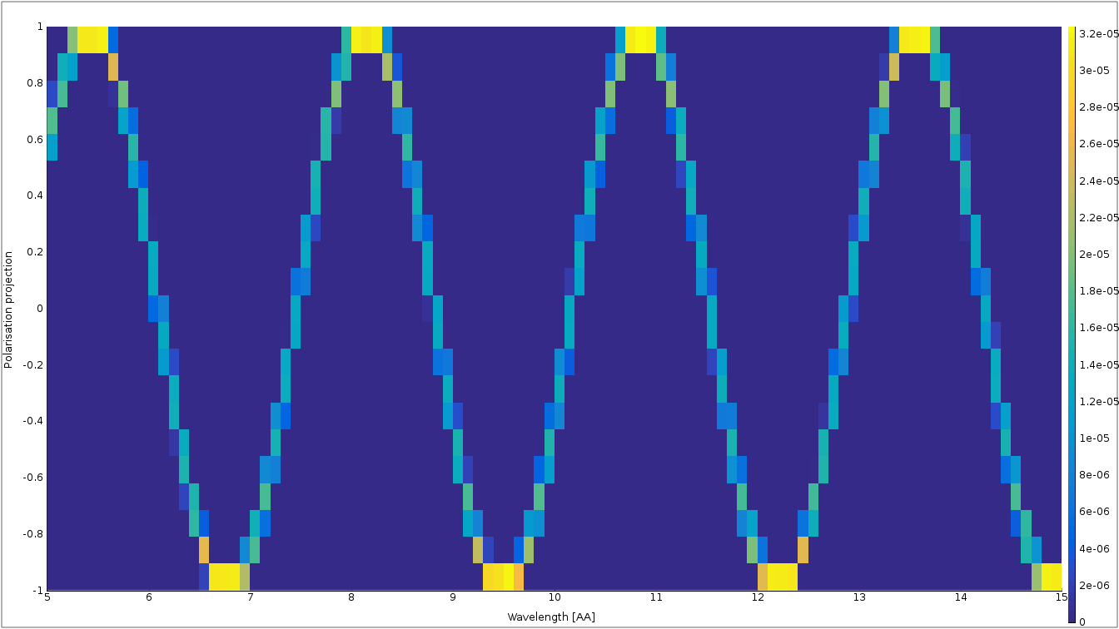
Pol_monitors along the way...

Slide 24
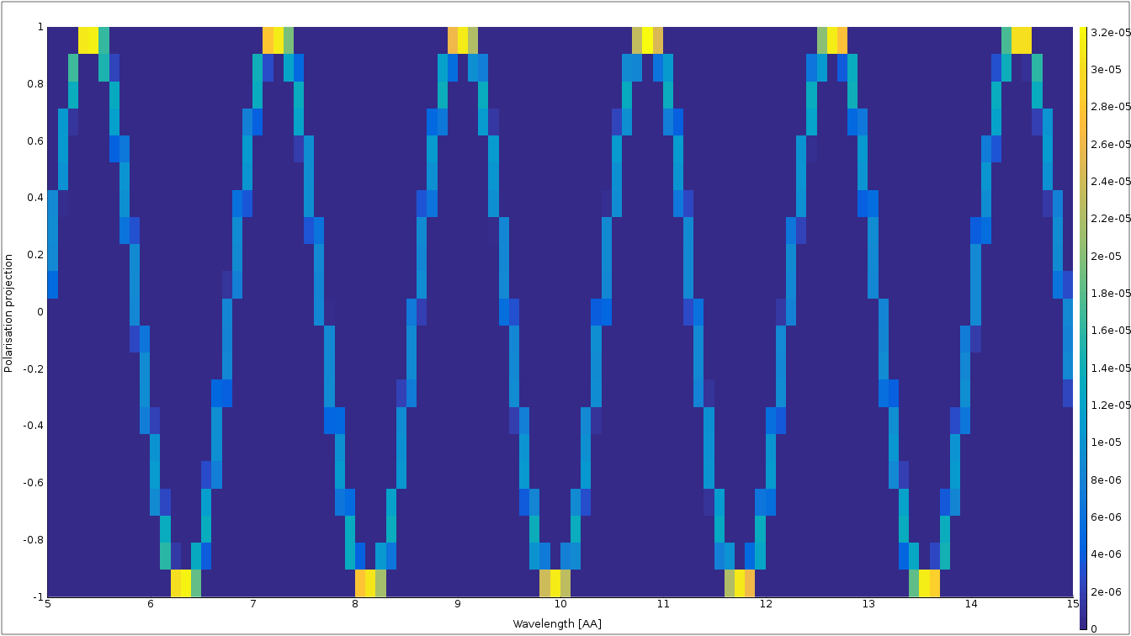
Pol_monitors along the way...

Slide 25
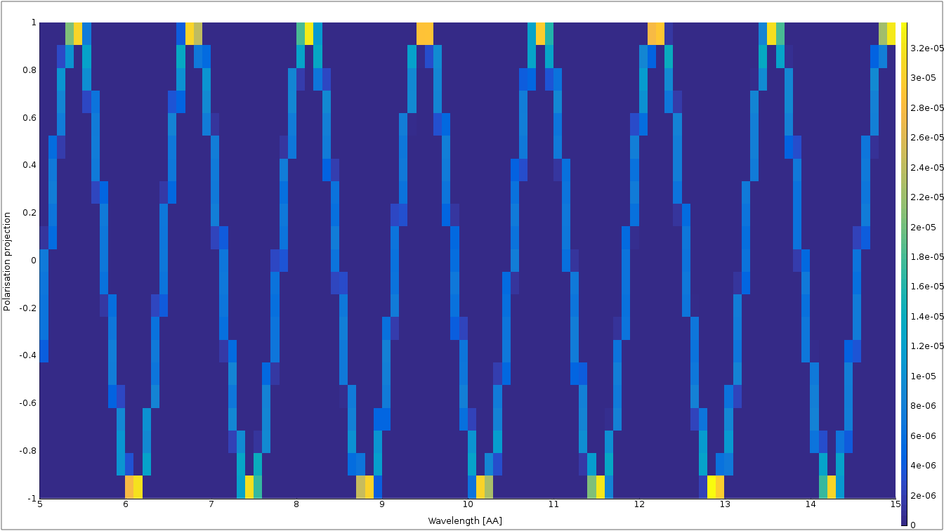
Nested fields

Slide 26
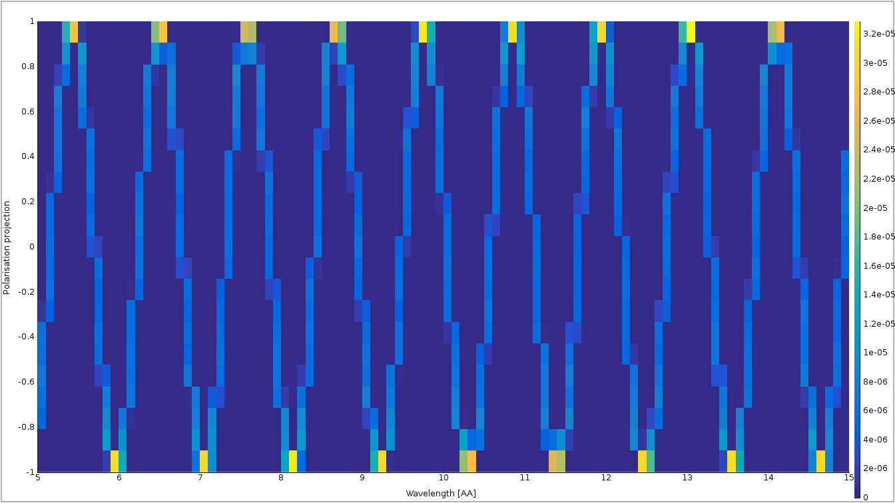
Nested fields

Slide 27
How does one go about it?
Example walk-through: SE-template

Slide 28
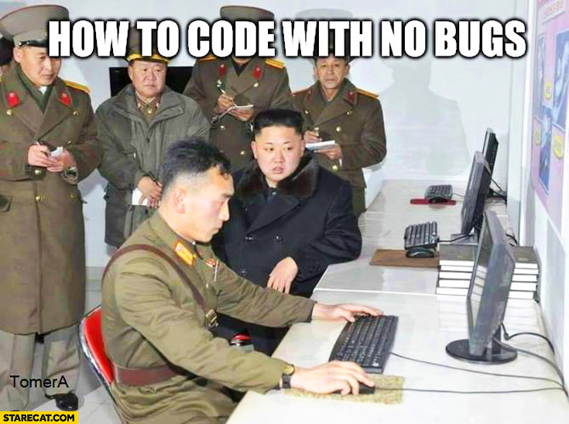
How does one go about it?
Example walk-through: SE-template

Slide 29
Getting help
Check example header.
Use mcdoc
Read/check the manual
User mailing list: mcstas-users@mcstas.org
Give us a call/write us an email!

Slide 30
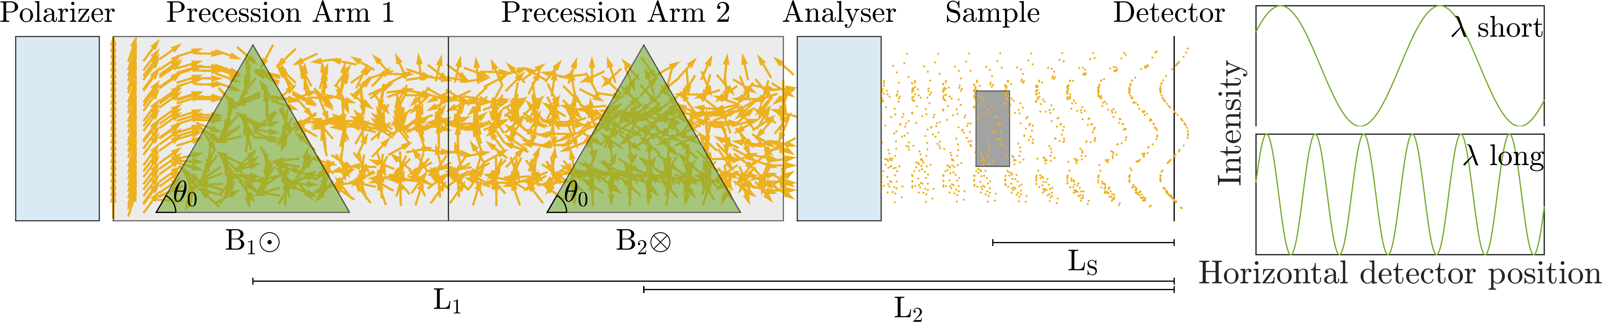
McStas example SEMSANS
Courtesy: M. Sales et.al.

Slide 31
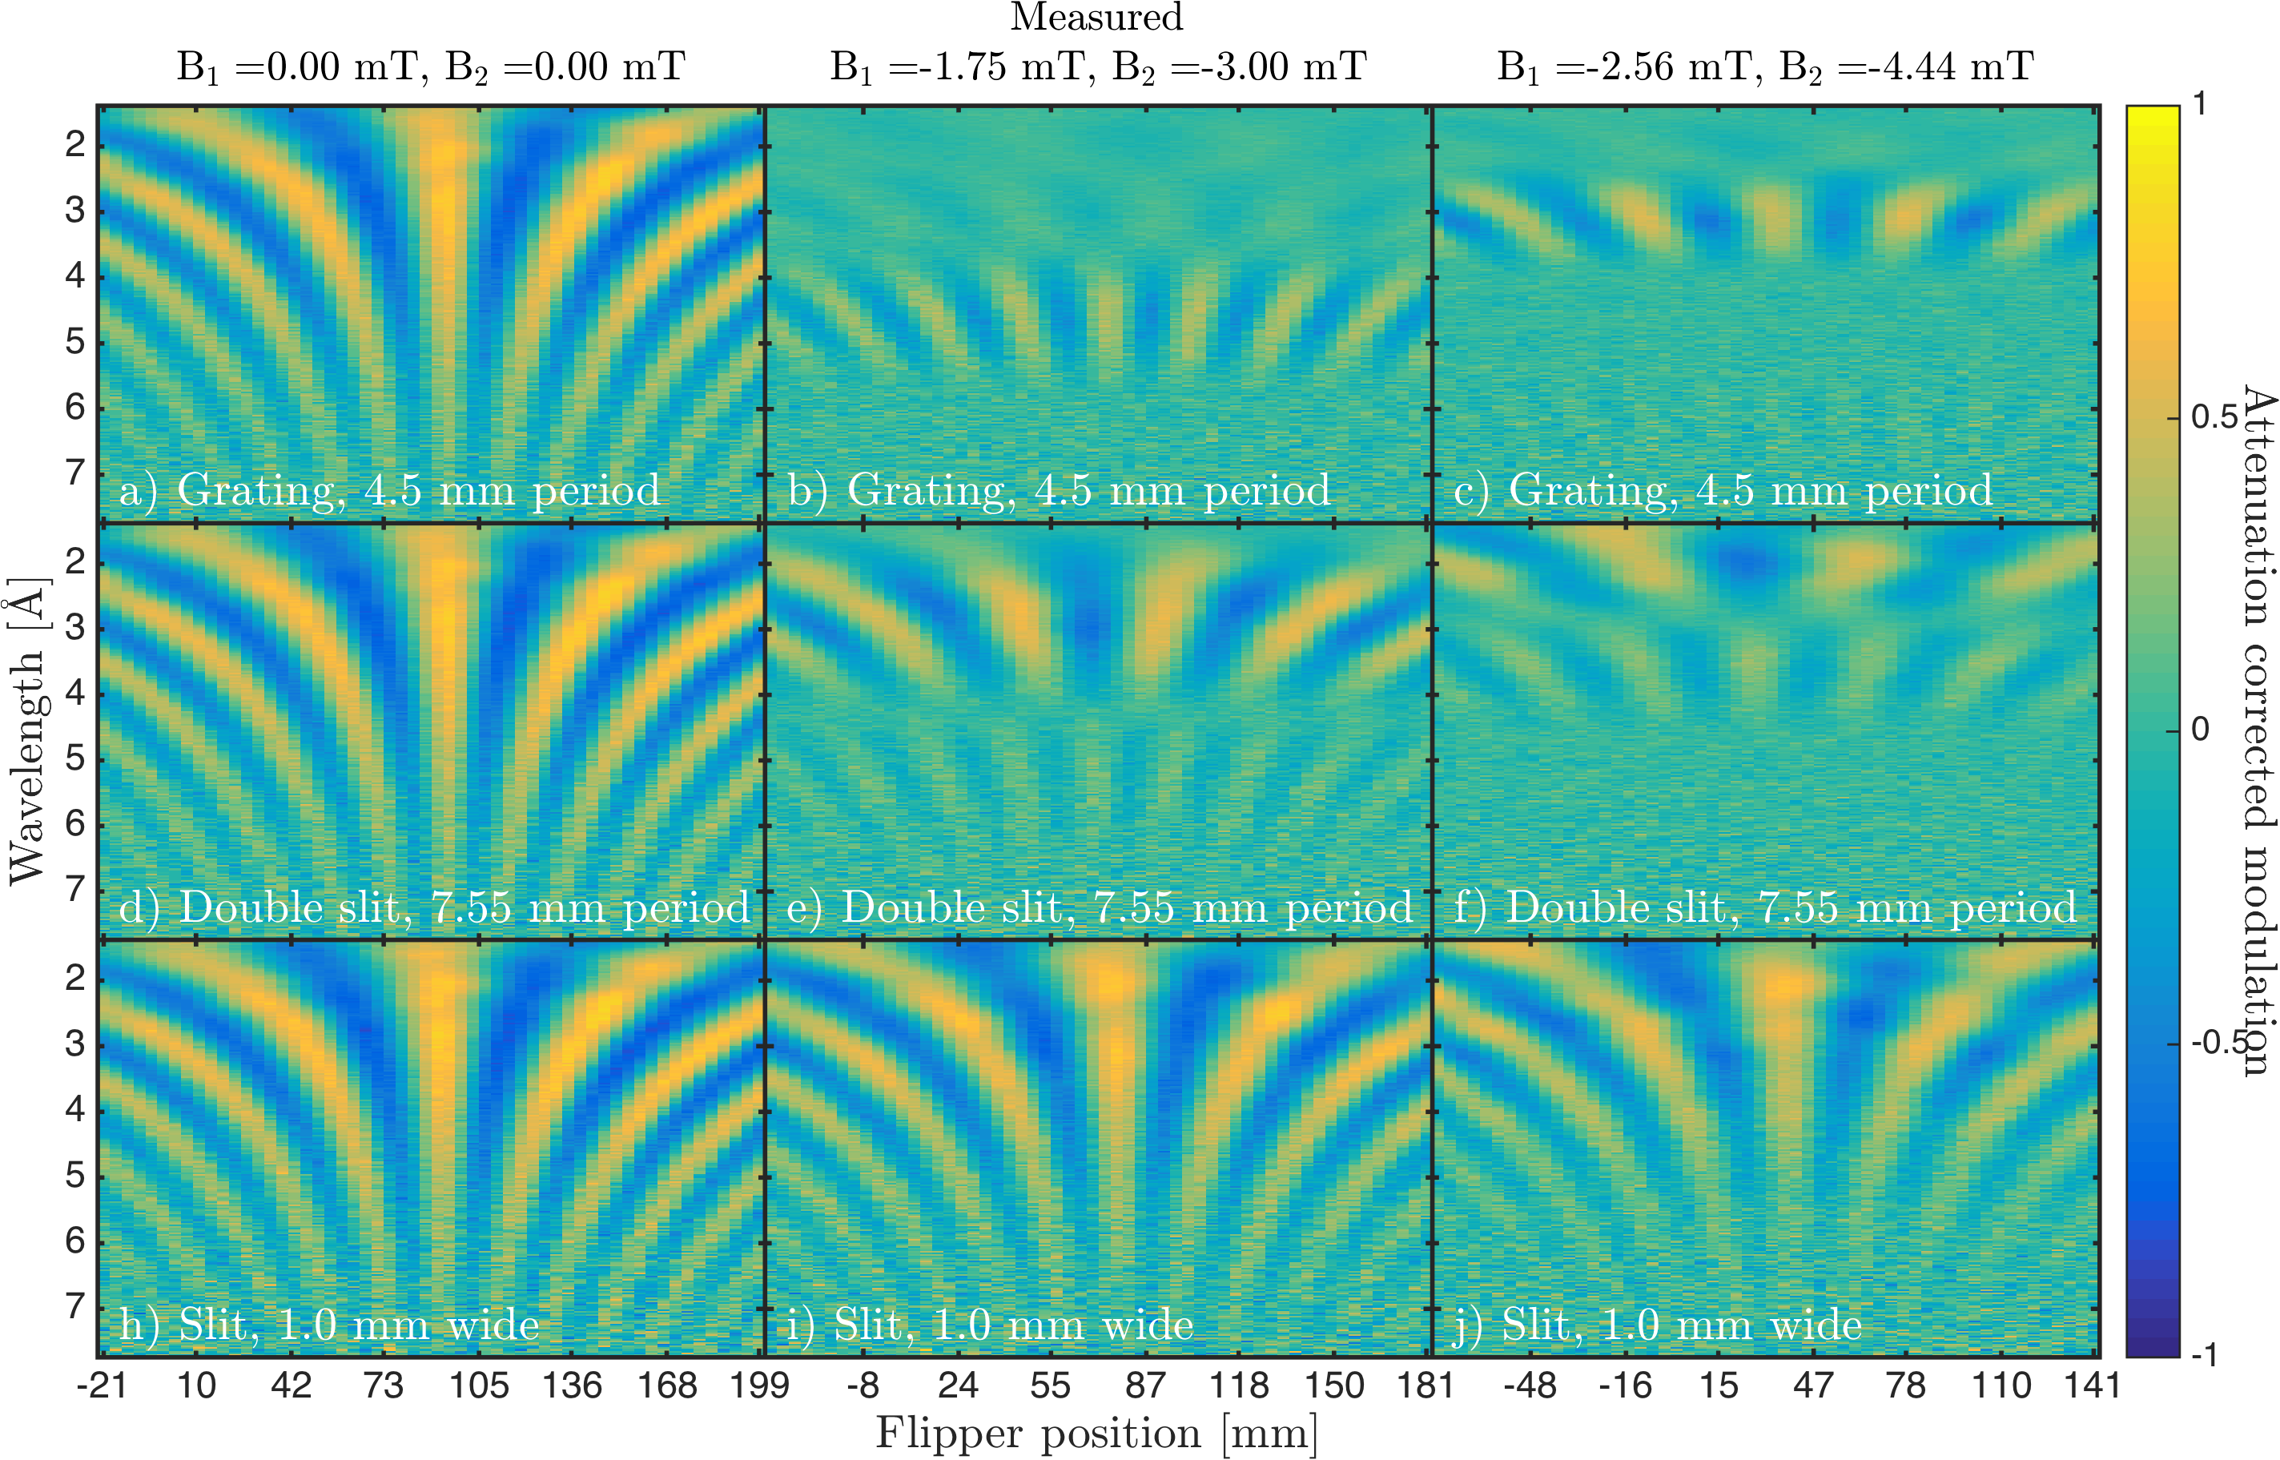
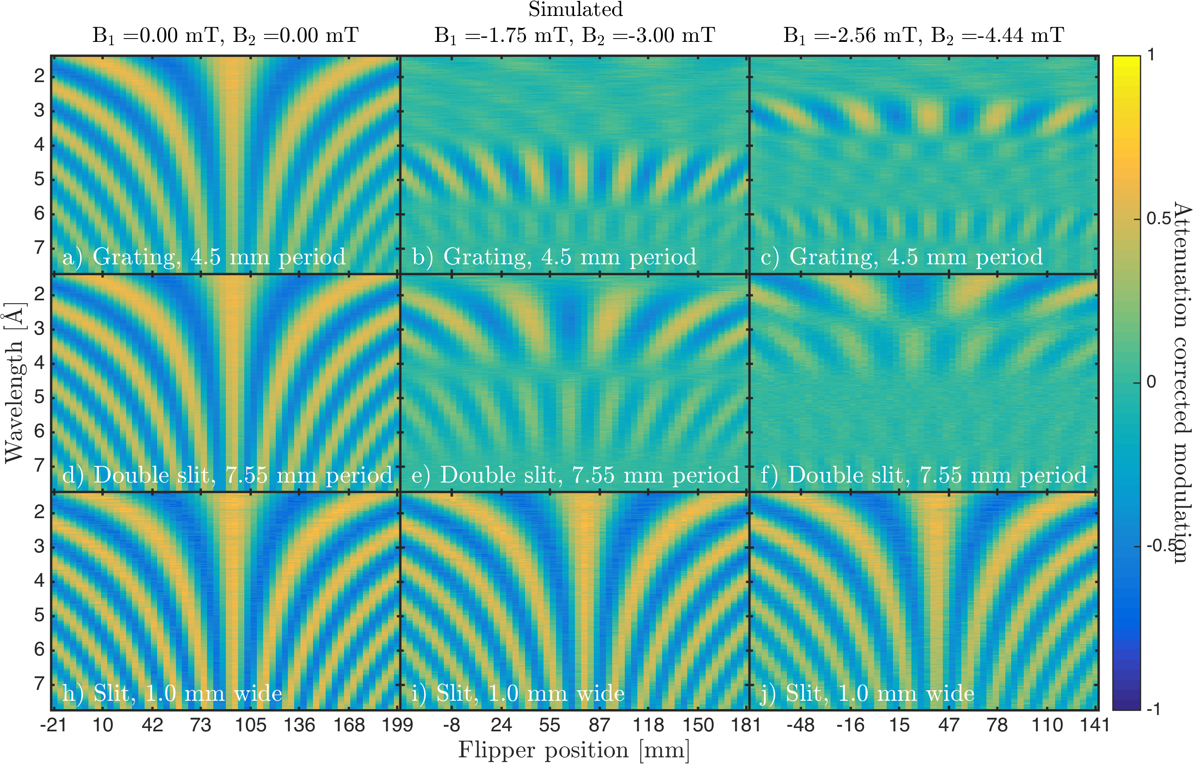
McStas example SEMSANS

Slide 32
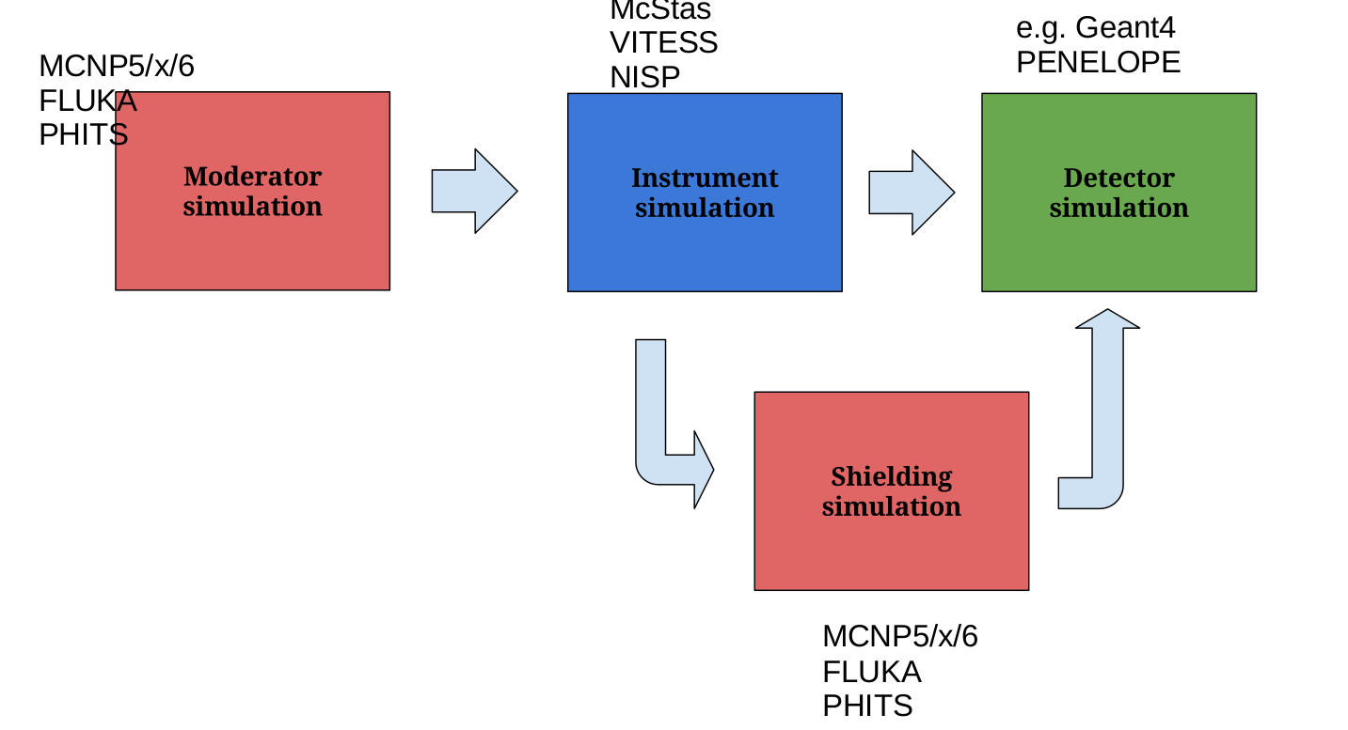
A goal: real sims with background

Slide 33
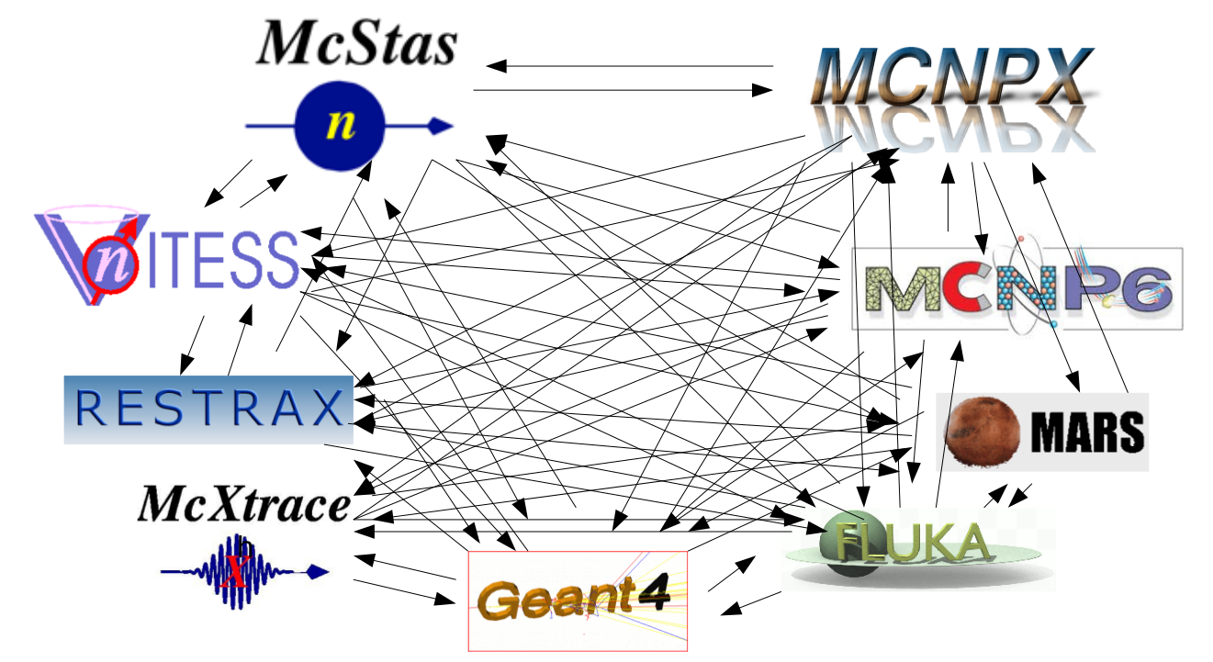
The problem

Slide 34
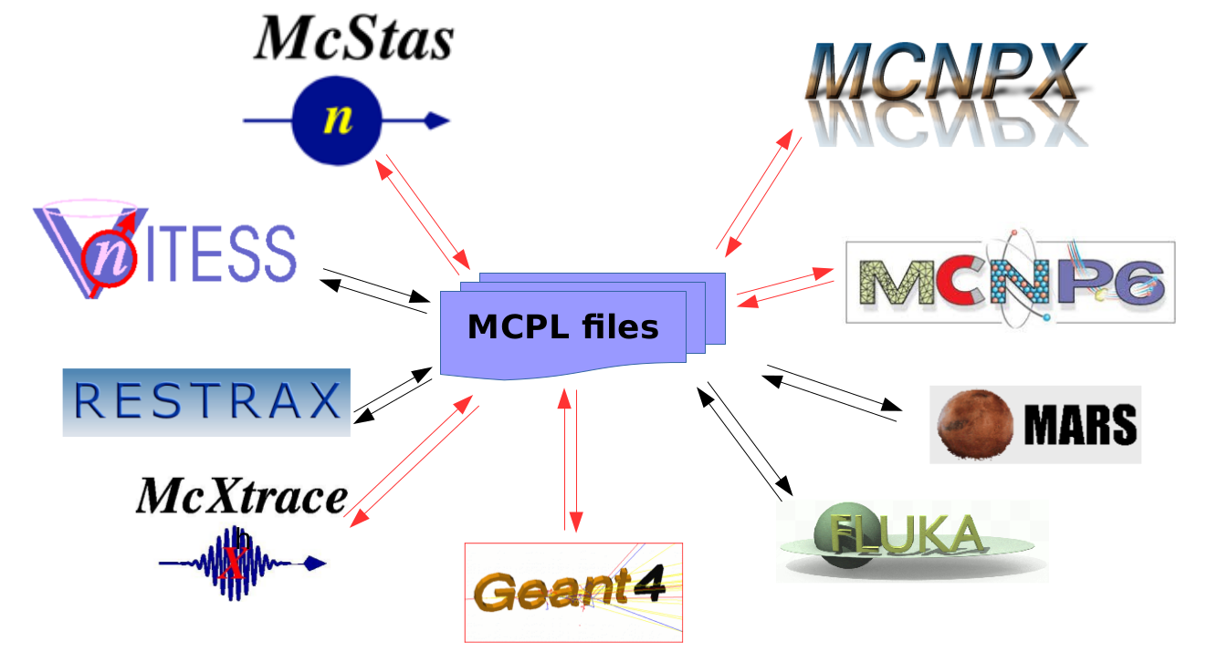
The solution

Slide 35
McStas components on the way
Things on the way
Magnetic fields:
Pol_FieldBox.comp
Tabled fields
Pol_constBfield.comp
Pol_simpleBfield.comp
3D entry/exit windows
Pol_simpleBfield_stop.comp
Pol_triafield.comp
Optics:
Monochromator_pol.comp
Pol_bender.comp
Pol_guide_vmirror.comp
Pol_mirror.comp
Pol_pi_2_rotator.comp
Transmission_polarisatorABSnT.comp
Pol_bender_tapering.comp
Pol_McRadia.comp
Dynamic coupling to RADIA
Monitors:
Pol_monitor.comp
MeanPolLambda_monitor.comp
PolLambda_monitor.comp
Pol_PSD_monitor.comp
Idealized components:
PolAnalyser_ideal.comp
Set_pol.comp
Pol_SF_ideal.comp
Sample component
Magnetic_single_crystal.comp
Contrib:
Foil_flipper_magnet.comp

Slide 36
McStas components on the way
Generalized Simple B-Fields: constant, functional, tabled, … but in more general shapes
RF-flipper
He3-objects

Slide 37
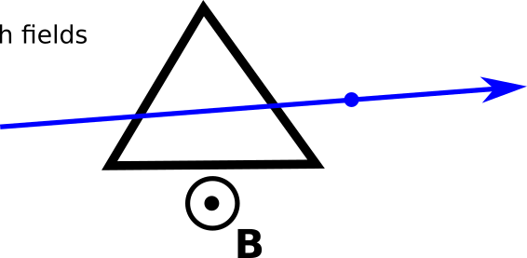
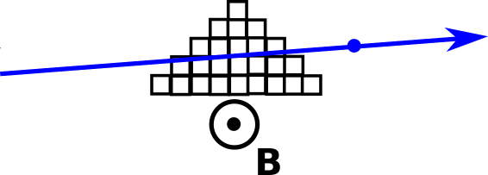
McStas components on the way
McRadia compared with analytical field description
Requires a mathematica license.
Analytical using Pol_triafield.comp
Voxelized 5x9 pts.

Slide 38
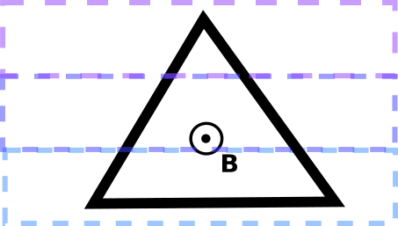
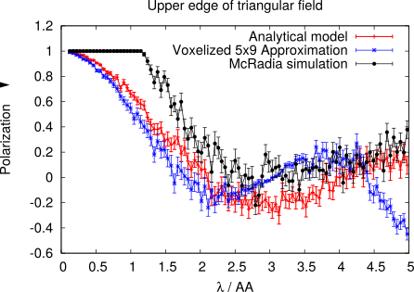
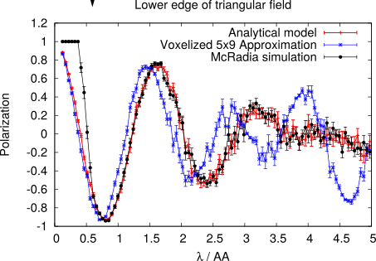
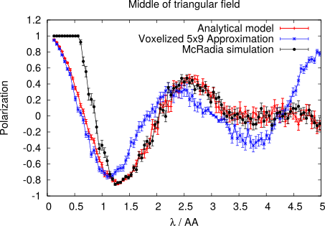
McStas components on the way
McRadia compared with other field descriptions
P

Slide 39
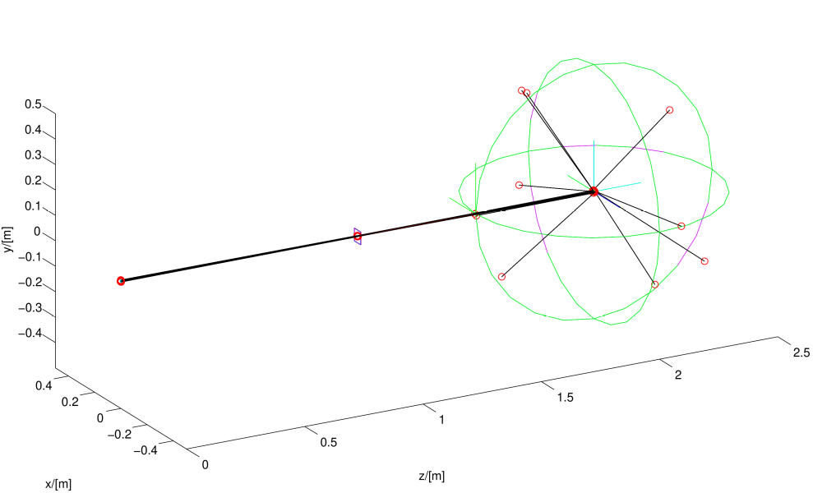
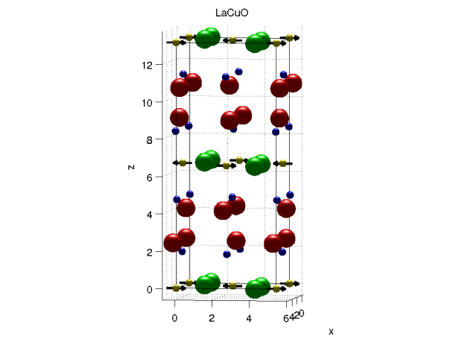

McStas components on the way
Magnetic single crystal

Slide 40
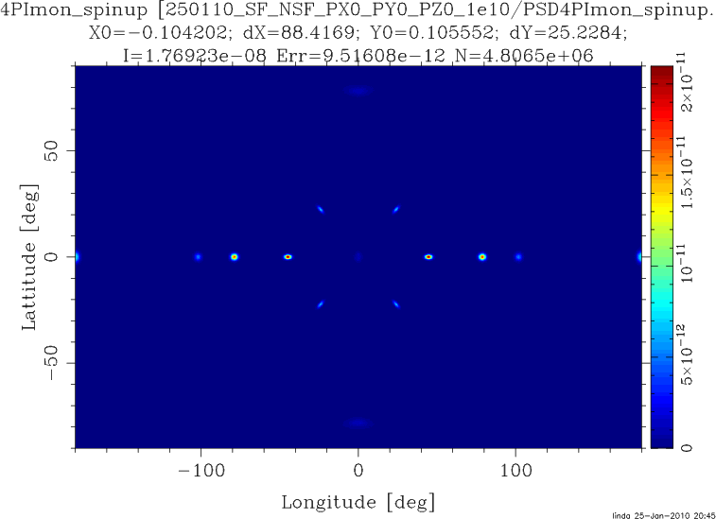
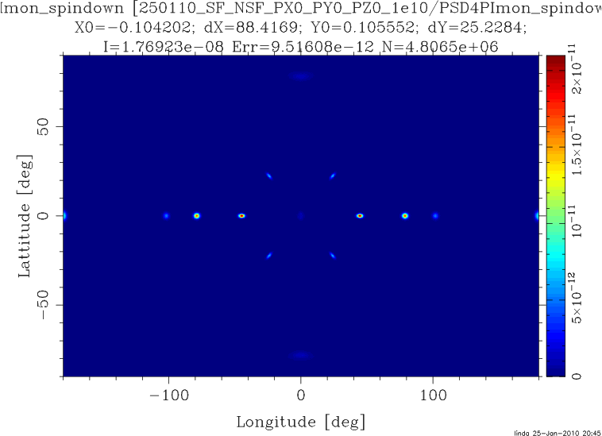
McStas components on the way
Magnetic single crystal – Unpolarized beam

Slide 41
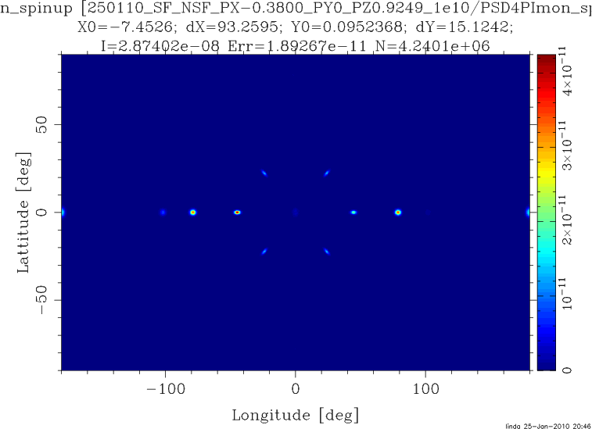
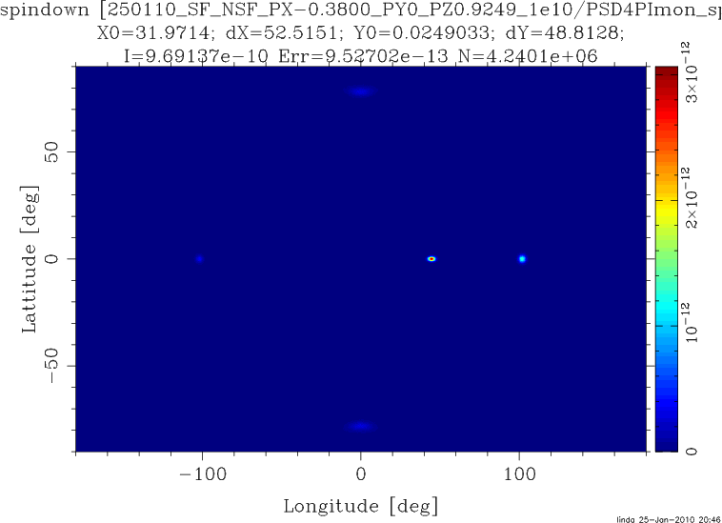
McStas components on the way
Magnetic single crystal – Polarized beam

Slide 42
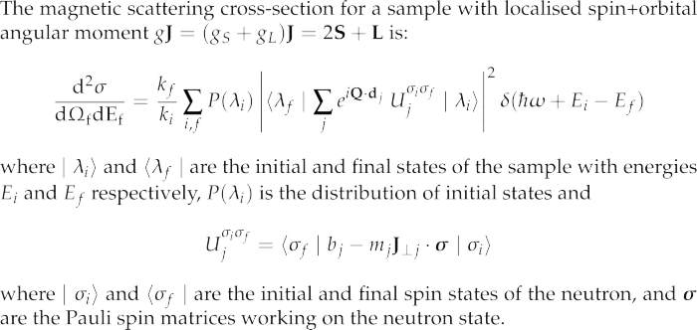
McStas components on the way
Magnetic single crystal
From: G. Shirane et.al. ,”Neutron Scattering with Triple-Axis Spectrometer”, Cambridge Univ. Press, 2002

Slide 43
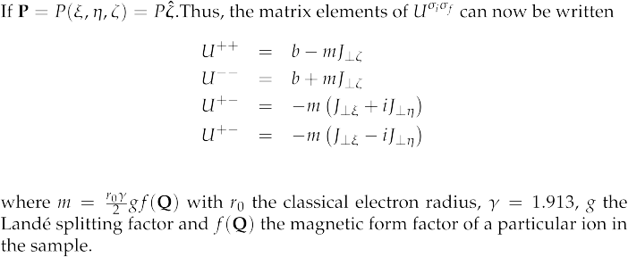
McStas components on the way
Magnetic single crystal

Slide 44
Acknowledgements
DTU
Peter Willendrup
Jacob Garde
ILL
Emmanuel Farhi
Copenhagen University
Kim Lefmann
Mads Bertelsen
PSI
Emmanouela Rantsiou
Uwe Filges
And all other contributors!
Kristian Nielsen
Kurt Clausen
Peter Christianse
Klaus Liutenant

Slide 45
Outlook/Discussion items
How can we interact better?
Better support for the community?
Code-sharing?

