Slide 1
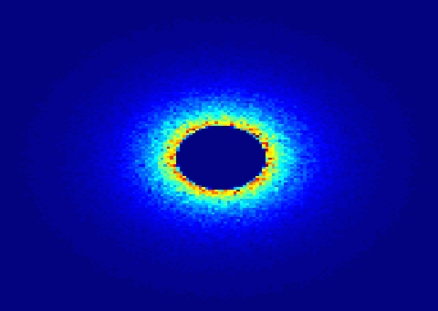
Small Angle Neutron Scattering

Slide 2
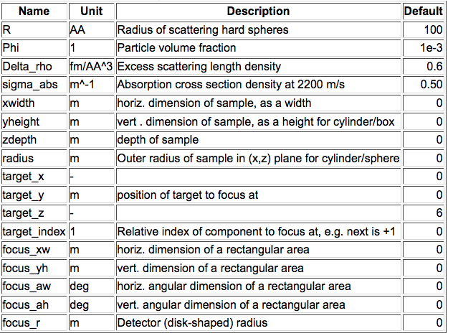
Sans_Spheres.comp

Slide 3
MORE SANS SAMPLES
Try ellipsoidal and
cylindrical particles
-or-
Elliptic cylinders
Go for Nanodiscs and Liposomes
Sample form: Box only
Particle concentration: MOLAR
SANS_AnySamp.comp
SANS_DebyeS.comp
SANSCylinders.comp
SANSEllipticCylinders.comp
SANSGuinier.comp
SANSLiposomes.comp
SANSNanodiscs.comp
SASview.comp
SANSNanodiscsFast.comp
SANSNanodiscsWithTags.
SANSNanodiscsWithTagsFast
SANSPDB.comp
SANSPDBFAST.comp
SANSShells.comp
SANSSpheres.comp
As always, more info at
http://mcstas.org/download/components

Slide 4
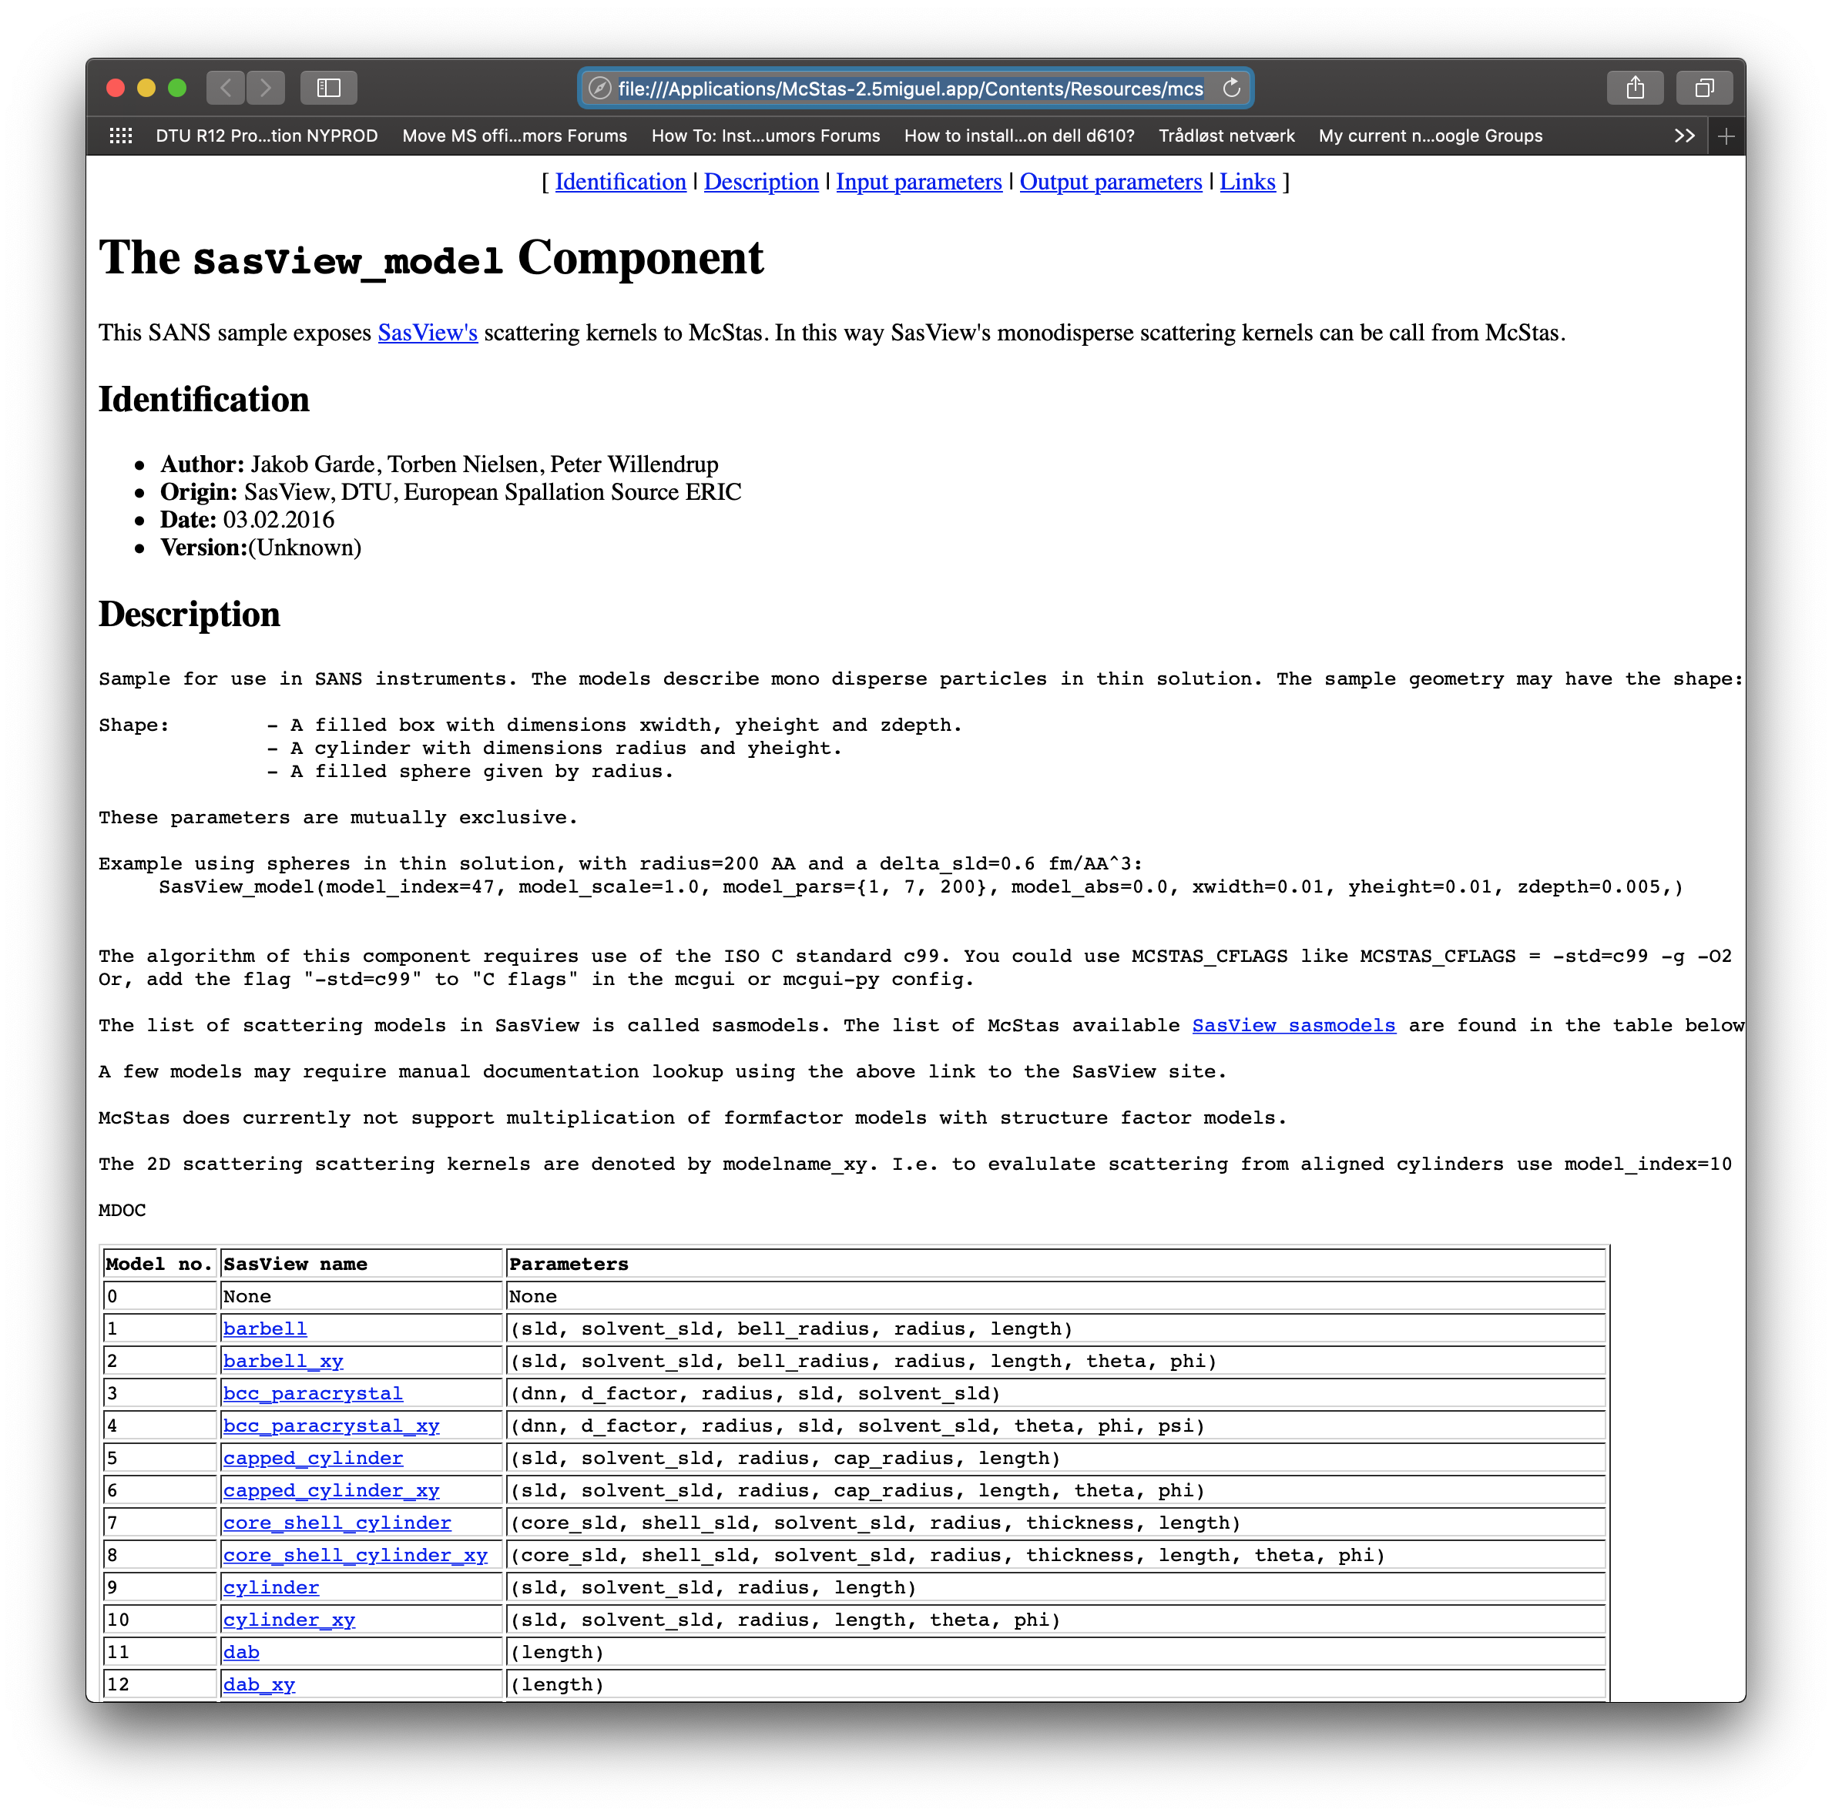
MORE SANS SAMPLES
Try ellipsoidal and
cylindrical particles
-or-
Elliptic cylinders
Go for Nanodiscs and Liposomes
Sample form: Box only
Particle concentration: MOLAR
… Or use one of many SASmodels
Definitions directly from SASview…
SANS_AnySamp.comp
SANS_DebyeS.comp
SANSCylinders.comp
SANSEllipticCylinders.comp
SANSGuinier.comp
SANSLiposomes.comp
SANSNanodiscs.comp
SASview.comp
SANSNanodiscsFast.comp
SANSNanodiscsWithTags.
SANSNanodiscsWithTagsFast
SANSPDB.comp
SANSPDBFAST.comp
SANSShells.comp
SANSSpheres.comp
As always, more info at
http://mcstas.org/download/components

Slide 5
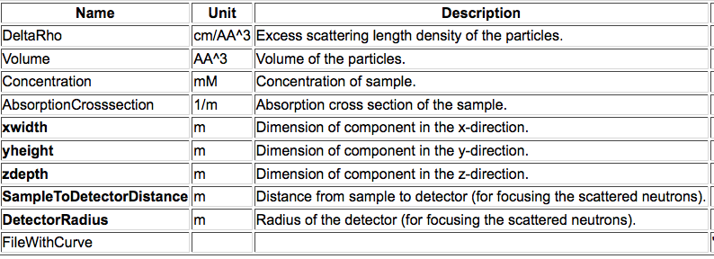
SANSCurve.comp
Mimick the behaviour of a sample: Feed I(q) curve

Slide 6
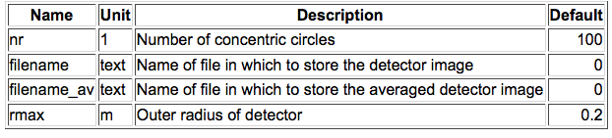
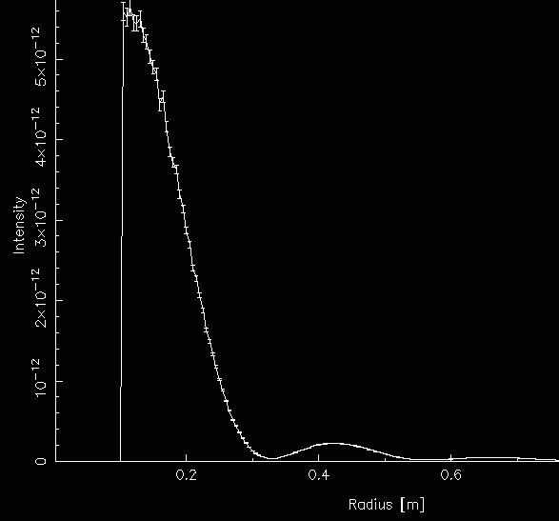
Revisit Monitors: PSD_monitor_rad.comp
COMPONENT My_monitor = PSD_monitor_rad(
nr=124, filename=“detector_image.dat”,
filename_av=“radial_averag.dat”, max=1)
AT (0, 0, 12) RELATIVE Sample

Slide 7
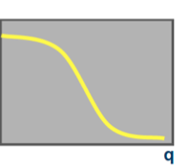
SANS Q MONITOR
I(r) and I(q) profiles
Input Parameters
RadiusDetector [m]
DistanceFromSample [m]
NumberOfBins
LambdaMin [AA]
Rfilename string
qFilename string
Restore_neutron
I(q)

Slide 8
EXERCISE
Open the file Ex_5_5_SANS.instr given to you.
Study the file. Notice the two instrument parameters
Insert a Sans_spheres_sample
  (R = 100, Phi = 1e-3, Delta_rho = 0.6, sigma_abs = 0,
xwidth=0.01, yheight=0.01, zdepth=0.01, focus_r=?, target_z=?)
Insert a PSD_monitor_rad 0.0001m behind the beamstop
  (rmax=0.2, nr=200, give filenames)
Use the instrument parameters to complete the components
Run a simulation with 1e7 neutrons
Plot the I(r) curve.
Change the sample-detector distance.
  What do you observe?
Curious? Lost? Need help?
Try $ mcdoc or visit http://mcstas.org/download/components

Slide 10
SANS models
Get a new instrument: We’ll use the ISIS_SANS2d
We’ll explore some of the SANS-options that exist in McStas.
The SANS2D-model does not include a sample, nor detector at present, so we’ll add that in. Add Ls2d and RR to your DEFINE INSTRUMENT line in the top of the file to be able to scan them.
  Add a PSD_monitor to replicate the detector:
  COMPONENT detector_front = PSD_monitor(
  nx = 200, ny = 200, filename = "PSD.dat",
  xwidth = 1, yheight=1, restore_neutron=1)
  AT(0,0,Ls2d) RELATIVE sample.
  Add a sample – First we’ll use the the standard SANS_spheres comp:
COMPONENT sample = SANS_spheres(
xwidth=0.01, yheight=0.01, zdepth=0.001,
focus_xw=1, focus_yh=1, target_z=Ls2d,
R=RR, Delta_rho=0.6)
AT (0, 0, 0.2) RELATIVE psd4
Now run a simulation to see what you get.

Slide 11
SASmodels
Now we shall explore the possibilities that SasView_models can give us. Change the sample to a SasView_models.comp. Keep the target parameters but change the last line to:
model_index=51, model_pars={1,7,50}
The model_index indeicates which of a large number of models scatterung fucntions) the sample is using. You can use mcdoc to find out which, and what the parameters mean. Try to generate a picture similar to the one before.
Try a couple of the other SasView_models.
ex. model_index=23, model_pars={50,0.2}

Slide 12
SANS models
2D SANS images are all fine – but wouldn’t it be better if we could let the computer do the radial integration for us?
recipe: Insert another monitor – for instance a Monitor_nD with options=”radius ...”
or an instance of
SANSQ_monitor
Remember to use mcdoc – it’s your friend!

Slide 13
RESOURCES
Need more information?
Plan on doing a SANS experiment?
Visit the SANS world directory
Neutron scattering length densities
https://www.ncnr.nist.gov/resources/activation/
http://sld-calculator.appspot.com/
SASview
http://www.sasview.org/
Small angle scattering, various resources, animations and tutorials
http://smallangle.org/

