Slide 1
Monochromators
Mads Bertelsen, ESS DMSC

Slide 2
Monochromators
Purpose of monochromators
McStas implementation and advise
Component overview:
Monochromator
Monochromator_curved
Single_crystal
Exercise

Slide 3
Monochromators: Braggs law
Uses crystal with certain lattice spacing d to select the approrpiate wavelength
Wave / interference phenomonem
Described with Braggs law

Slide 4

Monochromator_flat
Simple monochromator, 2D rectangle
Dimensions zwidth and yheight, oriented in yz plane
Q or DM: $Q=2π/DM$
Can give mosaicity and maximum reflectivity
Limited functionality, does not contain multiple scattering, or higher orders
Easy to use

Slide 5
McStas monochromators
2D objects, no thickness
Orientation
x’
x
x
z’
z
z
COMPONENT Source() AT (0,0,0) ABSOLUTE
COMPONENT Mono() AT (0,0,1) RELATIVE Source ROTATED (0,theta,0) RELATIVE Source
COMPONENT Monitor AT (0,0,1) RELATIVE beam
COMPONENT Monitor AT (0,0,1) RELATIVE mono
COMPONENT beam = Arm() AT (0,0,0) RELATIVE mono ROTATED (0,theta,0) RELATIVE mono

Slide 6
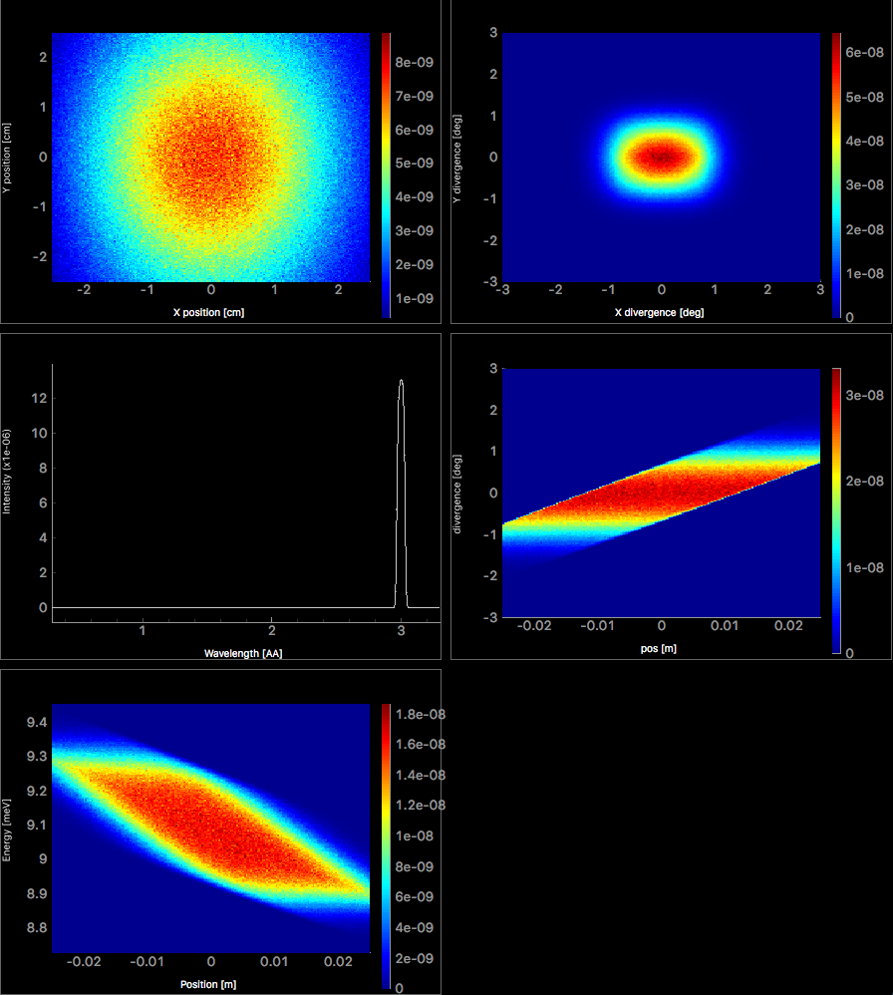
Monochromator_flat
2D Position
2D Divergence
Homogeneous spatial distribution
Small divergence distribution
Only first order simulated
Correlated position and divergence
Correlated divergence and energy
1D Wavelength
2D Pos Div
2D Pos Energy

Slide 7

Monochromator_curved
NH = 3 NV = 3
gap
Many flat monochromators, 2D rectangles
Dimensions zwidth and yheight, NH x NV
Q or DM: $Q=2π/DM$
Can give mosaicity and maxium reflectivity
Limited functionality, but does have higher orders
Easy to use
yheight
zwidth

Slide 8
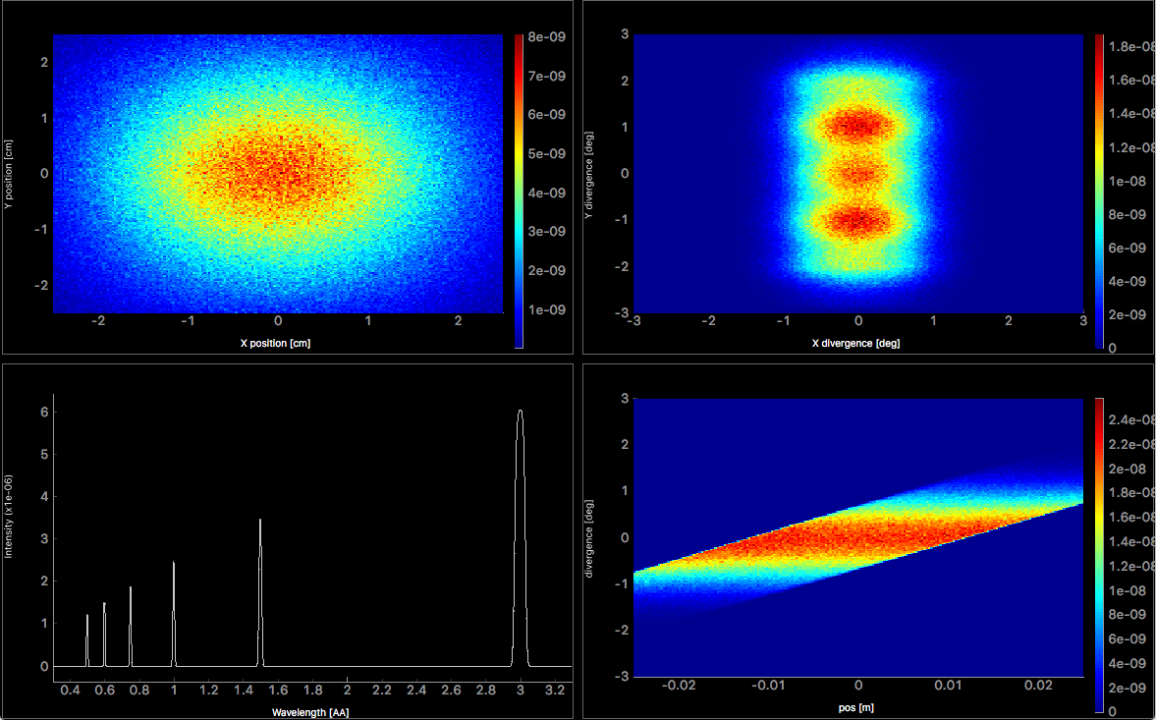
Monochromator curved example
NH = 1
NV = 5
Higher vertical divergence
Several Bragg orders
2D Position
2D Divergence
1D Wavelength
2D Pos div

Slide 9
Single_crystal
Sample component that describes a single crystal with mosaicity
Box geometry appropriate for monochromator
Have to set crystal parameters (other reflections available)
Simulates transmission and absorption
Simulates multiple scattering and higher orders of Braggs laws
Not as easy to use
Have to set up focusing by using many of these together!
Will be explained in tomorrows sample session

Slide 10
Monochromator exercise
Solution on github, use if you are stuck
Add a monochromator_curved after your guide from previous exercise
Set orders = 0 to simulate all orders of Braggs law
Define selected wavelength as input parameter
Calculate theta angle for monochromator in initialize section
Remember extra arm to define new beam direction
Confirm that multiple orders are observed in the output
Extra tasks
Experiment with focusing parameters, NH, NV, RV, RH
Experiment with the distance between guide and monochromator

