Slide 1
McStas diagnostics
Mads Bertelsen, European Spallation Source, DMSC

Slide 2
Overview
Monitors
Flags: EXTEND and WHEN combination
Monitor_nD and Pre_monitor_nD
Correlations ”backwards” in instrument
Scatter_logger
Overview of scattering

Slide 3
Using monitors everywhere
In real experiments, we only measure the neutron once
In McStas you can add monitors along your instrument to understand how the beam changes
A bit obvious after a week of training

Slide 4
Viewing a subset of data with EXTEND and WHEN
Flexible approach
May need to understand the code of the sample component
Can split the output into signal and background
DECLARE %{ int number_of_scattering; %}
TRACE
COMPONENT sample = Isotropic_sqw (…) AT (0,0,0) RELATIVE Sample_position EXTEND %{ number_of_scattering = SCATTERED; %}
COMPONENT psd_first_order = PSD_monitor (…) WHEN (number_of_scattering == 1) AT (0,0,0) RELATIVE Detector_position
COMPONENT psd_multiple_scat = PSD_monitor (…) WHEN (number_of_scattering > 1) AT (0,0,0) RELATIVE Detector_position

Slide 5
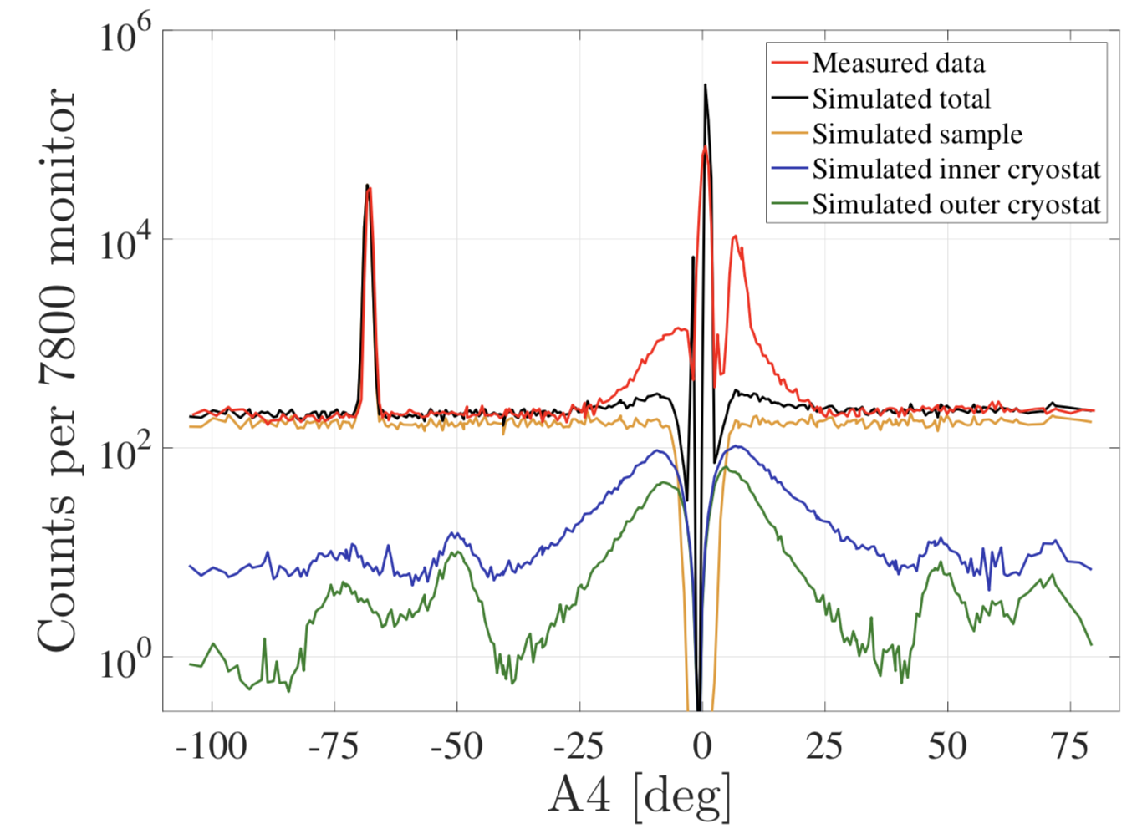
Viewing a subset of data with EXTEND and WHEN
Flexible approach
May need to understand the code of the sample component
Can split the output into signal and background

Slide 6
PreMonitor_nD and Monitor_nD
Use Monitor_nD to find correlations
PreMonitor_nD sends neutron state
Monitor_nD recieve state with the ”use premonitor” option
TRACE
COMPONENT PreMonitor_nD ( monitor_comp=At_moderator_position) AT (0,0,0.1) RELATIVE Source
COMPONENT guide = Guide_gravity(l=9.5,…) AT (0,0,2) RELATIVE Source
COMPONENT At_moderator_position = Monitor_nD( xwidth=0.12,yheight=0.12, options=”x bins=100, y bins=100, use premonitor”) AT (0,0,10) RELATIVE guide

Slide 7
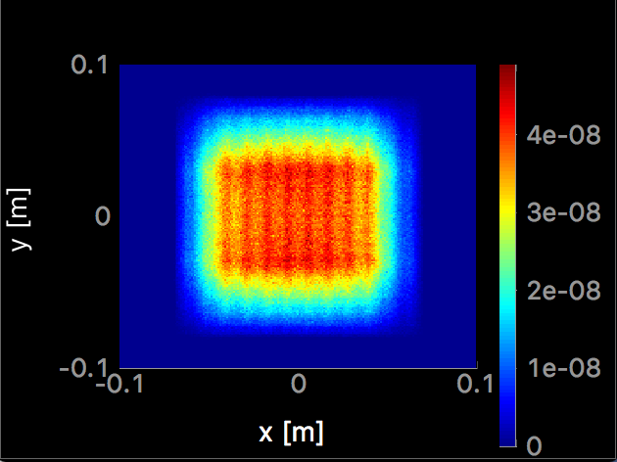
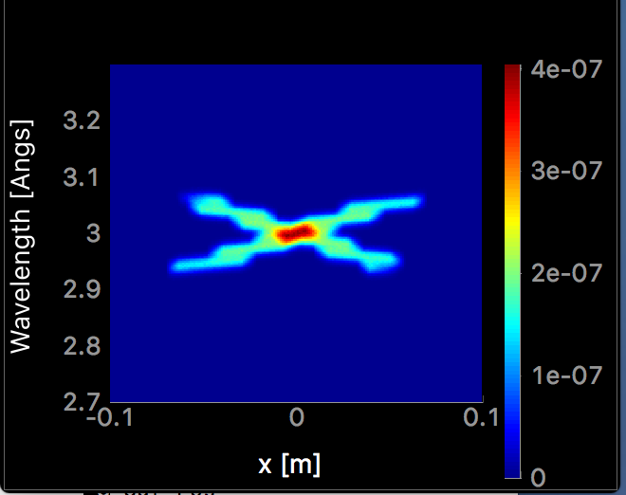
Examples of PreMonitor_nD results
Moderator origin of rays that go to the sample
source
guide
monochromator
PreMonitor_nD just after moderator
sample
Monitor_nD at sample position

Slide 8
Scatter logger
Components used for logging what happens during McStas simulation
Use provided examples for use!
Scatter_logger
Scatter_logger_stop
Scatter_log_iterator
Scatter_log_iterator_stop
JUMP
Monitor_nD
Arm
Source
Scatter_log_iterator
Monitor_nD
Scatter_logger
guide
Scatter_logger_stop
Arm
Scatter_log_iterator_stop

Slide 9
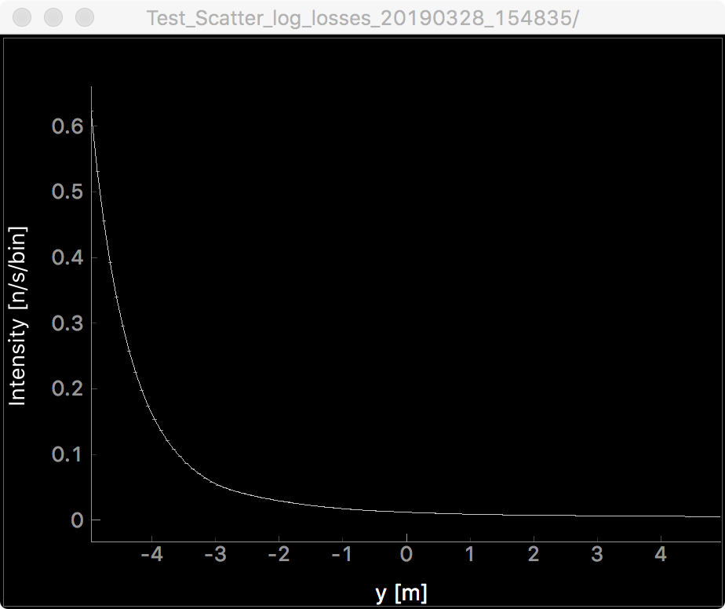
Scatter logger examples
Intensity loss along straight guide
Shielding thickness
Background
Test_Scatter_log_losses.instr

Slide 10
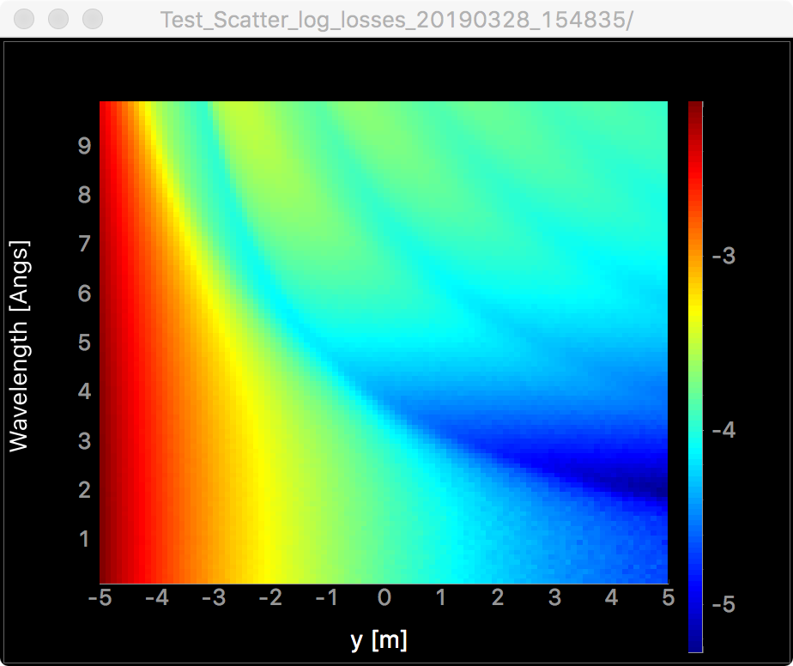
Scatter logger examples
Intensity loss along straight guide
Shielding thickness
Background
Test_Scatter_log_losses.instr

Slide 11
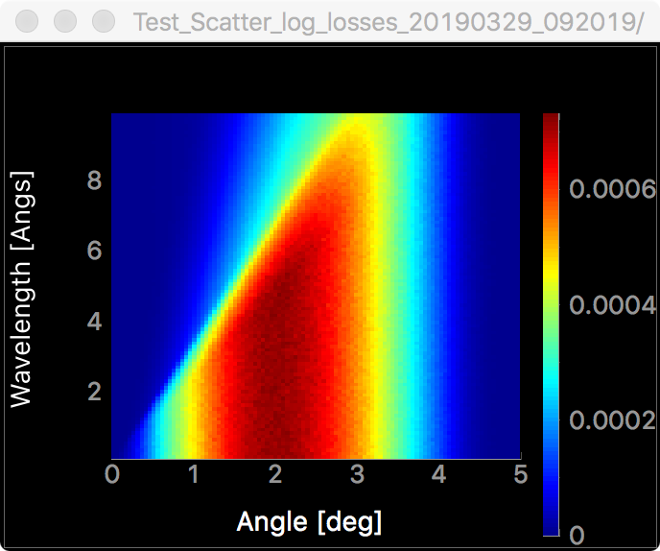
Scatter logger examples
Intensity loss along straight guide
Shielding thickness
Background
Test_Scatter_log_losses.instr

Slide 12
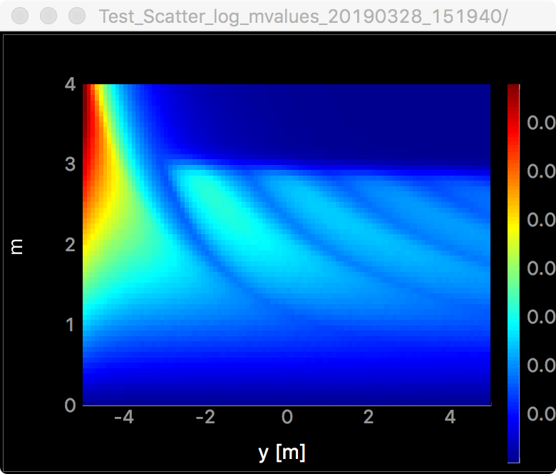
Scatter logger examples
m value required for reflection
10 m straight guide with m=3
Test_Scatter_log_mvalues.instr

Slide 13
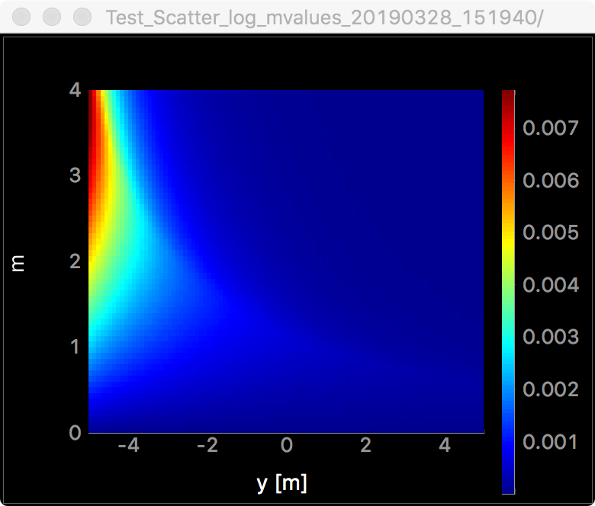
Scatter logger examples
Reflection number 1
m value required for reflection
10 m straight guide with m=3
Test_Scatter_log_mvalues.instr

Slide 14
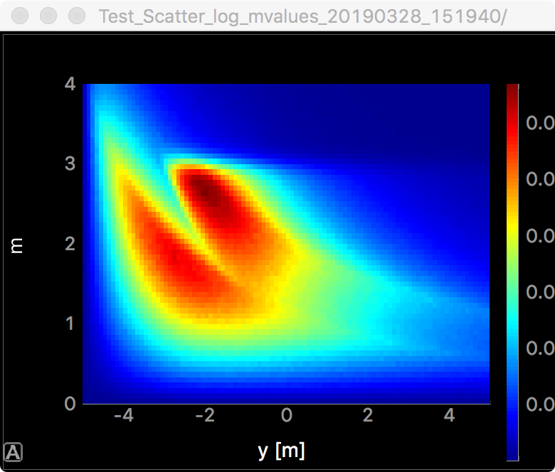
Scatter logger examples
Reflection number 2
m value required for reflection
10 m straight guide with m=3
Test_Scatter_log_mvalues.instr

Slide 15
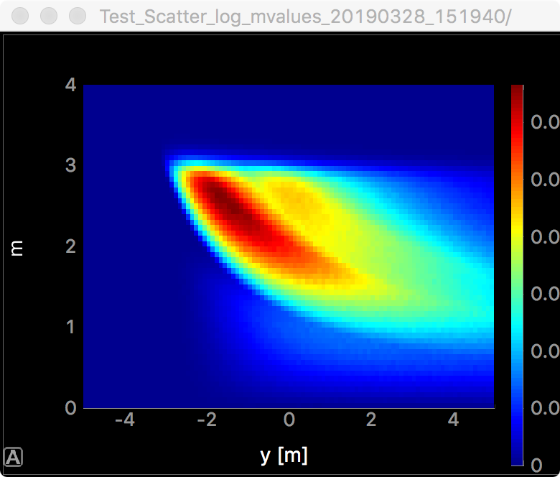
Scatter logger examples
Reflection number 3
m value required for reflection
10 m straight guide with m=3
Test_Scatter_log_mvalues.instr

Slide 16
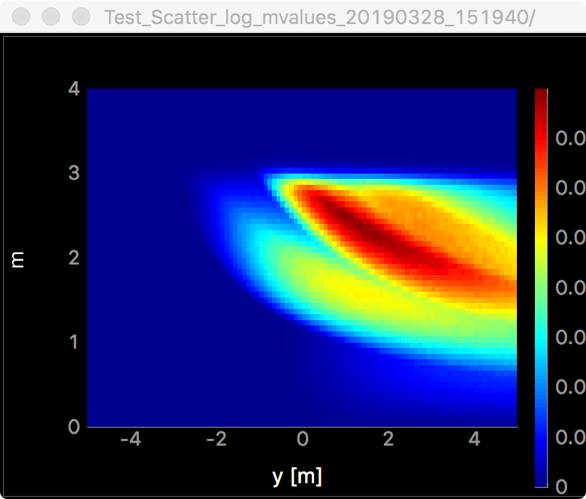
Scatter logger examples
Reflection number 4
m value required for reflection
10 m straight guide with m=3
Test_Scatter_log_mvalues.instr

Slide 17
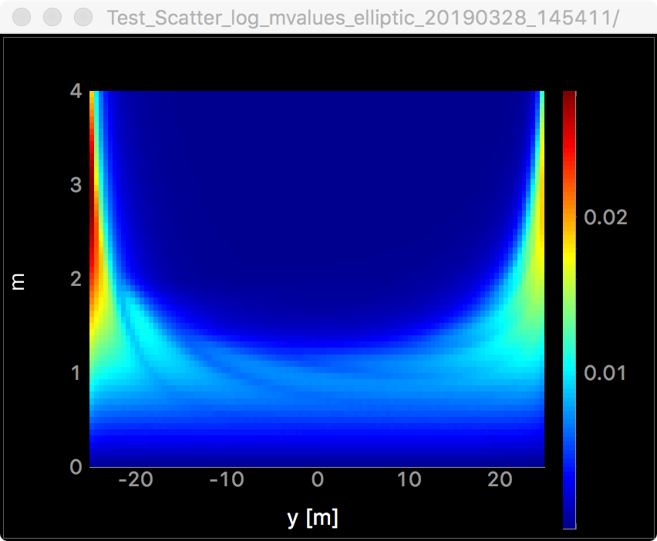
Scatter logger examples
m value required for reflection
50 m elliptical guide with m=3

Slide 18
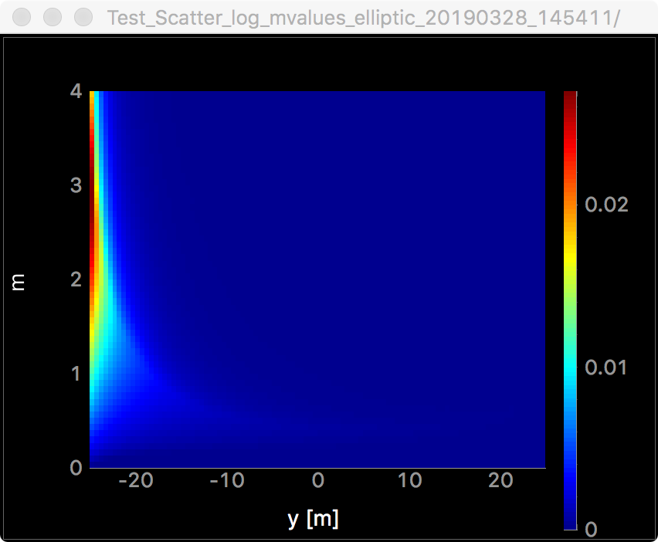
Scatter logger examples
Reflection number 1
m value required for reflection
50 m elliptical guide with m=3

Slide 19
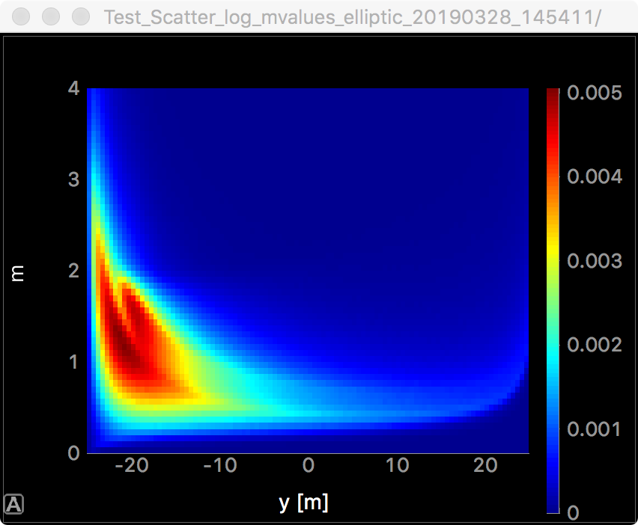
Scatter logger examples
Reflection number 2
m value required for reflection
50 m elliptical guide with m=3

Slide 20
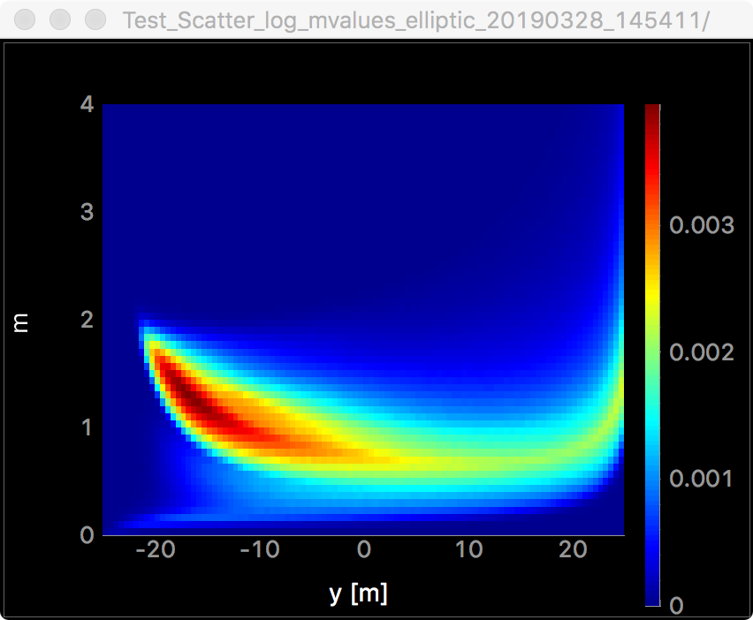
Scatter logger examples
Reflection number 3
m value required for reflection
50 m elliptical guide with m=3

Slide 21
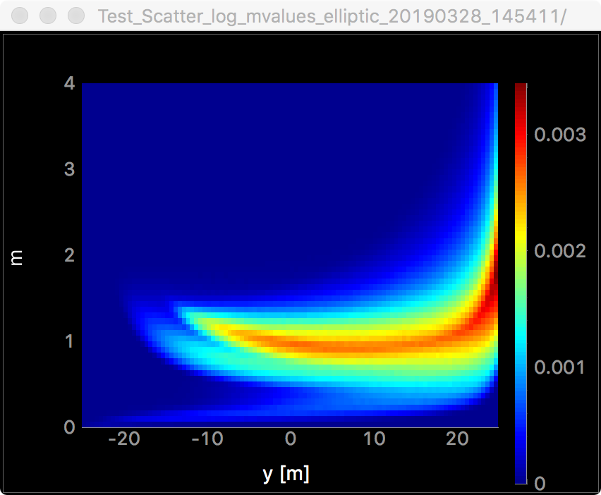
Scatter logger examples
Reflection number 4
m value required for reflection
50 m elliptical guide with m=3

Slide 22
m values for straight and elliptic
10 m straight guide
50 m elliptic guide

Slide 23
Conclusion
The main advantage of simulation is that they further our understanding
Use diagnostics tools such as Scatter_logger and Monitor_nD to record information
Use this information to make better and cheaper instruments

