Slide 1
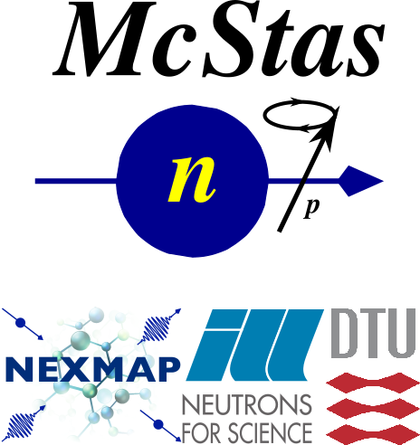
Simulating Polarized Neutron Scattering Experiments and Equipment with McStas
Erik Bergbäck Knudsen, DTU Physics

Slide 2
Mcstas “particle” model
Neutron ray/package:
Weight: (p) # neutrons left in the package Position: (x, y, z)
Velocity: (v_{x}, v_{y}, v_{z})
Polarization: (s_{x}, s_{y}, s_{z})
Time: (t)
$P_{n}=\frac{1}{p_{n}}\sum_{i}^{p}{P_{i,n}}; n=raynumber$
$P_{n}$
n
$P=\frac{1}{N}\sum_{n=0}^{N}{P_{n}}$
$P$
$P_{i,n}=2\left(\left\langle \hat{s_{x,i}}\right\rangle \hat{i_{x,i}}+\left\langle \hat{s_{y,i}}\right\rangle \hat{i_{y,i}}+\left\langle \hat{s_{z,i}}\right\rangle \hat{i_{z,i}}\right)$
From G. Williams: “Polarized neutrons”, Oxford Science Publ., 1988

Slide 3
McStas detectors/monitors
Monitoring: How and What do we monitor?
n
$P_{\hat{h}}=\frac{\sum_{n=0}^{N}{p_{n}}P_{n}⋅\hat{h}}{\sum_{n}^{N}{p_{n}}}$
n
n
n
n
$P$
$\hat{h}$
n
n

Slide 4
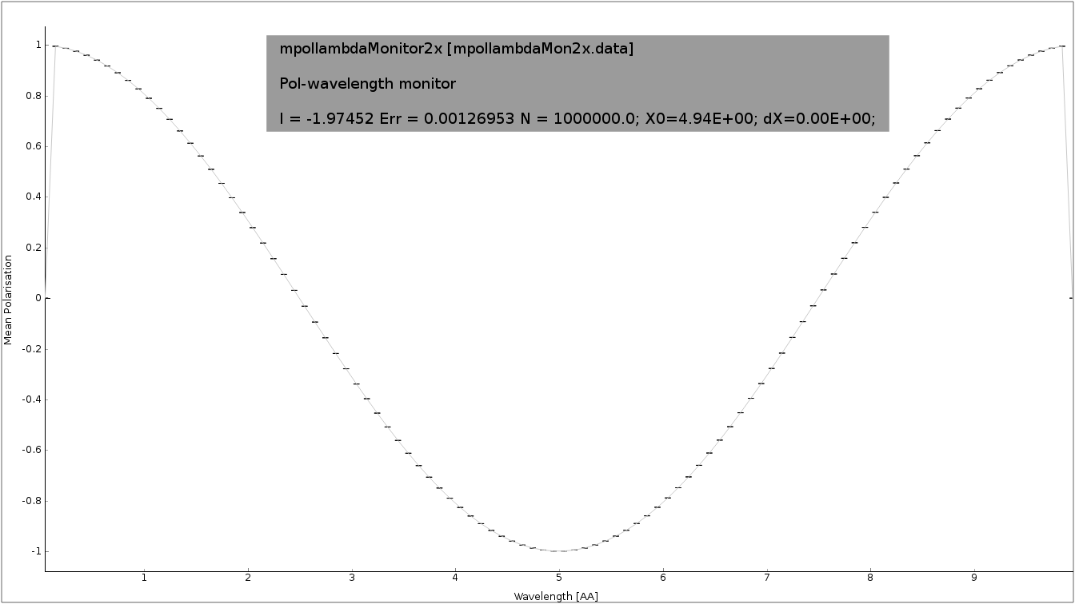
McStas detectors/monitors
Monitoring: How and What do we monitor?
n
n
n
n
n
$P$
$\overset{}{h}$
n
n

Slide 5
McStas detectors/monitors
Monitoring: How and What do we monitor?
n
n
n
n
n
$\overset{}{h}$
n
$P$

Slide 6



Polarization monitors
Available monitors:
Pol_monitor.comp: 0D
PolLambda_monitor.comp: 2D
MeanPolLambda_monitor.comp: 1D

Slide 7



McStas precession algorithm
Magnetic fields in McStas
The challenge:
Fast beam/ray transport: #
Unknown magnetic field and field strength
>1 Magnet → nested fields.
$rays>{10}^{6}$

Slide 8
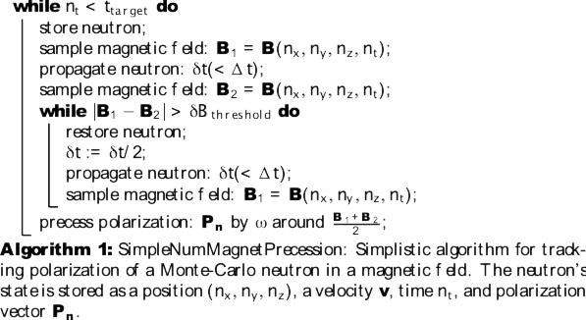
McStas precession algorithm
From: Knudsen et.al., J. Neutron Research, 2014

Slide 9
McStas precession algorithm
B₂
B₁
n
$δt$

Slide 10
McStas precession algorithm
B₂
B₁
n
$δ\overset{}{t}=δt/2$

Slide 11
McStas precession algorithm
From: Knudsen et.al., J. Neutron Research, 2014

Slide 12
McStas precession algorithm
From: Knudsen et.al., J. Neutron Research, 2014

Slide 13
McStas precession algorithm
void mc_pol_set_timestep(double dt);
void mc_pol_set_angular_accuracy(double domega);
From: Knudsen et.al., J. Neutron Research, 2014

Slide 14
McStas polarization components
Magnetic fields:
Pol_FieldBox.comp
Pol_constBfield.comp
Pol_Bfield.comp
Pol_Bfield_stop.comp
Pol_triafield.comp
Optics:
Monochromator_pol.comp
Pol_bender.comp
Pol_guide_vmirror.comp
Pol_mirror.comp
Pol_pi_2_rotator.comp
Transmission_polarisatorABSnT.comp
Pol_bender_tapering.comp
Idealized components:
PolAnalyser_ideal.comp
Set_pol.comp
Monitors:
Pol_monitor.comp
MeanPolLambda_monitor.comp
PolLambda_monitor.comp
Contrib:
Foil_flipper_magnet.comp

Slide 15
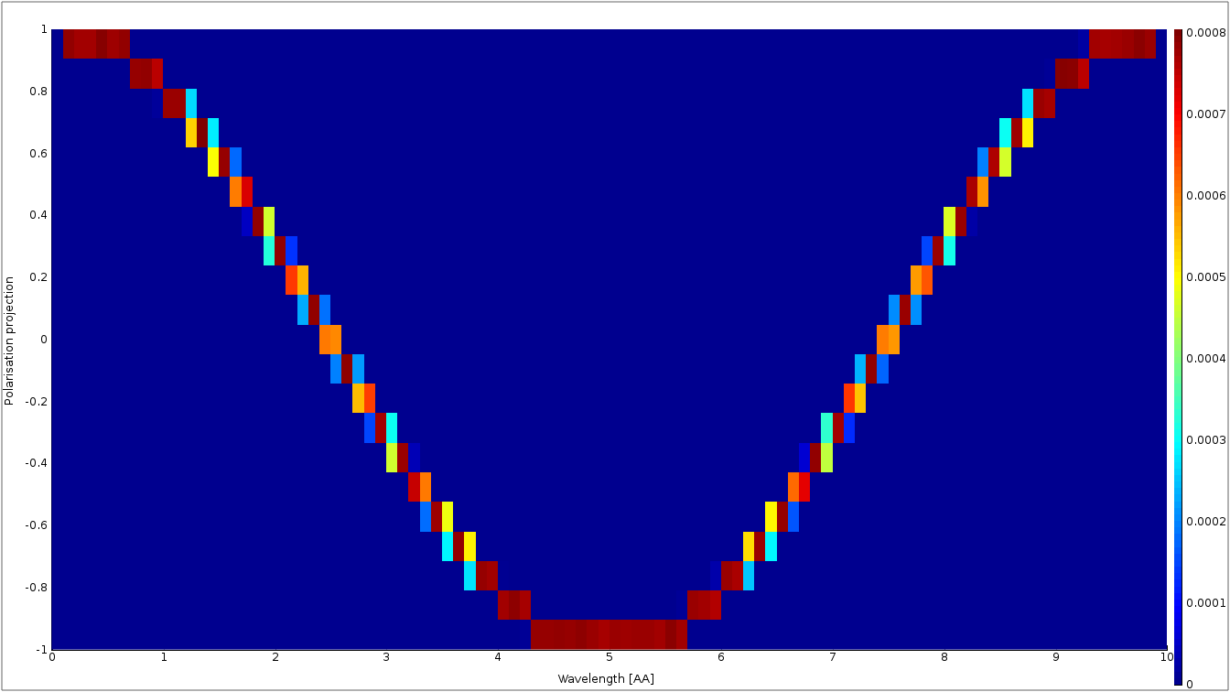
McStas polarization monitors
PolLambda_monitor
Monitors
MeanPolLambda_monitor
n
n
n
n
n
n
n
Pol_monitor
$P∥\left(m_{x},m_{y},m_{z}\right)=0.87$

Slide 16
McStas magnetic fields
Pol_constBfield.comp
Single constant Magnetic field in a “box”.
- user may specify a wavelength to flip. - blocking walls

Slide 17
McStas magnetic fields
Pol_FieldBox.comp
Single Magnetic field in a “box”
- optional user supplied field c-function

Slide 18
McStas magnetic fields
Pol_Bfield.comp
Pol_Bfield_stop.comp
- Entry/Exit contruction allows for nested magnetic field descriptions. - Any magnetic fields through user supplied c-function - Tabled magnetic fields

Slide 19
Windows can be many shapes
B-Fields: constant, functional, tabled, … in more general shapes

Slide 20
McStas Polarization Capabilities IV
Pol_simpleBfield.comp
Pol_simpleBfield_stop.comp
- Entry/Exit contruction allows for nested magnetic field descriptions. - Any magnetic fields through user supplied c-function - Tabled magnetic fields

Slide 21
Pol_monitors along the way...

Slide 22
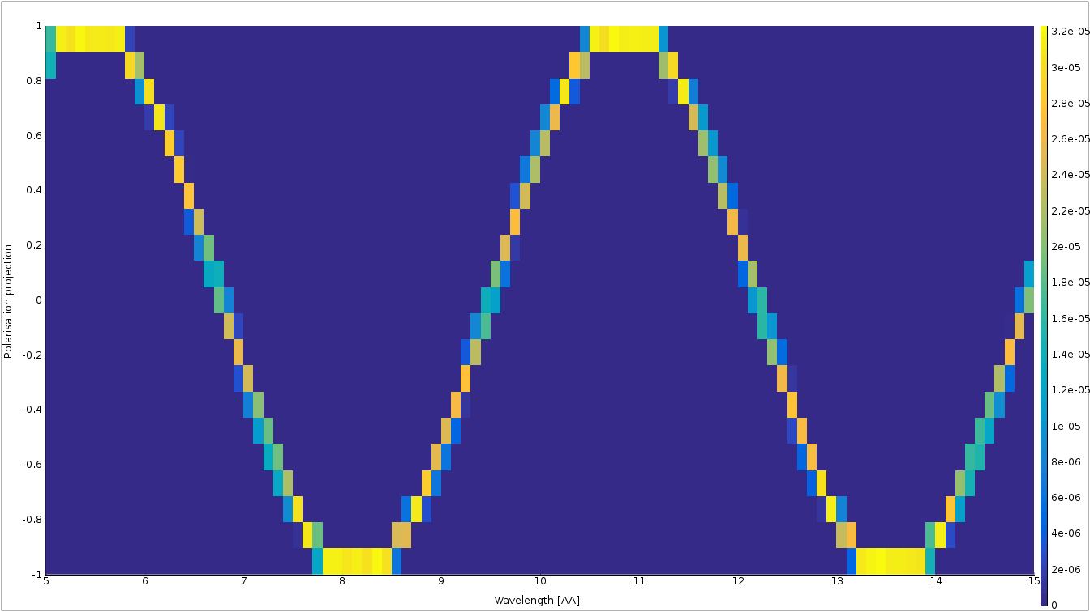
Pol_monitors along the way...
Pol_lambda_mon 1 placeholder

Slide 23
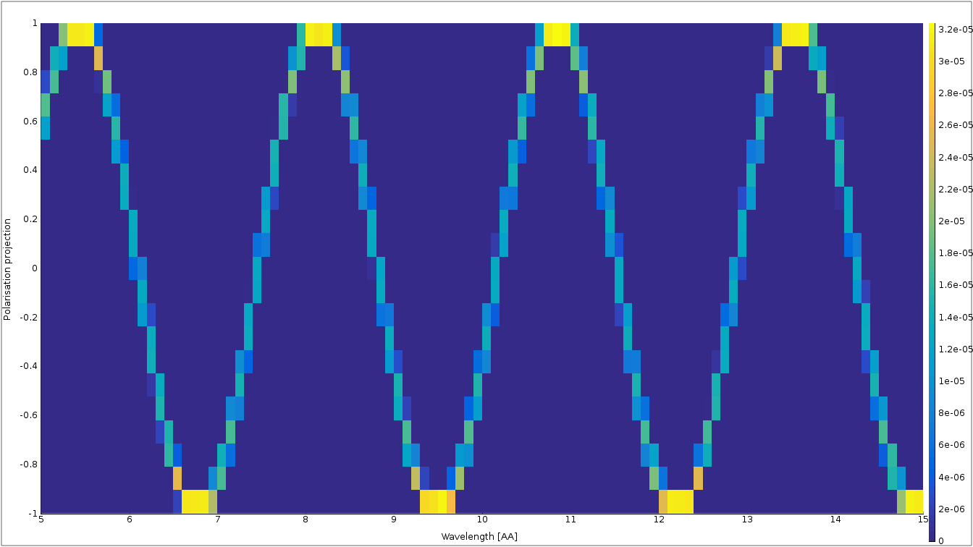
Pol_monitors along the way...

Slide 24
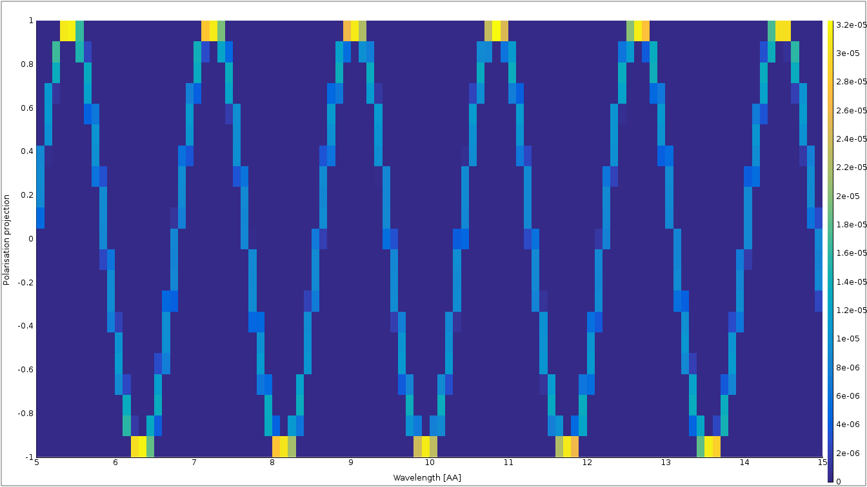
Pol_monitors along the way...

Slide 25
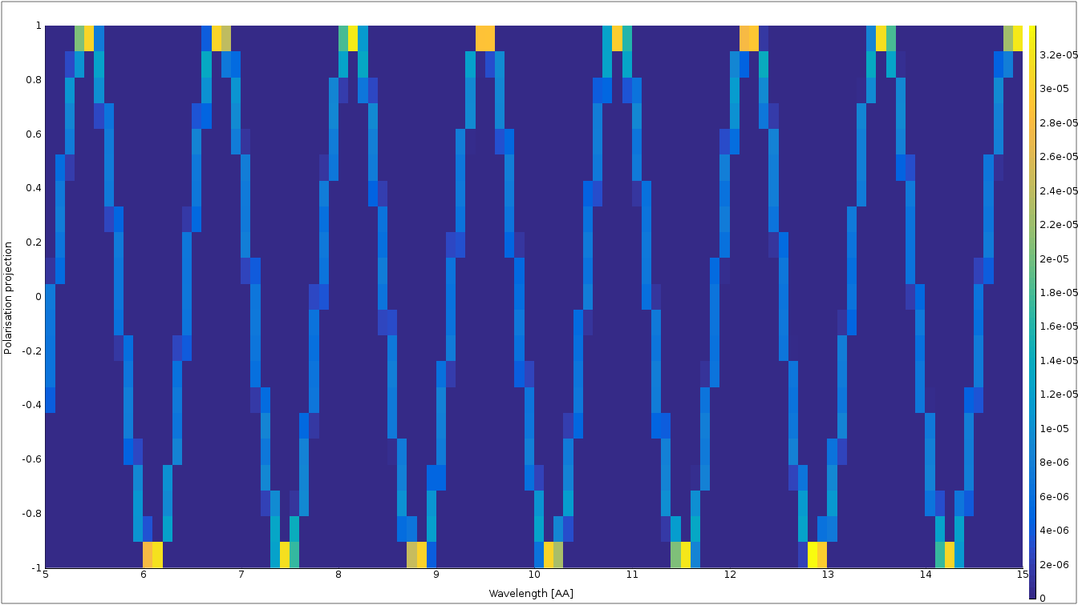
Nested fields

Slide 26
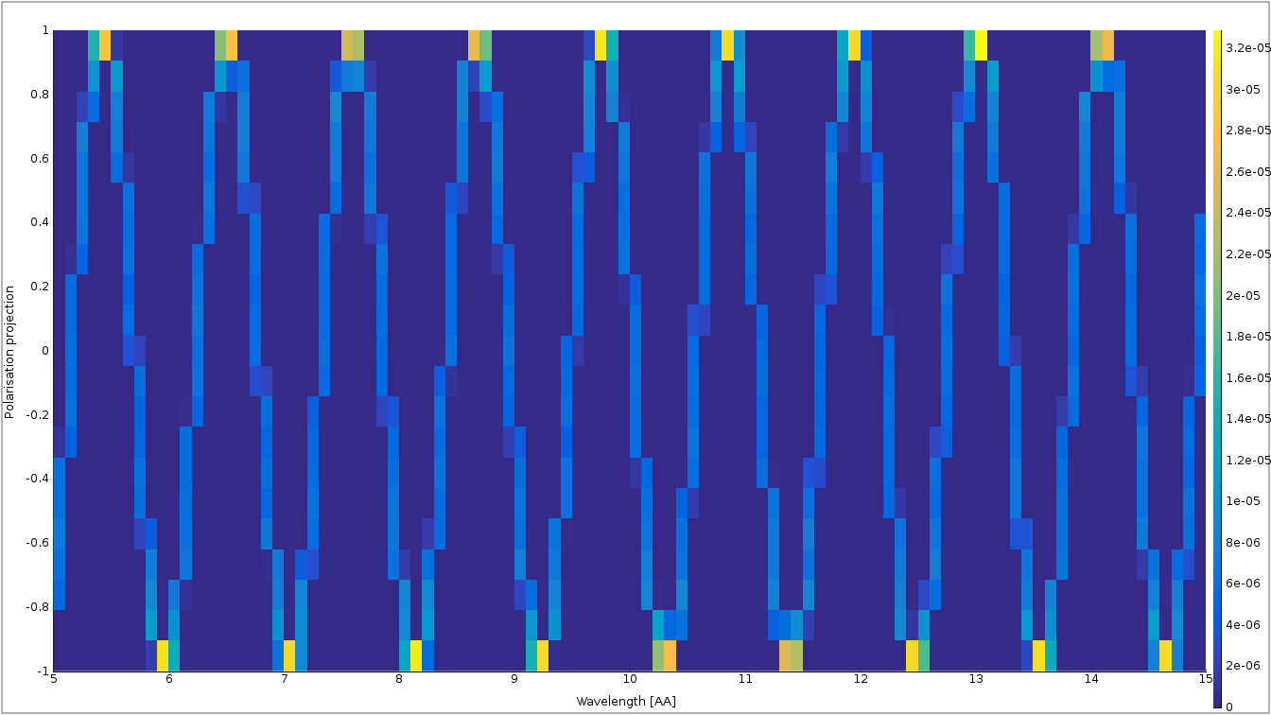
Nested fields

Slide 27
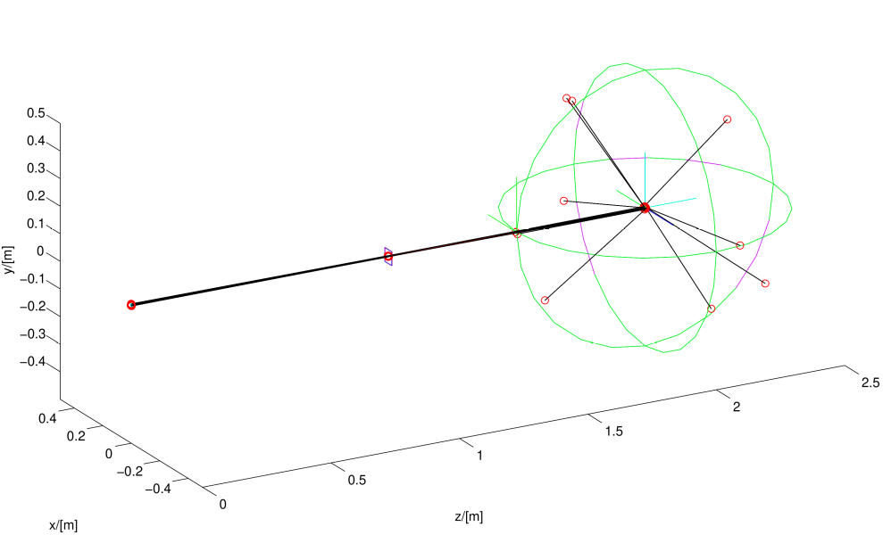
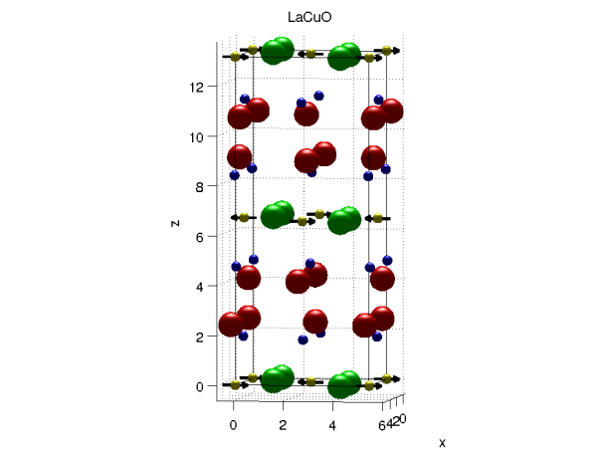

McStas component on the way
Magnetic single crystal

Slide 28
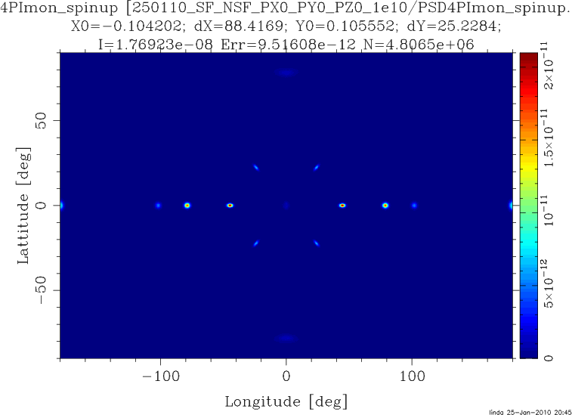
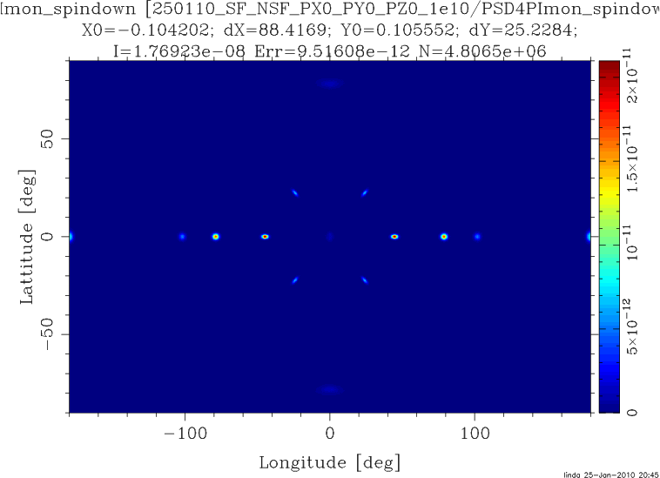
McStas component on the way
Magnetic single crystal – Unpolarized beam

Slide 29
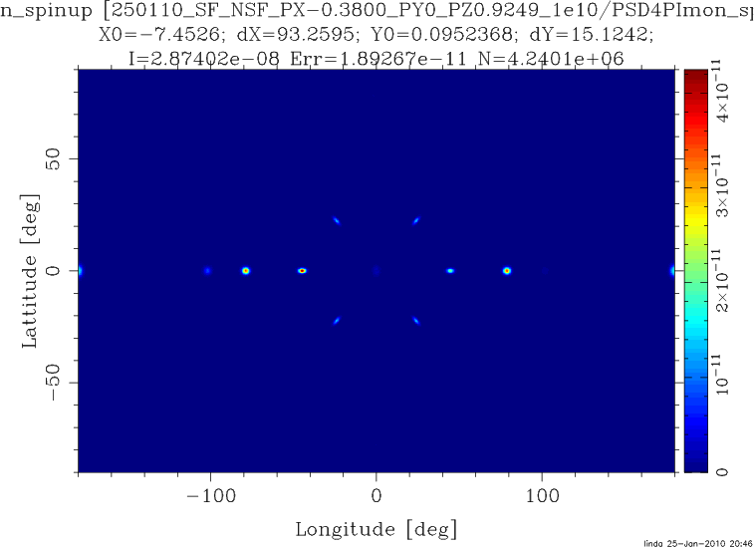
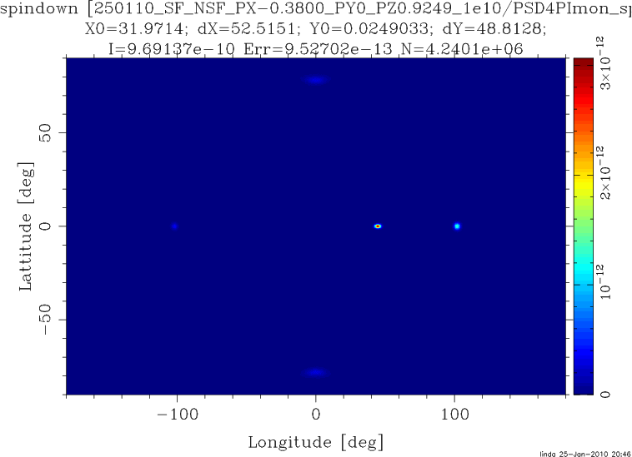
McStas component on the way
Magnetic single crystal – Polarized beam

Slide 30
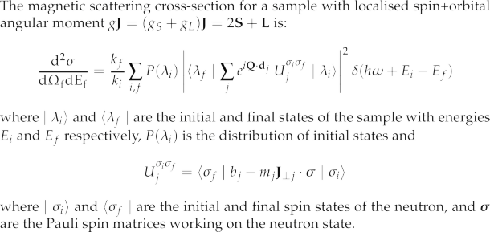
McStas components on the way
Magnetic single crystal
From: G. Shirane et.al. ,”Neutron Scattering with Triple-Axis Spectrometer”, Cambridge Univ. Press, 2002

Slide 31
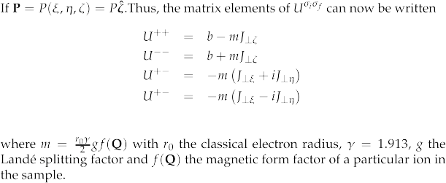
McStas components on the way
Magnetic single crystal

