Slide 1
McStas: Liquids and Powders Dynamics
E. Farhi, ILL

Slide 2
Isotropic density samples in McStas
Outline
Scattering law, a bit of theory
The Isotropic_Sqw component and input data files
How to get S(q,w) data sets:
From MD
From lattice dynamics
From experiments
Exercise: a “liquid” TOF spectrometer
Exercise: separate contributions
Disclaimer: in case of errors and uncertainties, please correct me...

Slide 3
Neutron-matter interaction
Selections rules
K_{f}=K_{i}+Q
E_{f}=E_{i}+w
Material
2q
K_{i}, E_{i}
Q, w
(d=2p/Q)
K_{f}, E_{i}
Bragg's law (diffraction on structure – atoms separated by distance d)
$nλ=2π/{K_{i}}=2dsinθ$
Scattering law (intensity per solid angle and energy, dynamics)
$\frac{d^{2}σ}{dΩ{dE}_{f}}=\frac{K_{f}}{K_{i}}\left[\frac{σ}{4π}S\left(Q,ω\right)\right]$
Holy Book (Squires)
Dynamical structure factor S(Q,w) is characteristic of each material
Reflects ordering of matter (atom/molecule positions – movements - domains)

Slide 4
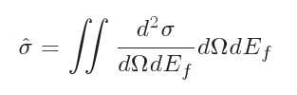
Scattering law
The double differential scattering cross section gives the probability for a neutron to scatter for a given solid angle and energy
The total intensity is the full integral over all scattering possibilities.
Effective total scattering cross section
V.F. Sears. Adv. Phys., 24, 1, 1975.

Slide 5
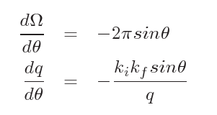

Computing the total scattering probability
The total scattering cross section is given in (Ω,E_{f}) space, but S is given in (q,ω)
A variable change must be done for the integration (Jacobian).
We like to play games
in (q,w) space
Effective cross section
in (q,w) space
Probability to transmit
$p=e^{−ρ\hat{σ}x}$
n
Scattering distribution
S(q,ω)
with importance sampling to
scatter preferably where S is large

Slide 6
How to get S(q,w) data sets
Liq/Powder/Xtal
S(Q) or F(Q)
or S(|Q|,w)
Experiments
(corrected)
Inter-atomic
potential u(r)
Molecular
Dynamics
$\vec{F}=−∇u\left(\vec{r}\right)=−m\vec{γ}$
MDANSE
McStas
Sqw
R, v
S(|Q|,w)
Ab-initio MD
Pseudo-potential
Simulated
experiment
Ab-initio Lattice Dyn.
S(Q,w) 4D
MD step is done prior to the virtual experiment (NAMD, VASP, GROMACS, ...).
Computationally intensive (e.g. use clusters). Then use FFT(r,t)
McStas provides a few sample S(Q,w): Rb, Ge, H2O, D2O, D2, ...
Isotropic_Sqw: Handles elastic and inelastic for both coherent and incoherent channels

Slide 7
Isotropic_Sqw syntax
Isotropic_Sqw(
Sqw_coh=FILE_COH,
Sqw_inc=FILE_INC,
radius=R,
height=H)
More component parameters can specify geometry, physical properties, ...
The data files specify the S(Q,w) or S(Q) values as a matrix with Q,w extent. Additional fields can be included as meta data (# lines).

Slide 8
Isotropic_Sqw data format
Open McStas, select Help / Comp Ref, then Data files. Select a .sqw file, e.g. He4_liq_coh.sqw
Look at format: Header and meta data, axes, matrix
Used # fields:
density, weight, sigma, Temperature
Meta data can be given as component parameters.

Slide 9
Isotropic_Sqw data format
# Sqw data file for Isotropic_Sqw
# liquid He4: coherent part, no incoherent, atomic number 2
# Elementary Excitation Data by R.J. Donnelly et al., J. Low Temp. Phys., 44 (1981) 471
# WARNING: line width is constant, intensity is not right
#
# Physical parameters:
# V_rho 0.072 atom density per Angs^3
# weight 4.002 in [g/mol]
# density 0.4784 in [g/cm^3]
# sigma_abs 0.00747 absorption scattering cross section in [barn]
# sigma_coh 1.34 coherent scattering cross section in [barn]
# sigma_inc 0 incoherent scattering cross section in [barn]
# Temperature 2 in [K]
# classical 0 experimental, contains Bose factor
#
# q axis values
# vector of m values in Angstroem-1
0.001000 0.011000 0.02 …
# w axis values
# vector of n values in meV
0.001391 0.011391 0.021391 0.0313 …
# sqw values (one line per q axis value)
# matrix of S(q,w) values (m rows x n values), one line per q value
9.721422 10.599145 11.344954 …
He4_liq_coh.sqw
Such files can be written from an iFit iData_Sqw2D object:
sqw2d = iData_Sqw2D(...);
saveas(sqw2d, ‘filename.sqw’,’mcstas’)

Slide 10
Sqw file from experiments
Reduce the experimental data, correct it for e.g. empty cell, parallax, detector efficiency, …
Correct for absorption, incoherent scattering, multiple-scattering, ...
Integrate over |Q| as Isotropic_Sqw is isotropic.
Write a text file with [Q,w] and S(Q,w) vectors/matrices. Add meta-data.

Slide 11
Sqw file from MD
Set the system box, (pseudo) potential/FF
Equilibrate, and couple to thermostat (NVT)
Run calculator in MD mode (NVE)
Convert trajectory (R,t) into S(|Q|,w) [MDANSE]
Analysis/Scattering/DCSF and DISF → .nc file
Export into .sqw text files.
sqw2d = iData_Sqw2D(‘DCSF.nc’);
saveas(sqw2d, ‘DCSF.sqw’,’mcstas’);

Slide 12
Sqw file from Lattice Dynamics
Create a crystal, calculate displacements or so.
Assemble the ‘phonon’ representation
Evaluate S(Q,w) on powder average
Export to McStas Sqw

Slide 13
Sqw: Exercise 1: a liquid TOF
Aim: A simple spectrometer (and diffractometer)
Create a new instrument from 'template (test)'.
Call it Liquid_simple and define input parameters (lambda=2.36, string coh=”Rb_liq_coh.sqw”, string inc=”Rb_liq_inc.sqw”)
Insert a Source_simple φ1cm sending λ=lambda with dλ/λ=1%. Focus onto a 1x1cm² area.
Insert an Isotropic_Sqw 3m away, using σ_{coh}=coh, σ_{inc}=inc with φ1cm x 5cm.

Slide 14
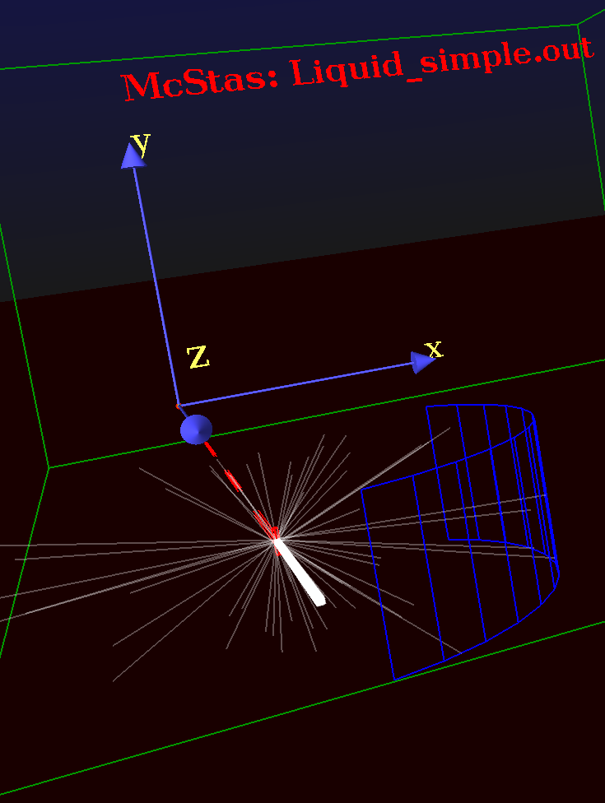
Sqw: Exercise 1: a liquid TOF
Add a Monitor_nD cylindrical detector φ1m x 30cm, sensitive to (θ,y) for diffraction, centred on the sample, with 100 bins.
Add the same, but sensitive to (angle,energy) with automatic energy limits.
Save, run in Trace 3D to check geometry.

Slide 15
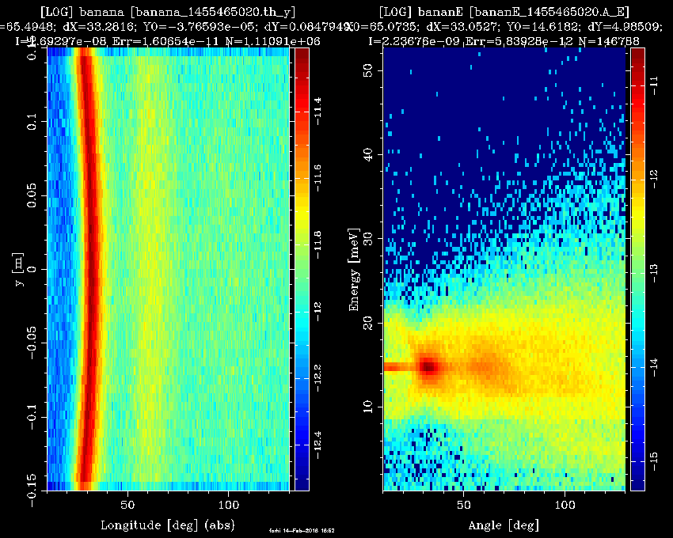
Sqw: Exercise 1: a liquid TOF
Run in Simulation/PGPLOT mode with 1e8 neutron events.
Plot results !
Comment on the diffraction pattern and the inelastic one.

Slide 16
Sqw: Exercise 2: contributions
Insert an instrument variable in the DECLARE block, as 'flag_scat'.
DECLARE %{
int flag_scat=0;
%}
After the AT token of the 'sample', insert an EXTEND block that sets flag_scat to the number of SCATTERED events.
EXTEND %{
flag_scat=SCATTERED; // nb of scattered events
%}

Slide 17
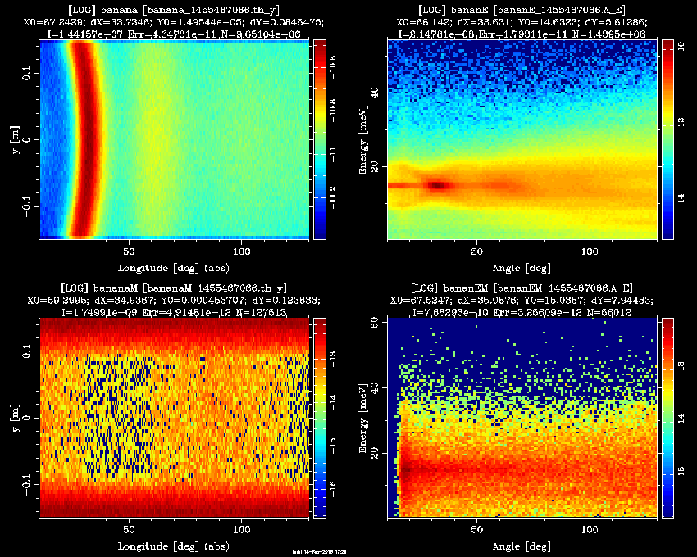
Sqw: Exercise 2: contributions
Duplicate the 2 monitors, and make them sensitive to multiple-scattering only. Add a WHEN(flag_scat) between the COMPONENT and the AT keywords:
COMPONENT …
WHEN(flag_scat > 1)
AT ...
Save and Run !
How much multiple scattering ratio at λ=2.36 Å
Make the sample φ5cm and repeat.

Slide 18

Sqw: Exercise 3: from iFit: build
McStas can be controlled from within iFit.
Open Matlab/iFit
Create the Liquid_simple model with:
model = mccode(‘Liquid_simple’)
Plot the geometry with:
plot(model) % has contextual menus
Then run it with (default 1e6 event and pars)
data = iData(model, [], nan);
subplot(model)

Slide 19
Sqw: Exercise 3: from iFit: eval
Specify parameters
data = iData(model, ‘lambda=2.36; coh=Cu.laz’)
Do a scan:
data = iData(model, ‘lambda=[1.2 2.4 3.6]’)
Change neutron events #
model.UserData.options.ncount = 1e7;

Slide 20
Sqw: Exercise 3: from iFit: optim
Fix all parameters but lambda, Maximize model value:
mlock(model, ‘all’); munlock(model, ‘lambda’)
xlim(model, ‘lambda’, [1 3]); % bounds
fmax(model, ‘lambda=2.36’, ‘’, nan)
fmax(model, ‘lambda=2.36’, ‘OutputFcn=fminplot’, nan)

Slide 21
Sqw: Exercise 3: from iFit: crazy
You can add two McStas models:
model=mccode(‘instr1’)+mccode(‘instr2’)
Edit the instrument and re-compile
edit(model)
...

