Slide 1
Erik Knudsen, DTU Physics
Sources and Monitors

Slide 2
Sources: In general
A source component generates Monte Carlo neutrons. In McStas terms this means:
Set the neutron state to something representative of the source we are trying to model.
i.e.: insert values in the neutron state vector: {x,y,z, vx,vy,vz, t, sx,sy,sz, p} drawn from appropriate distributions.
EXAMPLE: Neutrons from a uniform wavelength distribution emerging from a circular aperture.

Slide 3
Access the docs
IMPORTANT:
All (and more) of this information can be found in the online pdf component documentation, e.g.
https://github.com/McStasMcXtrace/McCode/raw/master/docpkg/manuals/mcstas/Component_manual.pdf
or
http://mcstas.org/download/components/doc/manuals/mcstas-components.pdf
- also distributed with your McStas installation - mcdoc -c
The component documentation along with the command:
“mcdoc <component_you_are_searching_for>”
are your best friends when using McStas

Slide 4

Sources: Example 1
$$x∈U\left[−R,R\right]; y∈U\left[−R,R\right]; wherex^{2}+y^{2}<R$$
Neutron spatial coordinates are picked from a uniform distribution on a circle with radius R.

Slide 5



Sources: Example 1
Length of the velocity vector encodes the wavelength
$$λ_{1}∈U\left[1,4\right] ⇒ \left|v_{1}\right|=f\left(λ_{1}\right)$$
$$λ_{2}∈U\left[1,4\right] ⇒ \left|v_{2}\right|=f\left(λ_{2}\right)$$
$$λ_{3}∈U\left[1,4\right] ⇒ \left|v_{3}\right|=f\left(λ_{3}\right)$$

Slide 6
Sources: Example 1
focus_xw
Neutron velocity vector is picked to point at a ROI.
In McStas: this is defined by the parameters: focus_xw, focus_yh, and
dist
focus_yh
dist

Slide 7
Sources: Example 1
TRACE
COMPONENT origin = Progress_bar() AT(0,0,0) ABSOLUTE
COMPONENT src = Source_simple(
radius=0.05, lambda0=2.5, dlambda=1.5,
focus_xw=0.1, focus_yh=0.1, dist=5)
AT(0,0,0) RELATIVE origin

Slide 8
Monitors: in general
REALITY:
Monitors:
Intensity probe of the beam
Transparent to neutrons → Efficiency <1%
Detectors:
Should detect all neutrons → Efficiency as high as possible
SIMULATIONS (McStas):
In McStas:
We can program monitors and detectors to behave any way we like. We refer to both of those indistinguishably as ‘monitors’.
E.g. monitor with Efficiency =100% and Transparency=100%
(With exception of PSD_Detector that models a “physical” He³ detector)

Slide 9
Monitors: Example PSD_monitor

Slide 10
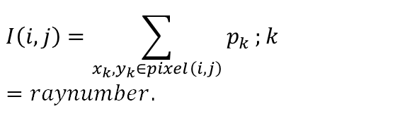
Monitors: Example PSD_monitor
When the simulation has been completed, the detected intensity in pixel (i,j) is:
$$I\left(i,j\right)=\sum_{x_{k},y_{k}∈pixel\left(i,j\right)}{p_{k}};k=raynumber.$$
… during simulation, the pixels are maintained as running sums.

Slide 11
...
TRACE
COMPONENT origin = Progress_bar() AT(0,0,0) ABSOLUTE
COMPONENT src = Source_simple(
radius=0.05, lambda0=2.5, dlambda=1.5,
focus_xw=0.1, focus_yh=0.1, dist=5)
AT(0,0,0) RELATIVE origin
COMPONENT psd = PSD_monitor(
xwidth=0.2, yheight=0.2, filename=”psd.dat”)
AT (0,0,5) RELATIVE src
COMPONENT lm = L_monitor(
xwidth=0.2, yheight=0.2, filename=”lm.dat”,
Lmin=0, Lmax=8)
AT (0,0,5+0.01) RELATIVE src
Monitors: Example PSD_monitor and L_monitor

Slide 12


Sources: Mathematical sources
Source_simple:
Square or circular surface emitting neutrons from either uniform or Gaussian wavelength (or energy) distribution.
Neutrons are directed towards a square target.
Source_div:
Square surface emitting neutrons from either uniform or Gaussian wavelength (or energy) distribution.
Neutrons have a divergence defined by either uniform or Gaussian distribution.

Slide 13
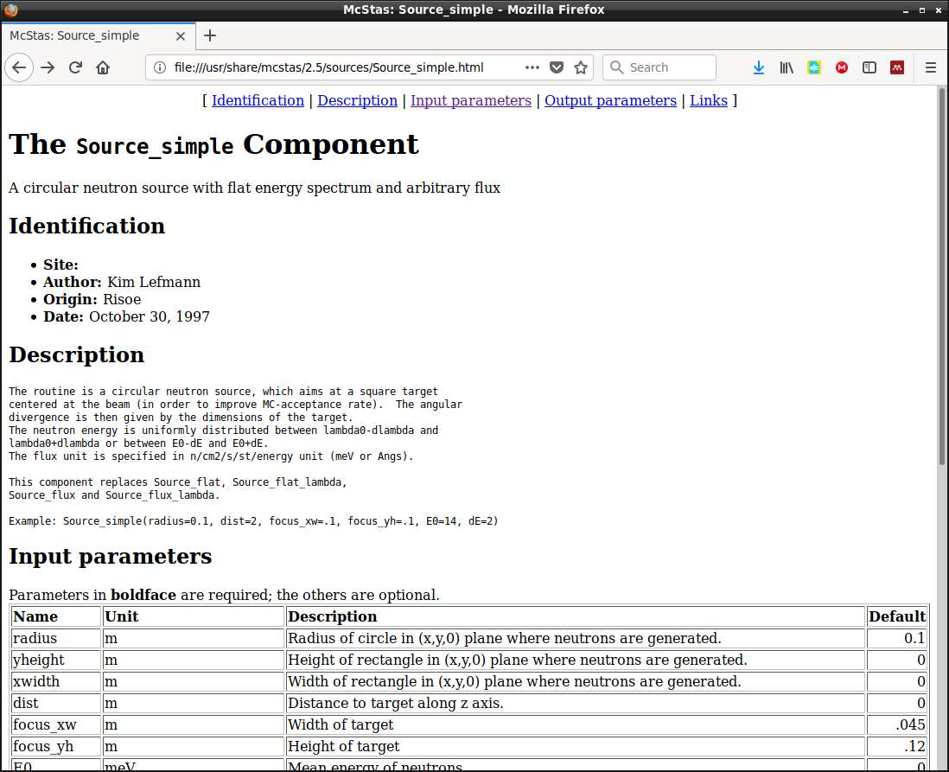
Source_simple docs
Try “mcdoc Source_simple”
or
( in GUI ) Help → mcdoc Component Reference → (In Webpage ) Source_simple

Slide 14
Source_simple docs
Try “mcdoc Source_simple”
or
( in GUI ) Help → mcdoc Component Reference → (In Webpage ) Source_simple
Click “Input parameters”

Slide 15
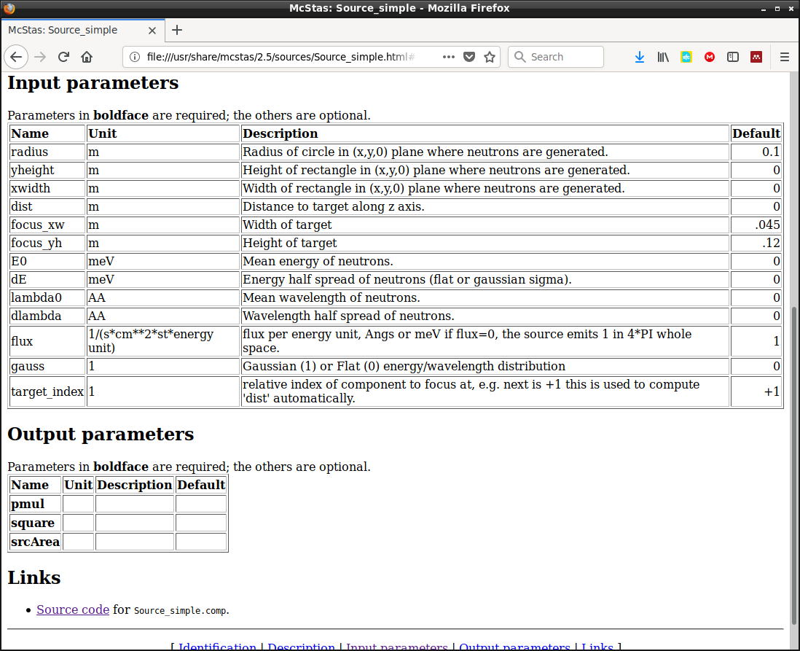
Source_simple docs
Try “mcdoc Source_simple”
or
( in GUI ) Help → mcdoc Component Reference → (In Webpage ) Source_simple

Slide 16
Monitors: Example PSD_monitor and L_monitor
Let’s do a very simple exercise on this:
Head on over to:
Exercise 1 - Sources and Monitors on github
https://github.com/McStasMcXtrace/Schools/tree/master/ESS_May_2021/Wednesday_May_5th/2_Component_basics/Exercise

