Slide 1
Moving Optics
Velocity selector
Disk Chopper
Fermi Chopper

Slide 2
Not optics that move... but
...optics with moving parts
...optics with moving parts

Slide 3
Moving Optics
I.e. we can’t do:
COMPONENT something = Sometype(
par1=value1, par2=value2, ….)
AT( f_x(t), f_y(t), f_z(t) )RELATIVE someother
So what can we do?

Slide 4
Moving Optics
I.e. we can’t do:
COMPONENT something = Sometype(
par1=value1, par2=value2, ….)
AT( f_x(t), f_y(t), f_z(t) )RELATIVE someother
So what can we do?
Instead, we operate internally in the component on the neutron state, e.g. “rotate” the neutron etc.
n
n

Slide 5
DISK CHOPPER
Define time structure of the beam
Time Of Flight (TOF) measurements

Slide 6
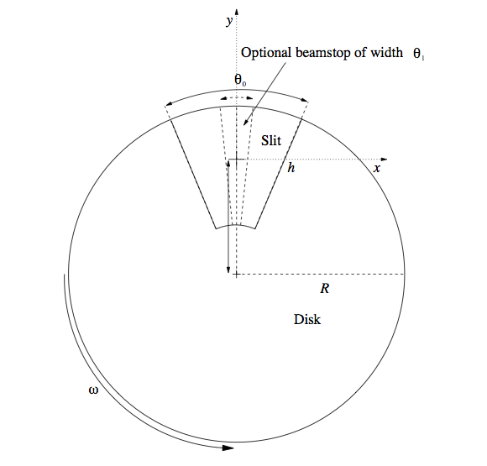
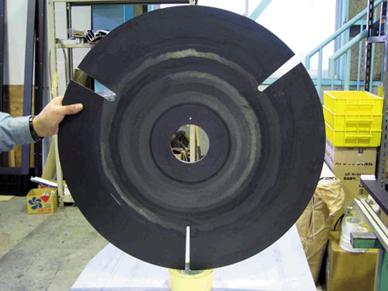
Disk Chopper

Slide 7
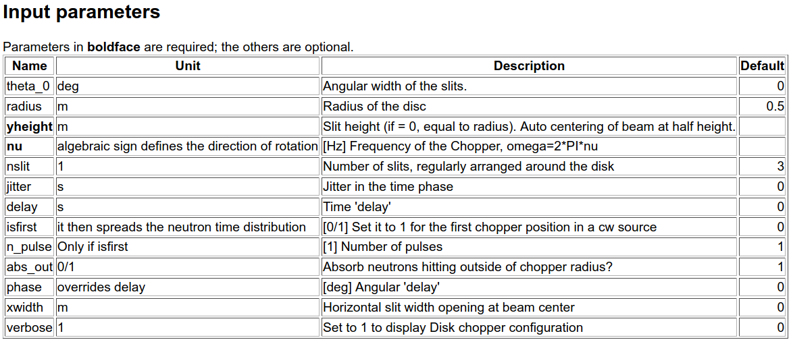
Disk Chopper

Slide 8
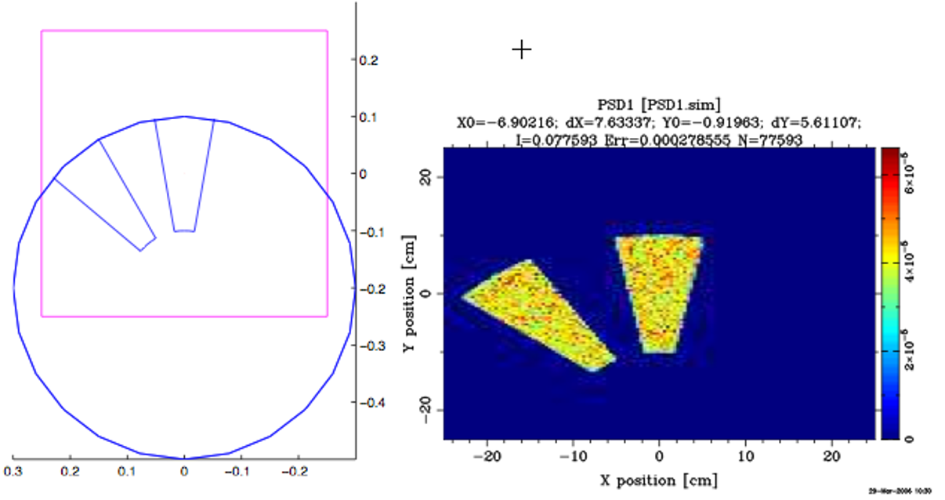
Disk Chopper

Slide 9
Disk Chopper
Let’s do an exercise on this – head on over to github and find it there:
https://github.com/McStasMcXtrace/Schools/tree/master/ESS_May_2021/Wednesday_May_5th/4_Choppers_and_other_rotating_optics
g_optics/README.md

Slide 10
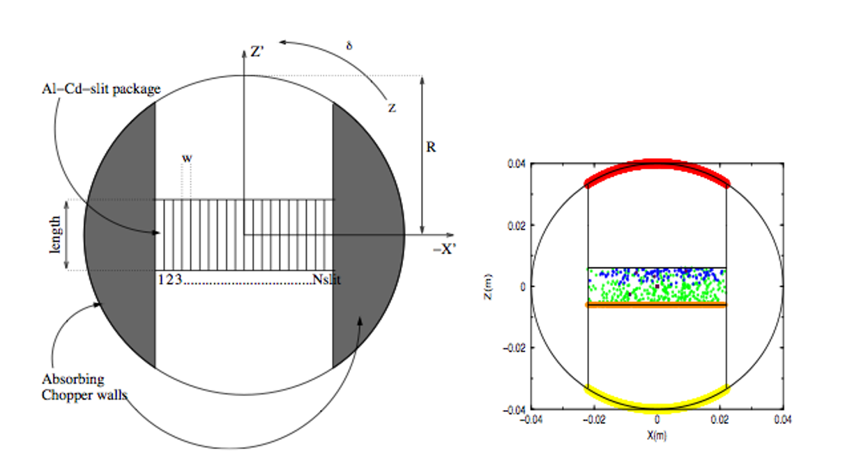
Fermi Chopper

Slide 11
Velocity Selectors
-
Select the neutron energy you want

Slide 12
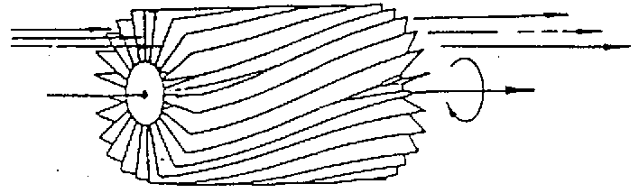
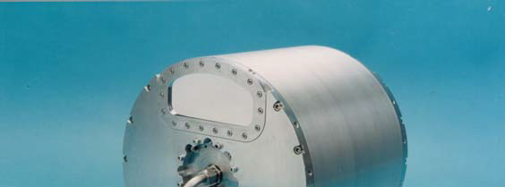
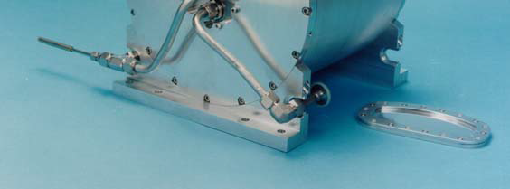
Velocity Selectors
‘broad’ monochromatization δλ/λ ≈ 10 %
ILL.FR
Astrium

Slide 13
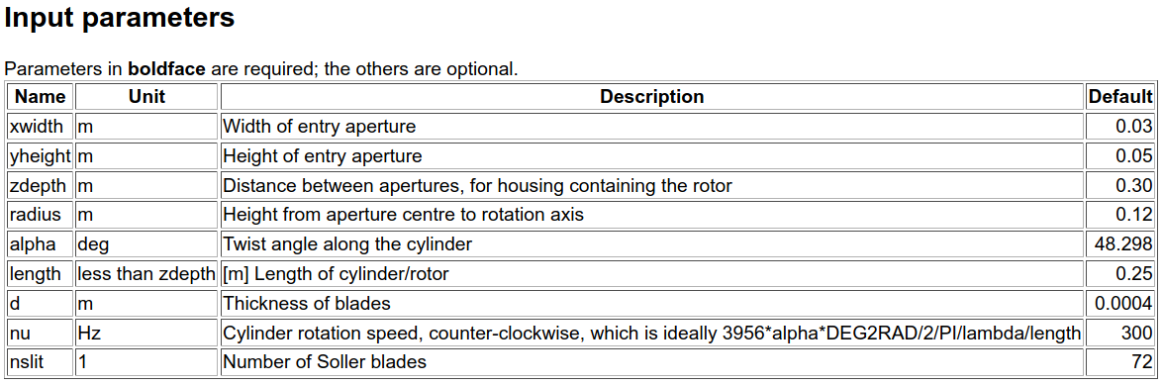
Velocity Selector
housing

Slide 14
Velocity Selectors
Let’s do an exercise on this also:
Go to the same place on github you were before and do the second Task:
https://github.com/McStasMcXtrace/Schools/blob/master/ISIS_April_2021/Tuesday_April_13th/4_Choppers_and_other_rotating_optics/README.md

