Slide 1
Guides and gravity in McStas
Mads Bertelsen

Slide 2
Overview
Description of phase-space and propagation
Reflectivity
McStas coordinate system
Gravitation in McStas
Guide components with support for gravity
Guide_gravity
Elliptic_guide_gravity
Breaking line of sight
Examples from guide_bot
Exercise

Slide 3
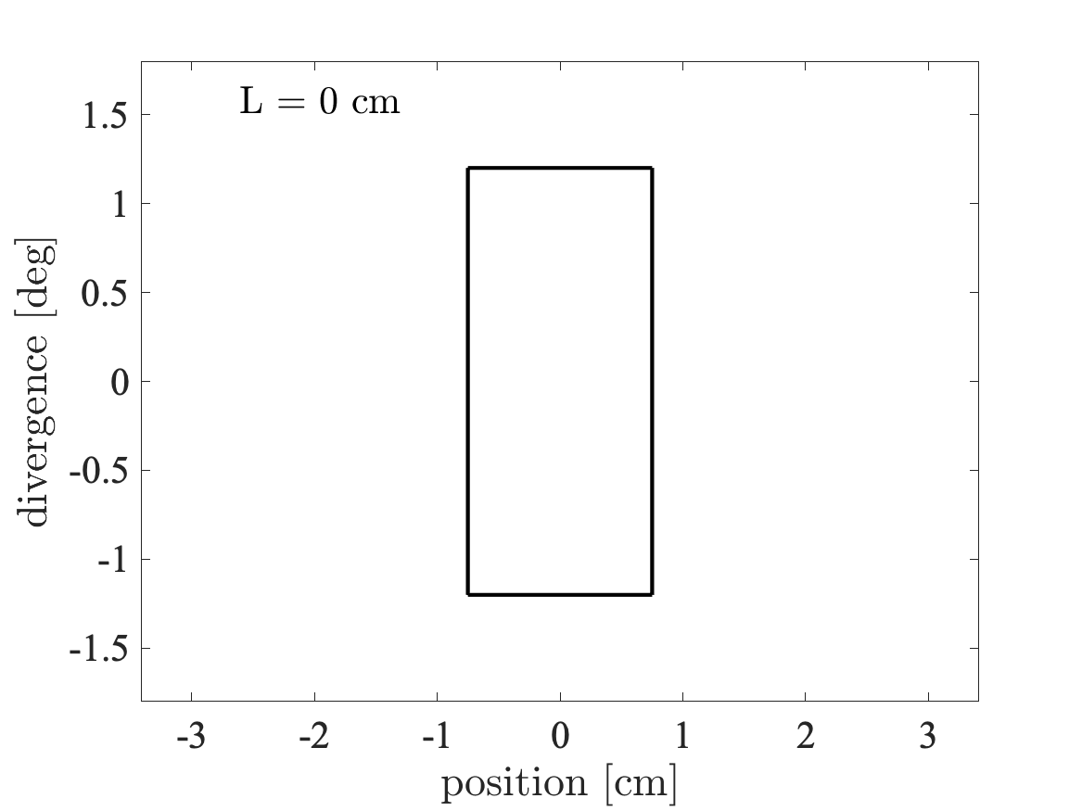
Beam propagation in free space
“Phase-space” at source
Divergence
z
v
𝜂x
x

Slide 4
Beam propagation in free space
Wanted “phase-space” at sample
Divergence
z
v
𝜂x
x

Slide 5
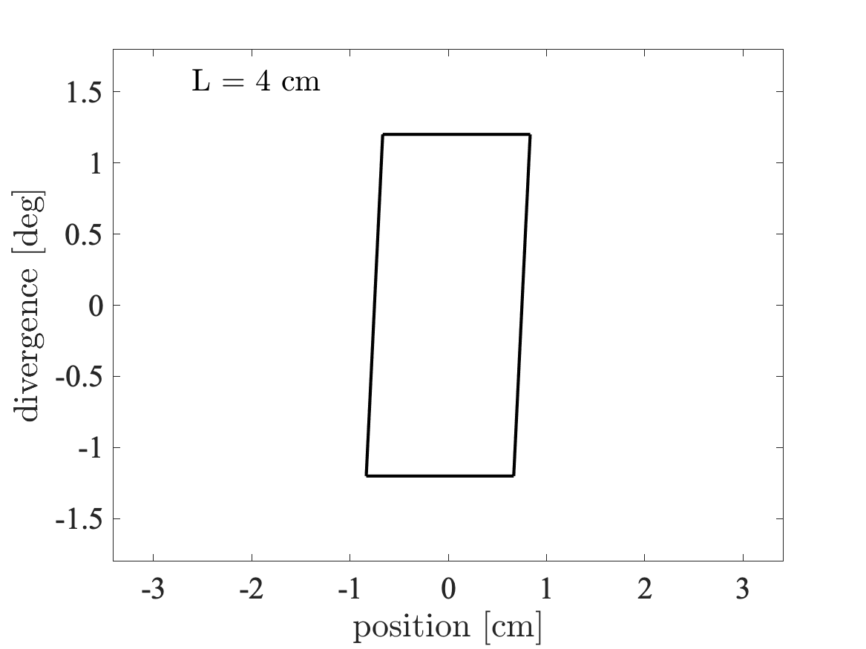
Beam propagation in free space
Divergence
z
v
𝜂x
x

Slide 6
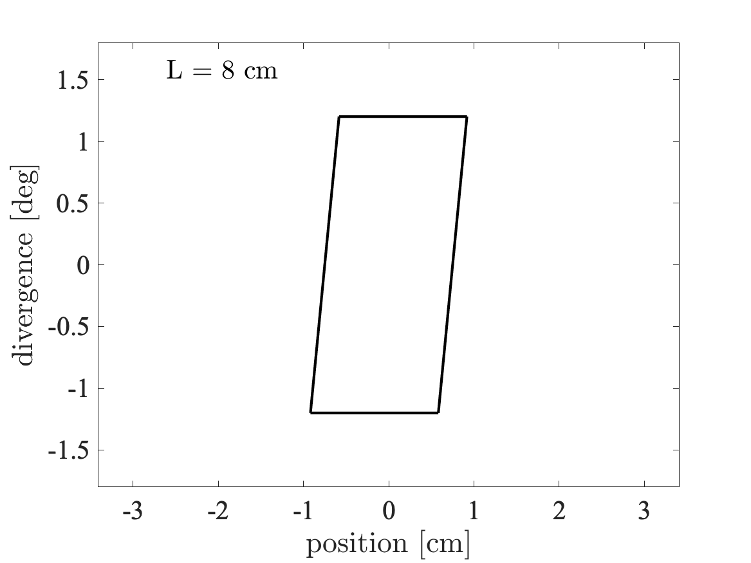
Beam propagation in free space
Divergence
z
v
𝜂x
x

Slide 7
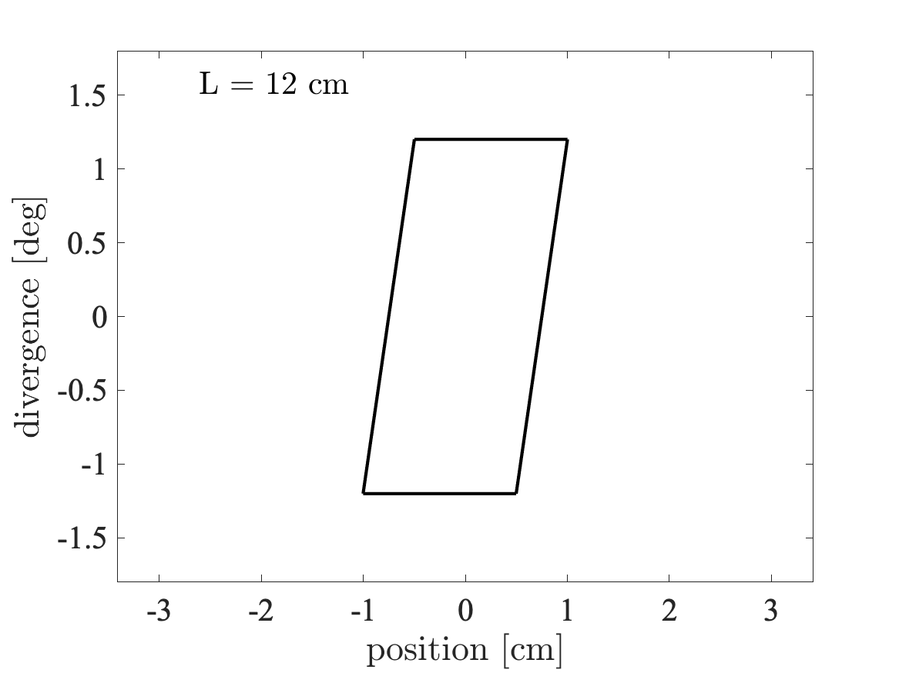
Beam propagation in free space
Divergence
z
v
𝜂x
x

Slide 8
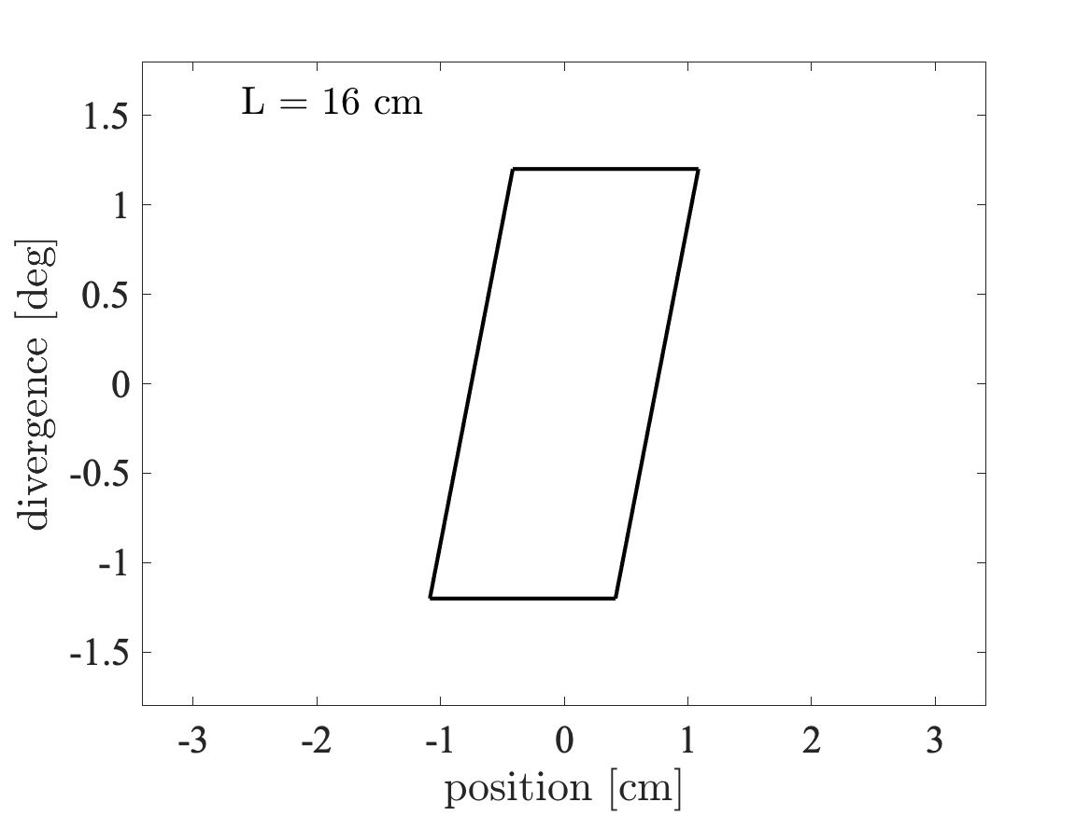
Beam propagation in free space
Divergence
z
v
𝜂x
x

Slide 9

Beam propagation in free space
Divergence
z
v
𝜂x
x

Slide 10
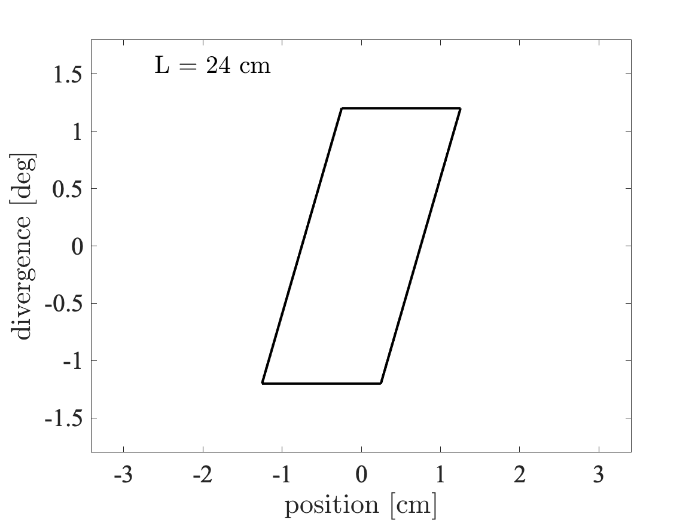
Beam propagation in free space
Divergence
z
v
𝜂x
x

Slide 11
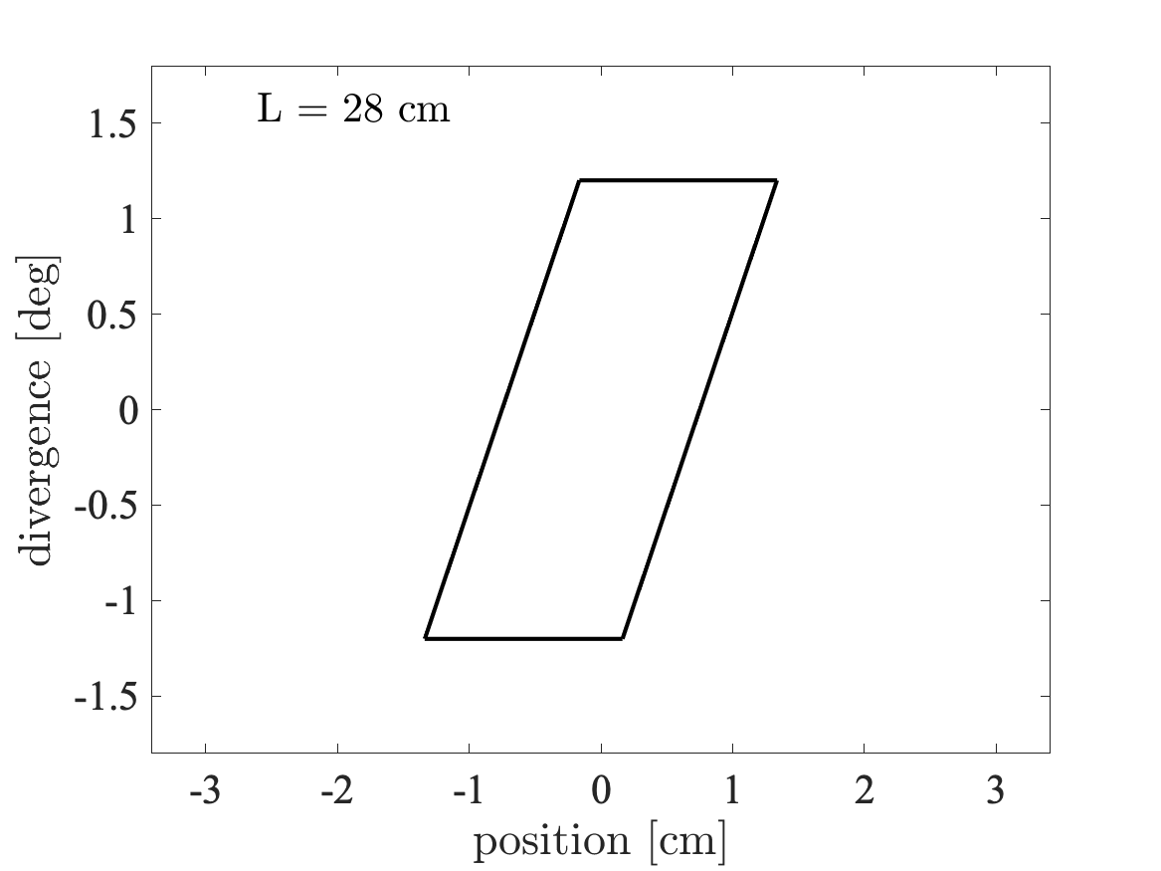
Beam propagation in free space
Divergence
z
v
𝜂x
x

Slide 12
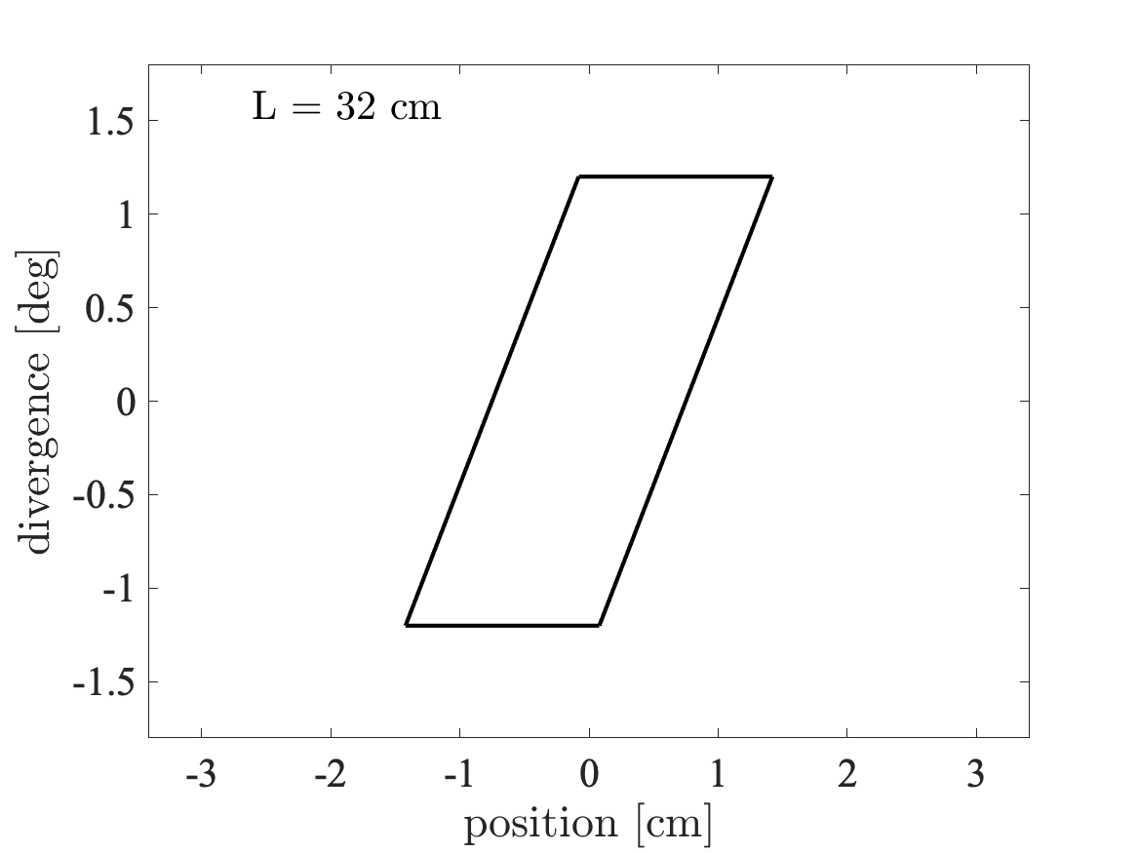
Beam propagation in free space
Divergence
z
v
𝜂x
x

Slide 13
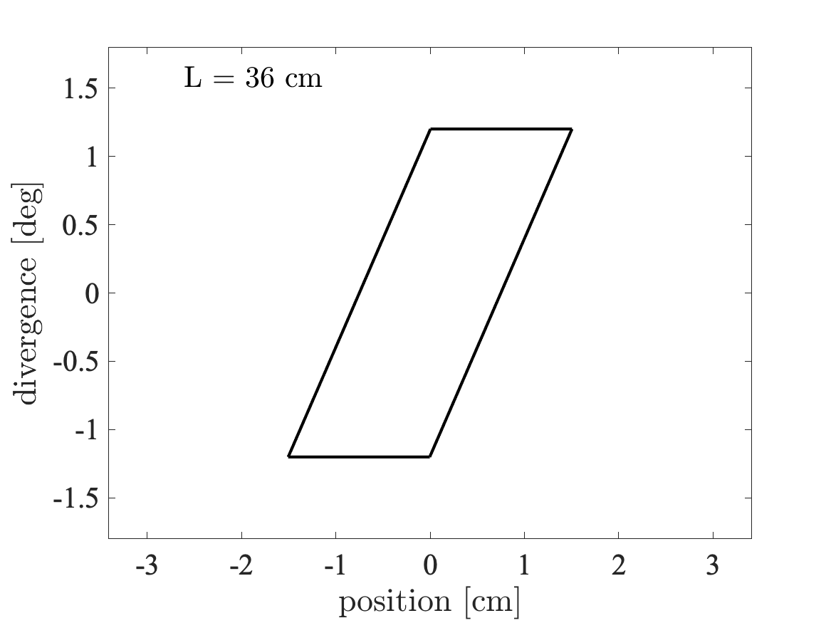
Beam propagation in free space
Divergence
z
v
𝜂x
x

Slide 14

Beam propagation in free space
Divergence
z
v
𝜂x
x

Slide 15
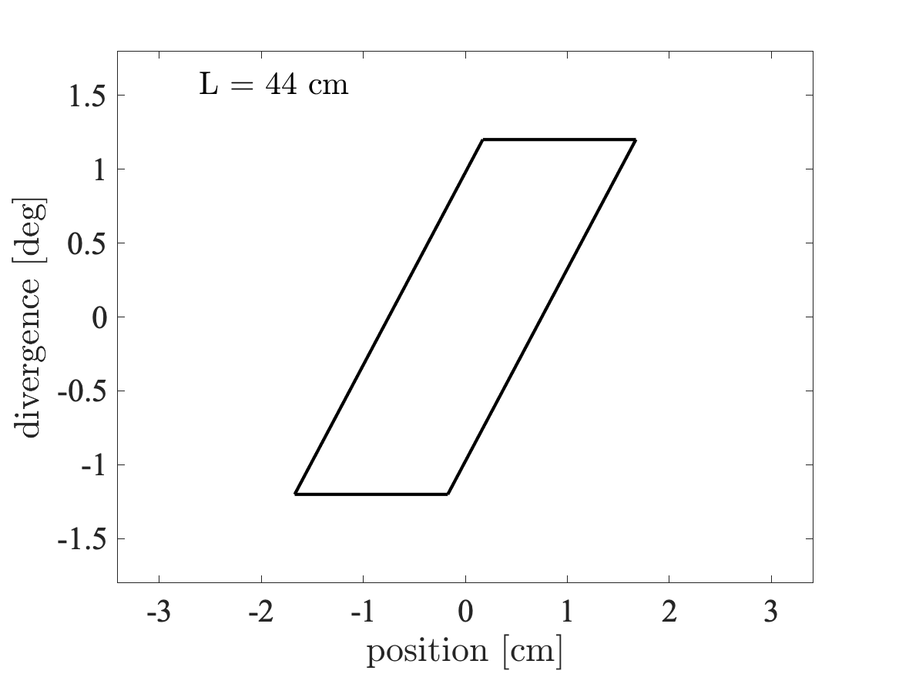
Beam propagation in free space
Divergence
z
v
𝜂x
x

Slide 16
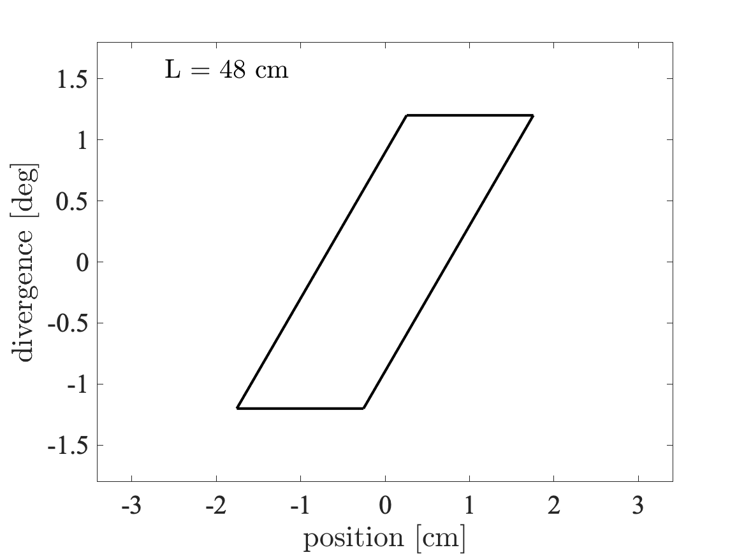
Beam propagation in free space
Divergence
z
v
𝜂x
x

Slide 17

Beam propagation in free space
Divergence
z
v
𝜂x
x

Slide 18

Beam propagation in free space
Divergence
z
v
𝜂x
x

Slide 19

Beam propagation in free space
- We lost some phase-space to propagation
Divergence
z
v
𝜂x
x

Slide 20
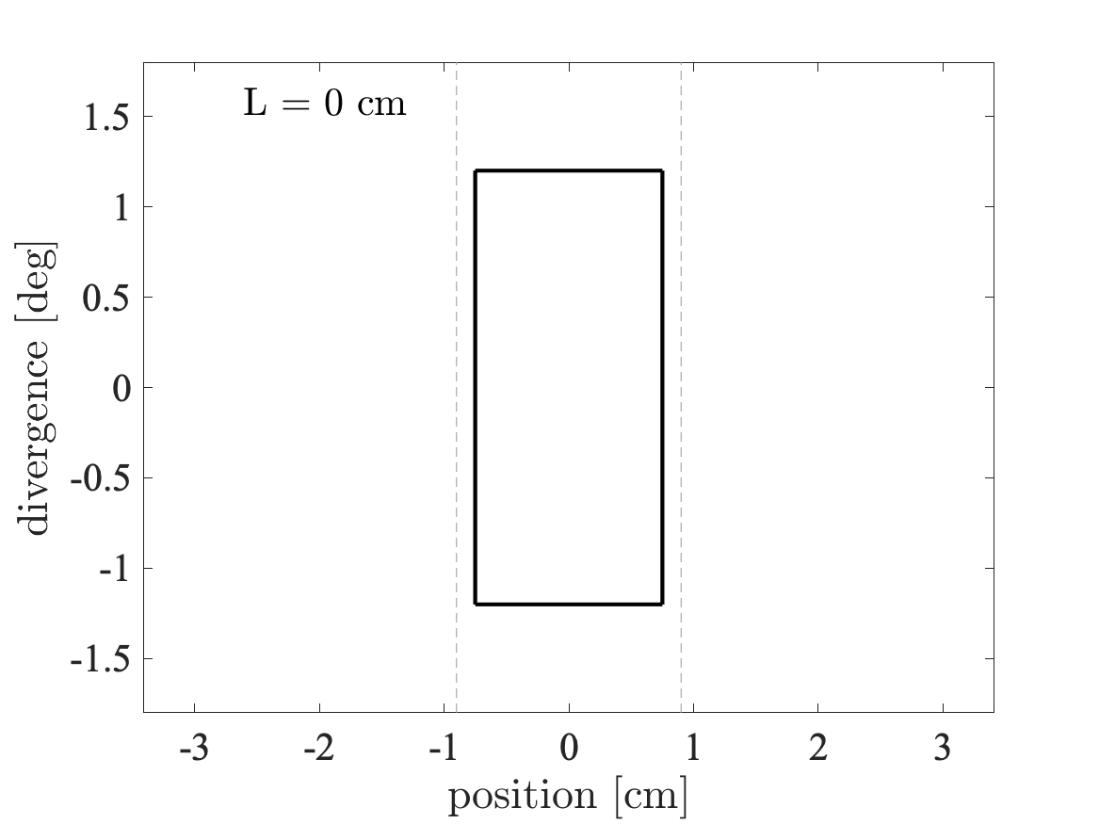
Beam propagation in guide
Wanted “phase-space” at sample
Divergence
z
v
𝜂x
x

Slide 21

Beam propagation in guide
Divergence
z
v
𝜂x
x

Slide 22
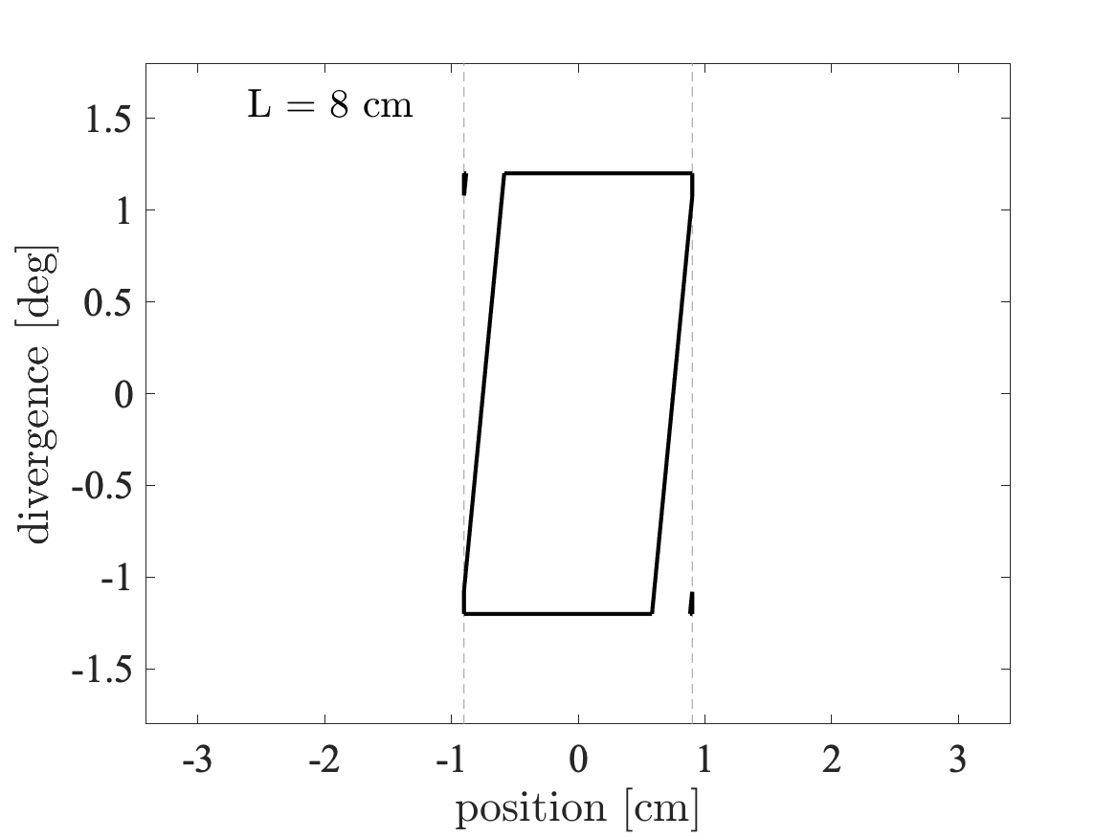
Beam propagation in guide
Divergence
z
v
𝜂x
x

Slide 23
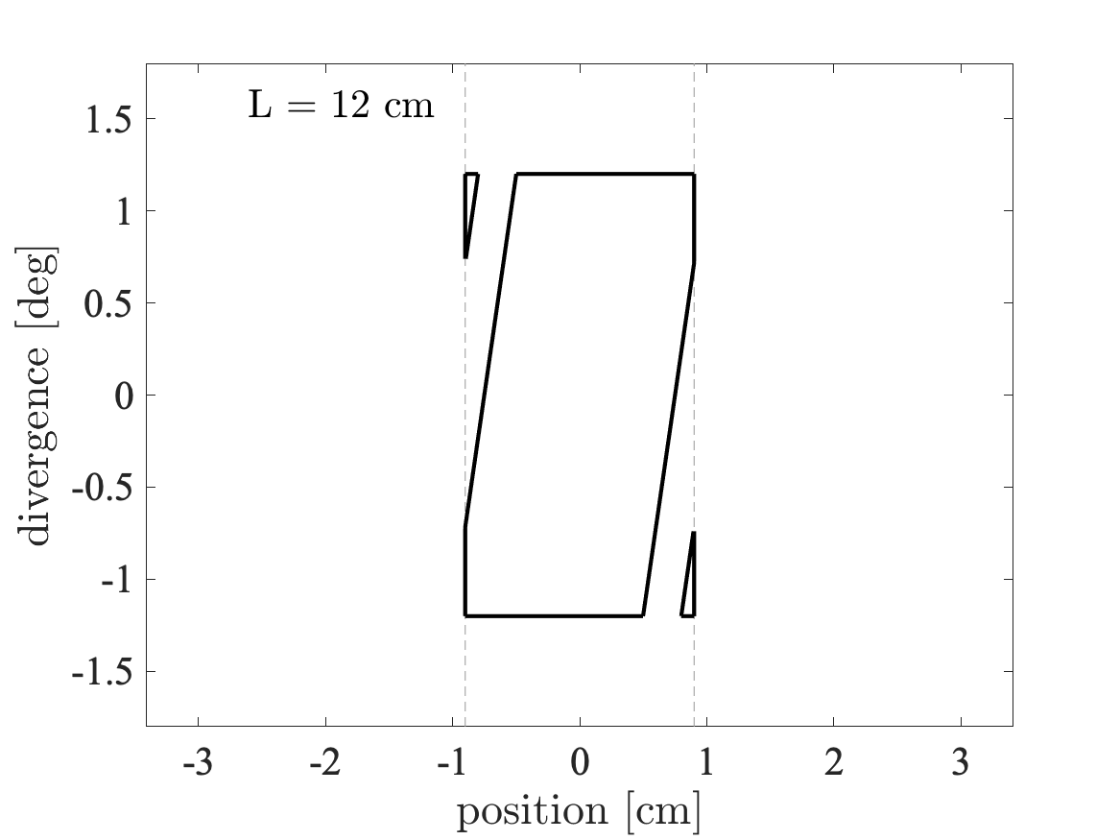
Beam propagation in guide
Divergence
z
v
𝜂x
x

Slide 24
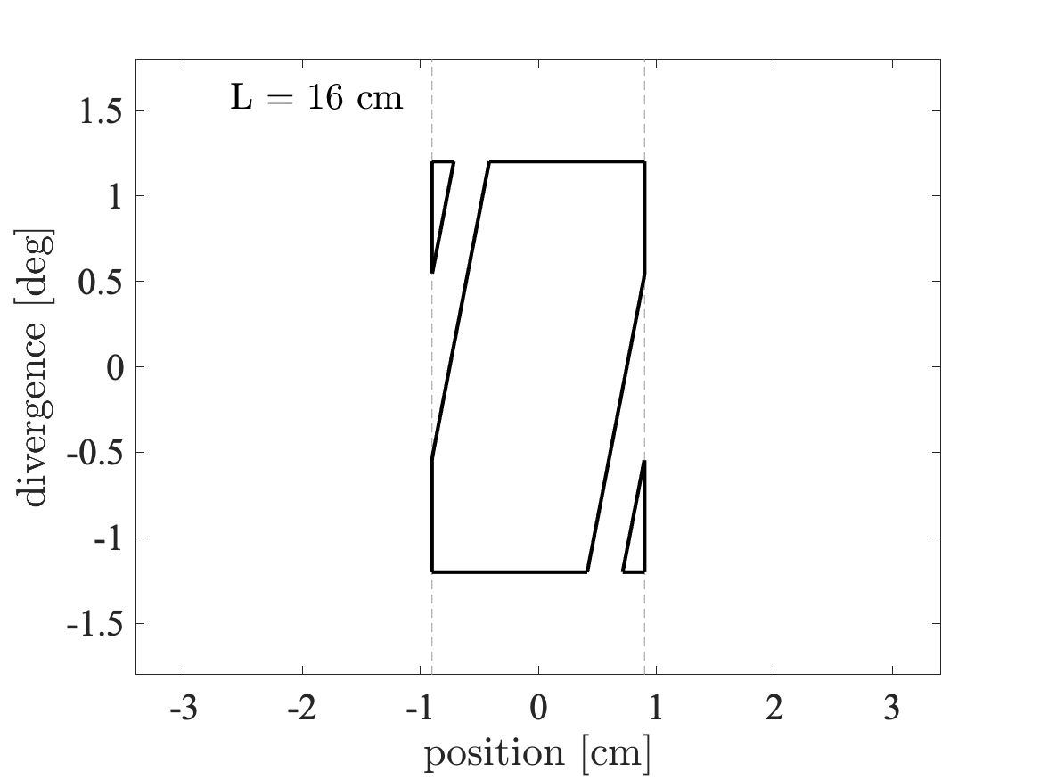
Beam propagation in guide
Divergence
z
v
𝜂x
x

Slide 25
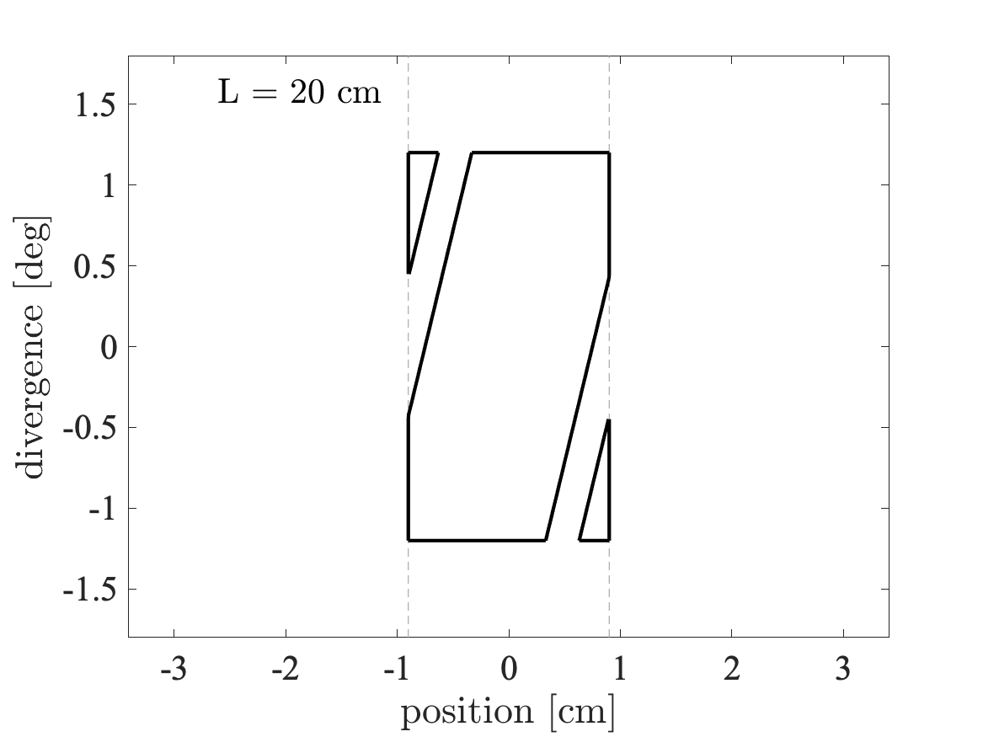
Beam propagation in guide
Divergence
z
v
𝜂x
x

Slide 26

Beam propagation in guide
Divergence
z
v
𝜂x
x

Slide 27

Beam propagation in guide
Divergence
z
v
𝜂x
x

Slide 28

Beam propagation in guide
Divergence
z
v
𝜂x
x

Slide 29
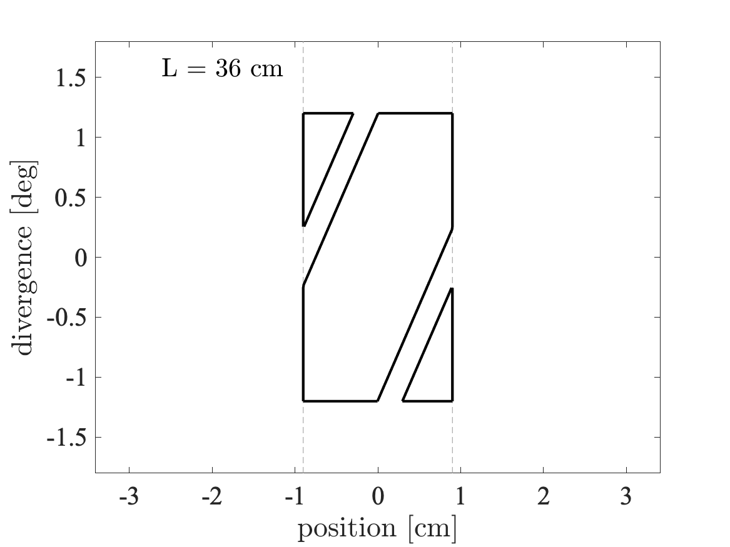
Beam propagation in guide
Divergence
z
v
𝜂x
x

Slide 30

Beam propagation in guide
Divergence
z
v
𝜂x
x

Slide 31

Beam propagation in guide
Divergence
z
v
𝜂x
x

Slide 32

Beam propagation in guide
Divergence
z
v
𝜂x
x

Slide 33
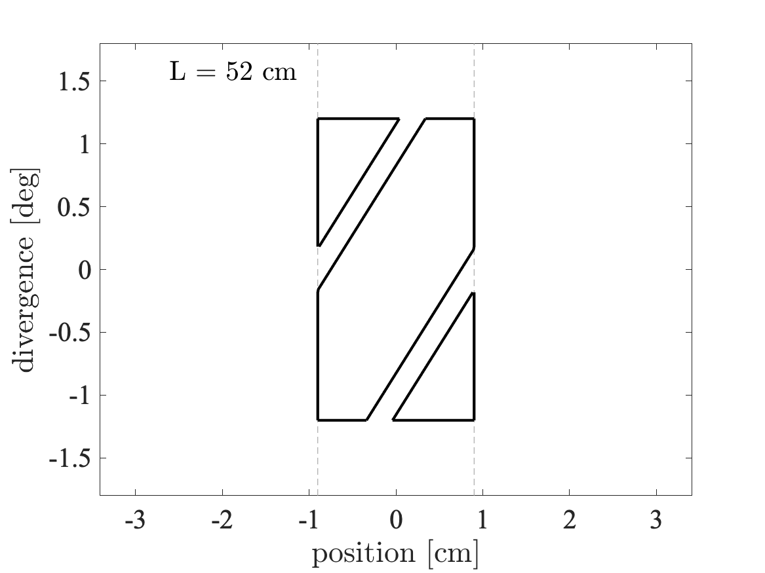
Beam propagation in guide
Divergence
z
v
𝜂x
x

Slide 34
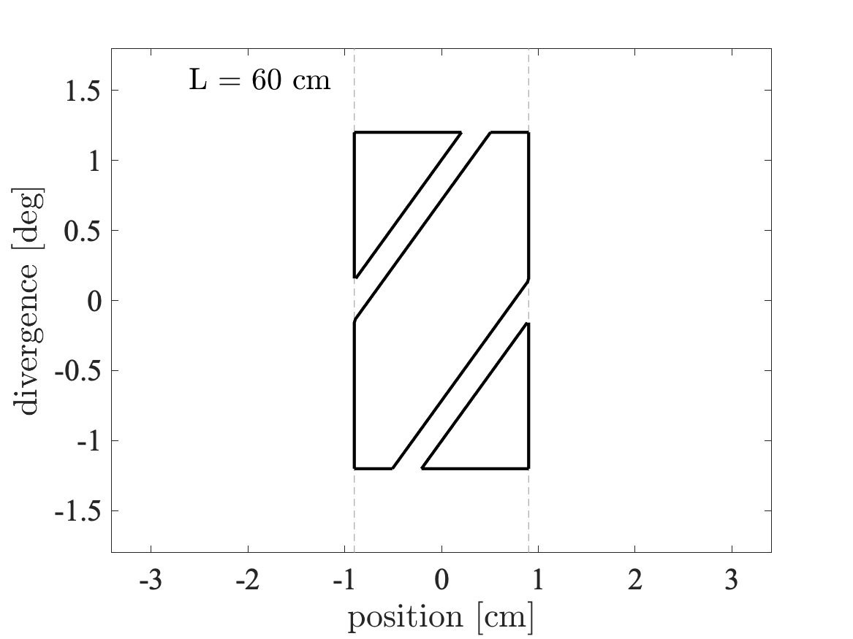
Beam propagation in guide
Divergence
z
v
𝜂x
x

Slide 35
Beam propagation in guide
We got some phase-space back from guide reflection!
Divergence
z
v
𝜂x
x

Slide 36
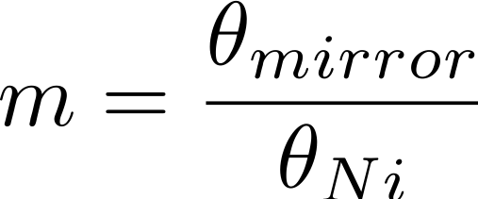
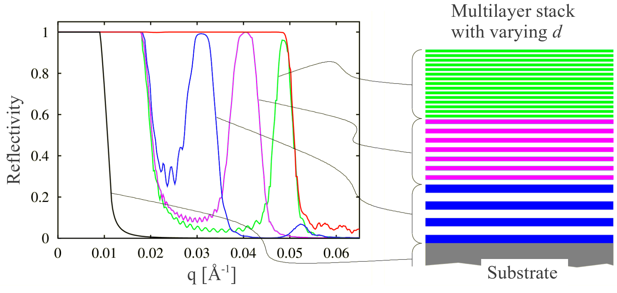
Reflectivity curves
Reflectivity, super mirror, reflectivity curve
ki
kf
q
𝛳

Slide 37
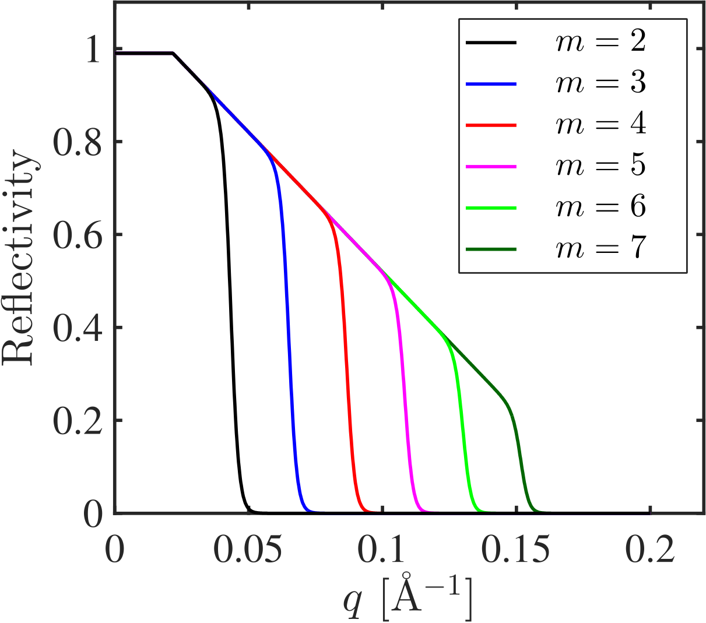
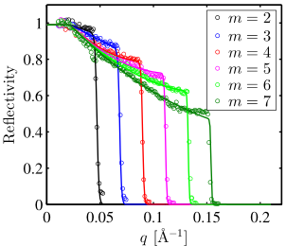
Reflectivity curves in McStas
McStas standard model
McStas fitted model
Slope:$−α$
$α$ = 0 W = 0
Only m matters
Better mirrors available today
Cutoff: $\frac{tanh⁡}{W}$

Slide 38
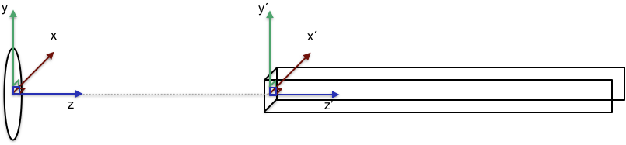
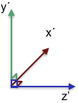
Guide placement in McStas
The center is the front of the guide element
Tip: Insert a guide at the end of the guide
COMPONENT Source AT (0,0,0) ABSOLUTE
COMPONENT Guide(length=A) AT (0,0,2) RELATIVE Source
COMPONENT Arm AT (0,0,A) RELATIVE Guide

Slide 39
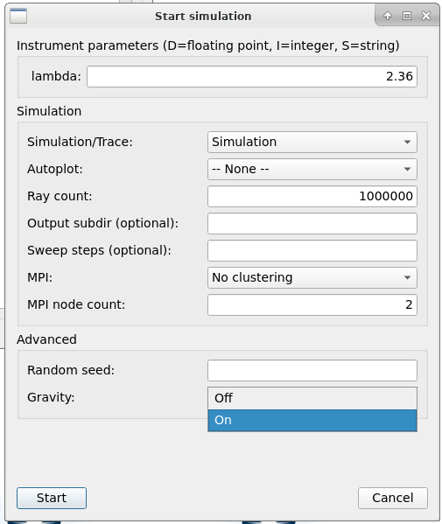
Gravitation in McStas
Enabled by adding -g / --gravitation on command line or by selecting “Gravity On” in mcgui
Default ~ gravity on earth #define GRAVITY 9.81 /* [m/s^2] gravitational acceleration */ ( If on the moon, use -DGRAVITY=1.62 ;-) )
For guides, only Guide_gravity and Elliptic_guide_gravity support parabolic propagation. (Many others propagate linearly in v direction.)
As you will see in the practical, implications are greatest with long wavelengths and at long distances
“How about e.g. elliptic mirror optic X that does not support gravity?”
often a good workaround is to add a monitor close to the surface of object X, this takes care that propagation up to the monitor includes gravitation:
Gravity is enabled in any call to PROP_DT, PROP_Z0 etc., but not in intersect_* routines (most monitors use PROP_Z0 directly, no intersect_ call first
OK to propagate without gravitation e.g. within sample, through velocity selector etc. / range of ~cm’s

Slide 40
Popular guide components: Guide_gravity
Typical guide component with gravity, parameter-interface similar to e.g. Guide.comp
Many additional features, channels, fermi chopper, … (see mcdoc pages for more info)
w1
w2
h1
h2
l

Slide 41
Popular guide components: Guide_gravity
Typical guide component with gravity, parameter-interface similar to e.g. Guide.comp
Many additional features, channels, fermi chopper, … (see mcdoc pages for more info)
w1
w2
h1
h2
l

Slide 42
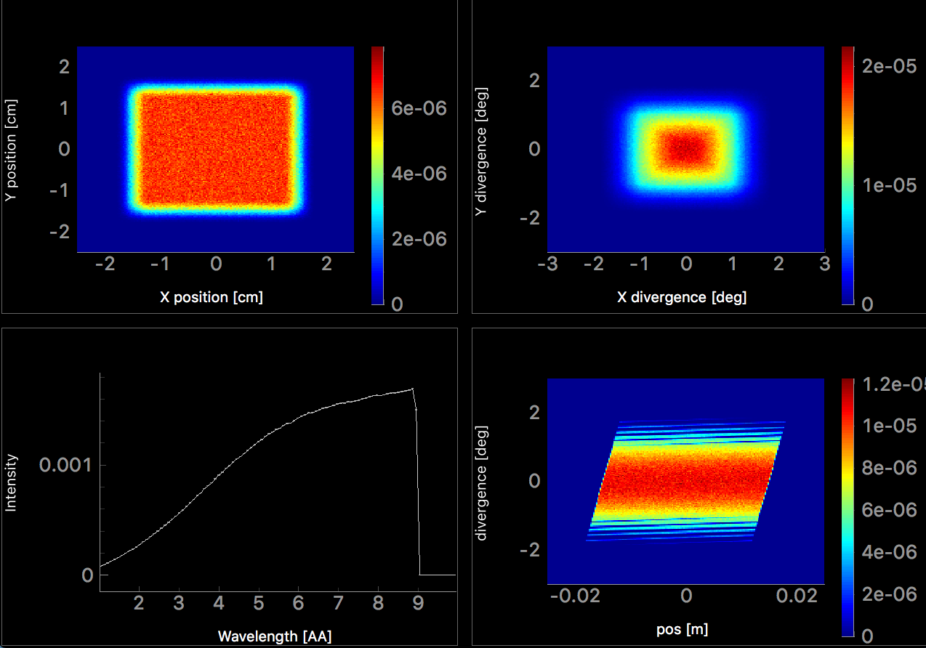
Popular guide components: Guide_gravity
Typical guide component with gravity
Position
Divergence
Wavelength
Position - Divergence

Slide 43
Popular guide components: Elliptical_guide_gravity
Useful for elliptic and parabolic guide geometries, focusing, ballistic, coating distribution, …
xwidth and yheight at DimensionsAt = ”entrance” , ”mid” or ”exit”
linxw linyh
l
loutxw loutyh

Slide 44
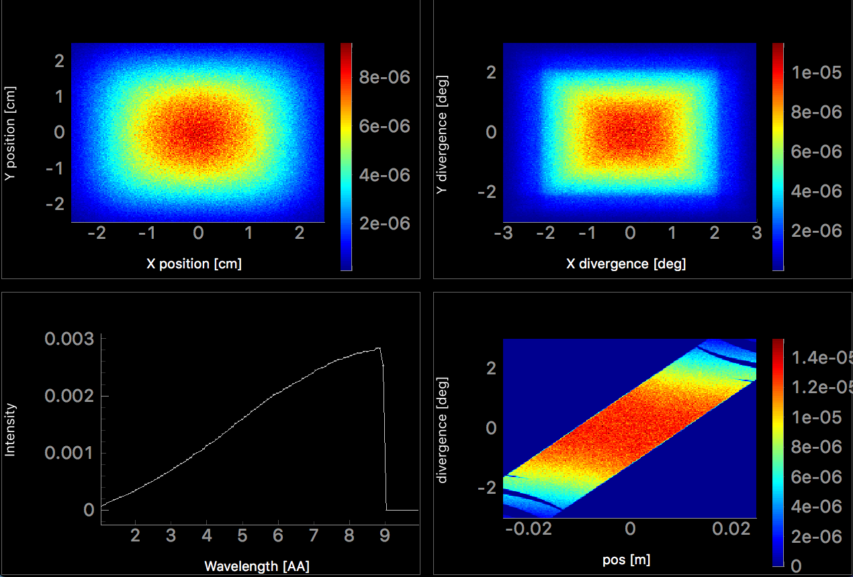
Popular guide components: Elliptical_guide_gravity
Useful for elliptic and parabolic guide geometries, focusing, ballistic, coating distribution, …
Position
Divergence
Wavelength
Position - Divergence

Slide 45
Comparison: Guide_gravity and Elliptic_guide_gravity
Guide_gravity
Elliptic_guide_gravity
Position
Divergence
Position
Divergence
Wavelength
Position - Divergence
Wavelength
Position - Divergence

Slide 46
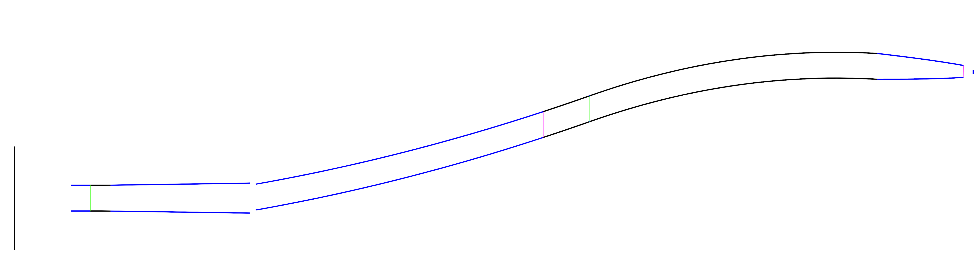
Breaking line of sight
Importance of breaking line of sight, ways of doing so, …

Slide 47


Breaking line of sight
Bender / Guide_curved component or many straight sections
Mind the gaps, avoid overlap

Slide 48
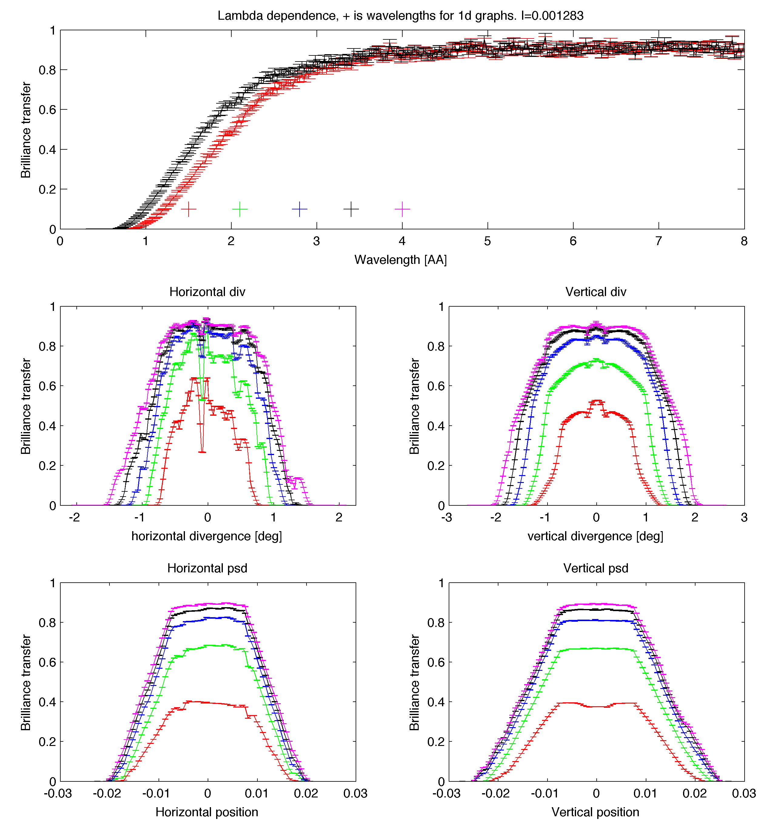
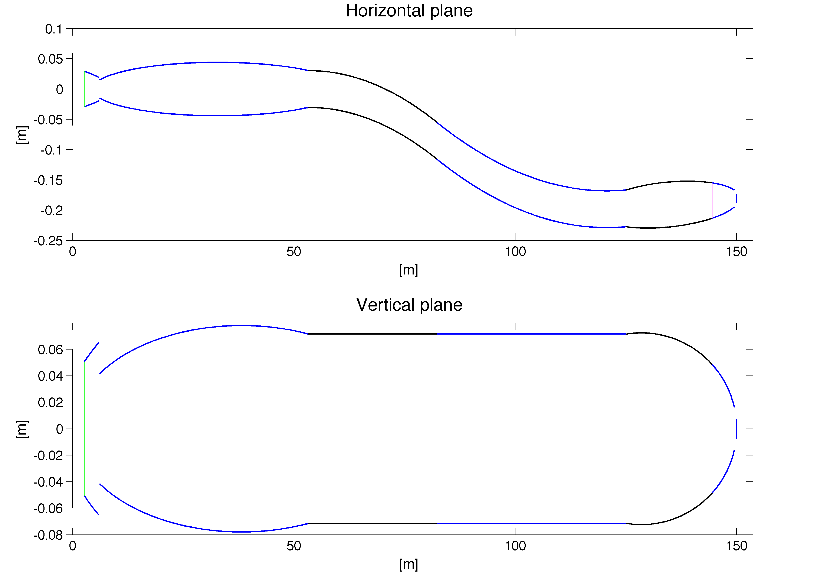
Guide optimization
Optimization result from MATLAB guide_bot
Python guide_bot available

Slide 49
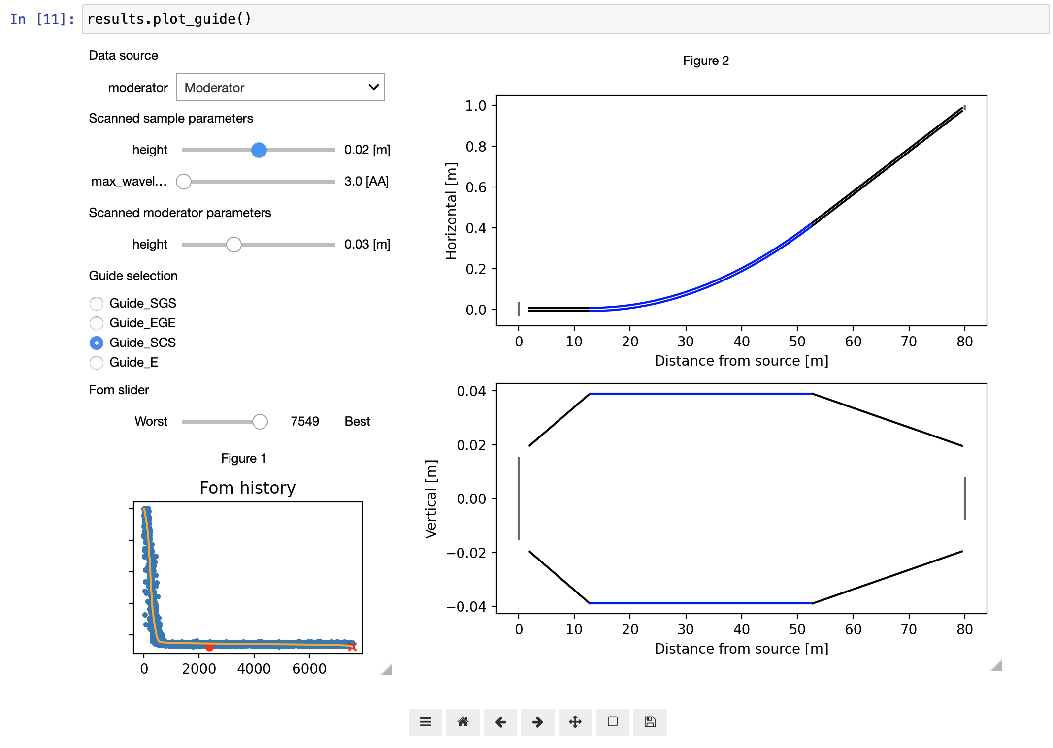
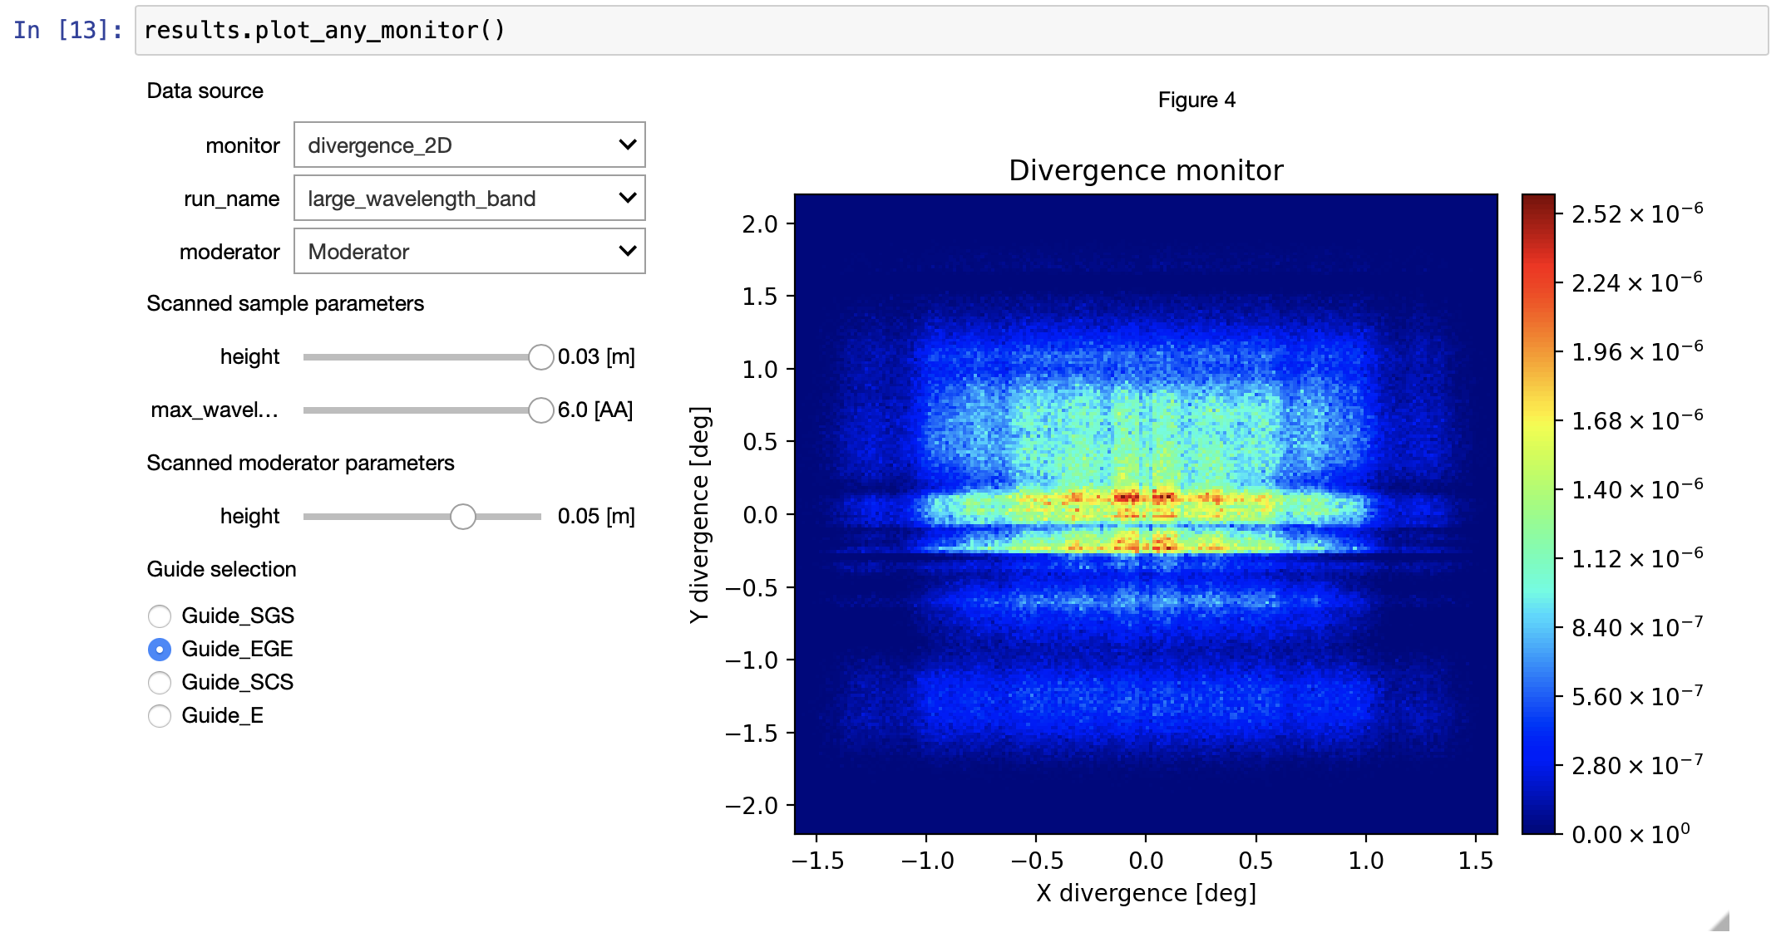
Guide optimization
Optimization results from python guide_bot
pip install guide_bot --upgrade

Slide 50
Guide exercise
Solution on github, use if you are stuck
Insert a guide and use an instrument input parameter to set the length
Use monitors to see the resulting beam
PSD_monitor (spatial distribution)
Divergence_monitor (divergence distribution)
L_monitor (wavelength distribution)
Posdiv_monitor (acceptance diagram)
Extra tasks:
Scan guide length
Introduce a gap by using two guide components
Use Guide_gravity and extend to 100 m length
Investigate the effect of gravity on the transport of long-wavelength neutrons

