Slide 1
Further samples…
SANS, reflectometry, imaging, inelastic scattering
Peter Willendrup

Slide 2
Further samples in McStas
A look at the “Sample functionality matrix”
Models for SANS
Inelastic scattering, examples:
Phonon_simple
Isotropic_sqw
McStas performance, TAS / Chopper

Slide 3
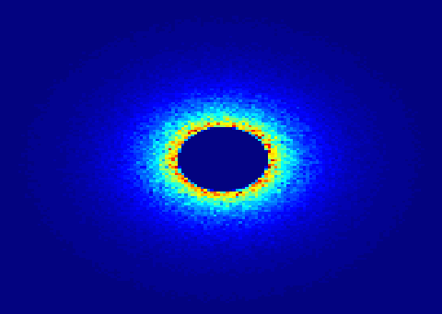

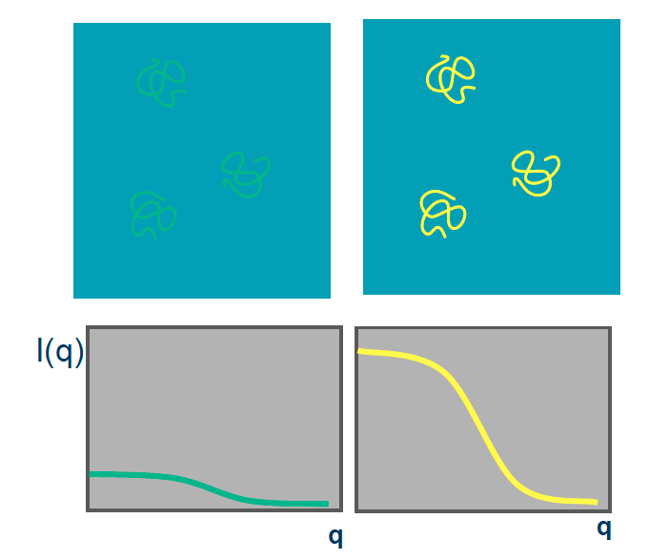
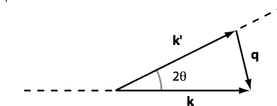
Small angle scattering SANS
SANS method can be used for many types of material
Often: Molecule + Liquid (buffer solution)
Isotropic scattering
Small Angle Neutron Scattering
Elastic Scattering
Small angle -> small q -> big r
Gain information on the molecular scale 10-100Å
Low signal to noise
Contrast method
Instrument requirements: good collimation, long flight distance after detector.

Slide 4
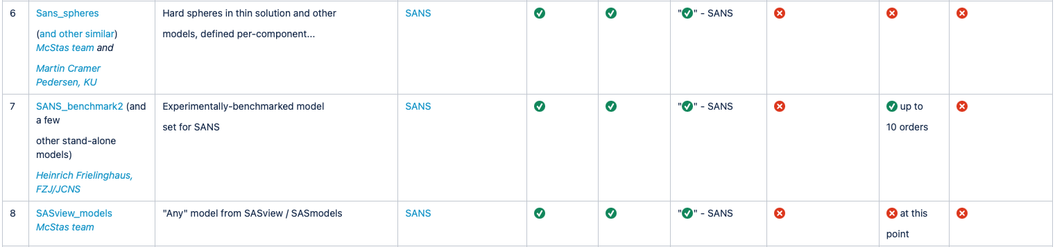
SANS models in McStas

Slide 5
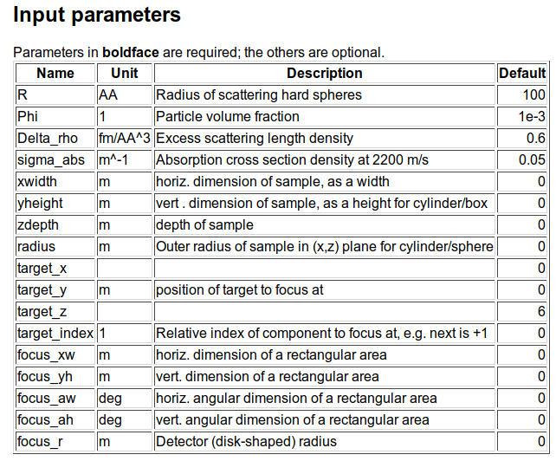
Example: SANS spheres
Dilute, monodisperse, hard spheres in solution, with given contrast and radius

Slide 6
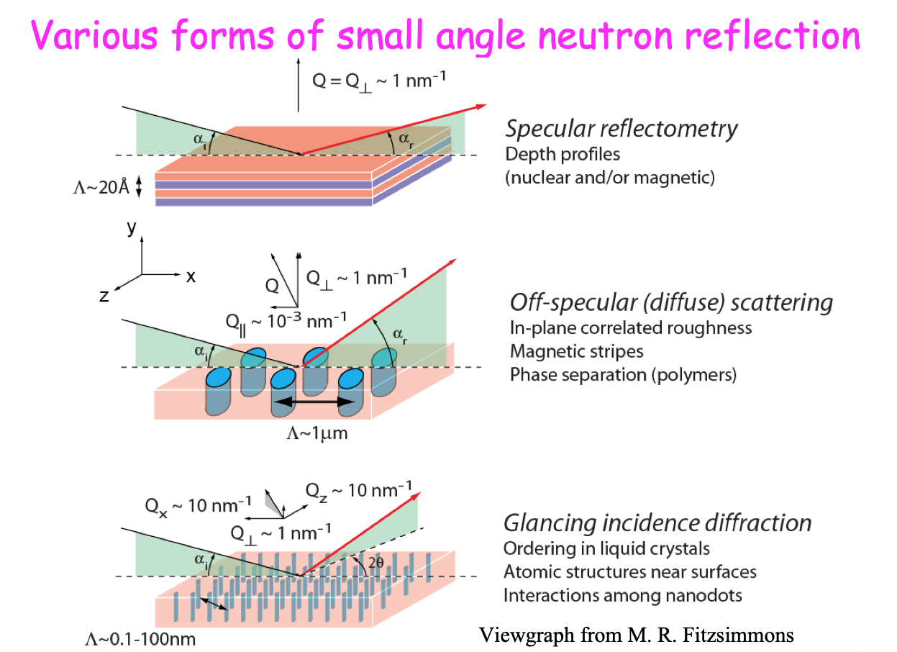
Reflectometry
Used to probe properties of surfaces and interfaces - solids and liquids

Slide 7
Reflectometry samples in McStas

Slide 8
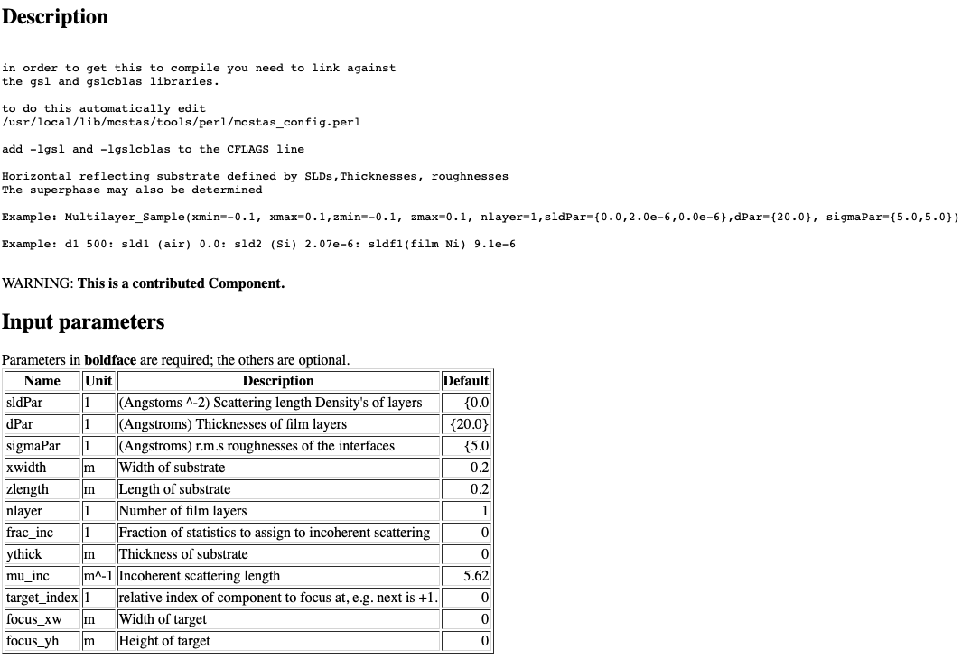
Example: Multilayer_sample

Slide 9
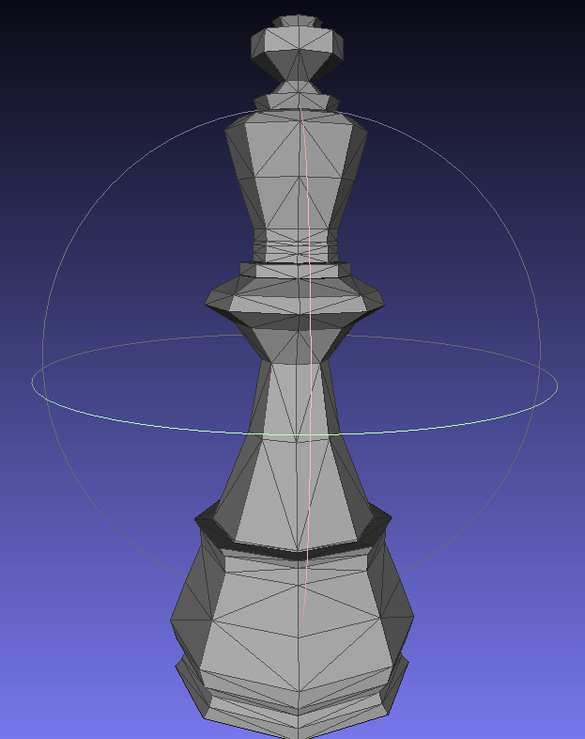
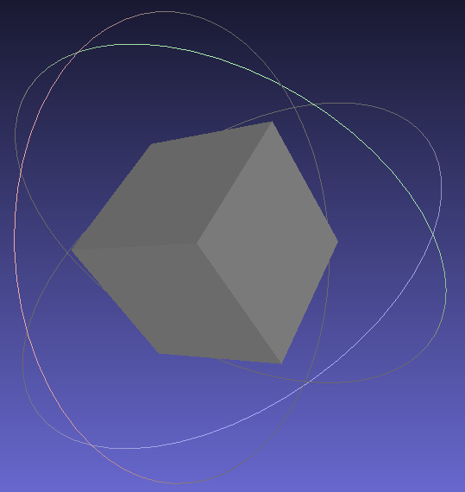
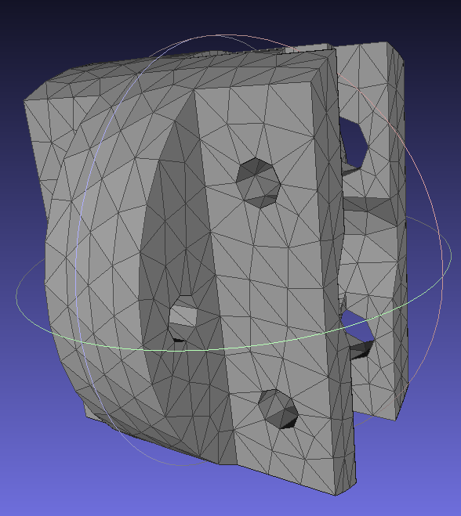
Absorption Imaging - simple shapes or OFF’s of single-phase material blocks
An additional complex geometry enables to use any point set to describe the material volume (geomview OFF file).

Slide 10
Absorption Imaging - simple shapes or OFF’s of single-phase material blocks
An additional complex geometry enables to use any point set to describe the material volume (geomview OFF file).
New developments are in the pipe e.g. for multi-phase materials, refractive effects, phase-contrast imaging techniques, these are not ready yet.

Slide 11
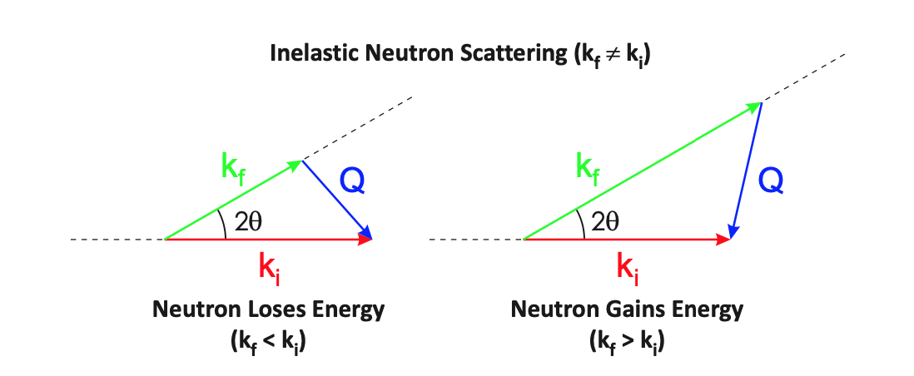
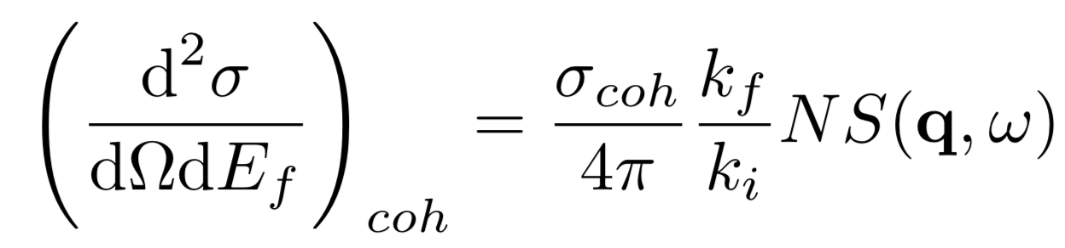
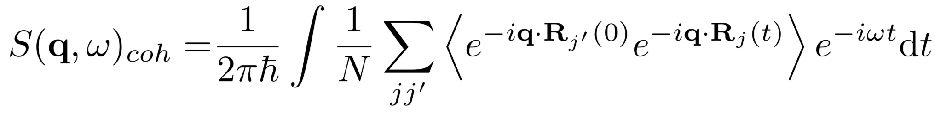
Inelastic scattering S(q,w)
Partial differential cross section
Scattering function
Phonons, Spin waves, …

Slide 12
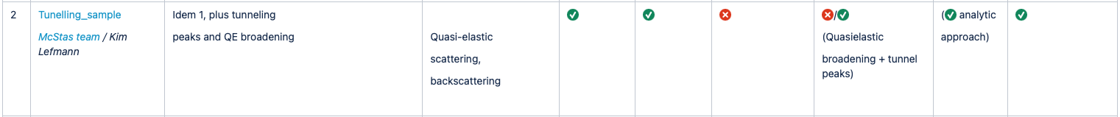
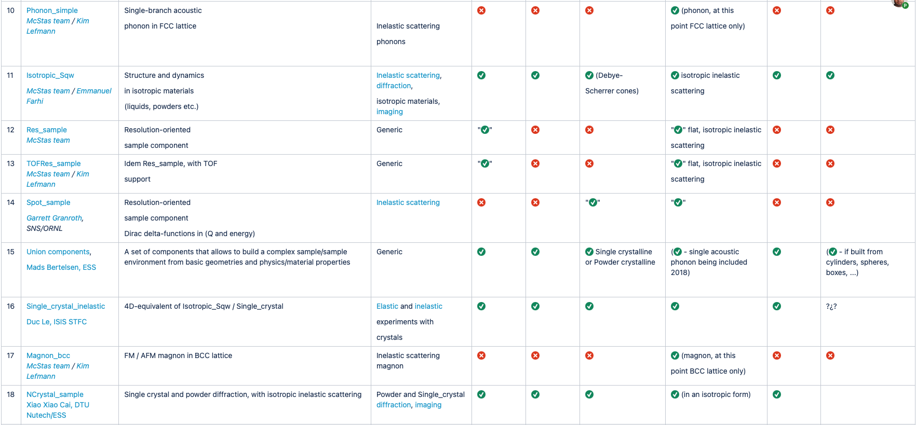
McStas samples with inelastic options

Slide 13

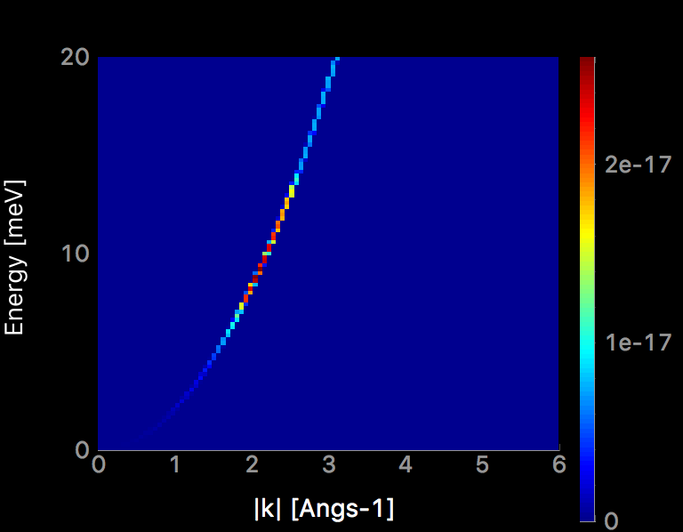
Example component: Phonon_simple
One isotropic acoustic phonon branch in all Brillouin zones on FCC Bravais single crystal
Dispersion relation, theory and mcstas
⍵
Dispersion
q₀
q

Slide 14
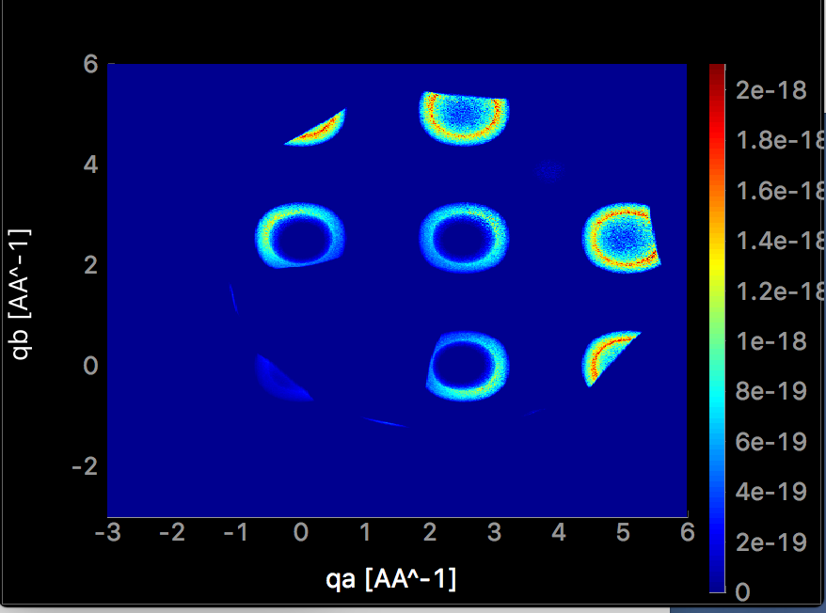
Example component: Phonon_simple
4 meV energy transfer
Example of the output
Elastic scattering only
Combine with Single_crystal for elastic-inelastic scattering
Magnon_fcc is conceptually very similar
Describes coherent “closed-form” inelastic scattering, generalisations foreseen, different lattice-dep. Other dispersion shapes?

Slide 15
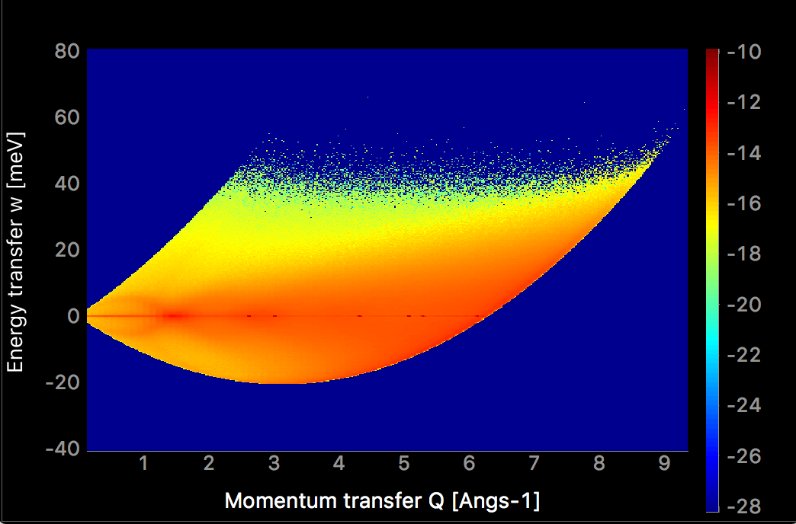
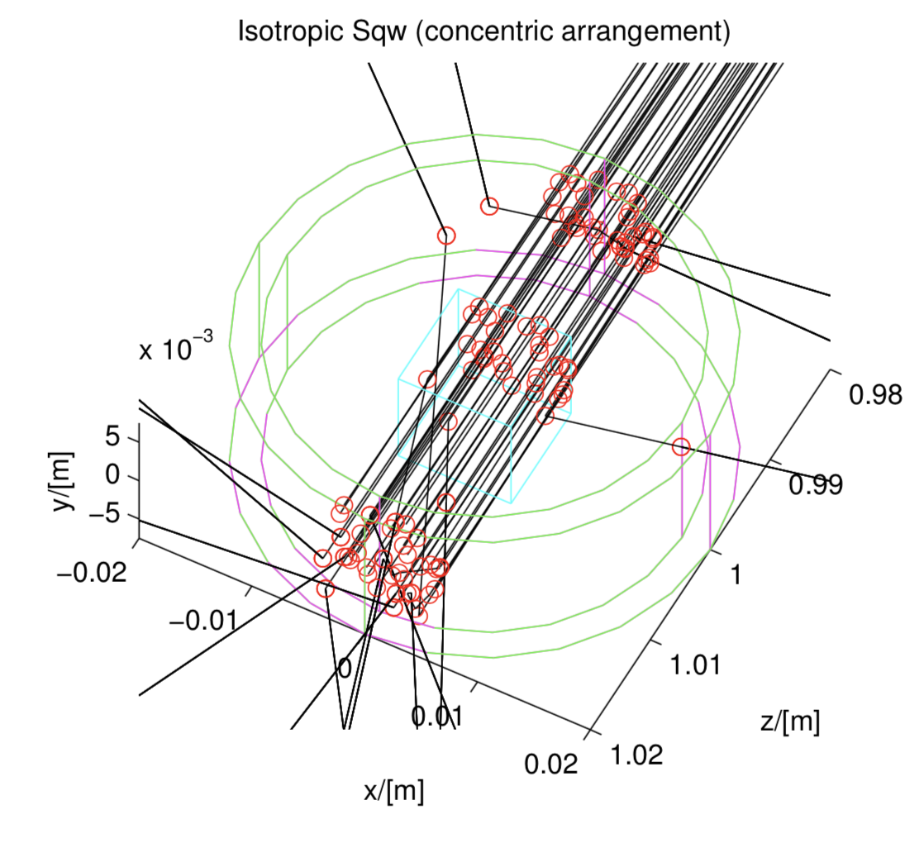
Example component: Isotropic_sqw
Isotropic processes (powder, liquid, …)
Use data files to describe S(|q|,w) directly, coherent and incoherent - isotropic scattering
Supports concentric geometries

Slide 16
Example component
Single_crystal_inelastic
Contribution from Duc Le, ISIS
“Marriage” between Single_crystal and 4D equivalent of Isotropic_Sqw
BIG tables, lots of memory, close to impossible to use for anything but “locally” in reciprocal space, i.e. in TAS settings
We are looking for good alternatives

Slide 17
Inelastic scattering in McStas
Monte carlo sampling issues
Need to sum over large amount of possible final states to find cross section
Need large amount of rays to sample all the options
q_{y}
+d⍵
+⍵
q_{x}
dq_{y}
dq_{x}
dq_{z}
q_{z}

Slide 18
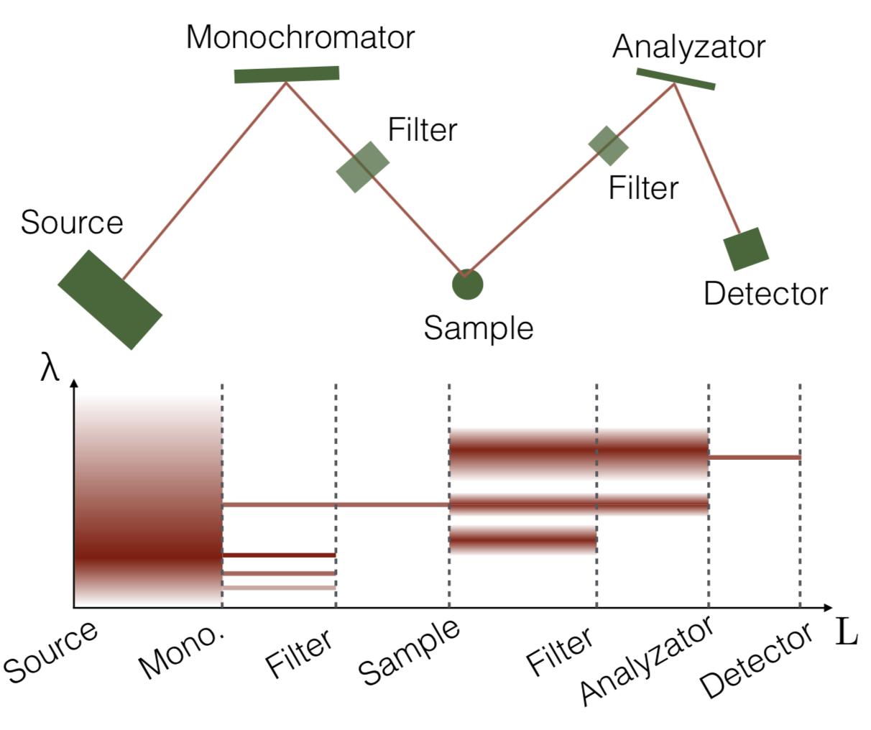
TAS
Only a small fraction of neutrons arrive, most are simulated in vain

Slide 19
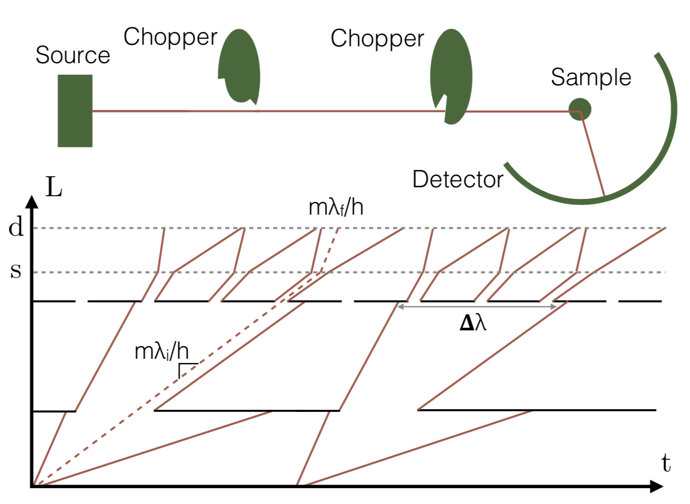
Chopper spectrometers
Only a small fraction of neutrons arrive, most are simulated in vain

Slide 20
Conclusions
SANS
Lots of choice, many models (challenge can be to decide what to choose)
Reflectometry:
Only little choice, Multilayer_sample or “a mirror”
Imaging:
Single-phase “blocks” of material, new developments are in the pipe
Inelastic scattering
Inelastic scattering supported in McStas, not all cases fully covered
Longer computational times required
Advantages from simulation especially important for spectroscopy (resolution function)

