Slide 1
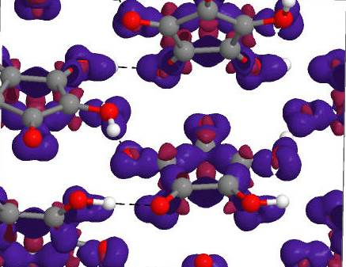
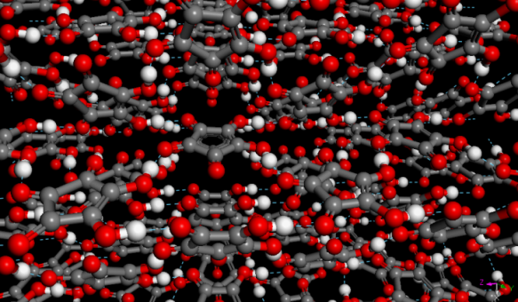
Virtual Experiments: Molecular Spectroscopy Sanghamitra Mukhopadhyay and Peter Willendrup
Notes:
OUTLINE
Welcome
Main purpose of update: setting the stage …
Instruments (reminder): unique-in-the-world suite set of high-resolution indirect spectrometers (with high-res diff) + increasing use of direct particularly for Catalysis.
Barriers across instruments are largely artificial as well as dynamic, e.g., OSIRIS upgrade project, TOSCA 40 Hz operation, Xpress systems, complementary use of TOSCA and MAPS on catalysis, possibilities to use muons as complementary spectral probes.
Overarching use of common analysis tools and computer modelling: MANTID project as a unified platform, heavy use of SCARF cluster, extension of TOSCA paradigm to low and high energy transfers.
Availability of additional sample characterisation equipment.
From the group’s point of view, it is important we to explore opportunities across instruments, possible upgrades and improvements of scientific infrastructure at ISIS, as well as how our science programme maps onto our spectroscopic and data-analysis capabilities – THIS IS THE MAIN MOTIVATION BEHIND THIS SCIENCE-DRIVEN USER MEETING.
Keeping You Informed: GOOD VIBRATIONS.
The Importance of Impact for STFC and the REF: IMPACT STUDIES.
Recruitment.
A few words about the scope of this meeting.

Slide 2
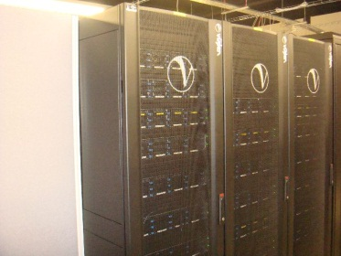
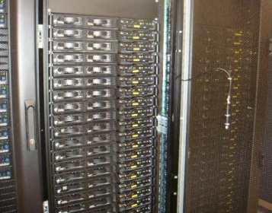
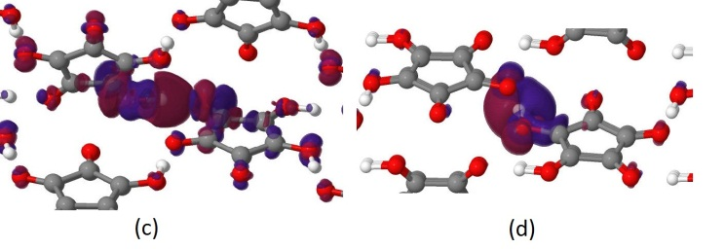
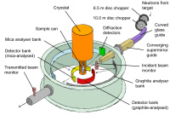
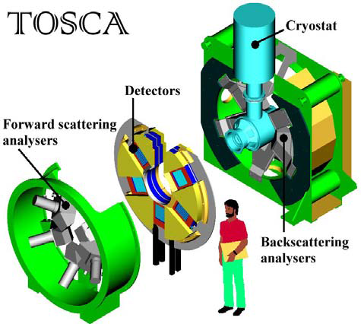
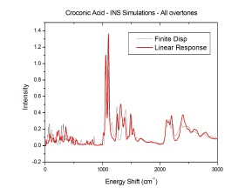
In-Silico Neutron Spectroscopy
Materials Modelling
High performance Computers
IRIS/OSIRIS
nMoldyn/MDANSE
Ω
Python Wrapper
Experiments
MANTID
Experiments

Slide 3
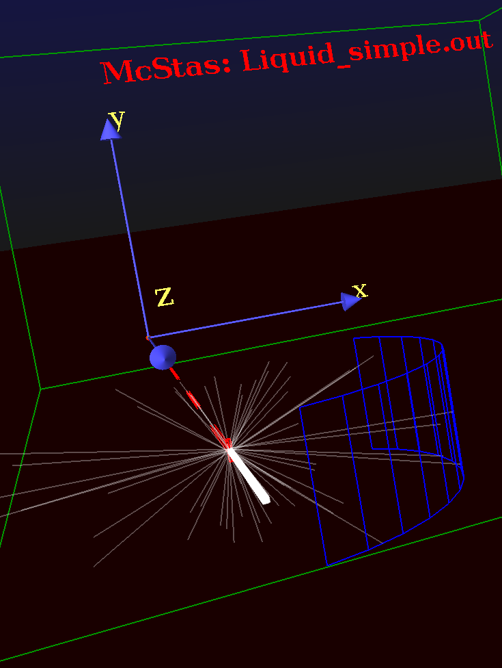
Virtual Experiments: Neutron Spectroscopy
High performance Computers
Materials Modelling
High performance Computers
nMoldyn/MDANSE
Ω
Python Wrapper
Virtual Experiments
MANTID
Virtual Experiments

Slide 4
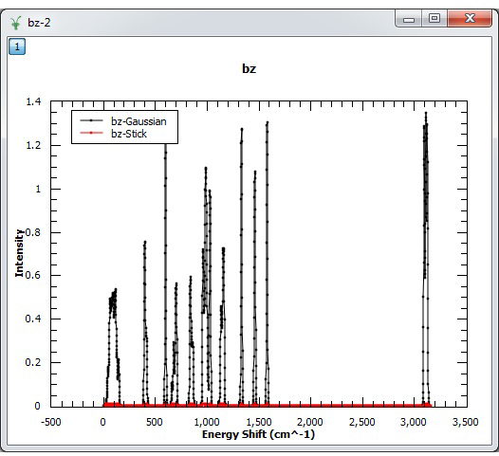
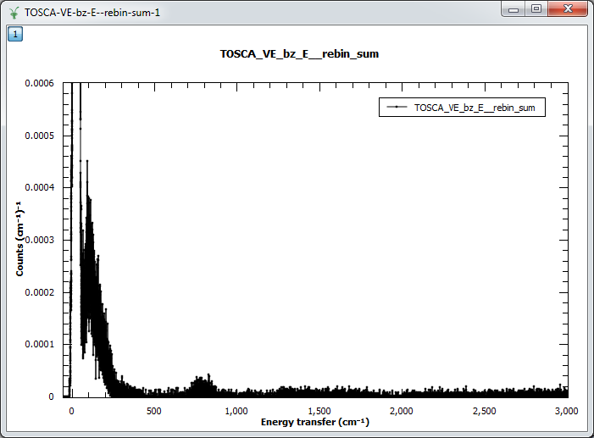
Virtual Experiments: Neutron Spectroscopy
S(Q,W)
CASTEP DFT Simulations Phonon file
VDOS
McStas Instrument TOSCA
Data reduction in MANTID
Data Virtual Experiments

Slide 5
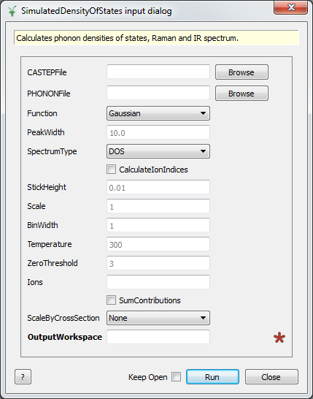
Virtual Experiments: Neutron Spectroscopy
CASTEP DFT Simulations Phonon file
VDOS

Slide 6
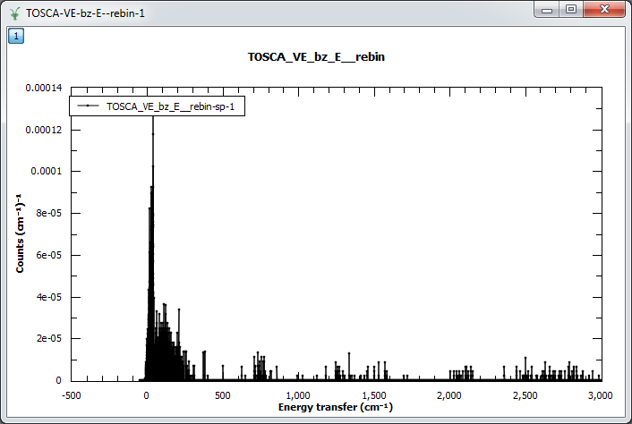
Virtual Experiments: Neutron Spectroscopy
VDOS
Data reduction in MANTID
S(Q,W)
McStas Instrument TOSCA
Single Detector

Slide 7
Virtual Experiments: Neutron Spectroscopy
VDOS
Data reduction in MANTID
S(Q,W)
McStas Instrument TOSCA
52 Detectors

Slide 8
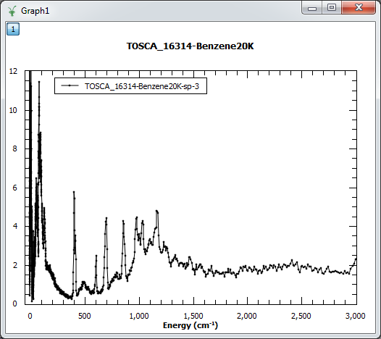
Virtual Experiments: Neutron Spectroscopy
VDOS
Data reduction in MANTID
S(Q,W)
McStas Instrument TOSCA
TOSCA Experiments

