Slide 1

Powered by McStas technology
Tutorial Workshop @ SOLEIL Mar. 9th- 11th 2022
Peter K Willendrup (pkwi@fysik.dtu.dk)
Emmanuel Farhi (emmanuel.farhi@synchrotron-soleil.fr)

Slide 2
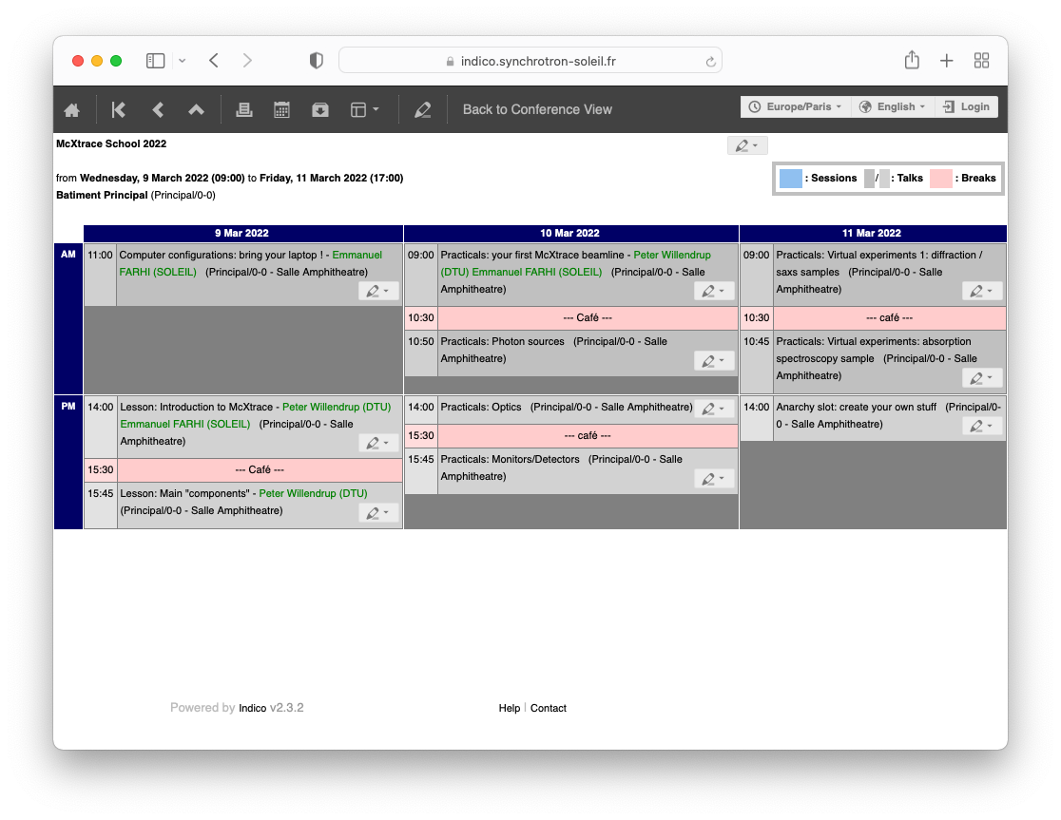
Programme
https://indico.synchrotron-soleil.fr/event/37/timetable/?layout=room#20220309.detailed

Slide 3
Programme
https://indico.synchrotron-soleil.fr/event/37/timetable/?layout=room#20220309.detailed
Teaching material is on GitHub:
https://github.com/McStasMcXtrace/Schools/tree/master/SOLEIL_March_2022

