Slide 1
Monte Carlo Particle Lists
MCPL

Slide 2
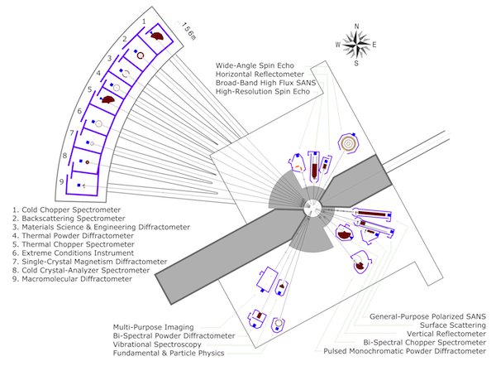
Legacy: 2016 overview
Monte Carlo vs. ray tracing – where are we heading?
MCNP: target, moderator, reflector design
McStas: (+other ray-tracing codes) for instrument design
GEANT4: for shielding and backgrounds
Vitess & NADS & Particle swarms: shielding & optics
- design documentation for the instrument
MCNP: safety, dose-rates (future use of FLUKA or MARS)
GEANT4: detector design
MARS: Accelerator
→ Interfacing is important!
→ MCNP-McStas interface is insufficient
→ A common file format would facilitate
'cradle to grave' simulations, without
intermediate loss of information
(e.g. through fitting etc)
Monte Carlo Particle Lists: MCPL
2

Slide 3



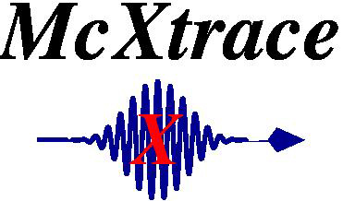
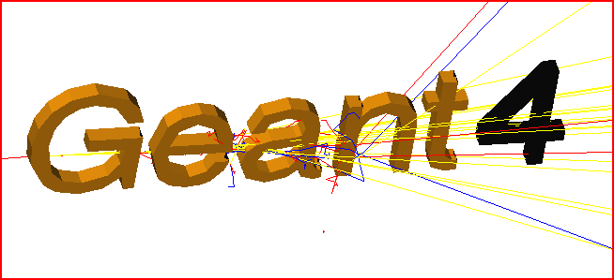
Software integration: MCPL
Mish-mash of converters and ad-hoc solutions of varying quality is what we want to avoid
MCNP5
h

Slide 4
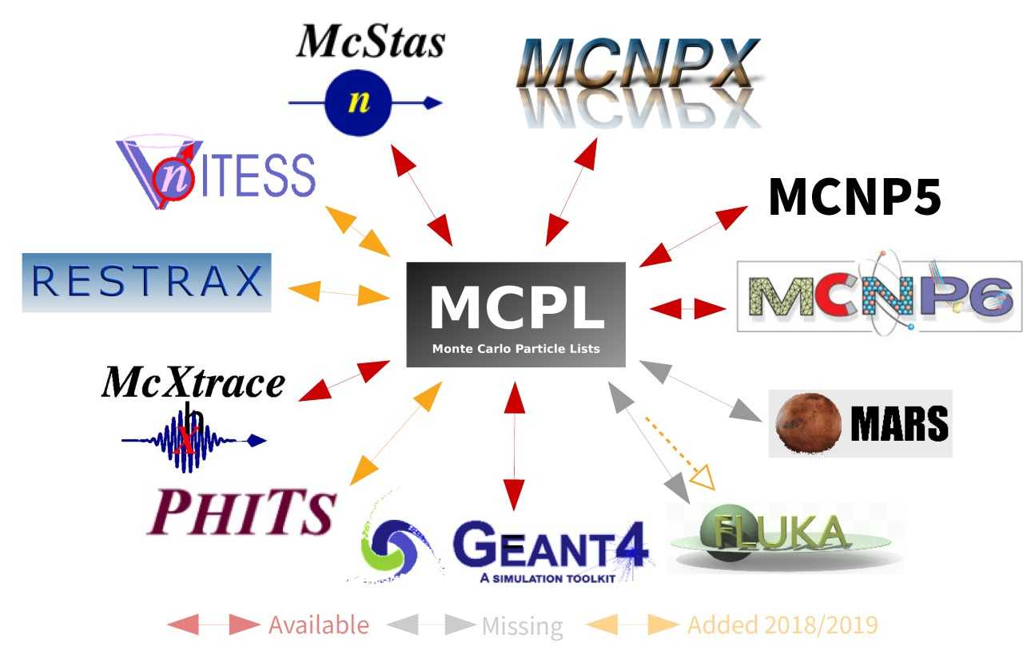
Software integration: MCPL

Slide 5

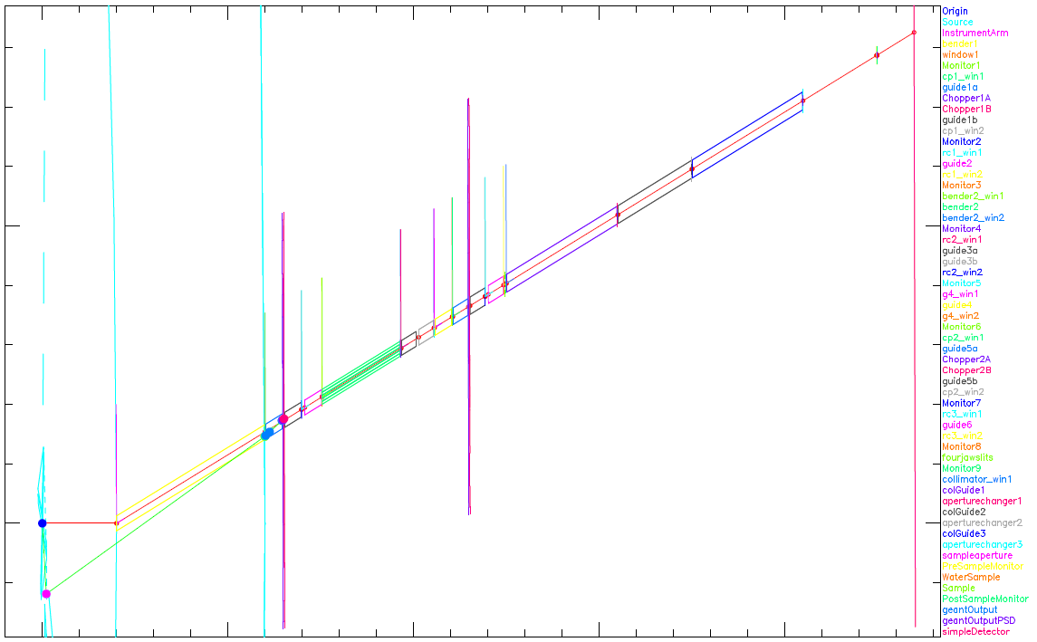
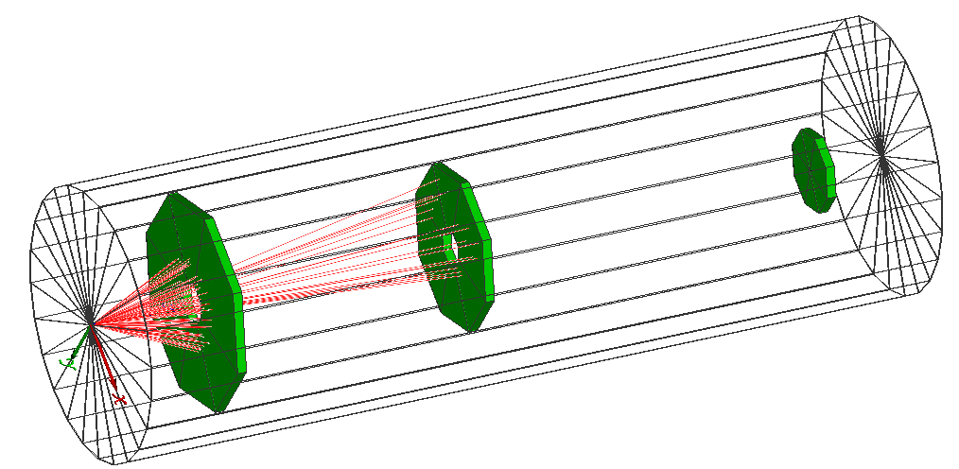
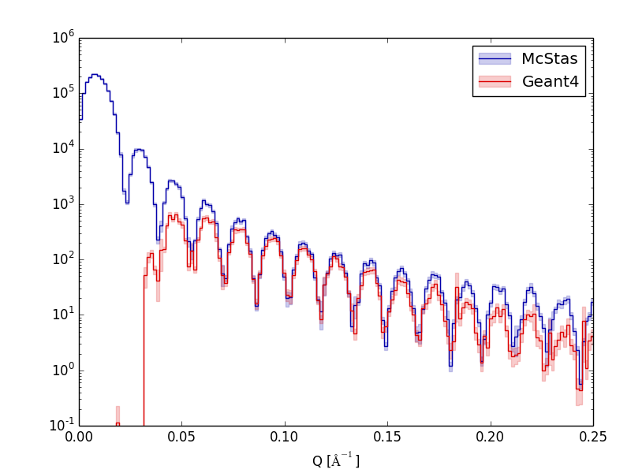

MCPL example use-case Typical MCPL usage in detector studies
First capture output of instrument simulations
- Set up by or with instrument scientist, using dedicated SW like McStas.
- Provides realistic distributions of neutron energies, divergence, etc.
- Might include modeling of representative sample
Or use output from shielding simulations for background studies
Then feed into detailed Geant4-based detector simulation
- Emulate detector response as needed
- Construct realistic high-level observables to study impact of detector
on instrument performance.
- Study other interesting aspects (rates & occupancy, efficiencies, etc.)

Slide 6
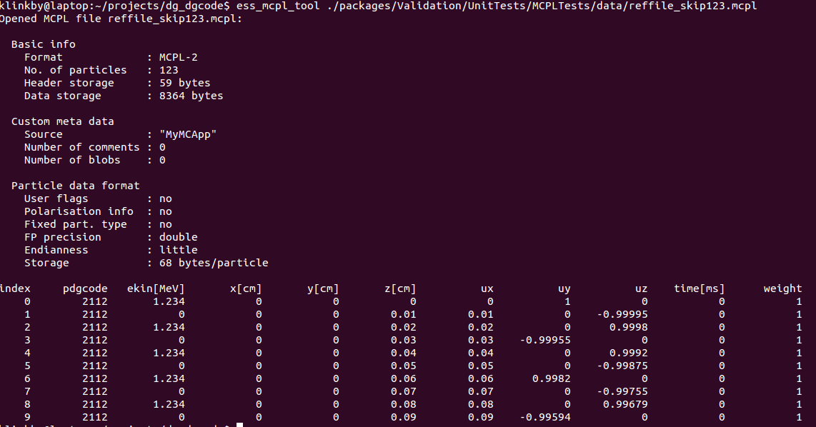
MCPL: hands-on
BB
Developed within the software framework of the ESS Detector Group – Thomas Kittelmann is the main developer
Core software (written in c) is stable and released
Use-cases for McStas-Geant4–MCNPX couplings: arXiv:1509.03036
https://mctools.github.io/mcpl/
https://mctools.github.io/mcpl/mcpl.pdf

Slide 7
MCPL: Coupling MCNP & McStas
One example, of particular interest concerns coupling MCNP and McStas through MCPL, exploiting varience production in MCNP : the DXT sphere.
DXT sphere combined with SSW interface, can be setup to bias simulations toward a given beamline (while conserving neutron weight)

Slide 8
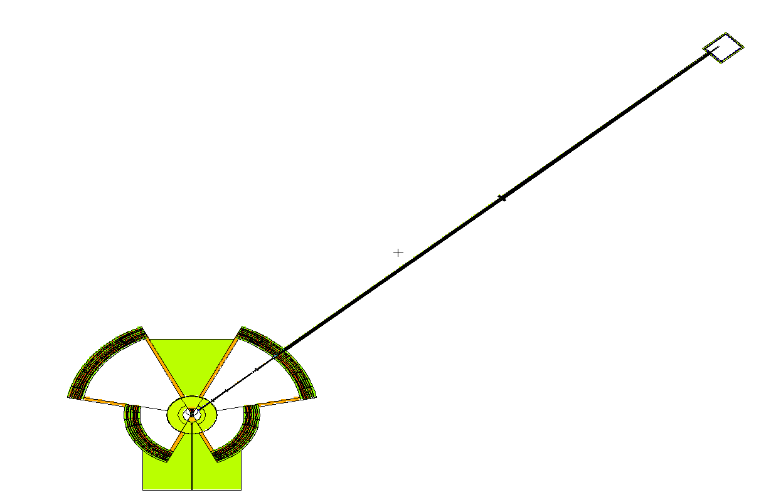
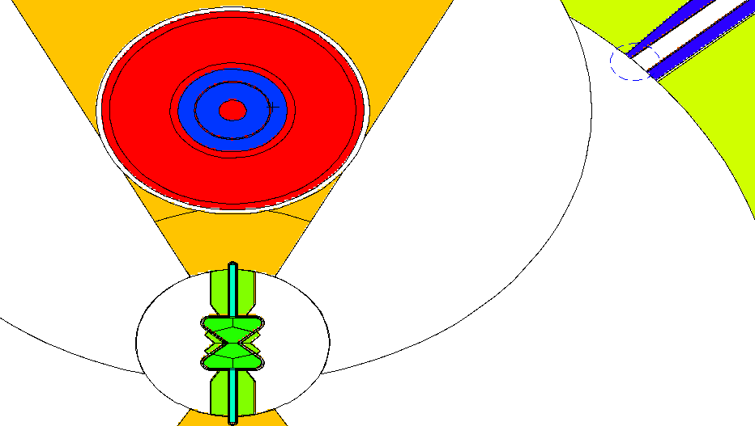
MCPL: Coupling MCNP & McStas
DXT sphere
SSW surface
=>SSW file including: gamma, neutrons at all energies (ie usable for background + signal)
=>convert to MCPL and use MCPL tools to select particles of interest
=>use MCPL file as source in McStas

Slide 9
MCPL: Coupling MCNP & McStas
Some words of caution: MCPL file inherit MCNP coordinate system
Mixture of low weight and high weight neutrons can be confusing
Let’s try it out
1. pick a folder on the cluster to work in
2. Copy one or more MCPL files from either /nfs/www/html/users/willend/MCPL/1e6/ ~ 30 Mb each
/nfs/www/html/users/willend/MCPL/1e7/ ~ 300 Mb each
3. Find the instrument ESS_butterfly_Guide_curved_test.instr via Files, New From Template…, ESS
4. Look in the code for rotations + translations taking you from the MCNP / TCS to the McStas / beamline coordinate system
5. Run the instrument for one or more combinations of Sector= and beamline=, both in ”simulation” and “trace” modes.

