Slide 1
Monochromators

Slide 2
Monochromators
Components
●Monochromator_flat
●Monochromator_curved
●Single_crystal
Use in instrument
●Monochromator
●Analyser
●Sample

Slide 3
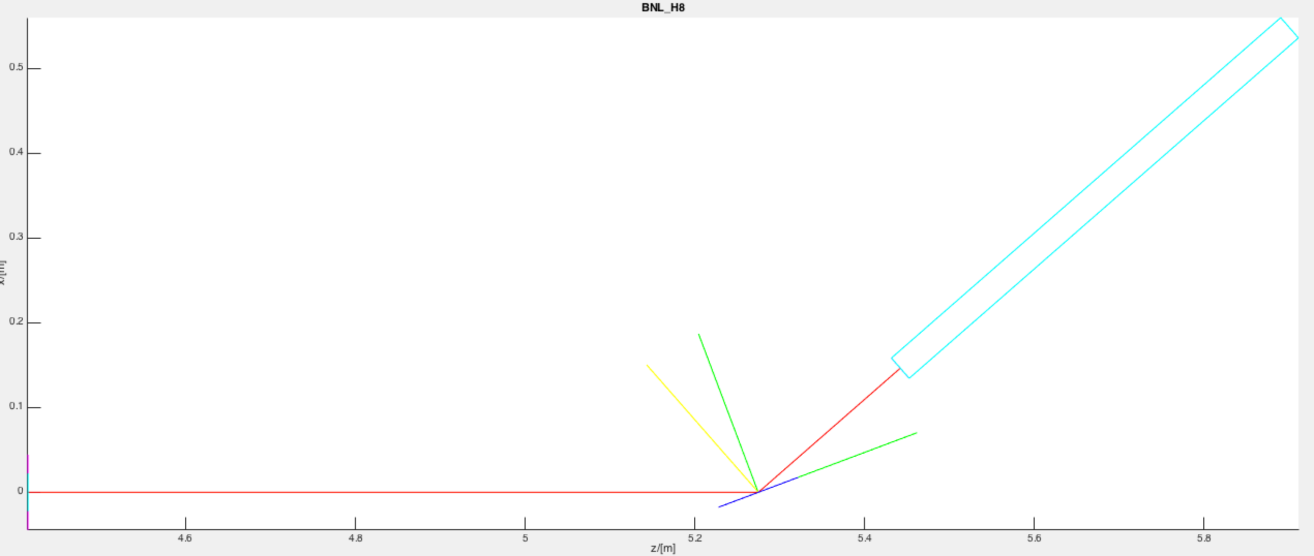
Quick step to the side:
Arm()’s can be used to define coordinate systems Here, a green arm orients the mono surf + planes
And a yellow the 2𝜃 direction

Slide 4
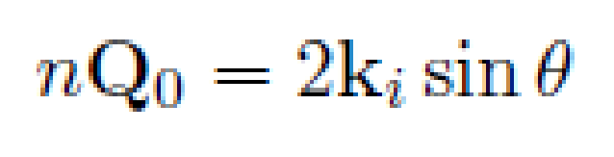
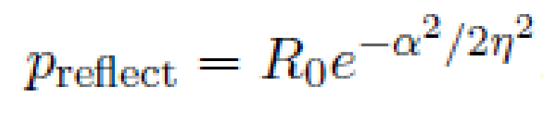
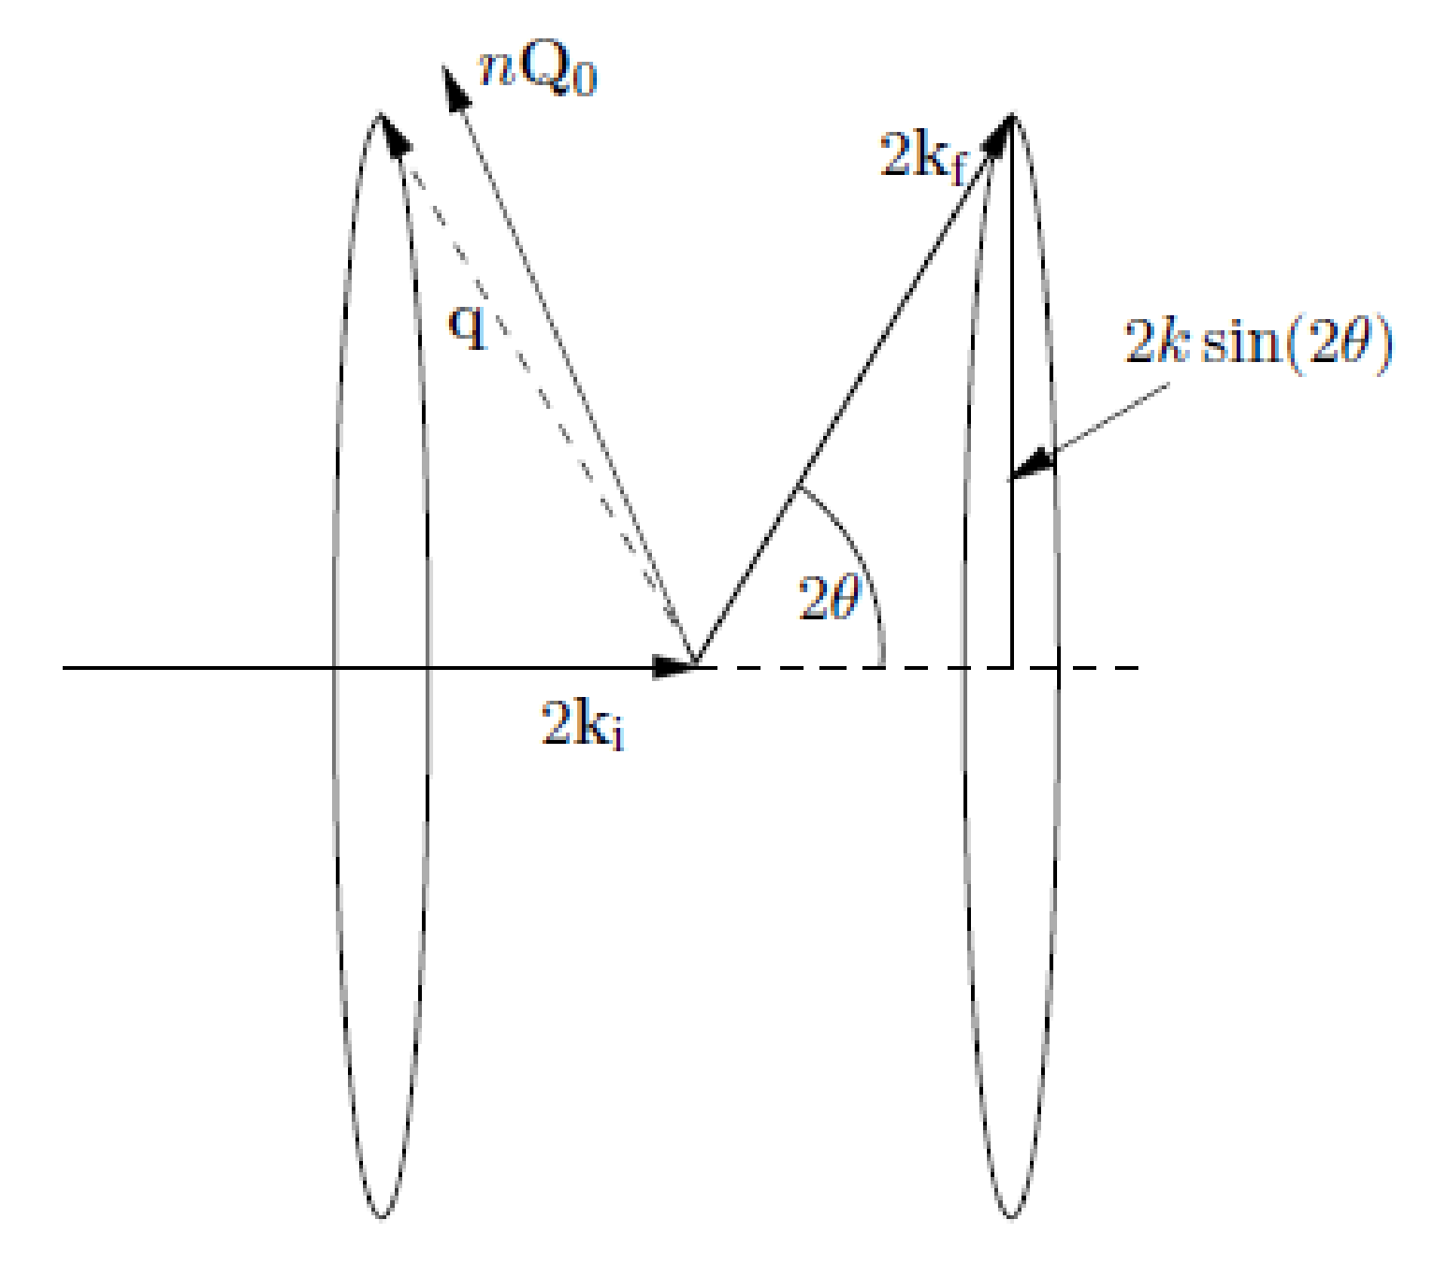

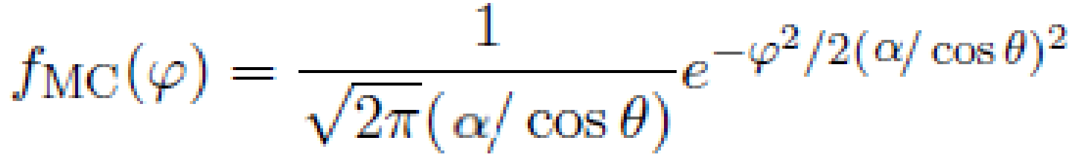
Monochromator_flat
Properties:
Infinitely thin, one scattering vector perpendicular to surface
●
- no multiple scattering/secondary extinction
- total reflectivity r0, not scattering cross sections
Mosaic, vertical and horizontal η
●
●
No variance of lattice parameter Δd/d=0
Algorithm:
●
If intersect determine order n,
●From mosaicity η and angle α from Q0 find prob
●
If reflected, determine direction on D-S cone
●
Calculate weight for

Slide 5
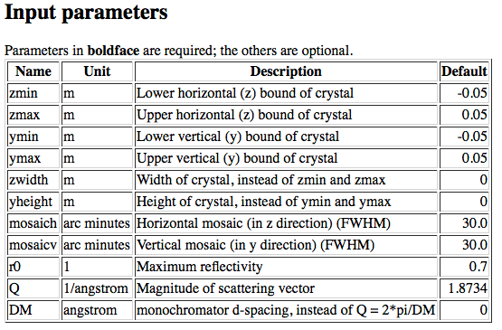
Monochromator_flat (link)
● xwidth = 0.1, yheight = 0.1,
● mosaich = MOSH, mosaicv = MOSV,
● r0 = 0.8, Q = 1.8734 (PG 002)

Slide 6
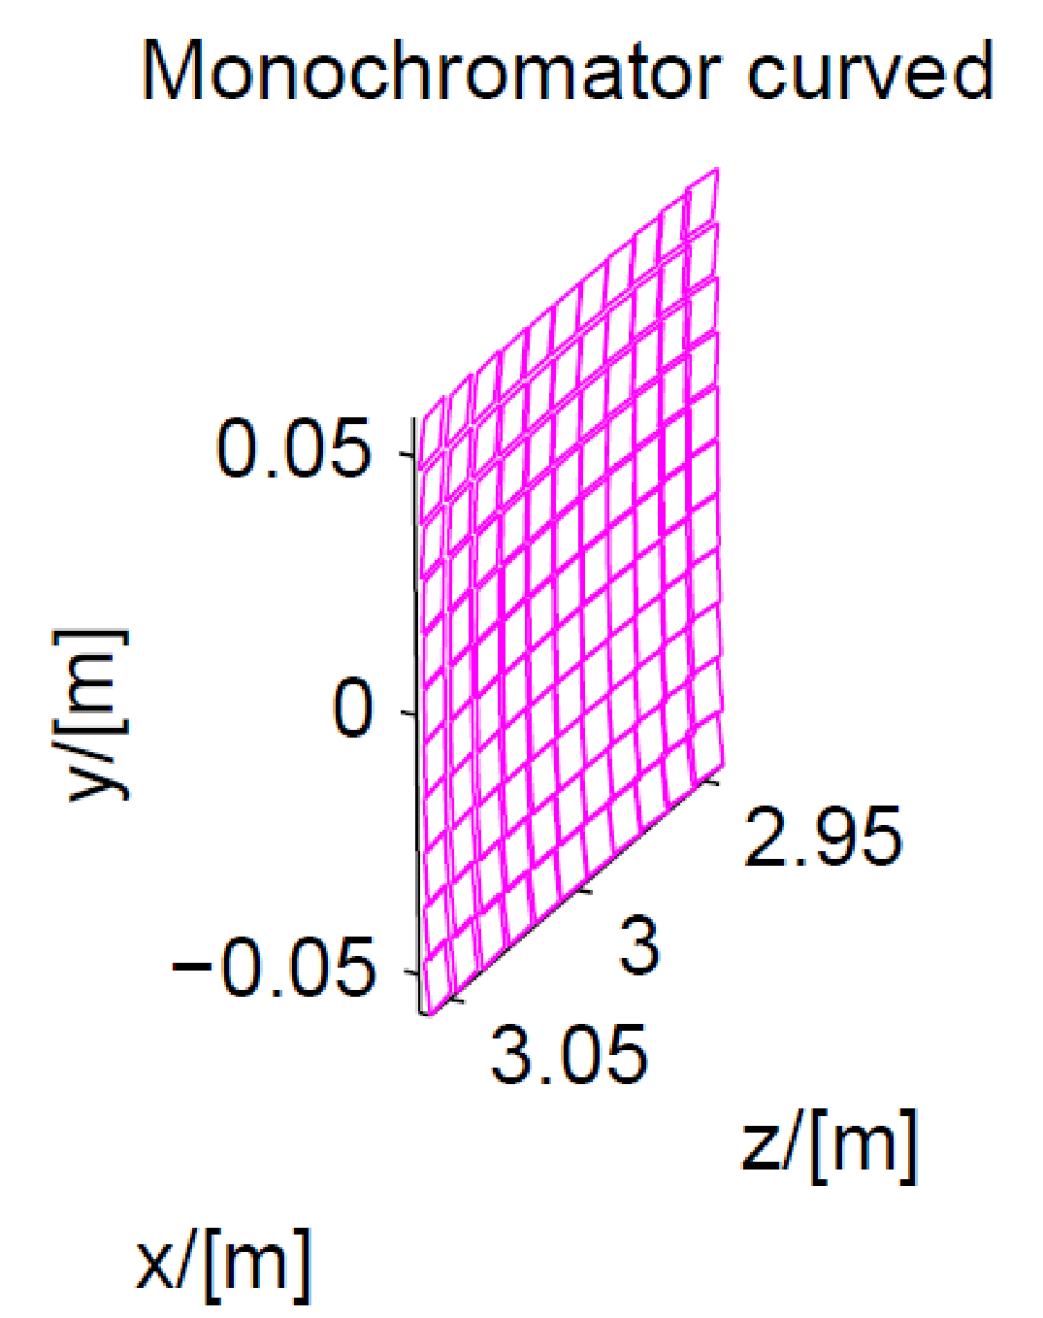
Monochromator_curved
Properties
●Array of single mosaic crystals (blades) with one scattering vector
●Infinitely thin, one scattering vector perp. to each surface of blade - no multiple scattering/secondary extinction
- total reflectivity r(k), not scattering cross sections
- total transmission t(k)
●Mosaic, vertical and horizontal η
●No variance of lattice parameter Δd/d=0
Algorithm
For each individual blade the same as Monochromator_flat

Slide 7
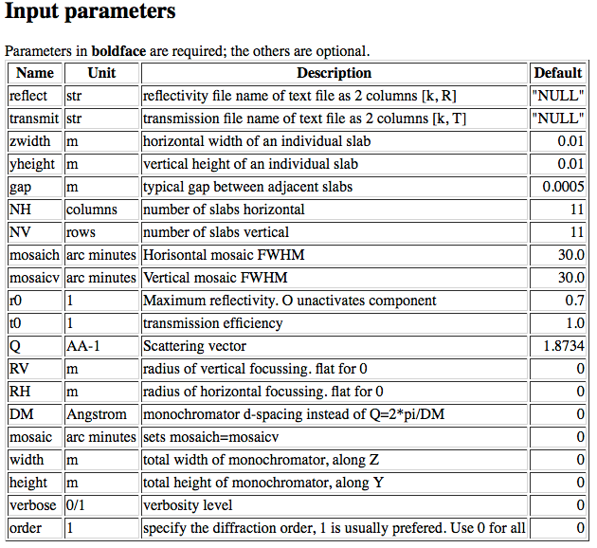
Monochromator_curved (link)
●5 vertical slabs :NV=5, yheight=0.02, zwidth=0.1, RV=1
●Use reflecivity list 'HOPG.rfl' provided in McStas datafiles
●Use transmission list 'HOPG.trm' provided in McStas datafiles
● r0 = 1,Q = 1.8734 (PG 002)

Slide 8
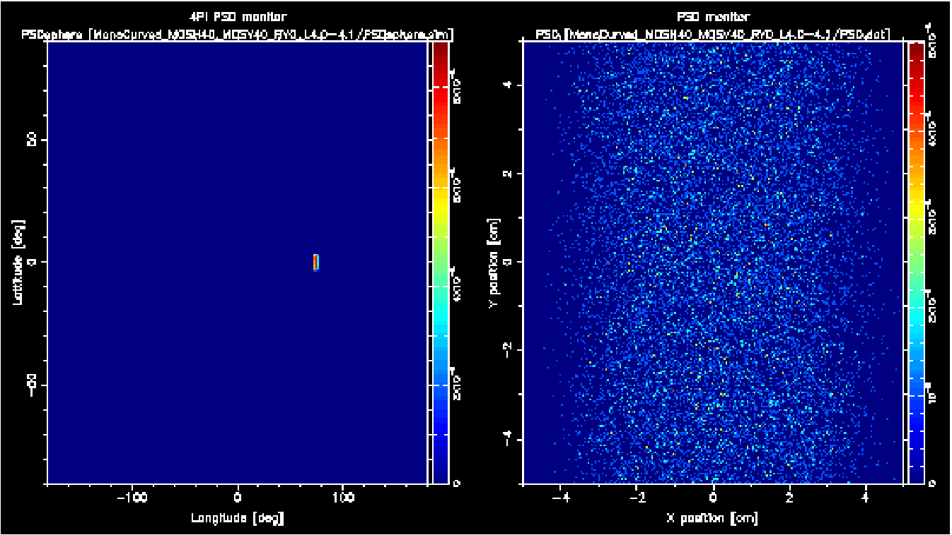
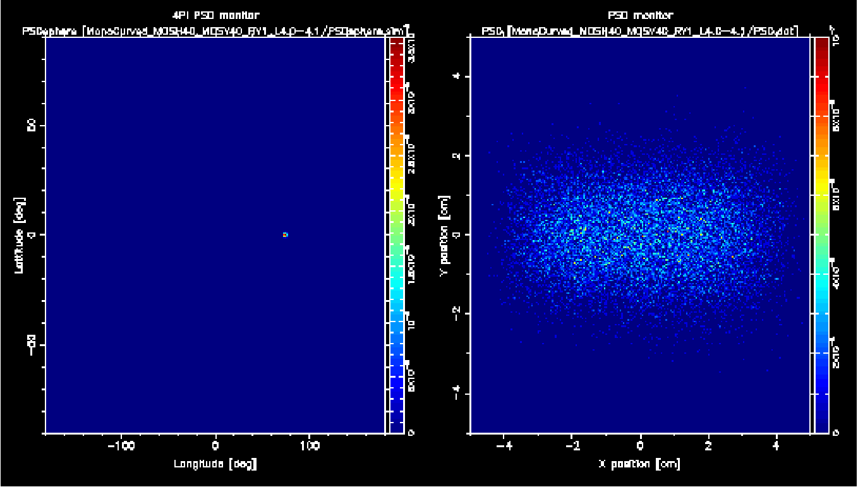
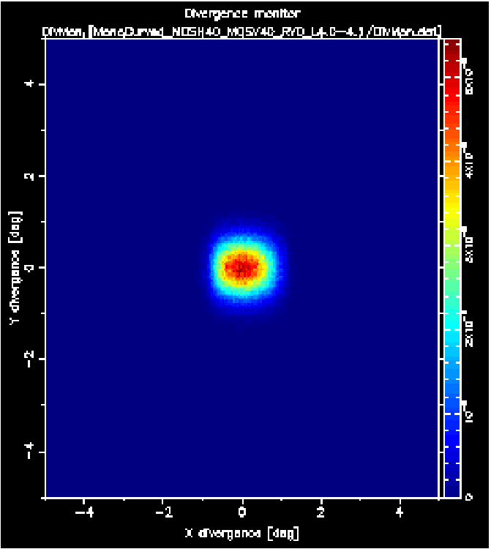
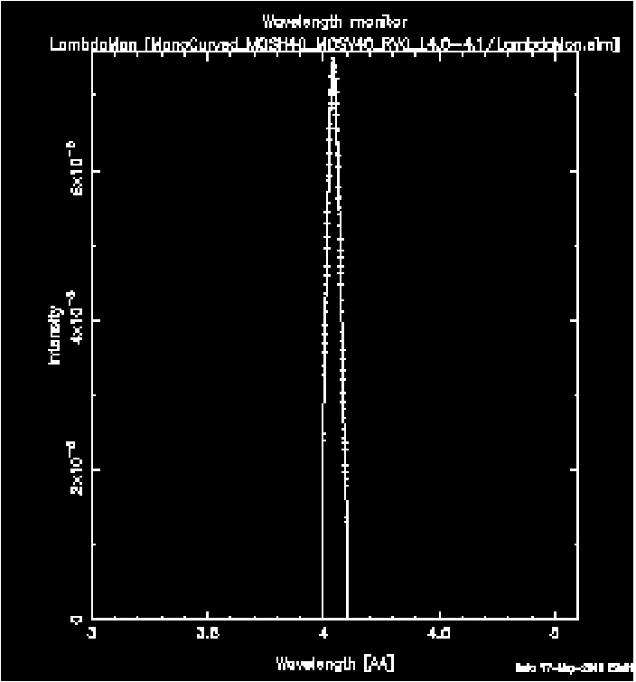
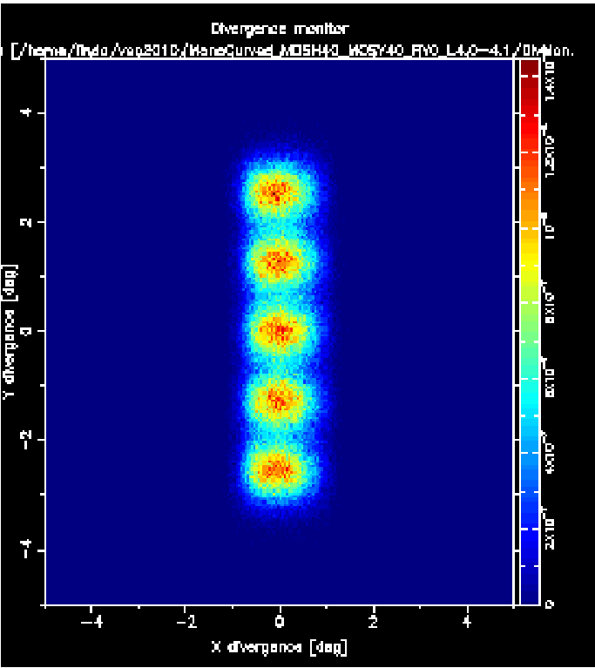
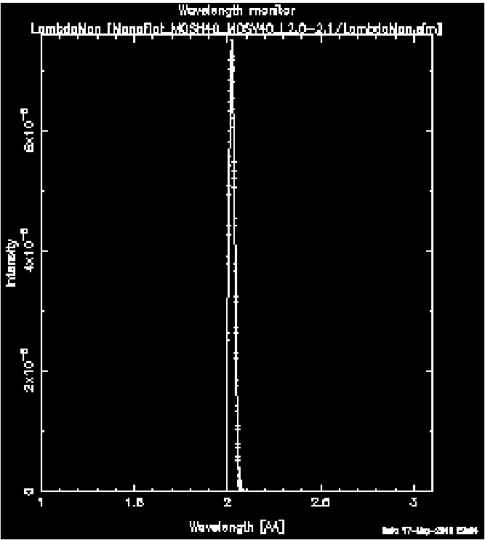
Monochromator_curved
No focus
With focus

