Slide 1
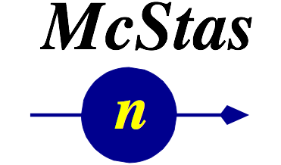





Practical:
Single crystals and powders

Slide 2

Agenda
Laue Camera
Use and modify the diffractometer
PSI_DMC

Slide 3
Laue Camera
First insert a source
File → New Instrument
Insert → Sources → Source_simple
// insert components here (e.g. Insert -> Source -> ...)
COMPONENT source_simple = Source_simple(
radius=0.05, dist=5, focus_xw=0.02,
focus_yh=0.05, lambda0=2, dlambda=1.9)
AT (0, 0, 0) RELATIVE PREVIOUS

Slide 4
Laue Camera
Now add a guide
Insert → Optics → Guide
COMPONENT guide = Guide(
w1=0.02, h1=0.05, w2=0.02, h2=0.05, l=20, m=1)
AT(0,0,2) RELATIVE source_simple

Slide 5
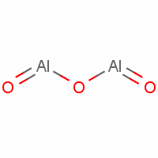
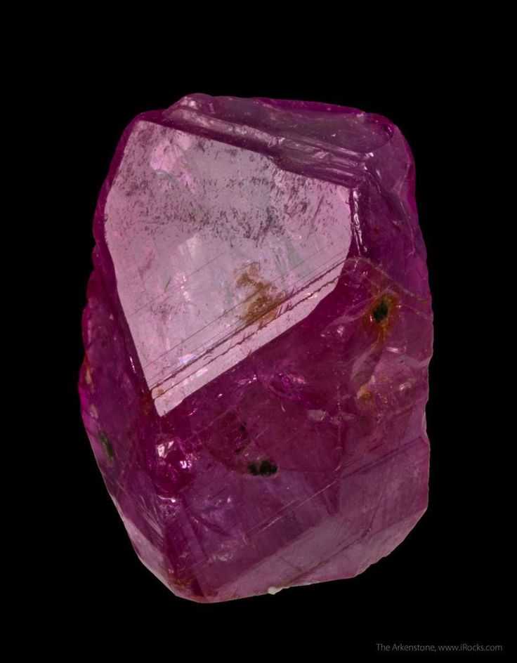
Laue Camera
Add a sample – in this case a standard crystal
Insert → Samples → Single_crystal
COMPONENT single_crystal = Single_crystal(
reflections="Al2O3_sapphire.lau",
yheight=0.05, radius=0.01, mosaic=1, delta_d_d=1e-4,
az=4.757, ay=0, az=0, bx=2.3785, by=0, bz=-3.364,
cx=0, cy=12.9877, cz=0,
p_transmit=0.1, order=1)
AT (0, 0, 20.5) RELATIVE PREVIOUS

Slide 6
Laue Camera
Add the ideal Laue Camera Monitor – covering 4π
Insert → Monitors → PSD_monitor_4PI
COMPONENT fourpi = PSD_monitor_4PI(
radius=1, filename="fourpi.dat", nx=201, ny=201)
AT(0,0,0) RELATIVE PREVIOUS

Slide 7
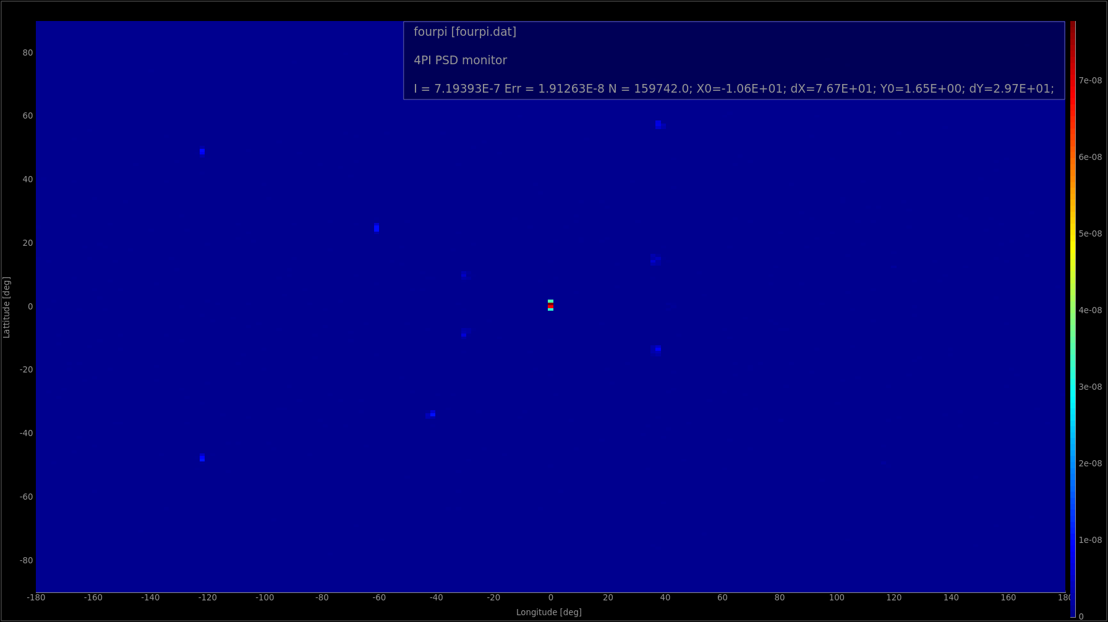
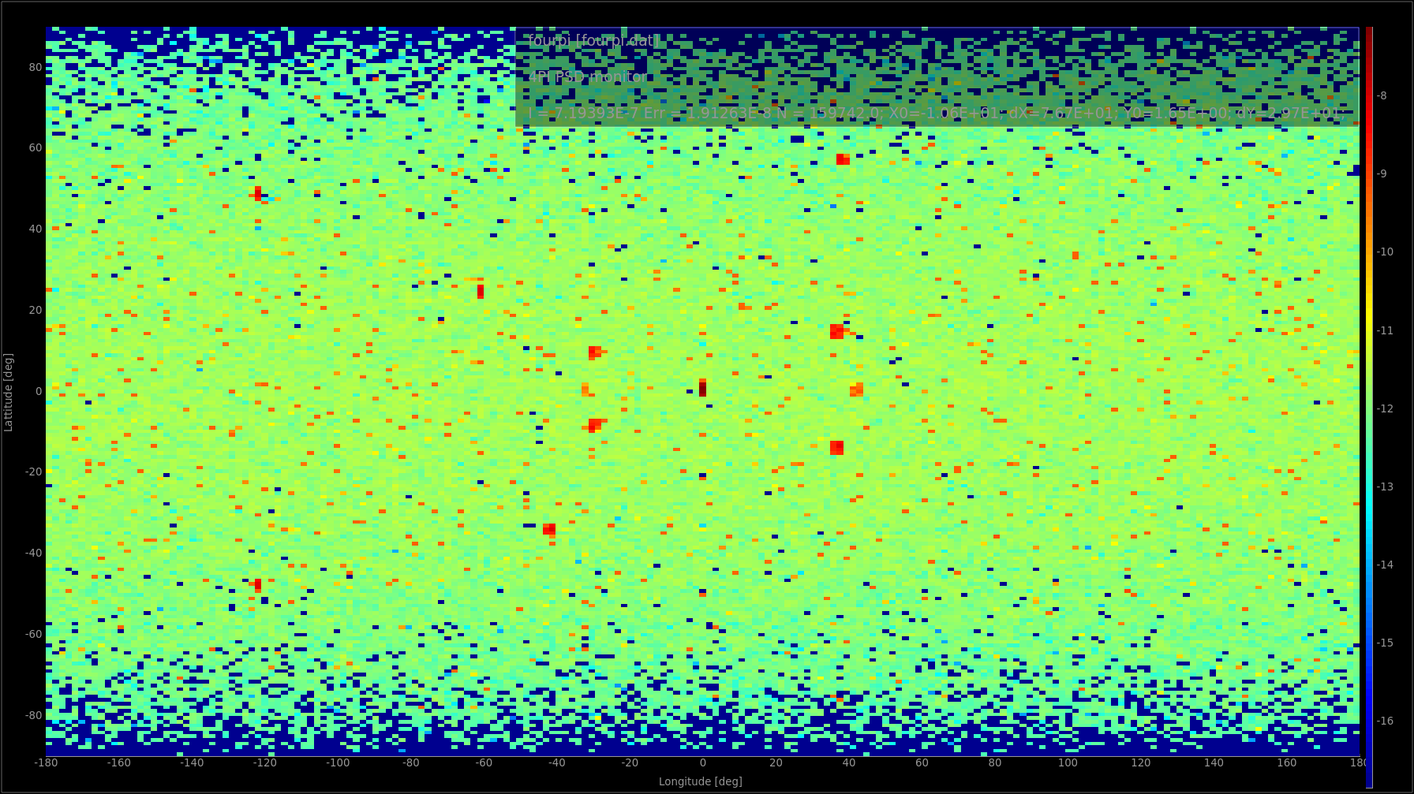
Laue Camera
Run your simulation ( you can safely increase the number of rays to 10⁷ - the ncount ) – you should get something like:
Press L for
logarithmic

Slide 8

Laue Camera
The coherent scattering is not much stronger than the incoherent “background”. Let’s use EXTEND and WHEN to make a monitor which only senses the coherent signal.
In the DECLARE section of your instrument – declare a variable of type char;
Add an EXTEND-block to the end of the Single_crystal component:
EXTEND
%{
myvar = hkl_info.type;
%}
Add another 4-PI monitor and insert WHEN (myvar==99) in front of the AT keyword. (99 is the ascii-code for ‘c’)
A current limitation in the WHEN grammar makes it necessary to do it this way.
Think of a possible way to only monitor incoherent scattering… HINT: type==’i’ for incoherent
From mcdoc:
* hkl_info.type: interaction type of event 't'=Transmit, 'i'=Incoherent, 'c'=Coherent

Slide 9
Laue Camera
Play around with this example instrument:
Add an Arm components before the sample to allow rotation around the Y-axis.
Add “SPLIT 20” before the sample COMPONENT statement. What happens?
Add a set of arms before the sample to add Y, Z, Y rotations (Eulerian cradle). Make the rotation angles input parameters.
Insert a different crystal instead e.g. “Al.lau”. i.e. change the crystal unit cell parameters and the reflection list.
Insert a powder sample instead

Slide 10
PowderN and More
In this exercise we will try to put two powder samples together in a few ways and compare the results.
Two samples in the same spot, and stochastically choose between them
Two samples stacked vertically
Two samples where one is behind the other.

Slide 11
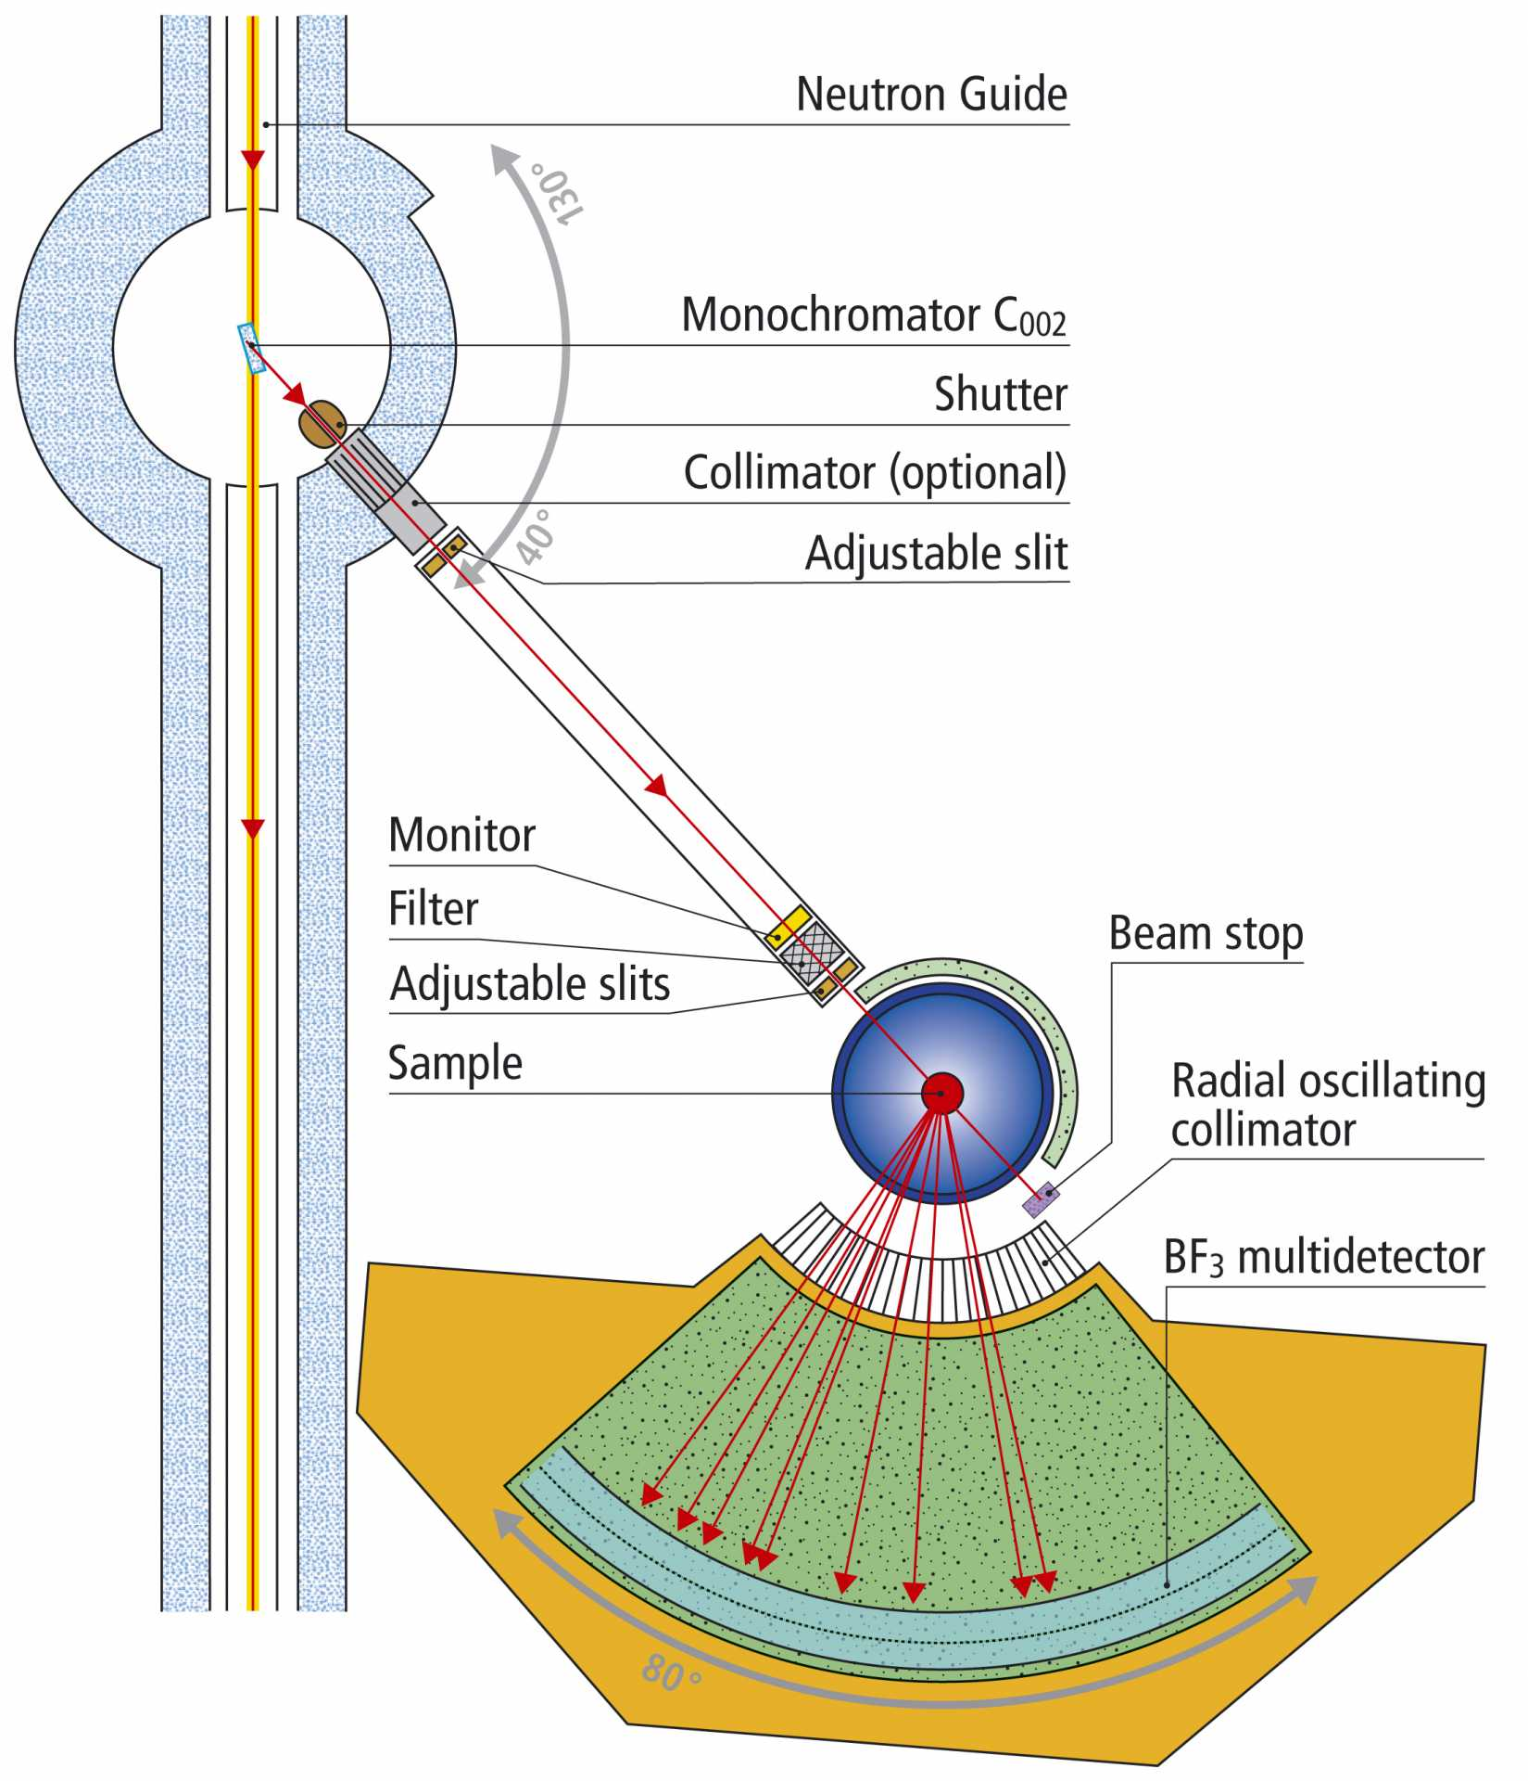
PowdersN and more
Let’s use the PSI_DMC instrument as a starting point. We will now make the simulation randomly choose between two powders. The instrument file can be found in the McStas distribution. ( File → New from template → PSI → PSI_DMC )
Add another powder in the same spot as the one already there. Look in the mcstas data directory for sample .laz-files
Add double r; inside the DECLARE section of the instrument file.
Add an Arm in front of the first one, and add to it an EXTEND-block. Add the following code in it: r=rand01();
Now add the following before the AT on the two powders. WHEN(r<0.5) and WHEN(r>0.5) respectively.
Run the instrument – Do you get what you expect?
What would you change to make the mixing factor !=0.5?
Use a similar technique to the Laue camera to make the detector only catch scattering from one sample.

Slide 12
PowderN and More
Change this to have two samples on top of each other.
Make a new copy of the instrument (or remove the edits you did before, but leave the second PowderN sample in place).
Change the y-position and size of the samples to be: +-sample_height/4.0 and sample_height/2.0 respectively
Add the statement GROUP samples after the AT at both samples. (N.b. “samples” is a name chosen arbitrarily. It has to be different than the component names though.)
Run a simulation – is there any difference to the previous result? Why/Why not?

Slide 13
PowderN and More
Move the samples around such that one is in front of the other.
Run a simulation – Do you still see the signatures of both samples?
Do you remember why this can be?
How can we get around this?

Slide 14
Intermission: A quick trick to remove the direct beam
If your monitor also can be hit by the direct beam, “swamping” the signal, you can do this:
Add the following code just after your sample code: EXTEND %{ if (!SCATTERED){ABSORB;}
%}
This will terminate all rays which the sample-code has not flagged as scattered. Note that the McStas definition of scattered includes many things (guide-wall reflections etc.)

Slide 15
PowderN and More
Increase the height of the detector and make it resolve the signal along y.
Set:
Options="banana, theta y auto limits bins=20", yheight=0.3
...In the detector.
Change the sample to be e.g. an Aluminium crystal.
COMPONENT single_crystal = Single_crystal(
reflections="Al.lau",
yheight=0.05, radius=0.01, mosaic=1, delta_d_d=1e-4,
az=4.0495, ay=0, ax=0, bx=4.0495, by=0, bz=0,
cx=0, cy=4.0495, cz=0,
p_transmit=0.1)
AT (0, 0, 0) RELATIVE PREVIOUS

Slide 16
PowderN and More
Insert more detector banks to modify DMC to become more like a Laue camera (catch more of the crystal signal). New banks could be above and below and on the other side of the sample. You will need to use a GROUP for this.
Increase the mosaicity of the crystal to scatter more of the beam. This can be done to an extent – think about what limits it, and how you could extract such limits from the simulations.
Using the WHEN keyword we can make a “sample changer”. Can you think of how?
HINT: similar to the earlier exercise with a mix of two crystals.

