Slide 1
Erik Knudsen, DTU Physics
Sources and Monitors part 2.

Slide 2
Sources: Source model overview
Mathematical:
Source_simple.comp
Source_div.comp
Pulsed sources:
ESS_butterfly.comp
ESS_moderator.comp
Moderator.comp
SNS_source.comp (*)
SNS_source_analytic (*)
ViewModISIS (*)
ISIS_moderator.comp (*)
Reactors :
Source_Maxwell_3.comp
Source_gen.comp
Source_gen4.comp
Source_multi_surfaces.comp (*)
I/O mechanisms:
MCPL_input/output.comp
Virtual_input/output.comp
Virtual_mcnp_ss_input/output.comp
Virtual_tripoli4_input/output.comp
Vitess_input/output.comp

Slide 3
Sources: Source_Maxwell_3
COMPONENT source = Source_Maxwell_3(yheight=0.156, xwidth=0.126, Lmin=0.1, Lmax=9.0, dist=1.5, focus_xw = 0.025, focus_yh = 0.12, T1=150.42, I1=3.67E11, T2=38.74, I2=3.64E11, T3=14.84, I3=0.95E11)
Parameters from the PSI cold source
Initial position and direction: as for Source_simple

Slide 4
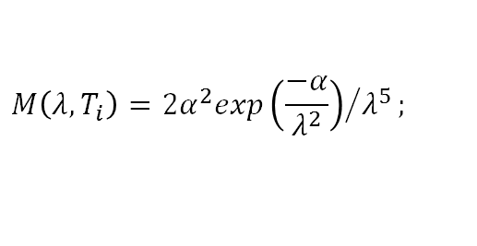

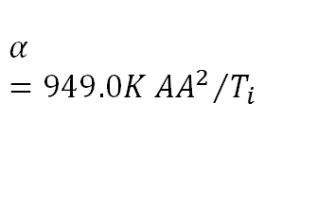
Sources: Source_Maxwell_3
COMPONENT source = Source_Maxwell_3(yheight=0.156, xwidth=0.126, Lmin=0.1, Lmax=9.0, dist=1.5, focus_xw = 0.025, focus_yh = 0.12, T1=150.42, I1=3.67E11, T2=38.74, I2=3.64E11, T3=14.84, I3=0.95E11)
Parameters from the PSI cold source
Intensity at a given wavelength drawn from a sum of (up to) 3 normalized Maxwellian distributions:
$$I\left(λ\right)=∑I_{i}M\left(λ,T_{i}\right);$$
$$M\left(λ,T_{i}\right)=2α^{2}exp{\left(\frac{−α}{λ^{2}}\right)}/{λ^{5}};$$
$$α=949.0K{{AA}^{2}}/{T_{i}}$$

Slide 5
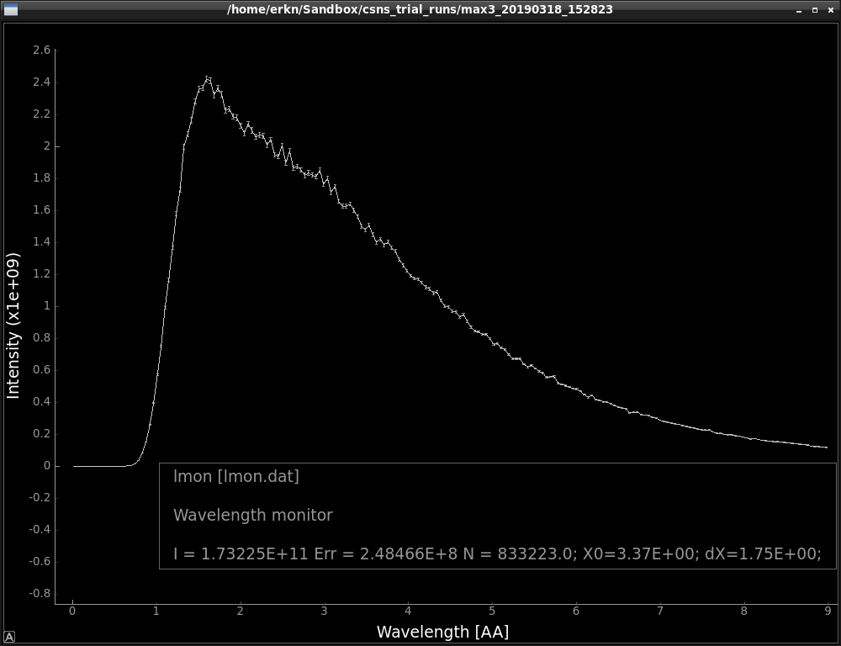
Sources: Source_Maxwell_3
COMPONENT source = Source_Maxwell_3(yheight=0.156, xwidth=0.126, Lmin=0.1, Lmax=9.0, dist=1.5, focus_xw = 0.025, focus_yh = 0.12, T1=150.42, I1=3.67E11, T2=38.74, I2=3.64E11, T3=14.84, I3=0.95E11)
Parameters from the PSI cold source

Slide 6
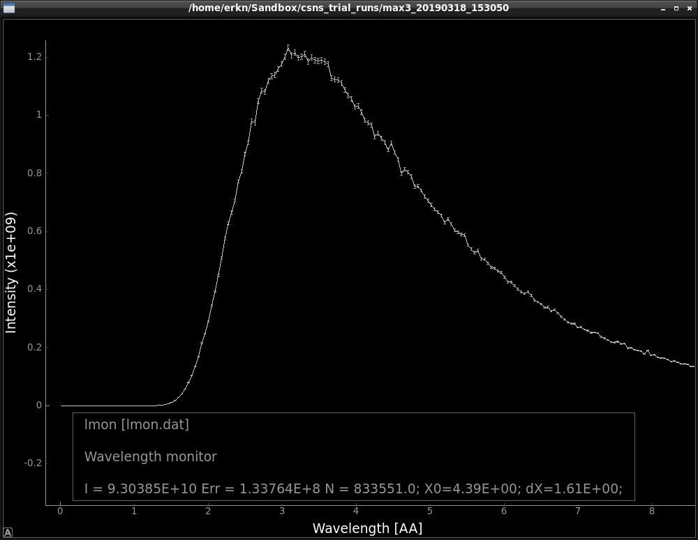
Sources: Source_Maxwell_3
COMPONENT source = Source_Maxwell_3(yheight=0.156, xwidth=0.126, Lmin=0.1, Lmax=9.0, dist=1.5, focus_xw = 0.025, focus_yh = 0.12, T1=150.42, I1=3.67E11, T2=38.74, I2=3.64E11, T3=14.84, I3=0.95E11)
Parameters from the PSI cold source
Just for fun – let’s see what happens if we remove the fast peak…

Slide 7
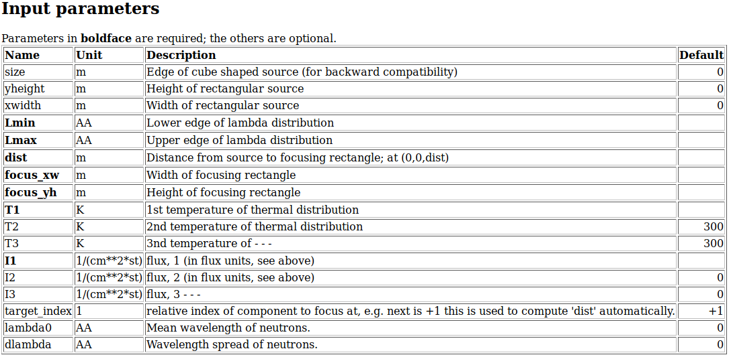
Sources: Source_Maxwell_3
COMPONENT source = Source_Maxwell_3(yheight=0.156, xwidth=0.126, Lmin=0.1, Lmax=9.0, dist=1.5, focus_xw = 0.025, focus_yh = 0.12, T1=150.42, I1=3.67E11, T2=38.74, I2=3.64E11, T3=14.84, I3=0.95E11)
Parameters from the PSI cold source
Just for fun – let’s see what happens if we remove the fast peak…

Slide 8
Sources: Source_gen (Source_gen4)
COMPONENT source = Source_gen(yheight=0.156, xwidth=0.126, Lmin=0.1, Lmax=9.0, dist=1.5, focus_xw = 0.025, focus_yh = 0.12, T1=150.42, I1=3.67E11, T2=38.74, I2=3.64E11, T3=14.84, I3=0.95E11)
Almost the same as Source_Maxwell_3: but with optional flux-files as input.

Slide 9
MCPL_input/output
Reads/writes events directly from MCPL-format files:
“T. Kittelmann et. al., “”, J. Phys. Comp., 2017
COMPONENT vout = MCPL_output(filename=”voutput.mcpl”, doubleprec=1,polarisationuse=1,verbose=1)
AT (Xout,Yout,Zout) RELATIVE PREVIOUS
COMPONENT vin = MCPL_input(filename=”voutput.mcpl”, polarisationuse=1,verbose=1)
AT (Xin,Yin,Zin) RELATIVE PREVIOUS

Slide 10
MCPL_input/output
Can include an Implicit Translation:
MCPL_output.comp
n
(r_{x},r_{y},r_{z})₀
n
AT(X_{OUT},Y_{OUT},Z_{OUT})
(r_{x},r_{y},r_{z})₁
(r_{x},r_{y},r_{z})₂
n

Slide 11
MCPL_input/output
MCPL_input.comp
Can include an Implicit Translation:
n
(r_{x},r_{y},r_{z})₀
MCPL_output.comp
BECOMES
n
AT(X_{IN},Y_{IN},Z_{IN})
(r_{x},r_{y},r_{z})₁
(r_{x},r_{y},r_{z})₂
n
(r_{x},r_{y},r_{z})₀
n
n
AT(X_{OUT},Y_{OUT},Z_{OUT})
(r_{x},r_{y},r_{z})₁
(r_{x},r_{y},r_{z})₂
n
AT(X_{OUT},Y_{OUT},Z_{OUT})

Slide 12
Pulsed sources:
Simplest case:
Use a continuous source!
Model a source with given wavelength and spatial distribution
and
… an infinitely short pulse length. I.e. t = 0 for all neutron rays.
COMPONENT src = Source_simple(
radius=0.05, lambda0=2.5, dlambda=1.5,
focus_xw=0.1, focus_yh=0.1, dist=5 )
AT(0,0,0) RELATIVE origin

Slide 13
Pulsed sources:
Simplest case:
Use a continuous source!
Model a source with given wavelength and spatial distribution
and
… an infinitely short pulse length. I.e. t = 0 for all neutron rays.
COMPONENT src = Source_simple(
radius=0.05, lambda0=2.5, dlambda=1.5,
focus_xw=0.1, focus_yh=0.1, dist=5 )
AT(0,0,0) RELATIVE origin
EXTEND
%{
t=0;
%}

Slide 14
Pulsed sources:
Simplest case:
Use a continuous source!
Model a source with given wavelength and spatial distribution
and
… an infinitely short pulse length. I.e. t = 0 for all neutron rays.
Or: Use a chopper
(see later)
COMPONENT src = Source_simple(
radius=0.05, lambda0=2.5, dlambda=1.5,
focus_xw=0.1, focus_yh=0.1, dist=5 )
AT(0,0,0) RELATIVE origin
EXTEND
%{
t=0;
%}

Slide 15
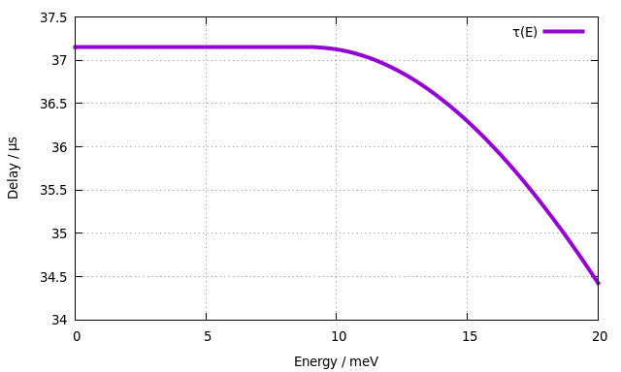

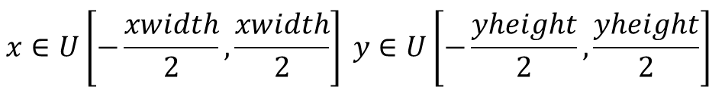
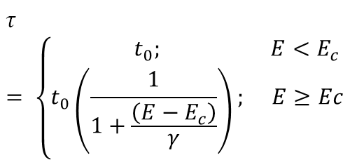
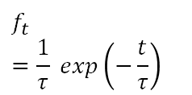
Pulsed Sources: Moderator
A flat pulsed source with uniform energy spectrum:
$$\begin{aligned}x∈U\left[−\frac{xwidth}{2},\frac{xwidth}{2}\right] y∈U\left[−\frac{yheight}{2},\frac{yheight}{2}\right] \\ \end{aligned}$$
$$\begin{aligned}\left|v\right|=f\left(λ\right) ;λ∈U\left[L_{min}L_{max}\right] \\ \end{aligned}$$
Time structure is given by energy dependent probability density function:
$$f_{t}=\frac{1}{τ} exp\left(−\frac{t}{τ}\right)$$
$$τ = \left\{\begin{matrix}t_{0}; & E<E_{c} \\ t_{0}\left(\frac{1}{1+\frac{\left(E−E_{c}\right)}{γ}}\right); & E≥Ec\end{matrix}\right.$$

Slide 16

Pulsed Sources: ESS_butterfly
Analytic fits to MCNP-generated files.
Specialized fits to each beamport.
Fast and reasonably accurate.

Slide 17
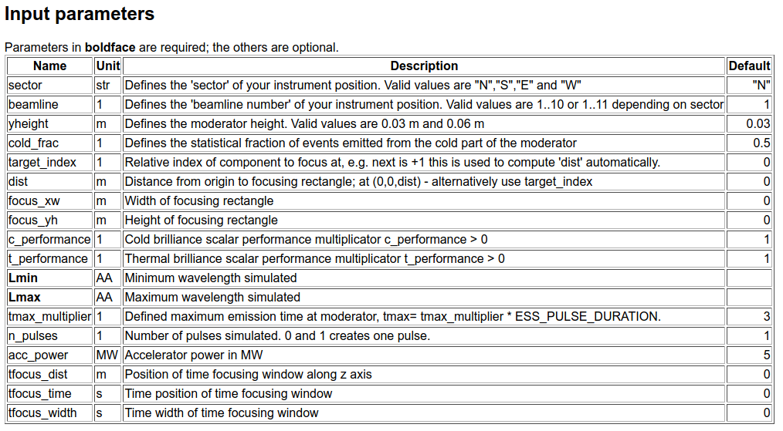
Pulsed Sources: ESS_butterfly

Slide 18
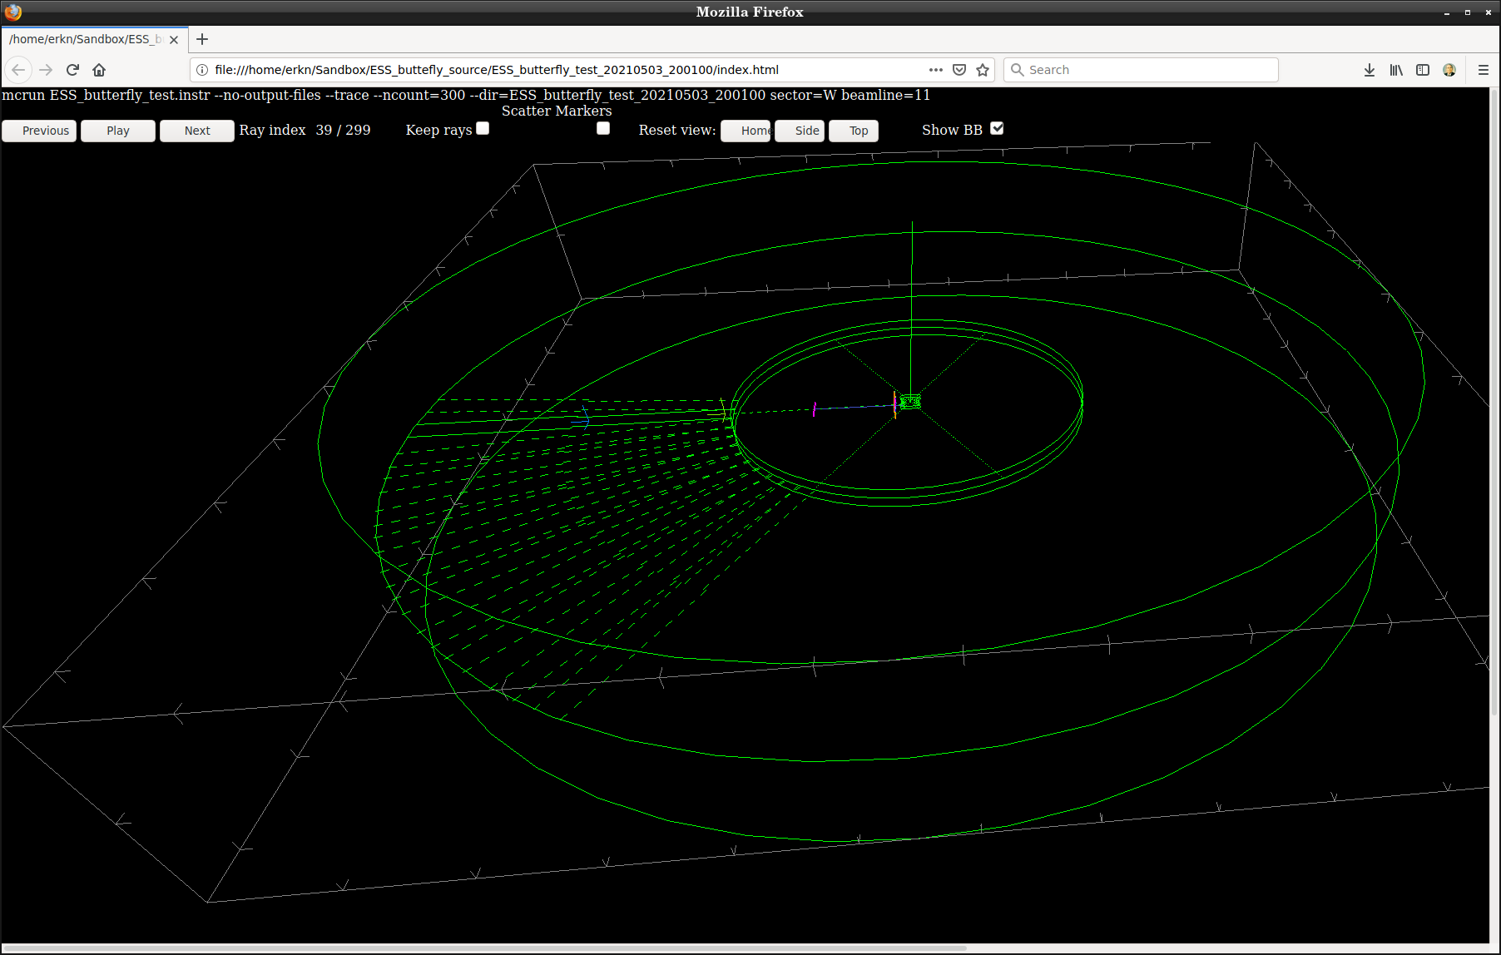
"W" - 11
Pulsed Sources: ESS_butterfly

Slide 19
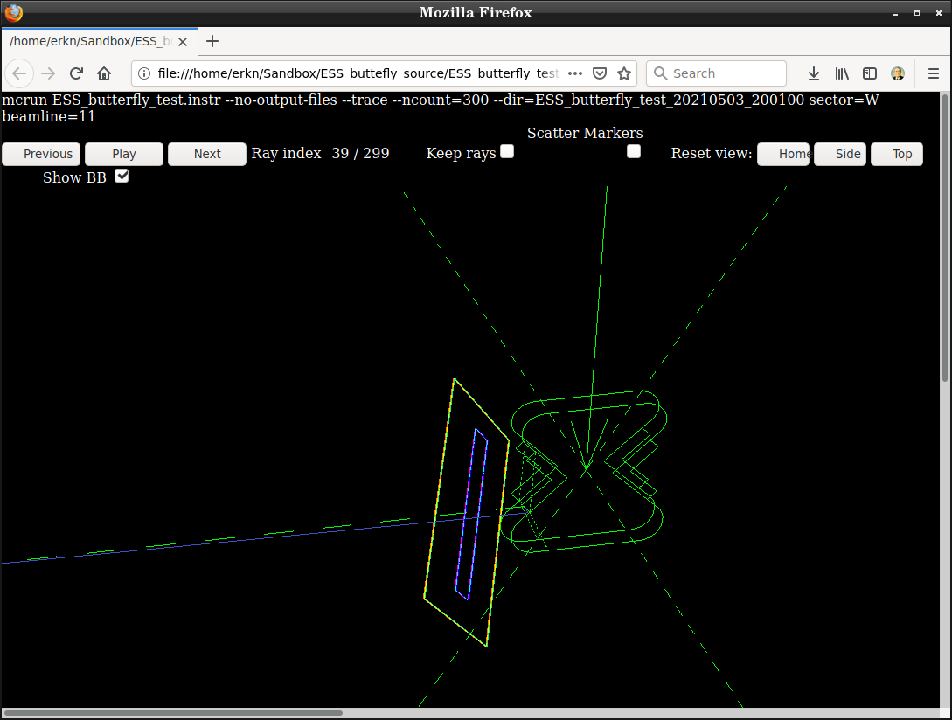
"W" - 11
Pulsed Sources: ESS_butterfly

Slide 20
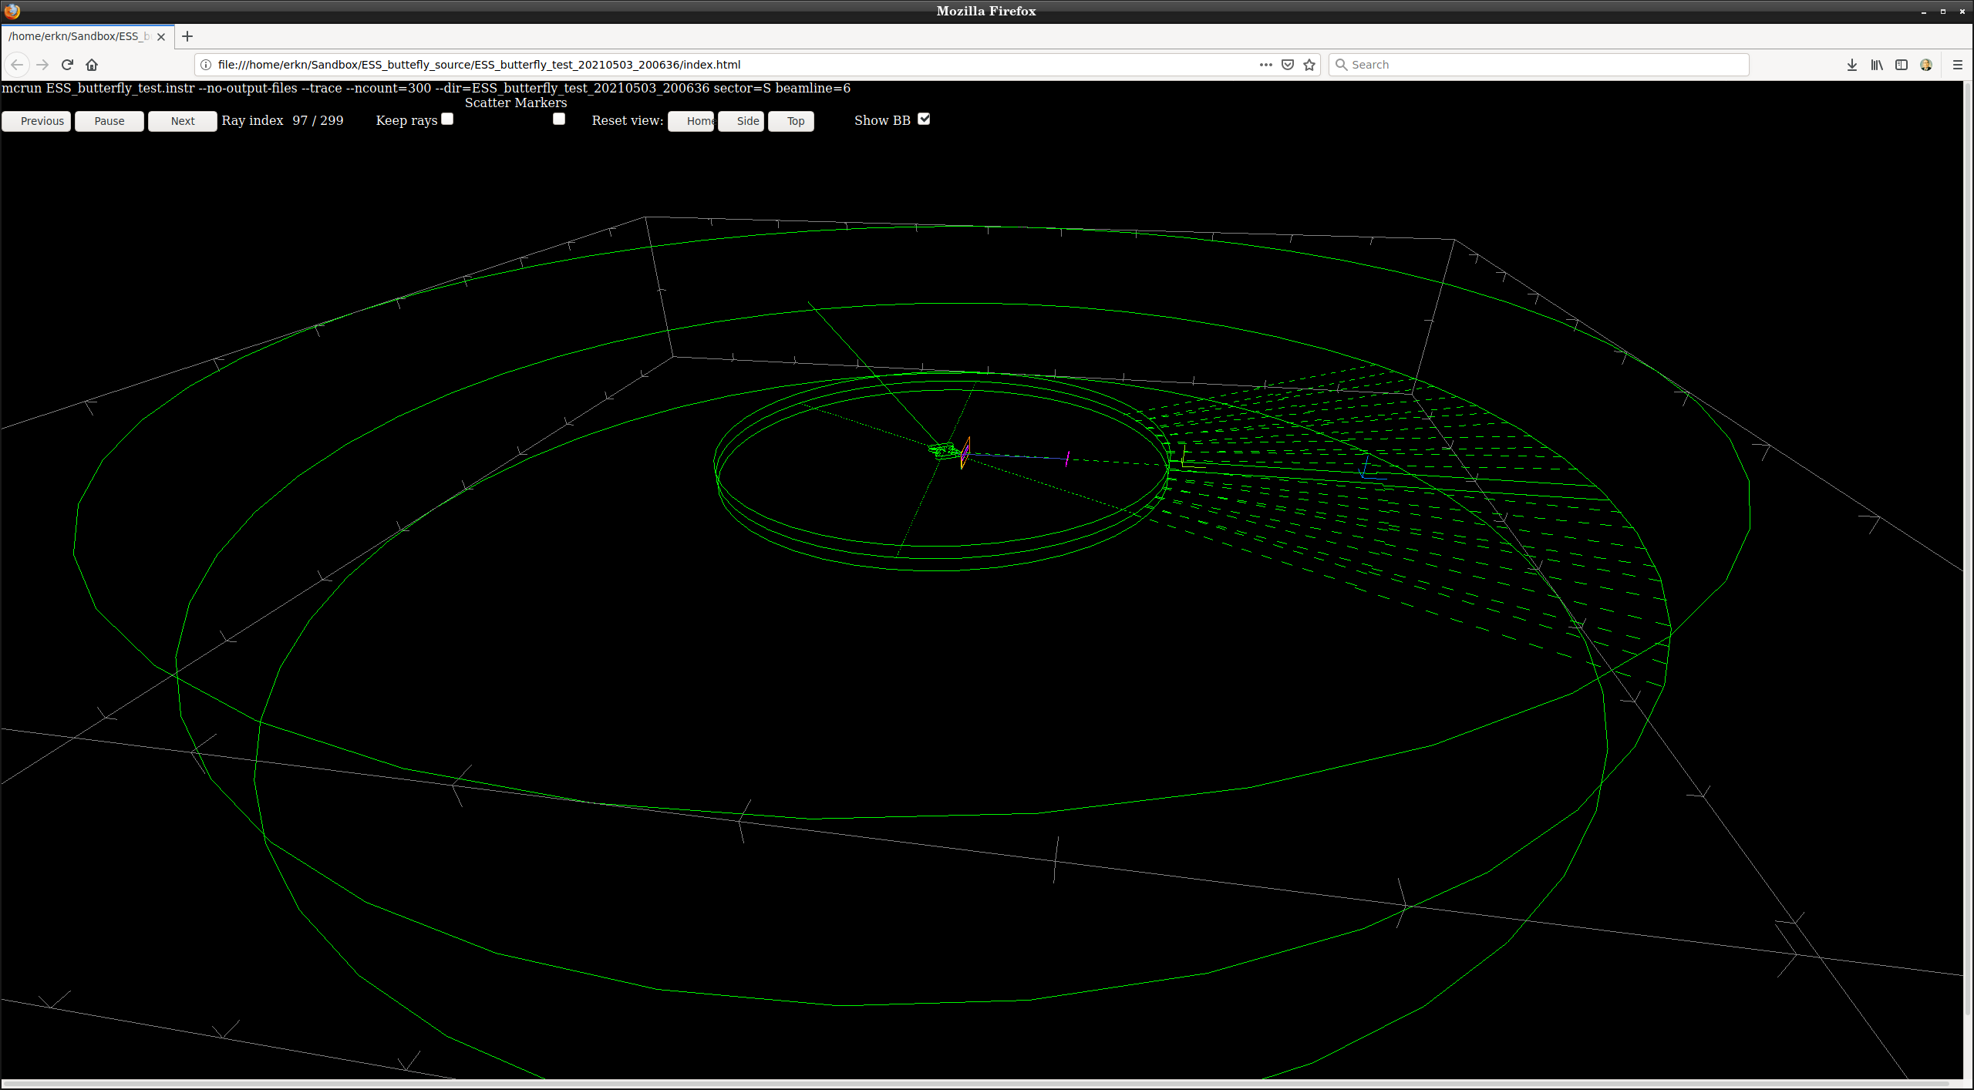
"S" - 6
Pulsed Sources: ESS_butterfly

Slide 21
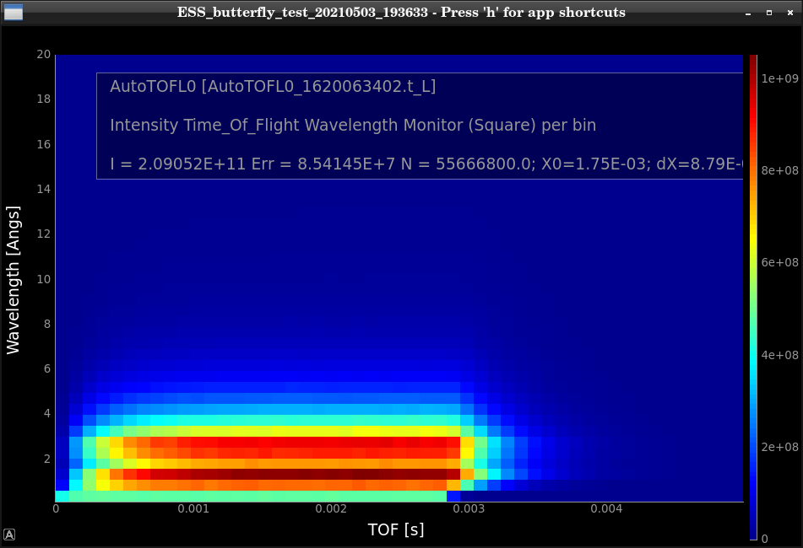
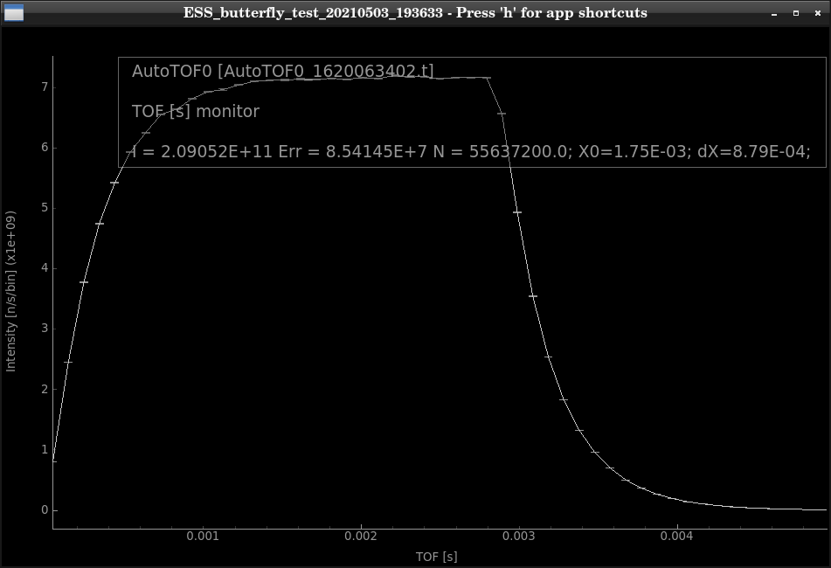
Pulsed Sources: ESS_butterfly
Example: N-1

Slide 22
Pulsed Sources: ESS_butterfly
n_pulses=3

Slide 23
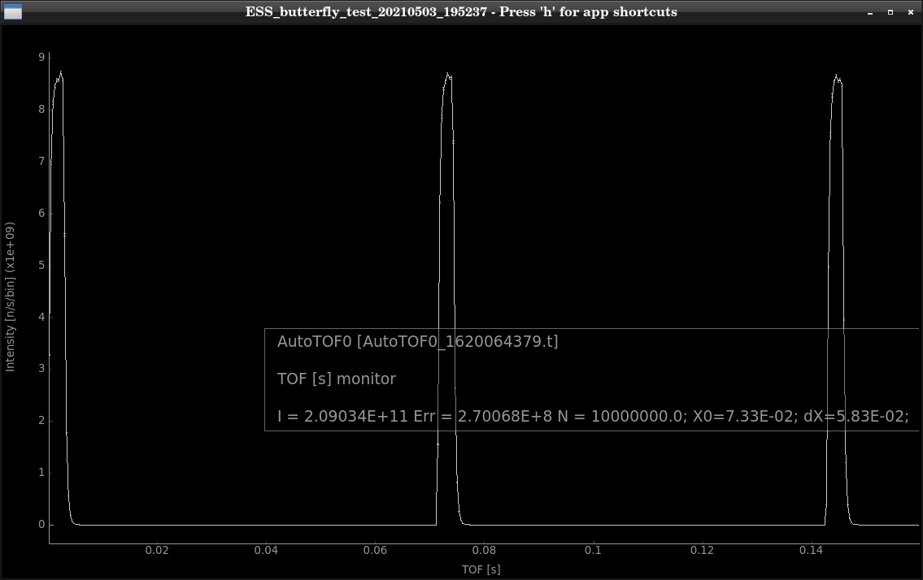
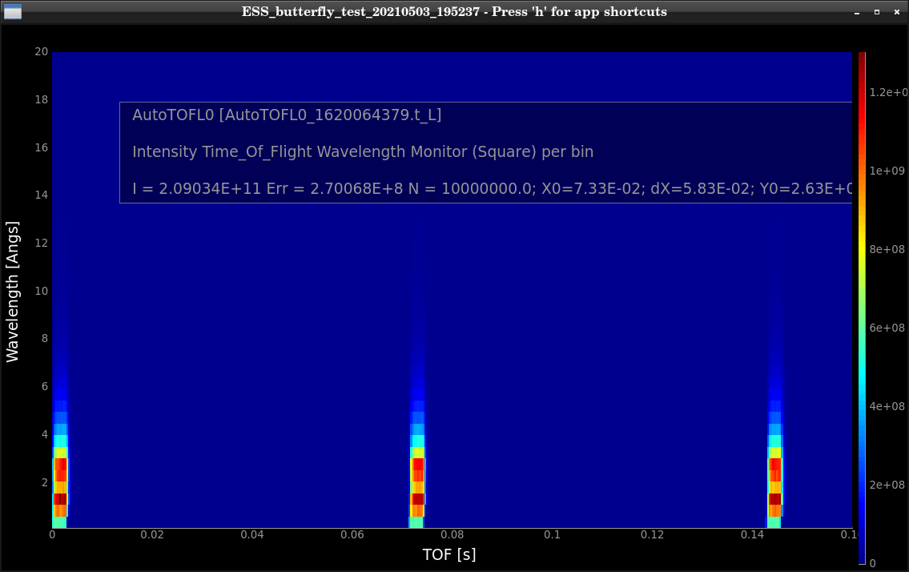
Pulsed Sources: ESS_butterfly
n_pulses=3

Slide 24
Pulsed Sources: ViewModISIS
Samples directly from tallies coming from e.g. MCNP target+moderator calculations.
Data file supplied for each beam port at ISIS.

Slide 25
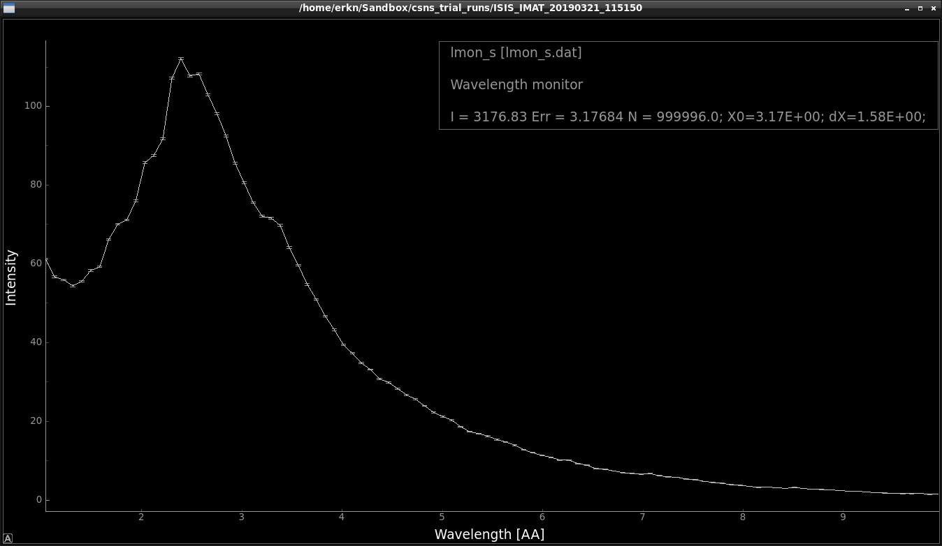
Pulsed Sources: ViewModISIS
Samples directly from tallies coming from e.g. MCNP target+moderator calculations.
Data file supplied for each beam port at ISIS.
ISIS T2: IMAT

Slide 26

Pulsed Sources: SNS_source
Samples directly from tallies coming from e.g. MCNP target+moderator calculations.
Originally from SNS but also used extensively at J-PARC
Can be used (with the proper input files) to model CSNS, and likely also ISIS.

Slide 27
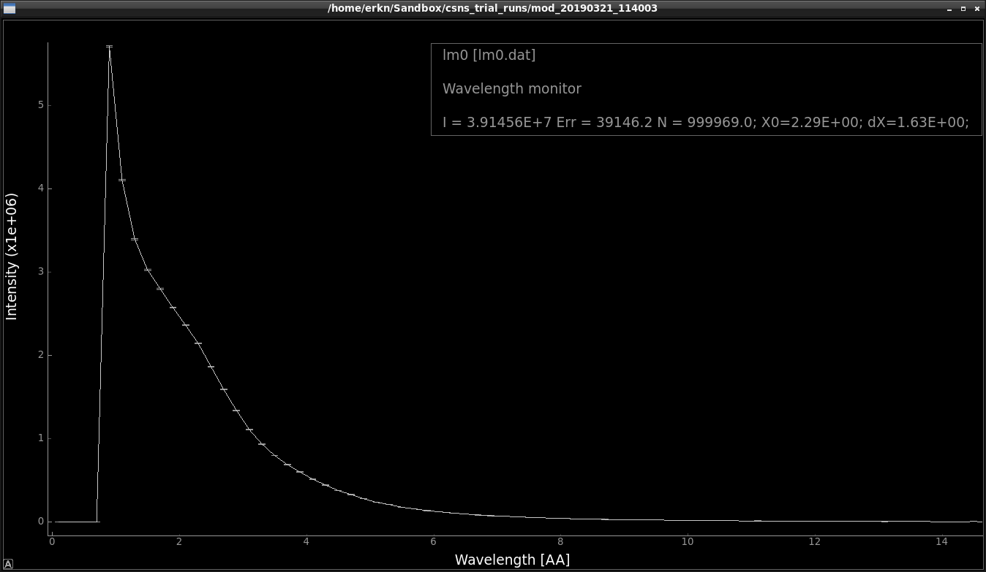


Pulsed Sources: SNS_source
Samples directly from tallies coming from e.g. MCNP target+moderator calculations.
Can be used (with the proper input files) to model CSNS-source.
Example (coming from you) is expected to be included in next release of McStas.

Slide 28


Pulsed Sources: SNS_source_analytic
Samples from fits of Padé-functions to tallies from SNS_source.
- Requires a complex fitting campaign
+ Much faster than SNS_source + “Cleaner” distributions where statistics are sketchy
Can be used (with the proper input files) to model CSNS-source.

Slide 29
















Monitors (some)
nD
Monitor_nD →
1D
L_monitor →
TOF_monitor →
Hdiv_monitor →
MeanPolLambda →
E_monitor →
2D
PSD_monitor →
PSD_monitor_4PI →
PolLambda_monitor →
Divergence_monitor →
DivPos_monitor →
$$I\left(λ\right)$$
$$I\left(x,y\right)$$
$$I\left(X\right)$$
$$I\left(t\right)$$
$$I\left(θ,φ\right)$$
or
$$I\left(X,Y\right)$$
$$I\left({\text{div}\text{.}}_{x}\right)$$
$$I\left(\overset{¯}{P},λ\right)$$
or
$$Z\left(X,Y,Z\right)$$
$$\left\langle \overset{¯}{P}\right\rangle \left(λ\right)$$
$$I\left({\text{div}\text{.}}_{x},{\text{div}\text{.}}_{y}\right)$$
or ...
$$I\left(E\right)$$
$$I\left({\text{div}\text{.}}_{x},x\right)$$

Slide 30
Monitors: Quick examples
COMPONENT my_L_monitor = L_monitor(xwidth=0.2, yheight=0.2,
nL=20, filename="Output.L", Lmin=2, Lmax=10)

Slide 31

In a histogram sense
Imagine a histogram, e.g. I(λ)
The RMS variance over that set becomes our statistical error bar E
…
…
In bin i, N events each carrying a fractional intensity pj so that
1
2
3
i
k

Slide 32
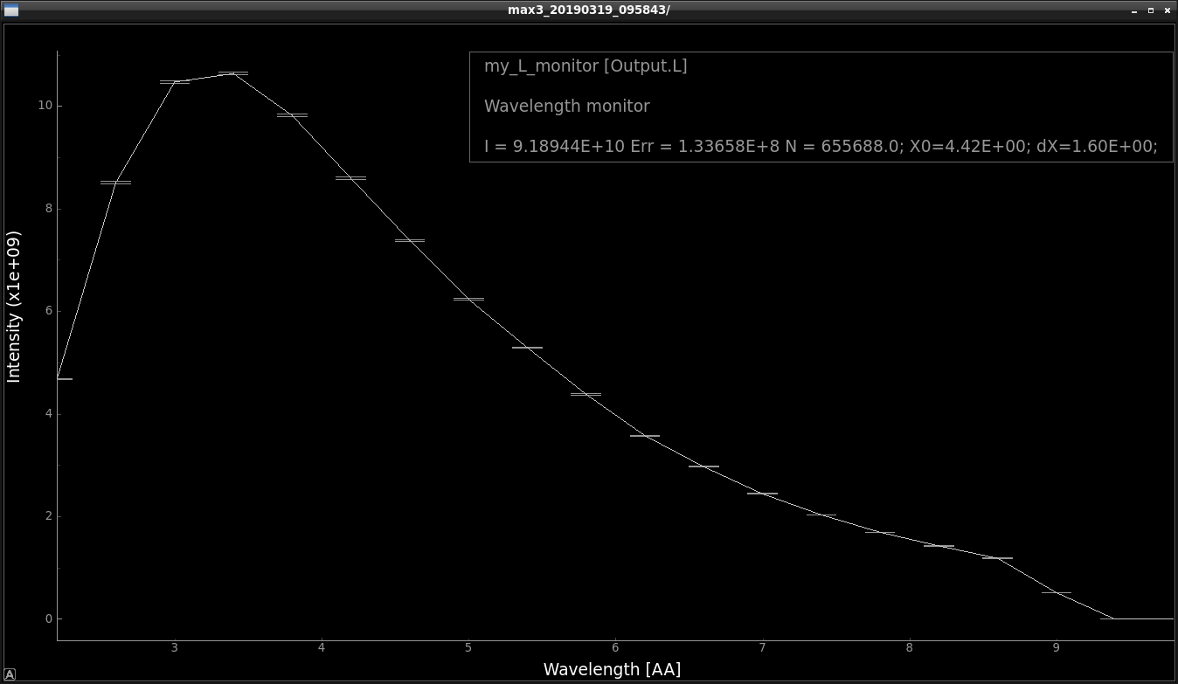
Statistics computed on the fly
In a histogram sense
Monitors: Quick examples
Imagine a histogram, e.g. I(λ)
The RMS variance over that set becomes our statistical error bar E
I
E
N
…
…
In bin i, N events each carrying a fractional intensity pj so that
1
2
3
i
k
# Events
Intensity / n/s
1st and 2nd moments of data
Estimated RMS MC error

Slide 33
Statistics computed on the fly
In a histogram sense
Monitors: Quick examples
Imagine a histogram, e.g. I(λ)
The RMS variance over that set becomes our statistical error bar E
I
E
N
…
…
In bin i, N events each carrying a fractional intensity pj so that
1
2
3
i
k
# Events
Intensity / n/s
1st and 2nd moments of data
Estimated RMS MC error
Statistics also available per bin (inside data file)

Slide 34
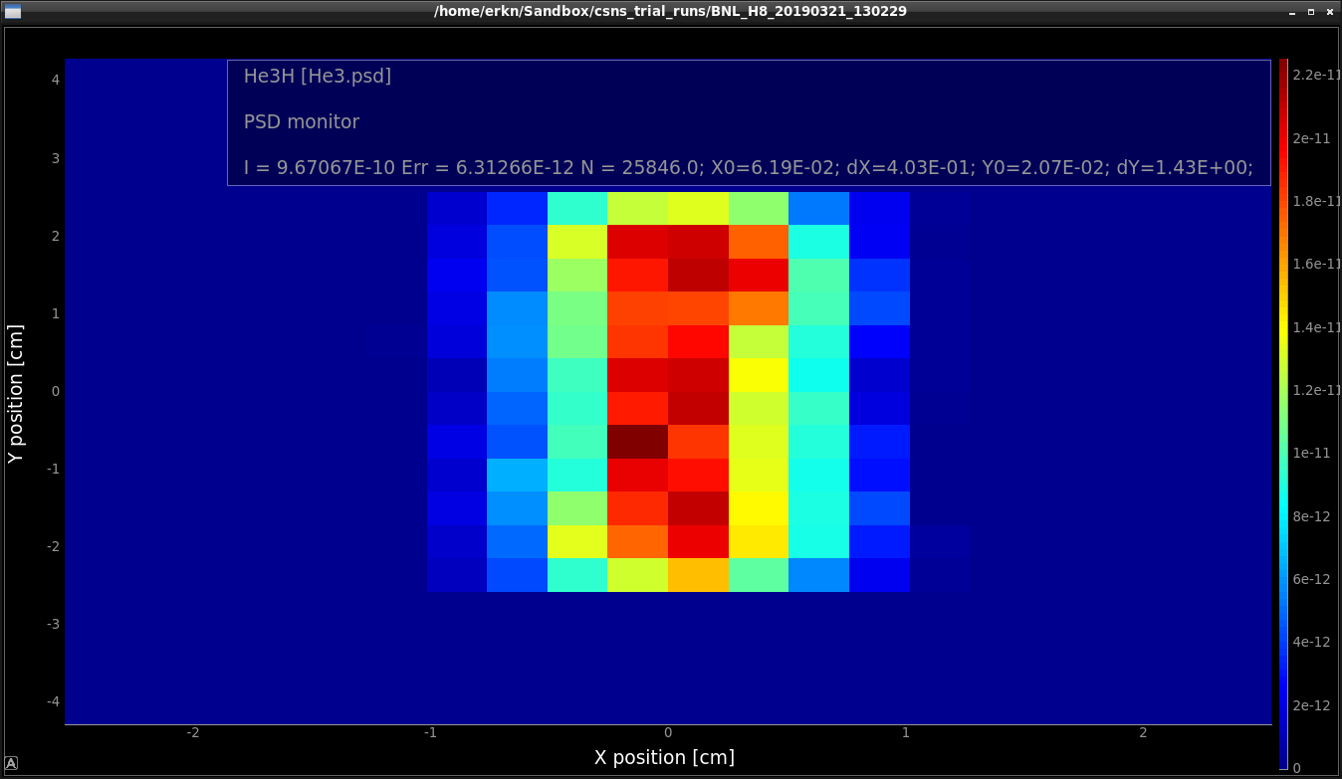
Monitors: Quick examples
In 2D
1st and 2nd moments

Slide 35
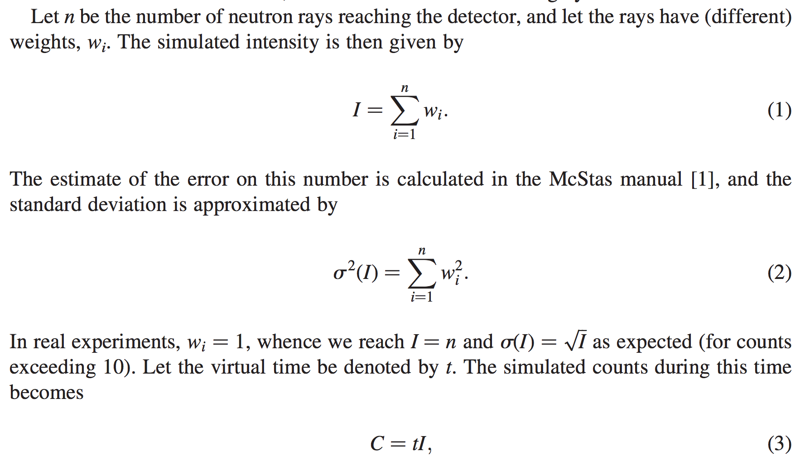
From "Virtual experiments - the ultimate aim of neutron ray-tracing simulations", K. Lefmann et al., Journal of Neutron Research 16, 97-111 (2008)

Slide 36
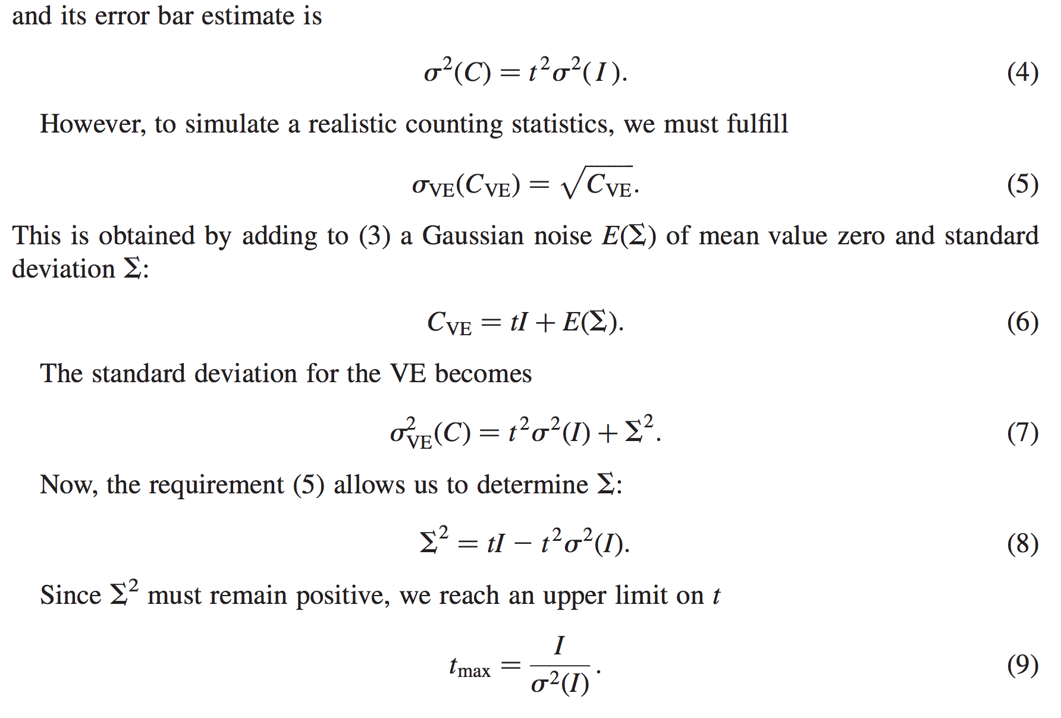
From "Virtual experiments - the ultimate aim of neutron ray-tracing simulations", K. Lefmann et al., Journal of Neutron Research 16, 97-111 (2008)

Slide 37
Sketch of an algorithm…
On a given McStas histogram
For the non-zero bins, calculate The smallest defines the “maximal counting time” allowed by your statistics
Preferably a “background” should be added - use a “known experimental value” or an estimate…

Slide 38
Monitor_nD
A general monitor for 0D/1D/2D records
The all-in-one , swiss-army-knife of monitors
Monitor_nD can have almost any shape, and record
any requested standard quantities

Slide 39
Monitor_nD
A general monitor for 0D/1D/2D records
Examples
COMPONENT MyMon = Monitor_nD( xwidth = 0.1, yheight = 0.1, zdepth = 0,
options = "intensity per cm2 angle,limits=[-5 5],
bins=10,with borders, file = mon1")
options = "banana, theta limits=[10,130], bins=120, y"
options = "multiple kx ky kz, auto abs log t, and list all neutrons"

Slide 40
Monitor_nD
… or monitor just about anything:
COMPONENT MyMon = Monitor_nD(xwidth = 0.1, yheight = 0.1,
user1=age, username1="Age of the Captain [years]",
options="user1, auto")

Slide 41
Exercise 2:
Head over to the github site and continue the exercise we started before:
https://github.com/McStasMcXtrace/Schools/tree/master/ISIS_April_2021/Tuesday_April_13th/2_Component_Basics/Exercise/

