Slide 1

Powered by McStas technology
Tutorial Workshop @ SOLEIL May. 9th- 11th 2023
Peter K Willendrup (pkwi@fysik.dtu.dk)
Emmanuel Farhi (emmanuel.farhi@synchrotron-soleil.fr)

Slide 2
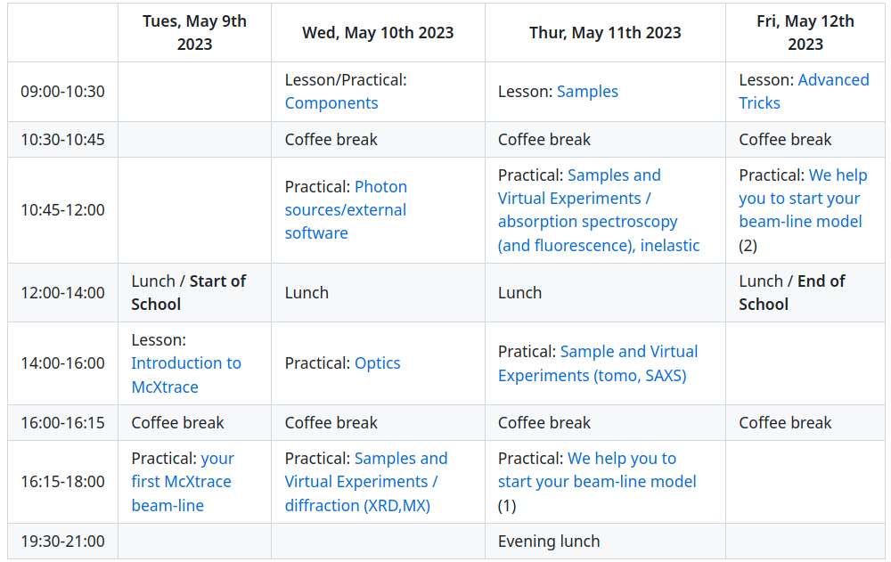
Programme
https://github.com/McStasMcXtrace/Schools/tree/master/2023/SOLEIL_May_2023
https://indico.synchrotron-soleil.fr/e/mcxtrace2023

