Slide 1


Adapting code for McStas 3 and GPUs
Peter Willendrup and Erik Knudsen DTU Physics

Slide 2
Agenda
McStas on GPU via OpenACC (a “high-level” #pragma driven access to CUDA see https://www.openacc.org and https://developer.nvidia.com/hpc-sdk)
How well (fast) does it work?
Simulation flow
What did we change?
What needs doing on an instrument / component?
What does not work
Warning: 1. Assumes previous experience with McStas 2. Does not introduce OpenACC

Slide 3
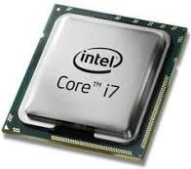
McStas 2.x -> McStas 3.0 main differences
Rewritten / streamlined simplified code-generator with
Much less generated code
improved compile time and compiler optimizations, esp. for large instrs
Much less invasive use of #define
Component sections -> functions rather than #define / #undef
Much less global variables, instrument, component and neutron reworked to be structures
Use of #pragma acc … in lots of places (put in place by cogen where possible)
New random number generator implemented
We couldn’t easily port our legacy Mersenne Twister
Experimenting with curand showed huge overhead for our relative small number of random numbers (we have hundreds or thousands of randnom numbers, not billions)
Complete change to dynamic monitor-arrays
Advantage of 3.0 also on CPU

Slide 4

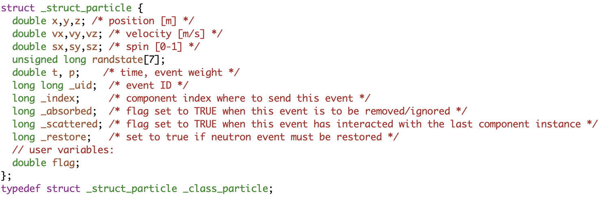
The neutron and USERVARS in the instrument
v2.5: Global variables
Can be probed using e.g. Monitor_nD with user1=“flag” which uses the function
also works with e.g. “x”
v3.0: particle struct, including any USERVARS like flag.
double particle_getvar(_class_particle *p, char *name, int *suc)

Slide 5
The neutron and USERVARS in the instrument
v2.5: Global variables
RNG state is a thread-variable contained on the _particle struct. Was earlier a global state in CPU settings
v3.0: particle struct, including any USERVARS like flag.
Side-effect: Every function in TRACE that uses random numbers must have _particle in the footprint
Particle state data are not global: Don’t use RESTORE_NEUTRON in TRACE to do a local restore, the macro only raises a flag

Slide 6
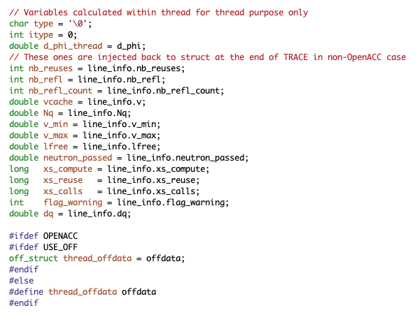
Samples required a good deal of (detective) work…
Key issue: (mis-) Use of / component DECLARE variables in TRACE for storing particle-dependent information, e.g. reflection list in PowderN etc. must be avoided.
Solutions:
1) Make local thread-variables, e.g.
2) Where meaningful, one could make atomic sections ala the monitors
Side-effect of thread-local vars:
Next neutron(s) in a SPLIT are no longer aware of e.g. available powder lines.
Potential, future solution: Mechanism to inject comp-specific code in the _particle

Slide 7
New monitor-tools for debugging use
Event_monitor_simple(nevents=1e6) - basic non-Monitor_nD event monitor. Writes a “log” file, independent from detector_out macros
Flex_monitor_1D , Flex_monitor_2D, Flex_monitor_3D, simple 1/2/3D “uservar” monitors tapping into the instrument USERVARS ala Monitor_nD
Useful for debugging even component internals: On McStas 3, if same ncount, same seed, same level of MPI parallelisation, the output should be identical on CPU and GPU

Slide 8
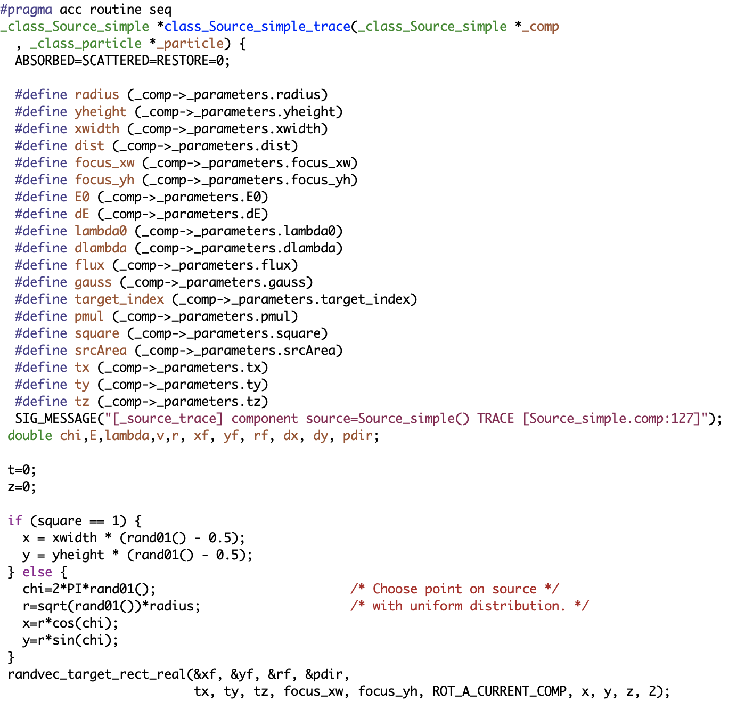
“Scatter-gather” approach not far from what we do in MPI settings, i.e. : GPU case: N particles are calculated in parallel in N GPU threads. (Leave to OpenACC/device how many actually are running at one time)
CPU case: N particles are calculated in M serial chunks over M processors.
Each component will correspond to a set of function. Trace is a GPU’ified function…
particle-loop and logic around, also running on GPU.
Init and finalisation codes run purely CPU.
Contains component trace
section
…. etc

Slide 9

Porting an instrument to 3.0 and GPU
Should give the SAME on CPU and GPU!
Instrument-level variables that are to become particle-dependent “flags”, e.g. for use in EXTEND WHEN must be put in the new section USERVARS %{ double flag; %}
Use of instrument input pars in extend and WHEN must use INSTRUMENT_GETPAR(varname)
Non-flag instrument vars to be used during TRACE / EXTEND / WHEN must be injected via #pragma acc declare create(var) and #pragma acc update device(var)
Declare-functions to be used in trace (e.g. in an EXTEND) must have #pragma acc routine

Slide 10
Common error-messages:
At compile-time, nvc is quite informative if using -Minfo:accel
At runtime, this indicates a GPU segfault
Often a symptom of “illegal access”, colliding memory, something isn’t thread-safe…
PGC-S-0155-Invalid atomic expression PGC-S-0000-Internal compiler error. Error: Detected unexpected atomic store opcode. PGC-S-0155-External variables used in acc routine need to be in #pragma acc create() - flag …
Failing in Thread:1
call to cuMemcpyDtoHAsync returned error 700: Illegal address during kernel execution

Slide 11
Porting a comp to GPU
Should give the SAME on CPU and GPU!
All pars must be setting parameters. New types: string a=“none” and vector b ( either ={1,2,3,4} static init or via pointer.)
All function-declarations must be moved to SHARE
DECLARE must only contain variable declarations. All initialization resides in INITIALIZE
If the comp uses external libs either
Avoid use in component TRACE (e.g. MCPL_input and output, handled in INIT/FINALLY)
Use NOACC keyword (e.g. Multilayer_sample use of GSL) - implies FUNNEL mode
Add #pragma acc routine to functions to execute in TRACE
Functions that call rand01() and friends must include _class_particle *_particle in footprint. (rand01() etc. are macros that carry thread-seed on _particle)s
Generally, don’t store ANY particle-derived vars on comp struct, make local TRACE vars instead.
Exception: Monitors, handle arrays in #pragma acc atomic clauses
Don’t use RESTORE_NEUTRON in TRACE to do a local restore, the macro only raises a flag

Slide 12
Highlights of comps that work differently
Monitor_nD uservars are strings user1=“flag”, they use _particle_getvar to access instrument USERVARS
MCPL_input and MCPL_output do most of their work in INIT/FINALLY - buffers transferred for TRACE use
PowderN + Single_crystal + Isotropic_sqw don’t check for “same particle as before” - in SPLIT cases, no particle state info is kept (we could potentially use _particle and “USERVARS” injected from the comps…)

Slide 13
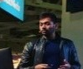
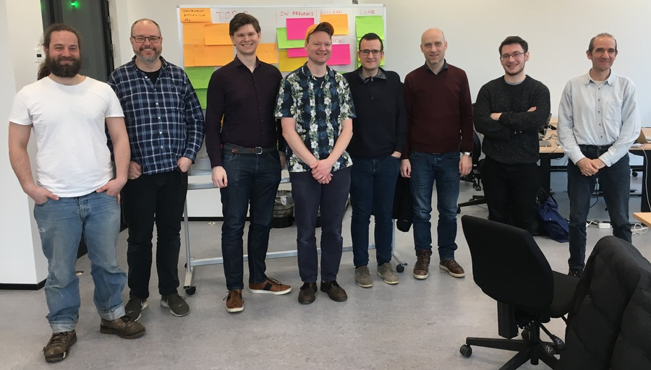

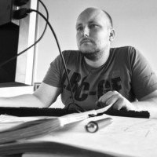


The team, Nvidia mentors and Hackathon hosts :-)
Vishal Metha
Gino - (RAMP)
Guido Juckeland
Torben
Peter
Mads
Tobias
Erik
Jakob
Emmanuel
Christian Hundt
Alexey Romanenko
Sebastian von Alfthan
Peter Willendrup, DTU Physics and ESS DMSC

Slide 14
What code-parts got #pragma acc
All monitors:
#pragma acc atomic sections for arrays
Obviously the code-generator… mcstas/src/cogen.c.in
Examples: 25 Instruments that use various global vars in DECLARE that are neither input parameters or USERVARS
Sources: (TRACE-functions in SHARE)
sources/Source_Maxwell_3.comp sources/Source_gen.comp
Misc: atomic capture for insertion in array of particle events misc/MCPL_output.comp
Samples: (TRACE-functions in SHARE)
samples/Isotropic_Sqw.comp
samples/Magnon_bcc.comp
samples/Phonon_simple.comp
samples/PowderN.comp
samples/SANS_spheres2.comp
samples/Single_crystal.comp
These share/runtime snippets: (A good mix of everything) share/adapt_tree-lib.c share/interoff-lib.c share/mccode-r.c share/mccode-r.h share/mccode_main.c share/read_table-lib.c share/r-interoff-lib.c share/ESS_butterfly-geometry.c share/ESS_butterfly-lib.c share/cov-lib.c share/monitor_nd-lib.c share/mcstas-r.c share/mcstas-r.h share/pol-lib.c share/ref-lib.c
Contrib comps: (atomics in mon’s, #pragma acc routine for TRACE-funcs) contrib/FermiChopper_ILL.comp contrib/Guide_honeycomb.comp contrib/ISIS_moderator.comp contrib/Lens.comp contrib/Mirror_Elliptic.comp contrib/Mirror_Parabolic.comp contrib/PSD_Detector.comp contrib/PSD_monitor_rad.comp contrib/SNS_source.comp contrib/SNS_source_analytic.comp contrib/ViewModISIS.comp
Optics: (TRACE-functions in SHARE + declare create for Gauss structures) optics/Elliptic_guide_gravity.comp optics/FermiChopper.comp optics/Guide_gravity.comp optics/Monochromator_curved.comp optics/Monochromator_flat.comp

Slide 15
New RNG ‘KISS’
We couldn’t easily port Mersenne Twister
Experimenting with curand showed huge overhead for our relative small number of random numbers
An RNG ‘state’ carried with each particle - bonus: same seed gives same numbers even when comparing between CPU and GPU
Required patching prototype of ALL functions making use of e.g. rand01()
New RNG is simple, fast and “good enough”: Reproduces results of 2.7 over all of the example suite, see http://new-nightly.mcstas.org

Slide 16
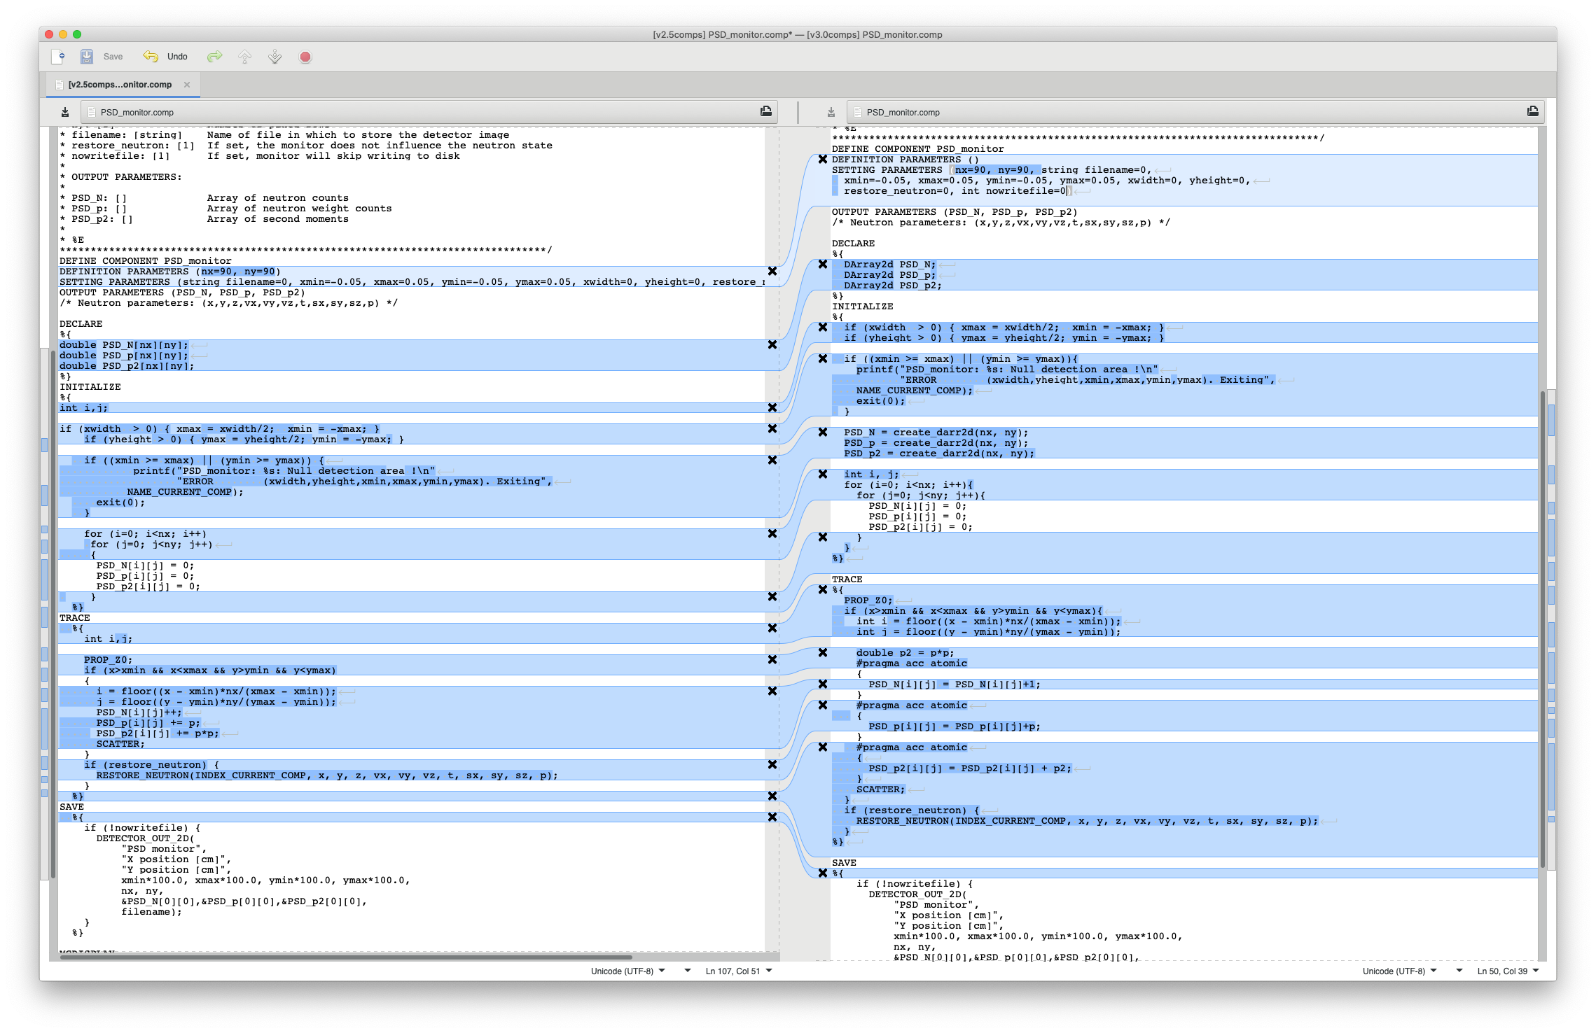
PSD lots of changes

Slide 17
Same seed and same # mpi nodes -> same output
Good for debugging
If they don’t give the same CPU vs GPU, some comp(s) are not fully ported
Use Event_monitor_simple to follow calculation pr. neutron

Slide 18
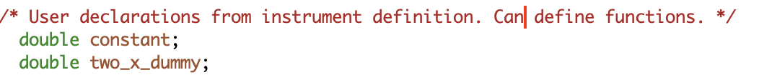
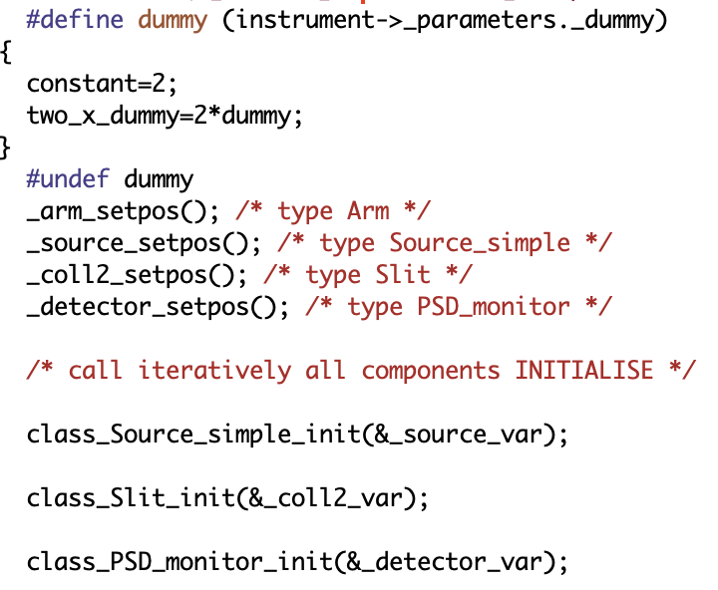
Declare section
Initialise section
Functions per component with related component structs

Slide 19
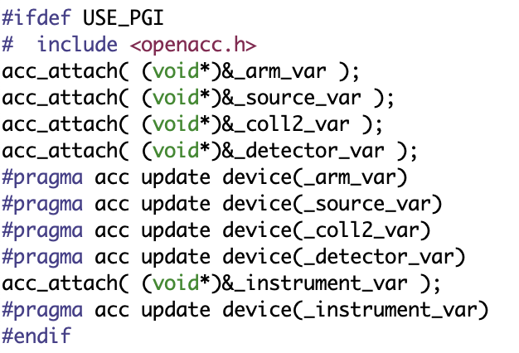
Instrument and component structs built on
CPU and transferred to GPU using OpenACC
pragmas at the
end of INITIALISE
Similar “host” update in FINALLY

Slide 20
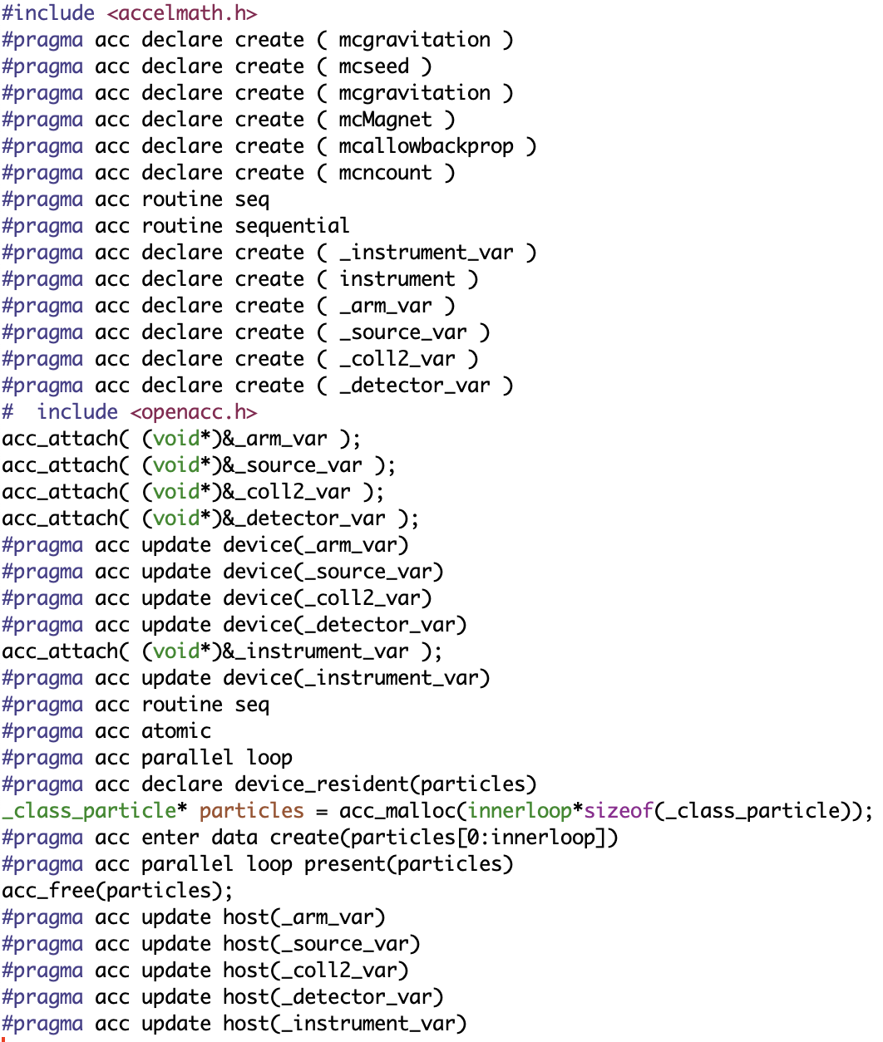
“Full” list
of pragmas and accel-code used
“math.h on GPU”
Needed basic variables / flags
GPUify all functions to be executed on GPU, i.e. in TRACE
Global instrument struct and component structs, including members like detector arrays etc.
OpenACC pure c-code, e.g. for the attaches (pointer-setup)
Ensure GLOBAL structs updated GPU-side end of INITIALISE
GPUify all functions to be executed on GPU, i.e. in TRACE
anything written to by multiple threads (detectors) should be “atomic”
Loop V1
Loop V2
Ensure GLOBAL structs updated host-side start of FINALLY

Slide 21
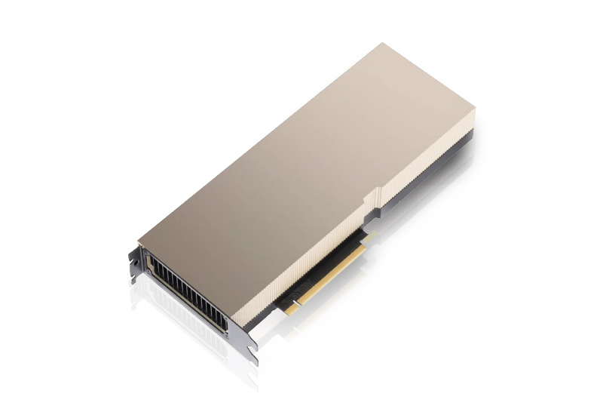
Conclusions
It really does work nicely!
Code changes much less invasive than envisioned!
It often gives a speedup of 1-2 orders of magnitude over 1 cpu
Most things work (we have workarounds or solutions in the pipe for the rest)
Documentation comes in the form of the released code + this set of slides…
McStas 3.0 is as of yet “ported” to GPU but not fully “optimised” performance-wise, we will try to go to another Hackathon
Union needs a dedicated Hackathon

