Slide 1
Guides and gravity in McStas
Peter Willendrup (slides from Mads Bertelsen)

Slide 2
Overview
Description of phase-space and propagation
Reflectivity
McStas coordinate system
Gravitation in McStas
Guide components with support for gravity
Guide_gravity
Elliptic_guide_gravity
Breaking line of sight
Exercise

Slide 3
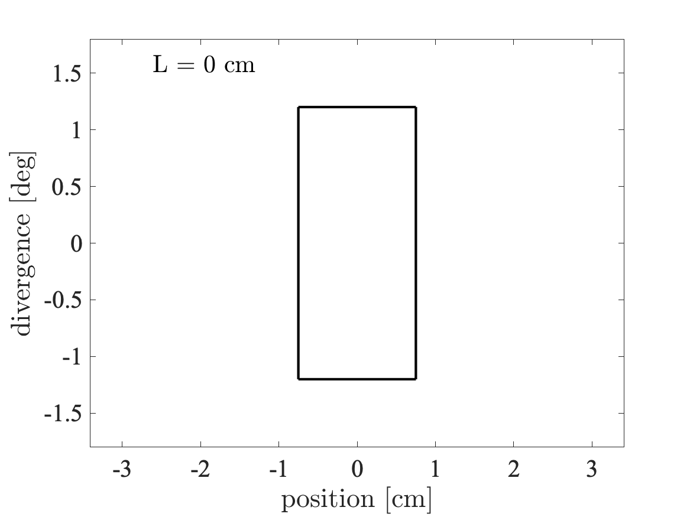
Beam propagation in free space
“Phase-space” at source
Divergence
z
v
𝜂x
x

Slide 4
Beam propagation in free space
Wanted “phase-space” at sample
Divergence
z
v
𝜂x
x

Slide 5
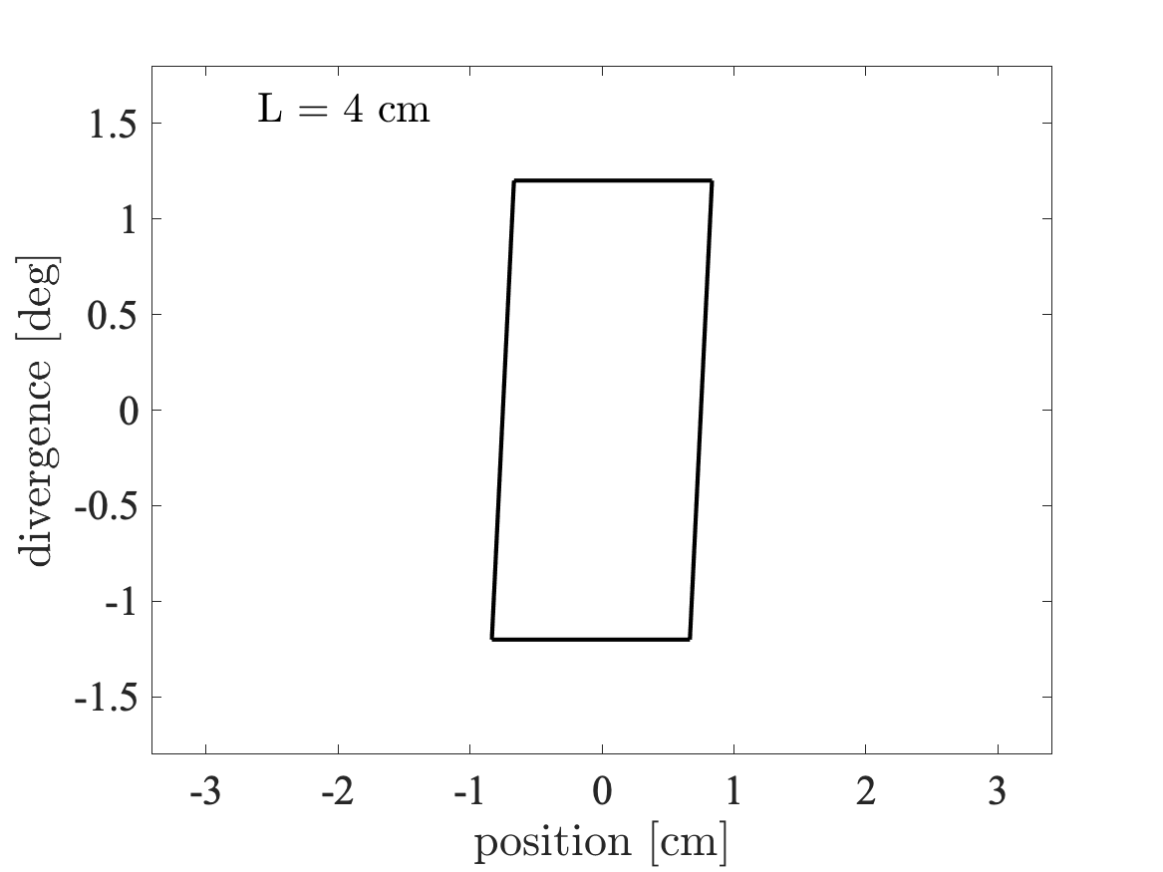
Beam propagation in free space
Divergence
z
v
𝜂x
x

Slide 6
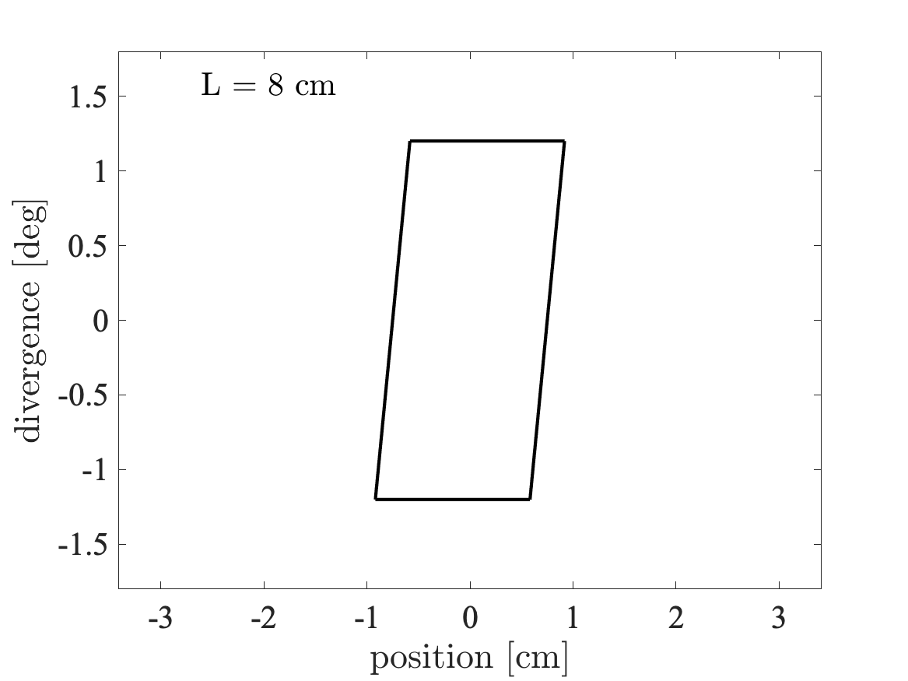
Beam propagation in free space
Divergence
z
v
𝜂x
x

Slide 7
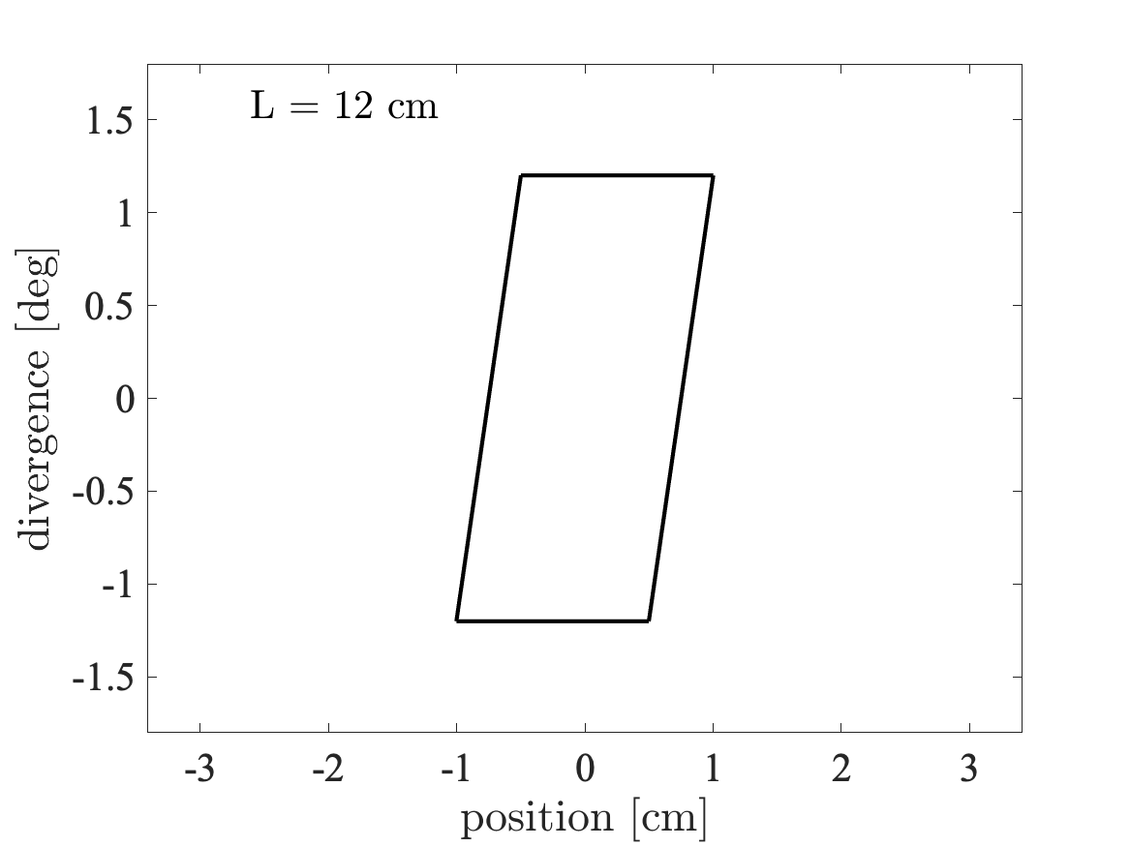
Beam propagation in free space
Divergence
z
v
𝜂x
x

Slide 8
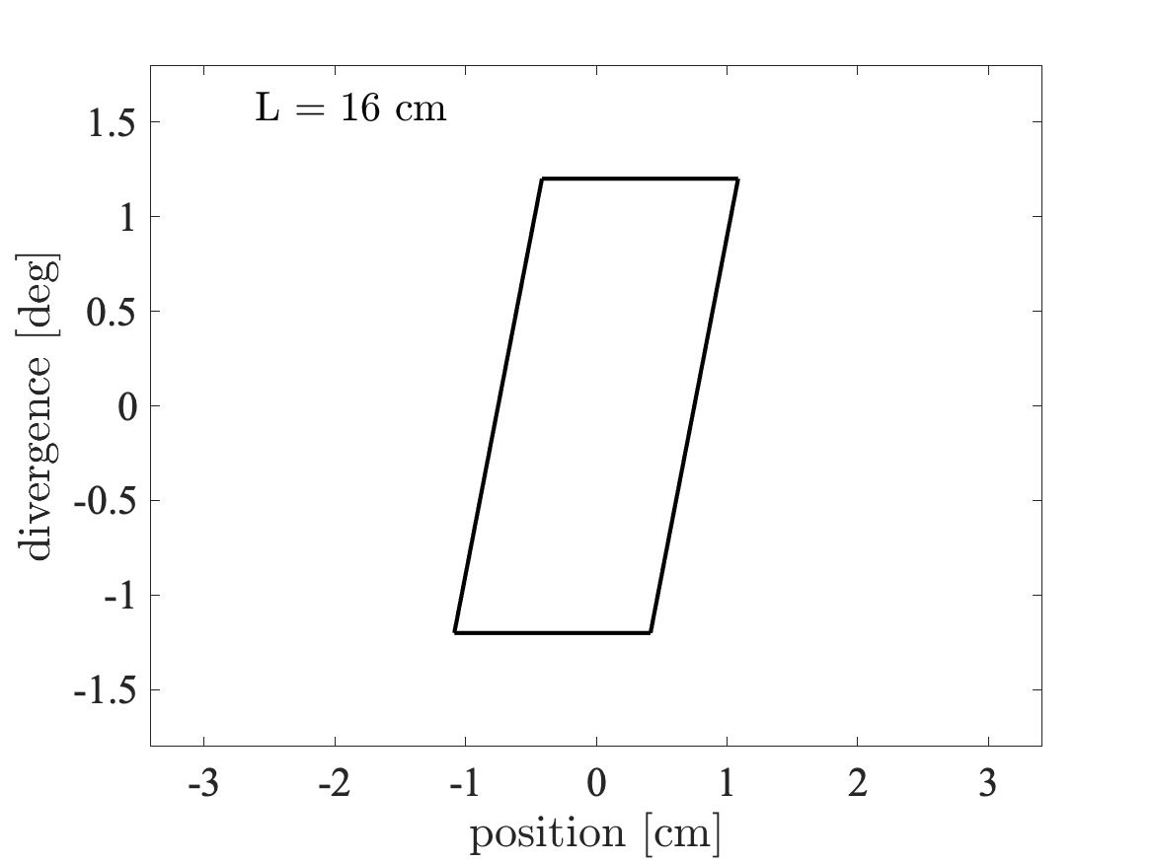
Beam propagation in free space
Divergence
z
v
𝜂x
x

Slide 9

Beam propagation in free space
Divergence
z
v
𝜂x
x

Slide 10
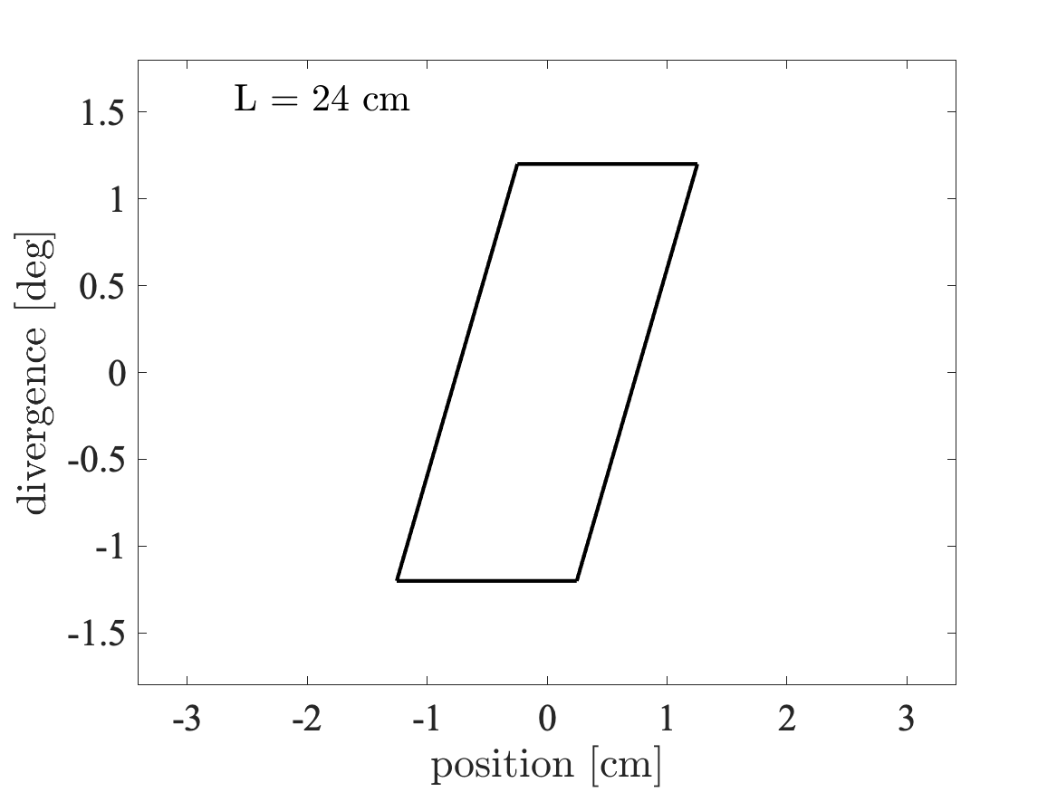
Beam propagation in free space
Divergence
z
v
𝜂x
x

Slide 11
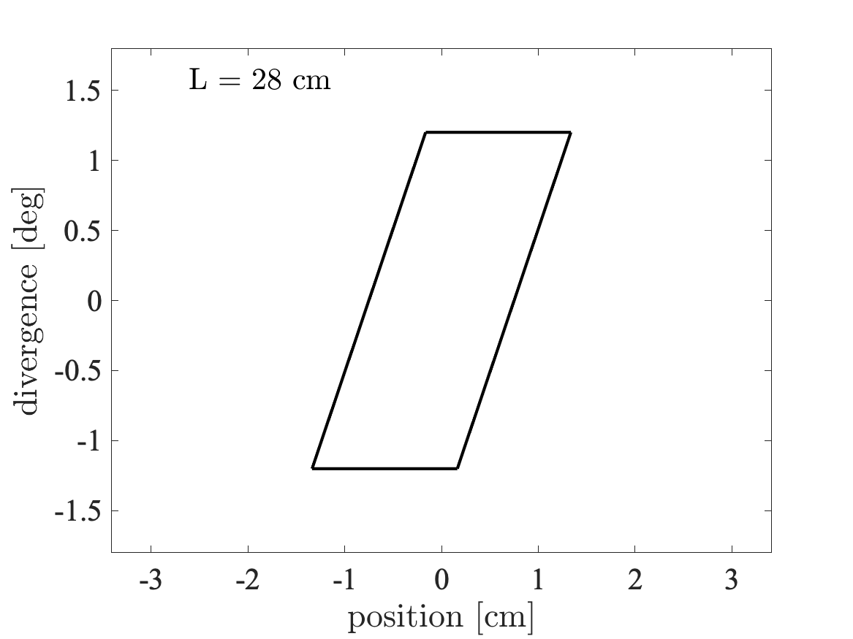
Beam propagation in free space
Divergence
z
v
𝜂x
x

Slide 12
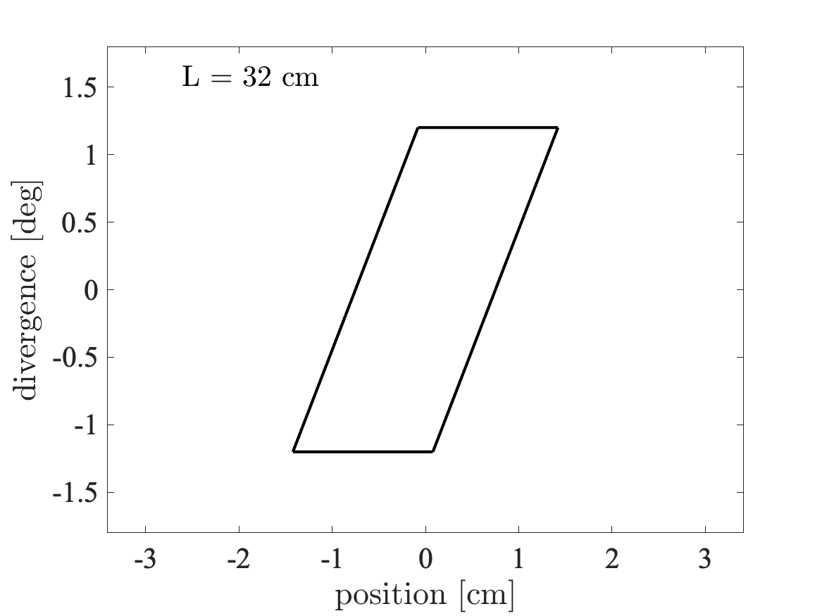
Beam propagation in free space
Divergence
z
v
𝜂x
x

Slide 13
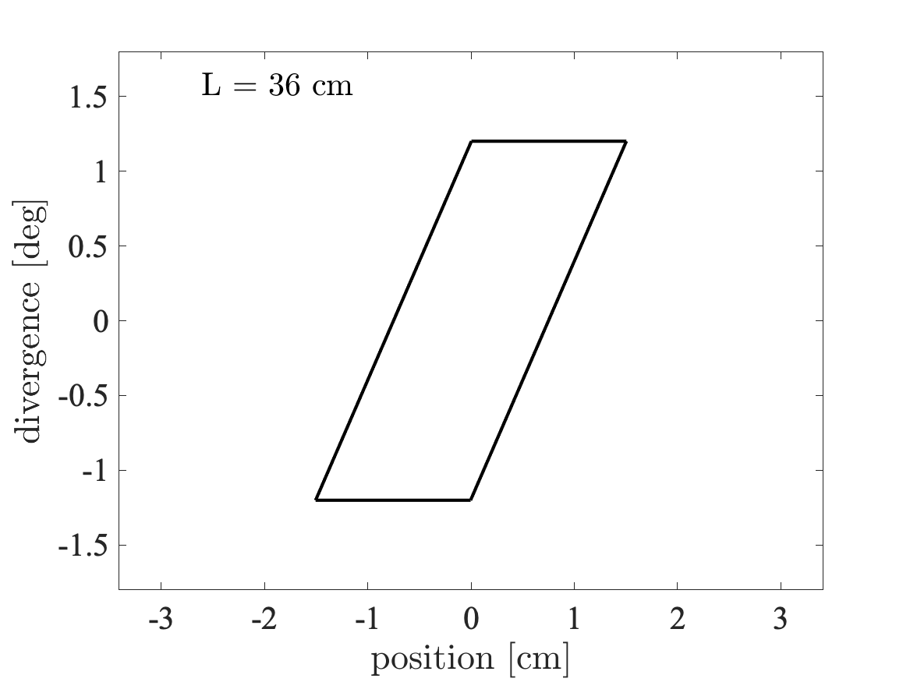
Beam propagation in free space
Divergence
z
v
𝜂x
x

Slide 14

Beam propagation in free space
Divergence
z
v
𝜂x
x

Slide 15
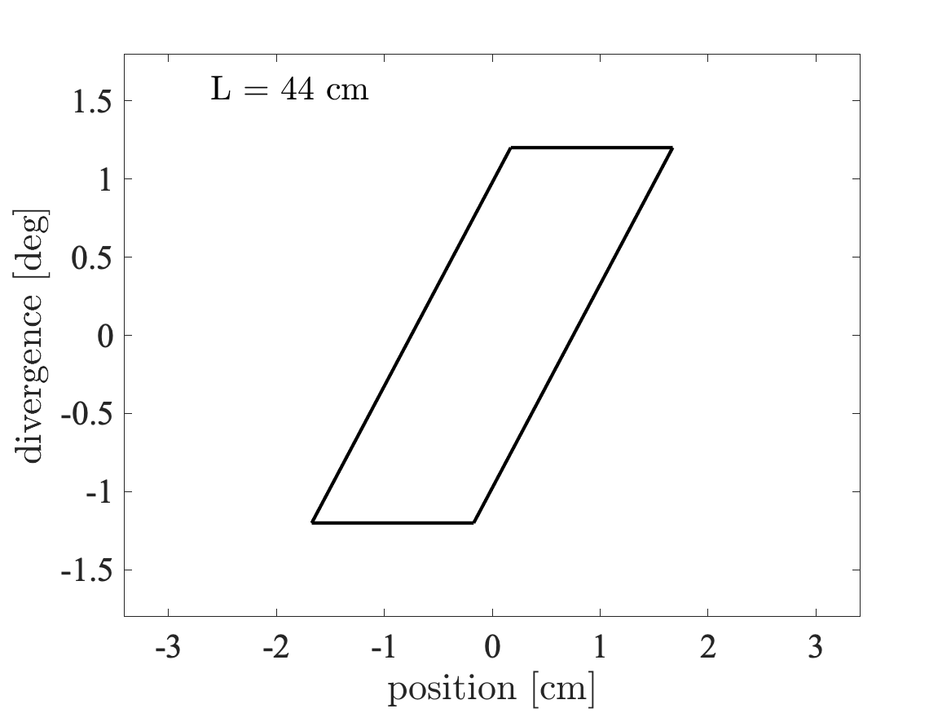
Beam propagation in free space
Divergence
z
v
𝜂x
x

Slide 16
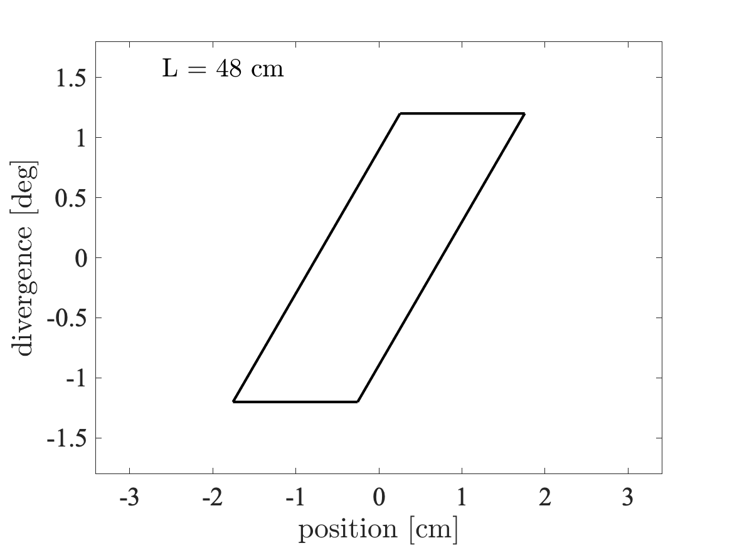
Beam propagation in free space
Divergence
z
v
𝜂x
x

Slide 17

Beam propagation in free space
Divergence
z
v
𝜂x
x

Slide 18

Beam propagation in free space
Divergence
z
v
𝜂x
x

Slide 19

Beam propagation in free space
- We lost some phase-space to propagation
Divergence
z
v
𝜂x
x

Slide 20
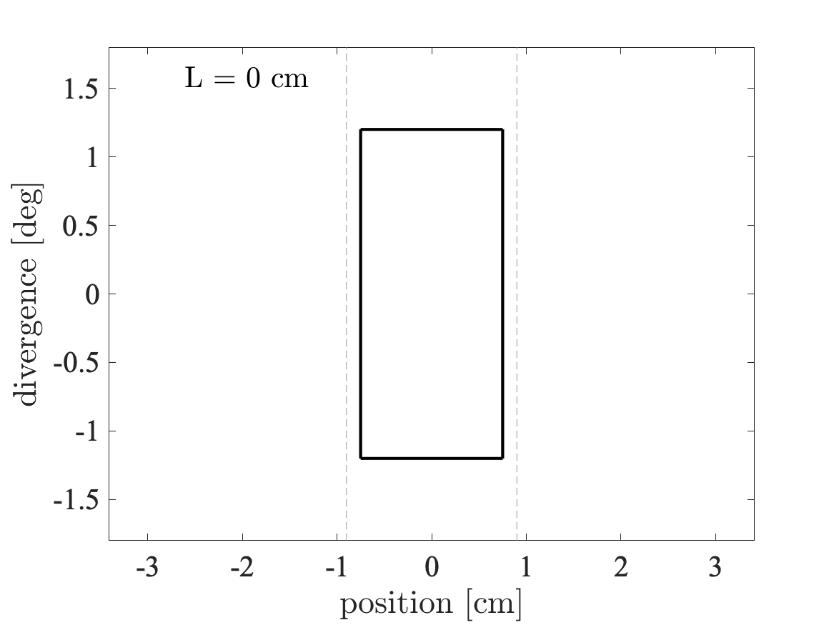
Beam propagation in guide
Wanted “phase-space” at sample
Divergence
z
v
𝜂x
x

Slide 21

Beam propagation in guide
Divergence
z
v
𝜂x
x

Slide 22
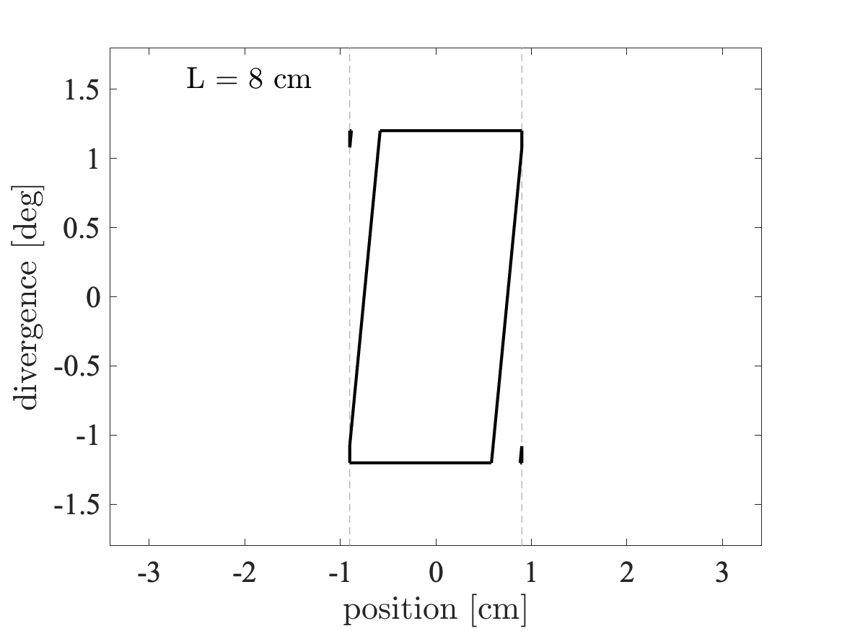
Beam propagation in guide
Divergence
z
v
𝜂x
x

Slide 23
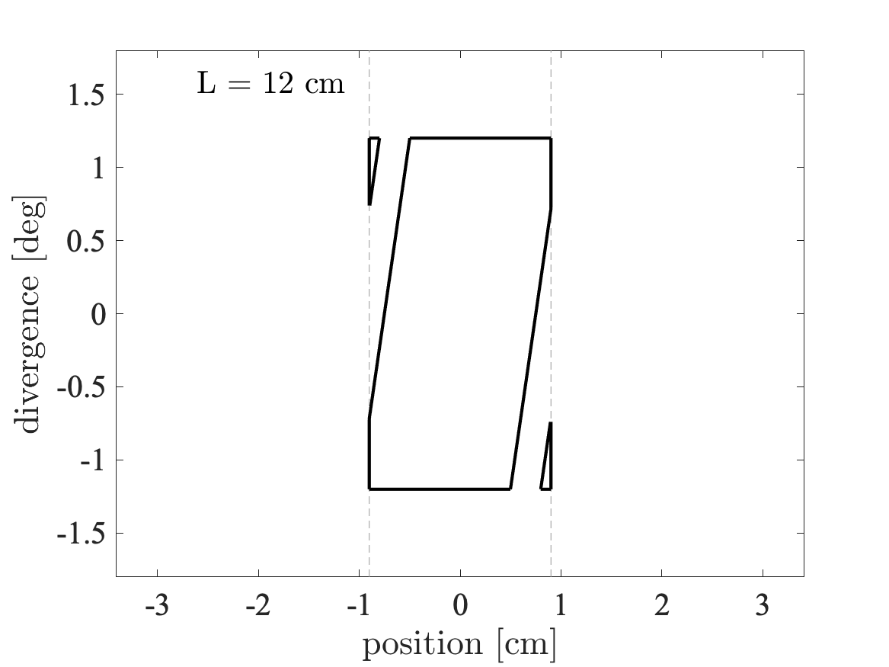
Beam propagation in guide
Divergence
z
v
𝜂x
x

Slide 24
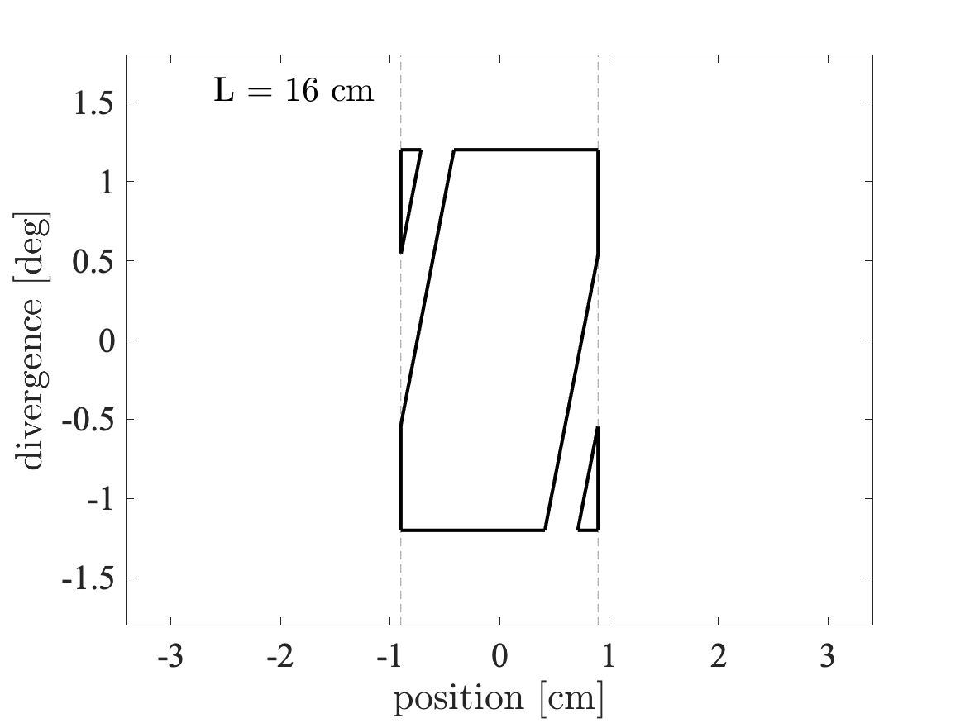
Beam propagation in guide
Divergence
z
v
𝜂x
x

Slide 25
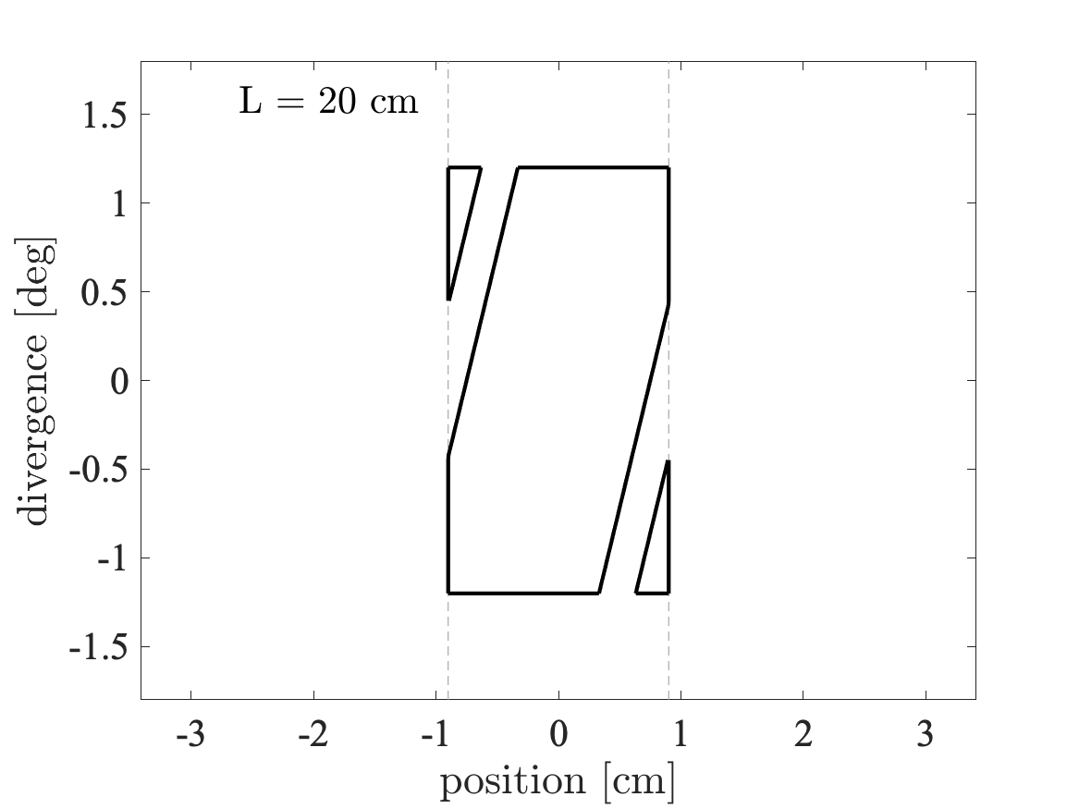
Beam propagation in guide
Divergence
z
v
𝜂x
x

Slide 26

Beam propagation in guide
Divergence
z
v
𝜂x
x

Slide 27

Beam propagation in guide
Divergence
z
v
𝜂x
x

Slide 28

Beam propagation in guide
Divergence
z
v
𝜂x
x

Slide 29
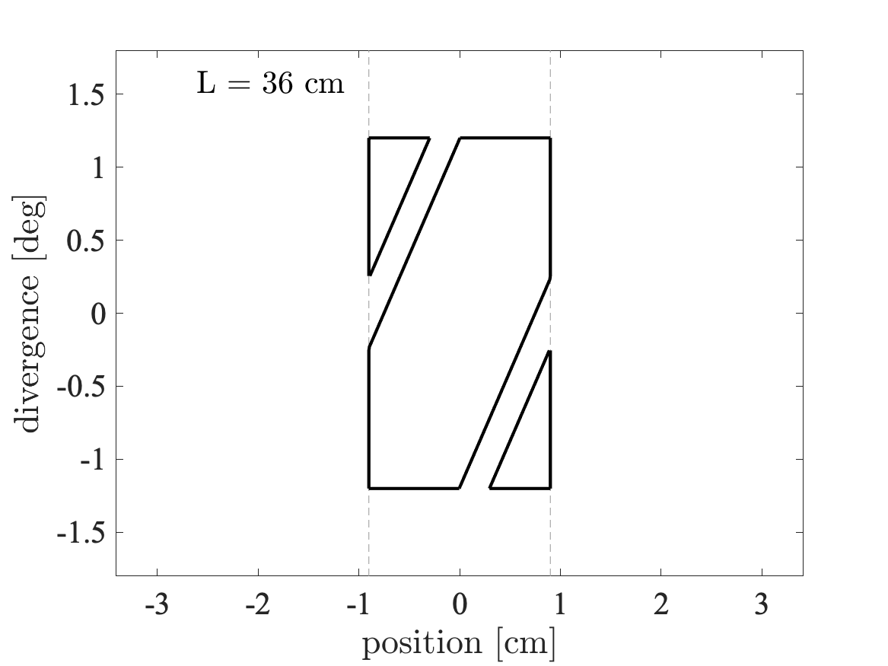
Beam propagation in guide
Divergence
z
v
𝜂x
x

Slide 30

Beam propagation in guide
Divergence
z
v
𝜂x
x

Slide 31

Beam propagation in guide
Divergence
z
v
𝜂x
x

Slide 32

Beam propagation in guide
Divergence
z
v
𝜂x
x

Slide 33
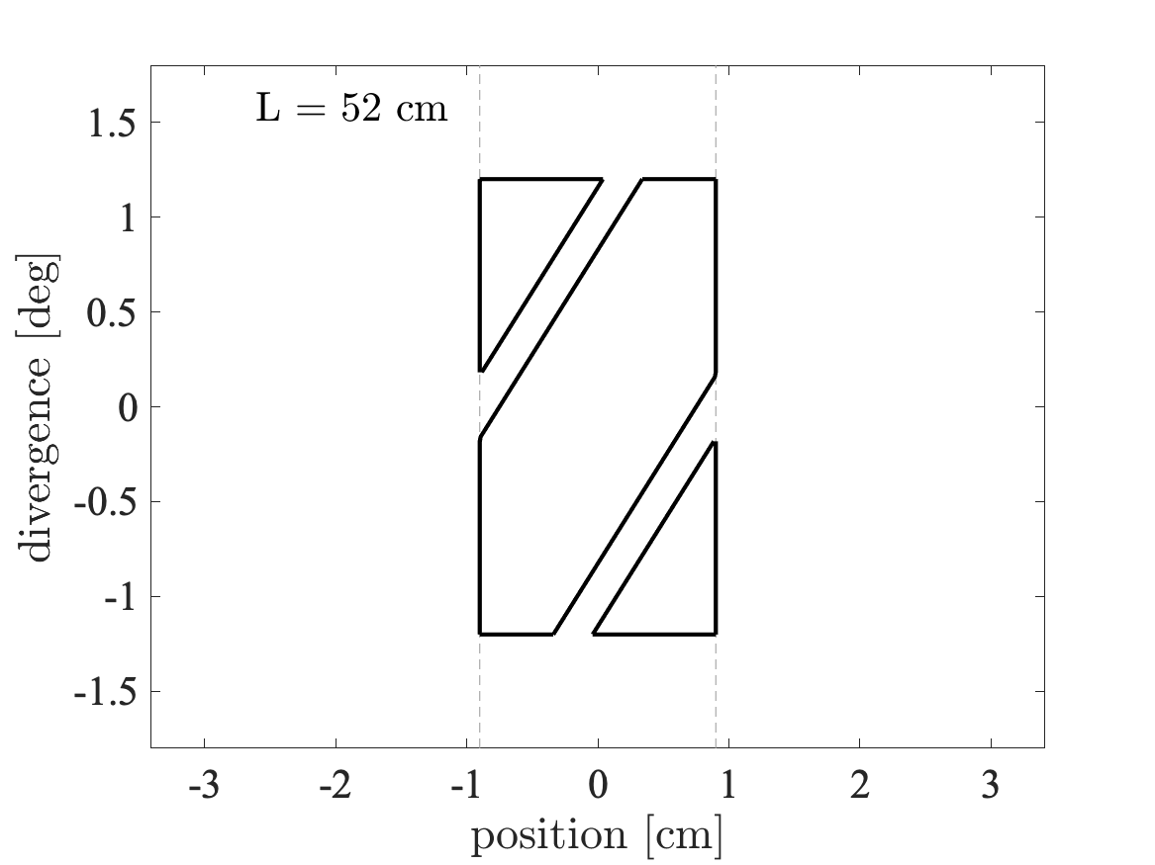
Beam propagation in guide
Divergence
z
v
𝜂x
x

Slide 34
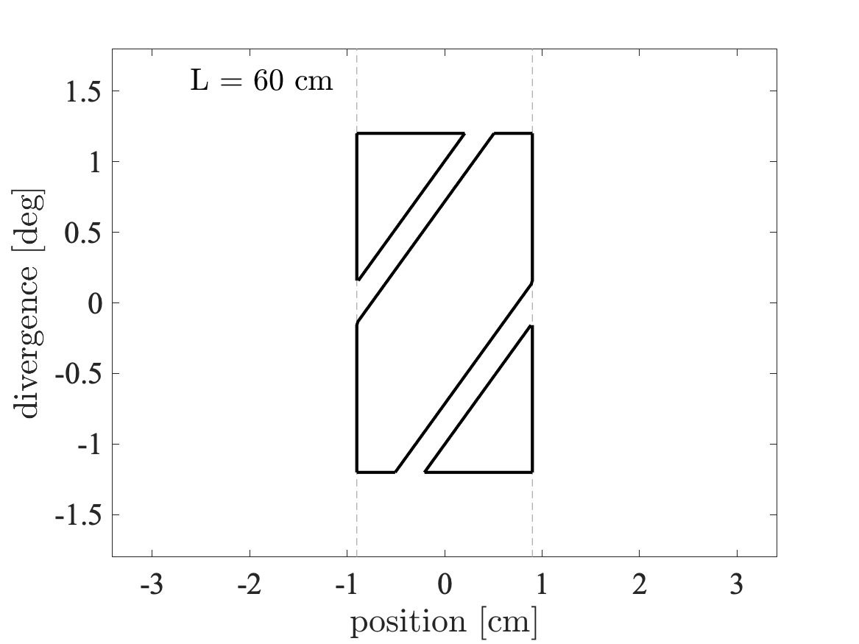
Beam propagation in guide
Divergence
z
v
𝜂x
x

Slide 35
Beam propagation in guide
With a guide we lost less phase-space area!
Divergence
z
v
𝜂x
x

Slide 36
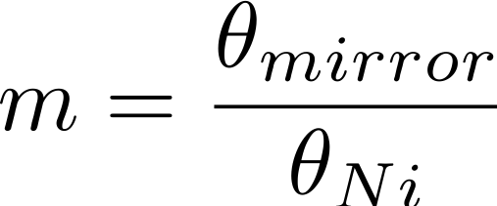
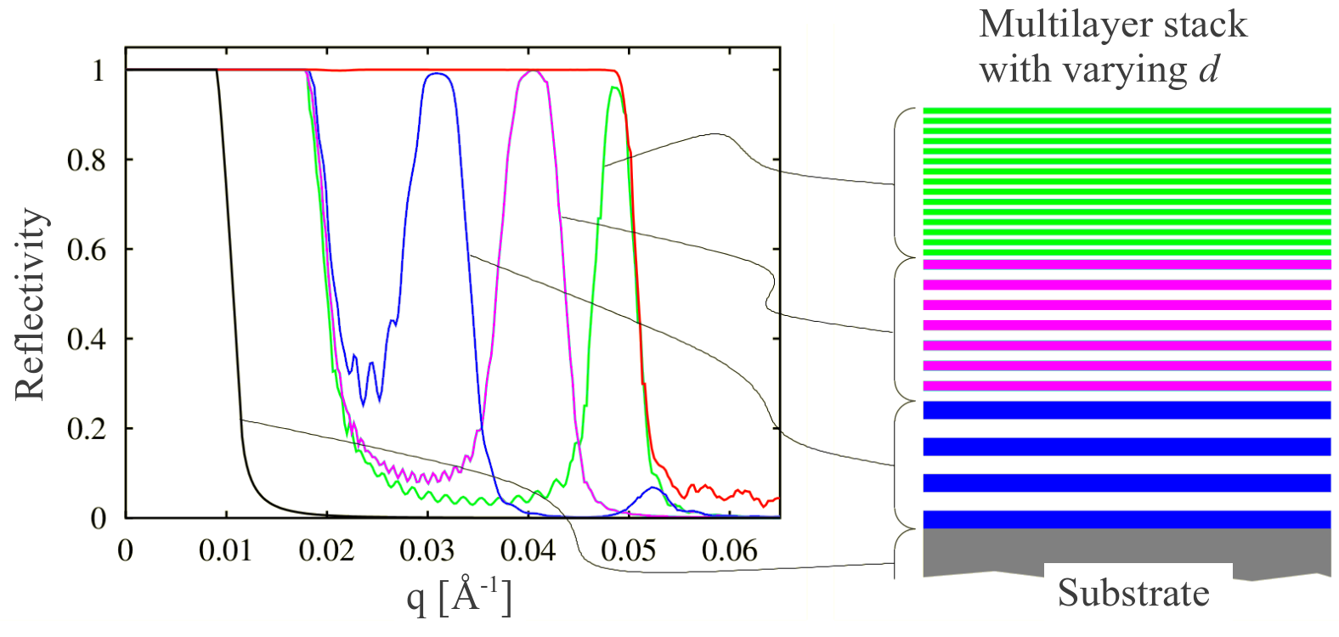
Reflectivity curves
Reflectivity, super mirror, reflectivity curve
ki
kf
q
𝛳

Slide 37
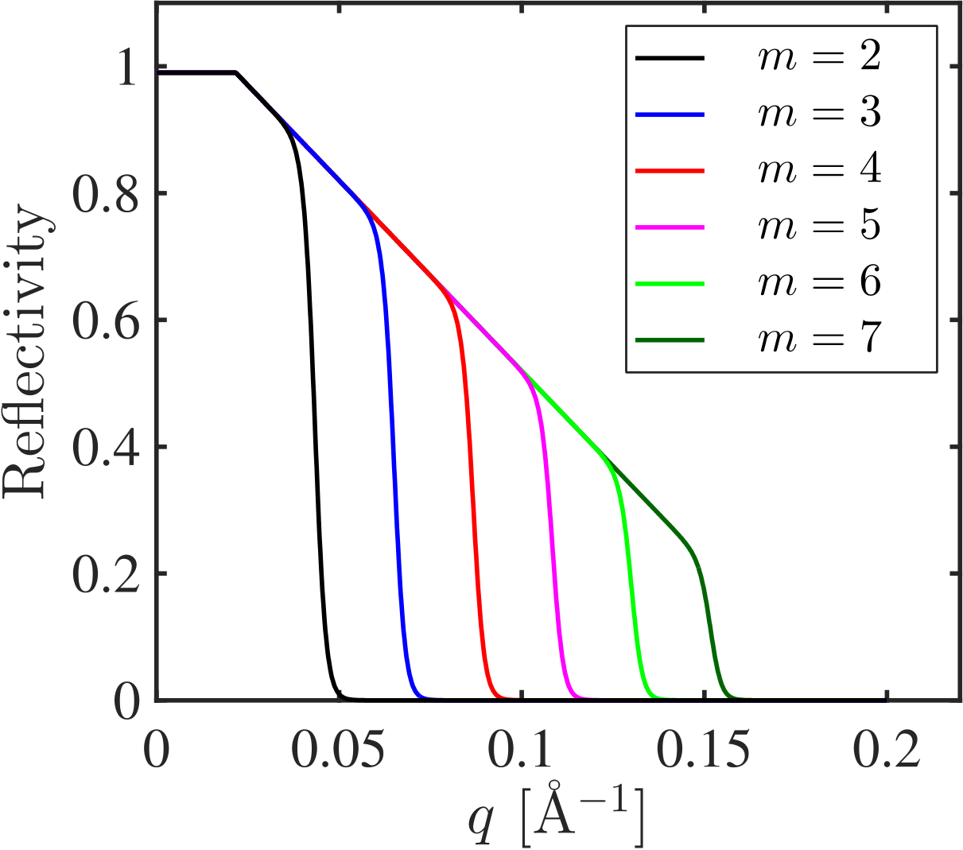
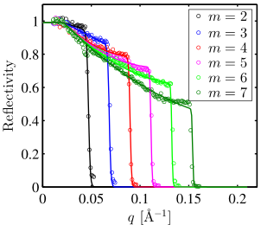
Reflectivity curves in McStas
McStas standard model
McStas fitted model
Slope:$−α$
$α$ = 0 W = 0
Only m matters
Better mirrors available today
Cutoff: $\frac{tanh⁡}{W}$

Slide 38
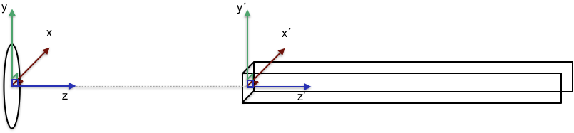
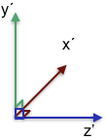
Guide placement in McStas
The center is the front of the guide element
Tip: Insert a guide at the end of the guide
COMPONENT Source AT (0,0,0) ABSOLUTE
COMPONENT Guide(length=A) AT (0,0,2) RELATIVE Source
COMPONENT Arm AT (0,0,A) RELATIVE Guide

Slide 39
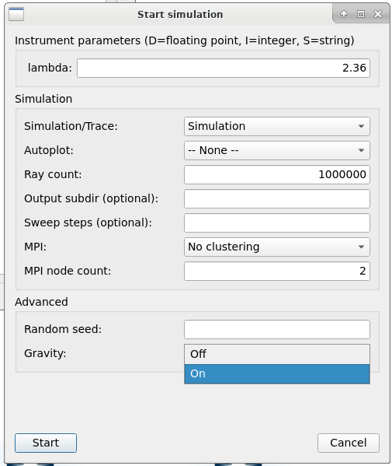
Gravitation in McStas
Enabled by adding -g / --gravitation on command line or by selecting “Gravity On” in mcgui
Default ~ gravity on earth #define GRAVITY 9.81 /* [m/s^2] gravitational acceleration */ ( If on the moon, use -DGRAVITY=1.62 ;-) )
For guides, only Guide_gravity and Elliptic_guide_gravity support parabolic propagation. (Many others propagate linearly in v direction.)
As you will see in the practical, implications are greatest with long wavelengths and at long distances
“How about e.g. elliptic mirror optic X that does not support gravity?”
often a good workaround is to add a monitor close to the surface of object X, this takes care that propagation up to the monitor includes gravitation:
Gravity is enabled in any call to PROP_DT, PROP_Z0 etc., but not in intersect_* routines (most monitors use PROP_Z0 directly, no intersect_ call first
OK to propagate without gravitation e.g. within sample, through velocity selector etc. / range of ~cm’s

Slide 40
Popular guide components: Guide_gravity
Typical guide component with gravity, parameter-interface similar to e.g. Guide.comp
Many additional features, channels, fermi chopper, … (see mcdoc pages for more info)
w1
w2
h1
h2
l

Slide 41
Popular guide components: Guide_gravity
Typical guide component with gravity, parameter-interface similar to e.g. Guide.comp
Many additional features, channels, fermi chopper, … (see mcdoc pages for more info)
w1
w2
h1
h2
l

Slide 42
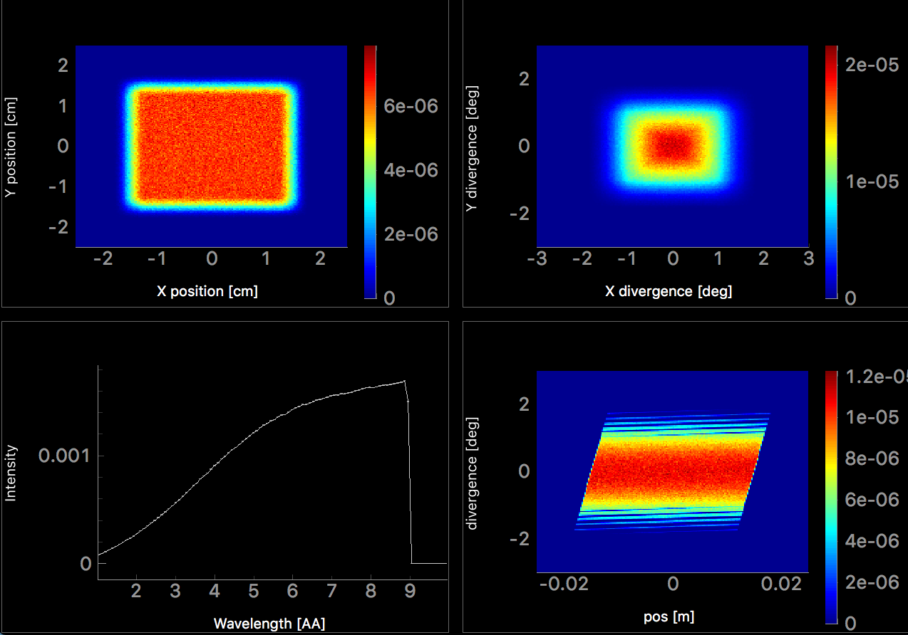
Popular guide components: Guide_gravity
Typical guide component with gravity
Position
Divergence
Wavelength
Position - Divergence

Slide 43
Popular guide components: Elliptical_guide_gravity
Only needed for LONG distance transport (>40m)
Useful for elliptic and parabolic guide geometries, focusing, ballistic, coating distribution, …
xwidth and yheight at DimensionsAt = ”entrance” , ”mid” or ”exit”
linxw linyh
l
loutxw loutyh

Slide 44
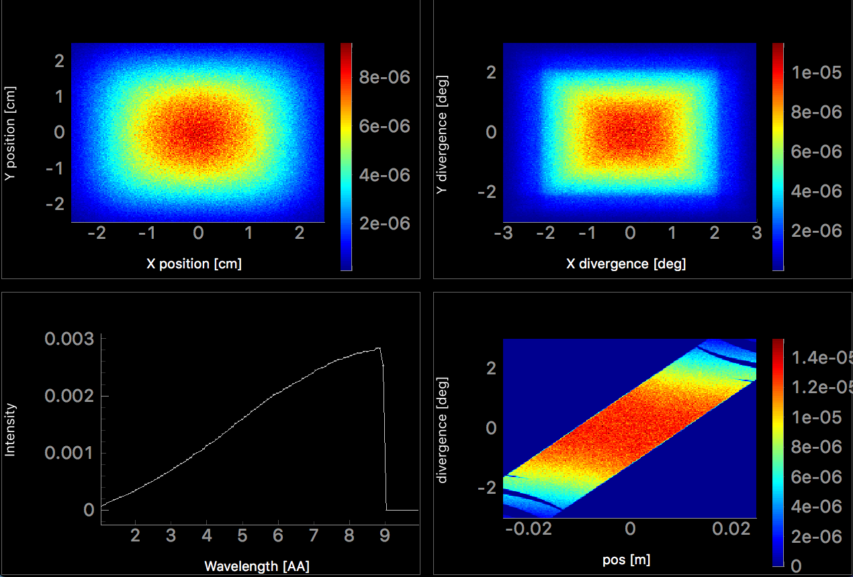
Popular guide components: Elliptical_guide_gravity
Useful for elliptic and parabolic guide geometries, focusing, ballistic, coating distribution, …
Position
Divergence
Wavelength
Position - Divergence

Slide 45
Comparison: Guide_gravity and Elliptic_guide_gravity
Guide_gravity
Elliptic_guide_gravity
Position
Divergence
Position
Divergence
Wavelength
Position - Divergence
Wavelength
Position - Divergence

Slide 46
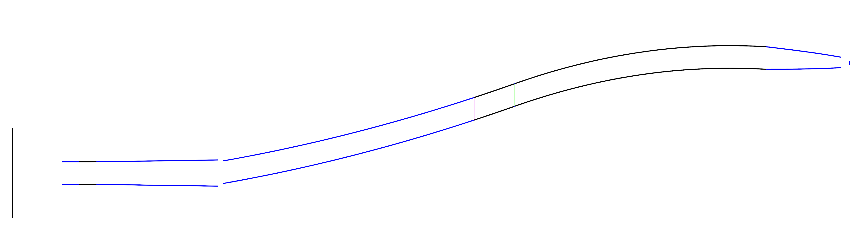
Breaking line of sight
Importance of breaking line of sight, ways of doing so, …

Slide 47


Breaking line of sight
Bender / Guide_curved component or many straight sections
Mind the gaps, avoid overlap

Slide 48
Guide exercise
Solution on github, use if you are stuck
•Start with instrument file provided on github
•Task 1)
– Compare output for two different guide lengths
•Task 2)
– Introduce a parameter that control width of the guide
– Compare two runs with different guide widths
• Optional Task 3)
– Check how much gravity impacts the output
• Optional Task 4)
– Exchange the last 20% of the guide with an elliptic nose.
– See the geometry with mcdisplay
– Identify how the resulting beam have changed

