Slide 1


mcstas-2.x vs. mcstas-3.0, status and elements of the GPU port
Peter Willendrup and Erik Knudsen DTU Physics

Slide 2
Agenda
McStas on GPU via OpenACC (a “high-level” #pragma driven access to CUDA see https://www.openacc.org and https://developer.nvidia.com/hpc-sdk)
How well (fast) does it work?
Simulation flow
What did we change?
What does not work
Warning: 1. Assumes previous experience with McStas 2. Does not introduce OpenACC

Slide 3
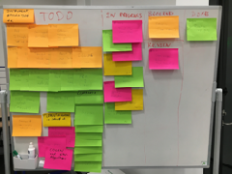
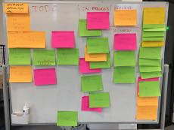







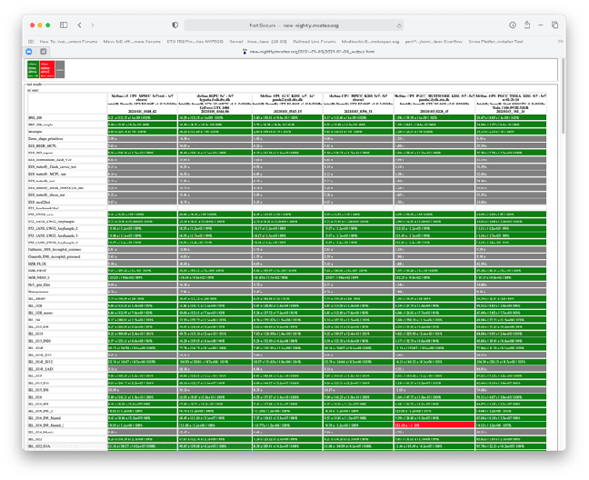
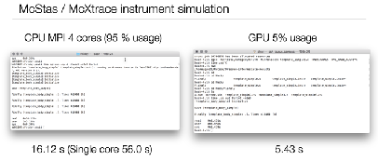

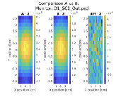


Main events on timeline of road toward GPU
Fall 2018 onwards: J. Garde further cogen modernisation and restructuring
October 2019 onwards: J. Garde & P. Willendrup: New RNG, test system, multiple functional instruments.
January 2020: One-week local hackathon @ DTU
with McCode & RAMP teams
2017: E. Farhi initial cogen modernisation
November 2020 Virtual Hackathon, setting release scope
March 2018: Participation at Dresden Hackathon. 1st “null” instrument prototype runs.
October 2019: Participation at Espoo Hackathon. First meaningful data extracted. Work on cogen and realising we need another RNG.
November- December 2019: First good look at benchmarks and overview of what needs doing for first release with limited GPU support.
2020 1st Corona lockdown P. Willendrup & E. Knudsen continue work on comp and cogen
December 15th 2020 McStas 3.0 release!
February 2020: First release McStas 3.0beta with GPU support was released to the public
mentor: Vishal Metha hackathon org.: Guido Juckeland
mentor: Christian Hundt hackathon org.: Sebastian Von Alfthan
Peter Willendrup, DTU Physics and ESS DMSC

Slide 4
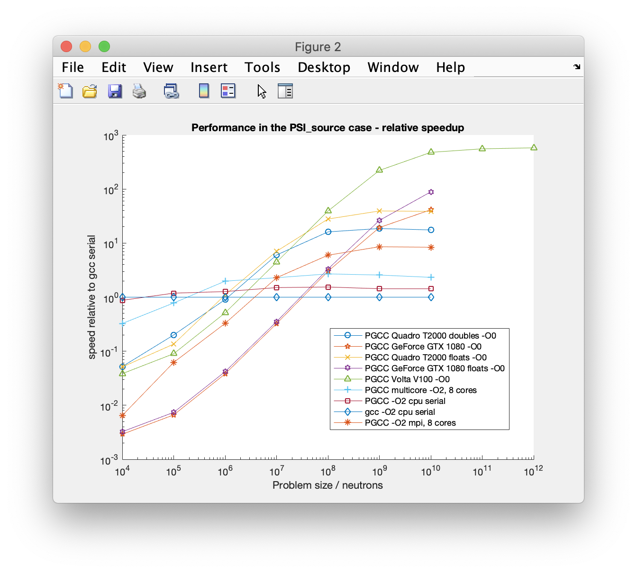
McStas heading for the GPU… November 2019 - first good look at performance.
Idealised instrument with source and monitor only - i.e. without any use of the ABSORB macro. (Likely a good indication of maximal speedup achievable.)
Speedup
Looks like a factor of ~600
~600
V100 execution speedups renormalised to wall- clock of single-core gcc standard simulation,
V100 run is 600 times faster than a single- core CPU run
Peter Willendrup, DTU Physics and ESS DMSC

Slide 5
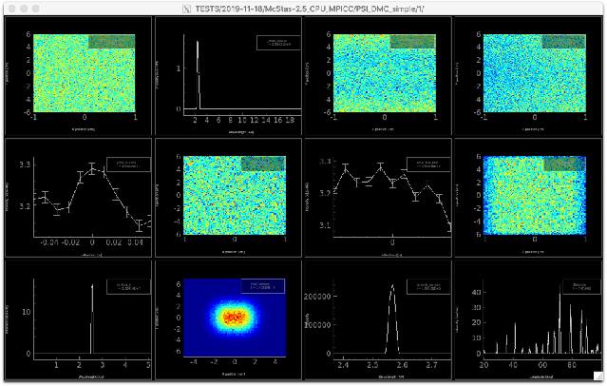

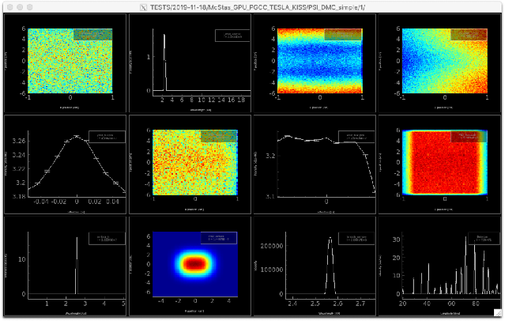
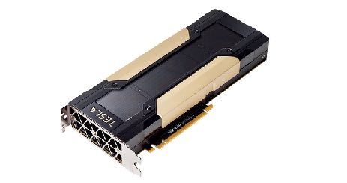
McStas heading for the GPU… first benchmarking numbers from November 2019
10-core MPI run, 1e9 in 200 secs
(1-core run, 1e9 would be 2000 secs)
9 instruments fully ported, also realistic ones like PSI_DMC (Aug 2020: 99 instrs)
vs.
~ i.e. 2 orders of magnitude wrt. a single, modern CPU core
Tesla V100 run, 1e9 in 22 secs
- If problem has the right size / complexity, GPU via OpenACC is great!
Peter Willendrup, DTU Physics and ESS DMSC

Slide 6
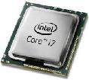
McStas 2.x -> McStas 3.0 main differences
Rewritten / streamlined simplified code-generator with
Much less generated code
improved compile time and compiler optimizations, esp. for large instrs
Much less invasive use of #define
Component sections -> functions rather than #define / #undef
Much less global variables, instrument, component and neutron reworked to be structures
Use of #pragma acc … in lots of places (put in place by cogen where possible)
New random number generator implemented
We couldn’t easily port our legacy Mersenne Twister
Experimenting with curand showed huge overhead for our relative small number of random numbers (we have hundreds or thousands of randnom numbers, not billions)
Complete change to dynamic monitor-arrays
Advantage of 3.0 also on CPU

Slide 7
Anatomy of a McStas GPU run (*)
Init, geometry, files etc. read on CPU
MPI if needed
Memory-structures
Built on CPU
Marked for transfer to GPU (#pragma acc declare create etc.)
Initialised and synced across
Trace-loop is a #pragma acc parallel loop
Calculation performed entirely on GPU
Component structs (incl. e.g. monitor-arrays) synced across
Finally and Save runs on CPU
MPI merge if needed
No printfs etc. available on GPU, automatically suppressed by #defines
(* Alternative layout via FUNNEL mode, see next 2 slides)

Slide 8
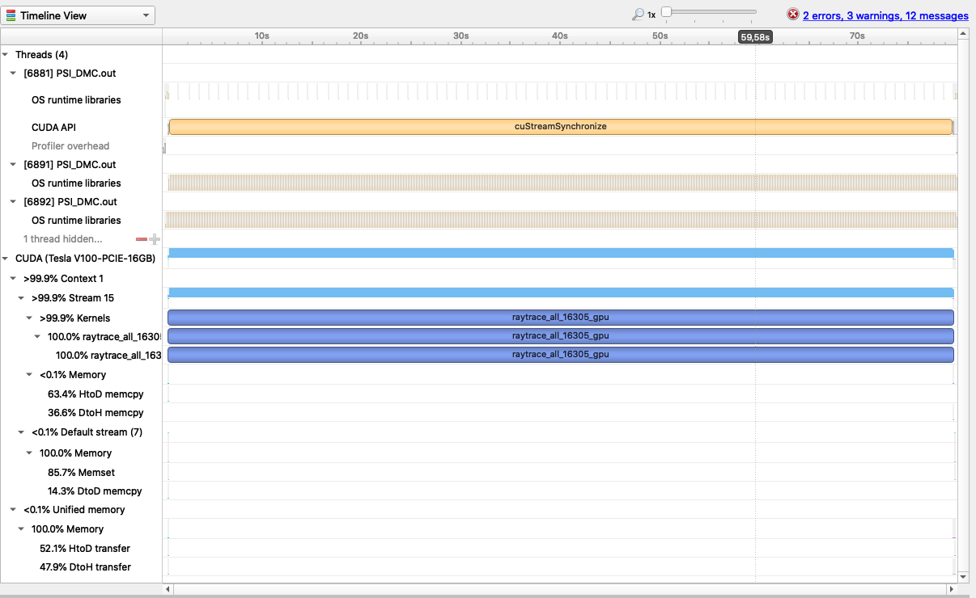
Profiling an example run…
Build and initialise instr/comp structures on host
Push problem to device
One big generated kernel calculates independent particle rays
Push back to host and save. Big problems, do multiple runs of the kernel for every ~2e9 rays (default is MAXINT limit, controllable via -DGPU_INNERLOOP).

Slide 9
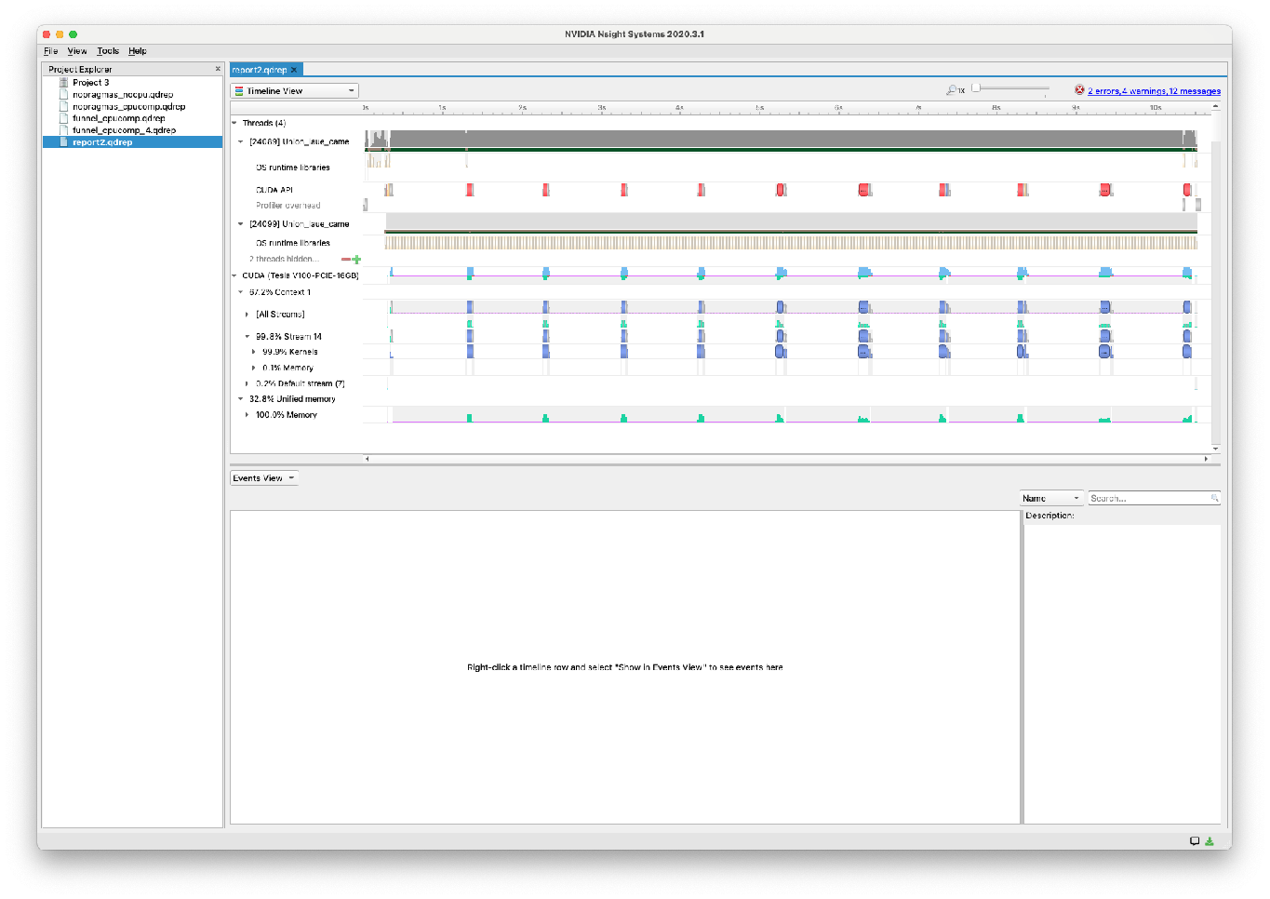
FUNNEL mode
Activated explicitly using -DFUNNEL or implicitly using CPUCOMPONENT in instrument or NOACC in comp header
Has N kernels / calculation zones instead of one
Separation at SPLIT
Separation if CPUCOMPONENT in instrument file ( CPUCOMPONENT A=Comp(vars=pars…) )
Separation if a component has NOACC in the header (See e.g. Multilayer_sample, Union_master )
Each of these “calculation zones” is finalised before the next one initiated.
Example: Union: Instrument up to Union_master can be GPU, then CPU, then GPU again
Can be as slow as single cpu…
Copying back and forth to/from GPU is costly…
Output from the code-generator: NOTE: CPU COMPONENT grammar activated:
1) "FUNNEL" raytrace algorithm enabled.
2) Any SPLIT's are dynamically allocated based on available buffer size.

Slide 10
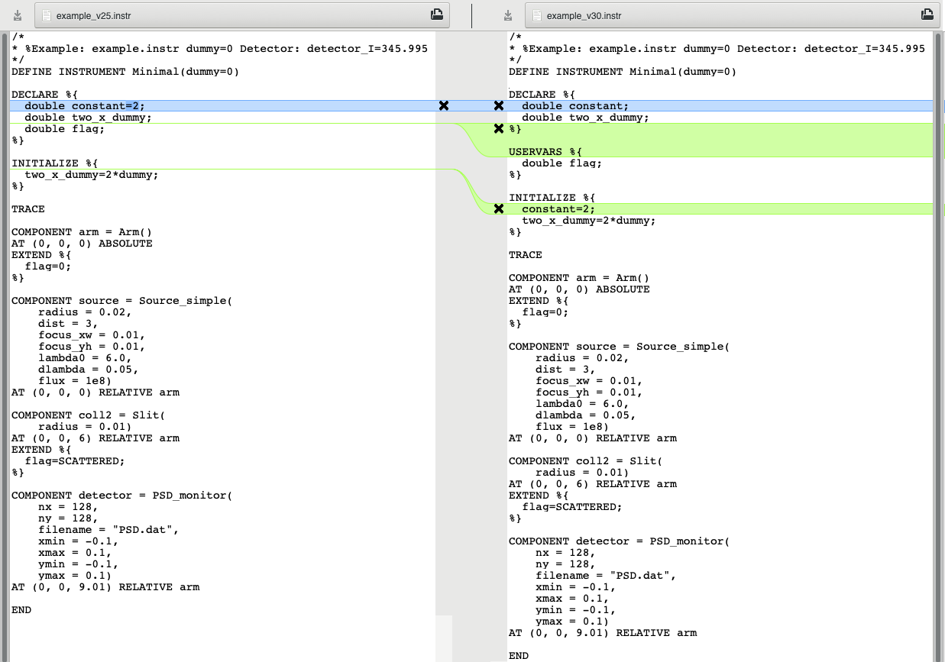
Illustration, simple instr with
Instr vars and “flag”
Arm
Source
Slit
PSD

Slide 11

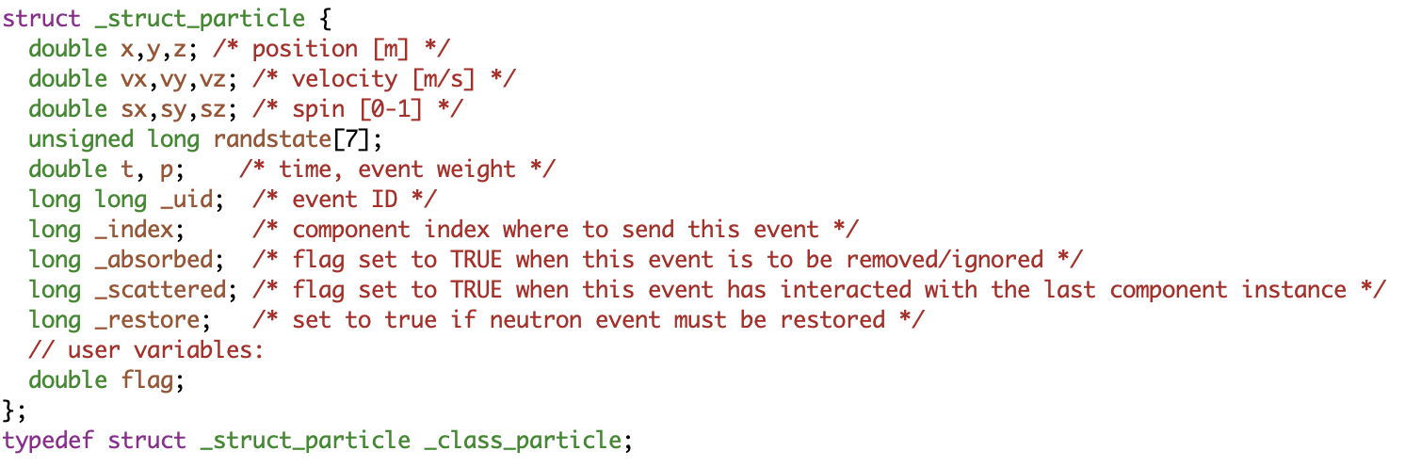
The neutron and USERVARS in the instrument
v2.5: Global variables
Can be probed using e.g. Monitor_nD with user1=“flag” which uses the function
also works with e.g. “x”
v3.0: particle struct, including any USERVARS like flag.
double particle_getvar(_class_particle *p, char *name, int *suc)

Slide 12
The neutron and USERVARS in the instrument
v2.5: Global variables
RNG state is a thread-variable contained on the _particle struct. Was earlier a global state in CPU settings
v3.0: particle struct, including any USERVARS like flag.
Side-effect: Every function in TRACE that uses random numbers must have _particle in the footprint
Particle state data are not global: Don’t use RESTORE_NEUTRON in TRACE to do a local restore, the macro only raises a flag

Slide 13
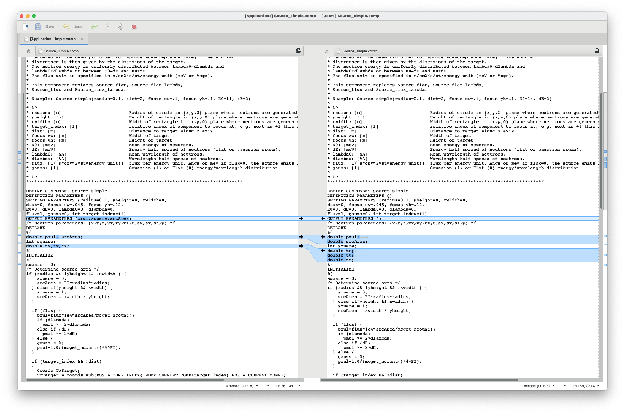
Source_simple minor changes

Slide 14
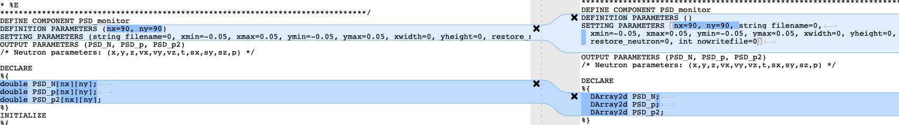
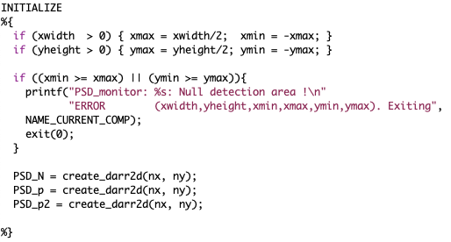
PSD has several changes
No more DEFINITION PARAMETERS
Use of new DArray2d for dynamic allocation

Slide 15
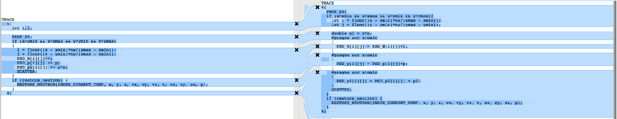
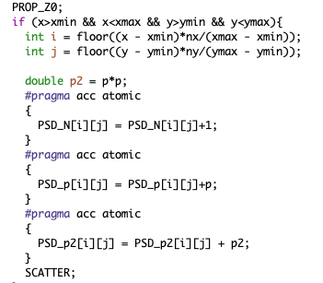
PSD lots of changes
Enabling atomic writes on the detector arrays

Slide 16
Compiler settings used for GPU:
( McStas 3.0 mcrun is preconfigured on Linux - excluding -Minfo=accel, simply use mcrun --openacc when compiling, can also combine with e.g. --mpi=N )
nvc -ta=tesla,managed -Minfo=accel -DOPENACC
Main “enable GPU”/OpenACC switch
Give accel debug information
Use CUDA shared memory for host-device-host allocation. Needed for our 2D-arrays at present, may include penalty, we could get rid.
Generate Tesla code. “compute capability” e.g. tesla:cc70 may be specified to indicate specific card.

Slide 17
Compiler settings used for GPU:
nvc -ta=tesla,managed -Minfo=accel -DOPENACC
Defaults for “GPU neutron loops”: 1) non-funnelled GPU_INNERLOOP=2147483647 2) funnelled GPU_FUNNEL_INNERLOOP=1024*1024
For CPU/threading, use below settings, with -DMULTICORE e.g. printfs are not nullified in TRACE
Main “enable GPU”/OpenACC switch
Give accel debug information
nvc -ta=multicore -Minfo=accel -DOPENACC ( -DMULTICORE )
Use CUDA shared memory for host-device-host allocation. Needed for our 2D-arrays at present, may include penalty, we could get rid.
Generate Tesla code. “compute capability” e.g. tesla:cc70 may be specified to indicate specific card.

Slide 18

What doesn’t work
Function pointers are not available on GPU
Solutions:
Code around if possible (integration routine pr. specific function to be integrated…)
Mark the component NOACC
Variadic functions are not available on GPU
Anonymous structs as comp pars are not available on GPU
Unfold into comp struct
User-defined fieldfunctions for polarisation had to be abandoned
No solution yet, may become handled via grammar
External libs generally can not be used in TRACE (“#pragma….” hard to add on 3rd party codes)
Handle in INIT / FINALLY (MCPL)
NOACC (GSL etc.)
Union master is for now NOACC, will eventually become supported on GPU
(Looks like we may have implemented a BUG in the NeXus/Mantid stuff…)

Slide 19
Highlights of comps that work differently
Monitor_nD uservars are strings user1=“flag”, they use _particle_getvar to access instrument USERVARS
MCPL_input and MCPL_output do most of their work in INIT/FINALLY - buffers transferred for TRACE use
PowderN + Single_crystal + Isotropic_sqw don’t check for “same particle as before” - in SPLIT cases, no particle state info is kept (we could potentially use _particle and “USERVARS” injected from the comps…)

Slide 20
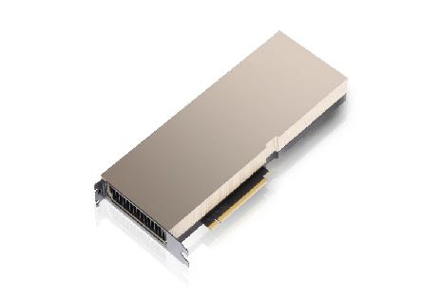
Conclusions
It really does work nicely!
Code changes much less invasive than envisioned!
It often gives a speedup of 1-2 orders of magnitude over 1 cpu
Most things work (we have workarounds or solutions in the pipe for the rest)
McStas 3.0 is as of yet “ported” to GPU but not fully “optimised” performance-wise, we will try to go to another Hackathon
Union needs a dedicated Hackathon

Slide 21
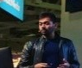
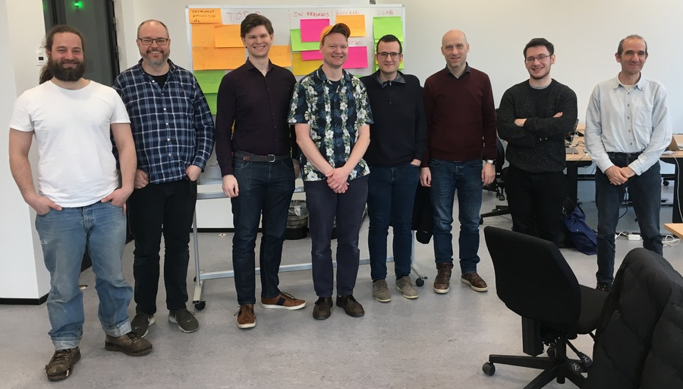




The team, Nvidia mentors and Hackathon hosts :-)
Vishal Metha
Gino - (RAMP)
Guido Juckeland
Torben
Peter
Mads
Tobias
Erik
Jakob
Emmanuel
Christian Hundt
Alexey Romanenko
Sebastian von Alfthan
Peter Willendrup, DTU Physics and ESS DMSC

