Slide 1
Full instrument simulations
Mads Bertelsen

Slide 2
Full instrument simulations
Introduction
ESS_Butterfly component
ESS instruments and repository
Exercise

Slide 3
Virtual experiments
McStas has the potential to simulate experiments in great detail
Takes significant effort to replicate or design a full instrument in this kind of detail
ESS instruments generally used simulations in their proposals to demonstrate their performance and argue for their construction

Slide 4
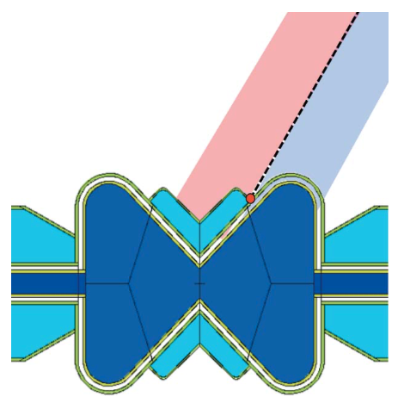
ESS_butterfly component
Model of the second ESS moderator that instruments are optimized for
The first actual ESS moderator will be a slightly different design
Spectrum, spatial and divergence distributions from fits to MCNP data
Can select specific beamport, which influences moderator performance
Aims guide towards interface between cold and hot source
Can be scaled with accelerator power in [MW]
Can simulated several pulses
Supports time focusing to speed up simulation
Moderator optimization paper

Slide 5
ESS simulation repository
Has McStas and in some cases ViTESS simulations of instruments
Many have custom components, or old versions of components for reproducability
https://git.esss.dk/dam-group/ess-instrumentmodels

Slide 6
Overview
Instrument |  | Guide | Sample | Backend | Single instr | Nexus
BEER | Primary and backend
BIFROST | Primary and backend (single channel)
C-SPEC | Guide
DREAM | Guide
ESTIA | Full instrument
FREIA | Guide (sample and detector commented)
HEIMDAL | Full instrument
LOKI | Full instrument
MAGiC | Guide
MIRACLES | Guide
NMX | Guide
ODIN | Full instrument
SKADI | Guide
V20 | Full
VESPA | Guide and sample / detector
VOR | Guide

Slide 7
Exercise
Run a ESS instrument from the ESS repository
https://git.esss.dk/dam-group/ess-instrumentmodels
Change the sample (or add a sample if missing)

