Slide 1
Inelastic samples
Peter Willendrup
Slides adapted from Mads Bertelsen, ESS DMSC
Slides adapted from Mads Bertelsen, ESS DMSC

Slide 2
Inelastic scattering in McStas
Introduction to inelastic scattering
Included components
Phonon_simple
Isotropic_sqw
Sampling performnace with data approach
McStas performance, TAS / Chopper
Exercise

Slide 3
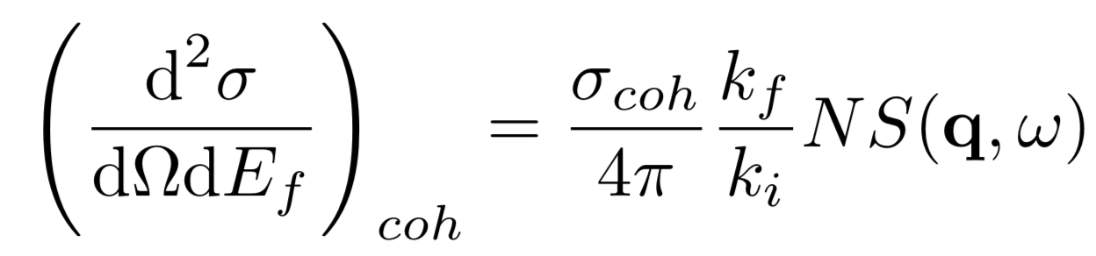
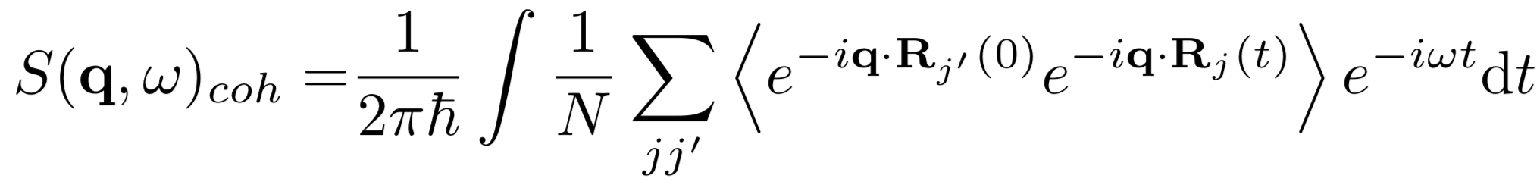
Inelastic scattering S(q,w)
partial differential cross section
Scattering function
Phonons, Spin waves, …

Slide 4
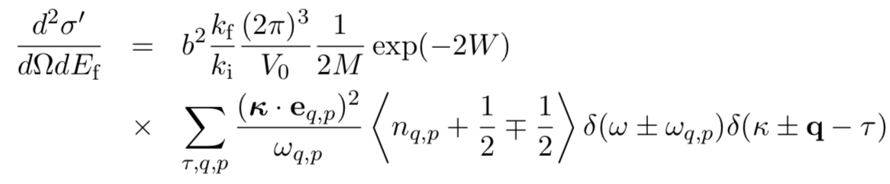



Popular component: Phonon_simple
One isotropic acustic phonon branch in all Briullion zones on FCC bravis single crystal
M - Atomic mass
b – scattering length
n – bose factor
a – fcc lattice spacing
c - speed of sound
𝜿 – measured q vector
q – Phonon scattering vector
Dispersion
For FCC Bravis

Slide 5
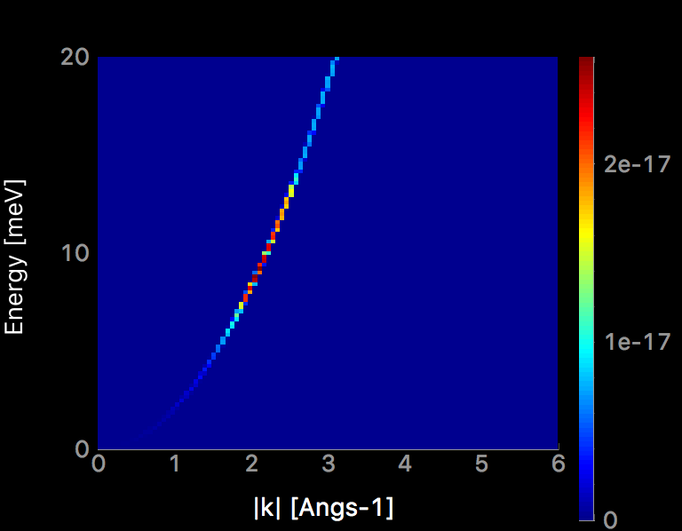
Popular component: Phonon_simple
Dispersion relation, theory and mcstas
⍵
q₀
q

Slide 6
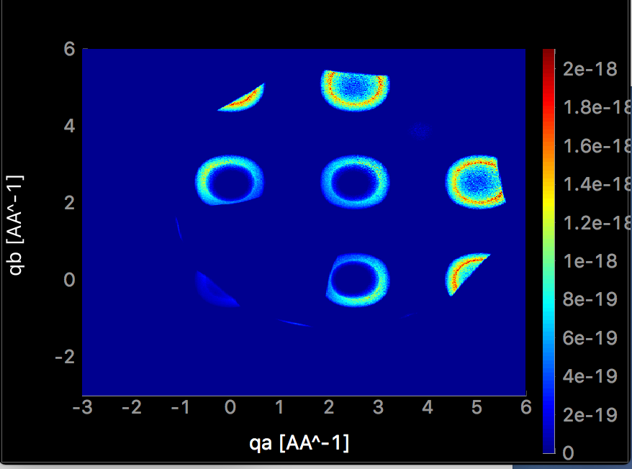
Popular component: Phonon_simple
4 meV energy transfer
Example of the output

Slide 7
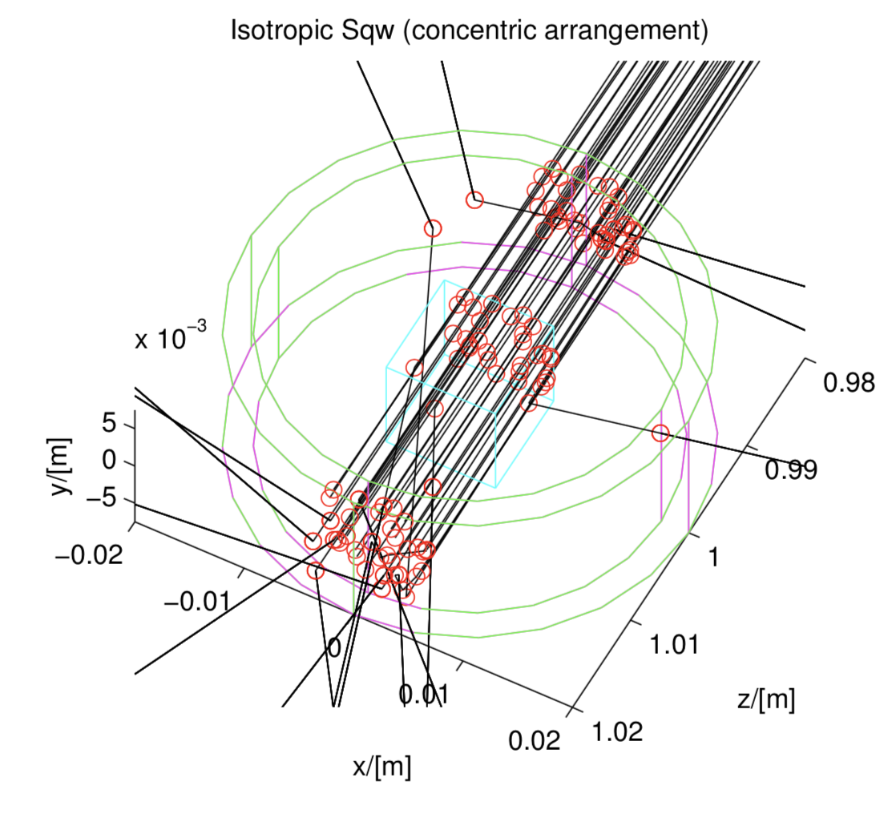
Popular component: Isotropic_sqw
Isotropic processes (powder, liquid, …)
Use data files to describe S(q,w) directly, coherent and incoherent
Supports concentric

Slide 8
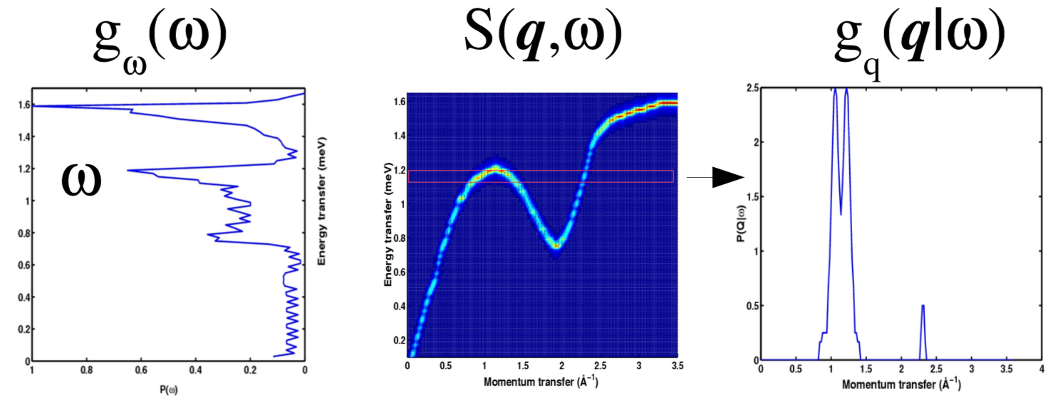
Popular component: Isotropic_sqw
Isotropic processes (powder, liquid, …)
Use data files to describe S(q,w) directly, coherent and incoherent
Supports concentric
P(Q|⍵)
⍵
P(⍵)
q
q

Slide 9
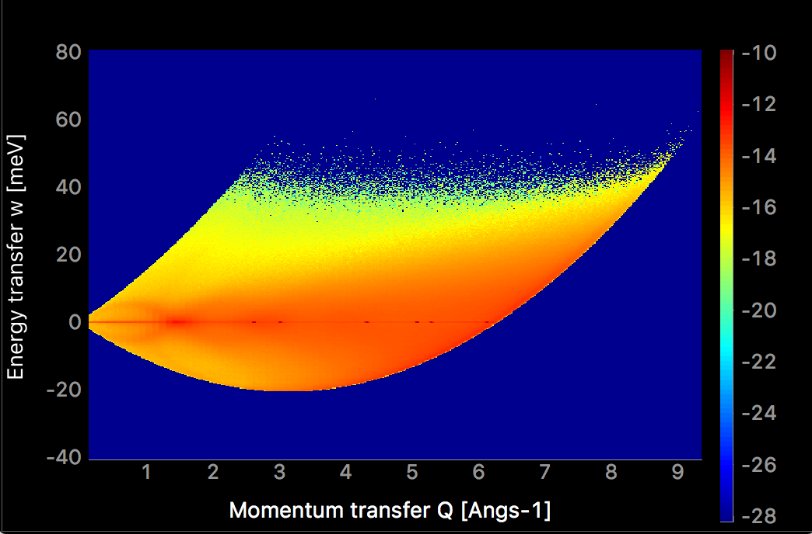
Popular component: Isotropic_sqw
Rb liquid in time of flight
Coherent and incoherent

Slide 10
Inelastic scattering in McStas
Monte carlo sampling issues
Need to sum over large amount of possible final states to find cross section
Need large amount of rays to sample all the options
q_{y}
+d⍵
+⍵
q_{x}
dq_{y}
dq_{x}
dq_{z}
q_{z}

Slide 11
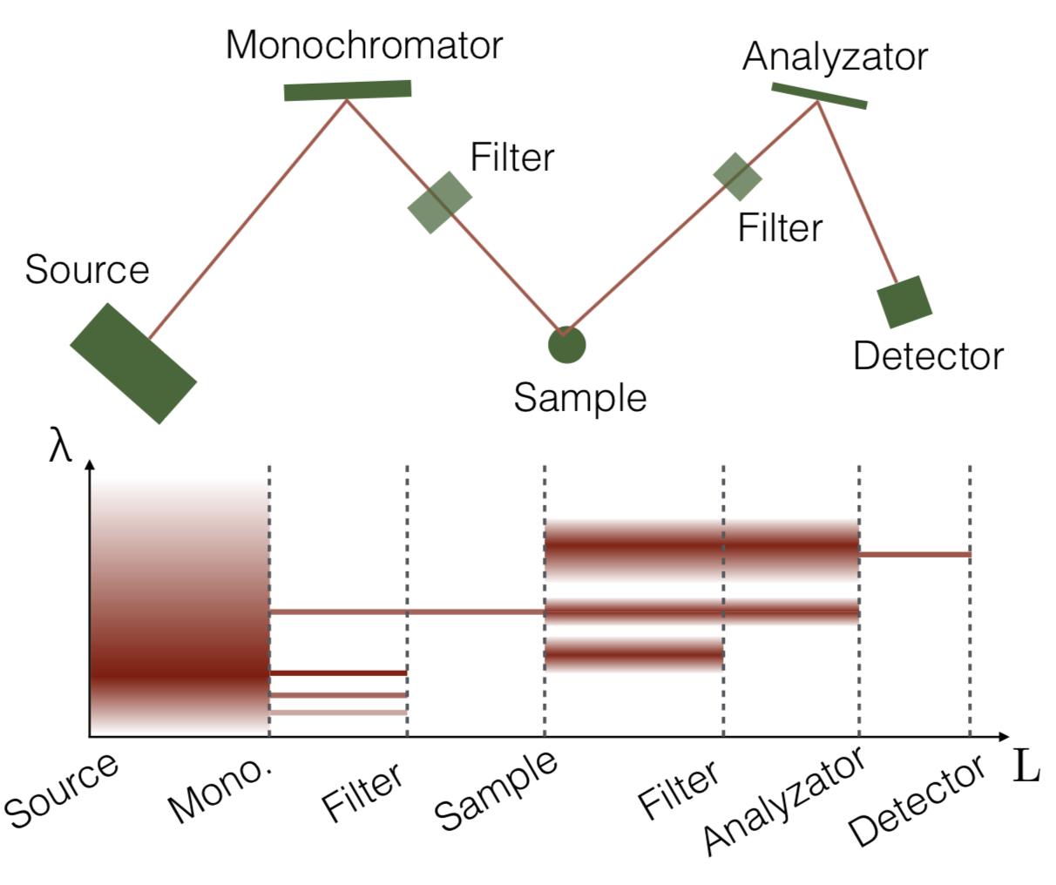
TAS
Only a small fraction of neutrons arrive, most are simulated in vain

Slide 12
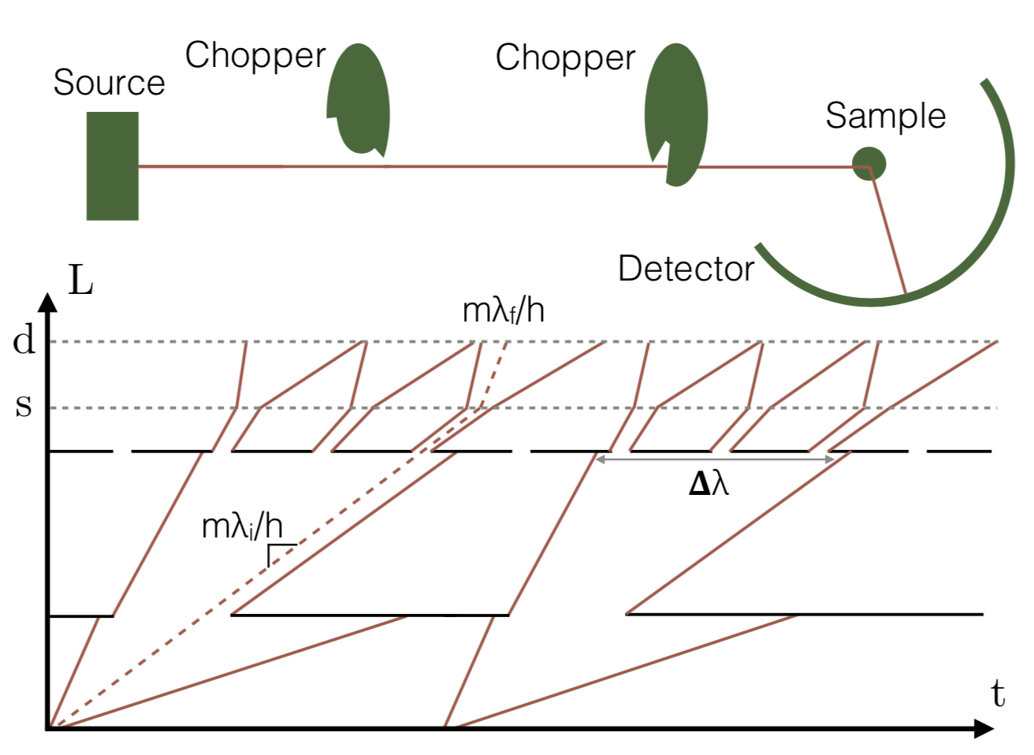
Chopper spectrometers
Only a small fraction of neutrons arrive, most are simulated in vain

Slide 13
Conclusion
Inelastic scattering supported in McStas, but could use more sample components
Longer computational times required
Advantages from simulation especially important for spectroscopy (resolution function)

Slide 14
Exercise
Use provided TAS instrument to scan the phonon dispersion
Requires that you work in folder containing components from the zip file
Further explanation on github

