Slide 1

Simulating Polarized Neutron Scattering Experiments and Equipment with McStas
Peter Willendrup, DTU Physics & ESS DMSC

Slide 2
Presentation content
Polarisation in McStas - how is it done
Polarised monitors
Precession algorithm
An overview of polarisation comps
An overview of polarisation instrument examples
A quick look at 3 of these
Words of warning

Slide 3
McStas “particle” model
Neutron ray/package:
Weight: (p) # neutrons left in the package Position: (x, y, z)
Velocity: (v_{x}, v_{y}, v_{z})
Polarization: (s_{x}, s_{y}, s_{z})
Time: (t)
$$P_{n}=\frac{1}{p_{n}}\sum_{i}^{p}{P_{i,n}};n=raynumber$$
$$P_{n}$$
n
$$P=\frac{1}{N}\sum_{n=0}^{N}{P_{n}}$$
$$P$$
$$P_{i,n}=2\left(\left\langle \overset{^}{s_{x,i}}\right\rangle \overset{^}{i_{x,i}}+\left\langle \overset{^}{s_{y,i}}\right\rangle \overset{^}{i_{y,i}}+\left\langle \overset{^}{s_{z,i}}\right\rangle \overset{^}{i_{z,i}}\right)$$
From G. Williams: “Polarized neutrons”, Oxford Science Publ., 1988

Slide 4
McStas detectors/monitors
Monitoring: How and What do we monitor?
n
n
$$P_{\overset{^}{h}}=\frac{\sum_{n=0}^{N}{p_{n}}P_{n}⋅\overset{^}{h}}{\sum_{n}^{N}{p_{n}}}$$
n
n
n
n
n
$$P$$
$$\overset{^}{h}$$

Slide 5
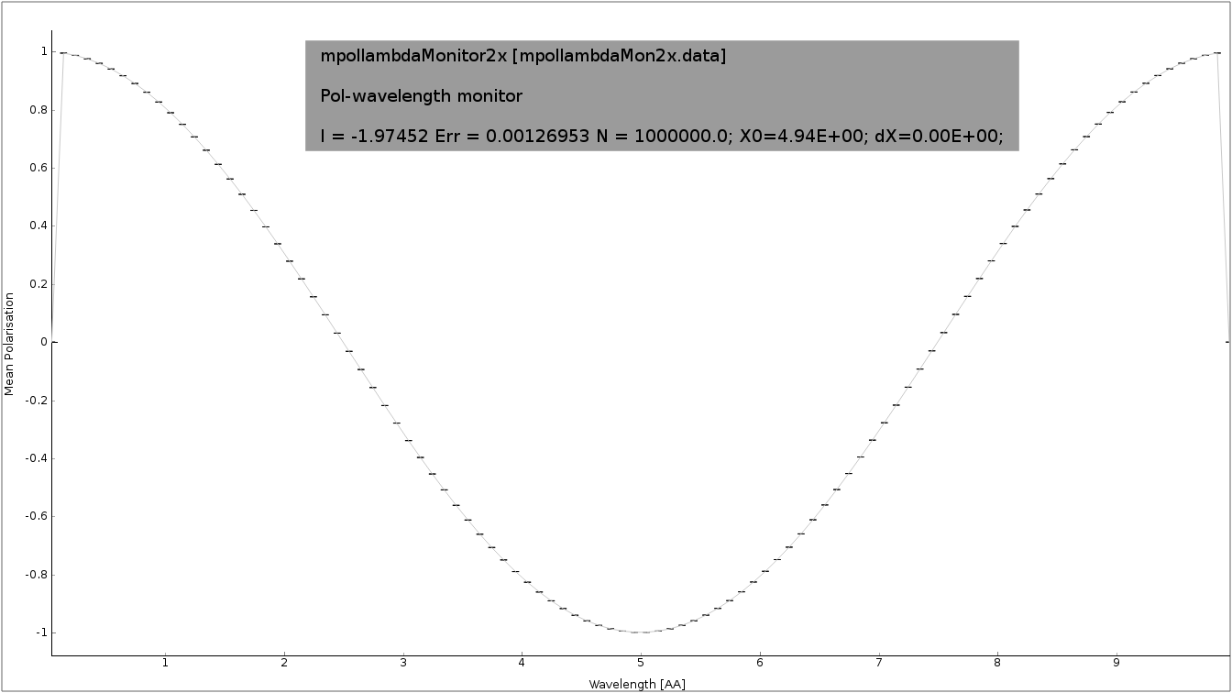
McStas detectors/monitors
Monitoring: How and What do we monitor?
n
n
n
n
n
n
n
$$P$$
$$\overset{^}{h}$$
$$\overset{^}{h}$$
E.g. polarisation along as fct. of wavelength

Slide 6
McStas detectors/monitors
Monitoring: How and What do we monitor?
$$P$$
Nota bene: weighted polarisation, not intensity
$$\overset{^}{h}$$
Polarisation along as fct. of wavelength

Slide 7
Polarization monitors
Available monitors:
Pol_monitor.comp: 0D
PolLambda_monitor.comp: 2D
PolTOF_monitor.comp: 2D
MeanPolLambda_monitor.comp: 1D

Slide 8
McStas precession algorithm
Magnetic fields in McStas
The challenge:
Fast beam/ray transport: #
Unknown magnetic field and field strength
>1 Magnet → nested fields.
$$rays>{10}^{6}$$

Slide 9
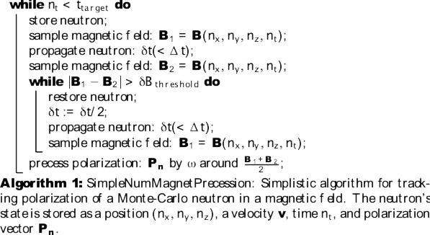
McStas precession algorithm
From: Knudsen et.al., J. Neutron Research, 2014

Slide 10
McStas precession algorithm
B₂
B₁
$$δt$$
n

Slide 11
McStas precession algorithm
B₂
B₁
n
$$δ\overset{}{t}=δt/2$$

Slide 12
McStas precession algorithm
From: Knudsen et.al., J. Neutron Research, 2014

Slide 13
McStas precession algorithm
From: Knudsen et.al., J. Neutron Research, 2014

Slide 14
McStas precession algorithm
void mc_pol_set_timestep(double dt);
void mc_pol_set_angular_accuracy(double domega);
From: Knudsen et.al., J. Neutron Research, 2014

Slide 15
McStas polarization components
Magnetic fields:
Pol_FieldBox.comp
(Pol_constBfield.comp 2.x)
Pol_Bfield.comp
Pol_Bfield_stop.comp
Pol_triafield.comp
(Pol_tabled_field 3.x)
Optics:
Monochromator_pol.comp
Pol_bender.comp
Pol_guide_mirror.comp
Pol_guide_vmirror.comp
Pol_mirror.comp
Transmission_polarisatorABSnT.comp
Pol_bender_tapering.comp
Monitors:
Pol_monitor.comp
MeanPolLambda_monitor.comp
PolLambda_monitor.comp
PolTOF_monitor.comp
Idealized components:
PolAnalyser_ideal.comp
Pol_SF_ideal.comp
Pol_pi_2_rotator.comp
Set_pol.comp
Contrib:
Foil_flipper_magnet.comp

Slide 16
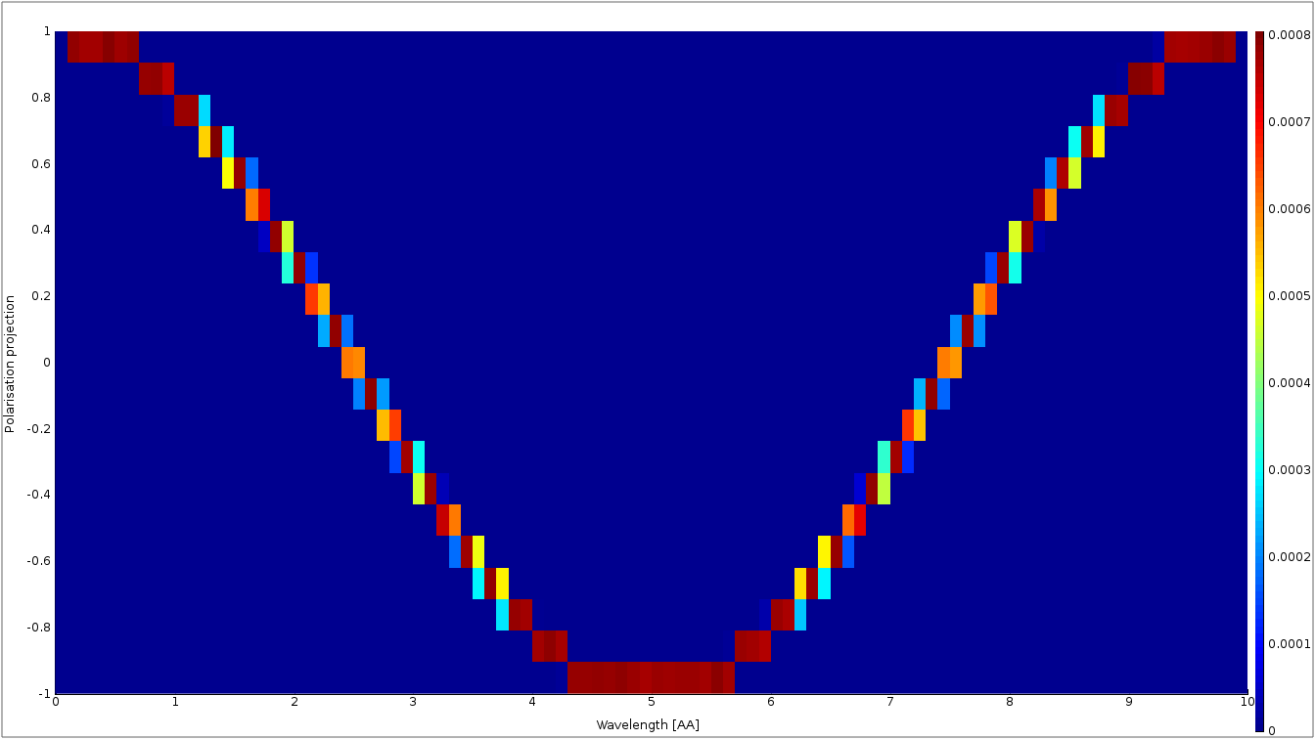
McStas polarization monitors
PolLambda_monitor
Monitors
MeanPolLambda_monitor
n
n
n
n
n
n
n
$$P$$
$$\overset{^}{h}$$
Pol_monitor
$$P∥\left(m_{x},m_{y},m_{z}\right)=0.87$$

Slide 17
McStas magnetic fields
Pol_constBfield.comp
Single constant Magnetic field in a “box”.
- user may specify a wavelength to flip. - “blocking walls”

Slide 18
McStas magnetic fields
Pol_FieldBox.comp
Single Magnetic field in a “box”
Constant or tabled magnetic fields

Slide 19
McStas magnetic fields
Pol_Bfield.comp
Pol_Bfield_stop.comp - Entry/Exit contruction allows for nested magnetic field descriptions. - Any magnetic field through user supplied c-function - Tabled magnetic fields
Standard field types:
Constant field
Rotating field
Gradient field
“Majorana” type field
Plus user-defined fields (McStas 2.x only) See pol-lib.c in share/ and the examples

Slide 20
Windows can be many shapes
B-Fields: constant, functional, tabled, … in more general shapes

Slide 21
McStas magnetic fields
Pol_Bfield.comp
Pol_Bfield_stop.comp - Entry/Exit contruction allows for nested magnetic field descriptions. - Any magnetic field through user supplied c-function - Tabled magnetic fields
Standard field types:
Constant field
Rotating field
Gradient field
“Majorana” type field
Plus user-defined fields (McStas 2.x only) See pol-lib.c in share/ and the examples

Slide 22
Pol_monitors along the way...

Slide 23
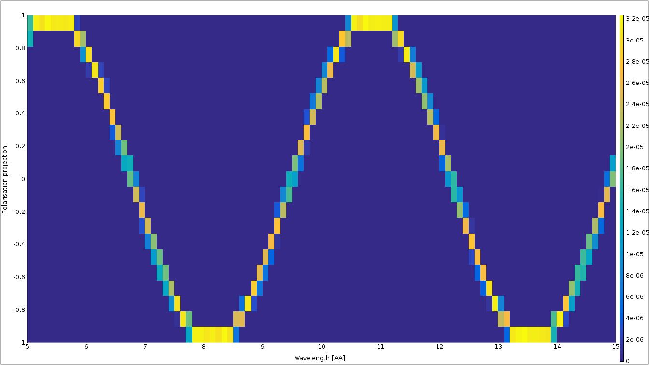
Pol_monitors along the way...
Pol_lambda_mon 1 placeholder

Slide 24
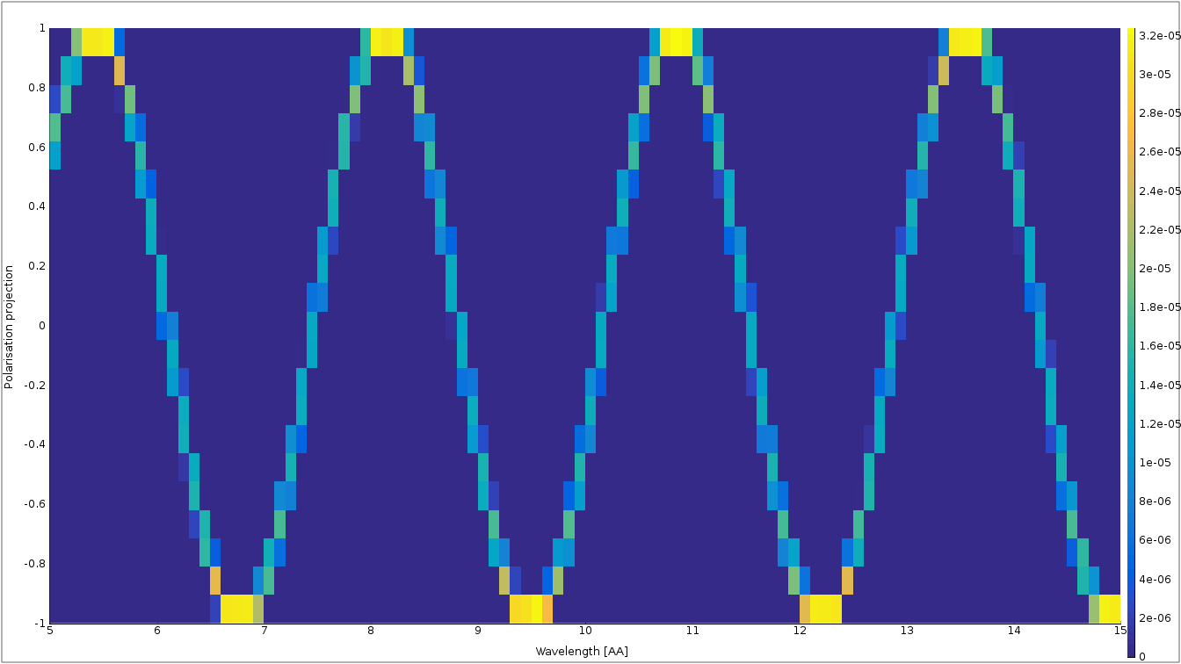
Pol_monitors along the way...

Slide 25
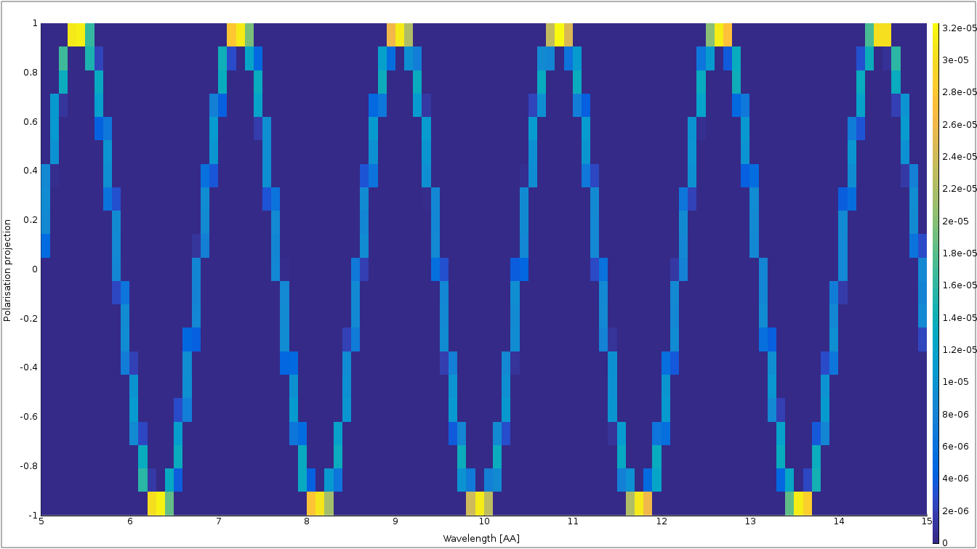
Pol_monitors along the way...

Slide 26
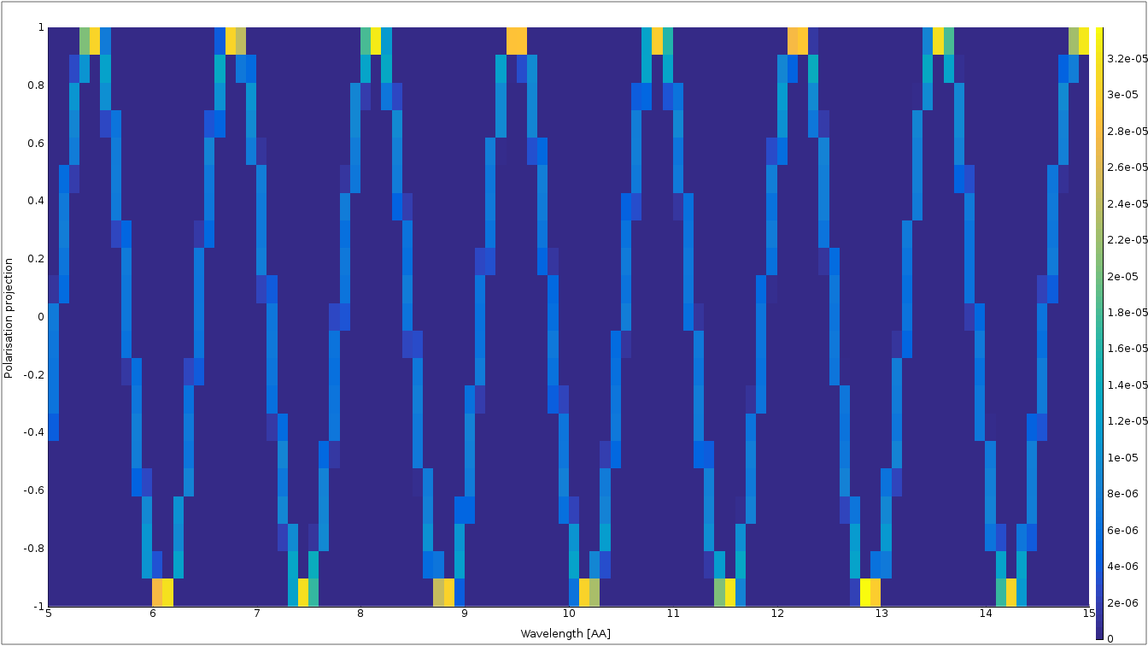
Nested fields

Slide 27
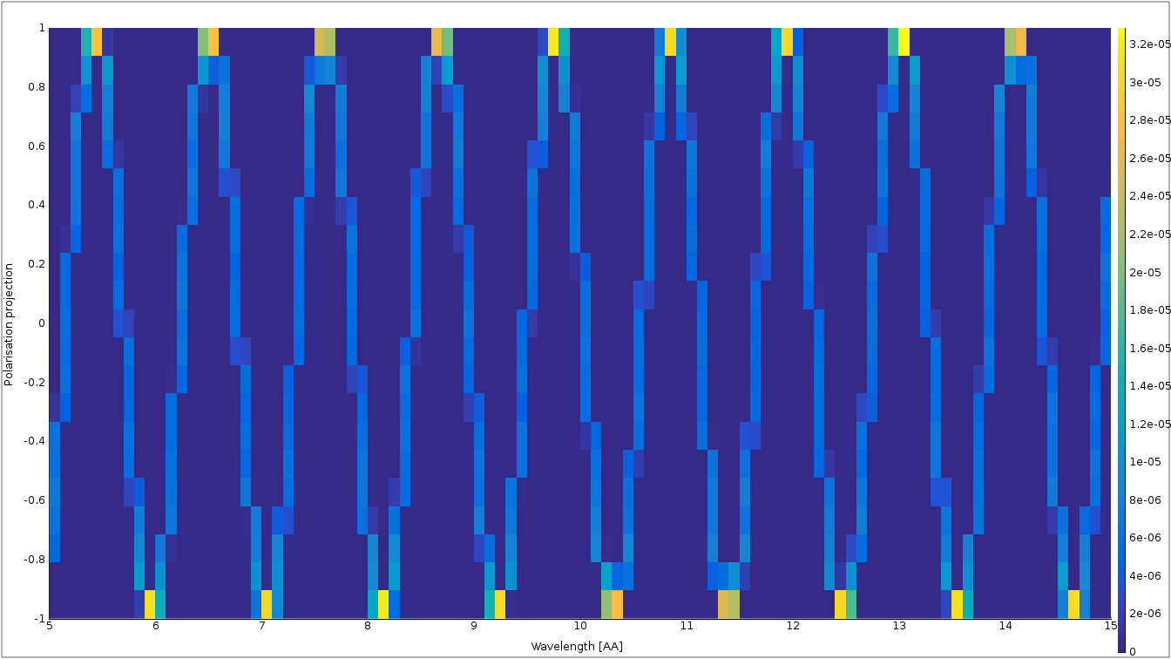
Nested fields

Slide 28
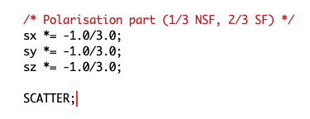
Simple McStas sample component
Incoherent.comp has SF / NSF solution

Slide 29
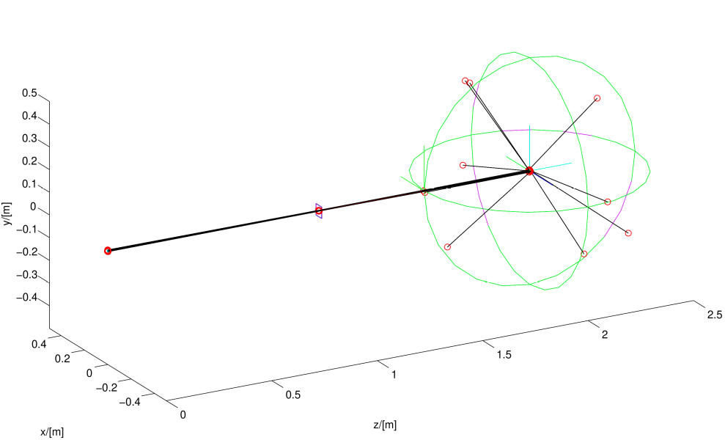
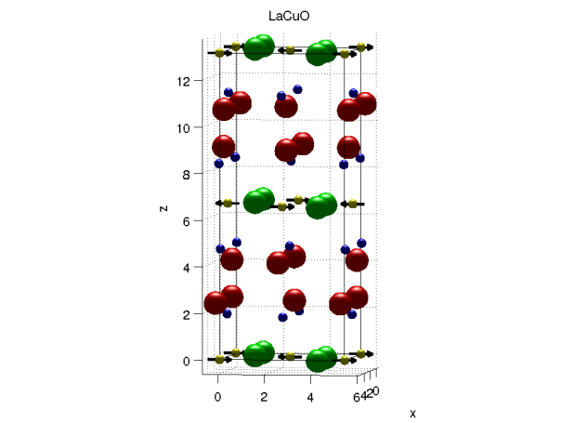

McStas sample component (2.x only)
Magnetic single crystal

Slide 30
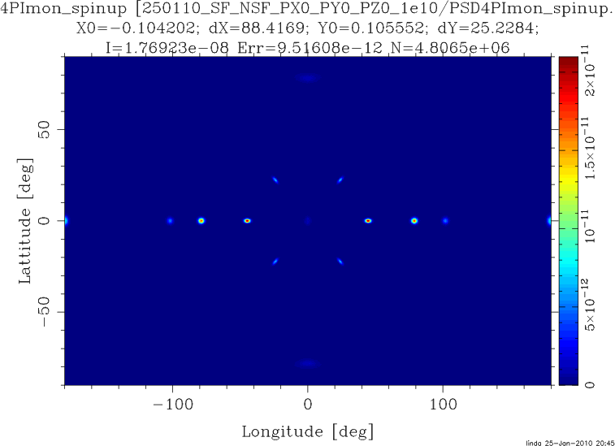
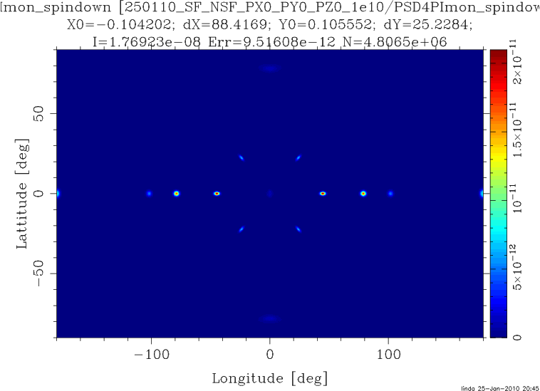
McStas sample component (2.x only)
Magnetic single crystal – Unpolarized beam

Slide 31
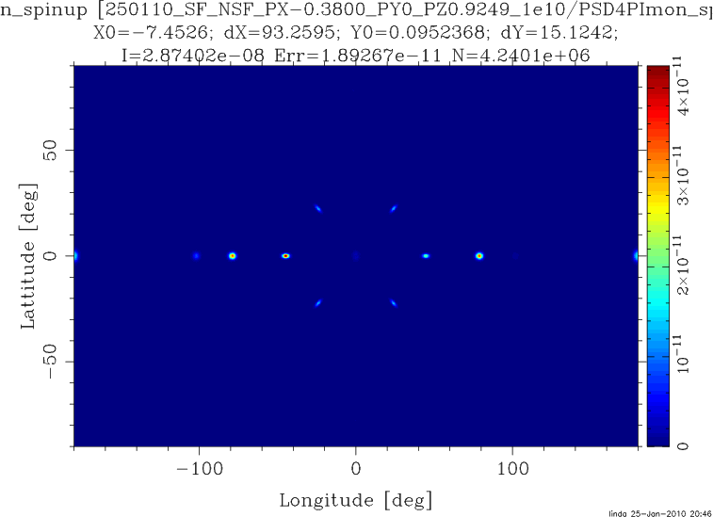
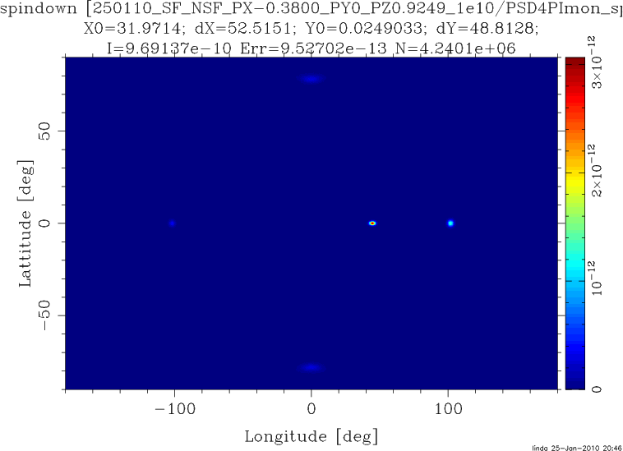
McStas sample component (2.x only)
Magnetic single crystal – Polarized beam

Slide 32
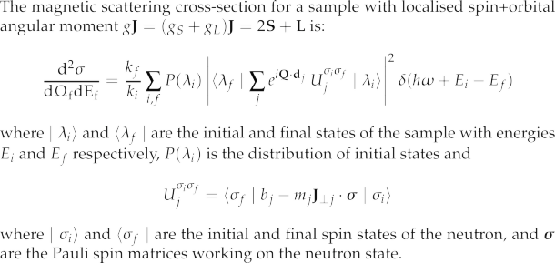
McStas sample component (2.x only)
Magnetic single crystal
From: G. Shirane et.al. ,”Neutron Scattering with Triple-Axis Spectrometer”, Cambridge Univ. Press, 2002

Slide 33
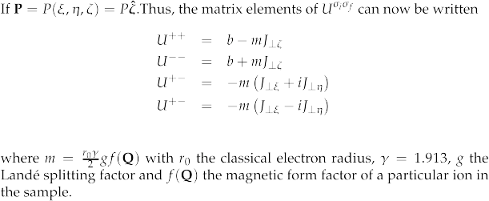
McStas sample component (2.x only)
Magnetic single crystal

Slide 34
Example instruments:
*Magnetic*.instr:
Test_Magnetic_Constant.instr
Test_Magnetic_Majorana.instr
Test_Magnetic_Rotation.instr
Test_Magnetic_Userdefined.instr (2.x only)
Test_single_magnetic_crystal.instr (2.x only)
*Pol*.instr: Test_Pol_Bender.instr
Test_Pol_Bender_Vs_Guide_Curved.instr
Test_Pol_FieldBox.instr
Test_Pol_Guide_Vmirror.instr
Test_Pol_Guide_mirror.instr
Test_Pol_MSF.instr
Test_Pol_Mirror.instr
Test_Pol_SF_ideal.instr
Test_Pol_Set.instr
Test_Pol_Tabled.instr
Test_Pol_TripleAxis.instr
SE*.instr: SEMSANS_Delft.instr
SEMSANS_instrument.instr
SESANS_Delft.instr
SE_example.instr
SE_example2.instr

Slide 35
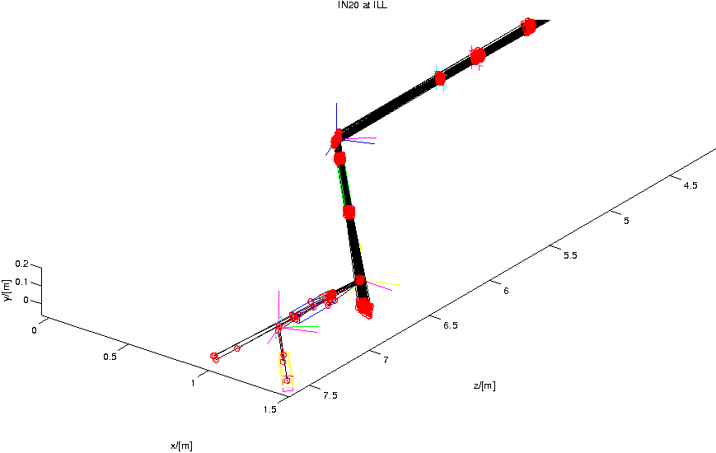
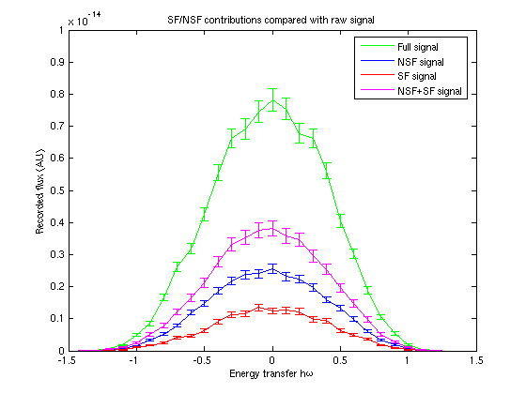
McStas: IN20 TAS model – comparing signals from Vanadium
UNPOLARISED
UP → UP + DOWN
UP → DOWN
UP → UP
Flux (AU)
Energy transfer

Slide 36
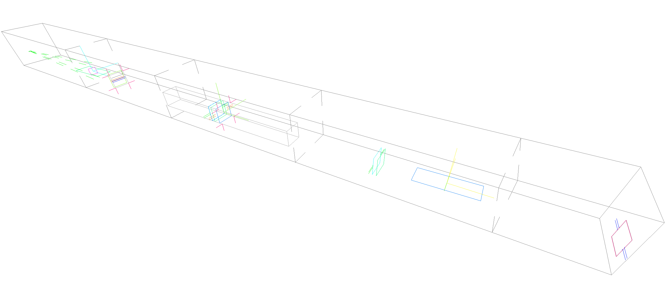
Generic spin-echo SE_example2.instr
V sample
Detector
Source
Guide-field 1
Transmission- polariser
Guide-field 2
π/2 flipper
Transmission- analyser
2 x π/2 flipper’s
π/2 flipper

Slide 37
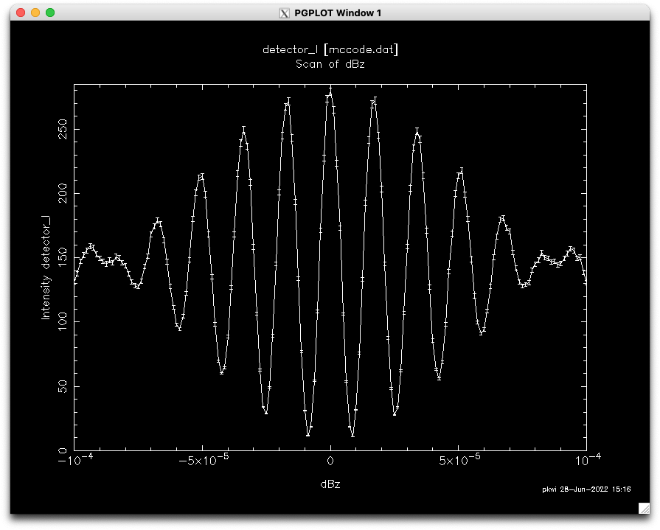
Tuning of guide-field 1 around its value allows us to see spin-echo:

Slide 38
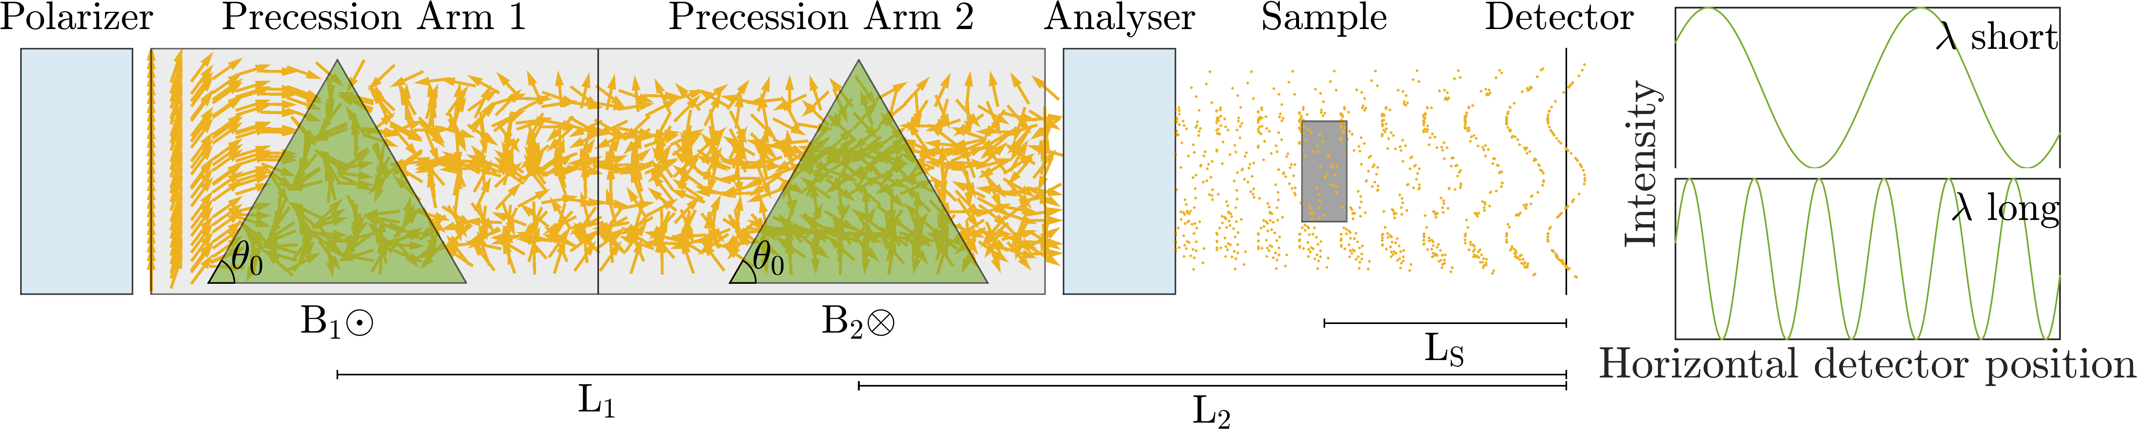
Highlight: McStas example SEMSANS
Courtesy: M. Sales et.al.

Slide 39
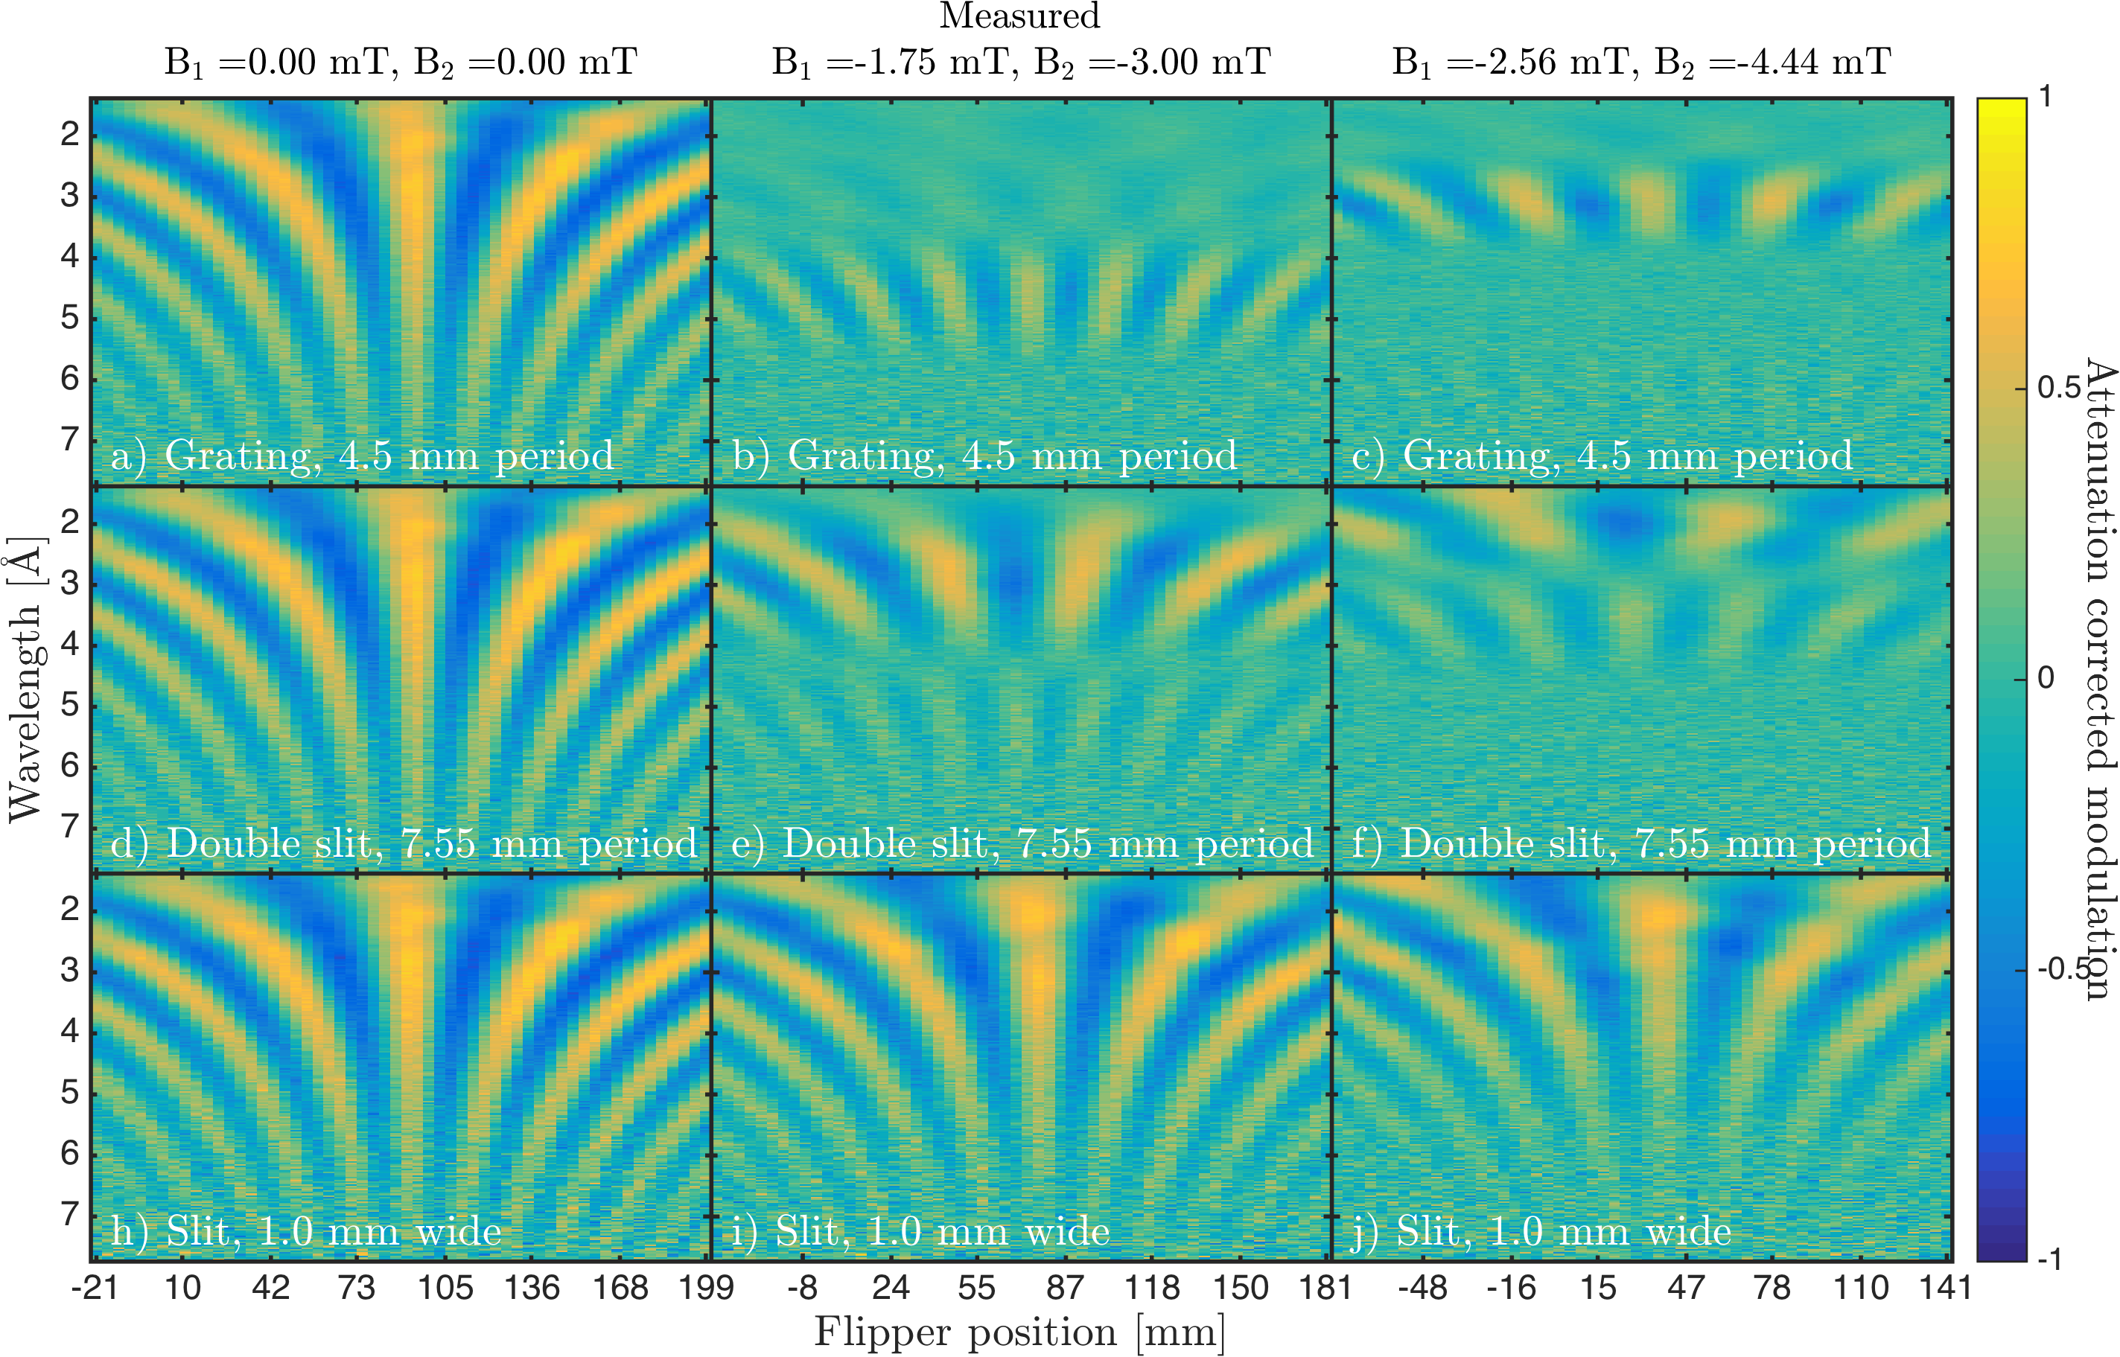
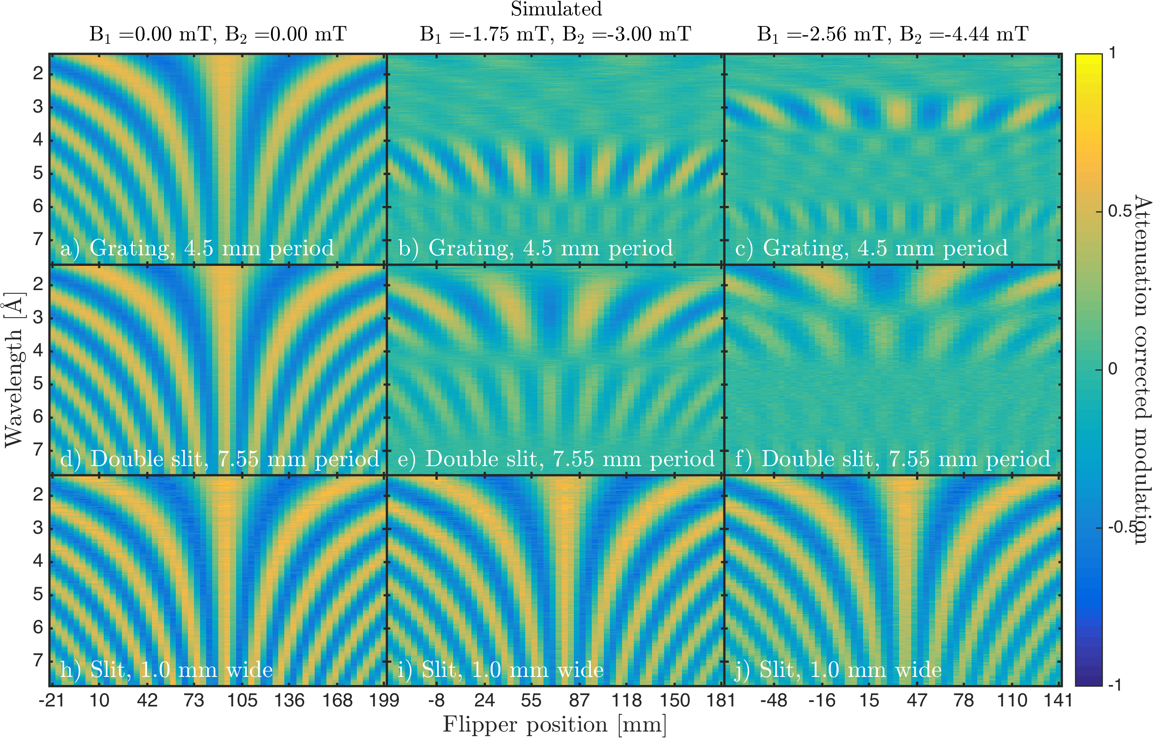
Experiment Simulation
Highlight: McStas example SEMSANS

Slide 40
Gotcha’s
Polarisation docs in manual are out of date wrt. the current code/algorithm…
For now, don’t combine gravity and polarisation! (Guide_gravity and Elliptic_guide_gravity can currently not be used within field regions.)
Memory-leak found in McStas 2.7.1 when using precession regions (Patch-release later this year, for now patch by using this updated pol-lib.c)
Pol_Bfield placement can be confusing depending on choice of geometry-parts…
McStas 3.x does not support
User-defined field functions (No function pointers on GPU… code-generator may rescue us later)
Having optics within tabled fields (tabled fields are for now only available in Pol_tabled_field which can not work in “concentric geometries)
GitHub issues exist or will be written, these things will eventually all be fixed!

