Slide 1
Access to DTU GPU nodes
Get a guest-account from Peter (active until end of April 2021)
Access via either
ThinLinc https://thinlinc.gbar.dtu.dk/main/
ssh to login2.hpc.dtu.dk)
https://www.hpc.dtu.dk/?page_id=2129 has information on interactive nodes, choose one, e.g.
voltash -X
Load McStas 3.0-dev from Peter’s account by running ~pkwi/McStas/mcstas/3.0-dev/environment (! On first access, please write a local mcstas config by mcrun --write-user-config !)
Load the Nvidia compilers module load nvhpc
Optionally you can also load mpi via module load mpi/4.0.1-gcc-8.3.0 (! not plug+play wrt OpenACC, needs manual addition of lib and include path in above config !)

Slide 2
Running an instrument on GPU
Copy an instrument in cp $MCSTAS/examples/ISIS_GEM.instr .
Compile for GPU mcrun -c --openacc ISIS_GEM.instr -n0
Run as usual, gives e.g.
GPU 1e7, -s1000 : Detector: monzns_I=52.7959 monzns_ERR=0.0702837 monzns_N=5.67842e+06 "monzns_1618479351.A_t" Finally [ISIS_GEM: GPU_1e7]. Time: 6 [s]
CPU 1e7, -s1000 : Detector: monzns_I=52.7959 monzns_ERR=0.0702837 monzns_N=5.67842e+06 "monzns_1618479397.A_t" Finally [ISIS_GEM: CPU_1e7]. Time: 1.08333 [min]

Slide 3
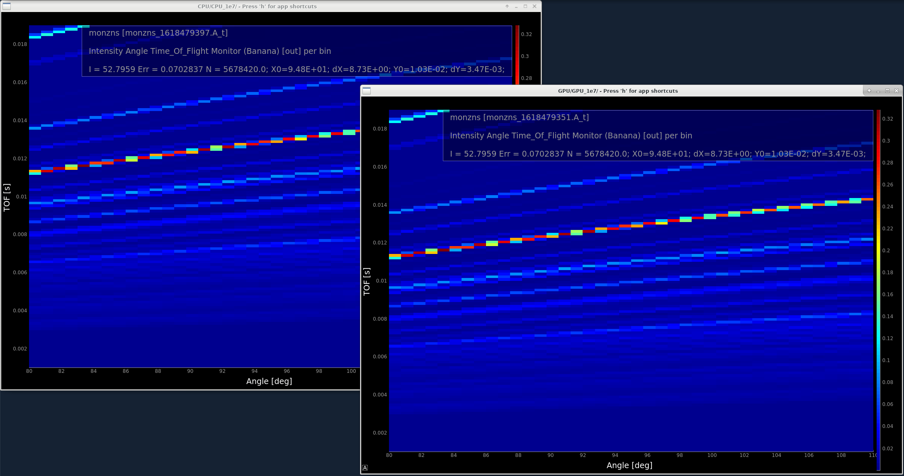
mcplot output

