Slide 1
Upgrading the RITA-2 spectrometer:
Prospects and McStas simulations
Kim Lefmann
Risø National Laboratory
Materials Research Dept.
PSI 16/1-2003

Slide 2
Collaborators
RITA-2
Stine N. Klausen, Risø
Des McMorrow, Risø
Luise Theil Kuhn, Risø
Peter Andersen, Risø
Christof Niedermayer, PSI
Joel Mesot, PSI
Bertrand Roessli, PSI
Peter Allenspach, PSI
Felix Altorfer, PSI
Albert Furrer, PSI
McStas etc.
Emmanuel Farhi, ILL
Peter Willendrup, Risø
Kristian Nielsen, Risø
Per-Olof Åstrand, Risø
Henrik Edwards, Risø
Mark Hagen, ANSTO
Alan Tennant, Oxford
Bella Lake, Oxford
Kurt N. Clausen

Slide 3
Contents
The RITA concept
The RITA-2 spectrometer at PSI
The RITA-2 upgrade
Introduction to neutron ray-tracing simulations
McStas simulations for RITA-2
Conclusion

Slide 4
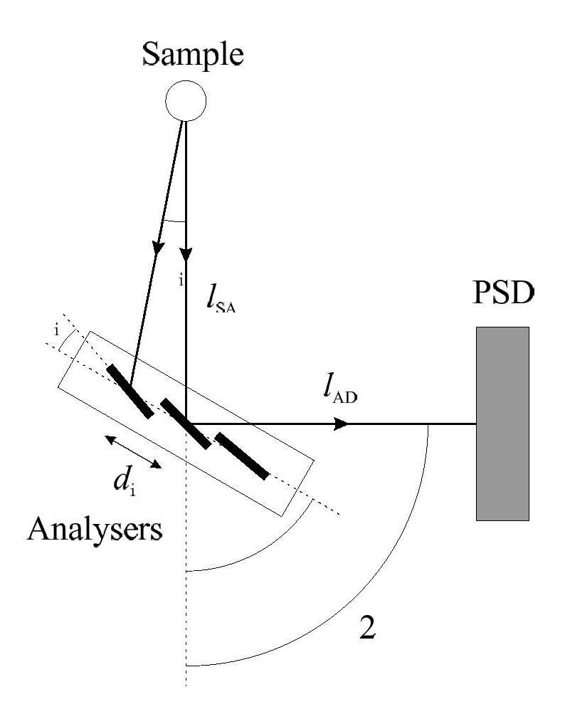
The RITA dream
Re-Invented Triple Axis
Use all known tricks to:
Maxmize flux
Minimize background
Increase data taking efficiency, i.e. measure several points + background simultaneously
Generic RITA analyzer system

Slide 5
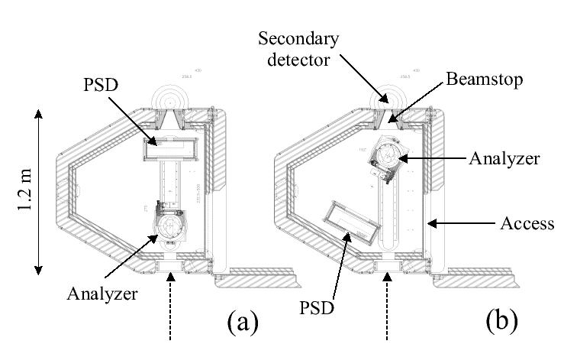
The RITA-2 concept
Optimized beam optics
Focusing
monochromator
Analyzer-detector tank
PSD Detector
Multi-bladed analyzer
The RITA-2 tank

Slide 6
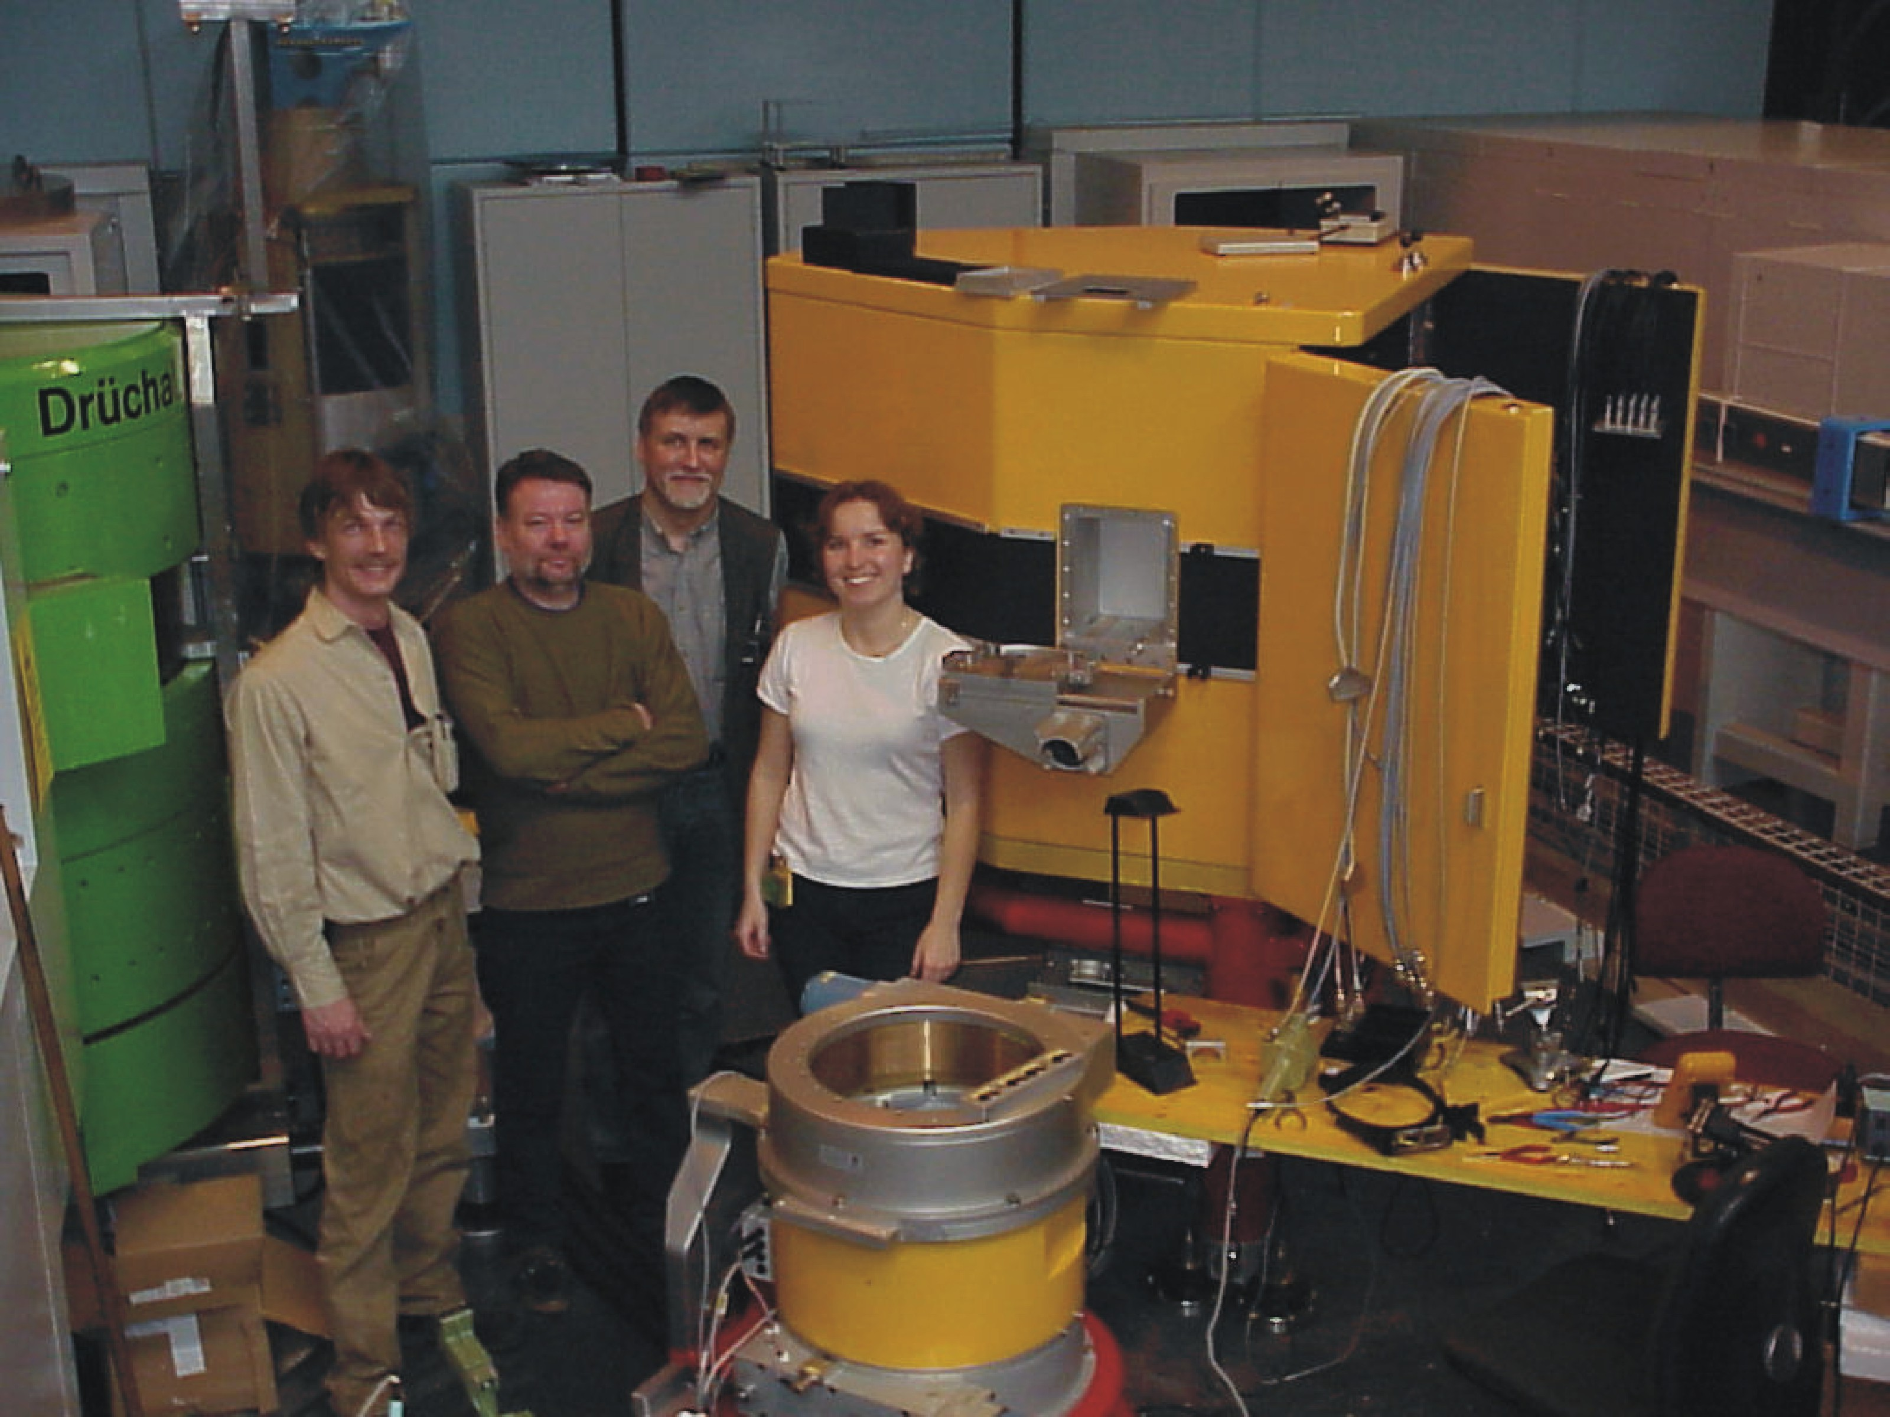
RITA-2 at PSI
Built for DR3, Risø
Installed PSI, April 2001
Joint venture Risø-PSI
Cold guide, 2.5-14 meV
Medium flux: 5·10⁶ n/s/cm²
at 7-10 meV; 1 mA
Information and manual on the home page:
rita2.psi.ch
S. N. Klausen et al, J. Appl. Phys. A (2002)

Slide 7
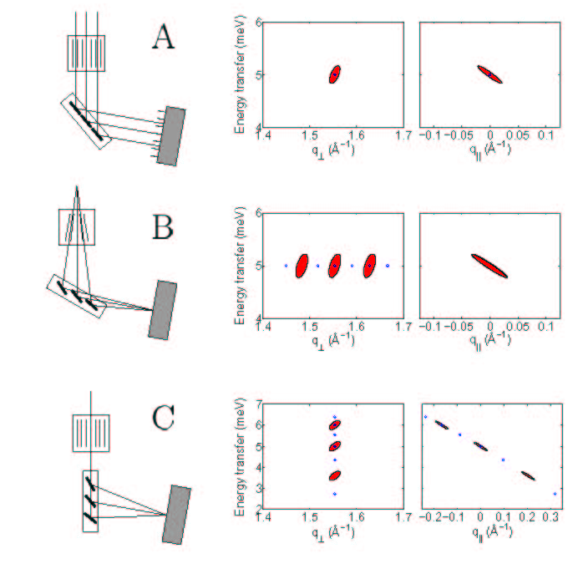
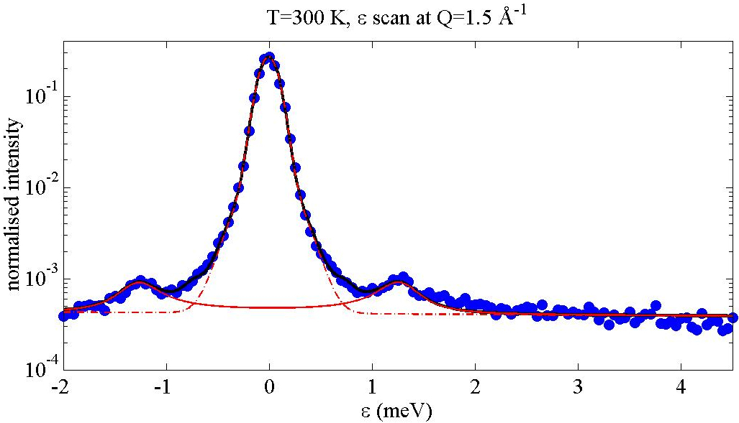
Focusing analyzer modes
Mode B: Magnetic fluctuations
in hematite nanoparticles

Slide 8
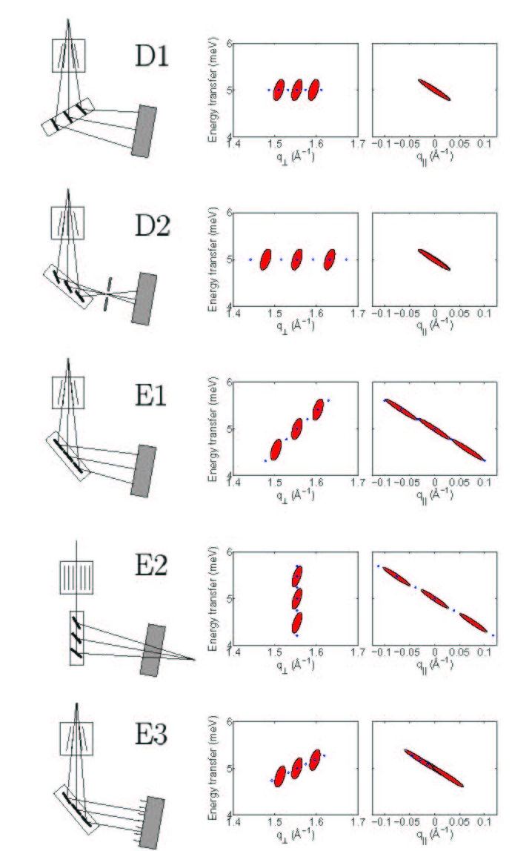
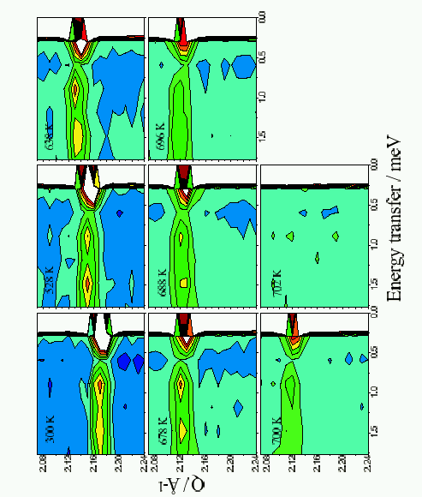
Dispersing modes .
K. Lefmann et al, Physica B (2000)
P. Zetterström et al (1999)

Slide 9
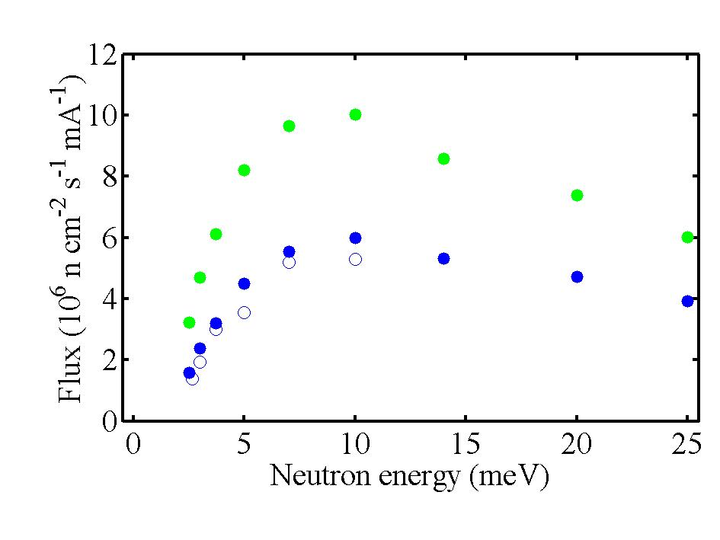
Upgrading RITA-2
A: Source
SINQ current from 1.0 mA to 1.3 mA, 2002
Gain factor: 30%
A new cold source, 2003
Gain factor: 10% • (λ/10 Å)
= 29% at 10 meV

Slide 10
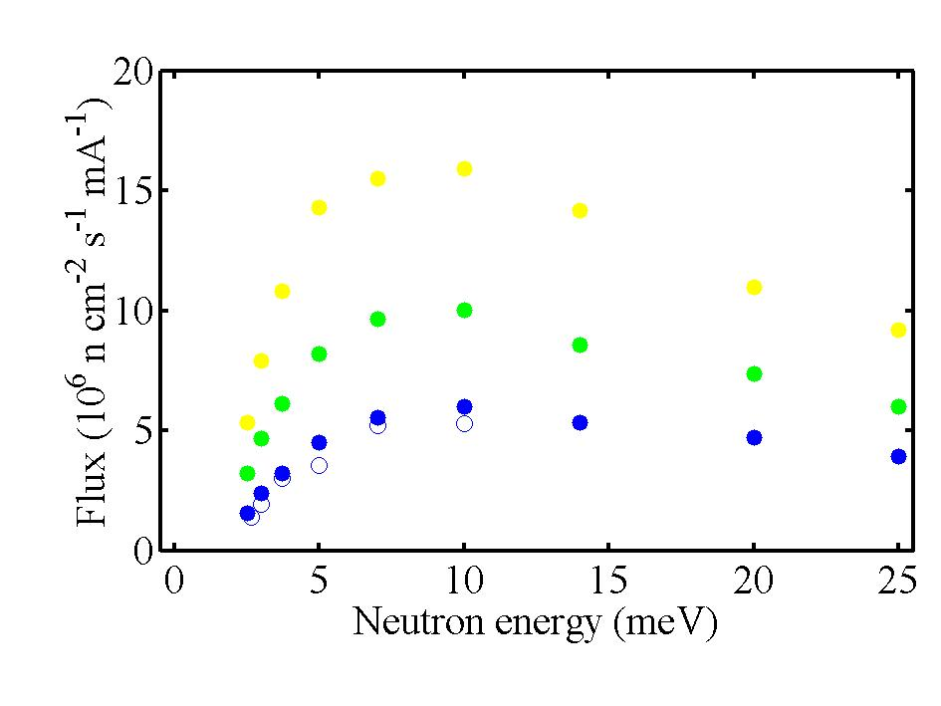
Upgrading RITA-2
B: Monochromator (2004)
More monochromator blades (5 to 9)
Gain factor: 8%
PG mosaicity larger (40’ to 80’)
Gain factor: 15%
Doubly focusing
Gain factor: 16%

Slide 11
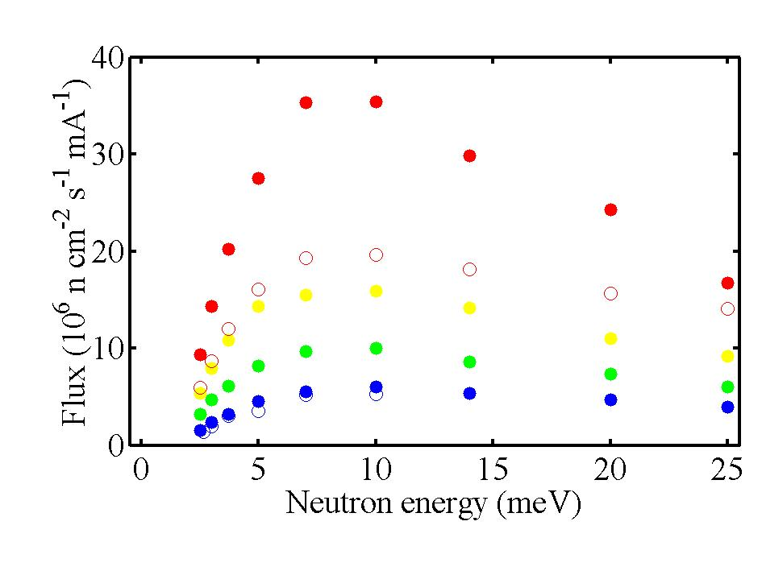
Upgrading RITA-2
C: Guide (2004)
Replace m=2 supermirror with m=3
Gain factor: 27%
Taller guide (12 to 15 cm), ballistic
Gain factor: 30%
Wider guide (3 to 5 cm)
Gain factor: 70%

Slide 12
Upgrading RITA-2
D: Geometry (2004)
Longer distance guide to monochromator
Gain: Monochromatic focusing
The guide behind RITA-2 (including the NCR instrument) is removed
Gain: Access to higher energies (14 to 25 meV)
Rotating velocity selector installed
Gain: Remove higher order contamination
Loss factor: 20%

Slide 13
Upgrading RITA-2
E: Analyzer (2003-2004)
New analyzer with movable axes
Gain: Remove ”gaps” in analyzer coverage
Flexible collimator after analyzer
Gain: Enable use of imaging analyzer modes

Slide 14
How to do neutron ray-tracing
Generate many ”neutron rays”; random initial parameters
Follow the rays from source to detector
Interact with components along the way
(as detailed as you can compute...)
Perform Monte Carlo Choices when necessary
Continue until statistics is sufficient
Optimize the simulations in all ways
(weight factor, focusing, virtual source, ...)
See the home page mcstas.risoe.dk

Slide 15
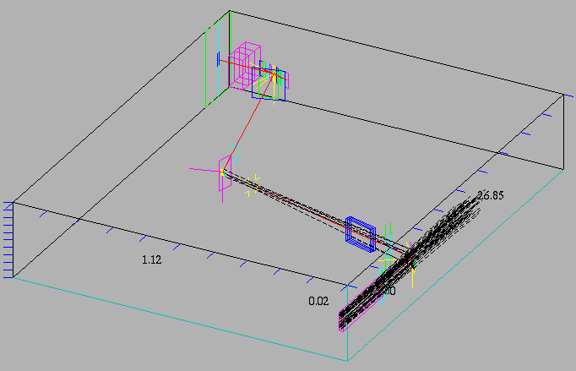
Ray-tracing RITA-2, I
The vertically focusing analyzer

Slide 16
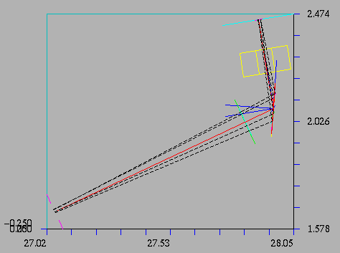
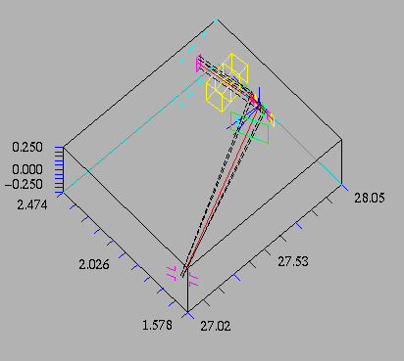
Ray-tracing RITA-2, II
The monochromatic
point-to-point focusing mode

Slide 17
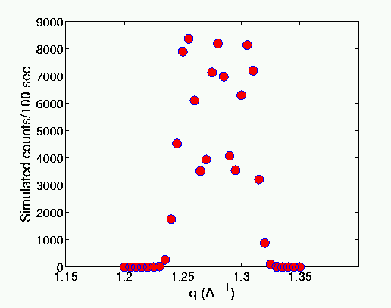
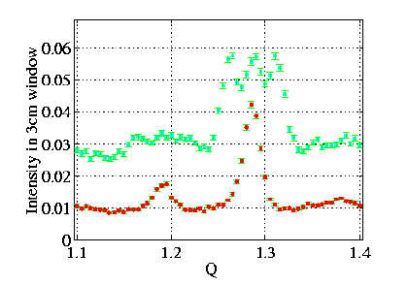
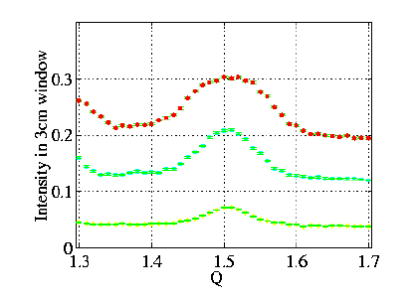
Planning a RITA-2 experiment
Left: Virtual experiment, 3 blades
Right: Real experiment, 1,3,5 blades

Slide 18
Conclusion and Outlook
RITA-2 will be upgraded over the next 15 months
RITA-2 will become comparable with IN-14 in uncollimated flux!
McStas simulations can add user-friendliness to the many RITA analyzer modes
Combined with a 15/17 T magnet, RITA-2 will become a true World class instrument!

Slide 19
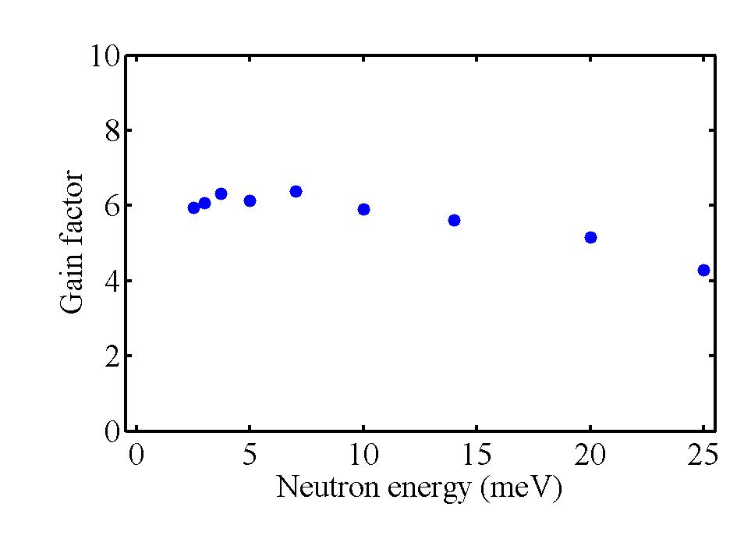
Flux gain at RITA-2
wider guide
taller guide
new cold source
more current
m=3 mirrors
Monochromatic
focusing
Doubly focusing
monochromator

Slide 20
The McStas package
Risø - ILL - ANSTO collaboration
Well tested and well documented code
Includes most necessary components for both reactor and TOF spectrometers
Realistic sample components are in progress
Interface to TASCOM control program
Version 1.7 (or 2.0) to be released early 2003, less dependent on external packages
Home page and mailing list at:
mcstas.risoe.dk
K. Lefmann and K. Nielsen, Neutron News (1999)

Slide 21
Neutron MC: The Dream
Describe all aspects of neutron scattering, allowing for:
Instrument design and test
Virtual experiments:
- Experiment planning
- On-line experiment verification
- Off-line data analysis

Slide 22
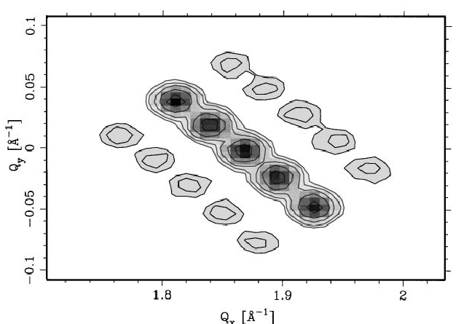
RITA-1 resolution function
Calculated in a single McStas simulation (5 min)
Full 4-dimensional correlations
3-D visualization (q_{vertical} neglected)
RESCAL-like output
K. Nielsen et al, Physica B (2000)

Slide 23
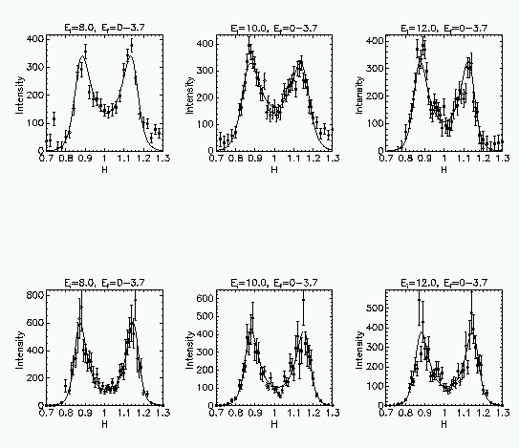
Analyzing RITA-1 data
La_{2-x}Sr_{x}CuO₄ HTSC
Is the 4-peak model sufficient to account for the data?
Experiment
B. Lake et al, Nature (1999), Science (2001), to be publ.
H. Edwards et al, ICNS-01 proceedings (2002)
Simulations

