Slide 1
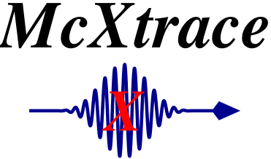





McXtrace ray-tracing technology platform
Peter Willendrup¹
Erik Knudsen¹
Andrea Prodi²
Jana Baltser²
Søren Schmidt¹
Martin Meedom¹
Henning Friis Poulsen¹
Manuel Sanchez del Rio⁴
Claudio Ferrero⁴
Karsten Joensen⁵
Kell Mortensen³
Robert Feidenhans’l²
Kim Lefmann²
¹Materials Research Division, RISØ DTU, Roskilde, Denmark
²Niels Bohr Institute, University of Copenhagen, Copenhagen, Denmark
³Faculty of Life Science, University of Copenhagen, Copenhagen, Denmark
⁴European Synchrotron Radiation Facility (ESRF), Grenoble, France
⁵SAXSLAB, Denmark (Formerly JJ X-RAY Systems)
1
McXtrace presentation, Sept 2010

Slide 2
Agenda
McXtrace project
Overview/status of technical aspects
Further ideas
Strong points for XFEL
2
McXtrace presentation, Sept 2010

Slide 3
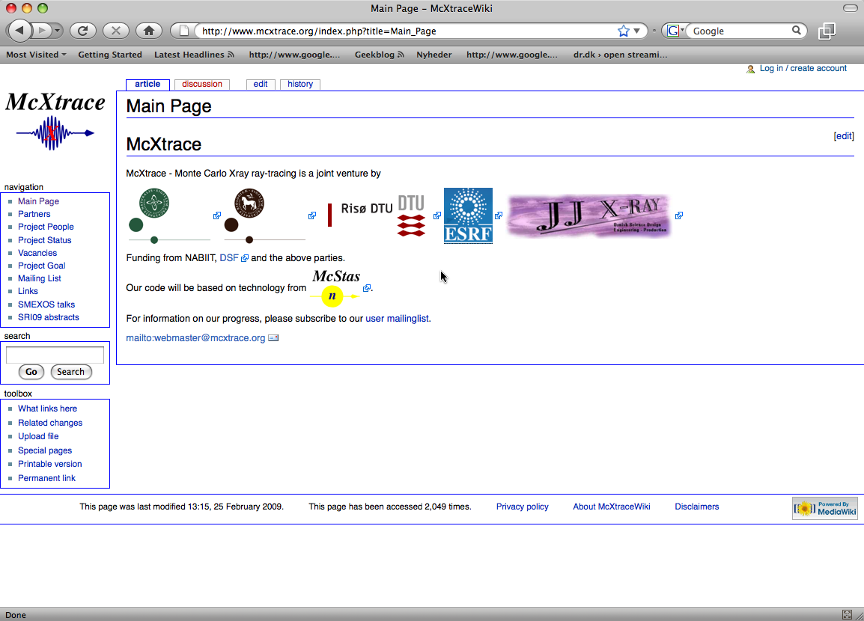
McXtrace Introduction
Flexible, general simulation utility for X-ray scattering experiments.
Built on technology from McStas and SHADOW codes, links to XOP
Joint effort by KU, RISØ DTU, JJ-Xray and ESRF
V. 1.0 will be out in 2010 but prerelease available
GNU GPL license
Open Source
Project website at
http://www.mcxtrace.org
3
McXtrace presentation, Sept 2010

Slide 4
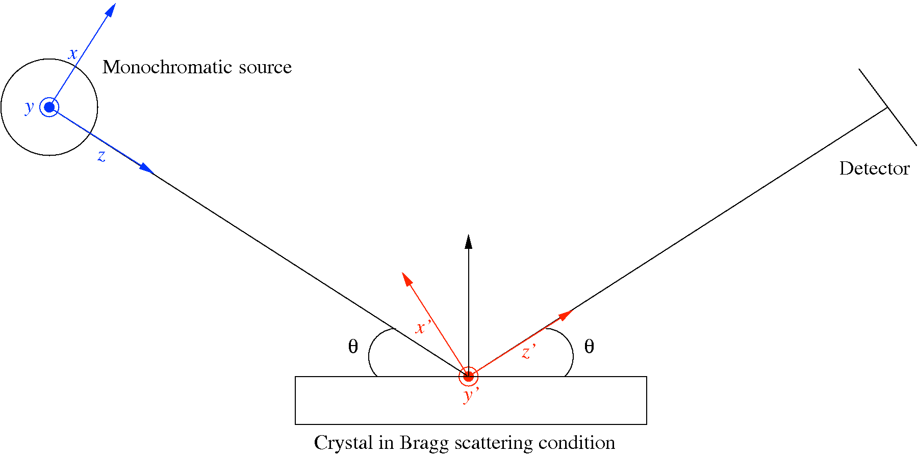
McXtrace: key concepts
Photon ray/package:
(r,k,φ,t,p,E)
r - spatial coordinates
k - wave vector
φ - phase
t - time
E - Electrical field polarisation
4
McXtrace presentation, Sept 2010

Slide 5
McXtrace: key concepts
Components: Here the X-ray – beamline interaction happens
Photon properties adjusted, e.g. different (r,k,φ,t,p,E) according to scattering propabilities etc.
Component classes:
Sources
Optics
Sample descriptions
Monitors / detectors
Ability to move between particle and wave picture as needed
5
McXtrace presentation, Sept 2010

Slide 6
McXtrace: key concepts
Instrument: Relative positioning of components in the lab frame
Coordinate system: Right-handed with z propagation axis and y “vertical”
Runtime library: Common functions used by all instruments / comps like
Random numbers
Propagation
Material properties
I/O
…
6
McXtrace presentation, Sept 2010

Slide 7


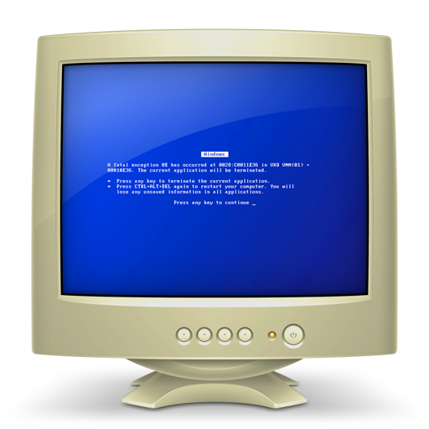
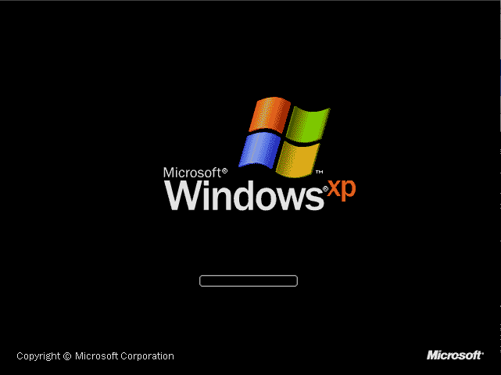
McXtrace/McStas overview
Portable code (Unix/Linux/Mac/Windows, 32 and 64 bit support)
Has run on all from iPhone to 1000+ node clusters
'Component' files (~100 in McStas, 15 in McXtrace) inserted from library
Sources
Optics
Samples
Monitors
If needed, write your own comps
DSL + ISO-C code gen.
7
McXtrace presentation, Sept 2010

Slide 8
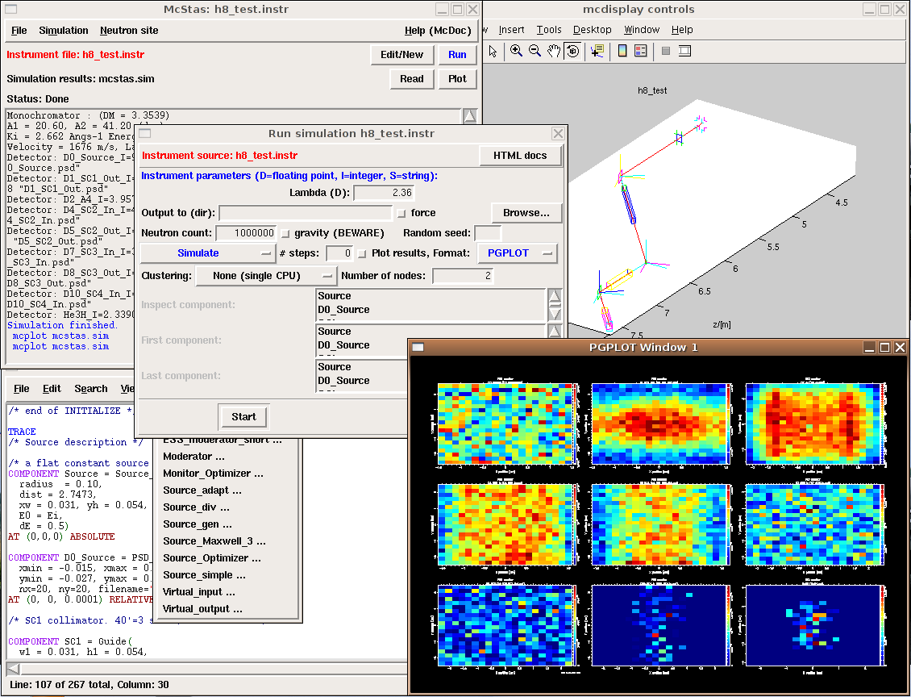
Tool layer overview
8
McXtrace presentation, Sept 2010

Slide 9
Tie ins with external software
General Philosophy: If someone does it well – interface to “industry standards” – do not reinvent
Examples:
  Flux Density spectra and spatial distribution (SPECTRA, …)
  Materials properties: (XOP, NIST-database, …)
  Wavefront propagation in regions (PHASE, SRW,…)
9
McXtrace presentation, Sept 2010

Slide 10
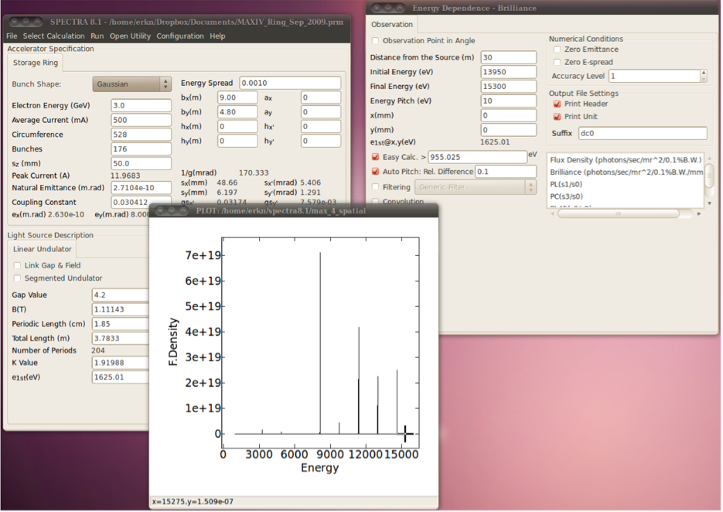
Tie ins with external software
General Philosophy: If someone does it well – interface not reinvent
Examples:
  Flux Density spectra and spatial distribution (SPECTRA)
  Materials properties: (XOP, NISP-database)
  Wavefront propagation in regions (PHASE)
Spectra
10
McXtrace presentation, Sept 2010

Slide 11
Tie ins with external software
General Philosophy: If someone does it well – interface not reinvent
Examples:
  Flux Density spectra and spatial distribution (SPECTRA, …)
  Materials properties: (XOP, NISP-database, …)
  Wavefront propagation in regions (PHASE, SRW, …)
McXtrace
PHASE
McXtrace
11
McXtrace presentation, Sept 2010

Slide 12
Tie ins with external software
General Philosophy: If someone does it well – interface not reinvent
Examples:
  Flux Density spectra and spatial distribution (SPECTRA)
  Materials properties: (XOP, NISP-database)
  Wavefront propagation in regions (PHASE)
McXtrace
PHASE
McXtrace
Coherent PSD monitor
Virtual Source
McXtrace Xray Beam
PHASE
McXtrace
A(x,y)
Phi(x,y)
A(x,y)
Phi(x,y)
12
McXtrace presentation, Sept 2010

Slide 13
Modular implementation
Three levels of source code:
  Instrument file – all users
      existing examples
      user written – GUI assisted
  Component files – some users
    Short pieces of code
    Easy to modify from existing
  ISO-C code – “no” users
    Assembled by code generation
    Very low overhead of unneeded code
    Includes runtime libs that comps rely on (propagation etc.)
Instrumentfile (average user, point/click, DSL)
Component (advanced user, modify from existing, c-code)
Kernel (McXtrace team)
13
McXtrace presentation, Sept 2010

Slide 14
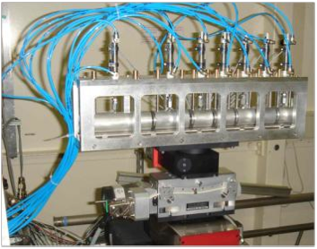
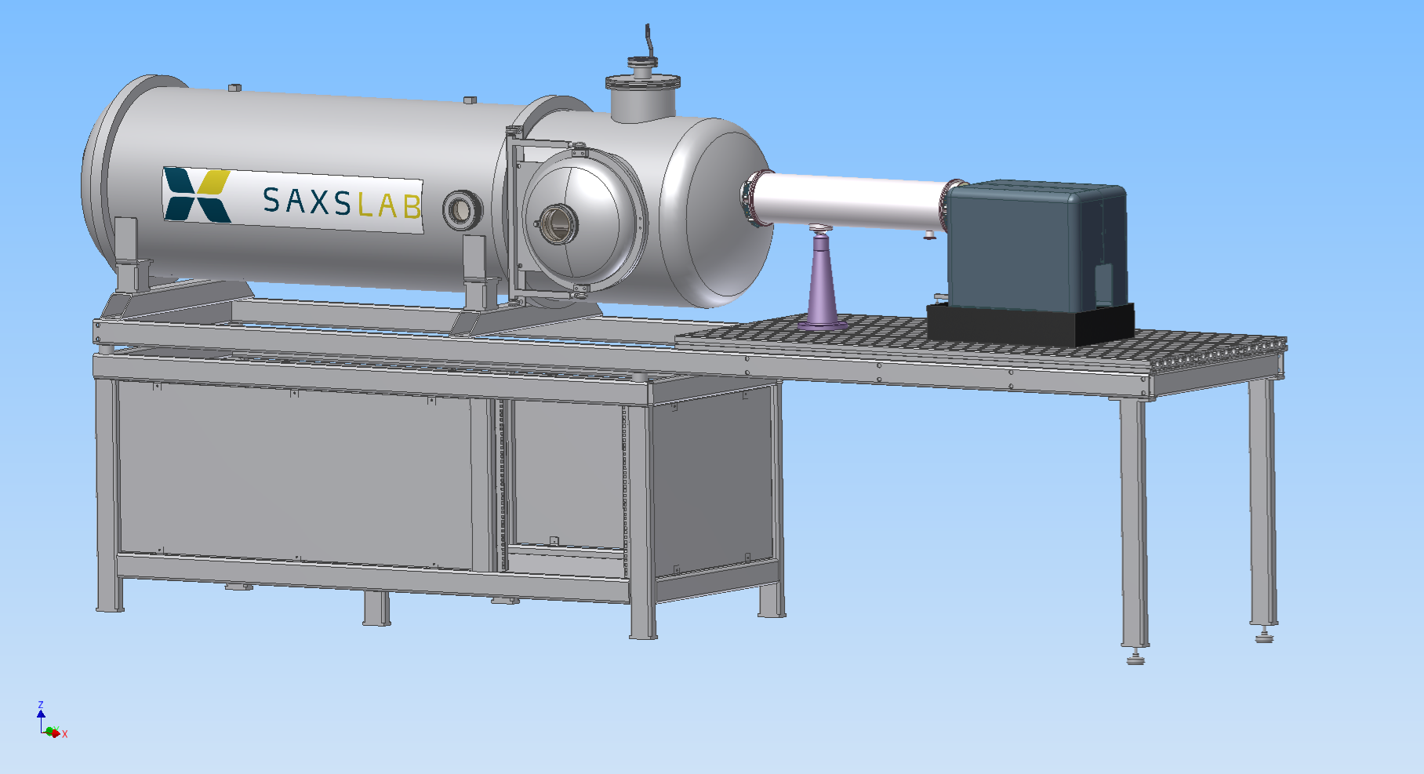
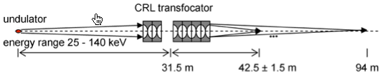
Example instrument descriptions
ID11@ESRF
SAXSLAB SAXS
Final aim is to cover “all scales” - lab and large scale facility sources, instruments
X-Ray Transfocators: Focusing Devices Based on Compound Refractive Lenses, G.B.M. Vaughan, A. Snigirev, M. Rossat, J.P. Wright, A. Bytchkov, H. Gleyzolle, submitted to Journal of Synchrotron Radiation
14
McXtrace presentation, Sept 2010

Slide 15

X-ray Compound Refractive Lens as longitudinally dispersive monochromator
Image size
h=(f₁ / p )σ
Compact Be lens
(λ₁ f₁)^{1/2}=(λ₂ f₂)^{1/2}=c
Source size
σ
H
f₁
p
f₂
✔
✔
✔
Example :
J. Als Nielsen
15
McXtrace presentation, Sept 2010

Slide 16
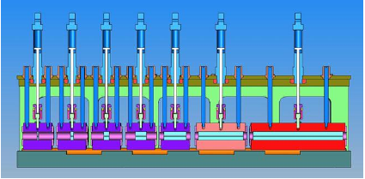
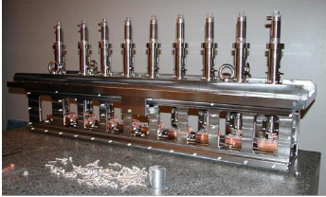
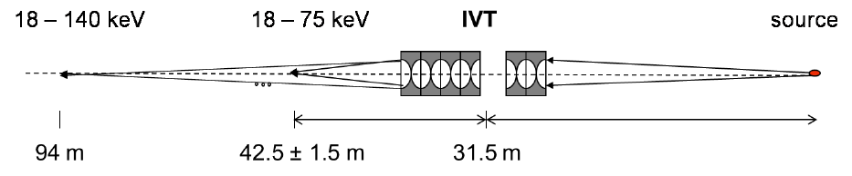
Be/Al Transfocator at ID11, ESRF
Beamline configuration, source is in vacuum undulator u22
G.B.Vaughan et al. (2010, submitted)
16
McXtrace presentation, Sept 2010

Slide 17
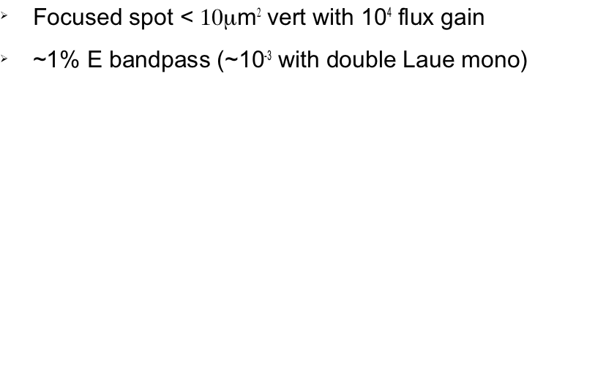
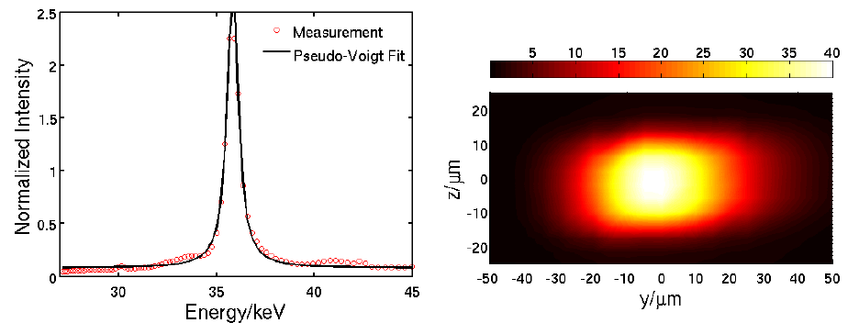
Experimental Results
G.B.Vaughan et al. (2010, submitted)
17
McXtrace presentation, Sept 2010

Slide 18
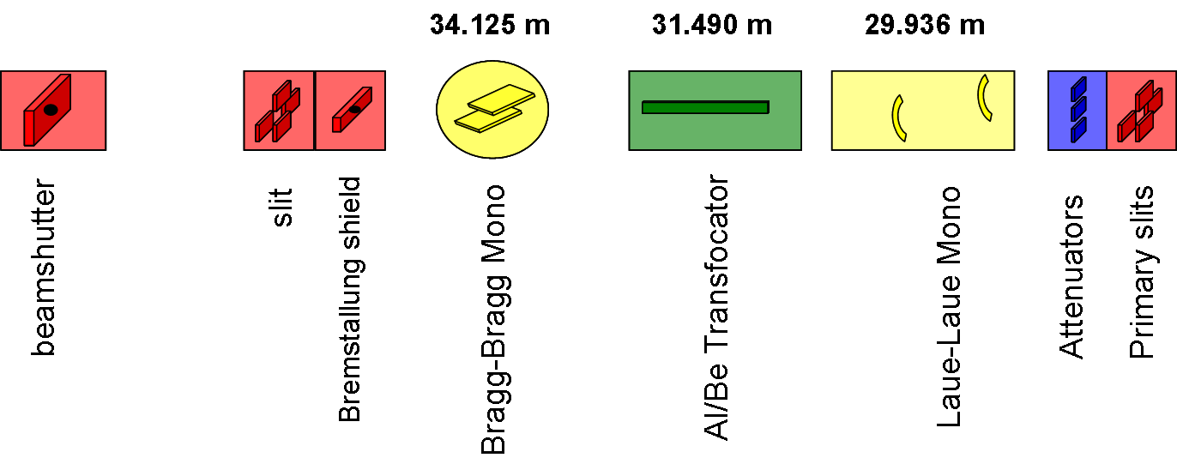
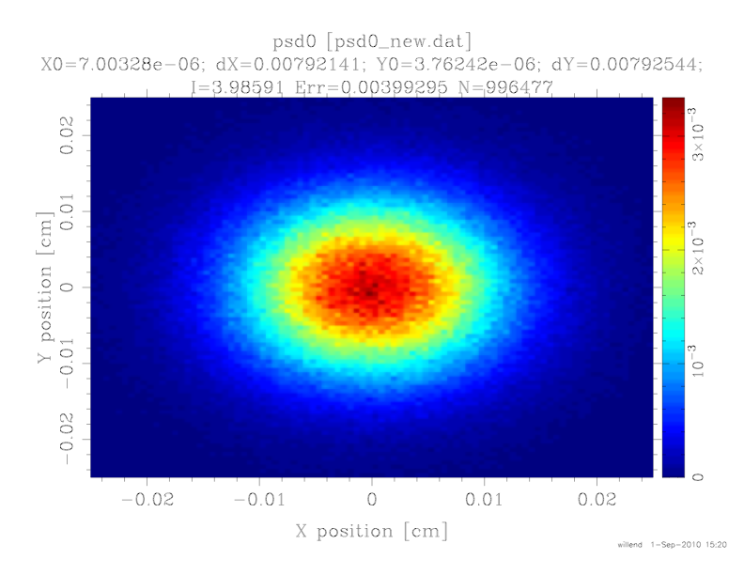
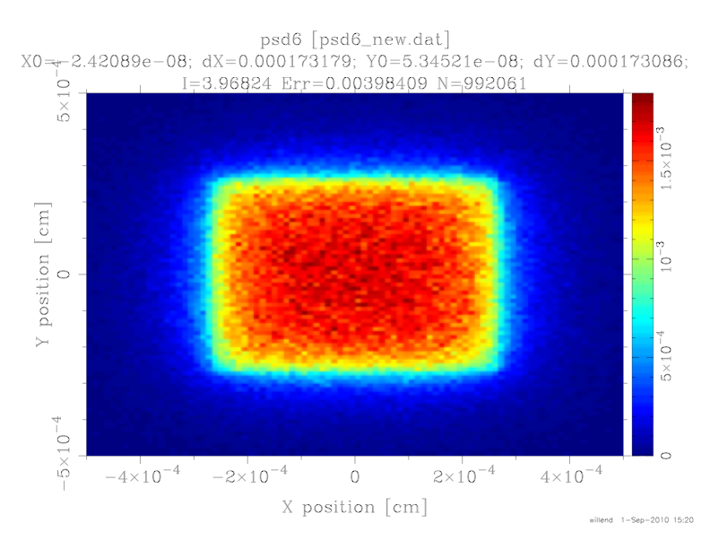
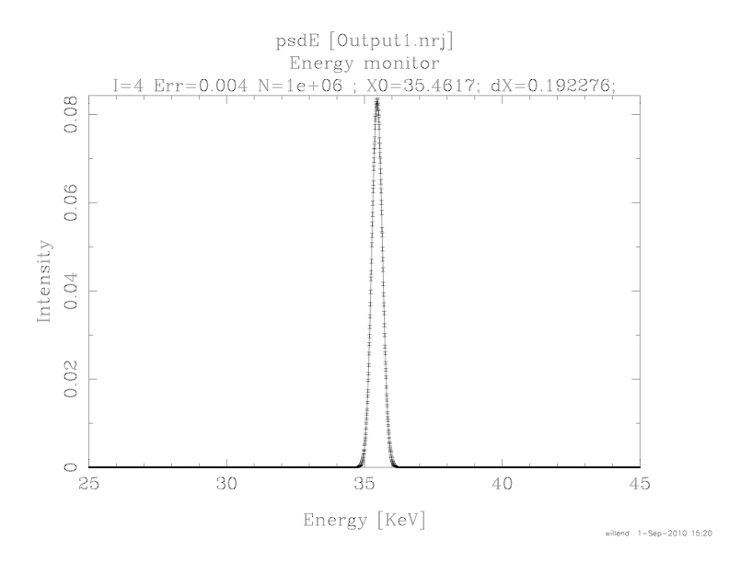
Mc-Xtrace simulation
500μm
10μm
18
McXtrace presentation, Sept 2010

Slide 19
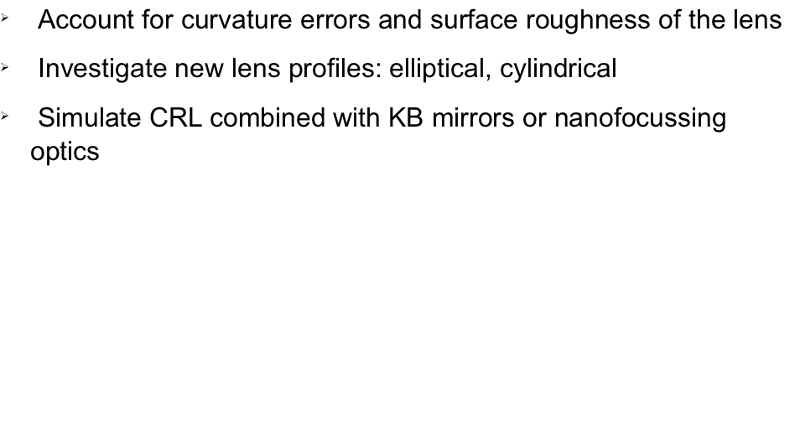
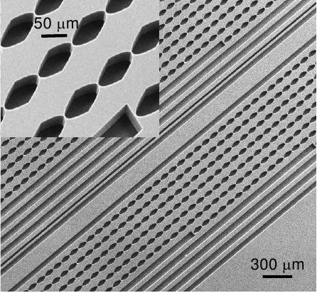
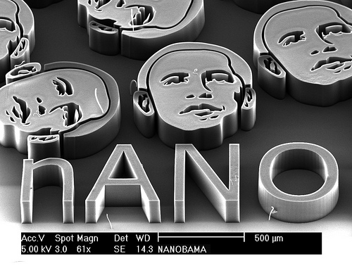
Mc-Xtrace will do more...
Si nanolens chip
Does nANO Obama focus ?
It works at all scales!
19
McXtrace presentation, Sept 2010

Slide 20
Timeline, XFEL relevant milestones
McXtrace project lasts 4 years (2009-12)
First official release out in 2010
First user training workshop in 2011
Expect first “validation” publication in 2011
…
20
McXtrace presentation, Sept 2010

Slide 21
Strong points
Modularity
Parallelization implemented already (MPI), CUDA draft implementation
Open Source “community code”, already has DK-FR collaboration and input from consultants (Feidenhans’l, Friis-Poulsen, Mortensen, Als-Nielsen…)
To be interlinked with “industry standard” software (Crystallographica, SHADOW, SPECTRA, XOP, PHASE, Fable, …)
Fine- or coarse-grained physics simulation
Would be easy to extract heat-load, ideas for influence on optics performance
Virtual experiments, convolution of machine and sample response
Teaching tool
XFEL has a chance to influence development plans
21
McXtrace presentation, Sept 2010

