Slide 1
McXtrace - an X-ray Monte Carlo ray-tracing software package
Erik Knudsen, Peter Willendrup, Søren Schmidt
Risø-DTU
Kim Lefmann, Andrea Prodi, Jana Baltser
University of Copenhagen

Slide 2
Code structure
Kernel vs. Component developer
Kernel:
    Propagation between components
    Positioning
    Code generation
Component developer
    Physics
    Interactions X-ray<->Matter
Notes:
Block diagrams about who has what resposibility
1) Kernel vs Simulator/Component developer
2) Instrument vs Component

Slide 3
Code structure
Component vs. Instrument
Instrument:
    Relative positions of components
    Interaction with simulator
Components:
    Interaction with X-ray wave packet
Kernel generated c:
    Not seen by users
Notes:
Block diagrams about who has what resposibility
1) Kernel vs Simulator/Component developer
2) Instrument vs Component

Slide 4
How?
Initially
  Independent particles
  State parameters
  Time domain prop. => k domain prop.
NEUTRON
(r,v,p,s)
X-RAY
(r,k,p,,t) etc.

Slide 5
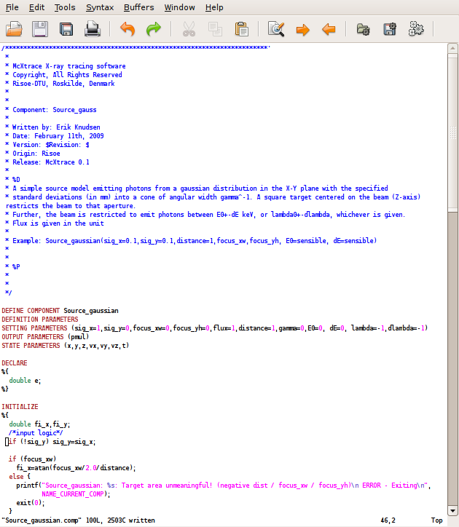
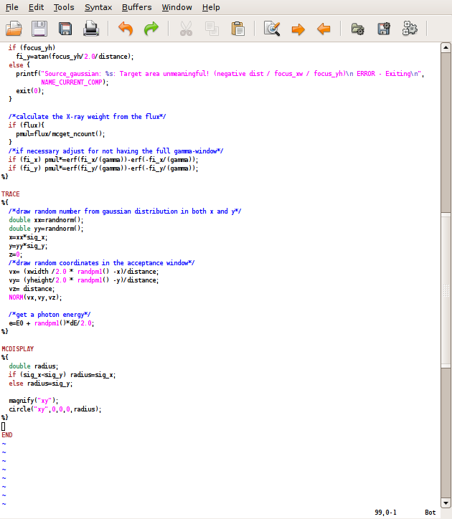
Component code

Slide 6
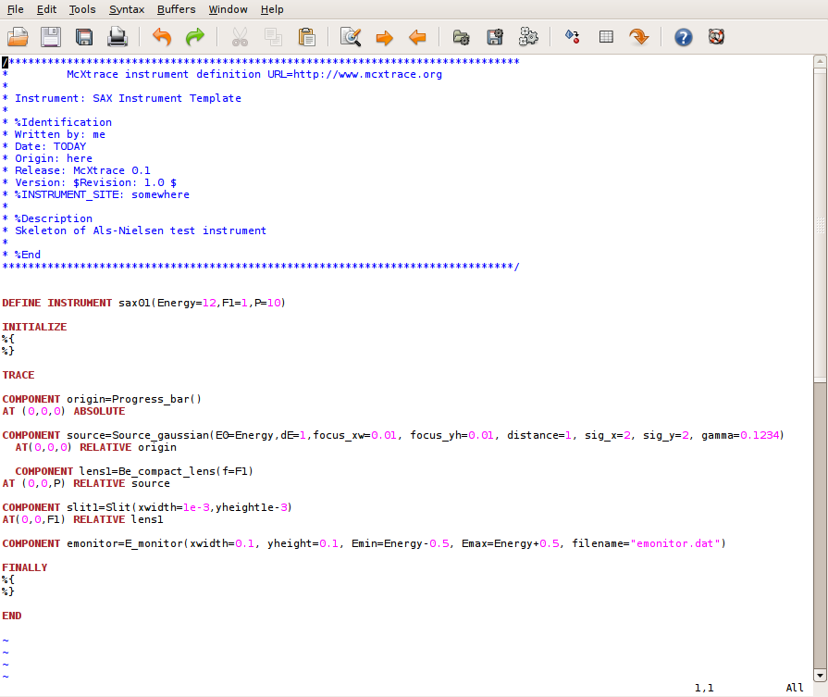
Instrument file

Slide 7
Generated code “buzzwords”
“Embarrasingly parallel” - linear speedup <1000 nodes via MPI (as tested on Teragrid)
Clever sampling
    SPLIT
    Focus windows
    Rudimentary adaptive source
Mersenne Twister random generator

Slide 8
Tie-ins with external software
General Philosophy:
  If someone else does it well, interface not reinvent
  BUT
  Have very simple versions in-house
Examples:
  Sources: Event files (from MCNPx, TRIPOLI4)
  Samples: S(q,w) (ab.initio model from VASP)

Slide 9
Sources
NEUTRON
X-RAY
MCNPx
TRIPOLI4
etc.
SPECTRA
XOP
URGENT
etc.
Event File
/
Brilliance Spectra
Event File
McStas
McXtrace
Virtual Source
Virtual Source

Slide 10
Interface CGRAPH
CGRAPH
Reflection list
Powder / Single Crystal component

Slide 11
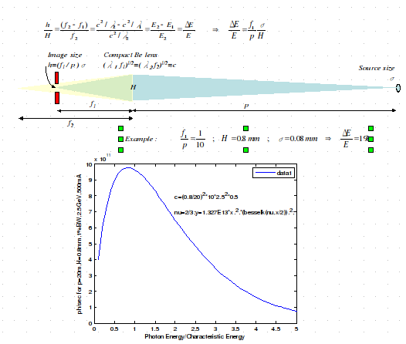
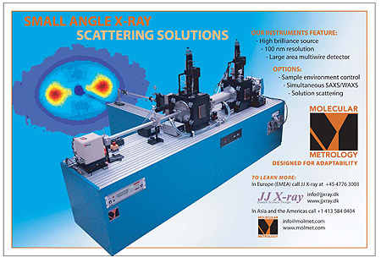
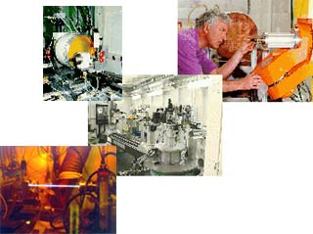
Examples and milestones
Low budget BL
JJ-Xray SAX
ESRF ID11

Slide 12
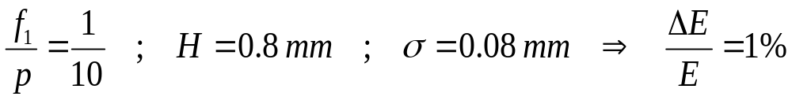
Low-budget monochromtic BL
Image size
h=(f₁ / p )σ
Compact Be lens
(λ₁ f₁)^{1/2}=(λ₂ f₂)^{1/2}=c
Source size
σ
H
f₁
p
f₂
✔
✔
✔
Example :

Slide 13
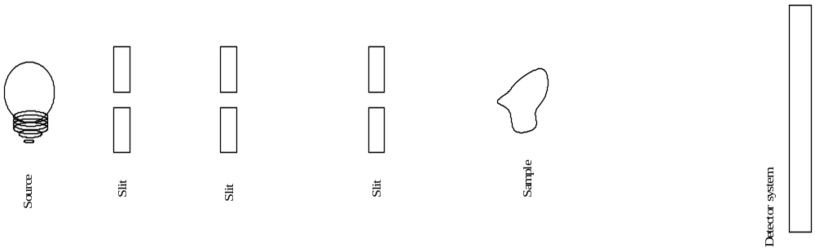
JJ-Xray SAX
✔
✔
✔
✔✘
✘

Slide 14
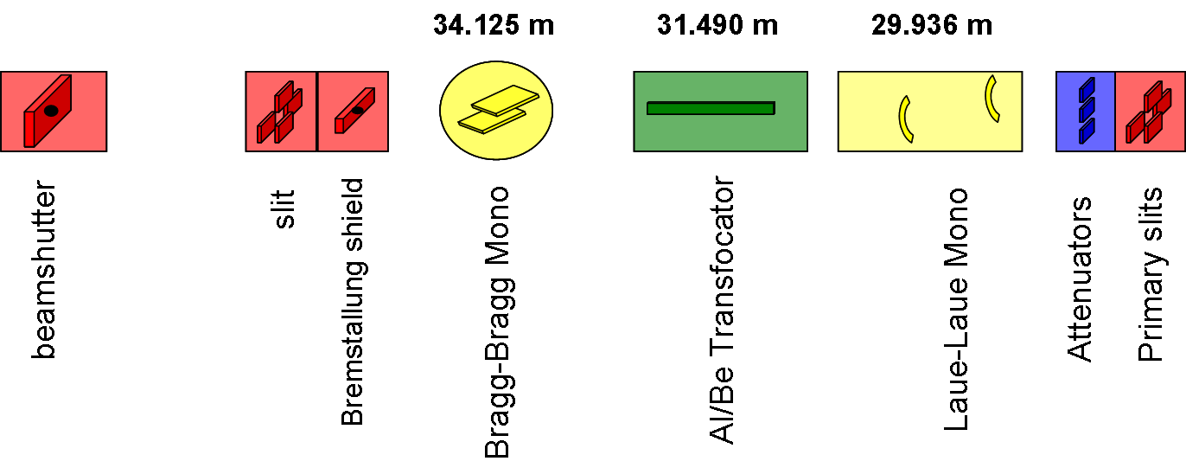
ID11 Primary optics
✘
✘
✘

✘
✔
✔
✔
✔
✔

Slide 15
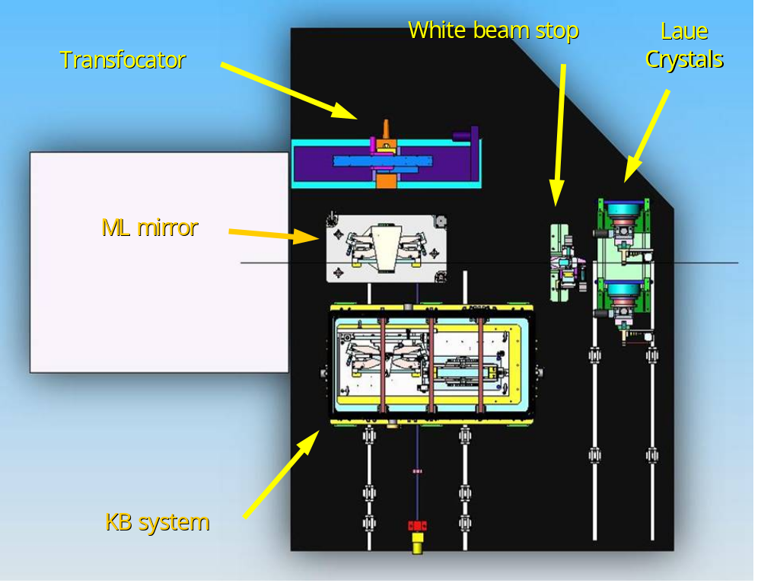
ID11 Focussing Optics

✘
✘
✔
✘


Slide 16
Port neutron comps in McStas
Monitors
  almost all portable
  easy to port
    => port on use basis
Sources
  most non-portable
Optics
  50/50 portable
  Either trivial or not at all
Samples
  50/50 portable
  Fairly easy

Slide 17
X-ray comps. In McXtrace
Monitors
  Energy, wavelength, PSD...
Sources
  Simple flat, point, flat divergent, flat gaussian
Optics
  Simple perfect slit, Simple compound lenses, Cylindrical mirror
What do you need?

Slide 18
Going forward
Post Doc working on partial coherence
  pre/post processing scheme
  Existing matlab model
General invitation to everyone:
  Contribute as much as you wish!
  Open Source (GPL) => Copyleft
    Website: www.mcxtrace.org
    Mailing list: mcxtrace-users@mcxtrace.org

Slide 19
Funding
NABIIT
  4 years funding
    2 postdoc., 2 Ph.D.-students
  Simulation
  Experimentation w. SAX on Nanodiscs
  Validation of Simulations

