Slide 1
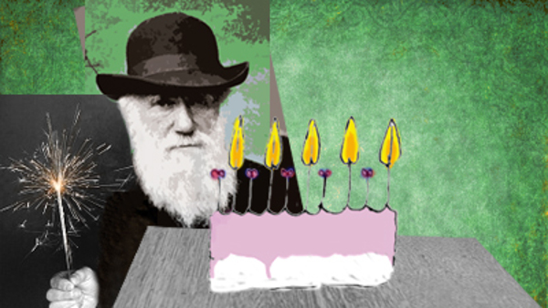
Happy Birthday Charles Darwin!
(February 12, 1809)

Slide 2
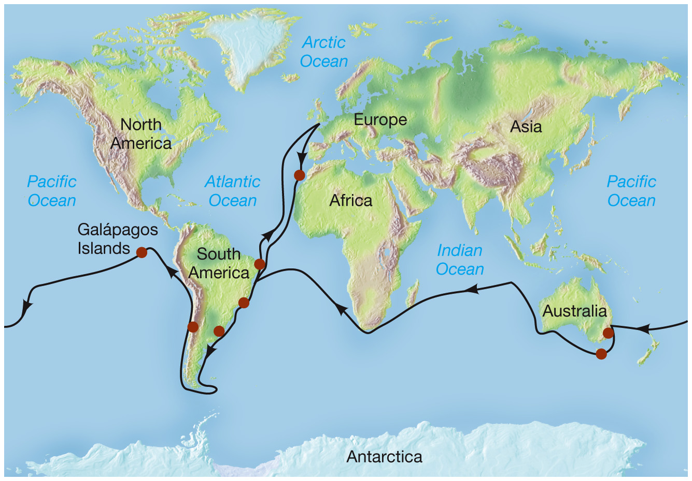
Voyage of the Beagle (1831-1836)
<number>

Slide 3
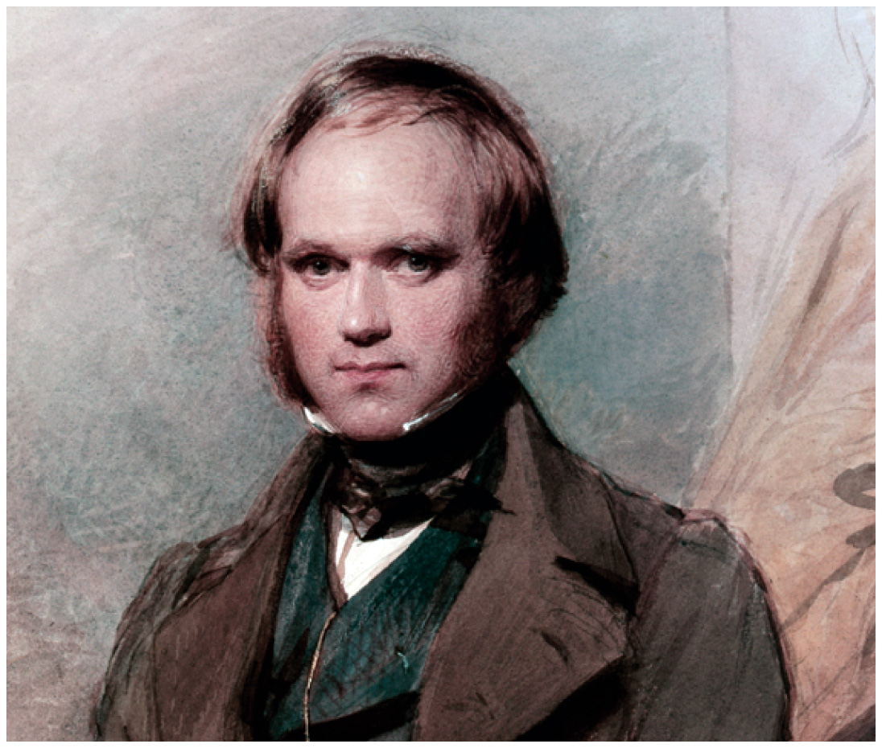
Where do different species come from?
<number>

Slide 4
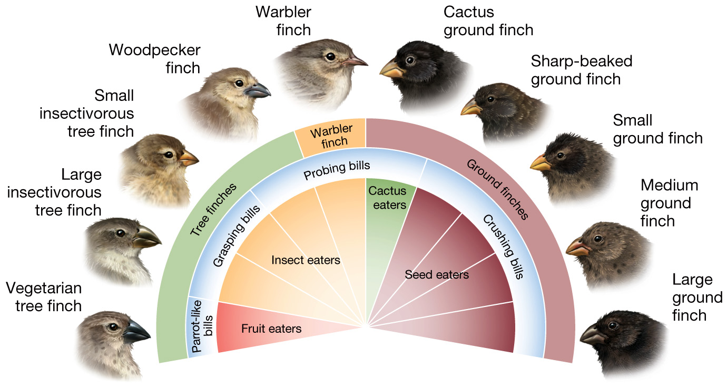
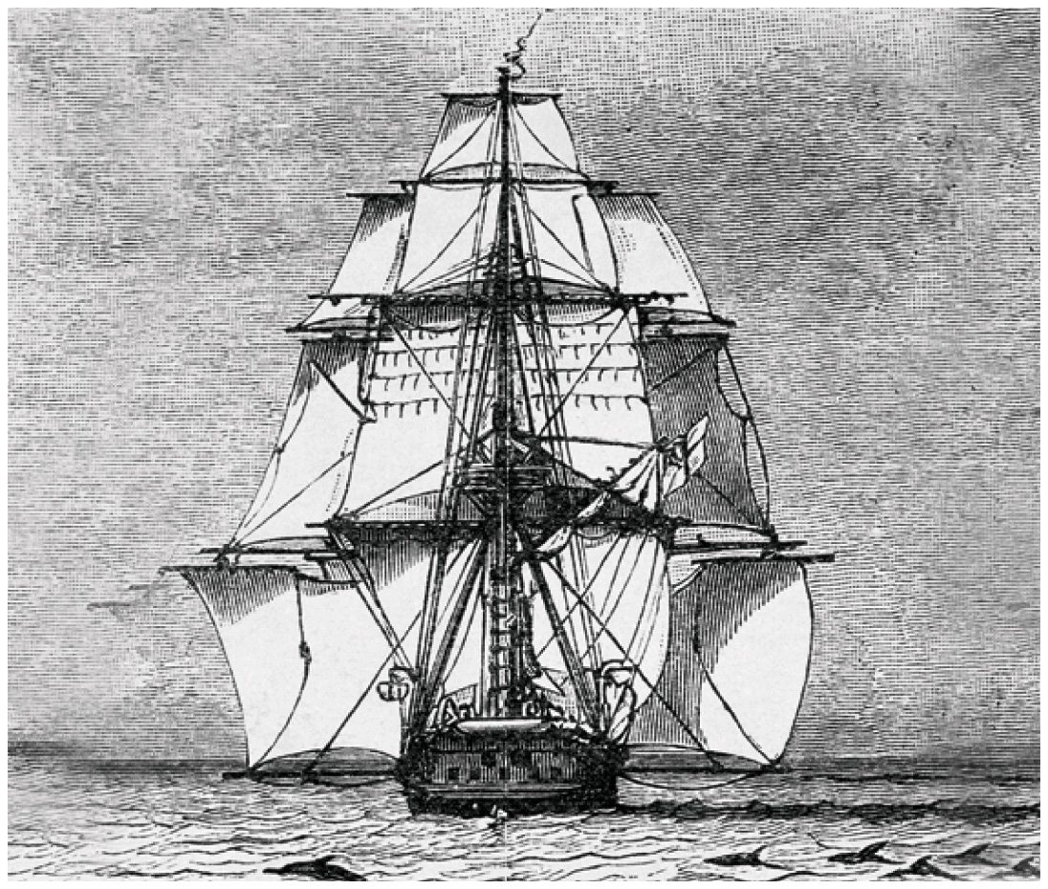
Voyage of the Beagle
<number>
Notes:
Travelled around the world and was very affected by the organisms he saw, but also the evidence of geological changes, and plate tectonics. Started to grasp how old the world might really be.
<number>

Slide 5
“. . . a naturalist, reflecting on the mutual affinities of organic beings, on their embryological relations, their geographical distribution, geological succession, and other such facts, might come to the conclusion that each species had not been independently created, but had descended . . . from other species.
Nevertheless, such a conclusion . . . would be unsatisfactory, until it could be shown HOW the innumerable species inhabiting this world have been modified . . .”
Notes:
<number>

Slide 6
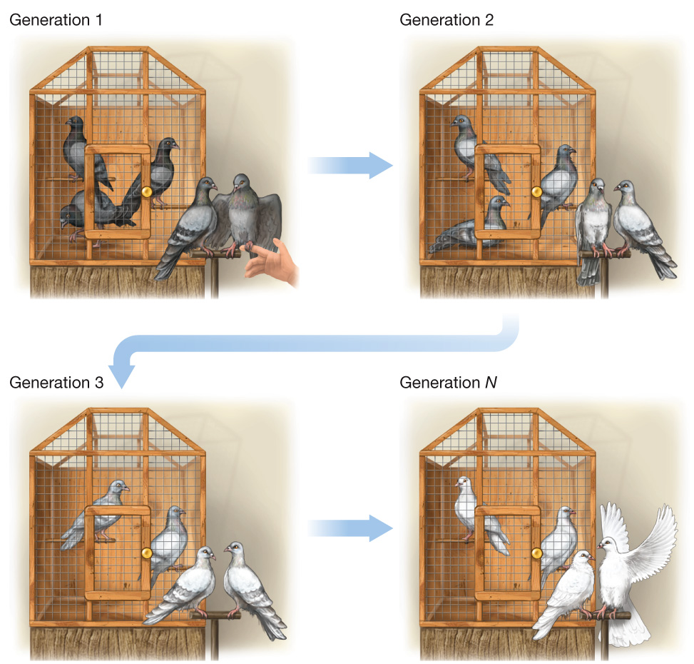
The Origin of Species (1859)
Darwin thought that by starting with the process of artificial selection that describing the process of natural selection as a generator of new species would be less controversial.
It wasn’t.
<number>

Slide 7
Darwin’s process
Darwin’s four postulates explain why/how evolution occurs:
Individuals within populations are variable
Some of these variations are passed onto offspring
Not all individuals produce the same number of offspring
Individuals with certain heritable traits produce more offspring
Notes:
How different from Lamarck’s process? It is a process of sorting individuals, not transforming individuals.
<number>

Slide 8
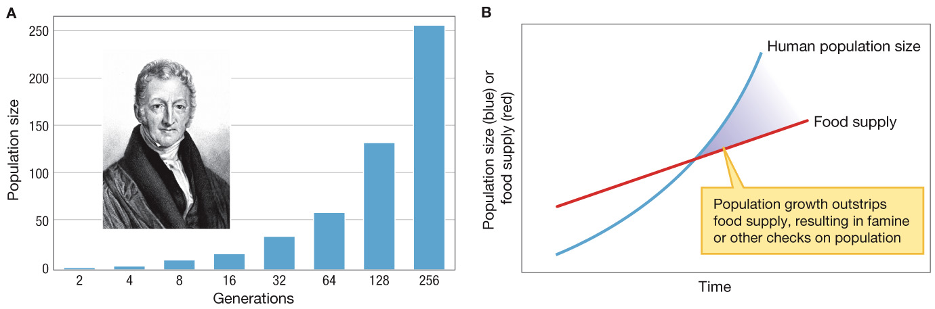
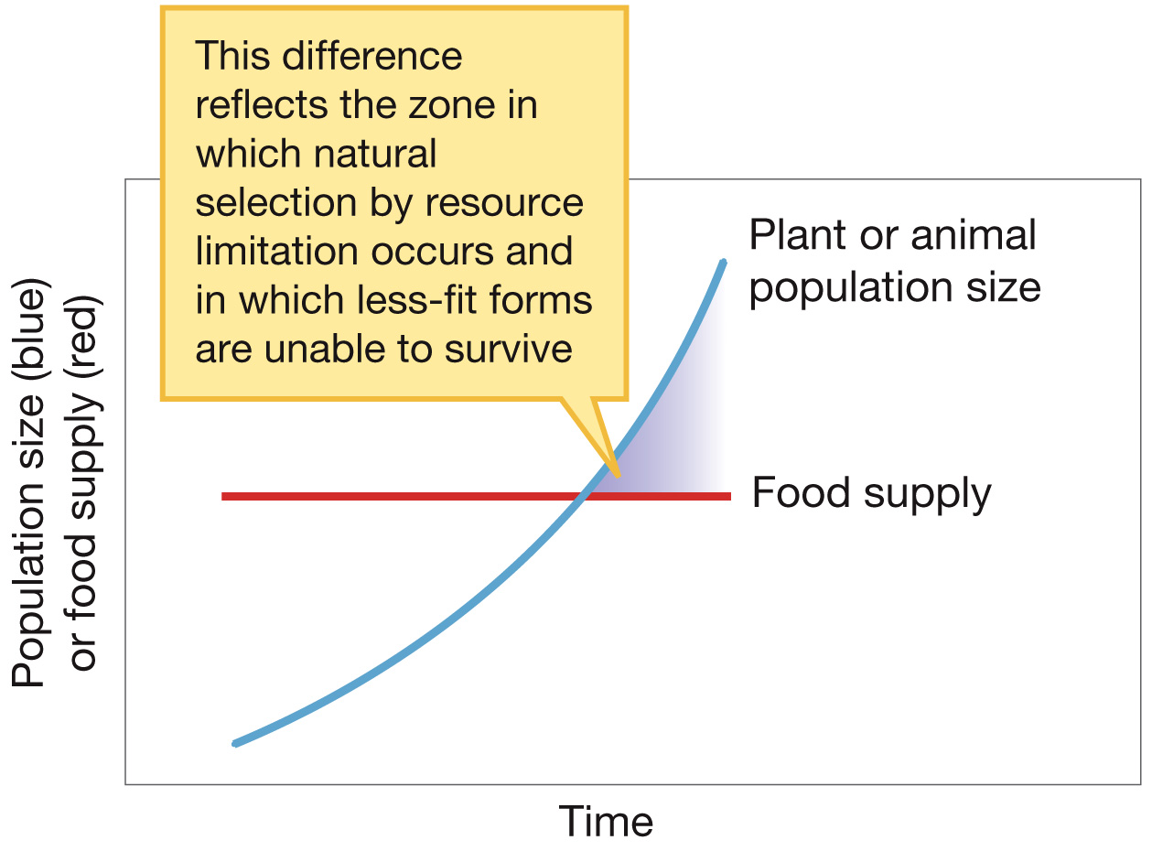
Darwin borrowed ideas from Malthus (1798) to show how natural selection operated as a population process
<number>
Notes:
Considering natural selection as a population process was an important step, as this shifted thinking from an individual perspective to the notion that an individual only mattered if it could reproduce, and reproduction was only going to happen if an individual was going to be in both a suitable environment with enough resources and that the species would only survive if enough individual were able to do this.
<number>

Slide 9
Darwin’s process
Let’s distill the 4 postulates to their essence
Natural selection occurs when:
1. Heritable variation
leads to
2. Differential reproductive success
KEY POINT: Evolution is simply an outcome (the pattern) of this process.
Notes:
The focus should be on reproduction, not survival!
<number>

Slide 10
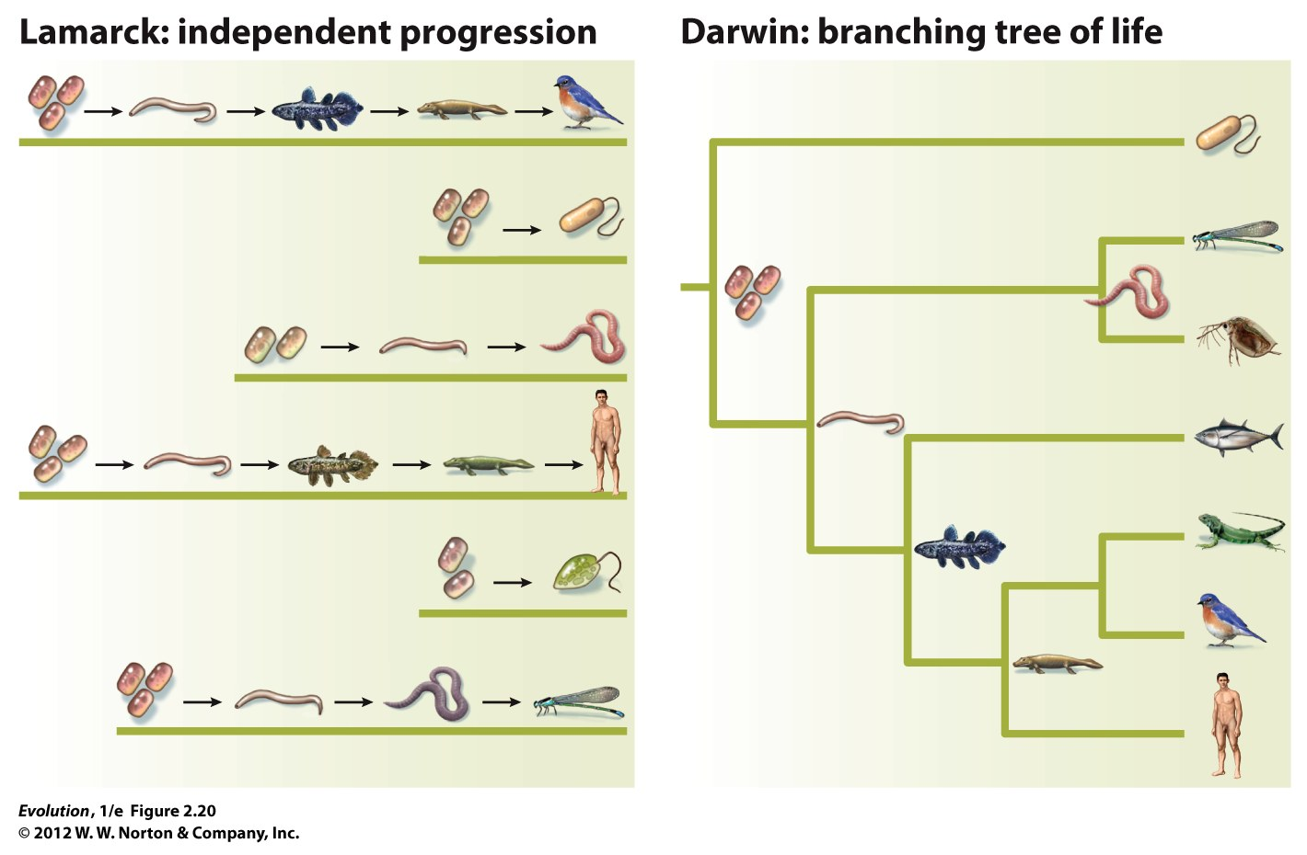
Notes:
<number>
FIGURE 2.20 Darwin’s theory versus Lamarck’s theory.
In Lamarck’s theory, species evolve independently and in parallel; in Darwin’s theory, species are descended one from another to form a branching tree of life.

Slide 11
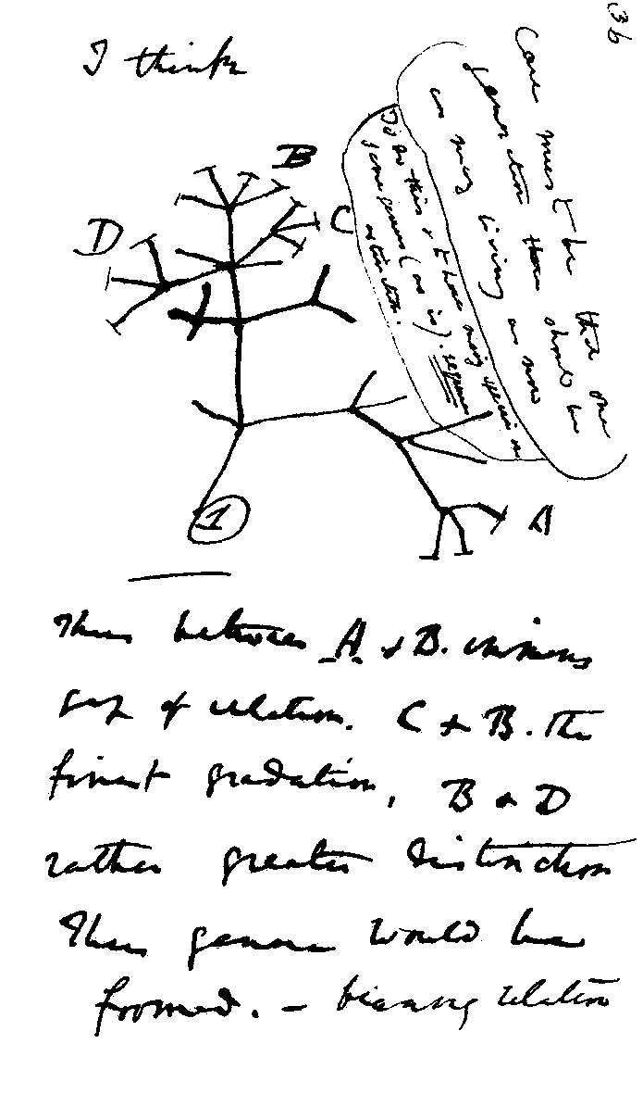
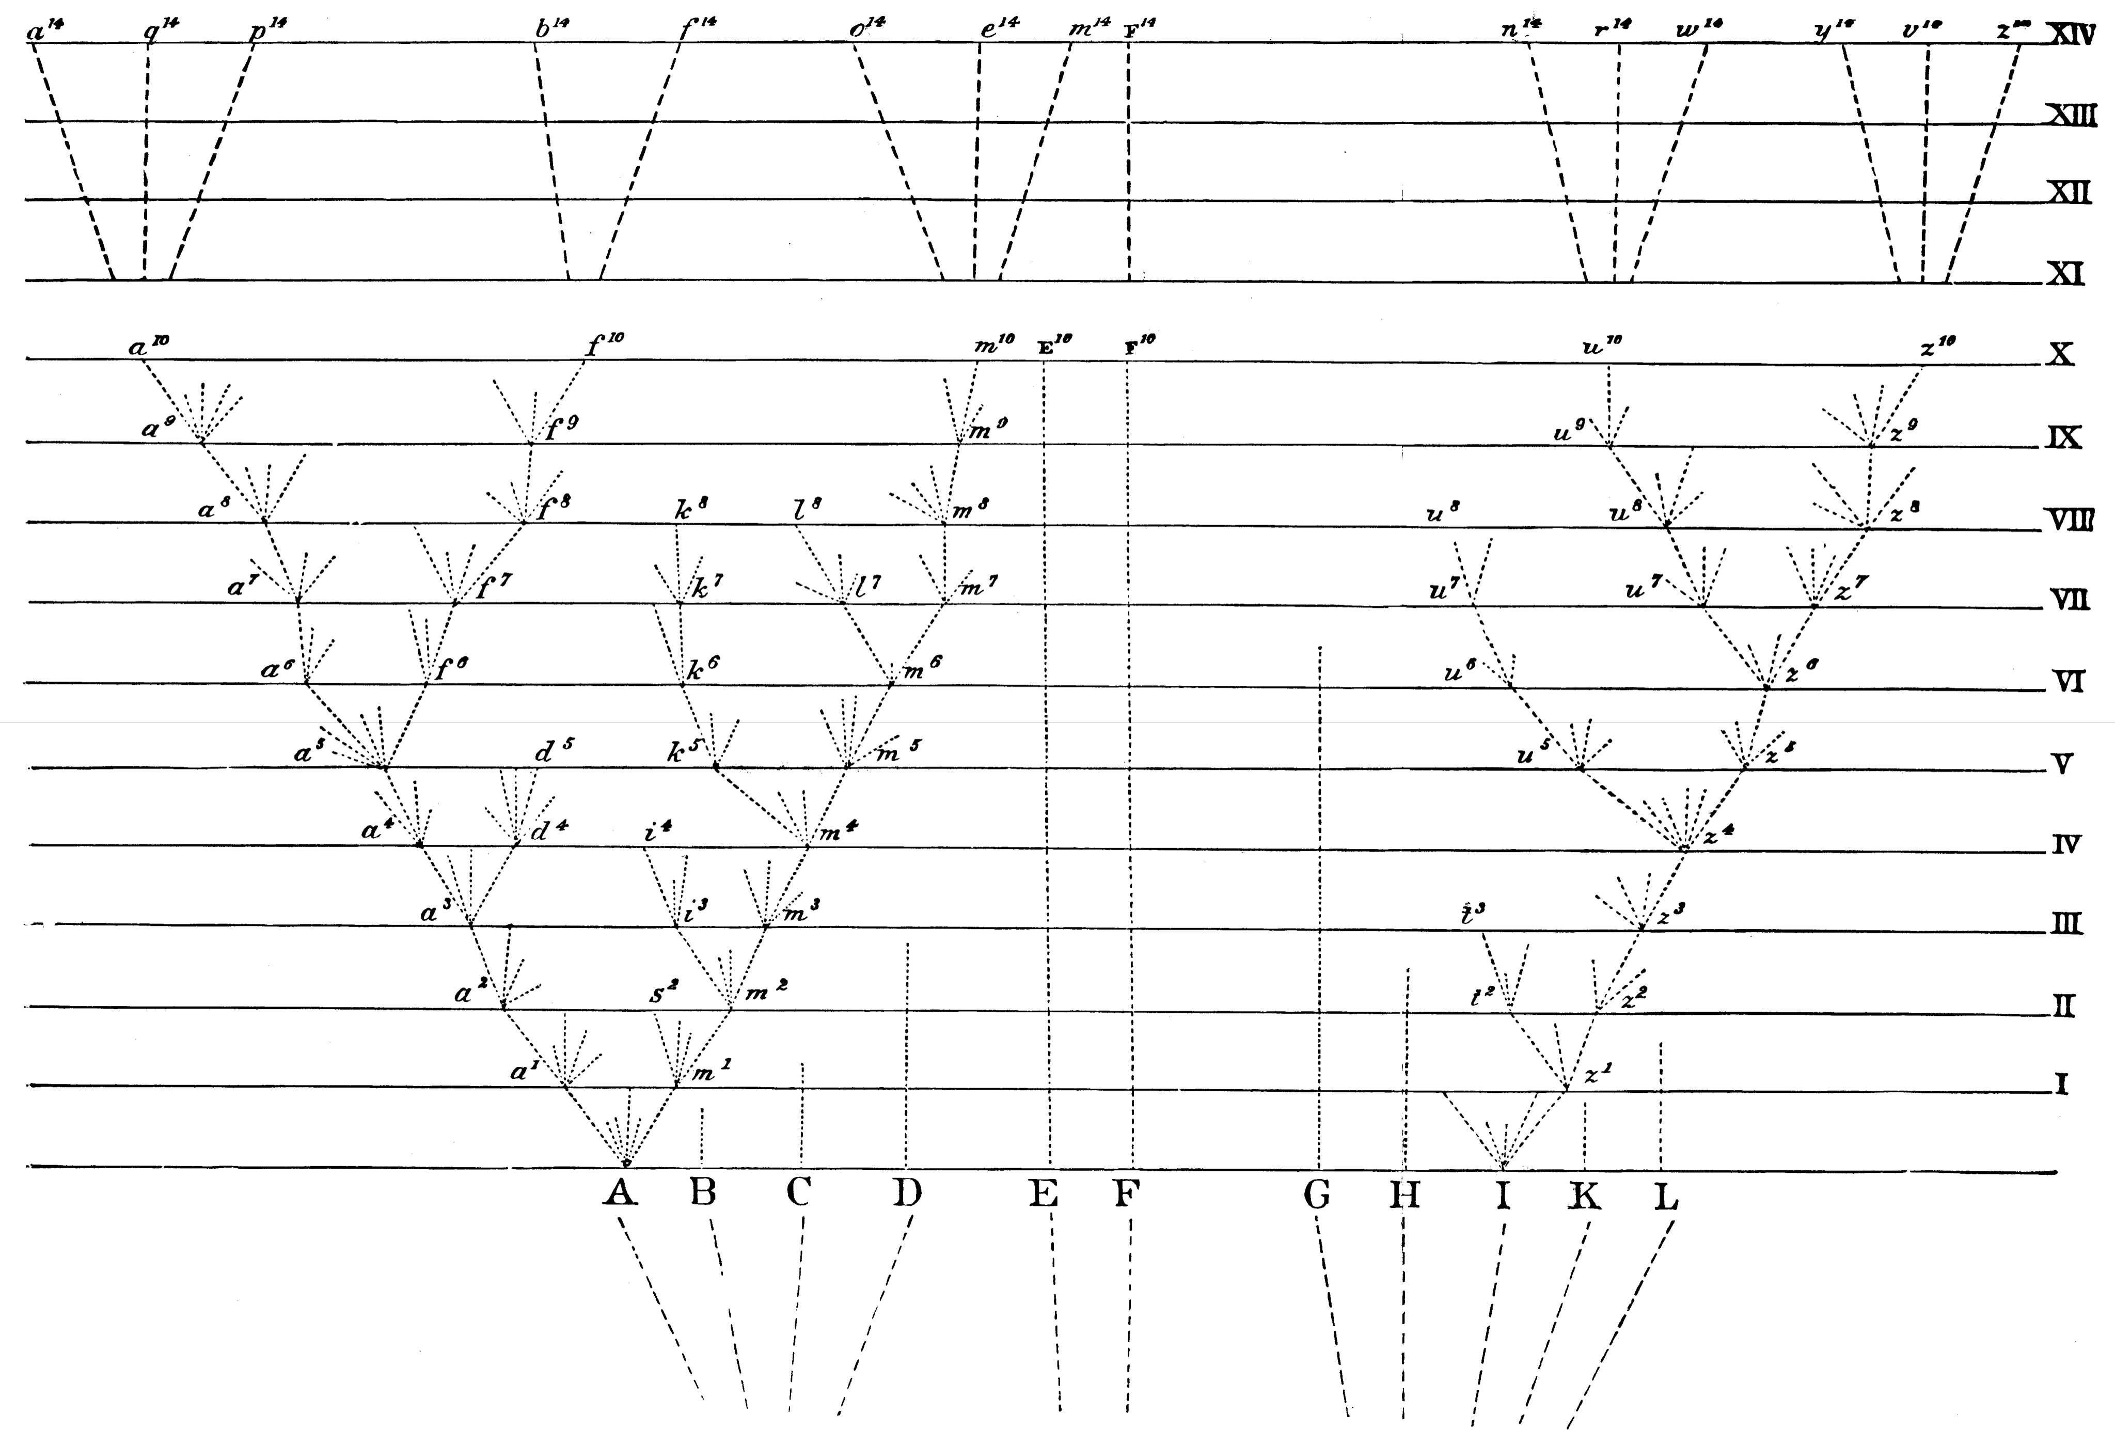
Evolutionary relationships -- « tree of life » -- phylogeny
Darwin (1859)
<number>
Notes:
<number>
Given this the only reasonable way to depict this process is through a phylogeny, with Darwin coining the term tree of life.

Slide 12
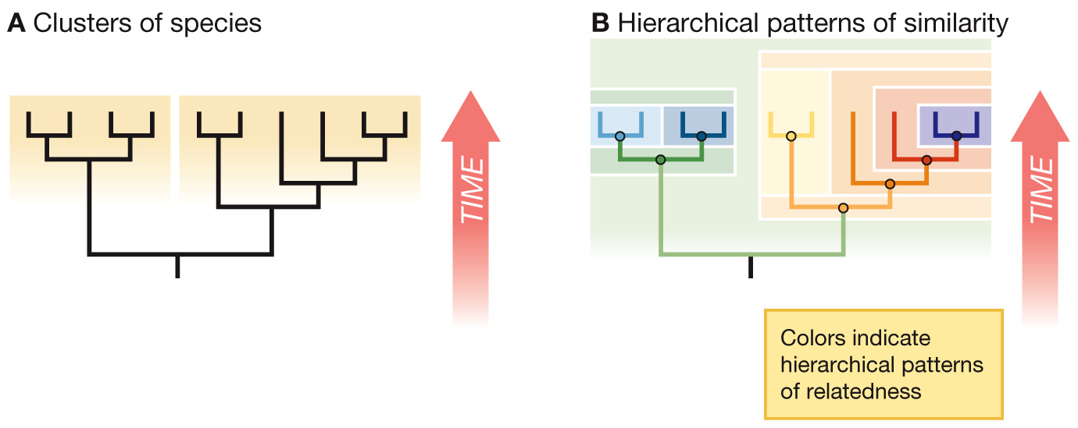
Phylogenies exemplify common descent
…hierarchical similarity also forms the basis for modern systematics
<number>
Notes:
<number>

Slide 13
Darwin revolutionized biology
Population thinking
Variation is key, not a mistake!
Tree thinking
Thinking about the evolutionary relationships among species is integral to understanding the evolution of characteristics
Notes:
<number>

Slide 14
Darwin had bad days too.
Darwin, in a letter to Lyell (1861)
<number>

Slide 15
Candy phylogeny
Imagine that these candies represent samples of different species,
which have diversified through descent with modification.
Make a character state matrix you can use to build a phylogeny.
1) Take 8 different kinds of candies
2) Fill in a worksheet with 10 characters (you decide!), and the character state for each candy type
3) Add your data to the super-matrix on the board, if it is not already included.
4) Using a clementine as the outgroup, draw a rooted phylogeny
and mark the synapomorphies on your tree
5) What is the score of your tree?
6) What are the splits in your tree?

