Slide 1
CIS342: Introduction to Systems Programming
Yuzhe Richard Tang

Slide 2
Administrivia
Instructor
Dr. Yuzhe (Richard) Tang
Office: 4-193, Sci-Tech Building
ytang100@syr.edu
Course syllabus:
http://tristartom.github.io/docs/syllabus-cis300.pdf

Slide 3
Teaching Goal
Learn how to program in Unix environment
Notes:
Difference to ‘Intro to crypto’. We are not interested in construction!!

Slide 4
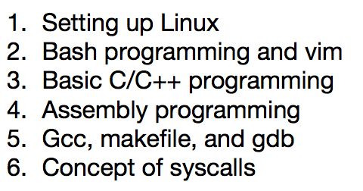
Teaching Goal
Learn how to program in Unix environment
Prerequisite:
Programming skills in Java/C/C++/etc (ECS102)
Skills to learn (from Syllabus [link])
Notes:
Difference to ‘Intro to crypto’. We are not interested in construction!!

Slide 5
Evaluation
This is 2-credit course
In-class exercises
Bring your computer to the classroom.
Exams

Slide 6
Materials
Slides/lectures are the most important!
In Blackboard/github webpage
Recommended readings
Bash
Bash Guide for Beginners: http://tldp.org/LDP/Bash-Beginners-Guide/html/index.html
Advanced Bash-Scripting Guide: http://www.tldp.org/LDP/abs/html/
System programming in C/C++/GDB:
Unix Programming Tools: http://cslibrary.stanford.edu/107/UnixProgrammingTools.pdf
Using GNU's GDB Debugger: Memory Layout And The Stack: http://www.dirac.org/linux/gdb/02a-Memory_Layout_And_The_Stack.php
CSAPP: Computer Systems: A Programmer's Perspective, by Randal E. Bryant and David R. O'Hallaron

Slide 7
Being an SU Student
Student Status
Good Standing, or Hold
Make sure you understand what each means
Grade and Transcript Issues
Course drop deadlines
link: www.syracuse.edu/academics/calendars/quarter-term/
Add deadline* Jan. 23
Financial drop deadline* Feb. 6
Academic drop deadline* Feb. 6
After that, you get the grade you get, stays on transcript
Grades stay on transcript, counts for your GPA
Very hard to compensate an F!

Slide 8
Honor Code
Syracuse University has an Academic Integrity Policy
Read it! (http://supolicies.syr.edu/ethics/acad_integrity.htm)
Violations WILL be reported!
Grading based on your own work
Do NOT allow ANYONE see your work
Do NOT try to look at ANYONE’s work
ANYONE includes other students, friends, family, resources from the Internet, etc.
Work includes code snippet, hw solutions, etc
Penalties for cheating are high
Best-case scenario: lose a letter grade
Worst-case scenario: expelled from the University
Don’t take chance! Cheating WILL be detected.
JUST DON’T CHEAT!

Slide 9
Why you need to learn Bash/Vim/C++
A quick demo
What’s going on there.

