Slide 1
Route Ranger: A Database System for all Hiking Enthusiasts
By:
Brian Kenney & Julia Nguyen

Slide 2
Overview
Scope of your app:
Route Ranger app is a database system that stores and lists all hiking trails available in the United States.
The issue is that it can be a hassle to find hikes given the plethora of data available on the internet, this app aims to simplify the process
Route Ranger capabilities:
Route Ranger shows users all the trails in the United States
Simple and sleek design
How will users interact with the app?
The database system is contributed by its users, each of who may add additional trails to the system. Every user can add trails such as description, latest status, trail condition, features, etc.
users can do the following:
Search existing trails
Add new trails
Update existing trails
Delete existing trails

Slide 3
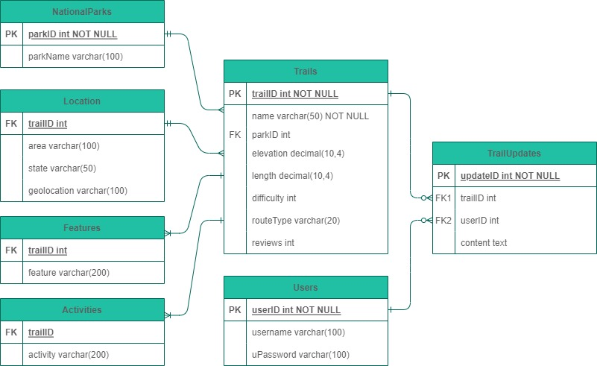
Database Design
Using Python packages Streamlit, Sqlite3, PIL, and Pandas to create the deployable database system
Following the first two normalizations given the relationship database design of SQL
1NF: One primary key that contains only unique values per table
2NF: All attributes in that table will rely solely on the primary key
Constraints necessary:
Primary Keys
Foreign Keys
Unique
Views (units needed)

Slide 4
Grading Criteria
Scope of your app (your goals): 20pts
Content: it is up to your team to decide how to demo your app: 50pts
Explain how your app works and show samples of its functionalities
Presentation 20 pts
clear content, good flow, and easy-to-follow explanations,
we suggest having at least a couple of slides for the project scope and a title slide with all team members listed
The demo can be done by one person on behalf of the team or all team can participate
Timeliness 10pts - Make sure your app is no longer than 5 min and no shorter than 4 minutes

Slide 5
Video Create and Upload
Option 1: Zoom Recording
Step 1. Start Zoom (zoom.iu.edu)
Step 2. Share screen via Zoom to record the presentation slides and audio (Handout Instructions).
Step 3. Save it to kaltura iu cloud or save to your local drive
If saved to kaltura
Log in to kaltura.iu and go to My Media
Select the video > click Actions > Publish > Select Unlisted or Published (Fig 1)
Select Share > Link to Media Page > copy the URL link
Figure 1. Select Actions > Publish > Unlisted
Screen Shot 2020-03-08 at 11.37.13 PM.png
Your Zoom recording is also saved in Zoom. You can download your video from the Recordings section (Zoom Video recordings are kept for ~120 days)
Download mp4 file (zoom recordings provide audio mp3 only and video+audio mp4). Then you can upload it to youtube or kaltura

