Slide 1
Route Ranger: A Database System for all Hiking Enthusiasts
By:
Brian Kenney & Julia Nguyen
Indiana University Bloomington
Luddy School of Informatics, Computing, and Engineering
Summer 2023
D532: Applied Database Technologies

Slide 2
Overview
Scope of your app:
Route Ranger app is a database system that stores and lists all hiking trails available in the United States.
The issue is that it can be a hassle to find hikes given the plethora of data available on the internet, this app aims to simplify the process
Route Ranger capabilities:
Route Ranger shows users all the trails in the United States
Simple and sleek design
How will users interact with the app?
The database system is contributed by its users, each of who may add additional trails to the system. Every user can add trails such as description, latest status, trail condition, features, etc.
Users can do the following:
Search existing trails
Add new trails
Update existing trails
Delete existing trails

Slide 3
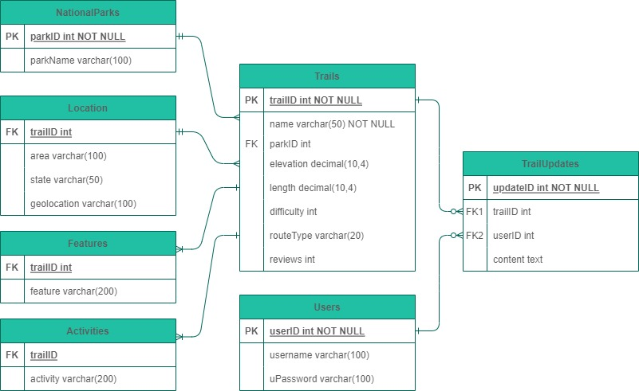
Database Design
Using Python packages Streamlit, Sqlite3, PIL, and Pandas to create the deployable database system
Following the first two normalizations given the relationship database design of SQL
1NF: One primary key that contains only unique values per table
2NF: All attributes in that table will rely solely on the primary key
Constraints necessary:
Primary Keys
Foreign Keys
Unique
Views (units needed)

