Slide 1
The Making of Department Schedules
An effort to optimize preferences

Slide 2

The Question
Can we use Python to create a schedule for the Math department that allows us to create an optimized schedule based on professors’ preferences?

Slide 3
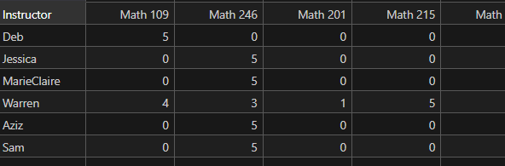
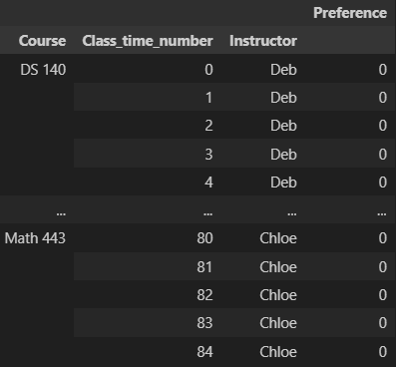
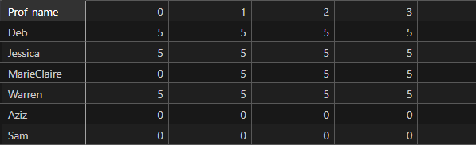
A table with all the preferences of all the teachers for each time and each class. The goal is to then optimize the preferences.

Slide 4
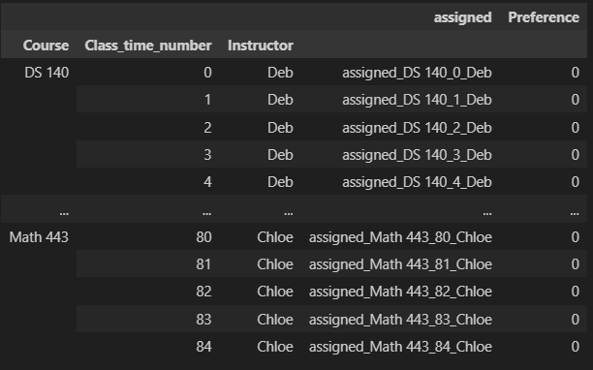
Creating a Model
Using linear algebra, we tell the program what equation we want solved and how we want it solved.

Slide 5
Constraints
If a class section happens at a time, then it must happen at that time throughout the week or not happen at that time at all.
A professor can only teach one class at a time
To increase variability in section offerings if a class has less than 8 sections, it should be offered at different times
Professors should teach between their minimum and maximum credits
Classes should be offered between their minimum and maximum number of sections

Slide 6
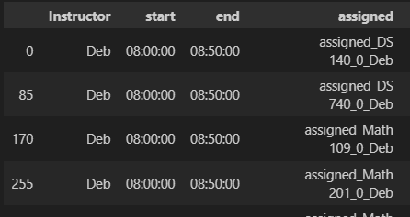
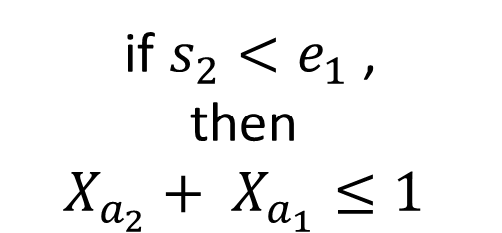





Teaching one class at a time
if $s_{2}<e_{1}$,
then
$$X_{a_{2}}+ X_{a_{1}}≤1$$

Slide 7
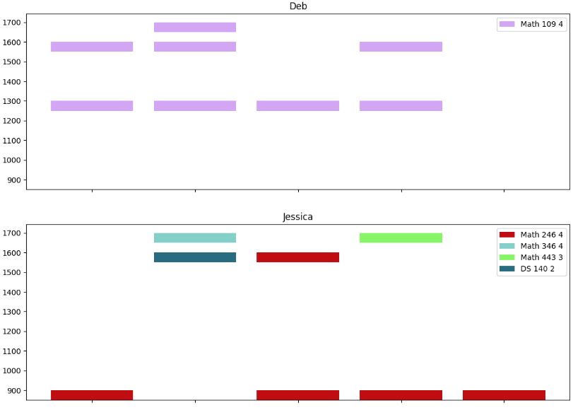
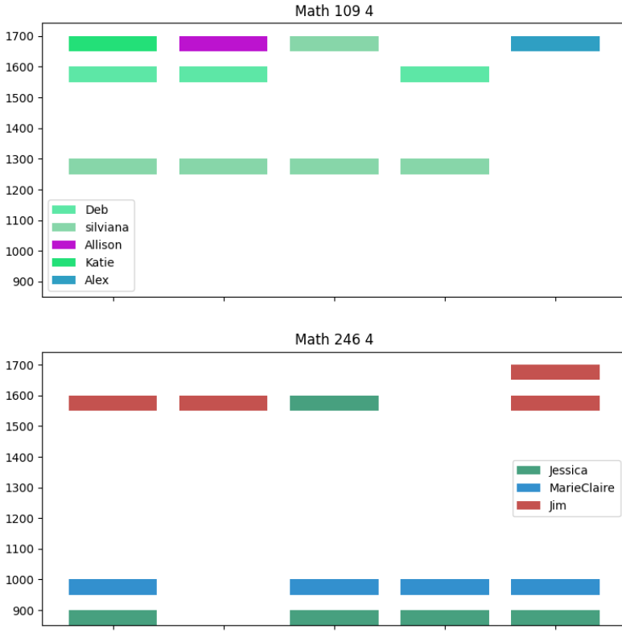

Visualizing the Results
Creating a visual allows us to see the results in a way that is much easier to understand and follow.

Slide 8
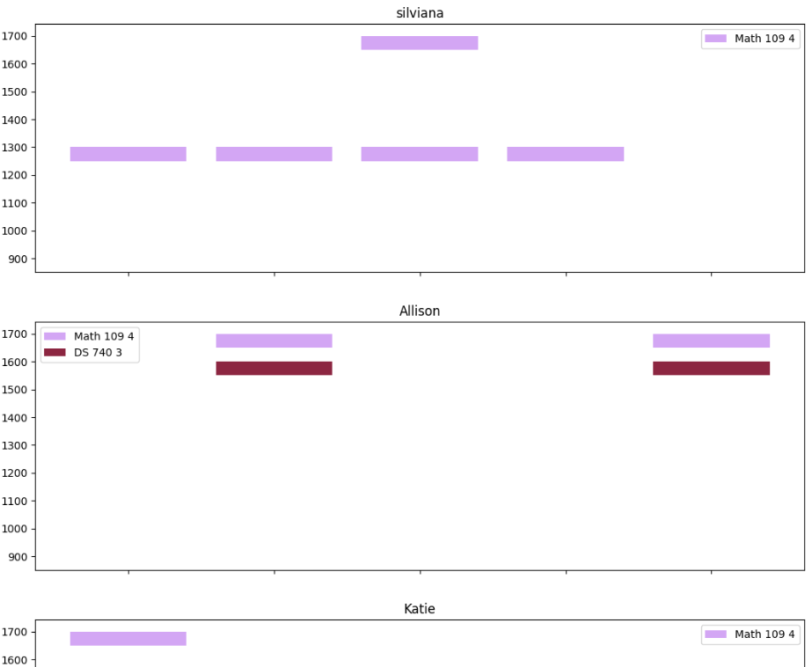



Slide 9
Future directions
- assignment across week error
- double check all constraints are working
- readability of code
- improve visualization of schedule

Slide 10
Questions?

Slide 11
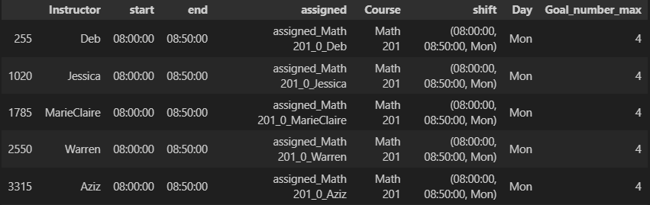





Variability in section meetings
If $s_{2}<e_{1} \text{and} { G}_{max}<8$,
then
$$X_{a_{2}}+ X_{a_{1}}≤1$$

Slide 12
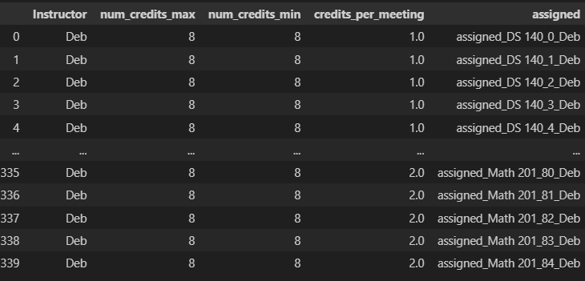
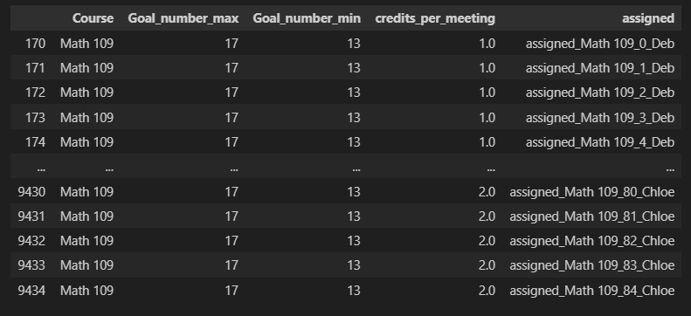
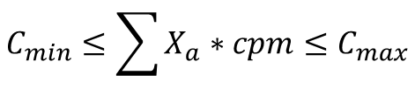
Professors and Classes credit max and min
$$C_{min}≤\sum{X_{a}∗cpm≤C_{max}}$$

Slide 13
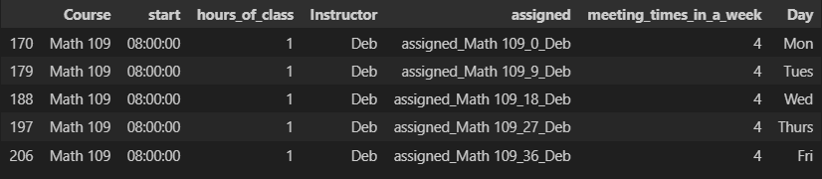

Assignment across week
$$\sum{X_{a}}=meeting times in a week$$
or
$$\sum{X_{a}=0}$$

