Slide 1
Welcome to BB2920: Genetics
Prof. Natalie Farny
1/12/2017
Lecture 1
ATC will be distributing clickers, please take one.
Syllabus and course schedule available online (We will cover a summary of important points from the syllabus. It is your responsibility to read the syllabus in full.)

Slide 2
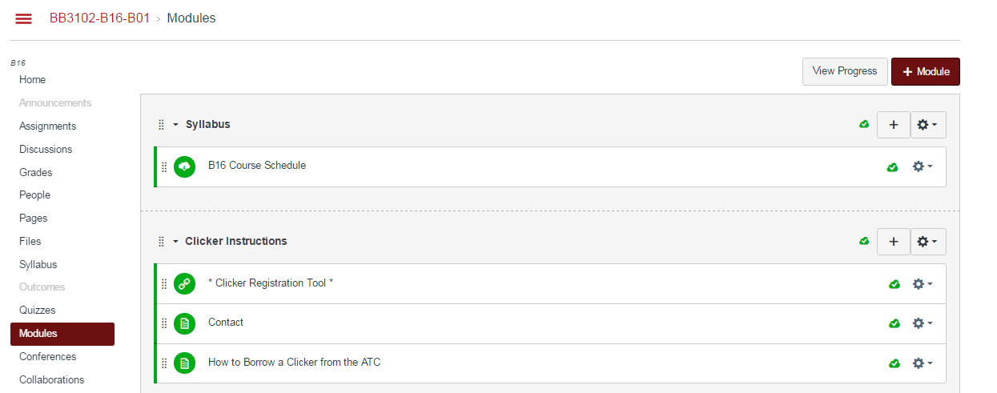
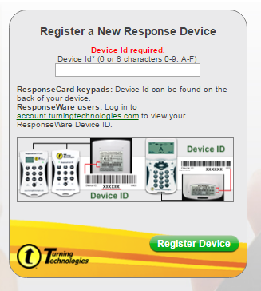
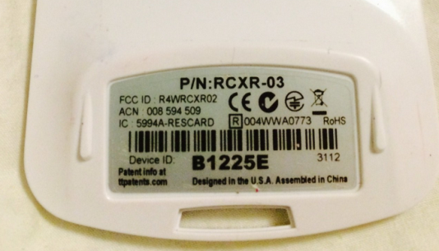
PLEASE…..
Register Your Clickers!!! Under “Modules” on Canvas.

Slide 3
What is your major?
Bio/Biotech or Biochem
BME
Other engineering
Other non-eng.
Undeclared

Slide 4
What year are you?
High school (Mass Academy)
Freshman
Sophomore
Junior
Senior
Grad. Student

Slide 5
Why are you taking this course? (choose the closest answer, but I am going to assume you are all here because you are SUPER excited about learning genetics)
Required for major or program (eg, pre-health)
Not required, but recommended, for major or program
Free elective/seemed like it might be interesting
I’m not sure why I’m here

Slide 6
Course Information
Office and Office Hours: GH203C, by appointment and announced (will be prior to problem set and exam dates)
Conferences: Wed 3pm HL116, problem solving with PLAs
Your PLAs:
Chloe LaJeunesse (cllajeunesse@wpi.edu)
Bernat Navarro Serer (bnavarroserer@wpi.edu)
Ginny Massa (vemassa@wpi.edu)
Shelby McQueston (smmcqueston@wpi.edu)
Recommended coursework: BB1035, BB2550 or BB2950, highschool-level knowledge of Mendelian genetics (remember Punnett squares?) and mitosis/meiosis, CH1010 is also strongly recommended

Slide 7
Overview of Course Policies
Canvas site: lectures and class capture, assignments and reading quizzes, JC quizzes
Participation 10%
Reading Quizzes: 5%
Problem sets: 20%
Journal club: 5%
Exams (3): 20% each, not cumulative in focus but in knowledge, if you fail Exam 1 you will hear from me
Grade cutoffs: 90+=A, 80-89=B, 70-79=C, <70=NR, this course will not be scaled.
Please review the course schedule carefully for quiz and problem set due dates and exams

Slide 8
Participation is worth 10%
Assessed by clickers
1 point per question (right or wrong)
Questions will be asked throughout each lecture
Each class will have at least one “Break-Out” problem solving session. You will solve a problem in groups, and enter your answers using your clickers.
~10% of clicker questions are excused (so you can miss a class or two without penalty). There are no make-ups for clicker questions

Slide 9
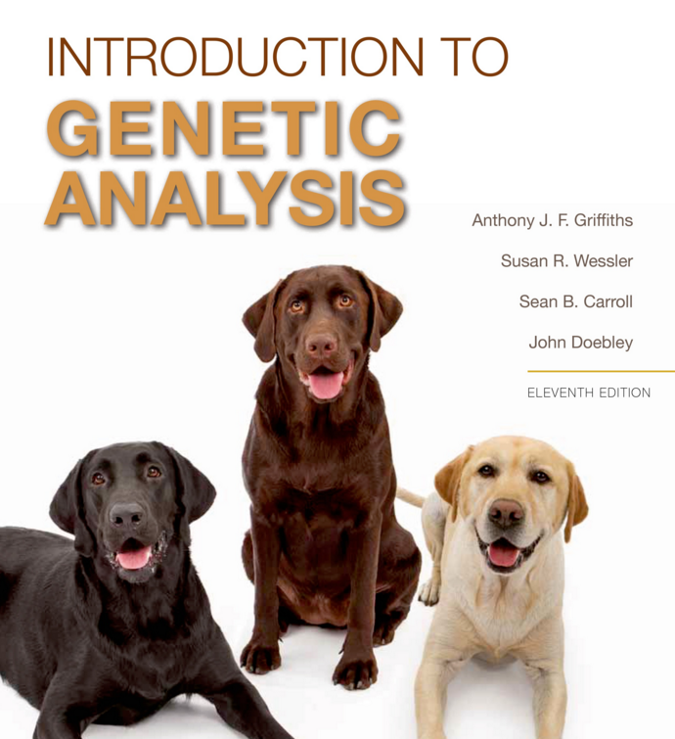
Textbook and Reading Quizzes
See Reading Schedule under “Assignments”
Exams will only cover material from class, but you must read in order to prepare for class
6 online reading quizzes worth 1% each (drop 1 lowest) will assess your reading
Reading quizzes are due BEFORE we talk about these topics in class. Why? Because scientific evidence on teaching indicates that students perform better in classroom activities when they have previewed the material.
Conference problems will come from this book
Can purchase/rent, get online only version, or there is a copy on reserve at the library
You may use other editions but are responsible for all assigned content from 11th ed.

Slide 10
isogenic
antimorph
phenotype
Genetics has its own unique vocabulary among biological disciplines.
You will need to “talk the talk” to do well in this course. Your reading will help you!
linkage
pleiotropy
genotype
codominance
recombinant
hemizygous

Slide 11
Problem Sets
6, drop lowest, 20% total
Check schedule for due dates
Help will be available from your PLAs during conference and office hours, and during my announced office hours
Assignments and solutions will be posted online
Due in class (handwritten NEATLY is ok, or typed)

Slide 12
Journal Club
Reading the current scientific literature related to course topics
Materials will be posted one week in advance, including the article(s), a reading guide and a journal club quiz (JCQ)
Three JCQs are 2.5% each, lowest dropped
Students will be randomly assigned to be responsible for certain questions on the reading guide (you will know your assignment in advance) and will be called upon during class to explain that question to your classmates.
All students will be expected to participate in our classroom discussion!

Slide 13
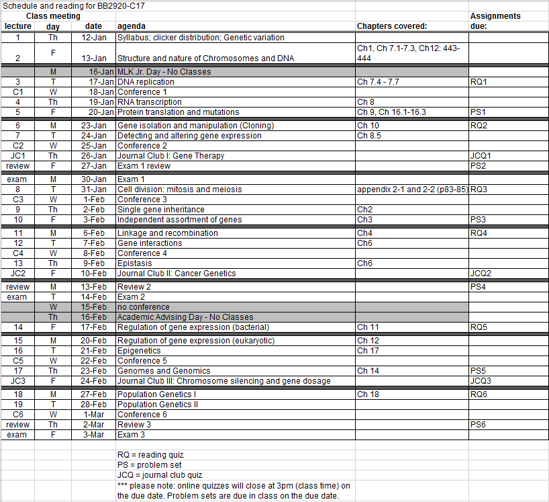
Check the course calendar on Canvas for due dates, and get these into your calendars now!!

Slide 14
Course Objectives - By the end of this course, students should be able to:
describe the sources and consequences of genetic variation, and genetic mutation, and their relationship to human conditions, and the functional and physical relationships between genes and gene products, genotype and phenotype;
apply knowledge of the molecular basis of genetic inheritance (DNA transcription and translation, RNA processing, and translation) to the interpretation of experimental data;
understand modern methods of manipulating genetic material in the laboratory, and demonstrate how these methods are used to test hypotheses;
predict and interpret the regulation of gene expression under specific physiological conditions, both in prokaryotes and eukaroytes;
apply the tenets of Mendelian inheritance to make predictions about the outcomes of genetic crosses;
analyze pedigrees to assess the inheritance pattern of genetic traits;
explain how the environment of a population influences its genetic constitution;
calculate human genetic disease risks;
read and participate in discussion of current scientific literature.

Slide 15

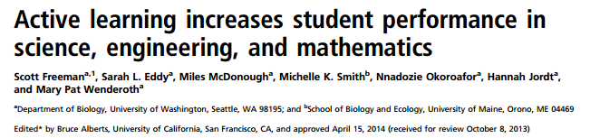
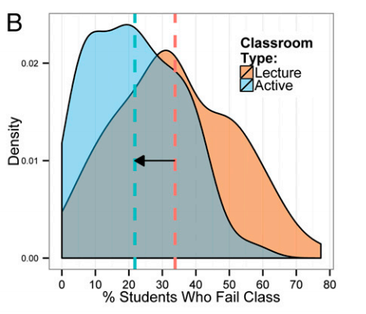
This is an active learning classroom. Please come prepared to participate! Why am I doing this to you?? Because scientific teaching tells us that active learning will help you get an A!!!
You are significantly less likely to fail! (or in our case, NR)
The same study shows an approximately 6% increase in exams scores in active learning classrooms vs. traditional lecture

