Slide 1
BB2920: Genetics
Prof. Farny
Lecture 11
2/6/17

Slide 2
Today’s Learning Objectives
Use the product and sum rules to calculate the probability of obtaining a genotype or phenotype from a multi-gene cross
Discuss linkage and recombination
Understand how to calculate recombination frequencies, and what that tells you about the relative location of genes.

Slide 3
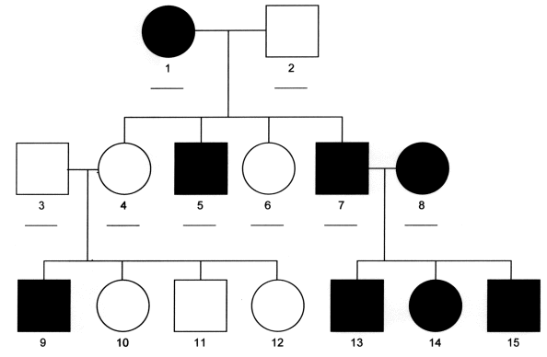
What is the inheritance pattern?
Autosomal Dominant
Autosomal recessive
X linked dominant
X linked recessive

Slide 4
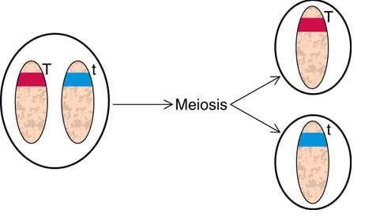
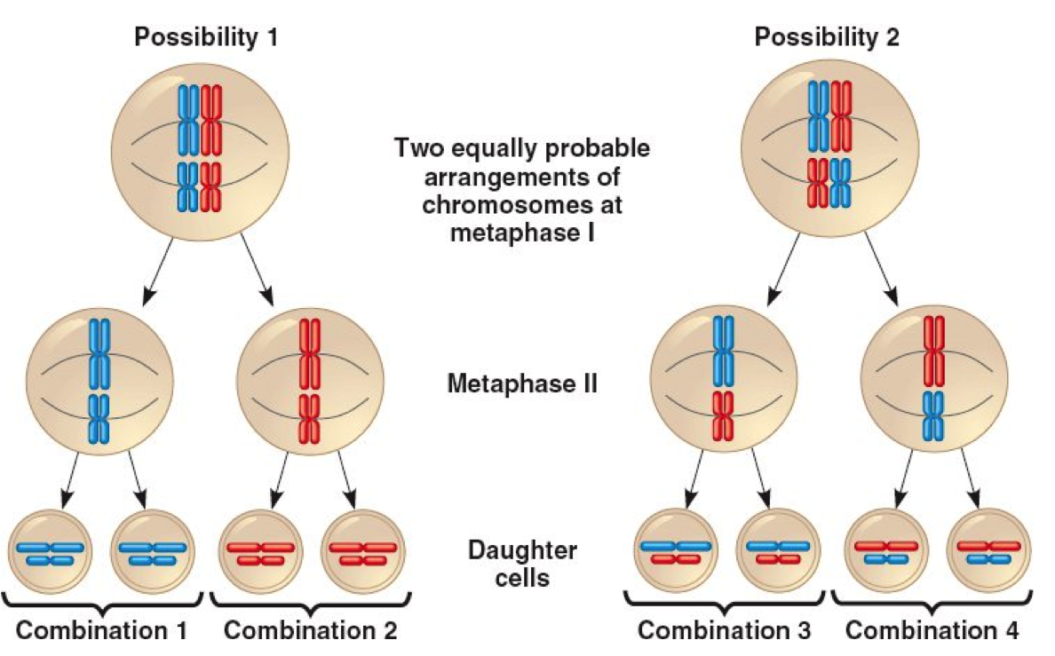
Mendel’s Laws
1: Equal segregation of alleles into gametes (I.e. the two alleles will always separate from each other)
2: Independent assortment of traits (genes) located on different chromosomes

Slide 5
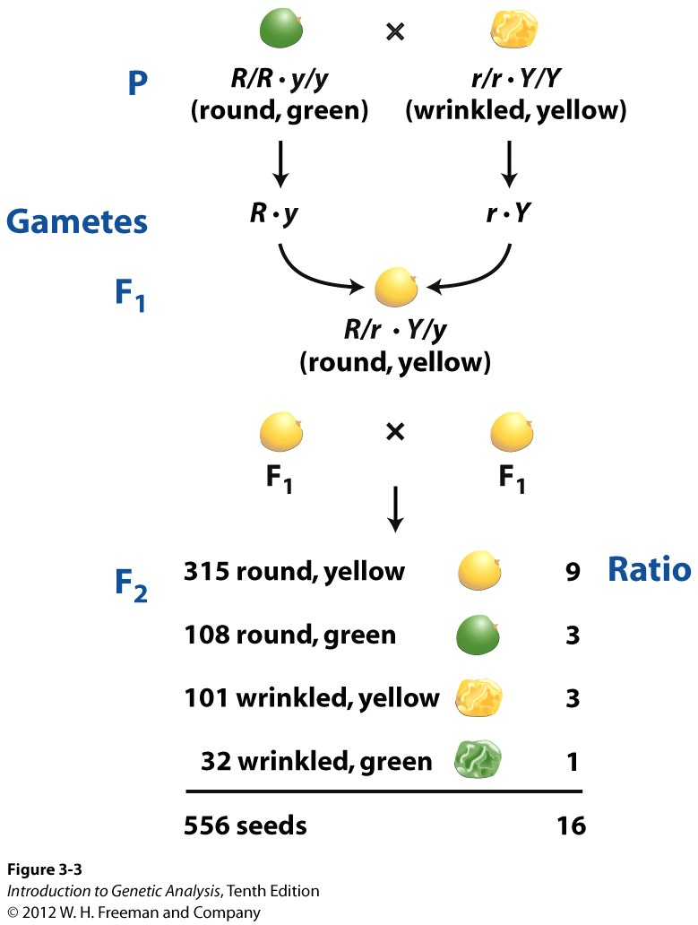
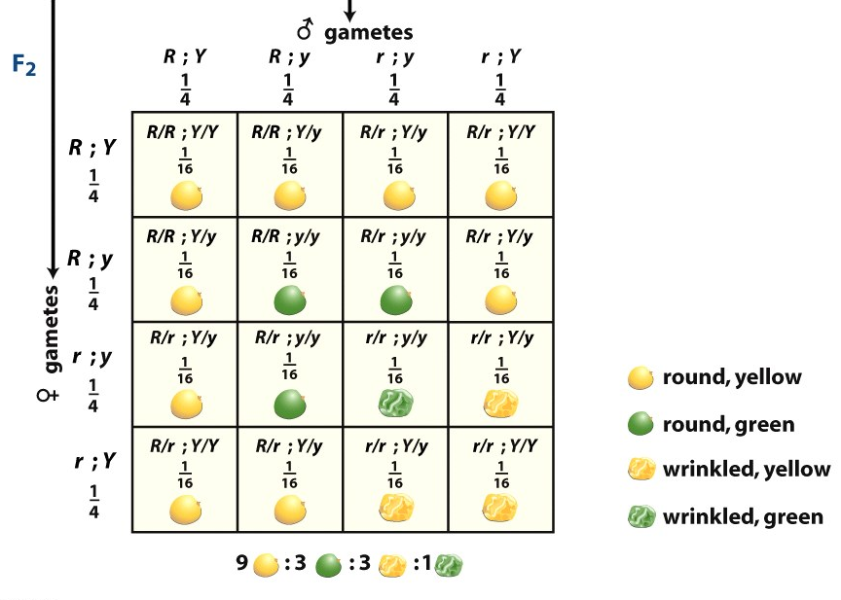
Mendel’s Second Law – Independent Assortment
alleles for different traits assort into gametes independently
(Chromosomes!)
gametic ratio
1:1:1:1
genotypic ratio
1:1:2:2:4:2:2:1:1
phenotypic ratio
Remember, this only applies when the genes are on different chromosomes!

Slide 6
Predicting probabilities of offspring in a pedigree
Product rule – calculates the probability of any single gene outcome
“AND” Rule
“the probability of independent events both occurring together is the product of their individual probabilities”
Aa x Aa and Bb x Bb
Probability of aabb?
1/4 x 1/4 = 1/16
1/4
1/4

Slide 7
Predicting progeny ratios
From AaBb x AaBb:
What is the probability of a homozygote (aabb OR AABB)?
Sum rule: “OR” rule
“the probability of either of two mutually exclusive events occurring is the sum of their individual probabilities”
probability of aabb = 1/16
probability of AABB = 1/16
probability of either = 1/16 + 1/16 = 2/16 = 1/8

Slide 8
Let’s apply the product rule to pedigree analysis:
A man who has an uncle with CF marries a woman whose sister has CF. (Recall that CF is an autosomal recessive condition)
Draw as much of this pedigree as you can, and label the genotypes of all individuals.
What is the probability that the couple’s first child will have CF?

Slide 9
What is the probability that the couple’s first child will have CF?
1/4
1/12
1/16
1/18
1/32

Slide 10
Predicting progeny ratios
For non-linked genes, use the product and sum rules
Product rule – calculates the probability of any single gene outcome (AND Rule)
“the probability of independent events both occurring together is the product of their individual probabilities”
Sum rule: (OR rule) the probability of either of two mutually exclusive events occurring is the sum of their individual probabilities

Slide 11
Consider the cross: (assume independent assortment)
A/A; B/b; C/c X A/a; B/B; C/c
What is the probability of obtaining a complete homozygous dominant genotype?
What is the probability of obtaining an offspring with a completely dominant phenotype?

Slide 12
Gene linkage and recombination
When genes are on the same chromosome and no longer follow the law of independent assortment, they are Linked
Hypothetical distances between genes can be calculated by observing ratios of recombinants = Recombination mapping

Slide 13
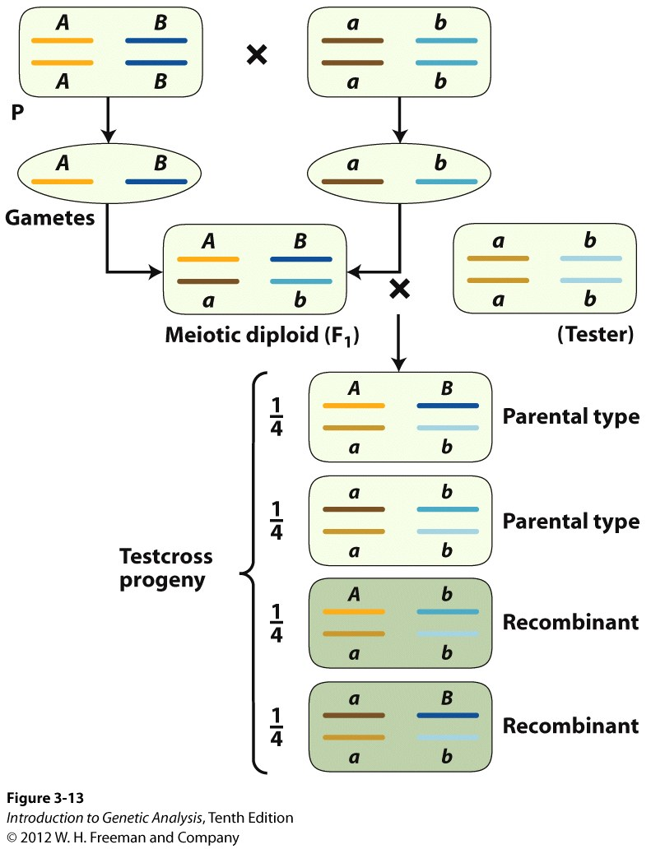
How do I know if two genes are linked?
Testcross can be used to check for independent assortment
dihybrid testcross
1:1:1:1 genotypic ratio
1:1:1:1 phenotypic ratio
If genes are NOT linked
50% parental type
50% recombinant
ratio 1:1:1:1
What if the genes are on the same chromosome???

Slide 14
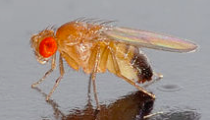
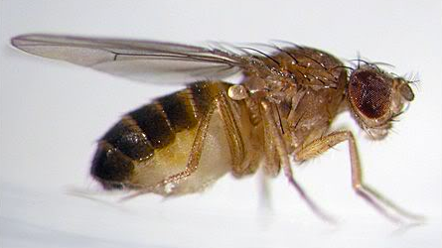
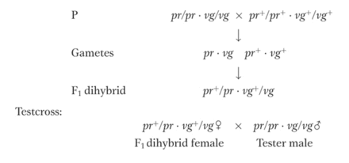
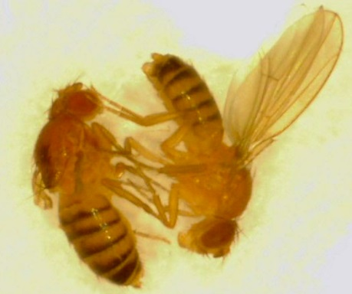
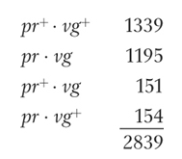
Are these genes linked? Perform a dihybrid testcross:
(pr and vg are autosomal)
total recombinants = 305 (much less than 50%)
parental
recombinant

