Slide 1
BB2920 Genetics
Prof. Farny
Lecture 12
2/7/17
Conference tomorrow
PS4 due Mon 3pm
Journal Club Quiz 2 Friday 3pm
Exam 2 Tuesday!
Sign up for a personal appointment to discuss Exam 1 – please e-mail me (all students are welcome, but especially if you were below the C range)
Office Hours Friday 11-12

Slide 2
Today’s Learning Objectives
Understand the principles of linkage and recombination
Calculate recombination frequency (RF) based on the outcomes of an F1 testcross
Examine pedigrees for evidence of linkage and use those pedigrees to estimate RF
Describe the use of molecular markers in identifying a disease locus in the genome

Slide 3
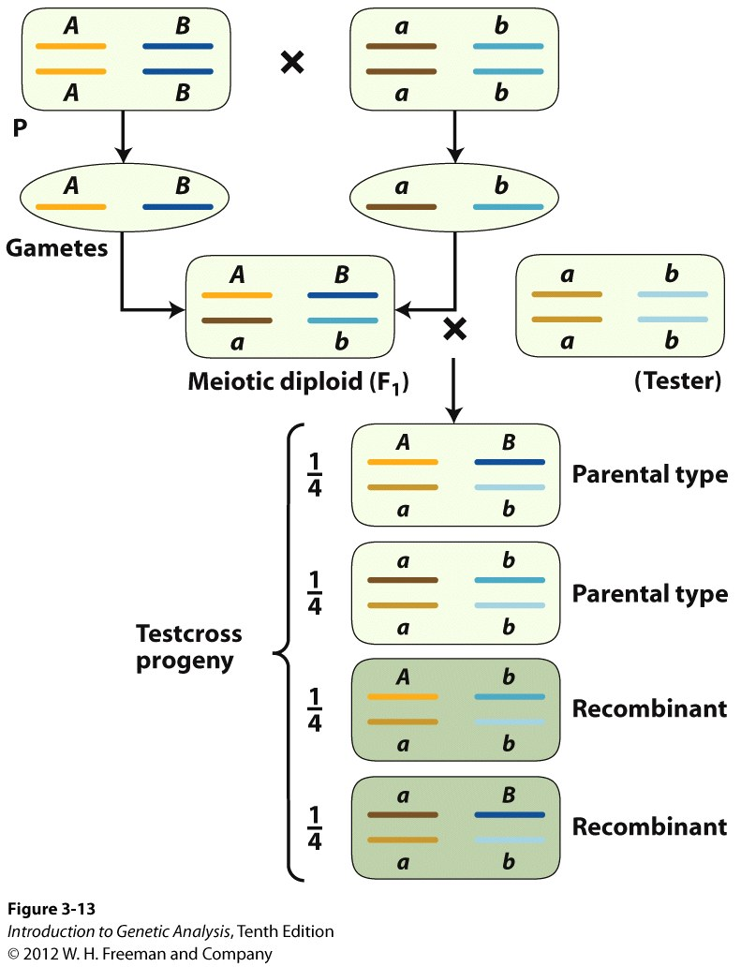
How do I know if two genes are linked?
Testcross can be used to check for independent assortment
dihybrid testcross
1:1:1:1 genotypic ratio
1:1:1:1 phenotypic ratio
If genes are NOT linked
50% parental type
50% recombinant
ratio 1:1:1:1
What if the genes are on the same chromosome???

Slide 4
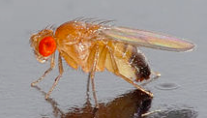
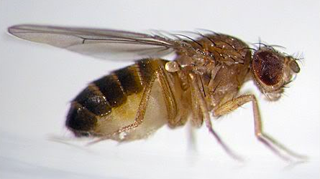
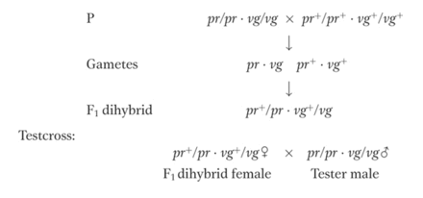
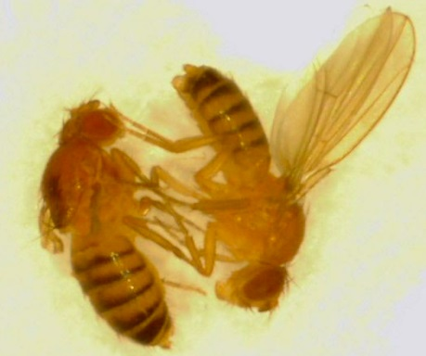
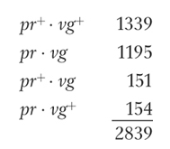
Are these genes linked? Perform a dihybrid testcross:
(pr and vg are autosomal)
total recombinants = 305 (much less than 50%)
parental
recombinant

Slide 5
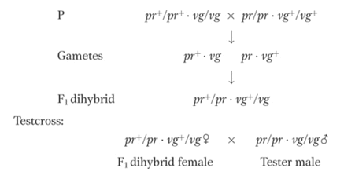
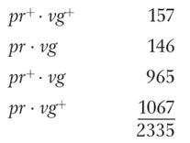
What if we swap the parental genotypes?
total recombinants = 303 (again less than 50%)
recombinant
%
parental

Slide 6
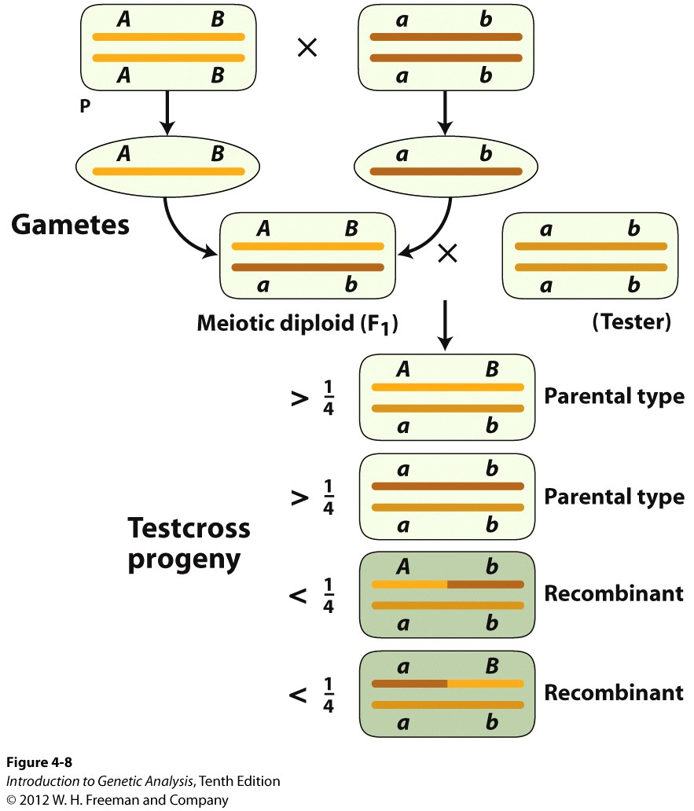
Dihybrid testcross results reveal linkage
two equally frequent non-recombinant (parental) classes totaling more than 50%
two equally frequent recombinant classes totaling less than 50%

Slide 7
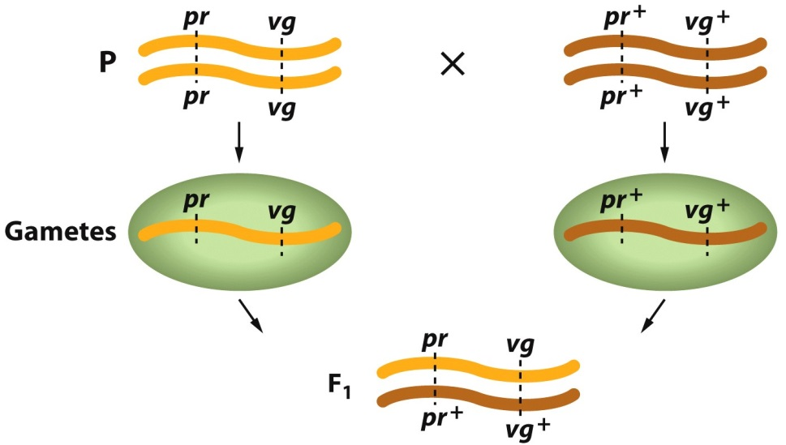
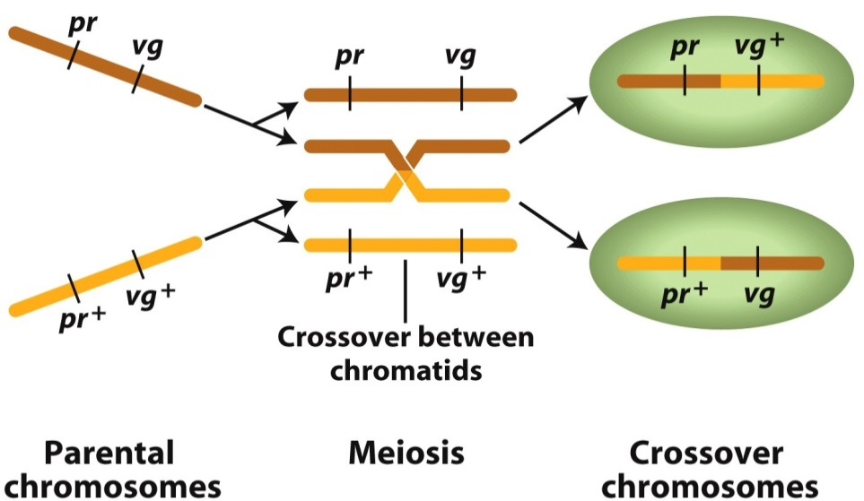
What’s going on at the chromosomal level?
pr+ vg+
Cis: both wildtype alleles on the same homolog
Trans: wildtype alleles on different homologs
pr vg
pr+ vg
pr vg+
linked alleles, combined notation:
example, pr+ vg+ / pr vg
crossover event occurs
between the two genes
recombinants

Slide 8
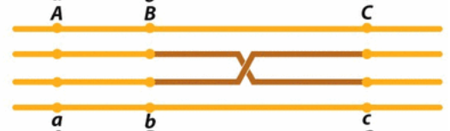
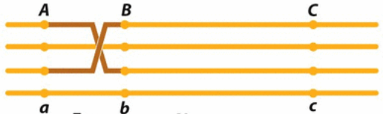
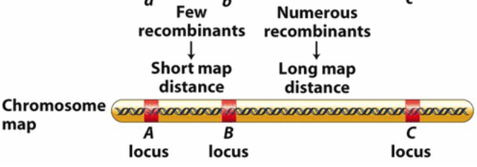
More crossover events occur between distant genes

Slide 9
Recombination frequencies can be used to determine the relative distance between two genes on the same chromosome
Cross 1:
Cross 2:
~ 11% recombinants
(305/2839) x 100 = 10.7%
(303/2335) x 100 = 12.9%
1 genetic map unit(m.u.) = 1 centiMorgan (cM) = 1% recombination frequency
pr 11.0 vg
Remember: recombination mapping is hypothetical! Actual DNA distances (in kb) may display a similar trend but do not convert directly from recombination frequency

Slide 10
Map units = recombination frequency = (recombinant offspring)/(total offspring) x 100%
In drosophila, the body color gene encodes for body color: the alleles are b+ for black body and b for brown
The cinnibar gene controls eye color: the alleles are cn+ for red eyes and cn for brown
You cross a b+/b+ cn+/cn+ female by a b/b cn/cn male to attempt to determine whether the genes are linked. Below are the phenotypes of the offspring from your F1 testcross:
Black body, red eyes: 48
Black body, brown eyes: 6
Brown body, red eyes: 5
Brown body, brown eyes: 44
Are these genes linked? If so, what map distance separates them?

Slide 11
About how many map units separate these two genes?
Rank | Responses
1 | 10.7
2 | 10.6
3 | 11
4 | 9.7
5 | 0.107
6 | Other
Values: 10.7, {10.7,...
Value Matches: 54

Slide 12
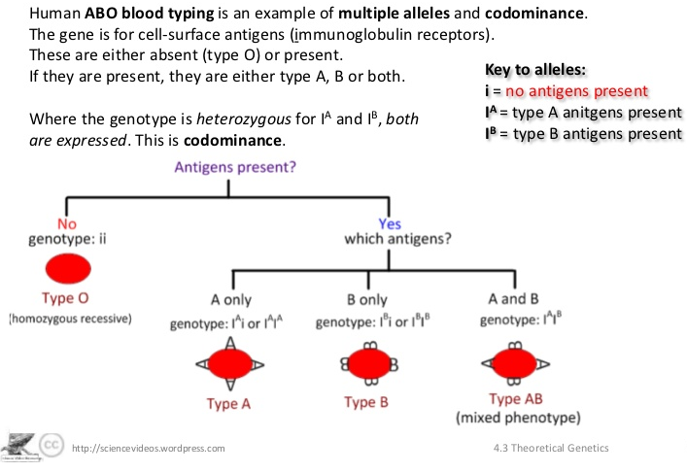
Human blood types are the classic example of codominance
Codominant genes have multiple alleles (more than two) that are not mutually exclusive and can be expressed at the same time

Slide 13
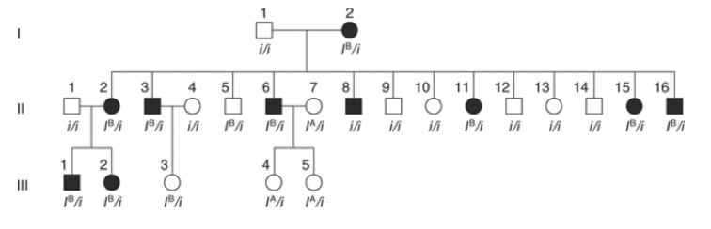
Consider this pedigree: It shows a family with a genetic disorder, and the blood type of each individual.
Three blood types here: i/i (Type O), I^{B}/i (Type B) and I^{A}/i (Type A)
Blood type genes are linked to the disease allele. Use F and f to indicate the disease alleles.

Slide 14
What is the inheritance pattern for the disorder?
Autosomal Dominant
Autosomal Recessive
X linked Dominant
X linked Recessive

Slide 16
What is the disease genotype of person I-2?
FF
Ff
ff

Slide 18
Which individuals are recombinant?
II-1, II-4 and II-7
II-2, III-1 and III-3
II-5, II-8 and III-3
II-3, II-6, II-8 and II-16

Slide 20
How close are the genes in map units?
6.9 m.u.
7.6 m.u.
12.9 m.u.
22.5 m.u.
40.3 m.u.

Slide 21
(78+66)/1119 x 100 = ~12.9%

