Slide 1
BB2920: Genetics
Prof. Farny
Lecture 13 – Snow Day Notes
2/9/17
These are the slides we would have covered today. Please review them. There are extensive explanations written in the notes section. We will do clicker questions related to these slides on Friday. JC2 is postponed to Monday. Happy Snow Day!!

Slide 2
Today’s Learning Objectives
Understand various relationships between genes that can alter expected Mendelian ratios of crosses
Understand and explain the following genetic concepts:
incomplete dominance
co-dominance
recessive lethal alleles
complementation
Epistasis (recessive, duplicated recessive, dominant, duplicated gene)
polygenic inheritance
penetrance and expressivity

Slide 3
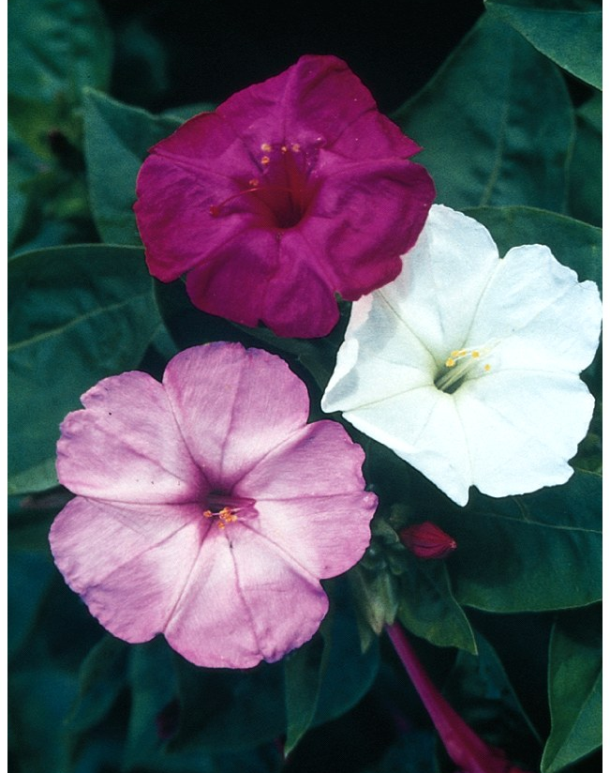
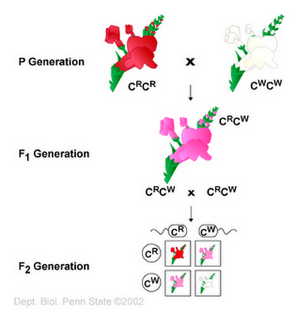
Incomplete dominance – one allele is not completely dominant over another, results in an intermediate phenotype
Fully dominant mutations are:
Haplosufficient – a single dominant allele provides enough of a gene dosage to result in a completely wildtype phenotype in the heterozygote
When the heterozygote is not the same as the wildtype, the dominant allele is:
Haploinsufficient – a single dominant allele does NOT provide enough of a gene dosage to result in a wildtype phenotype in the heterozygote.
Notes:
The first is the concept of incomplete dominance. In our previous examples, we have looked at genes where having only half the amount of the protein (like an Aa individual) looks the same phenotypically as a homozygous dominant (AA). But, sometimes having only half the protein creates only half of the phenotypes. In the example above, the heterozygote flowers that create only half the amount of pigment are not red but pink, an intermediate phenotype. Incomplete dominance affects the ratio of offspring we expect: instead of the standard 3:1 phenotypic ratio we expect from a Aa x Aa cross, in incomplete dominance we see 1:2:1 (dominant:intermediate:recessive). When one copy of a gene is not enough to give you a completely wild type phenotype, we say that this gene is haploinsufficient (“haplo-” meaning half, and “-insufficient”, meaning not enough). When half the amount of a gene is enough (as in the Yy gene example with pea color) we say the gene is haplosufficient.

Slide 4
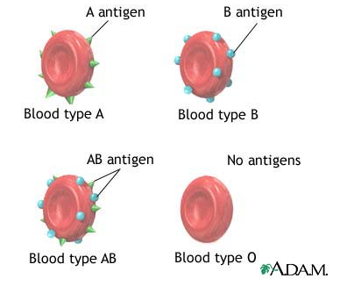
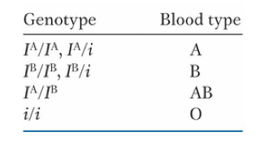
Co-dominance
Multiple alleles for a single gene
two of these alleles can be co-expressed in a heterozygote
Notes:
Co-dominance occurs when there are more than two alleles for a given gene, and it is possible for two alleles to be expressed at the same time. Examine the chart that describes the possible alleles for blood type in humans. An capital “I” is always dominant over a small “I”, which is why individuals that are I^A/i are Type A, and not Type O. However a person can have two different capital “I”s, I^A and I^B. When this happens, neither one is dominant over the other. The cells will just express both A and B together. So, this person is a heterozygote expressing both alleles at the same time, and BOTH contribute to the phenotype. This is different than normal dominance, because for a normal heterozygote (pea color, Yy), the mutant y protein may be expressed, but it does NOT contribute at all to the phenotype.

Slide 5
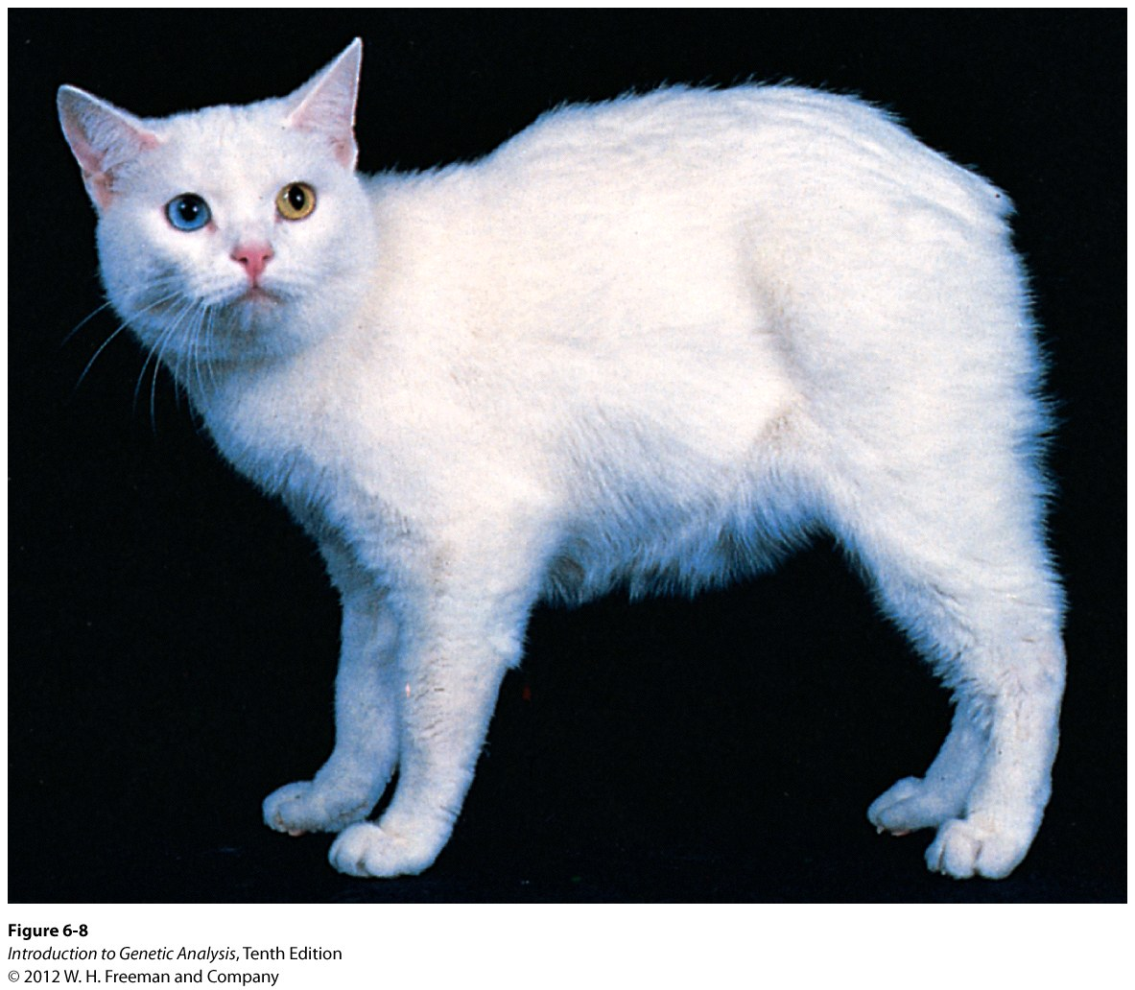
Recessive lethal alleles
an allele that is capable of causing the death of the organism
M = normal spine
M^{L} = abnormal spine
M/M = normal
M/M^{L} = Manx (no tail, intermediate spinal disfigurement)
M^{L}/M^{L} = lethal (spine disfigurement incompatible with life)
What is the outcome of crossing two manx cats?
M
M^{L}
M
M/M
M/M^{L}
M^{L}
M/M^{L}
M^{L}/M^{L}
Observed phenotypic ratio?
2 tailless: 1 normal
Pleiotropy – a single allele that affects more than one phenotype (tail and death)
Notes:
As the name suggests, lethal alleles occurs when a gene is absolutely essential for life. So, if an individual inherits two mutant copies, this situation is incompatible with life and the organism dies. Usually this occurs very early in embryonic development so that the individual is not born. If the wild type copy of the gene has complete dominance, you will see only offspring with the wild type phenotype from this cross (3:1, but the homozygous recessive are dead so you don’t see them). If the gene displays incomplete dominance you will see a 2:1 phenotypic ratio (2 of intermediate phenotype, and 1 wildtype). The example of the manx cats above is an example of a gene that displays incomplete dominance, or we can say the M allele is haploinsufficient. However this is also an example of a lethal allele. In this case the gene affects two phenotypes (the spine, and survival). When a single gene affects multiple phenotypes, we say this gene is pleiotropic.

Slide 6
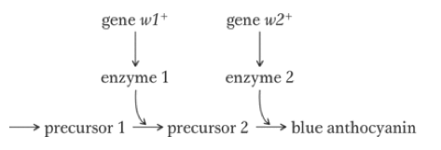
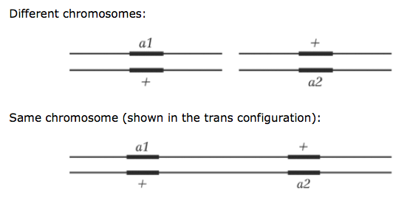
Inferring gene interactions by complementation
You find 100 white flowers in a population of mostly blue-flowered plants.
Are all these mutants caused by mutations in the same gene?
Complementation test
Notes:
Often you will see a phenotype, and you will not be sure how many genes are contributing to that phenotype. Say you are in a field and you see mostly blue-flowering plants. However, there are 100 or so that have white flowers. Are all 100 plants affected by the a mutation of the same gene, or do they represent 100 different mutations in different genes, or something in between? To find out, you can use a complementation test. The idea behind a complementation test is that if the mutations are in two different genes, then when you cross two white individuals you will end up with blue flowers, because the offspring will now be heterozygous for both genes, so the blue pigment can be produced. In this way, the mutations are said to “complement” each other.

Slide 7
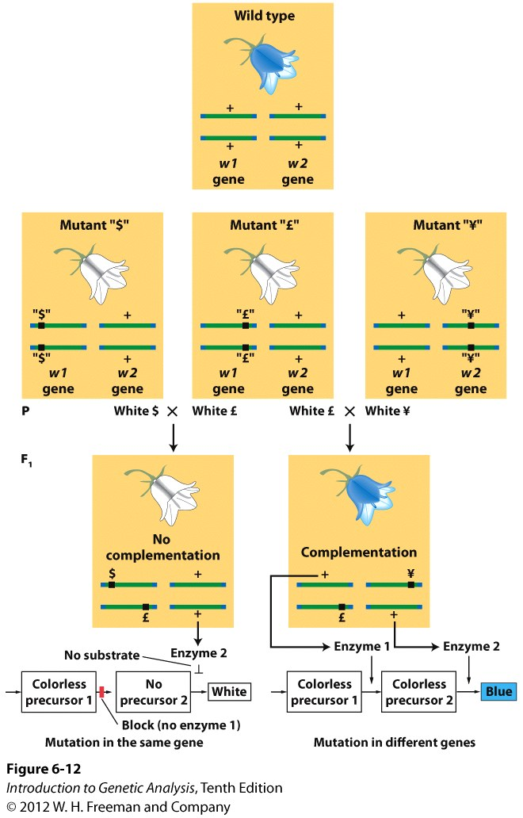
Complementation test: possible outcomes
cross two different white mutants:
What are the possible outcomes?
either all white offspring, or all blue offspring.
If offspring are all white?
that means the mutations were in the same gene in both parent plants (essentially these are different alleles of the same gene, so we refer to these mutants as allelic)
If offspring are all blue?
that means that the mutations were in different genes in each parent, so the mutations complement each other
Notes:
So, if white flower “$” and white flower “L” both have a mutation in gene w1, then when you breed them the offspring will all be white, because both parents have homozygous recessive mutations. The offspring will technically be a heretozygote, because it has two different mutant alleles, but the phenotype will be recessive (white flowers). In this case, the complementation test reveals that these mutations do NOT complement each other, so the mutations are in the same gene (even if they molecular mutation is different). Take another example with cystic fibrosis mutations: If two people with CF had children, and one parent was homozygous for the F508del mutation (F508del/F508del), and the other was homozygous for the G542X mutation (G542X/G542X), the offspring will be heterozygous for the mutations (F508del/G542X) but would still be affected by cystic fibrosis. And. ALL offspring of these two parents would have CF, just as ALL offspring of flower “”$” and flower “L” will be white. In the other case, if there are homozygous recessive mutations in two different genes that both independently result in white flowers, mutant “L” (genotype w1/w1; w2+/w2+) and mutant “Y” (genotype w1+/w1+; w2/w2), when you cross these individuals you will restore the functional heterozygous state to both genes, because the offspring are ALL w1+/w1; w2+/w2, so ALL offspring are wildtype phenotype (blue). In this case the mutations are said to complement each other.

Slide 8
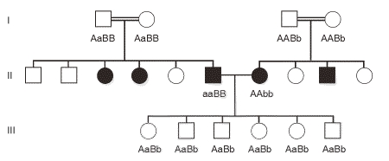
Complementation in human genetic disease: Profound congenital hearing loss
Notes:
This pedigree gives an example of complementation in humans. There are many genes in humans that contribute to our ability to hear (in the above example its genes A and B). A homozygous recessive mutation in any number of genes can result in deafness. Individuals within the deaf community often inter-marry (as in the individuals in generation II), and many times the children of a deaf couple are able to hear (generation III), because they are heterozygous for two different mutations. This is an example of complementation, because a wild type copy of each gene A and B is inherited by each of the offspring.

Slide 9
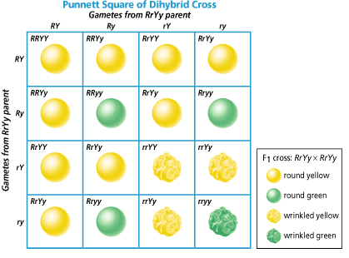
Unliked genes that are functionally independent result in 9:3:3:1 phenotypic ratio
Mendelian dihybrid F2 offspring:
9:3:3:1
Genes are on different chromosomes AND are functionally independent
Y/y is actually the chlorophyll degrading enzyme SGR/sgr
R/r is actually the starch storage enzyme SBEI/sbei
The FUNCTION of the SGR and SBEI proteins have nothing to do with each other!
Notes:
We’ve seen this figure before: when considering a cross between two dihybrids (in this case color and texture, R/r, Y/y) the phenotypic ratio of the offspring will 9:3:3:1. But this ratio assumes two important things:
That the genes are on different chromosomes (NOT linked) and therefore segregate independently during meiosis (we’ve already talked about this);
That the gene products are functionally independent (we have not yet talked about this!). “Functionally independent” means that the function of the protein made by the Y allele has nothing to do with the function of the protein made by the R allele. We know, for example, that the Y allele is actually a chlorophyll degrading enzyme called “staygreen” (SGR). The wrinkled phenotype is caused by a mutation in the starch storage enzyme SBEI. The ability of a pea cell to degrade chlorophyll is completely unrelated to the ability of the same cell to store starch. Thus, these gene products are said to be functionally independent.

Slide 10
Gene interactions – how do relationships between gene functions affect observed phenotypic ratios?
Drosophila eye color and wing shape?
enzyme A
enzyme B
eye pigment
wing development
two enzymes in the same biosynthetic pathway?
Gene products (aka: proteins) may have interactions that effect the phenotypes of the offspring, leading to unexpected phenotypic outcomes even when genes are not linked.
Notes:
But what if two genes are NOT functionally independent? Take an example: The enzymes at the top of the slide, enzyme A and enzyme B, have unrelated functions. Enzyme A affects eye color (red or purple), whereas enzyme B affects wing development (normal or vestigal). When a double mutant is made with both of these genes, they can be expressed within the organism completely independently (eg, an individual can have red eyes and vestigal wings, or red eyes and normal wings, or purple eyes and normal wings... etc). But when two or more genes are part of a pathway that leads to a single goal, a these genes do not act independently of each other in creating the resulting phenotype. For example, if there are mutations in both enzyme X and enzyme Z above, these will not give us independent phenotypes, they would both lead to a lack of arginine production (arginine production is the phenotype in this example).

Slide 11
Epistasis
a functional relationship between two mutants that changes the Mendelian 9:3:3:1 ratio
epistatic – one mutation takes precedence, overrides another
hypostatic – the mutation that is overriden
Genes are on different chromosomes (not linked!) but ARE NOT functionally independent!
Notes:
When genes produce proteins that interact in the same pathway, or in other words are NOT functionally independent, then these genes must function together in order to produce an ultimate phenotype. This interaction, or functional relationship between two genes, is called “epistasis”. Typically one mutation will take precedence over the other one. The first mutation that is the dominant in the pair is “epistatic” to the second mutation. The second mutation can be said to be “hypostatic” to the first mutation. There are multiple different ways in which epistasis can alter the phenotypic ratio, depending on the dominance or recessiveness of the alleles involved (you may find other types mentioned elsewhere, but we will concern ourselves with these four)

Slide 12

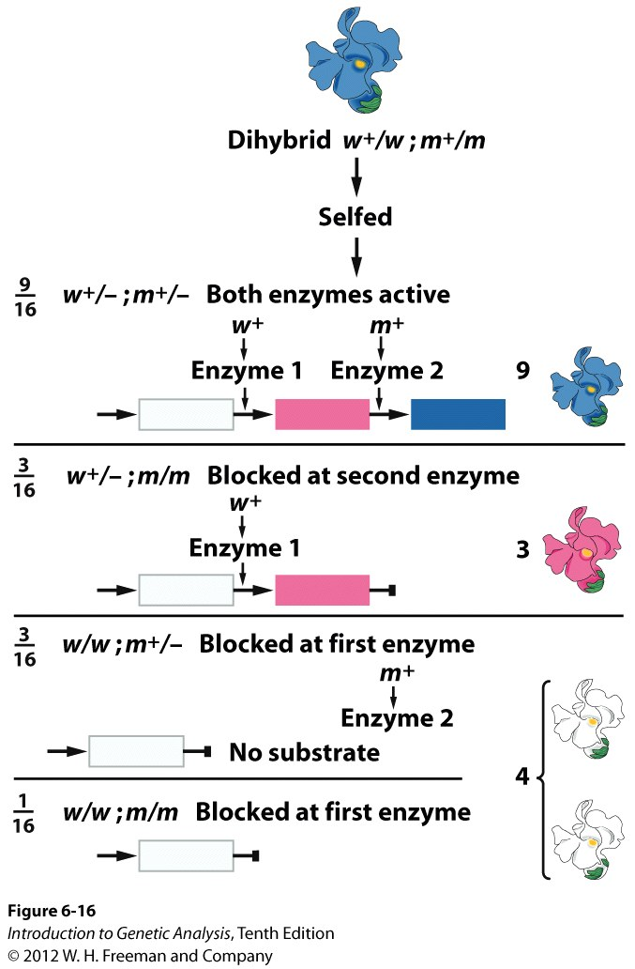
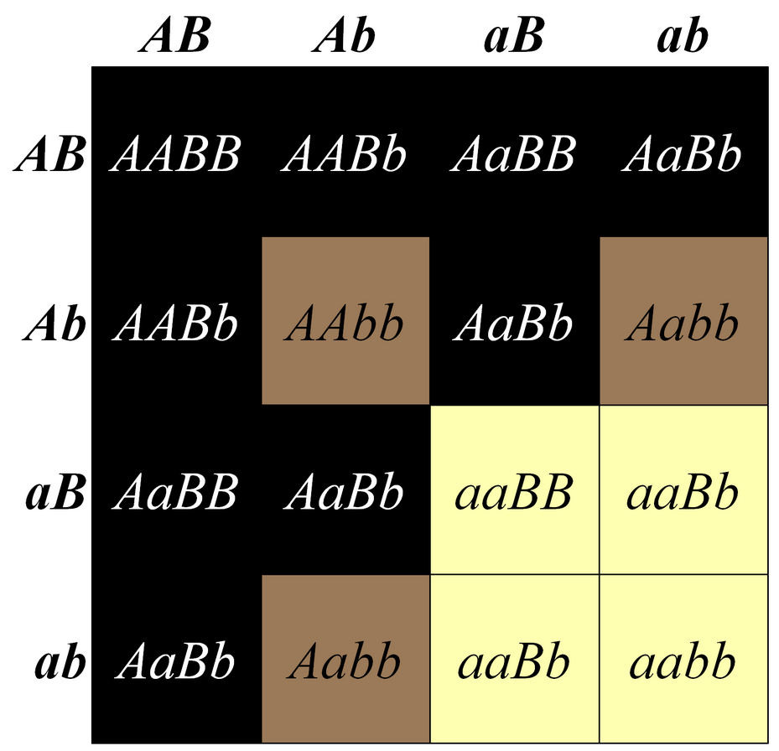
Recessive Epistasis
Two genes function in the same pathway and are required for a wild type phenotype
Intermediate phenotype exists
Both mutations are recessive
Genotypically the last two categories are different, but we cannot distinguish them on the phenotypic level.
Characterized by a 9:3:4 ratio of F2 offspring from dihybrid cross
Laborador Retreiver example in your text:
Notes:
When two genes affect a single phenotype, and the mutations involved are both recessive, AND an intermediate phenotype exists, the relationship is known as recessive epistasis. In the example above, there are two enzymes that are needed to create a blue pigment in a flower: gene w+ transforms a colorless precursor molecule into a magenta intermediate molecule; gene m+ converts the magenta intermediate into the final blue pigment. Both genes are needed for blue pigment to occur, but they must act in a specific order (w+ must perform its function first. If w+ does not perform its function, the function of m+ is irrelevant). Thus, w+ is epistatic to m+ (and m+ is hypostatic to w+).
The phenotypic ratio of a dihybrid cross in this case results in a 9:3:4 ratio of offspring. Genotypically the last two categories (in the bottom right corner of the Punnett square) are different, but we cannot distinguish them on the phenotypic level, because if gene w+ is non-functional, the genotype of gene m+ is irrelevant.
As an exercise, I recommend you draw out the Punnett square for this example, so you can demonstrate for yourself why this ratio is 9:3:4. Basically the “3” and the “1” categories of the 9:3:3:1 are being combined (phenotypically).

Slide 13
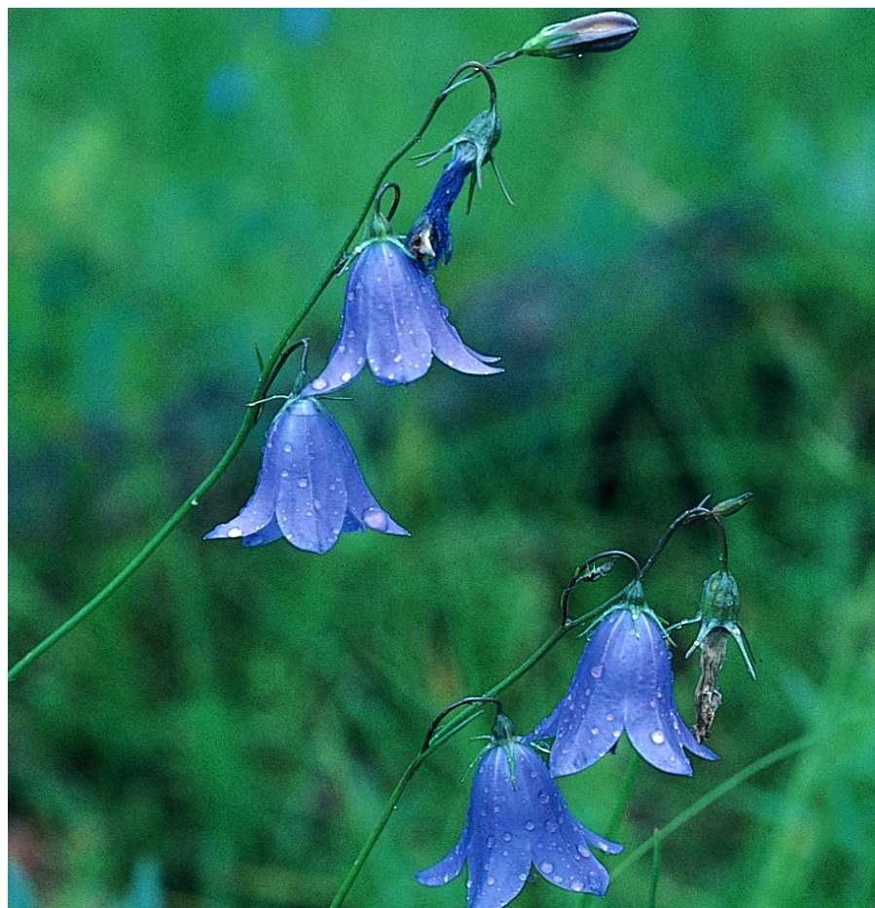
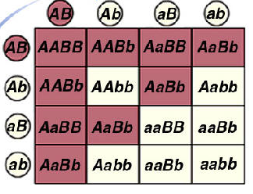
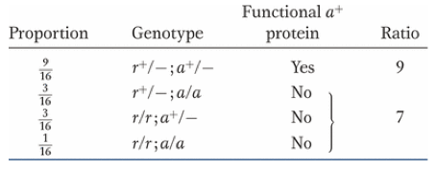
Duplicated recessive “epistasis” - or - the 9:7 ratio
two genes are in the same pathway
Both mutations are recessive
Both genes are required for the wild-type phenotype
There is no intermediate phenotype
example from your text, the blue flowered harebell – synthesis of the blue pigment requires the activity of both genes
the ratio that characterizes duplicated recessive epistasis is: 9:7 (F2 offspring of dihybrid cross)
Gene r+
Compound X
Blue
pigment
Gene a+
Notes:
Let’s say two genes are in the same pathway, and BOTH genes are required for the wild-type phenotype. There is no intermediate phenotype, so any individual that is homozygous recessive for one gene will have the same phenotype as the double homozygous mutant. The mutations are recessive, but either one results in a null phenotype (which is why its known as duplicated recessive).
Again, draw the Punnett Square. In this instance, the “3” “3” and “1” categories of the standard 9:3:3:1 are all the same phenotype, resulting in a 9:7 ratio. In this case, the use of the word “epistasis” is not exactly appropriate. Since both mutations are equally required, neither mutation is epistatic to the other. Historically the term used to describe this was “duplicated recessive epistasis” and you will see this term used elsewhere. Your textbook is very careful not to label this as epistasis, and instead just calls it the “9:7 ratio”. The important thing that this ratio tells you is that these two genes are both essential components in the same pathway, and that the mutations in both are recessive.
Note that this example is the same situation to the example for complementation. In this example, a flower that has either aa or bb is a white flower. Any blue flowers must have both and A and a B allele. Thus if a flower of AAbb (white) and one of aaBB(white) were crossed, the resulting offspring would be AaBb (blue) and would display complementation.

Slide 14
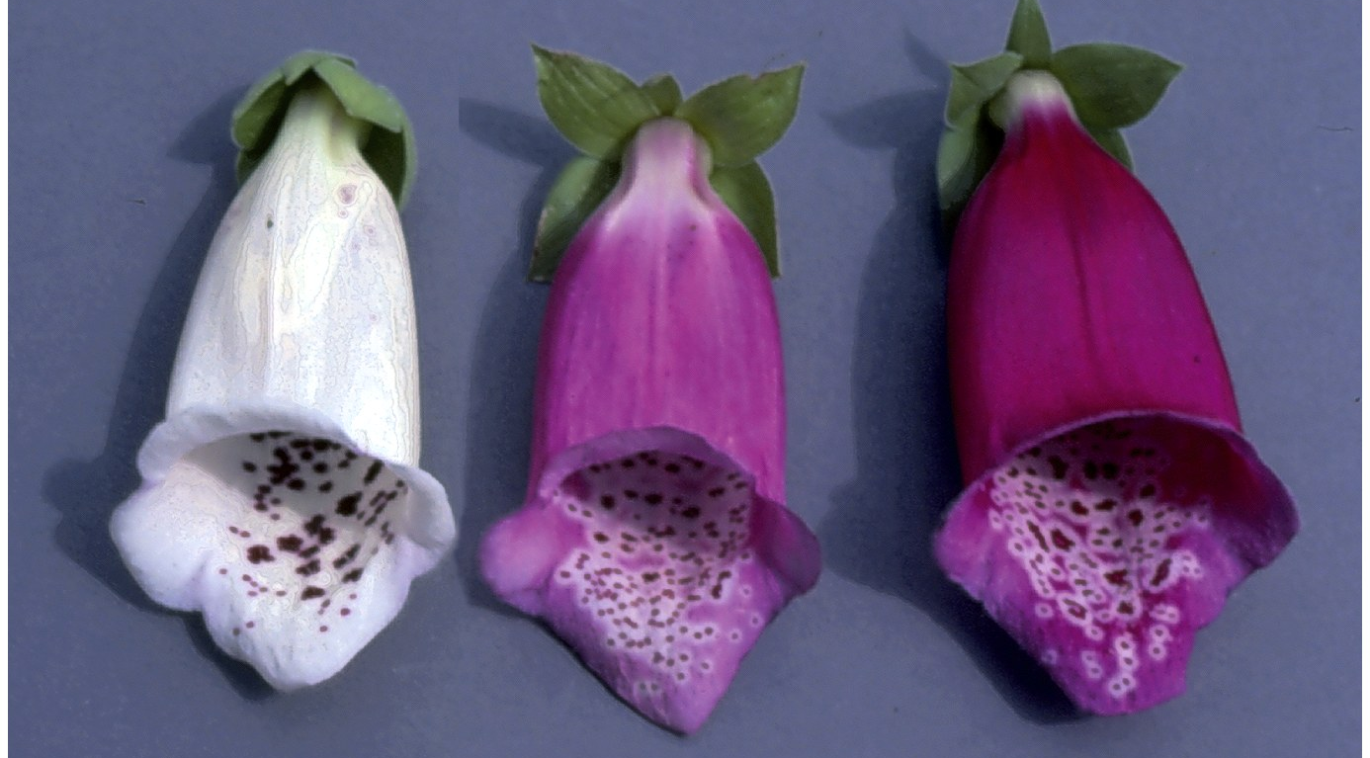
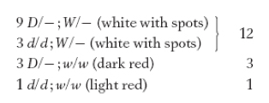
Dominant Epistasis
Similar is theory to recessive epistasis, except that the mutant alleles for both mutations are dominant
Still, the gene that is upstream will be epistatic to the gene that is downstream
In the example in your text, pg 230:
W is a dominant mutant allele that prevents pigment from being deposited in the main petal of the flower (therefore, for pigment to be present in the main petal, the genotype must be ww, otherwise the flower is white)
D is a dominant mutant allele that results in a darker than normal pigment
(dd results in light color flowers)
So, when a W allele is present, the flowers will be white, regardless of whether the dark pigment (D - ) or the light pigment (dd) is made
The ratio of phenotypes that characterizes dominant epistasis in F2 offspring from dihybrid cross is 12:3:1
Notes:
When two genes contribute to the same phenotype and the mutations in the genes in question are both dominant, the result is called dominant epistasis. Again, draw out the Punnett Square here and demonstrate for yourself why the 12:3:1 ratio exists. Basically the “9” and “3” categories of the 9:3:3:1 are being combined (phenotypically). In this case, gene W is epistatic to gene D, because if the W allele is present, it doesn’t matter whether or not the D allele is present. W’s function overrides D’s function. So W is epistatic to D; D is hypostatic to W.

Slide 15
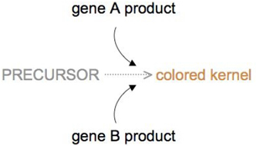
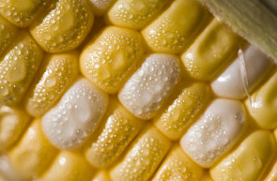
Duplicate Gene “epistasis”: the 15:1 ratio
For two functionally redundant genes, whenever any of the two dominant alleles is present, the phenotype will be seen. Thus, the only individual from a dihybrid cross that will be a different genotype will be the aabb individual.
Therefore, the phenotypic ratio that characterizes Duplicated Dominant is 15:1
Example: corn kernel color. Two enzymes both function to create corn color, and the single activity of either enzyme results in yellow kernels
geno: pheno:
A - - - wild type, yellow kernel
- - B - wild type, yellow kernel
aabb mutant, white kernel
}
15/16
1/16
Notes:
Here again, neither gene A nor gene B is truly epistatic to the other (that’s why epistatis is in quotes above). Their functions are related in that they have more or less the same function, so in order for a mutant phenotype to be seen, both genes must be mutated.

Slide 16
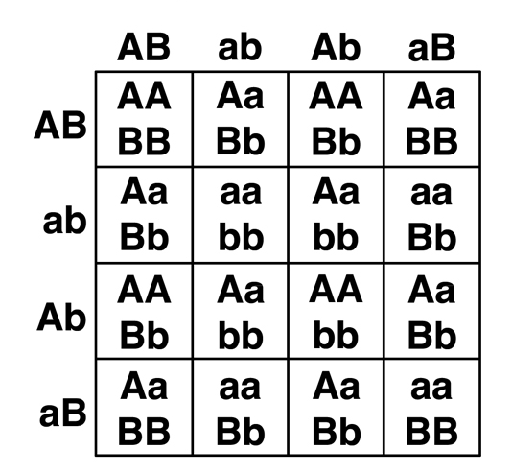
Tips for tackling epistasis problems:
The scenarios in the problem sets are all best described as one of these four options (9:3:4, 9:7, 12:3:1, or 15:1)
Using a generic Punnett square (like the one below) and writing in expected phenotypes (or shading boxes to match phenotype) is very helpful
Punnett Squares do not have to be included with answers, but you can include if you find it helpful (you can also just list the genotypes using dashes, as in the example below)

Slide 17
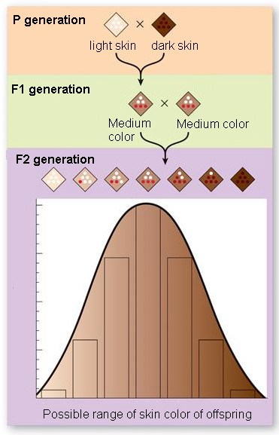
Can we use Mendel’s laws to explain continuous variation?
Polygenic inheritance: multiple genes affecting a single phenotype, explains the genetic component of continuous traits
Skin color: each dominant allele confers one “dose” of pigment
assume a cross between a very light skinned person and very dark skinned person:
a/a, b/b, c/c x A/A, B/B, C/C
F1 all heterozygous
F2 = 3³ = 27 possible genotypes
Doses of gene function:
a/a, B/b, c/c = 1 dose = light
A/A, B/b, c/c or A/a, B/b, C/c = 3 doses = medium
A/A, B/B, C/C = 6 doses = dark
Notes:
Imagine there are three genes that control skin color in humans (in reality, skin color has a significant environmental component and is likely controlled by more than 3 genes, but for the sake of an example we will ignore that). Imagine that each dominant allele for each gene confers one “dose” of pigment, such that A/A; B/B; C/C is a very dark skinned person (6 doses) and a/a; b/b; c/c is a very light skinned person (zero doses). The F1 generation in this case had medium skin (3 doses, AaBbCc). If you cross again the F1 generation with itself, you can achieve all possible genotypes conferring zero to 6 doses, however most individuals will have 2, 3 or 4 doses (remember there are 3^3 or 27 possible genotypes here, any only one is aabbcc and one is AABBCC and most in between will have some combination of dominant and recessive alleles). This will create a bell curve of possible phenotypes between two extremes, which is exactly our definition of continuous variation. Imagine if there are 6 or 10 or even more genes involved, this will create many more intermediate phenotypes between the two extremes. We call this polygenic inheritance - “poly” meaning many and “genic” for genes.

Slide 18
Why isn’t this considered a type of epistasis???
Doses of gene function:
a/a, B/b, c/c = 1 dose = light
A/A, B/b, c/c or A/a, B/b, C/c = 3 doses = medium
A/A, B/B, C/C = 6 doses = dark
Gene A
Pigment A
Gene B
Pigment B
Gene C
Pigment C
Notes:
This isn’t epistasis because each gene product is functionally independent. Gene A can work just fine even if genes B and C are not functional. So, while all genes are contributing to a common phenotype, none of the genes depends upon the others in order to function.

Slide 19
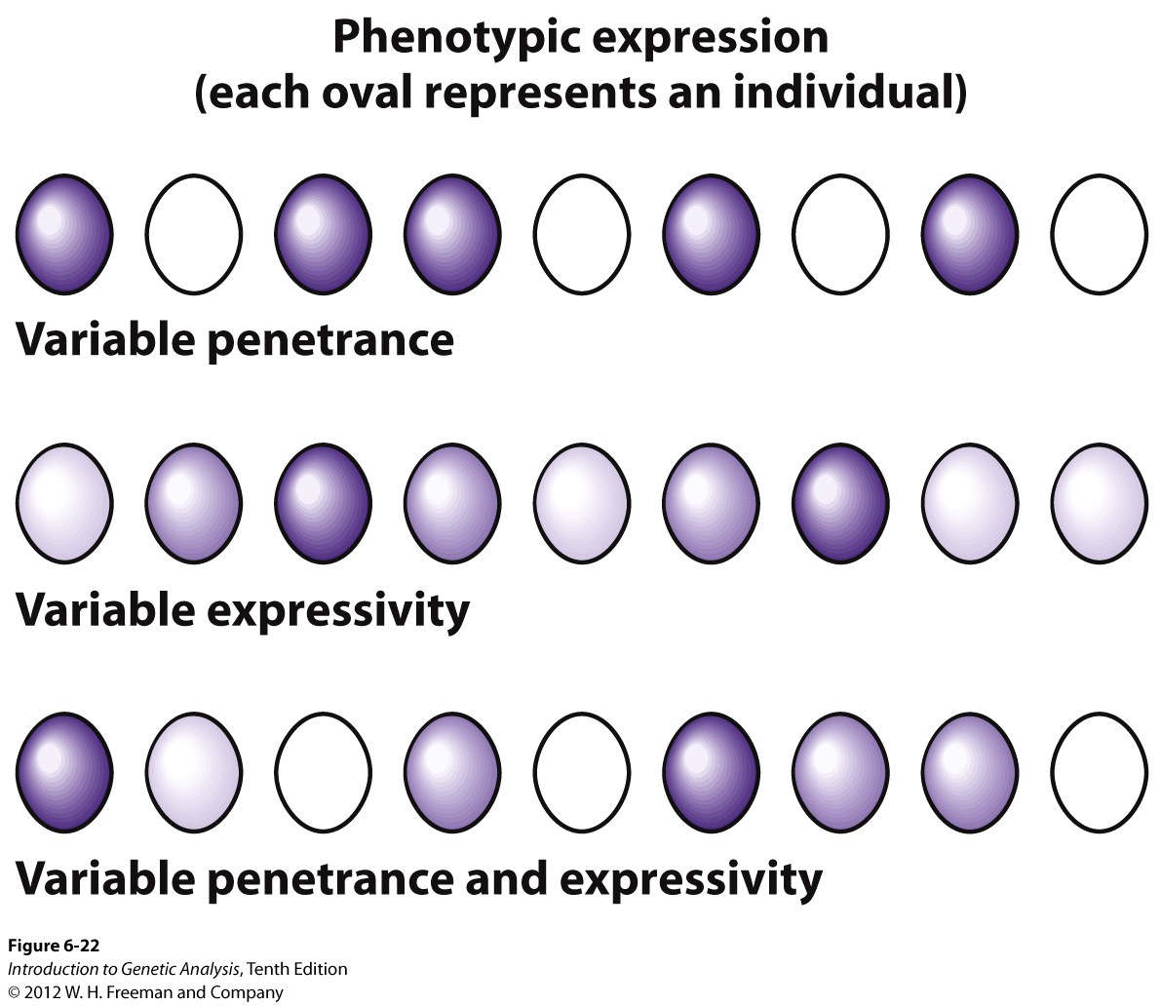
Expressivity and Penetrance
Occur when individuals with the same GENOTYPE do NOT have the same PHENOTYPE
Percentage of individuals with a given genotype that express the associated phenotype (AKA incomplete penetrance)
Example: Retinoblastoma (Rb) -hereditary eye cancer
A pair of sisters both inherit the homozygous recessive mutation that causes Rb (r/r). One sister gets Rb, the other does not.
Note! You must compare “apples to apples” – comparing individuals with the same alleles!
Notes:
Sometimes, individuals that have the same genotype do not explain the exact same phenotype. Even among people with CF that harbor the same homozygous deltaF508 mutation, some people might be more affected by digestive symptoms than others, or more prone to lung infections by bacterial strains. Often these differences are the effect of environmental factors. Or, sometimes mutations only confer an increased risk of disease, such that some people with the mutation will get the disease and some will not. All of the individuals represented by ovals above HAVE A DISEASE GENOTYPE. For a recessive mutation is would be a/a. BUT, if a phenotype is incompletely penetrant, some of the people with the disease genotype do not display the disease phenotype.
When a person has a homozygous recessive genotype for a disease allele, but does NOT display the disease phenotype, this phenotype is said to have incomplete penetrance. In the CF example, this would be a person that has two mutated copies of CFTR but does not have cystic fibrosis. This basically is very rare with CF, because CF mutations have a very high penetrance. But for other genes, the penetrance can be more variable.

Slide 20
Expressivity and Penetrance
Occur when individuals with the same GENOTYPE do NOT have the same PHENOTYPE
Describes the degree or intensity of a given phenotype
Example: Retinoblastoma (Rb) – hereditary eye cancer
A pair of sisters both inherit the homozygous recessive mutation that causes Rb (r/r). Both are affected with Rb, but one has a much more aggressive tumor than the other.
Notes:
Variable expressivity is a term used to describe the variability in the intensity of a phenotype. Back to our CF example: here again all of the individuals represented by the ovals above the same homozygous recessive CFTR mutation. However some people’s CF symptoms are worse than others.

Slide 21
Expressivity and Penetrance
quick and easy way to remember the difference between the two:
Penetrance = present or absent
(P for presence and penetrance)
Expressivity = high vs. low (don’t have a good nmenomic for this one, but just remember it’s the other one)
Example of Rb with variable expressivity and incomplete penetrance?
Notes:
A gene can simultaneously display both incomplete penetrance and variable expressivity. Its easy to get these concepts confused. An easy way to remember penetrance is that penetrace indicates whether a phenotype is present or absent. Expressivity is severity (highly or lowly expressed).

