Slide 1
BB2920-C16: Genetics
Prof. Farny
Lecture 14
2/17/17
Early Exam: Thursday March 2nd, 4-5pm, HL116
Any student may elect to take the exam early (subject to nondisclosure agreement). No sign up or explanation necessary!
PS5 due Thursday 2/23
JC3 materials are posted, due Fri 2/24

Slide 2
Today’s Learning Objectives
Understand negative regulation of the lac operon by lactose
Predict the transcriptional state of the operon under certain physiological conditions, or in response to particular mutations.

Slide 3
How many of you have studied the lac operon?
Yes, many times, I’m quite comfortable with it
Once or twice but I’m rusty
Never, this would be the first time

Slide 4
Regulating Gene Expression
Most genes aren’t “on” all the time. Why not?
Conserves energy and resources (you don’t bother to carry around your ski boots and an umbrella on a sunny day in July, do you?)
Different cell types have different metabolic and/or structural needs (neurons vs. skin vs. liver)
What are the signals/triggers that tell a cell to turn genes on or off?
- Environment (internal or external, nutrients available, temperature, other individuals or organisms nearby, etc, etc….)
Example: E. coli are prototrophs (can make the carbon sources they need for growth), but can turn genes on or off depending upon which carbon sources are available
In order for this to work, you need ?????
A way of sensing what’s available in the environment
A way of flipping a gene on or off, like a switch

Slide 5
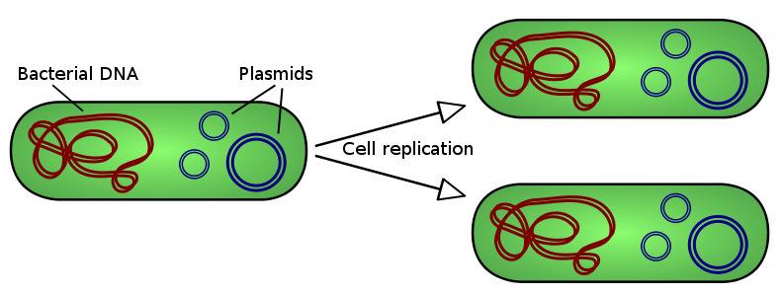
E. coli as a model for gene regulation
Haploid – one copy of each gene, single large circular chromosome, mutations will be expressed (no heterozygous state)
HOWEVER
Using plasmids, you can create a second copy of a gene if you wish (in order to examine dominance of different mutations)
These plasmids are called “F’ plasmids”
Lactose metabolism: E coli can use lactose as a carbon source but only when galactose and glucose are not available, turns on lactose metabolizing genes only when necessary

Slide 6
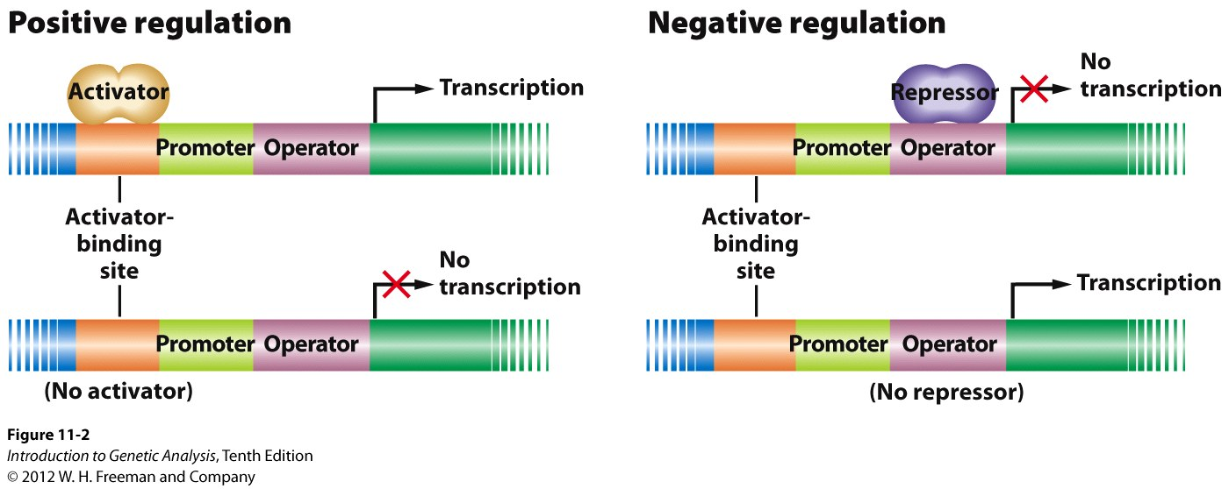
Genes can be either positively or negatively regulated
Activator must be present for transcription to occur (Think: regulator protein flips gene ON)
Repressor must be absent for transcription to occur (Think: regulator protein flips gene OFF)
Activator and repressor proteins can be both the “switches” (on/off) and the environmental sensors (they have to know when to bind and when not to)

Slide 7
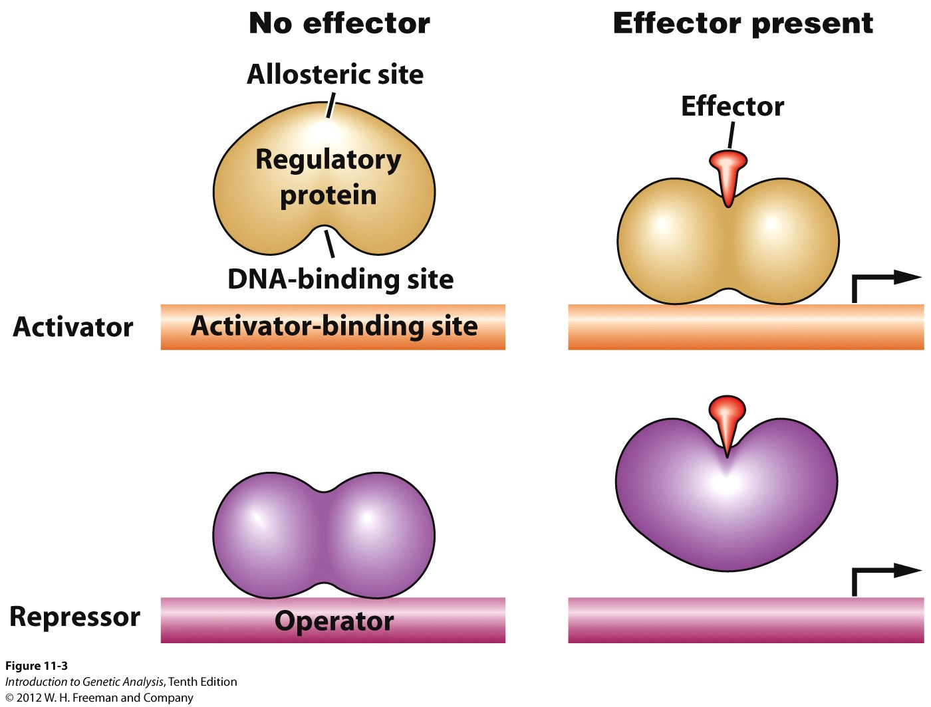
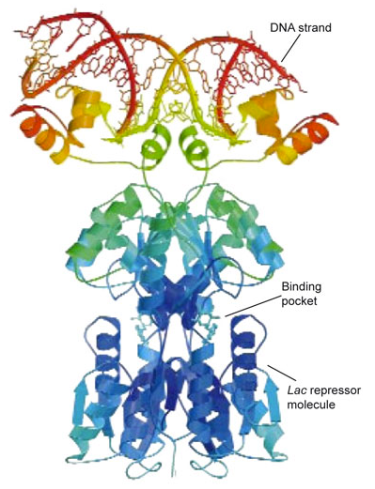
Activators and Repressors respond to effectors in the environment
the lacI repressor protein
DNA-binding domain: contacts the DNA
Allosteric site: the “sensor”, binds the effector
Effector: the “signal” in the environment that the regulatory protein responds to
(Example: carbon sources, lactose)

Slide 8
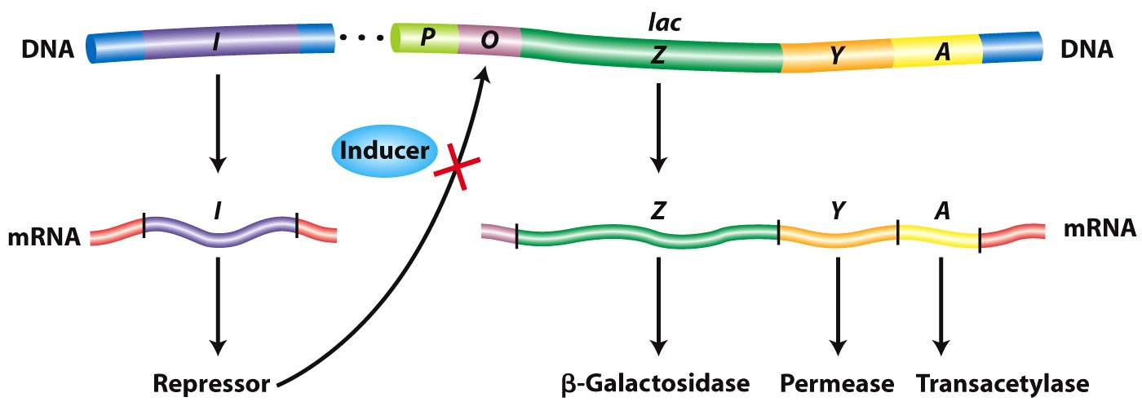
Example of negative regulation: the lac operon
Operon: a region of DNA that includes a multigenic (multi-cistronic) mRNA, and the regulatory elements that control the transcription of that mRNA
Regulatory components:
Promoter: binding site for RNA polymerase
Operator: between the promoter and the transcription start site, binding site for the lacI protein
lacI, repressor protein: made by a separate gene in the genome (not regulated, always made, and therefore technically not part of the operon, but critical to its function). Binds to the operator.

Slide 9
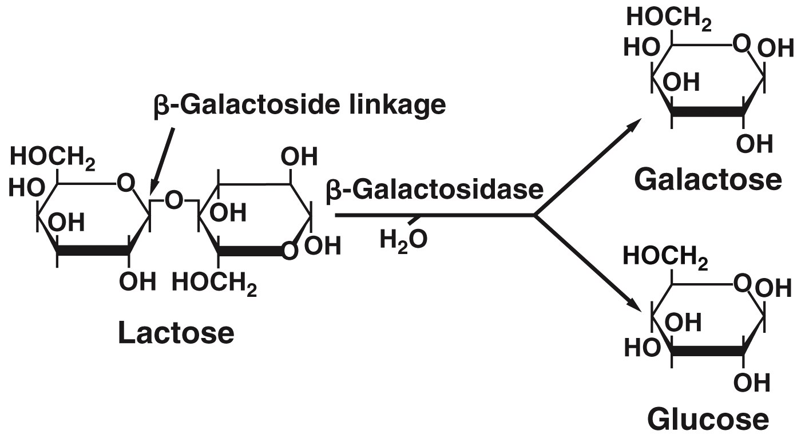
Example of negative regulation: the lac operon
Structural genes:
lacZ, encodes B-galactosidase: cleaves lactose into galactose and glucose
lacY, lactose permease: a transport protein that brings lactose into the cell from the environment
lacA, galactose transacetylase, exact role remains uncertain, but not essential for lactose metabolism

Slide 10
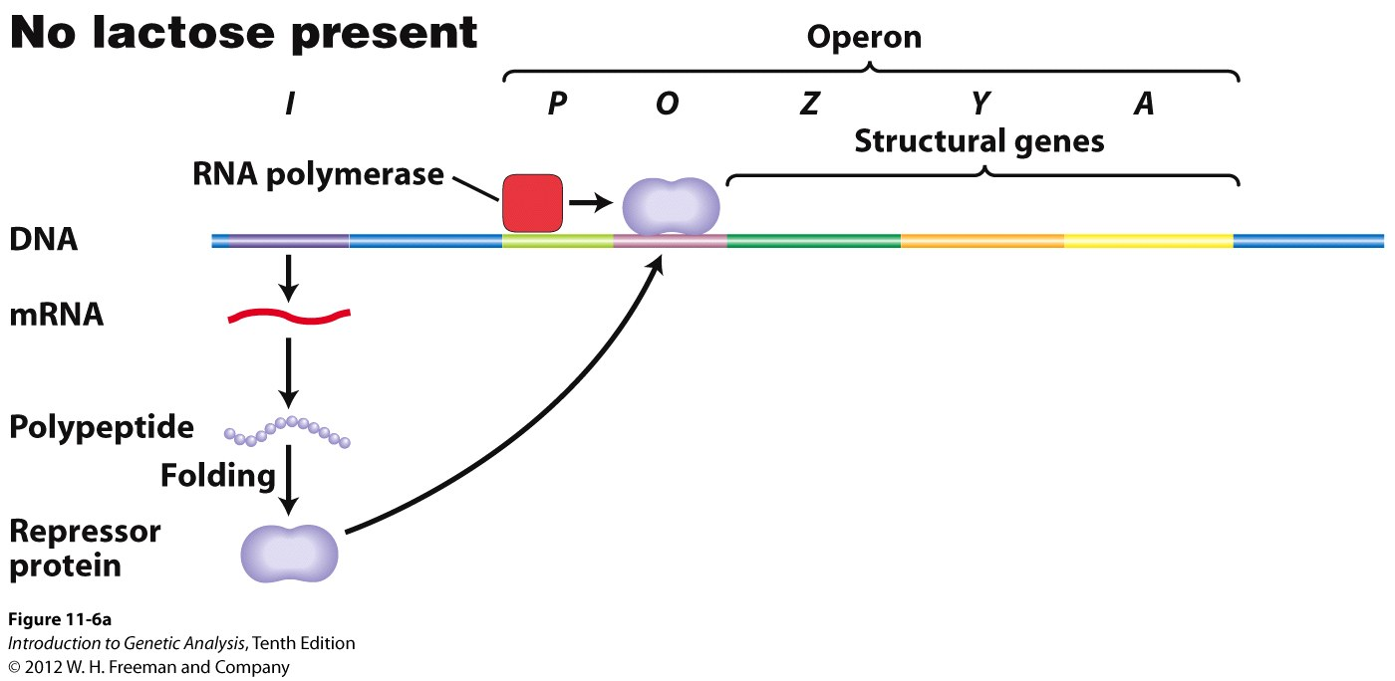
In the absence of lactose, the lacI repressor protein binds the operator, and the operon is “off” - no transcription of the lacZ lacY and lacA genes

Slide 11
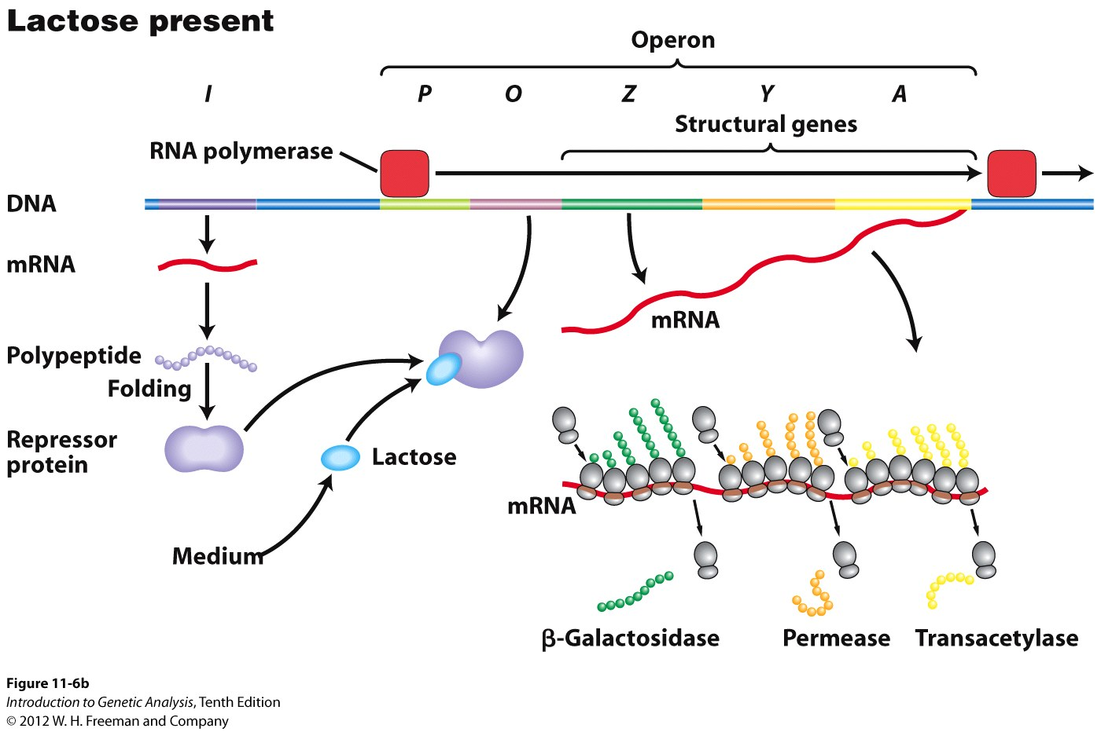
When lactose is present, the lactose binds to the lacI repressor, the repressor can no longer bind the operator, and the operon is “on” - transcription may begin, lacZ lacY and lacA are produced
Induction: turning the operon “on”
effectors are called inducers
system is referred to as inducible

Slide 12
Break Out!

Slide 13
Let’s make some predictions about the effects of mutations on the function of the lac operon
What would happen to the expression of Z Y and A if there was a deletion of the operator?
What would happen to the expression of Z Y and A if there is a mutation in the Lac I gene that prevents it from binding to lactose?

Slide 14
What would happen to the expression of Z Y and A if there was a deletion of the operator?
Z Y A would only be expressed in the presence of lactose
Z Y A would only be expressed in the absence of lactose
Z Y A would always be expressed, regardless of lactose
Z Y A would never be expressed, regardless of lactose

Slide 15
Let’s make some predictions about the effects of mutations on the function of the lac operon
What would happen to the expression of Z Y and A if there was a deletion of the operator?
What would happen to the expression of Z Y and A if there is a mutation in the Lac I gene that prevents it from binding to lactose?

Slide 16
What would happen to the expression of Z Y and A if there is a mutation in the Lac I gene that prevents it from binding to lactose?
Z Y A would only be expressed in the presence of lactose
Z Y A would only be expressed in the absence of lactose
Z Y A would always be expressed, regardless of lactose
Z Y A would never be expressed, regardless of lactose

Slide 17
Let’s make some predictions about the effects of mutations on the function of the lac operon
What would happen to the expression of Z Y and A if there was a deletion of the operator?
What would happen to the expression of Z Y and A if there is a mutation in the Lac I gene that prevents it from binding to lactose?

Slide 18
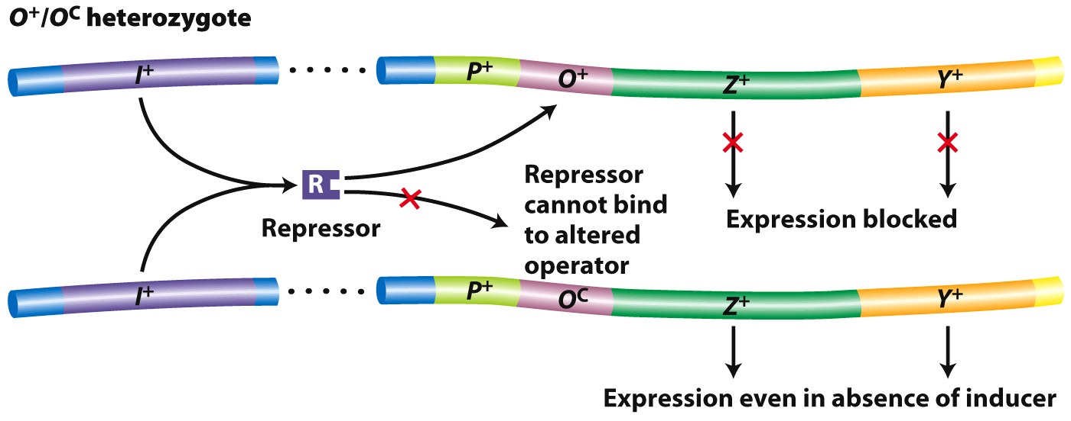
Operators are cis-acting: they must be in front of the operon they are regulating, on the same piece of DNA CIS=SAME
Heterozygotes can be made using F’ plasmids to create partial diploids of the operon with or without mutations
endogenote
F’
operator mutation: O^{C} constitutive expression, repressor can’t bind operator, operon is always “on”
Promoter mutation (P-) no polymerase binding = operon is always off

Slide 19
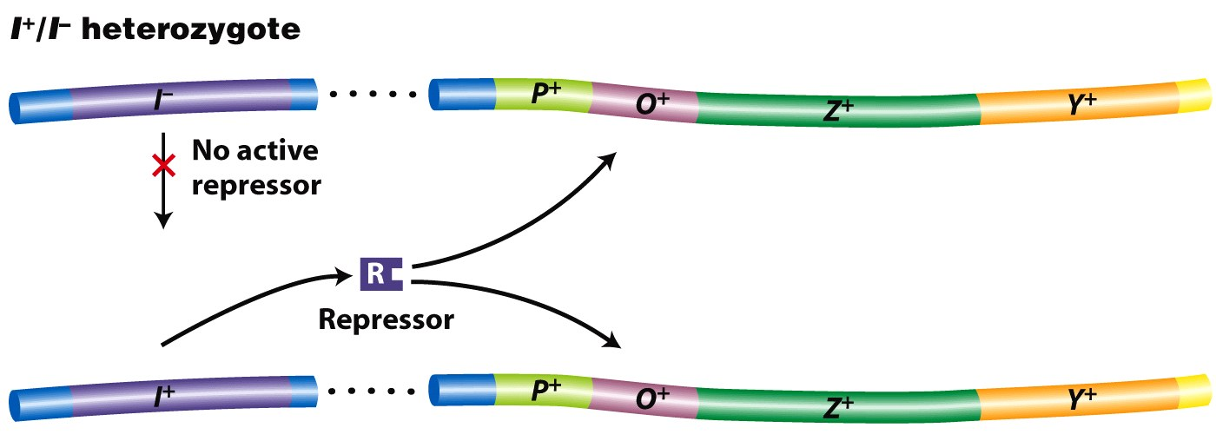
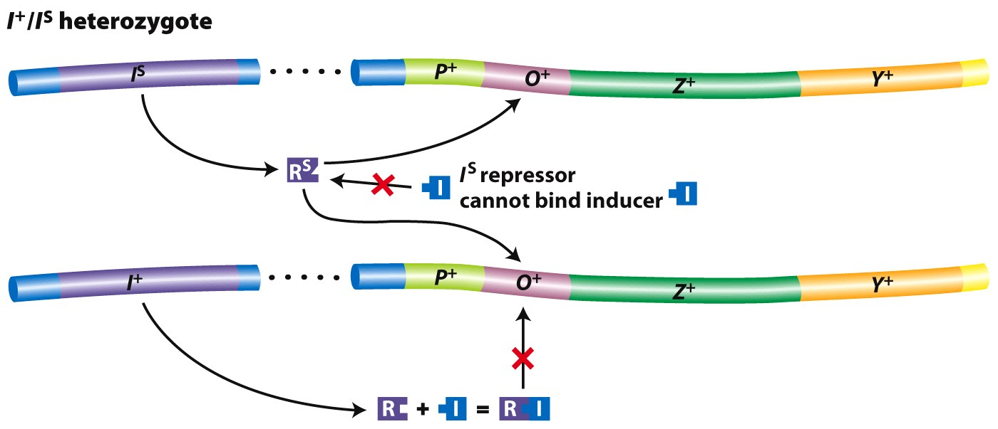
Heterozygotes can be made using F’ plasmids to create partial diploids of the operon with or without mutations
Repressors are trans-acting: they can regulate relevant operons regardless of whether they are encoded on the same DNA molecule
Making partial diploids can also help determine dominance
In this case, the I^{S} mutation is dominant over the normal I⁺ allele, which is dominant over I-
Repressor mutations:
I-, lacI protein is mutated or absent, cannot bind operator = operon constitutively “on”
I^{S}, the super-repressor, cannot bind lactose, always bound to operator even when lactose
is present = operon always “off”

Slide 20
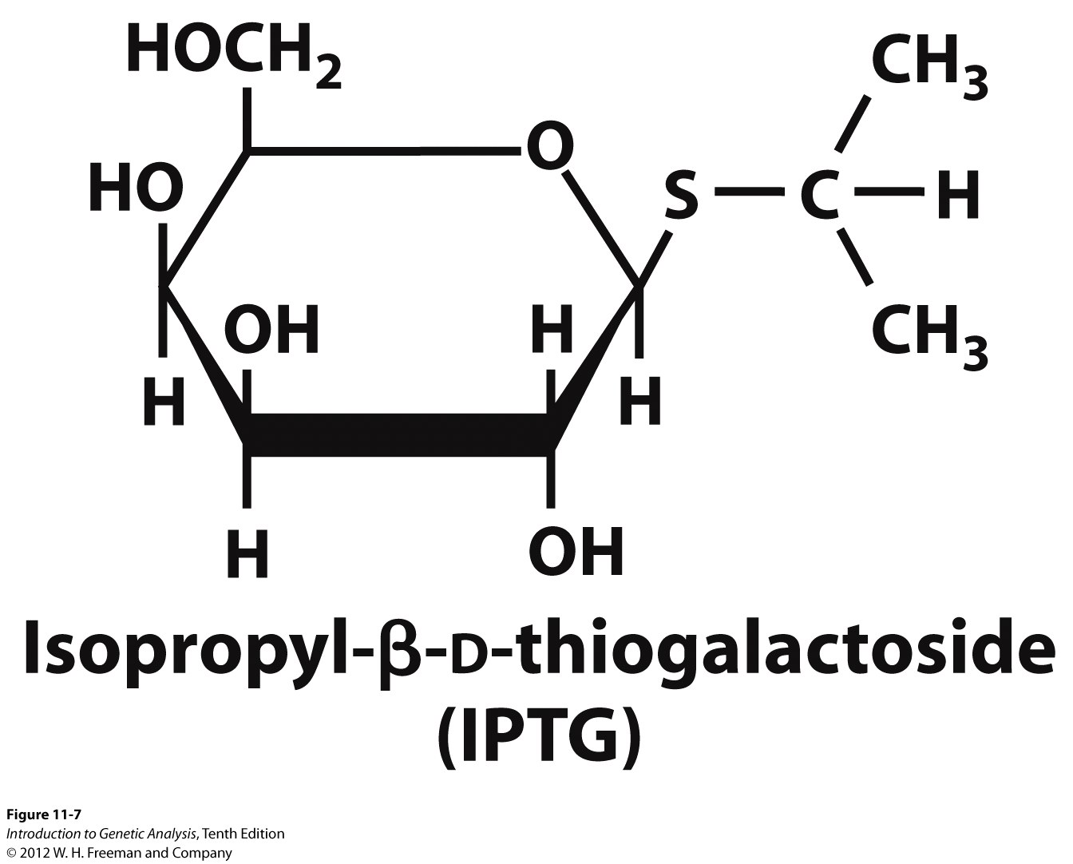
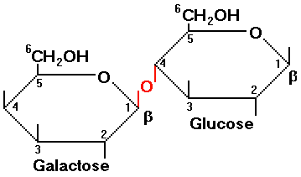
The lactose analog IPTG can bind the lacI repressor, but cannot be cleaved by B-galactosidase
lactose

Slide 21
Break Out! 2

Slide 22
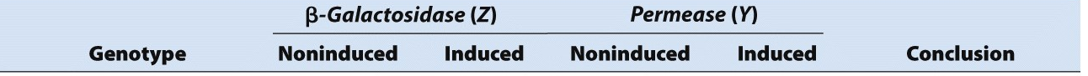
Consider the affects of the following mutations on the function of lacZ and lacY, as well as the result for the cell:
P O
Z Y A
I
I+ O+ Z+ Y+
I- O+ Z+ Y+
I+ O^{C} Z+ Y+
I^{S} O+ Z+ Y+
P- O+ Z+ Y+
anything not listed is assumed wildtype

