Slide 1
BB2920-C16: Genetics
Prof. Farny
Lecture 16
2/21/17
Conference Wednesday (I will be there!)
Office hours Thursday 10-11am
PS5 due Thursday 3pm
JC3 Friday

Slide 2
Today’s Learning Objectives
Discuss gene regulation in a eukaryotic system (Gal4-UAS system)
Describe an example of a biotechnology application of gene regulatory systems (tetracycline regulatory system)
Define epigenetic inheritance and describe some common examples and regulatory events

Slide 3
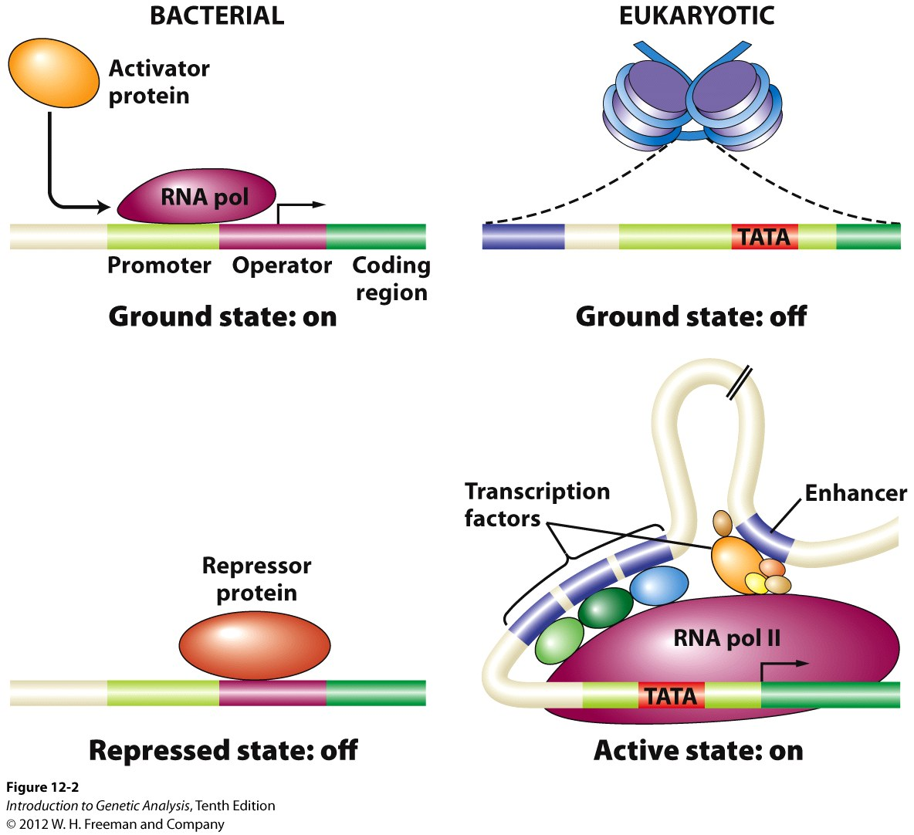
Regulating gene expression in eukaryotes
more complex than in bacteria.... reasons??

Slide 4
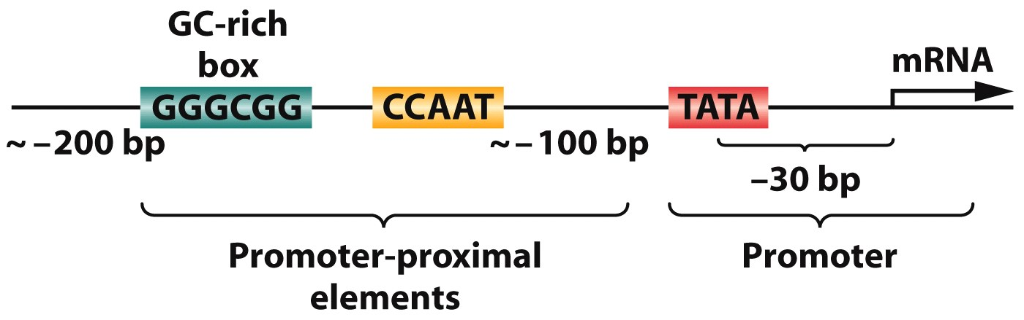
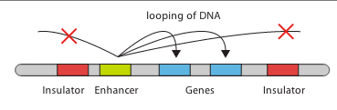
Eukaryotes have several different types of regulatory elements in addition to the promoter (these are DNA elements, so they are cis-acting)
proximal “close”:
GC-box
CCAAT-box
TATA-box
Distal “far”:
enhancers
insulators
Upsteam Activation Sequence (UAS)

Slide 5
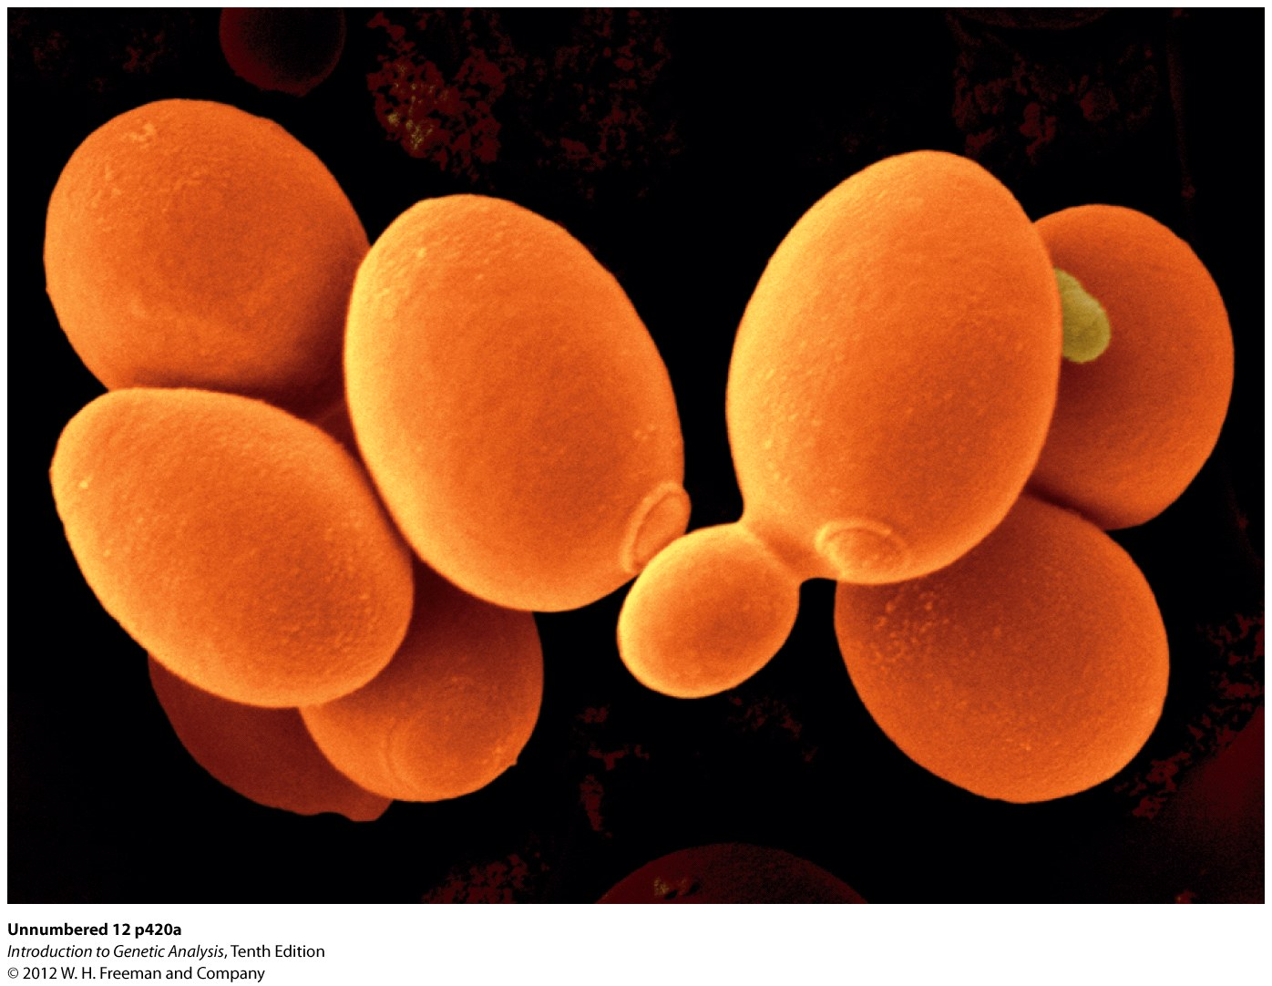
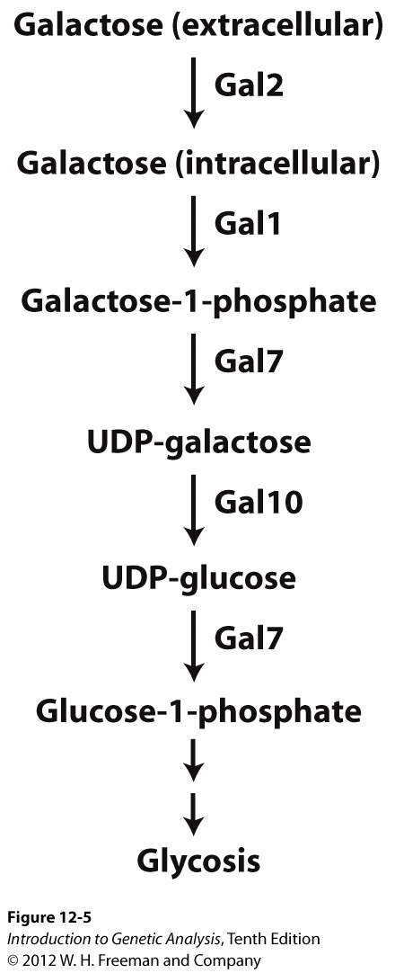
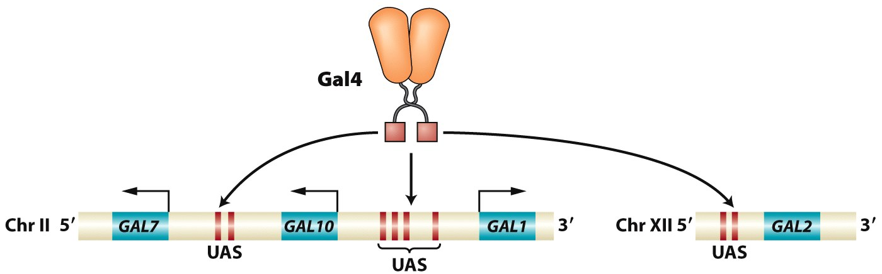
UAS
Upstream Activation Sequence
regulates galactose metabolism in yeast

Slide 6
Is Gal4 acting in cis or trans? Is the UAS acting in cis or trans?
Both act in cis
Both act in trans
Gal4 acts in cis and UAS acts in trans
Gal4 acts in trans and UAS acts in cis

Slide 7
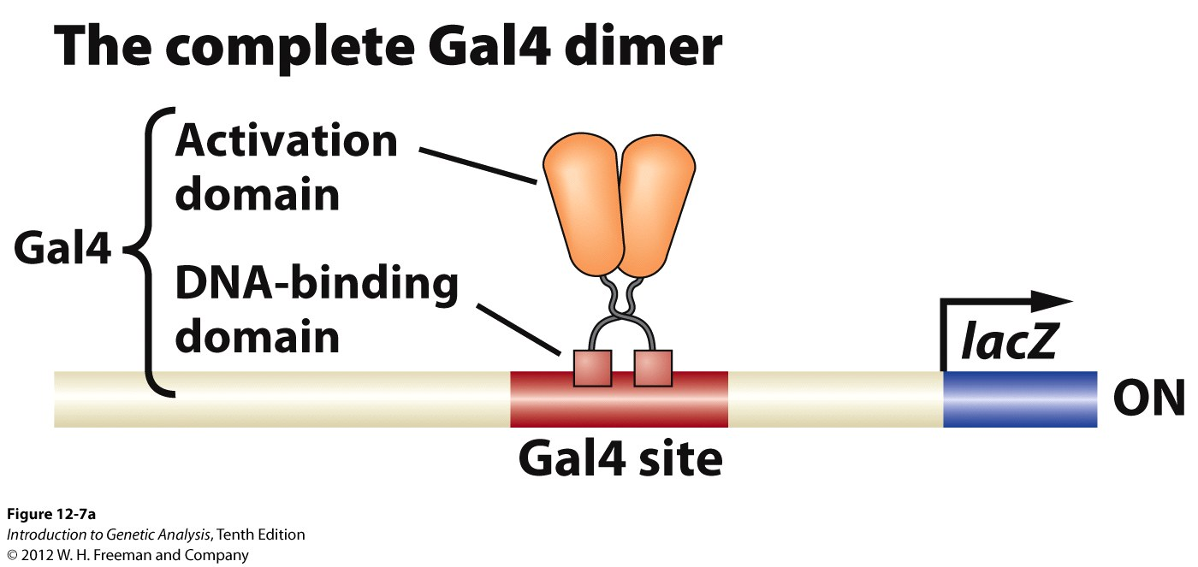
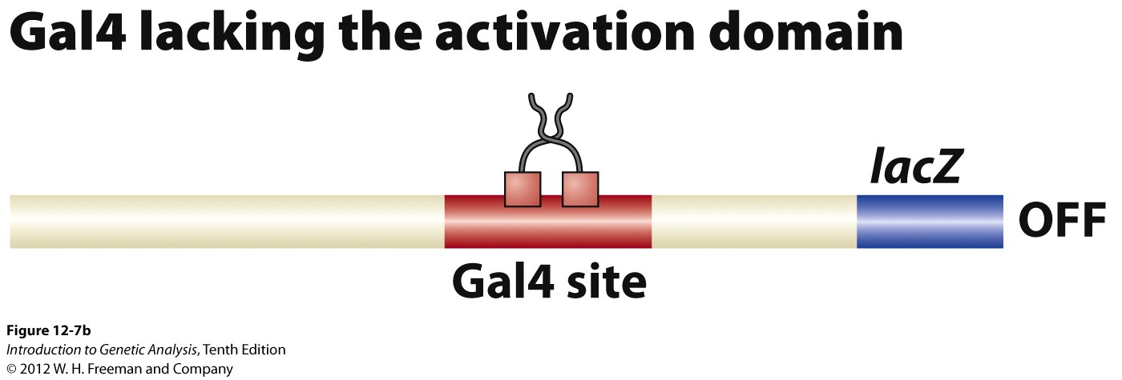
Gal4 is an activator TF that binds UAS sequences
Gal4 mutants that contain only the DNA binding domain and not the activation domain cannot activate transcription

Slide 8
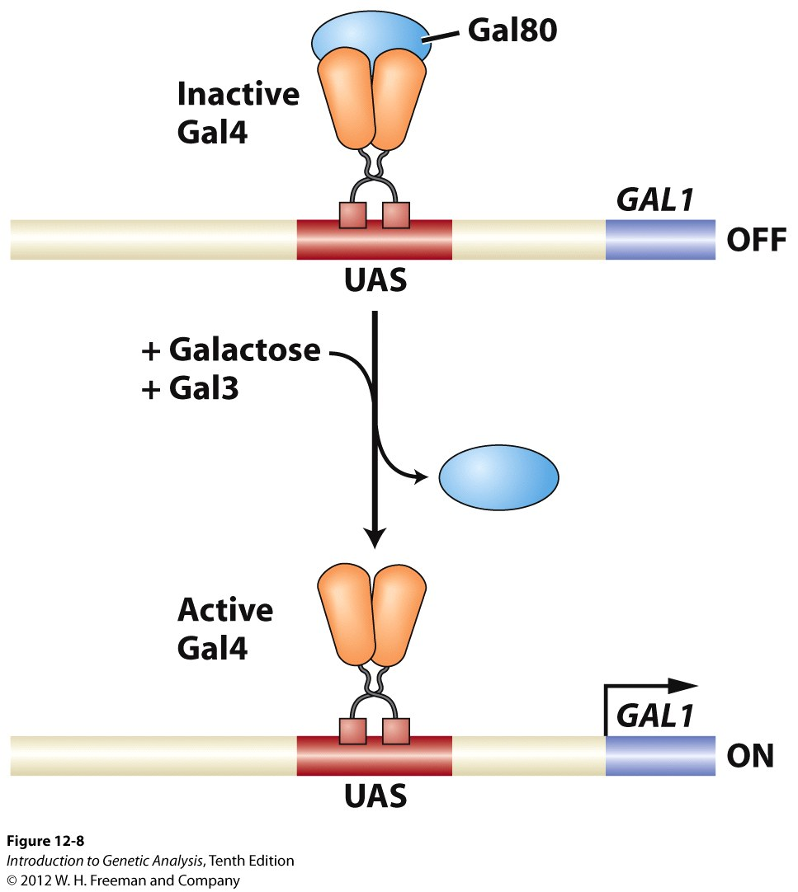
Gal4 activation by galactose is regulated by Gal80 and Gal3
note on nomenclature:
capital and italicized = the gene (GAL1)
Capital/lowercase, no italics = protein (Gal1, Gal1p)
mRNAs are treated like genes (GAL1)
Gal 3

Slide 9
The GAL System: summary
No Galactose:
Gal80 bound to Gal4
Gal4 bound to UAS
GAL metabolic genes OFF
+ Galactose:
Galactose binds Gal3
Gal3 “steals” Gal80 away from Gal4
Gal4 still bound to UAS
Gal4 can now activate GAL metabolic genes
Gal 3

Slide 10
A mutation in the allosteric site of Gal3 would cause which of the following?
GAL gene transcription is on in the presence of galactose and off in the absence of galactose
GAL gene transcription is off in the presence of galactose and on in the absence of galactose
GAL gene transcription is always off, regardless of galactose
GAL gene transcription is always on, regardless of galactose

Slide 11
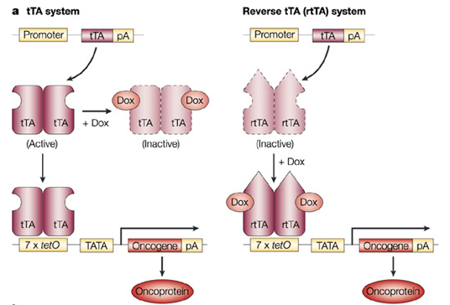
Biotechnology Applications: regulation of transgenes in mammalian cells by the Tetracycline Transcriptional Regulation System
transgene
transgene
protein
protein
“Tet OFF”
“Tet ON”
Jonkers & Berns Nature Reviews Cancer 2, 251-265 (April 2002)

Slide 12
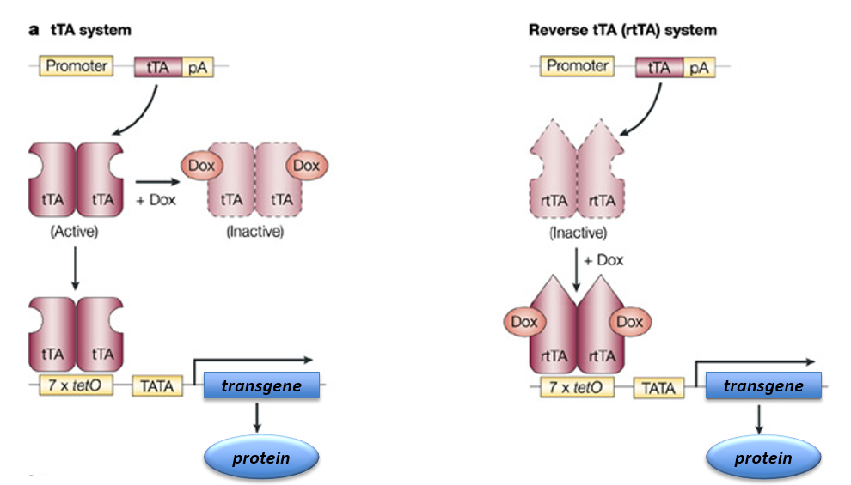
Is the tTA protein an activator or a repressor?
Activator
Repressor

Slide 13
Epigenetics: Regulating chromatin structure to regulate gene expression
Chromatin structure in eukaryotes makes most DNA inaccessible to RNA polymerase
Chromatin remodeling: the dynamic modification of chromatin architecture to regulate access of transcriptional machinery to the DNA and thereby regulate gene expression
Epigenetic Inheritance: the inheritance of chromatin states from one generation to the next

Slide 14
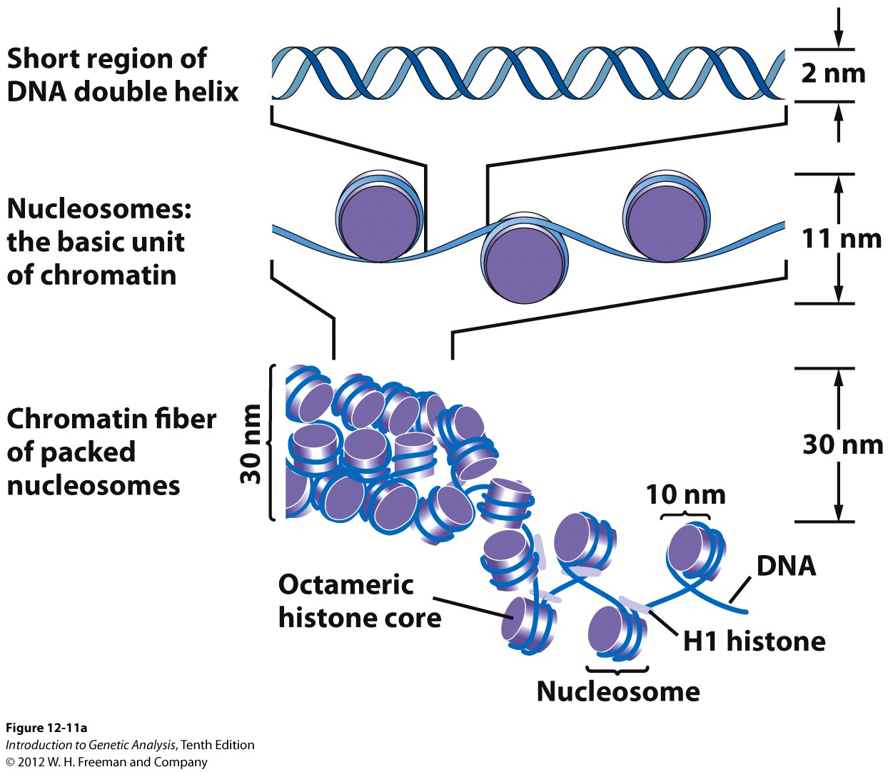
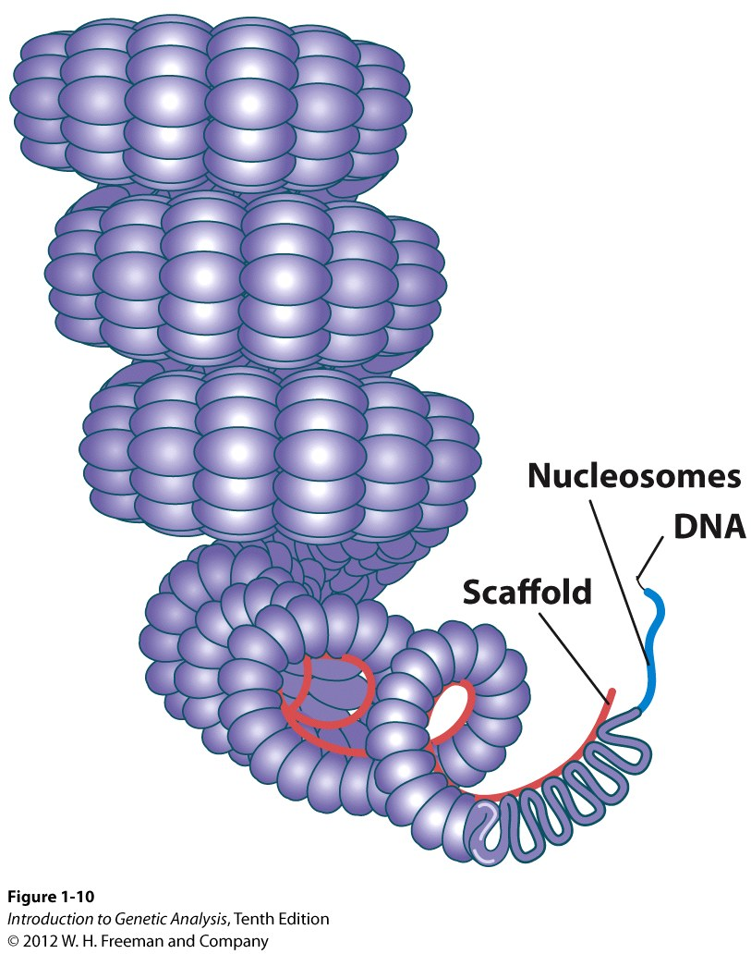
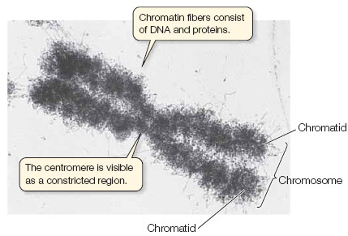
Chromatin architecture:
Multiple levels of coiling condenses the chromatin

Slide 15
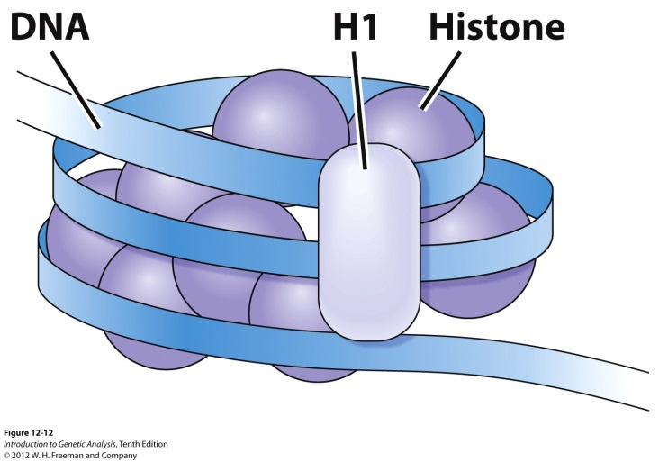
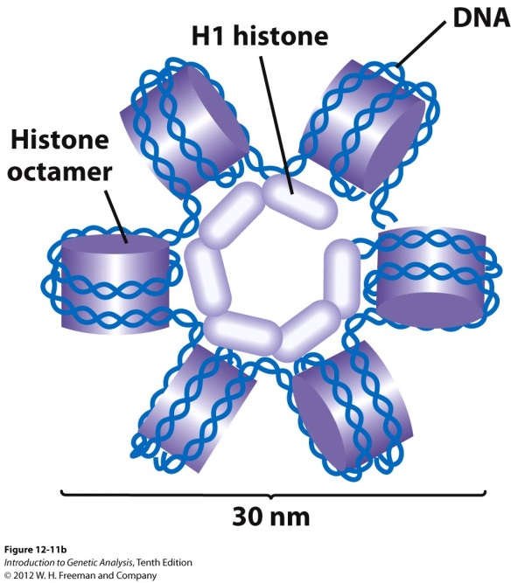
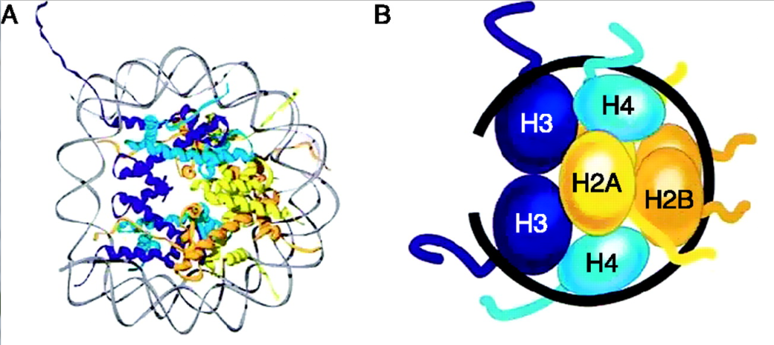
DNA is wound around protein “spools”
called nucleosomes
Histones: protein components of chromatin
Octamer, 2 each, H2A, H2B, H3, H4
H1 = nucleosome linker, folds nucleosomes into 30nm fiber
~146 bp of DNA per nucleosome (contacting the core proteins)

Slide 16
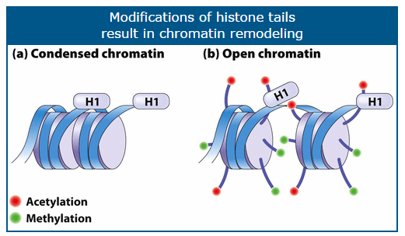
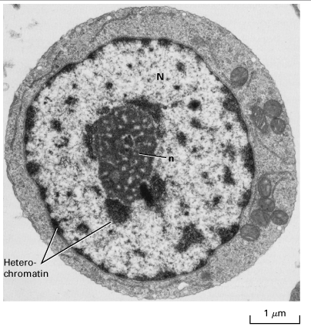

Epigenetics: modification of histone “tails” regulates transcription
Primary activating modification is acetylation, performed by HATs (histone acetyltransferases)
Histones can also be de-acetylated, by HDACs (histone deacetylases)
Histones are also methylated but the effects are more complicated…

Slide 17
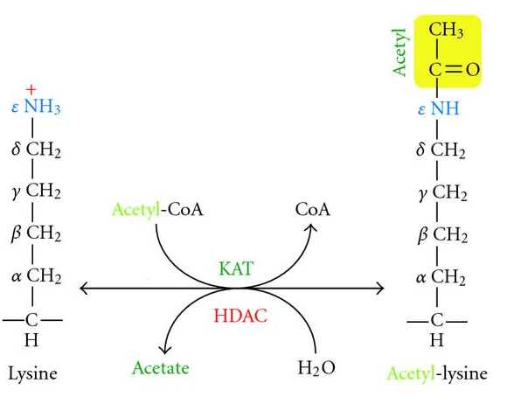
Which amino acid is most often the site of histone modification?
Arginine
Proline
Lysine
Cysteine

Slide 18
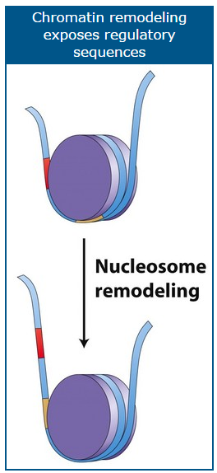
HOW does acetylation activate gene expression?
1) Shifts nucleosomes to reveal TF binding sites, promoters, or other regulatory sites (“nucleosome sliding”)
2) Increases space between nucleosomes, allowing chromatin to “open”
3) “Recruits” (encourages to bind) transcription factors, activators, and RNA polymerase to increase transcriptional frequency
TFs
RNA Pol II

Slide 19
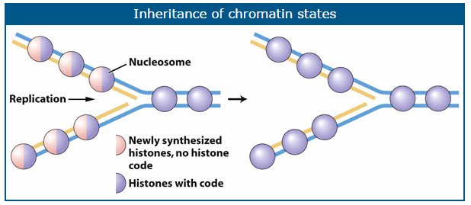
Inheritance of epigenetic marks (histone acetylation)
Replication: DNA strands are separated by helicase then coated with ssDNA-BP
Existing histones are broken up and scatter
Old histones combine randomly with newly translated copies of histones such that each new nucleosome is a combination of old and new
The old histones “train” the new ones in a process that is still under investigation

Slide 20
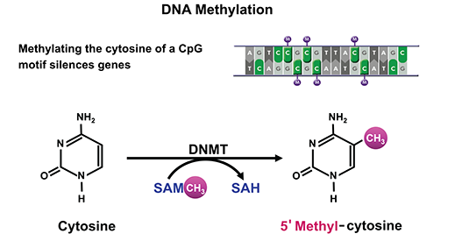
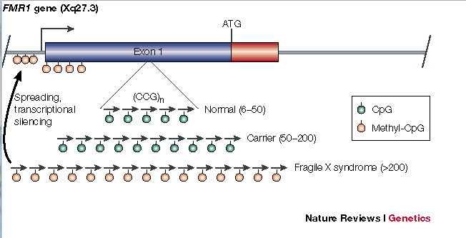
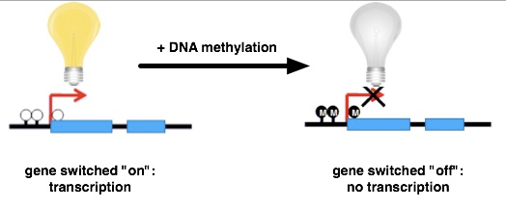
Epigenetic silencing of gene expression through DNA methylation

