Slide 1
BB2920-C16: Genetics
Prof. Farny
Lecture 17
2/23/17

Slide 2
Today’s Learning Objectives
Finish our discussion of epigenetic regulation of gene expression
Understand how non-disjunction leads to aneuploidy in cells
Discuss the mechanisms that are used to balance gene dosage from sex chromosomes

Slide 3
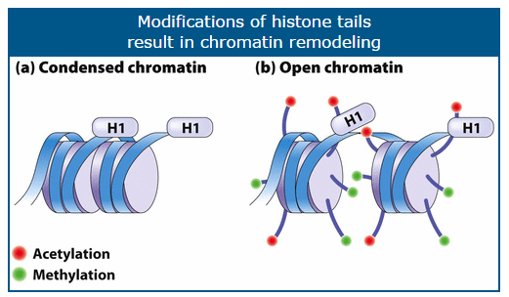
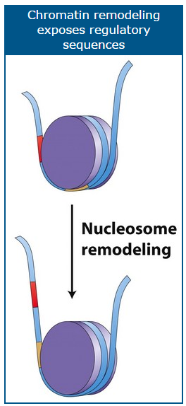
HOW does acetylation activate gene expression?
1) Shifts nucleosomes to reveal TF binding sites, promoters, or other regulatory sites (“nucleosome sliding”)
2) Increases space between nucleosomes, allowing chromatin to “open”
3) “Recruits” (encourages to bind) transcription factors, activators, and RNA polymerase to increase transcriptional frequency
TFs
RNA Pol II

Slide 4
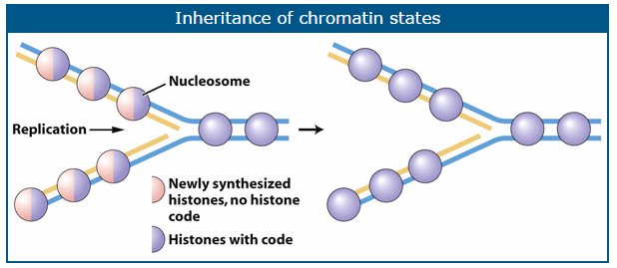
Inheritance of epigenetic marks (histone acetylation)
Replication: DNA strands are separated by helicase then coated with ssDNA-BP
Existing histones are broken up and scatter
Old histones combine randomly with newly translated copies of histones such that each new nucleosome is a combination of old and new
The old histones “train” the new ones in a process that is still under investigation

Slide 5
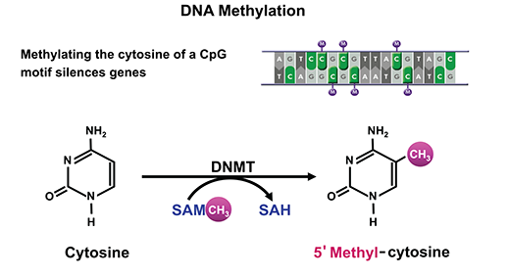
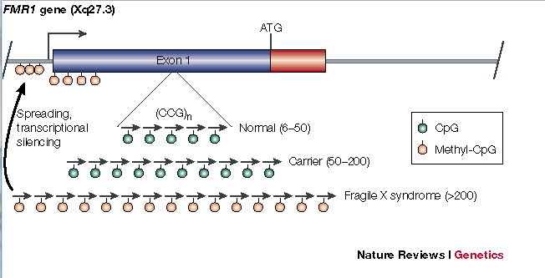
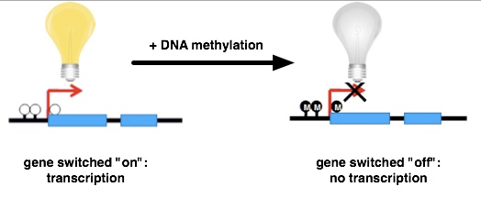
Epigenetic silencing of gene expression through DNA methylation

Slide 6
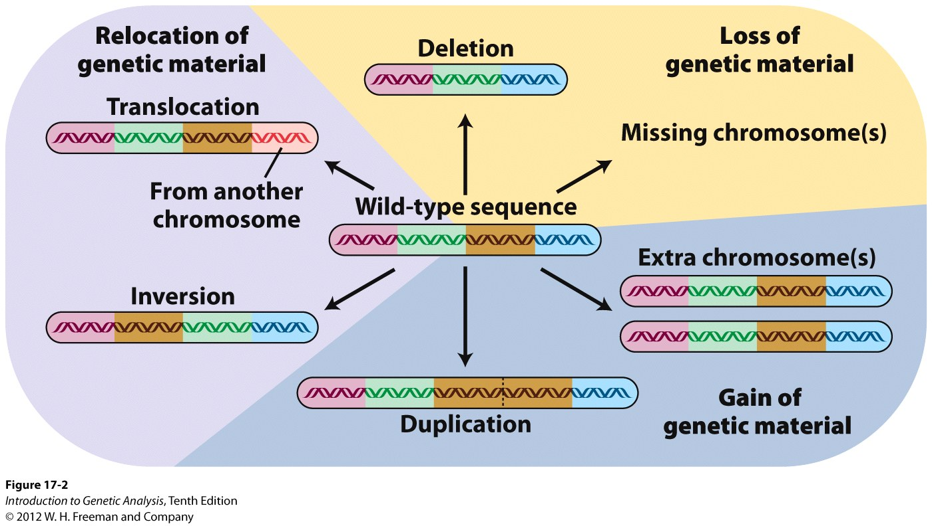
Types of Large-Scale Chromosomal Changes
chromosomal number changes

Slide 7
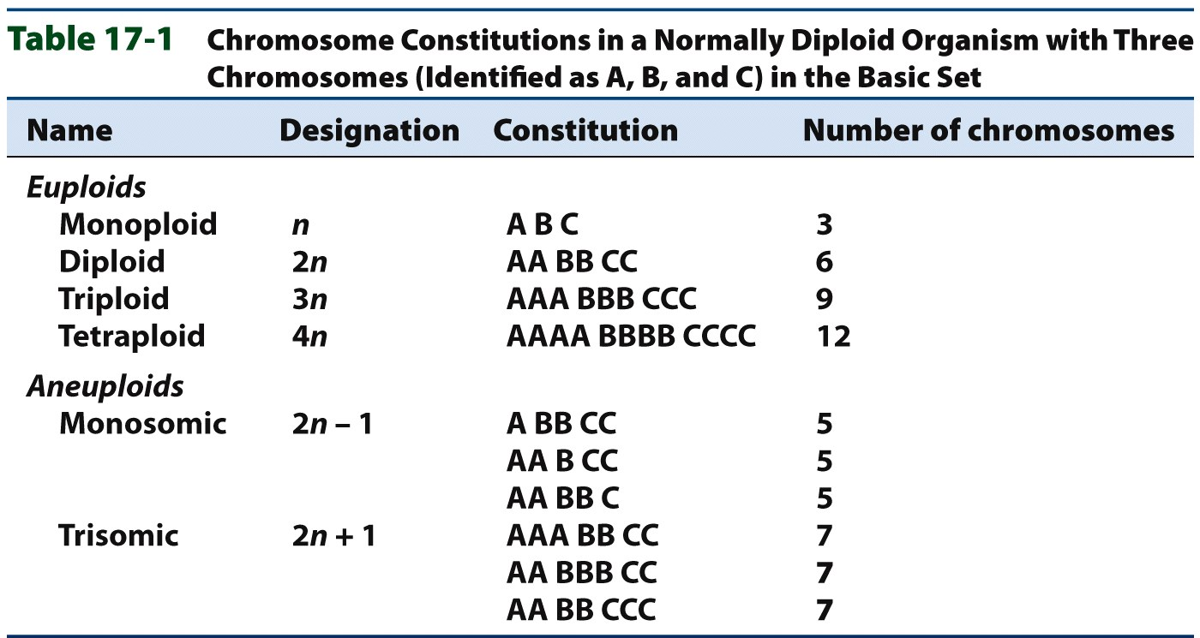
Changes in Chromosome Number: euploidy vs aneuploidy
euploidy: multiple copies of the entire genome (n, 2n, 3n, 4n...), can be normal or abnormal
aneuploidy: multiple copies of individual chromosome(s), typically abnormal
monoploid
vs
haploid??

Slide 8
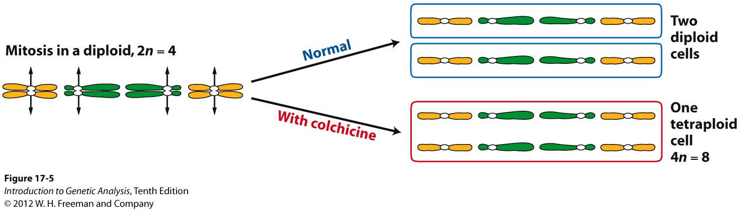
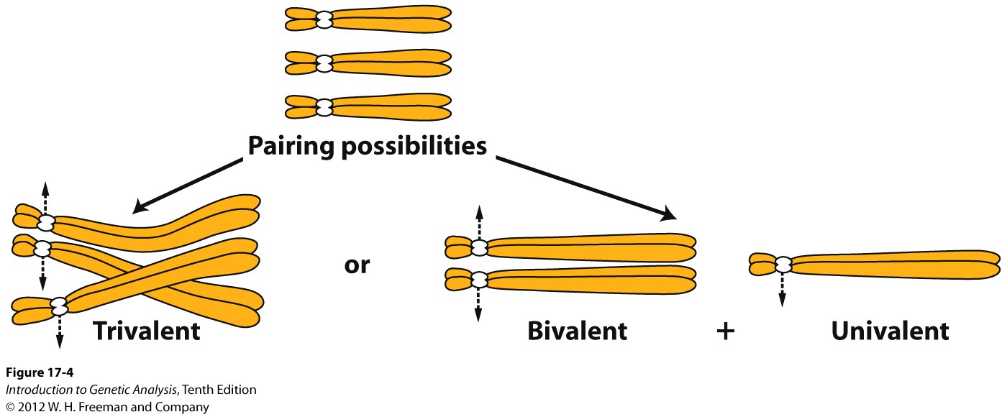
Polyploidy
multiple (total) genome copies result from mutagenic agents, errors in meiosis, or mating/fusing of cells from different species
Example: colchicine inhibits spindle formation during meiosis
Major problem with polyploids??

Slide 9
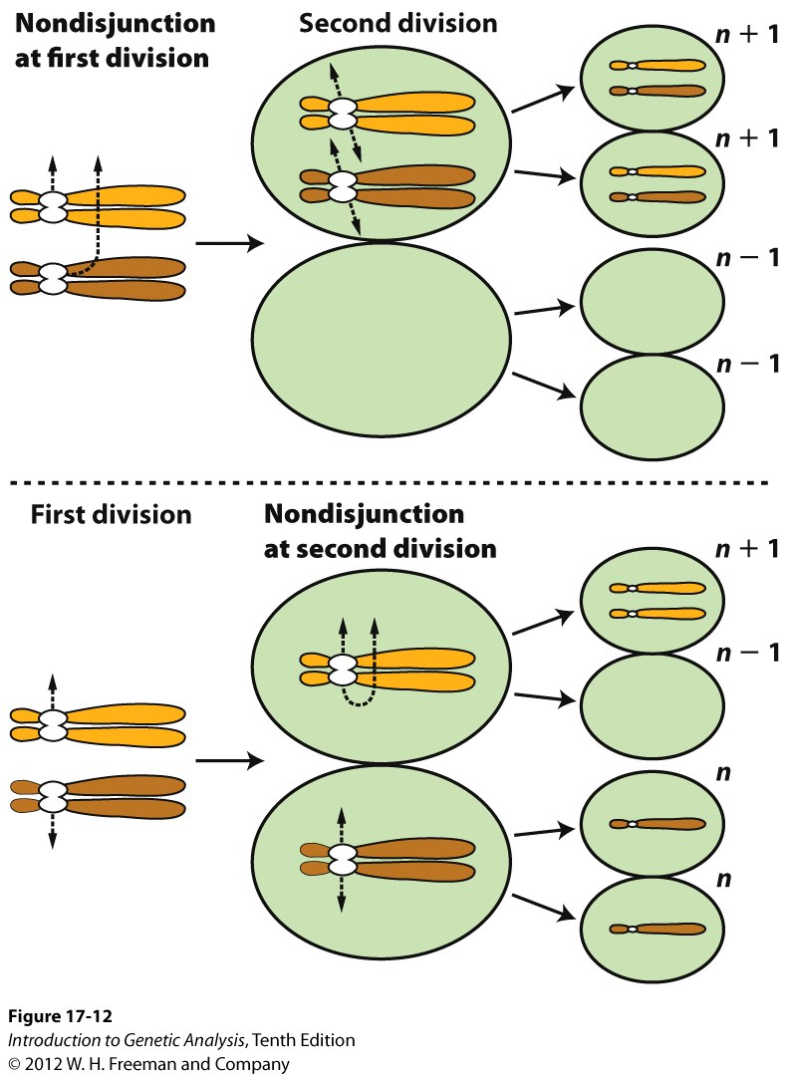
Aneuploidy
In diploid: trisomic (2n+1), monosomic (2n-1), nullisomic (2n-2)
aneuploidy is caused by non-disjunction:
the failure of chromosomes to separate during meiosis, can occur at either anaphase I or anaphase II
Human aneuploidies:
Turner Syndrome XO
Klienfelter Syndrome XXY
Down Syndrome (trisomy 21)

Slide 10
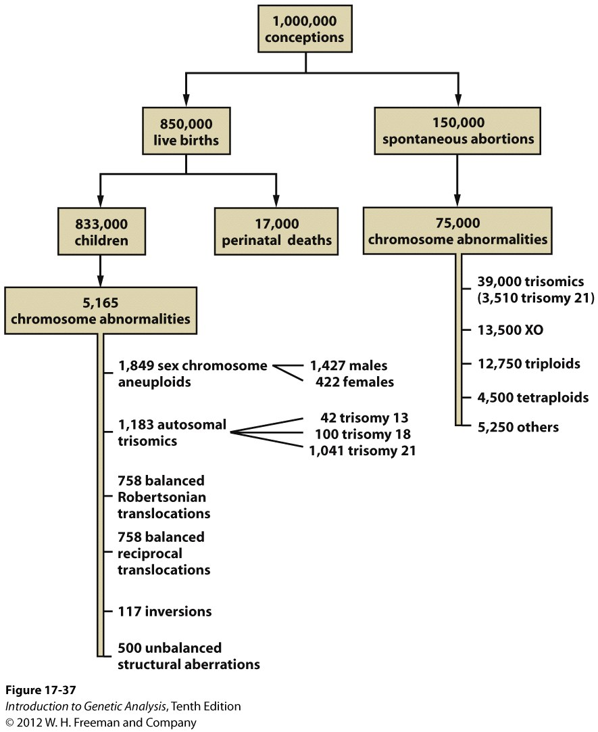
Aberrant Euploidy and Aneuploidy are typically lethal in humans
most trisomics and monosomics are lethal, especially when autosomes are affected

Slide 11
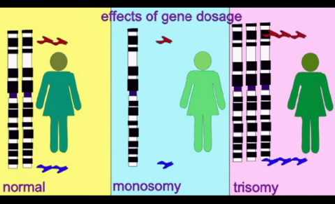
Aberrant Euploidy and Aneuploidy are typically lethal in humans
most trisomics and monosomics are lethal, especially when autosomes are affected

Slide 12
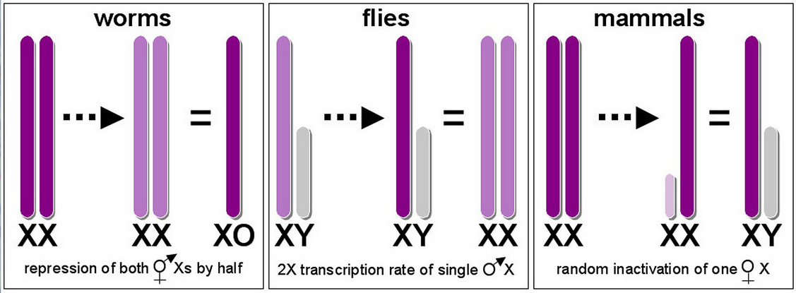
Dosage Compensation
What about the sex chromosomes? Aren’t those imbalanced?
Equalizes the transcription (gene dosage) between males and females

Slide 13
Which method do humans use?
#1
#2
#3

Slide 14
X chromosome inactivation videos
https://highered.mcgraw-hill.com/sites/0072995246/student_view0/chapter24/x_inactivation.html
http://www.hhmi.org/biointeractive/x-inactivation

Slide 15
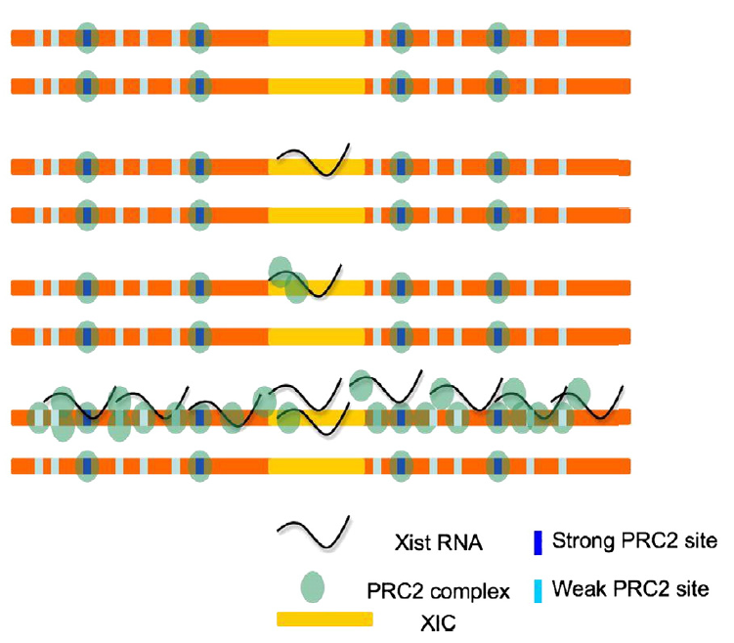
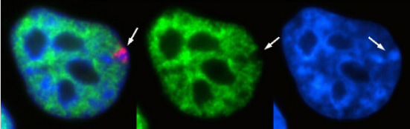
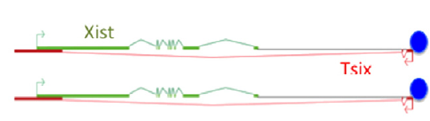
X Chromosome Inactivation in Humans
X inactivation Center (XIC)
Barr Body
Froberg et al.

Slide 16
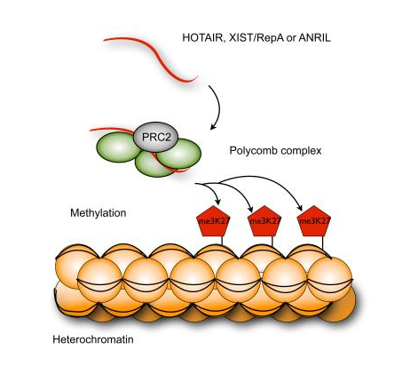
Xist recruits other proteins that help silence transcription on the X chromosome
Xist RNA
Compaction of chromatin, very little gene expression

Slide 17
Tsix prevents Xist expression on the active X chromosome (Xa)
“Antisense” to Xist RNA

