Slide 1
BB2920: Genetics
Prof. Farny
Lecture 5
1/20/17

Slide 2
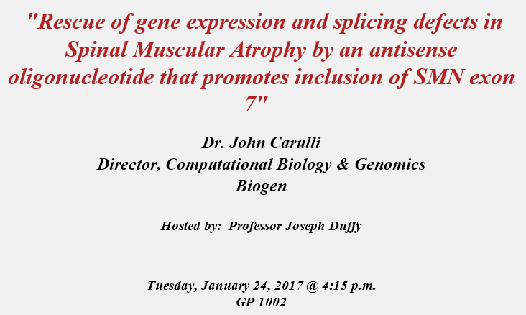
Extra Credit Opportunity
You will attend the seminar and/or read the research article, write a 1 page summary, and answer some questions online.
You will receive up to +3 points on the first exam for your participation and (quality) write-up.

Slide 3
Journal Club 1 posted tonight
Article on the use of CRISPR in engineered cells to cure cystic Fibrosis
Use the Reading Guide, there’s helpful stuff on there
Google everything!
Reading papers is HARD – don’t leave it to the last minute, and ask for help if you need it – consider forming a study group, or ask me or your PLAs for help.
Several (3-4) students will be assigned to each item on the reading guide. When that question comes up in our discussion, you will be called upon to provide an answer. More details on this to follow!

Slide 4
Today’s Learning Objectives
Understand the process and the purpose of transcription
Explain the function of promoters
Apply your understanding of transcription to analysis of sequences and prediction of transcriptional products
Understand the process and the purpose of post-transcriptional RNA processing in eukaryotes

Slide 5
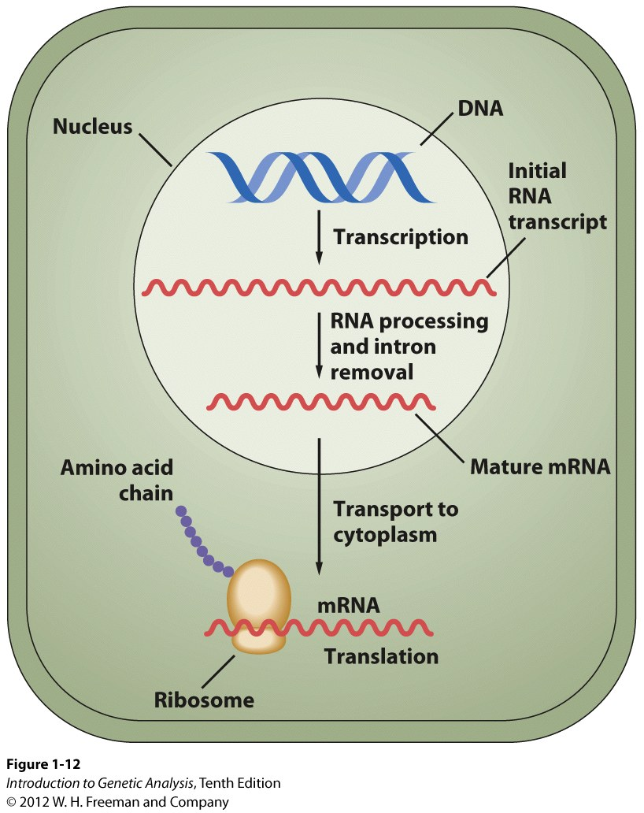
The Central Dogma of Molecular Biology
DNA
transcription
RNA
translation
Protein
replication
To transcribe (as in a text):
To make a very similar copy of some portion of the text, using the same language
Nucleic acid to nucleic acid (DNA to RNA)
To translate:
To convert from one language to another
Converts from nucleic acids to amino acids
(RNA to protein)

Slide 6
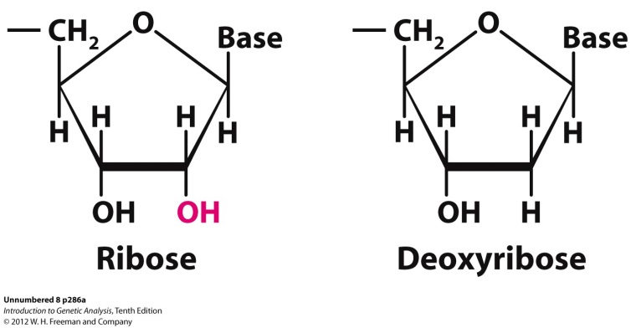
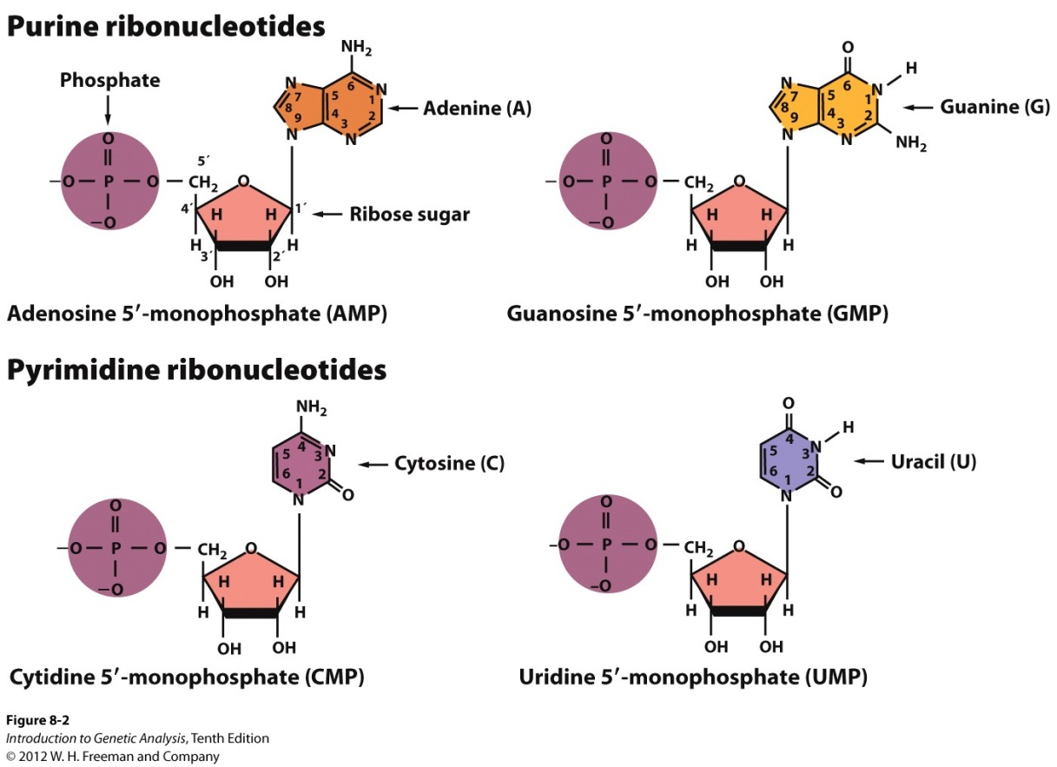
RNA: ribonucleic acid
Types of RNA
Informational:
messenger mRNA
(Pol II)
Functional:
transfer tRNA (Pol III)
ribosomal rRNA (Pol I)
small nuclear snRNA
many others....
Uracil replaces thymine in RNA

Slide 7
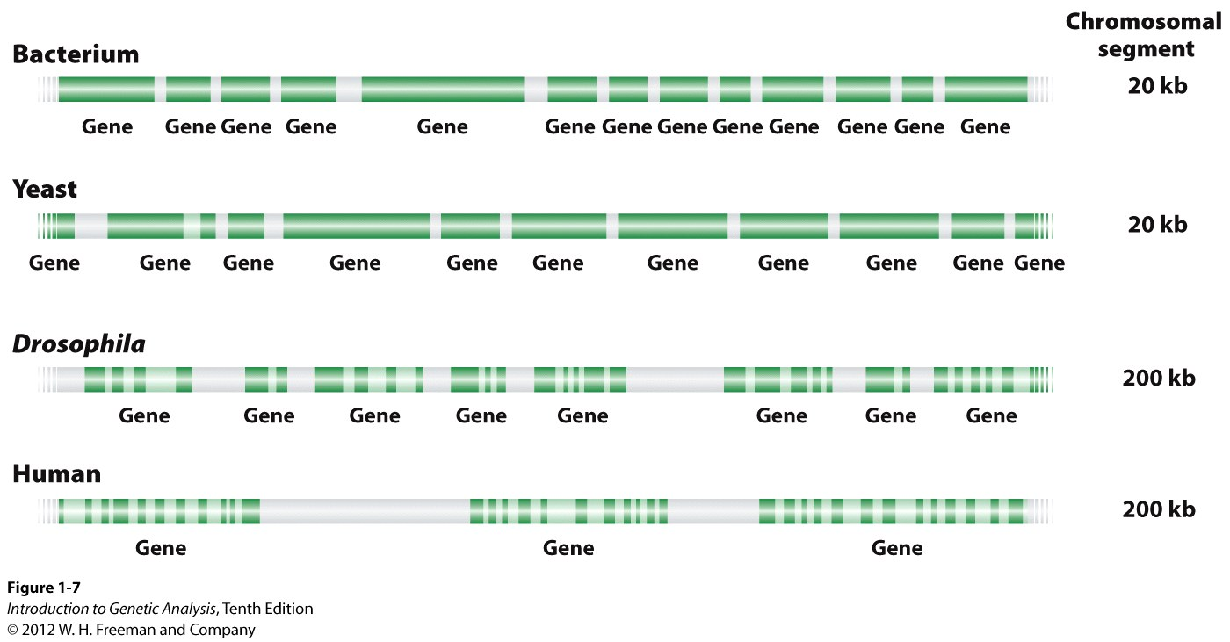
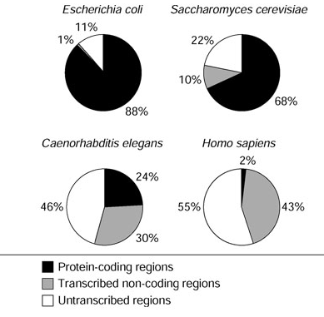
Organization of Genes within Genomes
DNA = gene
Genes are transcribed into mRNA in order to be made into proteins
transfer of informational content into a mobile, usable form

Slide 8
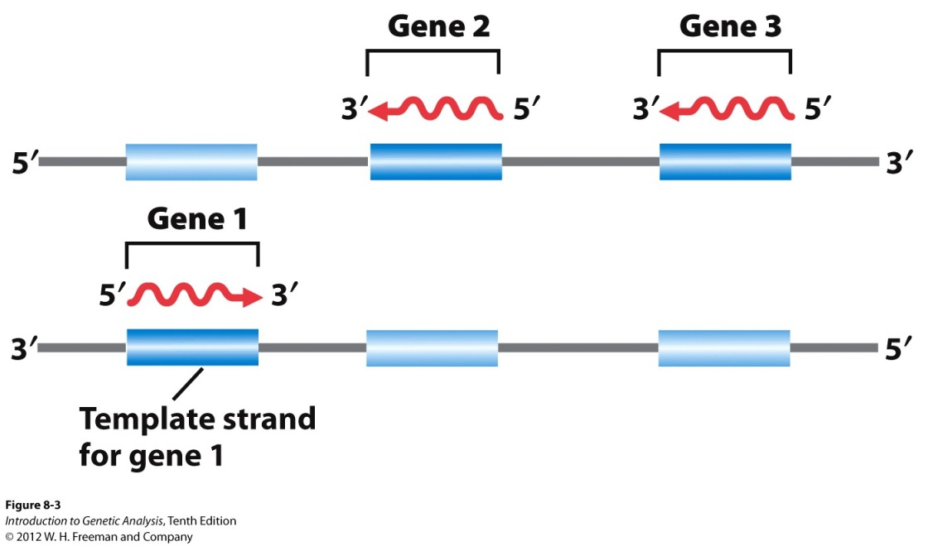
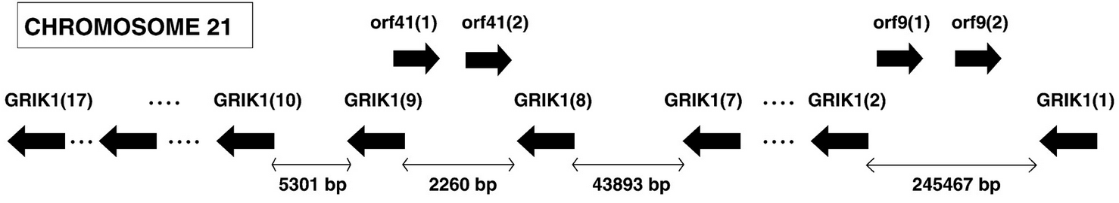
Genes can be present on both strands of DNA
http://www.pnas.org/content/99/26/17008

Slide 9
Which strand is which? How do I know which way an RNA is going to be made? (Remember your #1 Rule!!)
Nucleic acids (RNA and DNA) can only be synthesized in the 3’ → 5’ direction!
Nucleic acids (RNA and DNA) can only be synthesized in the 5’ → 3’ direction!
DNA is only synthesized 5’ → 3’, and RNA is only synthesized 3’ → 5’!

Slide 10
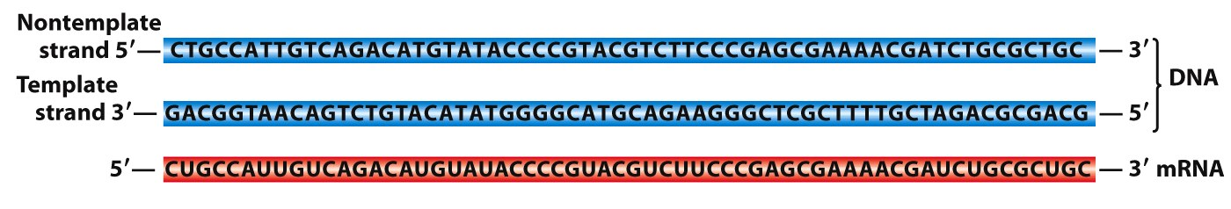
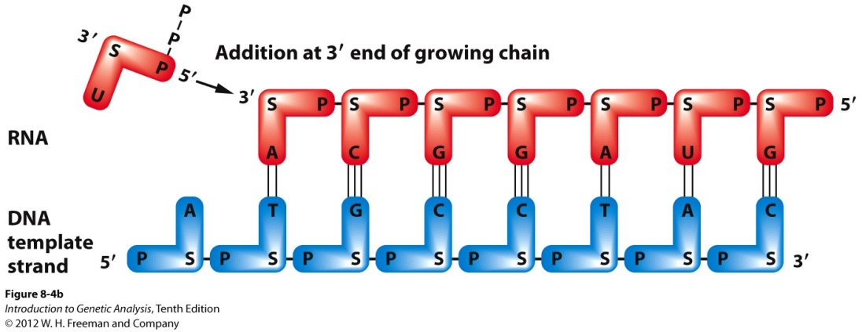
Which strand is which???
remember:
non-template = coding
non-coding = template
coding
Direction of transcription of template strand
Template is “read” from 3’ to 5’
RNA is synthesized from 5’ to 3’
SAME AS REPLICATION!
Nucleotides can only be added to free 3’ ends!
Even for RNA! EVER!
Direction of transcription

Slide 11
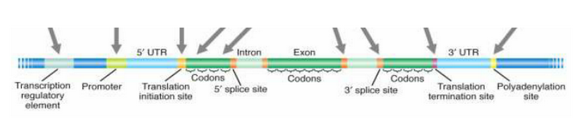
Components of a gene: Gene Architecture
Transcriptional unit
(all the regions that are transcribed):
5’ untranslated region
introns and exons
3’ untranslated region
Regulatory units: (parts of the gene that are NOT transcribed)
Promoter
Regulatory sites
others, will discuss later...
Direction of transcription
“Upstream”
“Downstream”
Prokaryotes: no introns, very little untranslated region
Notes:
how does the cell know where the gene starts?

Slide 12
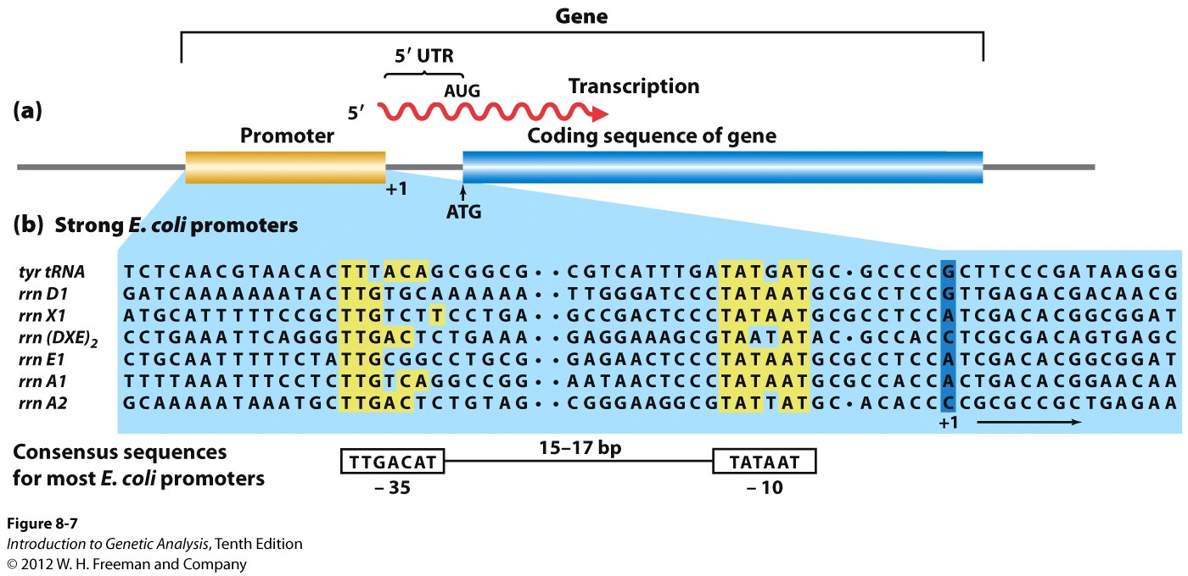
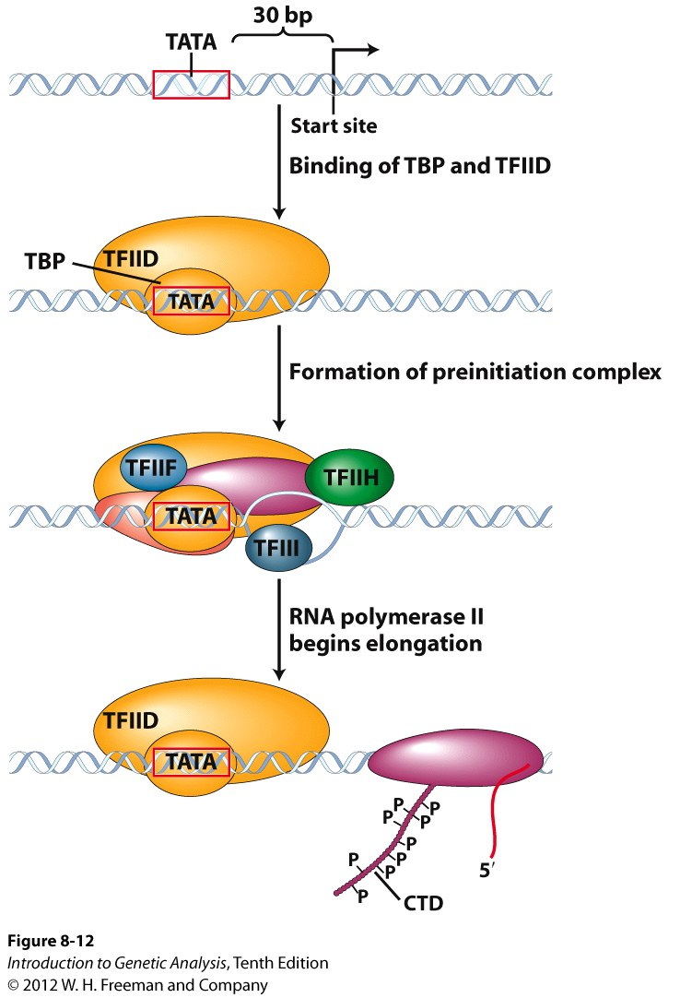
Promoter sequences indicate start sites for RNA transcription
prokaryotic:
prokaryotic and eukaryotic promoters are bound by transcription factors (TF)
which mark the start site and bring in the polymerase
eukaryotic:
-30
+1
numbering begins at the first nucleotide to be transcribed (+1), nucleotides in front of that (promoter) are numbered negatively from the +1 site

Slide 13
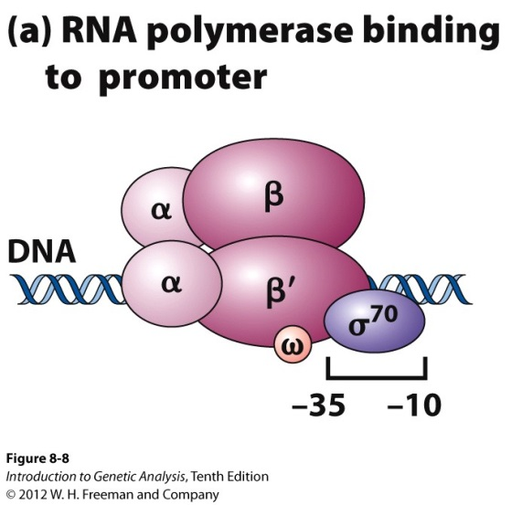
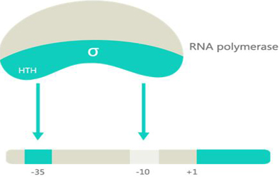
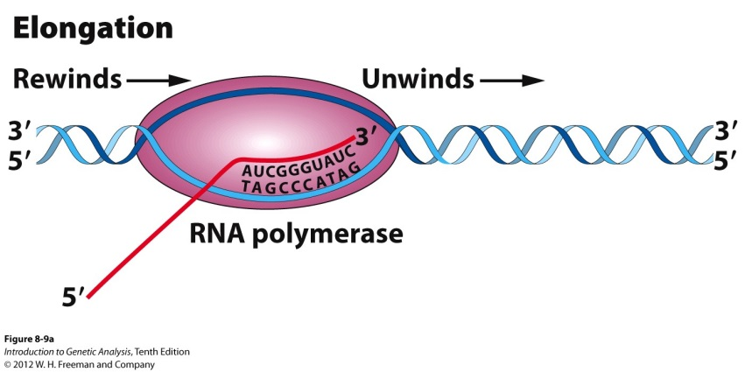
Transcription is performed by RNA polymerase
Prokaryotic:
Eukaryotic:
TATA binding protein = TBP
Sigma 70
recognizes the -35 and -10
Promoter sites
Transcription bubble

Slide 14
Break-out!

Slide 15
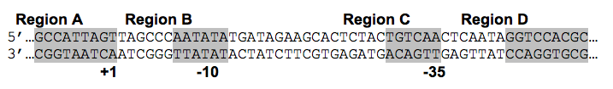
Consider this region of a typical prokaryotic gene:
Which strand (top or bottom) is the template strand?
Which region of this DNA sequence will be transcribed?
Give the sequence of the first 8 bases of the transcribed RNA.
HINT! It will help tremendously if you
Determine the direction of transcription, and then
Apply your most important rule!

Slide 16
Which strand is the template?
Top
Bottom

Slide 18
Which region will be transcribed?
Region A
Region B
Region C
Region D

Slide 20
The sequence of the first 8 bases of the transcribed RNA is: remember sequence is always written 5’ → 3’
Rank | Responses
1 | ACUAAUGG
2 | ACUAAUGGC
3 | ACUAAU
4 | ACUAAUCC
5 | CGGUAAUC
6 | Other
Values: ACUAAUGG
Value Matches: 0

Slide 22
Which region is upstream of the promoter?
Region A
Region B
Region C
Region D

Slide 23
Transcription is performed by RNA polymerase
Prokaryotic:
Eukaryotic:
TATA binding protein = TBP
Sigma 70
recognizes the -35 and -10
Promoter sites
Transcription bubble

Slide 24
Let’s briefly review: Here is an eukaryotic gene region. What is the direction of transcription?
5’
3’
-30
+1
→
←

Slide 25
Which strand is the CODING strand?
5’
3’
-30
+1
Top
Bottom
Always begin these types of problems by identifying and labeling strands, even if the question doesn’t ask (helps for replication questions too)

Slide 26
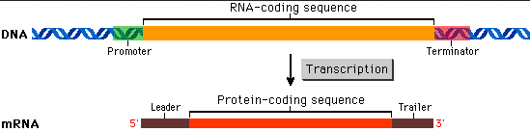
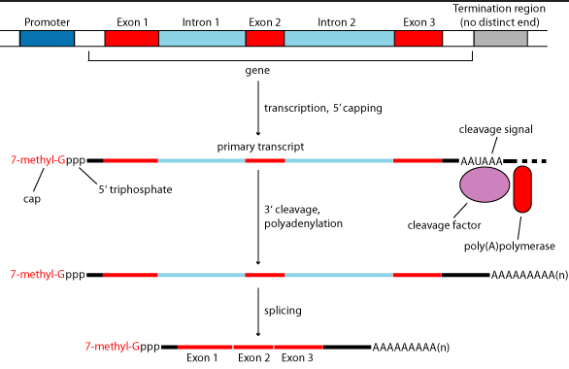
Prokaryotic mRNAs are ready-to-go; Eukaryotic mRNAs require processing
Prokaryote:
DNA
Eukaryote:
mRNA

Slide 27
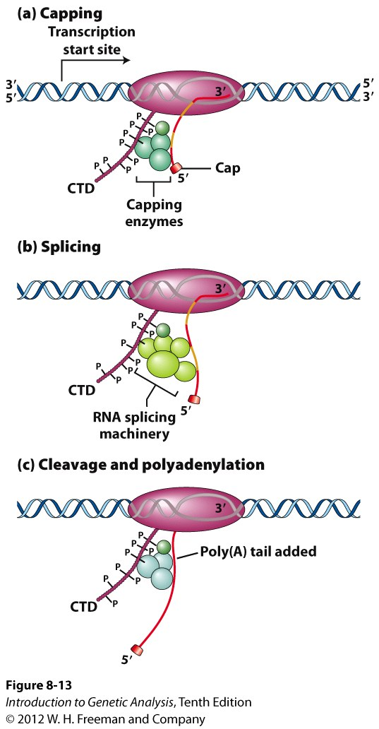
Eukaryotic mRNAs require processing
Processing is said to occur co-transcriptionally
RNA pol II CTD – C-terminal domain:
processing enzymes “ride along”
Capping:
7-methylguanosine, 5’-5’ linkage
(“backwards” G)
why? protects 5’ end
Splicing:
removal of introns
Cleavage and polyadenylation:
AAUAAA sequence
mRNA cut
poly-A tail added by poly A pol.
why? protects 3’ end
Notes:
in prokaryotes, the RNA is made and that’s it. In eukaryotes, the RNA is processed before it is ready for translation into protein

