Slide 1
BB2920: Genetics
Prof. Farny
Lecture 9
2/2/17
Office Hours this week: Friday 10-11, GH203C
PLA help hours: TONIGHT 7-9 SL lounge
PS3 due Tomorrow
RQ4 due Monday

Slide 2

JC2 available now under Modules
Reading Guide has 18 questions (numbered)
Each student is assigned a number (4-5 students will have same question)
E-mail with people with the same number to discuss the answer to your question

Slide 3
Today’s Learning Objectives
Explain how meiosis generates variation:
Crossing over between homologous chromosomes
Independent assortment of chromosomes
Review the principles of basic Mendelian inheritance
Predict the outcomes of single gene crosses for genes on autosomes and sex chromosomes

Slide 4
Meiosis generates variation in two distinct and important ways
Crossing over between homologous chromosomes https://youtu.be/BhJf9MHHmc4
Independent assortment of homologous chromosomes http://youtu.be/wAHEejRUQdw

Slide 5
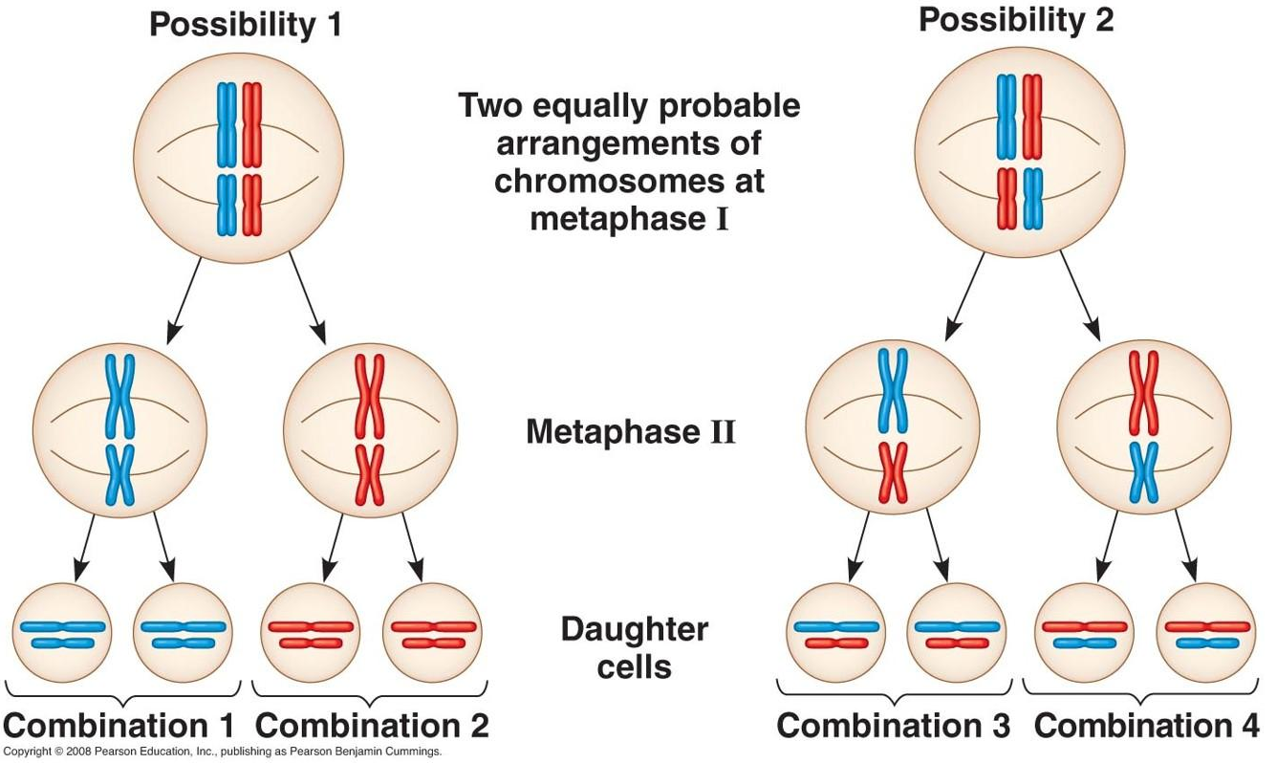
Independent assortment of homologous chromosomes in Meiosis I
maternal and paternal copies of chromosomes can separate into either cell during meiosis I
Occurs completely randomly, based on how the bivalents align on the metaphase I plate
possible gametes = 2^{n} (n=haploid chromosome #)

Slide 6
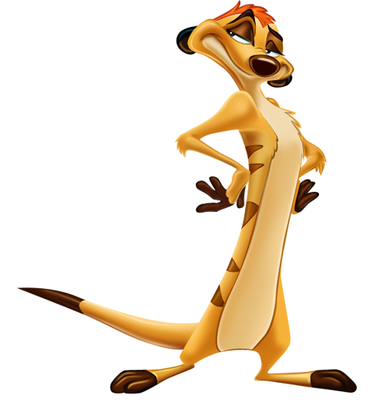
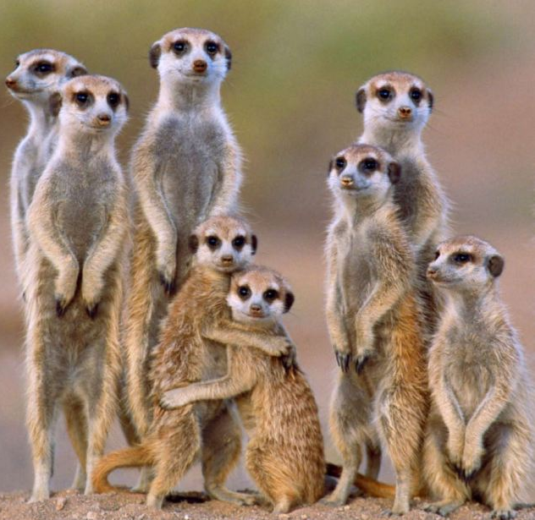
In meerkats, the diploid chromosome number is 36. How many possible different types of sperm could a male meerkat produce just by independent assortment of chromosomes?
Rank | Responses
1 | 262144
2 | 68719476736
3 | 1413720
4 | 144
5 | 21214
6 | Other
Values: 262144
Value Matches: 61

Slide 7
Meiosis: Summary important points
Pairing, crossing over in Prophase I, major source of genetic variation
Segregation of homologous chromosomes in Anaphase I (NOT sister chromatids!)
Independent assortment of homologs in Meiosis I, creates significant variation
Nice video summary of meiosis, crossing over, and independent assortment: http://youtu.be/rqPMp0U0HOA

Slide 8
How comfortable are you with basic Mendelian genetics? (I.e., Punnett squares, dominant vs. recessive, homozygous vs. heterozygous)
Studied it many times. I am very comfortable with this material
Seen it once or twice but I’m a bit rusty
Never learned this before today

Slide 9
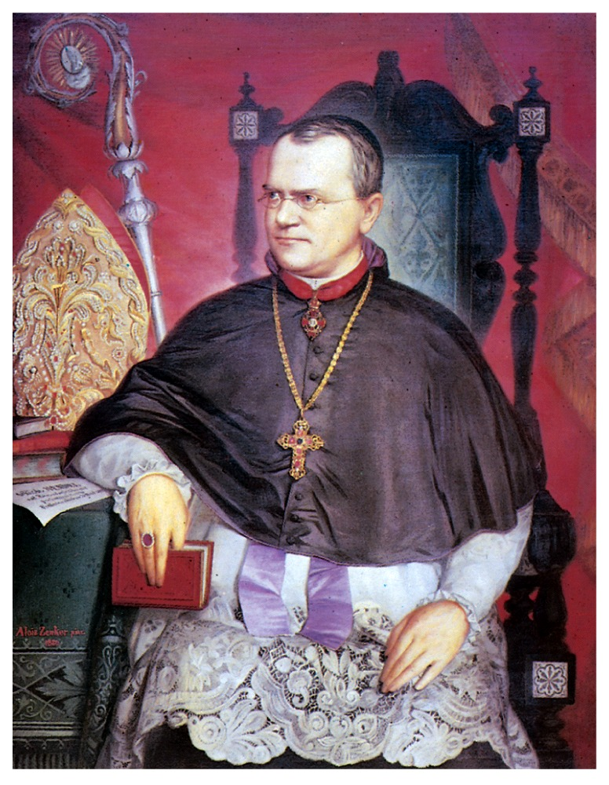
The Early Days of Genetics
sheep breeders had noticed for some time that certain traits were inherited in predictable patterns
Gregor Mendel
Augustinian friar
mid 1800s
Brno (now Check Republic)
controlled breeding of peas

Slide 10
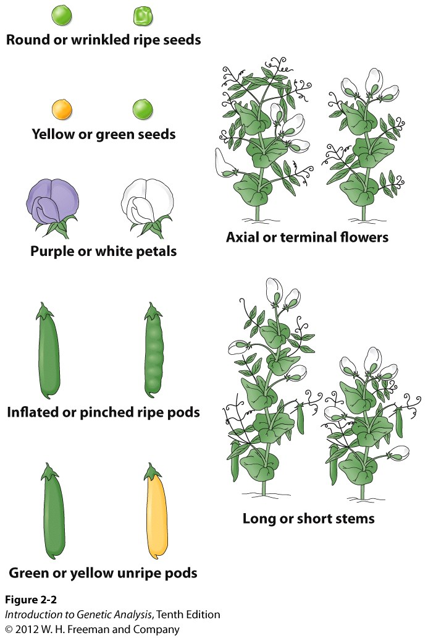
Mendel’s model system: Peas
7 phenotypes
Characters/traits (=genes!)
Different version of the trait are called alleles (differences in DNA!)
Pure breeding lines: result in only the parental phenotype when bred

Slide 11
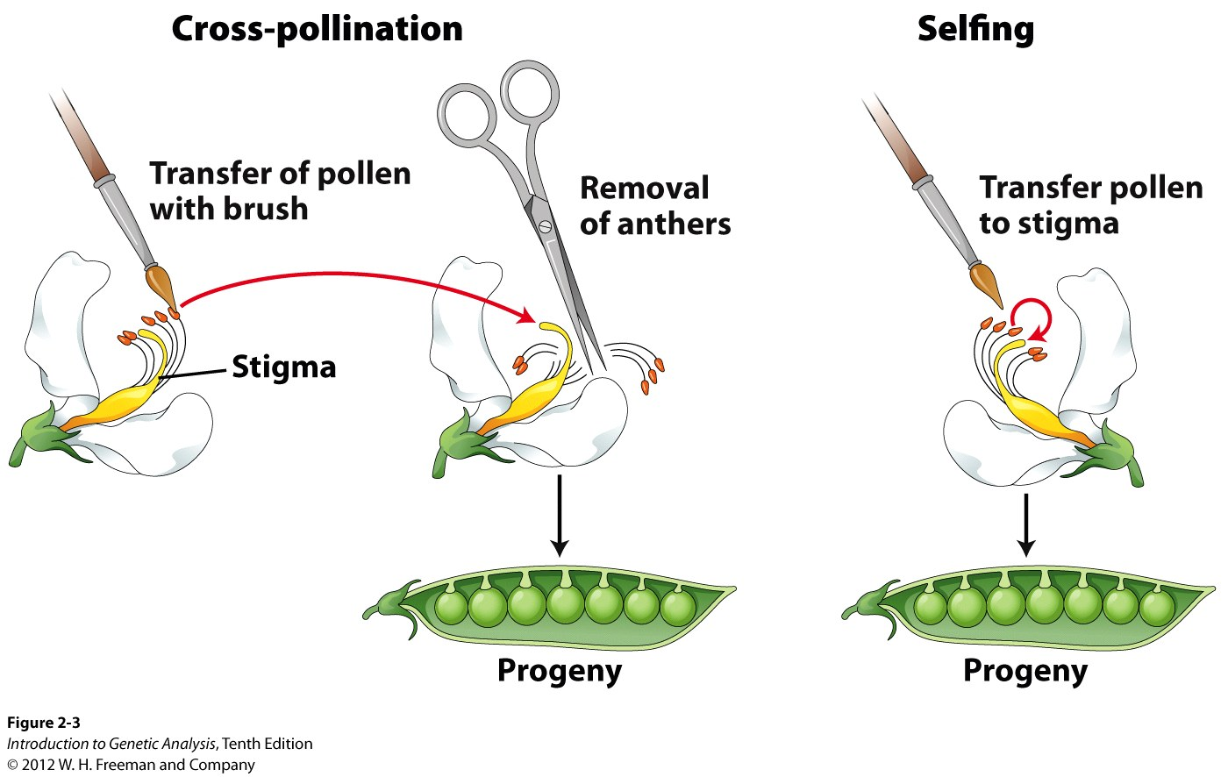
Cross: Controlled mating of two individuals
obtain desired genotype
deduce genotypes of parents
Selfing: individual with both reproductive organs reproduces (crosses) to itself
× symbol is used to indicate a cross
a haploid mating: A × a
a diploid mating: A/a × A/a
A/– : – represents either A or a

Slide 12
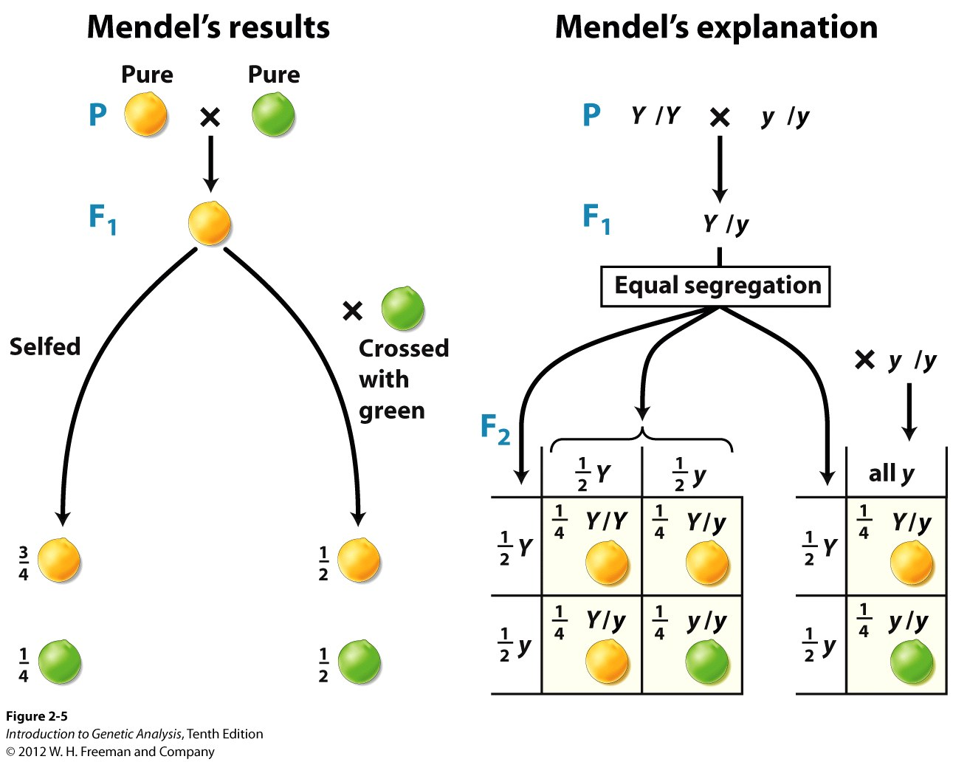
P = parents, parental generation
F = filial generation (offspring)
Phenotypic Ratio:
F1 result: all yellow
F2 result: 6022 yellow, 2001 green
How can these results be explained?

Slide 13
individuals have two copies of each allele
alleles separate into gametes equally (1:1 ratio) – Mendel’s first law: equal segregation (Remember, this is due to the separation of homologous chromosomes during meiosis!)
Y is dominant (yellow color prevails over green)
y is recessive
Homozygous (Y/Y or y/y)
two copies of the same allele
Heterozygous (Y/y) two different alleles

Slide 14
Genotypic vs Phenotypic Ratios
Genotypic ratio: # of each genotype that results from the cross
Phenotypic ratio: # of each phenotype that results from the cross
Genotypic and phenotypic ratio of F1 self cross?

Slide 15
What is the genotypic ratio of the F2 self cross?
1:1
2:1
1:2:1
1:1:1:1
2:2
3:1

Slide 16
What is the phenotypic ratio of the F2 self cross
1:1
2:1
1:2:1
1:1:1:1
2:2
3:1

Slide 17
Remember that “alleles” are really genes! On Chromosomes!
Segregating equally into gametes during meiosis!
Example: Cystic Fibrosis
Carrier gametes:
F = wildtype,
f = affected
Unaffected: FF
Carrier: Ff
Affected: ff
What is “f” on the molecular level?
Mutations: F508del,
G542X, and 1900 others
What did Mendel know??
F F f f
FF
Ff
Ff
ff

Slide 18
Think-Pair-Share
Mendel’s yellow peas are yellow because they do not have any chlorophyll. Green peas contain chlorophyll. We know that yellow is dominant to green.
Propose a functional mutation in a gene affecting the chlorophyll that would account for the existence of green peas in the homozygous recessive individual. (Think: Gain-of-function or Loss-of-function? –morphs?)

Slide 19
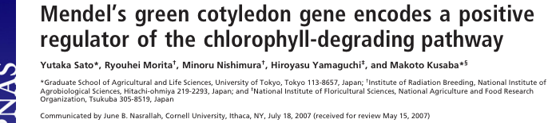
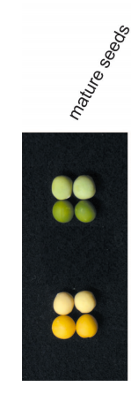
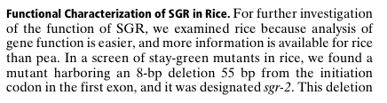

SGR is a chloroplast protein
When expressed, promotes the breakdown of chlorophyll
The mutant form cannot promote the breakdown of chlorophyll (amorph!) so the peas remain green
55 nt
SGR ORF
AUG
8nt deletion, frameshift
stop
We use Y and y for yellow or green
…. Could be SGR and sgr

Slide 20
SGR/SGR
sgr/sgr
SGR SGR sgr sgr
SGR/sgr

Slide 21
Break-out!
Let’s breed, y’all!

Slide 22
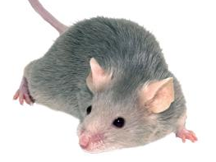

A breeding conundrum…
You obtain a male and a female breeding pair of mice with black fur from a collaborator. You are told that they are pure breeding individuals. You breed the pair several times and collectively obtain 38 animals: 29 black and 9 grey.
You think you know what’s going on, but just to be sure you breed the female with another gray fur male from your own mouse colony that you know to be pure breeding. This time out of 19 offspring, 9 are black and 10 are grey.
What is the genotype of each animal? (male 1, male 2 and the female?)
male 2
female
female
male 1
X
X
9
10
29
9

Slide 23
Think Aloud Problem Solving: What would I do to solve this? What are the necessary steps?
What is the genotype of each animal? (male 1, male 2 and the female?)
male 2
female
female
male 1
X
X
9
10
29
9

Slide 24
What is the genotype of the female?
B/B
B/b
b/b

Slide 25
What is the genotype of male 1?
B/B
B/b
b/b

Slide 26
What is the genotype of male 2?
B/B
B/b
b/b

Slide 27
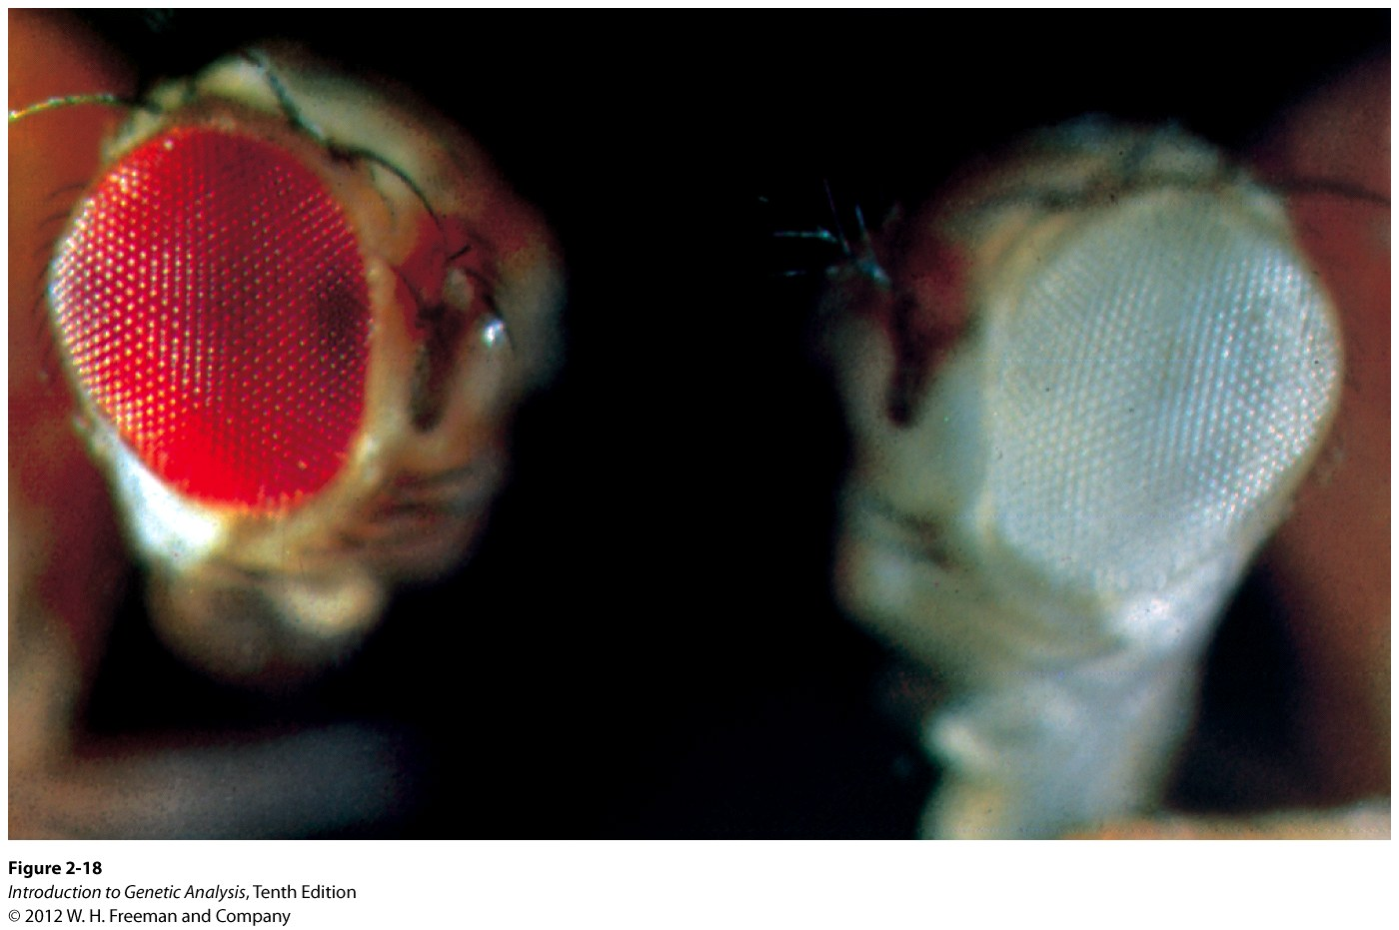
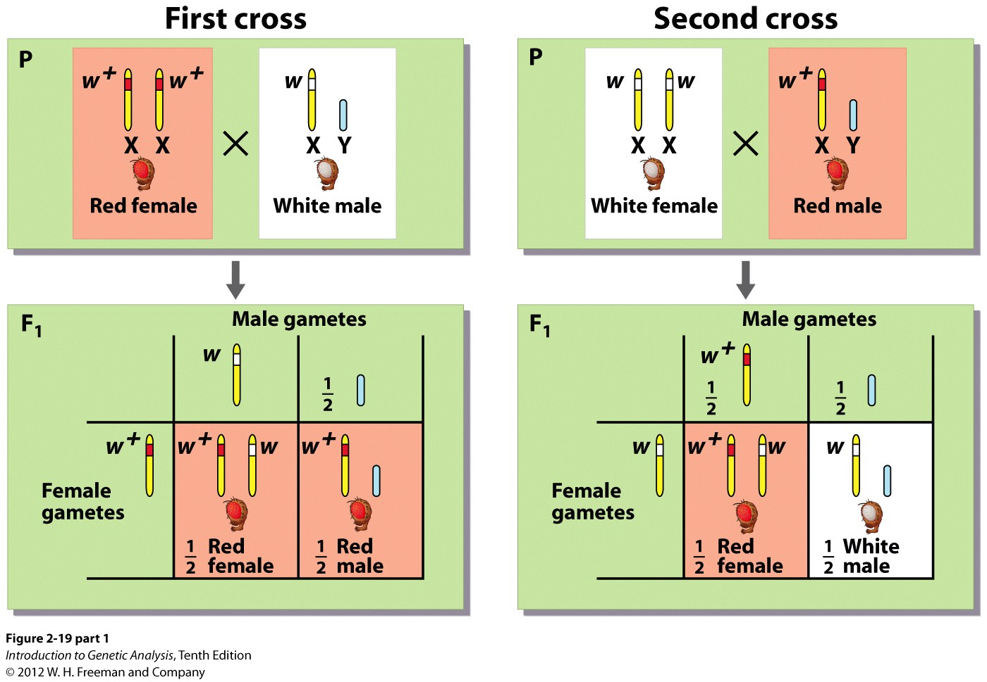
What if the affected gene is on a sex chromosome?
Sex-linked inheritance
Drosophila can have white (w) or red (w+)eyes
Red (w+) is dominant over white (w)
The gene is on the X chromosome
Females are homogametic
Males are heterogametic
Fly males (like humans) are hemizygous for genes on the X chromosome
Different phenotypic ratios are seen in males and females
ratios depend on the sex of the parent (it matters which parent is white or red)
w+ (red) is still dominant over w (white) when two alleles are present
What are the phenotypic ratios expected from each cross?
All individuals are red
same as Mendel’s F1 crosses
All females are red, all males are white

Slide 28
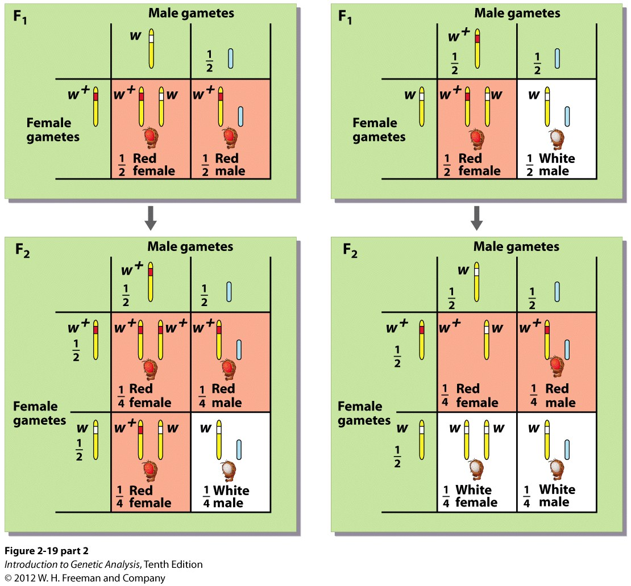
Inheritance patterns: Sex-linked inheritance
Predict the F2 offspring:
F2 offspring:
3:1 phenotypic ratio
1:2:1 genotypic ratio
What are the genotypic and phenotypic ratios of each of these crosses??

