Slide 1
BB2920: Genetics
Prof. Farny
Exam 1 Review

Slide 2
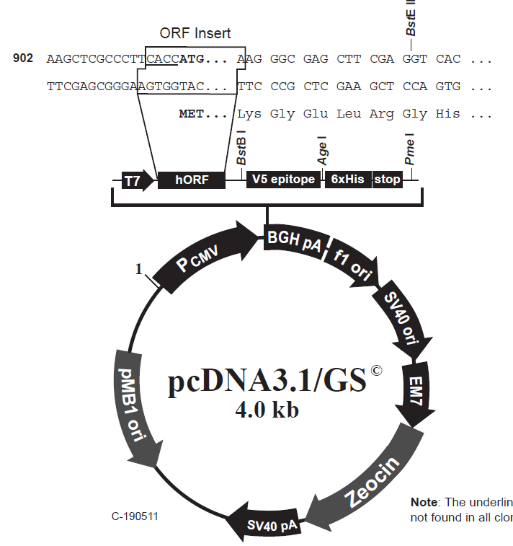
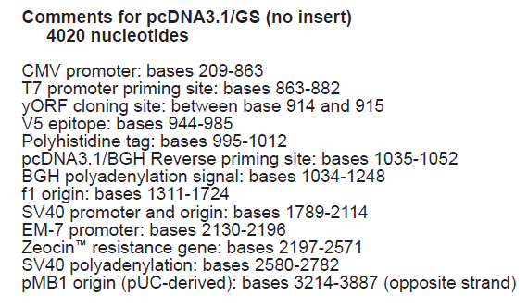
Anatomy of a Plasmid
[Put gene of interest in here]
G/AATTC
EcoRI
TT/CGAA

Slide 3
A cloning your CFTR gene
Digest vector and CFTR insert with EcoR1 and BstB1 to create sticky ends
EcoRI
BstBI
6kb CFTR gene from PCR, with EcoRI on 5’ end and BstBI on 3’ end
4kb plasmid
insert
+
Linear plasmid
6kb
CFTR gene
Mix insert and vector in the same tube in the presence of DNA ligase.
Sticky ends of vector and insert will pair, and ligase will seal the pieces together
EcoR1
total size=
10kb
4kb
BstBI

Slide 4
Anatomy of a Plasmid
[Put gene of interest in here]
Draw the vector and insert with overhangs after restriction digest
G/AATTC
EcoRI
TT/CGAA

Slide 5
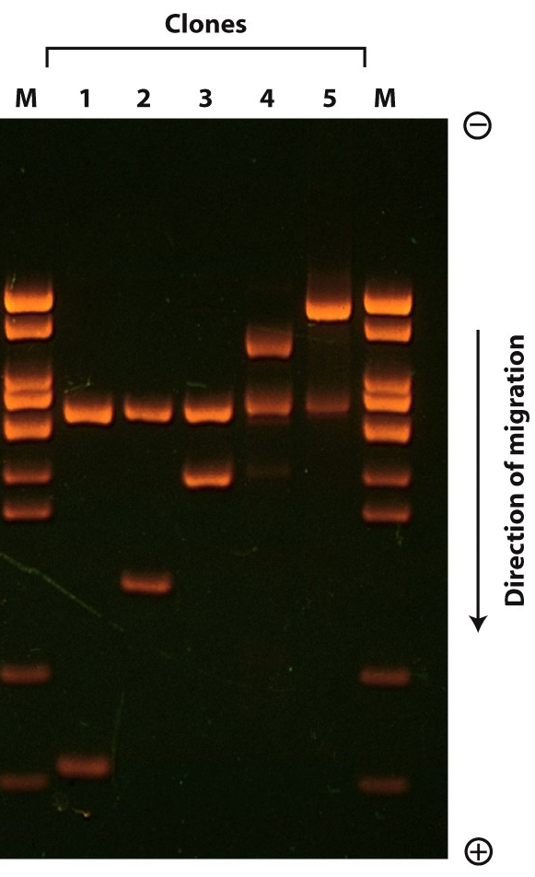
After your cloning reaction, you want to check to make sure your insert and vector ligated together correctly. You digest a sample of the completed clone with EcoRI and BstBI. Which of the following lanes is your expected clone?
6kb
CFTR gene
EcoR1
1
2
3
4
5
total size=
10kb
Kb:
9
7
5
4
4kb
BstBI
3
2
1
0.5

Slide 6

A cloning conundrum…. (based on a true story!!)
NcoI site in mutant
6kb
CFTR gene
1.5kb
EcoRI site
6kb CFTR gene from PCR, with EcoRI on the ends
EcoR1
total size=
10kb
4kb plasmid
+
4kb
NcoI site in mutant
BstBI
You have cloned CFTR from wild type and CF patient samples. The mutation you have cloned is the R347P mutation, which results in the creation of an NcoI restriction site. The affected gene region is here:
C
X
Oh no! You’ve mixed up the tubes! (Note: Sharpie dissolves in ethanol!) How can you use restriction digest to tell the clones apart?
X
P
Digest the wildtype, the mutant, and the original (empty) vector with Nco1, BstBI and EcoR1, then run the pieces on a gel. What do you expect the gel to look like?

Slide 7
Draw it out! Once you cut with the EcoRI, BstB1 and NcoI enzymes, what size are the products? How would these look on a gel?
WT and Mut CFTR plasmids:
Original Plasmid as a control:
NcoI site in mutant only
CFTR total gene size
= 6kb
1.5kb
EcoR1
BstBI
EcoR1
4.5kb
total size=
10kb
4kb
4kb
BstBI

Slide 8
Which gel represents the expected results of the experiment?
Gel 1
Gel 2
Gel 3
Gel 4
M
(Kb)
V wt mt
V wt mt
V wt mt
V wt mt
6
5
4
3
2
1
Gel1
Gel2
Gel3
Gel4
V=empty vector
wt = wild type CFTR
mt = CFTR R347P mutation

Slide 9
Draw it out! Once you cut with the EcoRI, BstB1 and NcoI enzymes, what size are the products? How would these look on a gel?
WT and Mut CFTR plasmids:
Original Plasmid as a control:
NcoI site in mutant only
CFTR total gene size
= 6kb
EcoR1
BstBI
1.5kb
EcoR1
4.5kb
4kb
total size=
10kb
4kb
BstBI

Slide 10
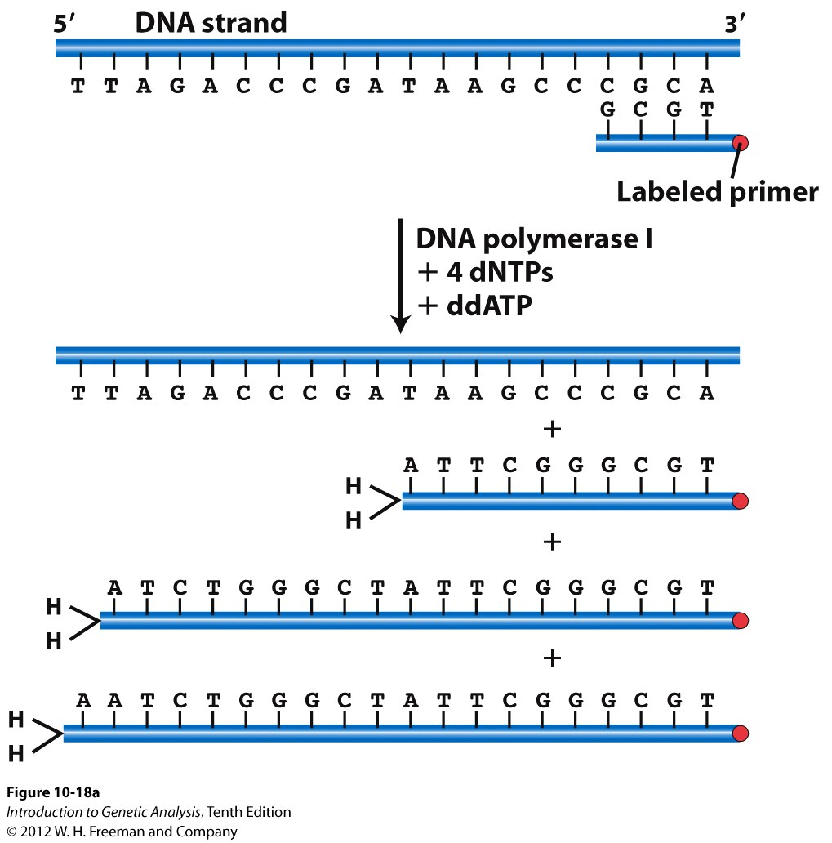
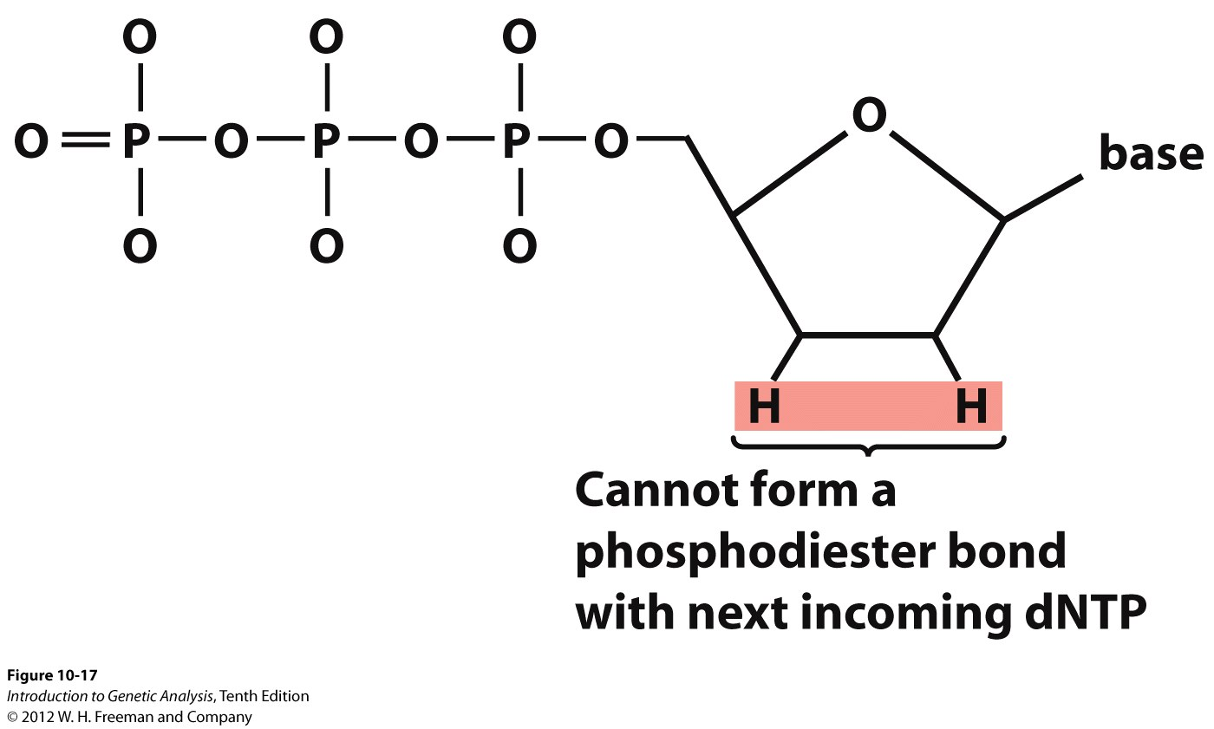
Dideoxy (Sanger) Sequencing of DNA
ddNTP
What are the FOUR things I need for a sequencing reaction??
polymerase
primer
ddNTPs
template DNA

Slide 11
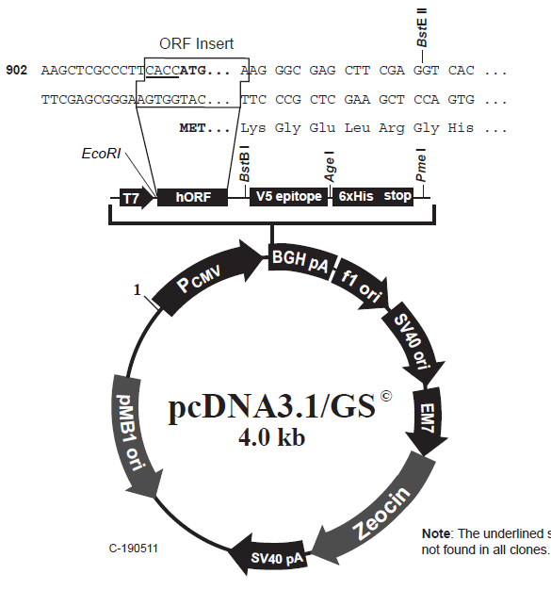
You want to sequence confirm the CFTR sequence in your newly un-mixed-up plasmids. Where on this plasmid would you design the sequencing primer to bind?
NcoI site in mutant
6kb
CFTR gene
1.5kb
EcoR1
total size=
10kb
4kb
BstB1

Slide 12
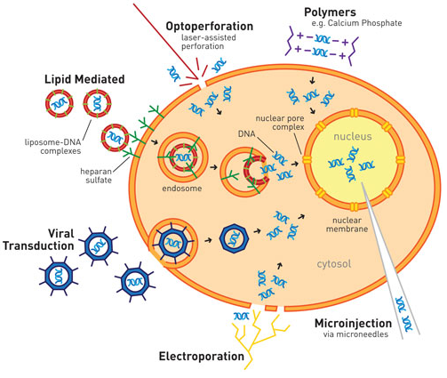
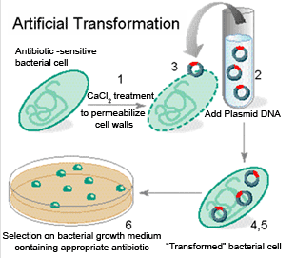
Plasmid-based gene expression in prokaryotes and eukaryotes
Eukaryotes: Transfection
Prokaryotes: Transformation
http://www.odec.ca/projects/2006/sidh6h2/images/bgdiagram.gif
With a prokaryotic promoter, proteins are expressed.
With a eukaryotic promoter, copies of the plasmid are made and purified but no protein expressed.
http://www.genengnews.com/Media/images/Article/LifeTech_TFXN_Methods21222185092.jpg
Genes with eukaryotic promoters will be expressed in the cell. Prokaryotic promoters are not recognized.

Slide 13
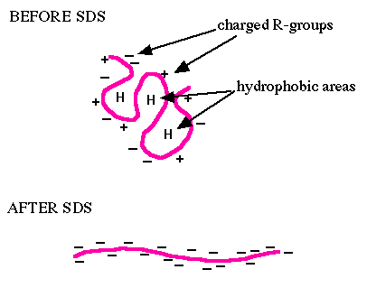
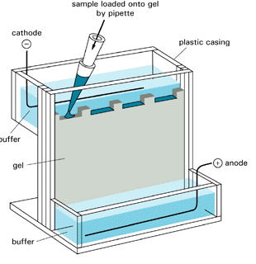
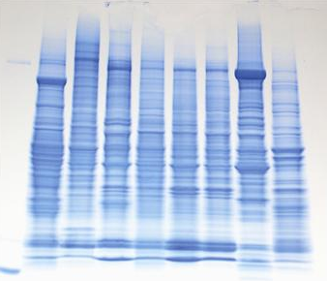
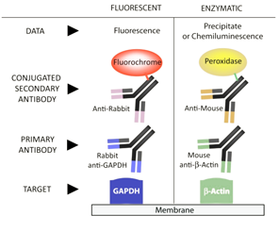
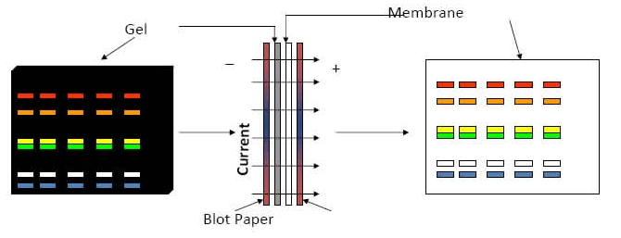
Western blot
make a lysate in SDS
sodium dodecyl sulfate
imparts a net negative charge
so that proteins separate only
by size
run PAGE
polyacrylamide
gel electrophoresis
separated
proteins
transfer to membrane
detection with antibodies

Slide 14
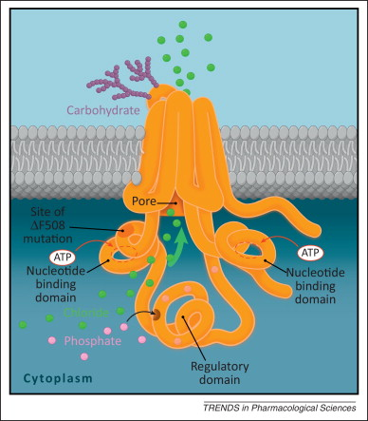
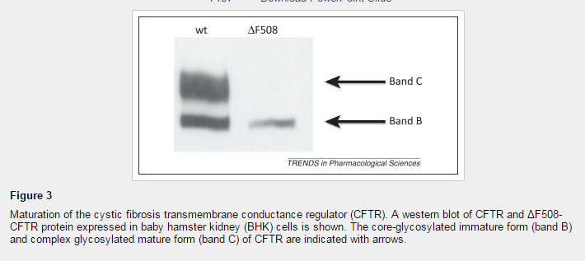
deltaF508 mutation changes the 3-dimensional folding of the protein and prevents glycosylation This lack of glycosylation is detectable by Western blot as a change in band size
Trends in Pharmacological Sciences 2013 34, 119-125DOI: (10.1016/j.tips.2012.11.006)

Slide 15
Recall our two mutations from Monday: nonsense and non-conservative missense. You have cloned these mutations and transfected these into a human cell line, and are looking at the expression of CFTR from these plasmids. Just looking at the pre-processed band, how might these proteins look on a Western blot?
nonsense
nonsense
nonsense
nonsense
missense
missense
missense
missense
large
small
A B C D
Gel A
Gel B
Gel C
Gel D

