Slide 1
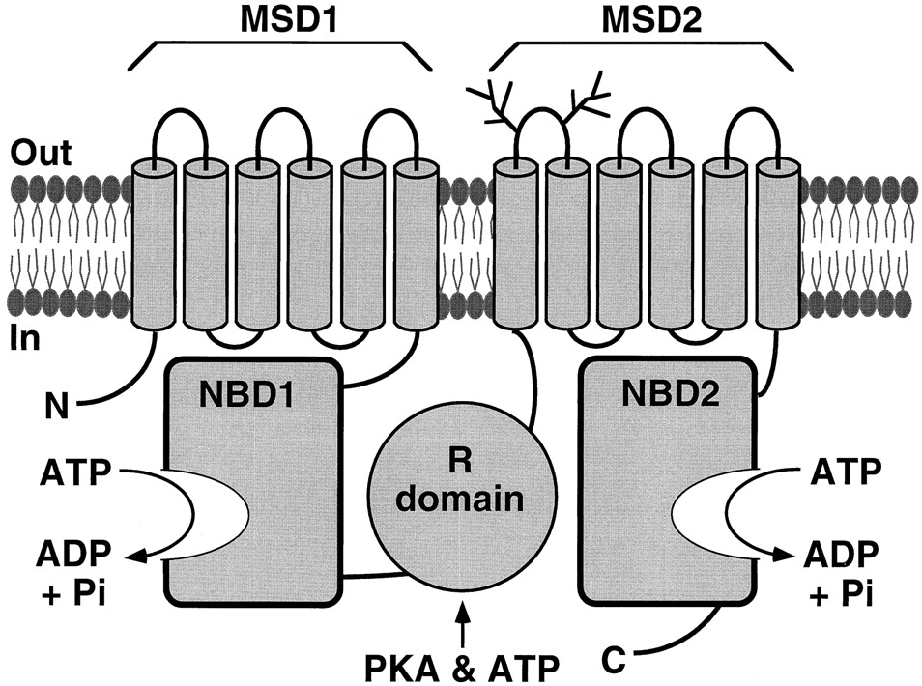
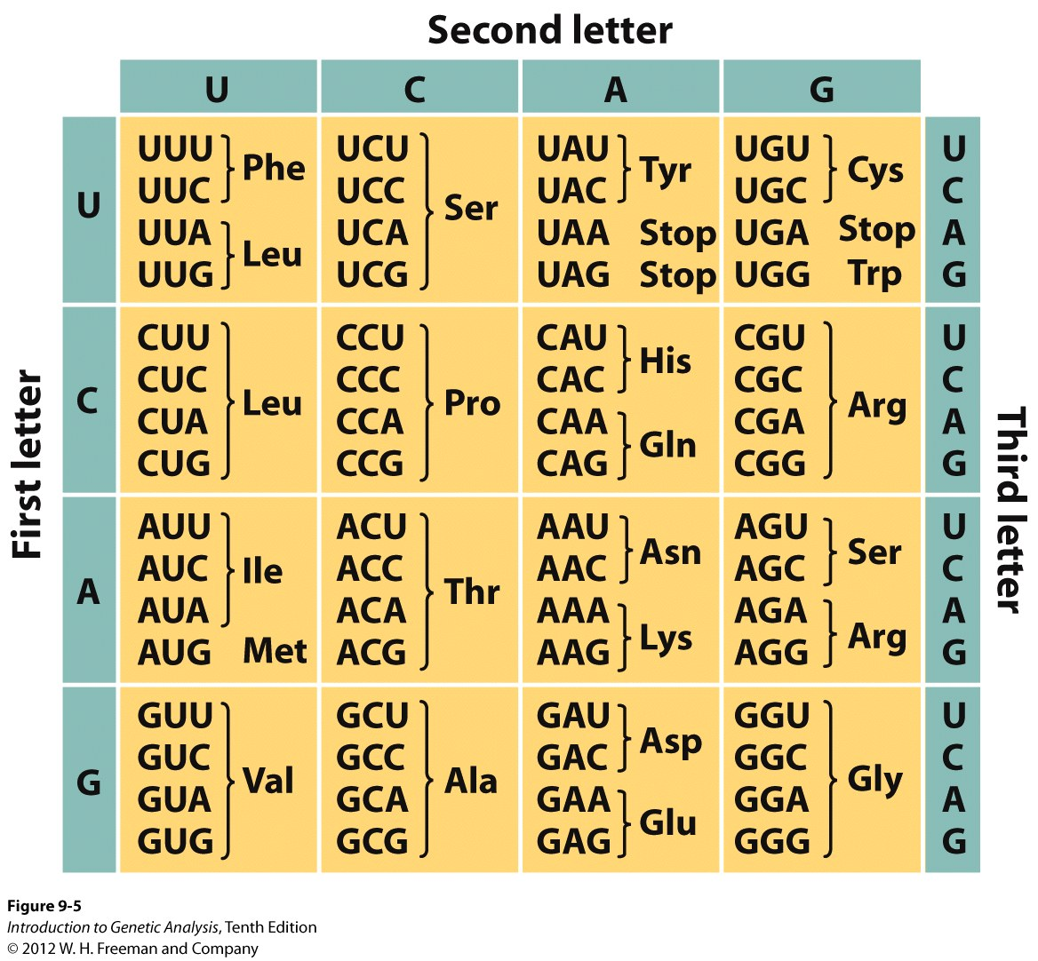
Below are mRNA sequences from actual CF patients that encode a region NBD2:
unaffected
individual
…uug caa cag ugg agg aaa gcc…
patient 1
…uug caa cag uga agg aaa gcc…
patient 2
…uug caa cag ugg agc aaa gcc…
Remember the possible mutations:
Frameshift (insertion or deletion)
Missense (conservative or non-conservative)
Nonsense
Silent

Slide 2
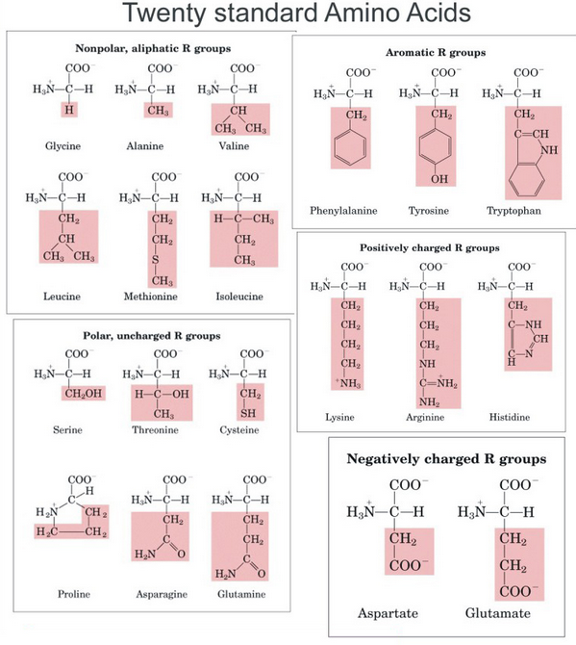

Slide 3
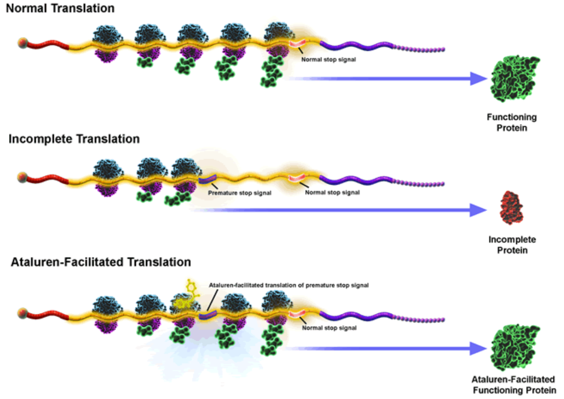
Nonsense mutation read-through: a novel therapeutic strategy
Researchers are currently developing a new drug for the treatment of some patients with CF, called Ataluren. Ataluren allows the ribosome to “read-through” the mutant nonsense stop codons, but not normal stop codons. This means as the ribosome encounters a nonsense mutation, it will insert an amino acid and keep going with translation. A schematic of the process is below:
ptcbio.com
Notes:
Class question: What could be the extended utility of a drug like Ataluren (A: useful for any nonsense mutation disease)? What are its limitations (not useful for CF due to misssense or DNA deletion mutations)? Hints: Is this drug specific for CFTR?

Slide 4
Questions:
What type of mutation does patient 1 have?
What type of mutation does patient 2 have?
Which patient, 1 or 2, do you think might have a more severe form of the disease? Why?
Would Ataluren help patient 1? Patient 2? Both? Neither? Why?

