Slide 1
BB2920 Genetics
Prof. Farny
Lecture 13 + Exam 2 Review
2/10/17
JC2 Monday
PS4 Monday
PLA help Sunday 7-9pm SL lounge
Office Hours Monday 10:30-12, GH203C
Exam Tuesday

Slide 2
Today’s Learning Objective
Learn to identify various relationships between unlinked genes that can alter expected Mendelian ratios from monohybrid (A/a x A/a) and dihybrid (A/a B/b x A/a B/b) crosses

Slide 3
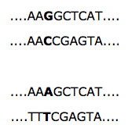
Mapping with molecular markers
Regions of variation within the genome that can serve as markers of recombination
Useful for mapping the rough location of genes
We refer to these differences not as genotypes (because they aren’t necessarily within a gene), but as HAPLOTYPES
Single Nucleotide Polymorphisms (SNP, “snip”)
single nucleotide changes
common, often outside of gene
often silent or conservative missense when within genes
Repeats (mini- or microsatellites)
short repeat sequences that are found in known locations.
The number of repeats varies naturally among individuals and can be used to track inheritance of chromosomes
mini: 15-100 nt repeats
micro: di- or tri- nucleotide repeats
Eg. cacacaca or gttgttgttgtt

Slide 4
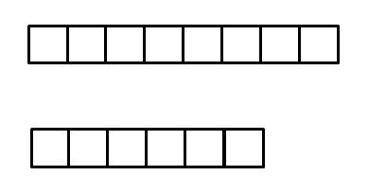
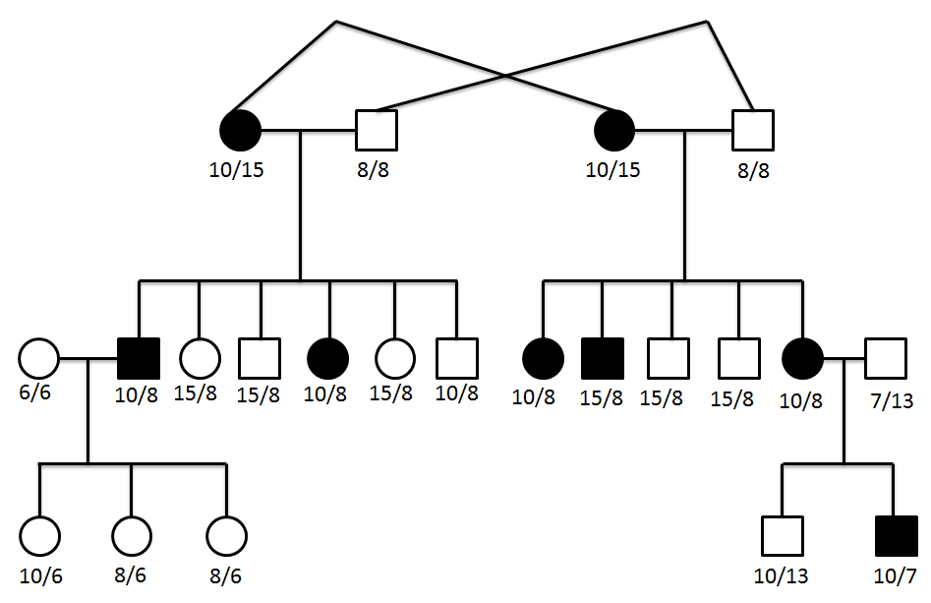
The following pedigree shows a family where a pair of identical twin sisters marry a pair of identical twin brothers (identical twins have identical DNA). The sisters are both affected with a rare disorder. Assume the twin brothers, and the individuals that marry into the family in the second generation, are homozygous for the wildtype allele. Also shown on the pedigree are designations for minisatellite repeats that are linked to the gene that causes the disorder.
The numbers under each symbol in the pedigree indicate the number of minisatellite repeats identified in that individual using PCR. For example:
8 repeats
6 repeats
If a person had the two minisatellite alleles above, they would be designated 8/6.
What is the inheritance pattern of this disorder?
Are these genes linked?
Which offspring are recombinant?

Slide 5
Gene interactions – how do relationships between gene functions affect observed phenotypic ratios?
Drosophila eye color and wing shape?
enzyme A
enzyme B
eye pigment
wing development
two enzymes in the same biosynthetic pathway?
Gene products (aka: proteins) may have interactions that effect the phenotypes of the offspring, leading to unexpected phenotypic outcomes even when genes are not linked.
Notes:
Take an example: The enzymes at the top of the slide, enzyme A and enzyme B, have unrelated functions. Enzyme A affects eye color (red or purple), whereas enzyme B affects wing development (normal or vestigal). When a double mutant is made with both of these genes, they can be expressed within the organism completely independently (eg, an individual can have red eyes and vestigal wings, or red eyes and normal wings, or purple eyes and normal wings... etc). But when two or more genes are part of a pathway that leads to a single goal, a these genes do not act independently of each other in creating the resulting phenotype. For example, if there are mutations in both enzyme X and enzyme Z above, these will not give us independent phenotypes, they would both lead to a lack of arginine production (arginine production is the phenotype in this example).

Slide 6
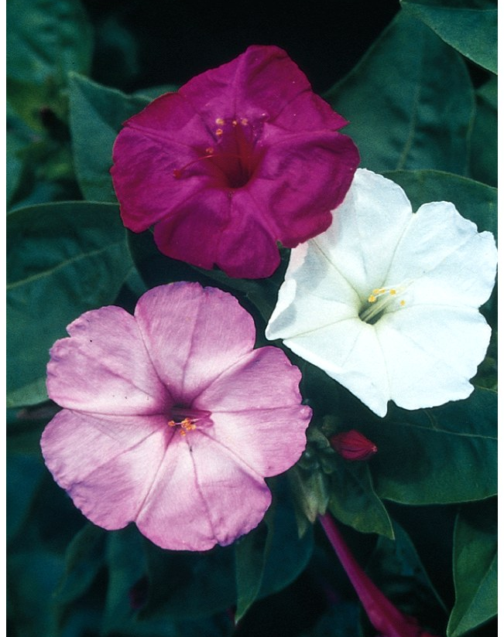
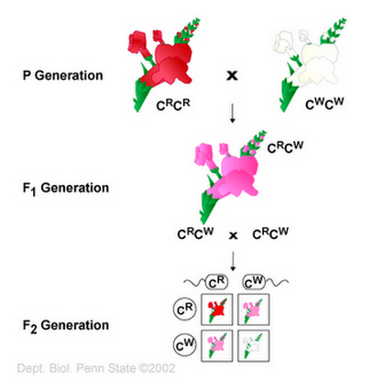
Incomplete dominance – one allele is not complete dominant over another, results in an intermediate phenotype
Fully dominant mutations are:
Haplosufficient – a single dominant allele provides enough of a gene dosage to result in a completely wildtype phenotype in the heterozygote
When the heterozygote is not the same as the wildtype, the dominant allele is:
Haploinsufficient – a single dominant allele does NOT provide enough of a gene dosage to result in a wildtype phenotype in the heterozygote.

Slide 7
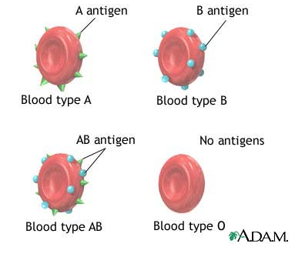
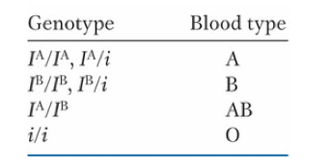
Co-dominance
Multiple alleles for a single gene
two of these alleles can be co-expressed in a heterozygote

Slide 8
Are co-dominant alleles haplosufficient or haploinsufficient?
haplosufficient
haploinsufficient

Slide 9
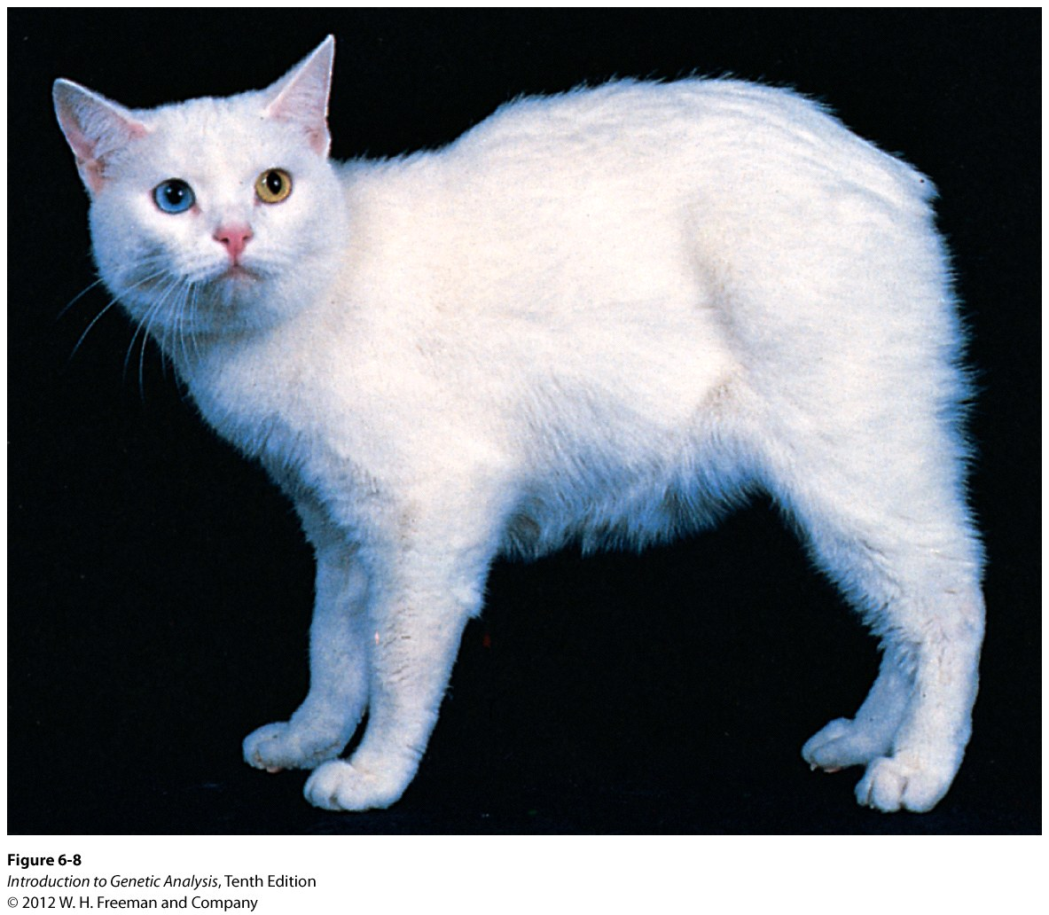
Recessive lethal alleles
an allele that is capable of causing the death of the organism
M = normal spine
M^{L} = abnormal spine
M/M = normal
M/M^{L} = Manx (no tail, intermediate spinal disfigurement)
M^{L}/M^{L} = lethal (spine disfigurement incompatible with life)
What is the outcome of crossing two manx cats?
M
M^{L}
M
M/M
M/M^{L}
M^{L}
M/M^{L}
M^{L}/M^{L}
Observed phenotypic ratio?
2 tailless: 1 normal
Pleiotropy – a single allele that affects more than one phenotype (tail and death)
Notes:
As the name suggests, this occurs when a gene is absolutely essential for life. So, if an individual inherits two mutant copies, this situation is incompatible with life and the organism dies. Usually this occurs very early in embryonic development so that the individual is not born. If the wild type copy of the gene has complete dominance, you will see only offspring with the wild type phenotype from this cross (3:1, but the homozygous recessive are dead so you don’t see them). If the gene displays incomplete dominance you will see a 2:1 phenotypic ratio (2 of intermediate phenotype, and 1 wildtype). The example of the manx cats above is an example of a gene that displays incomplete dominance, or we can say the M allele is haploinsufficient. However this is also an example of a lethal allele. In this case the gene affects two phenotypes (the spine, and survival). When a single gene affects multiple phenotypes, we say this gene is pleiotropic.

Slide 10
Break-out! The Curious Case of the Outdoor Mouse

Slide 11
The Curious Case of the Outdoor Mouse
You are a mouse breeder for a biological supply company. A wild female mouse (literally from outdoors) infiltrates your breeding colony and mates with one of your pure breeding wildtype male lab mice. Both animals have brown fur and look entirely phenotypically normal. Curious as to the outcome of this cross, you allow the intruder female to remain and track the offspring she has with this male over several litters. Within 6 months, this pair has five litters and a total of 43 brown, normal-looking offspring. Curiously, only 13 of the offspring are male.
A) Is this an example of incomplete dominance, co-dominance, or a lethal recessive? (Hint: examine the ratios of the offspring! Does it fall into one of the expected categories? What is the phenotype we are examining?)
B) Draw a Punnett square to illustrate the results of your breeding based on your answer to part A. (hint: the fact that there are only 13 males is significant!!)

Slide 12
The phenotype of the offspring we are evaluating is:
Fur color
Indoor vs.Outdoor mouse
Sex
Size of the offspring

Slide 13
Is this a case of:
Incomplete dominance
Co-dominance
Recessive lethal allele
Haploinsufficient allele

Slide 14
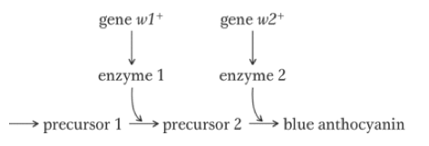
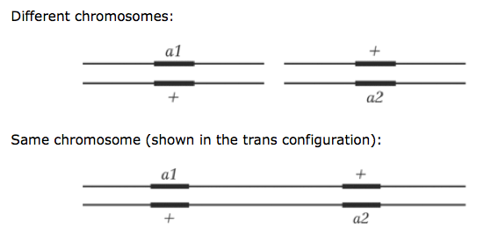
Inferring gene interactions by complementation
You find 100 white flowers in a population of mostly blue-flowered plants.
Are all these mutants caused by mutations in the same gene?
Complementation test

Slide 15
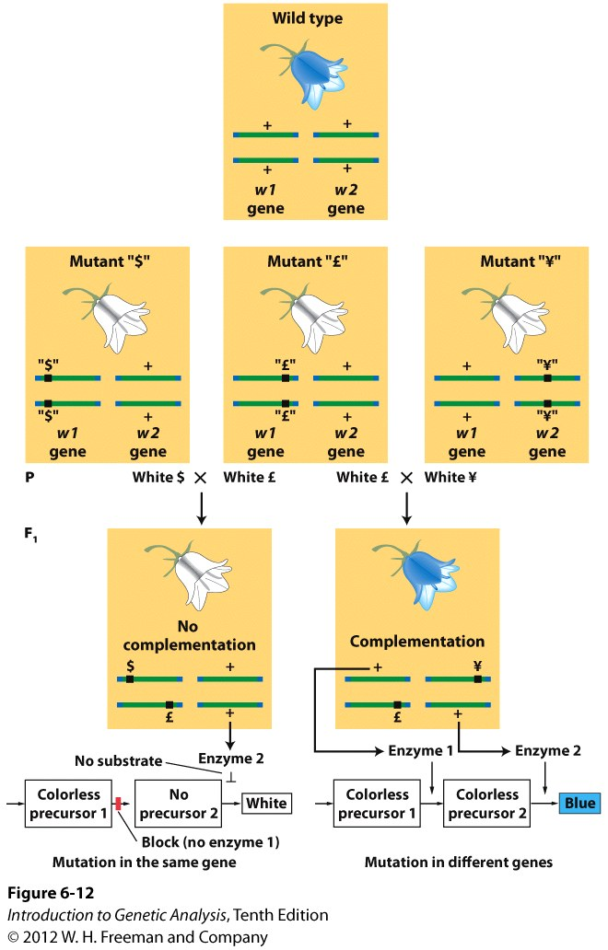
Complementation test: possible outcomes
cross two different white mutants:
What are the possible outcomes?
either all white offspring, or all blue offspring.
If offspring are all white?
that means the mutations were in the same gene in both parent plants (essentially these are different alleles of the same gene, so we refer to these mutants as allelic)
If offspring are all blue?
that means that the mutations were in different genes in each parent, so the mutations complement each other

Slide 16
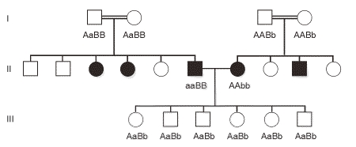
Complementation in human genetic disease: Profound congenital hearing loss

Slide 17
An individual has inherits two different alleles of CFTR: one containing the delta508F deletion, and the other with a nonsense mutation. Can these mutations complement each other?
Yes
No

Slide 18
Epistasis
a functional relationship between two mutants that changes the Mendelian 9:3:3:1 ratio
epistatic – one mutation takes precedence, overrides another
hypostatic – the mutation that is overriden
Genes are on different chromosomes (not linked!) but ARE NOT functionally independent!

Slide 19

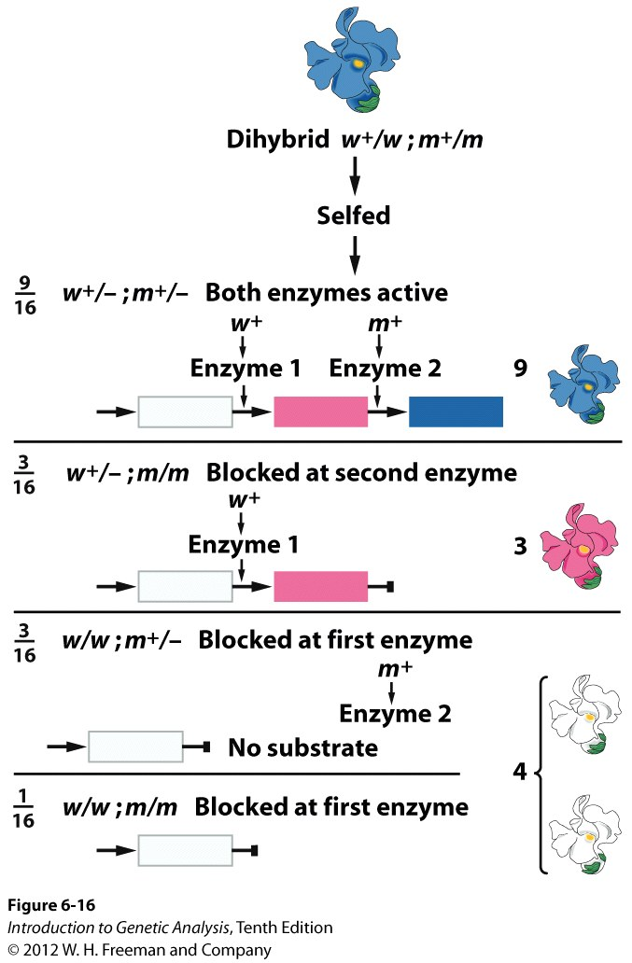
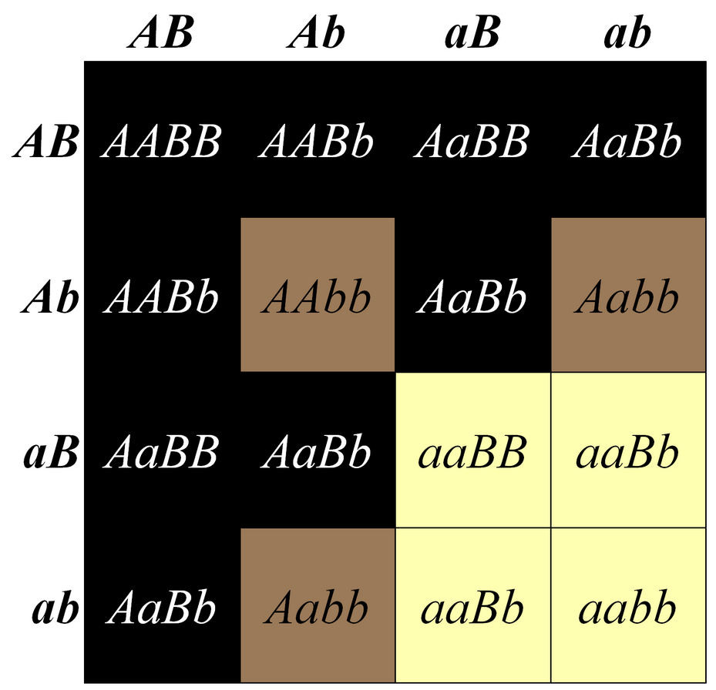
Recessive Epistasis
Two genes affect a single phenotype
Intermediate phenotype exists
9:3:4 ratio of offspring.
Genotypically the last two categories are different, but we cannot distinguish them on the phenotypic level.
Laborador Retreiver example in your text:

Slide 20
Which is the epistatic gene?
Gene w+
Gene m+
neither
It cannot be determined from this information

Slide 21
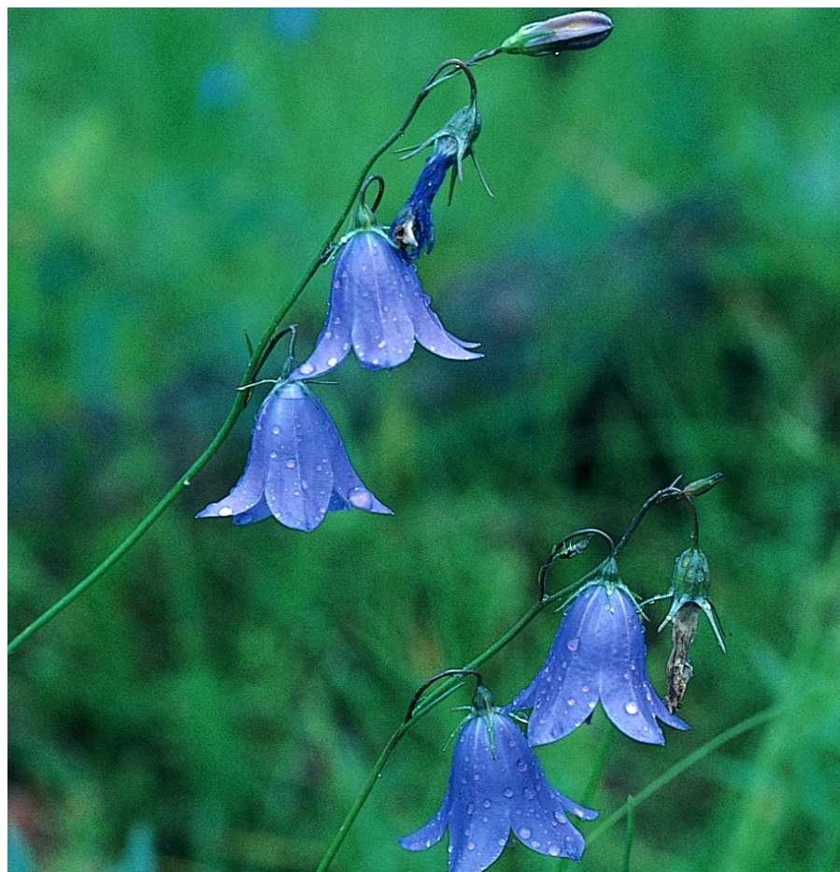
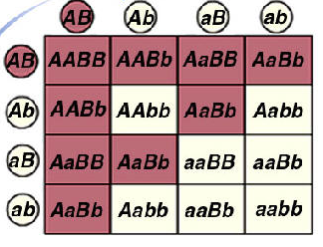
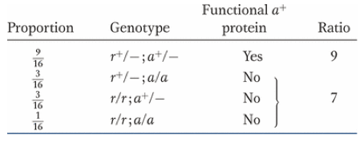
Duplicated recessive “epistasis” - or - the 9:7 ratio
two genes are in the same pathway, and BOTH genes are required for the wild-type phenotype. There is no intermediate phenotype, so any individual that is homozygous recessive for one gene will have the same phenotype as the double homozygous mutant. The mutations are recessive, but either one results in a null phenotype (which is why its known as duplicated recessive).
example from your text, the blue flowered harebell – synthesis of the blue pigment requires the activity of both genes
the ratio that characterizes duplicated recessive epistasis is: 9:7
Gene r+
Compound X
Blue
pigment
Gene a+

Slide 22
Which is the epistatic gene?
Gene r+
Compound X
Blue
pigment
Gene a+
Gene r+
Gene a+
Neither
It cannot be determined from this information

Slide 23
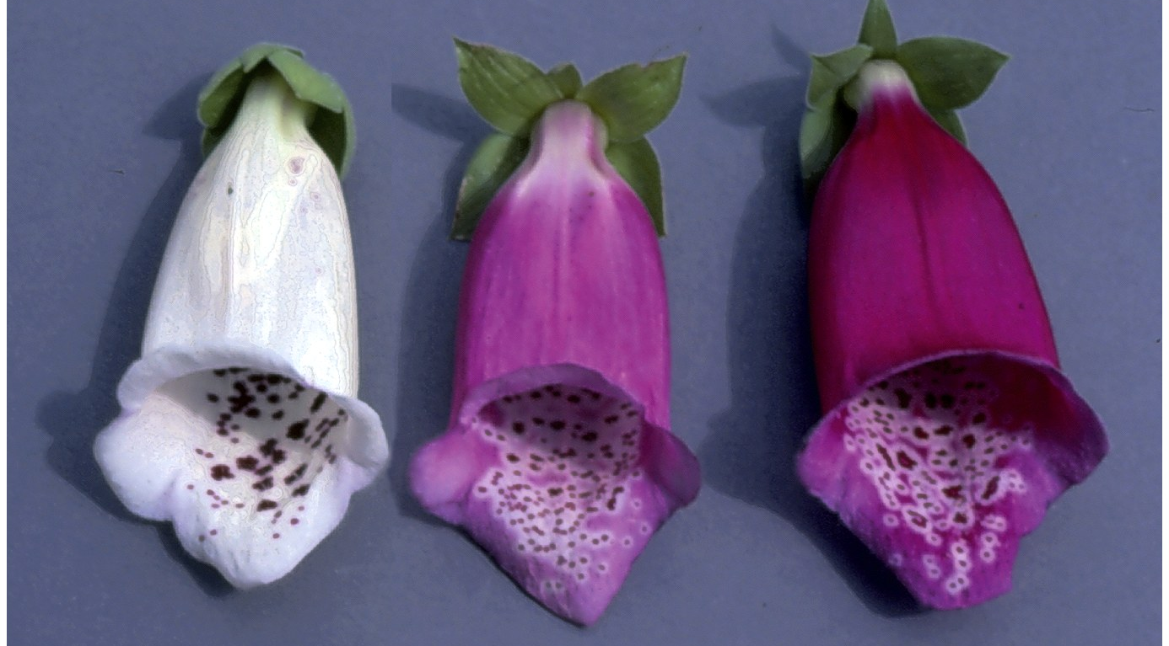
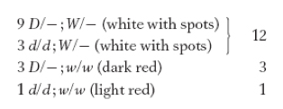
Dominant Epistasis
Similar is theory to recessive epistasis, except that the mutant alleles for both mutations are dominant
Still, the gene that is upstream will be epistatic to the gene that is downstream
In the example in your text, pg 230:
W is a dominant mutant allele that prevents pigment from being deposited in the main petal of the flower (therefore, for pigment to be present in the main petal, the genotype must be ww, otherwise the flower is white)
D is a dominant mutant allele that results in a darker than normal pigment
(dd results in light color flowers)
So, when a W allele is present, the flowers will be white, regardless of whether the dark pigment (D - ) or the light pigment (dd) is made
The ratio of phenotypes that characterizes dominant epistasis in F2 offspring from dihybrid cross is 12:3:1

Slide 24
Which is the epistatic gene?
Gene d
Gene w
Neither
It cannot be determined from this information

Slide 25
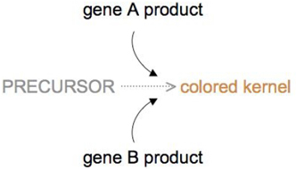
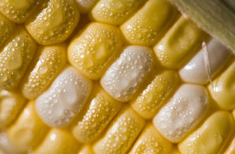
Duplicate Gene “epistasis”: the 15:1 ratio
For two functionally redundant genes, whenever any of the two dominant alleles is present, the phenotype will be seen. Thus, the only individual from a dihybrid cross that will be a different genotype will be the aabb individual.
Therefore, the phenotypic ratio that characterizes Duplicated Dominant is 15:1
Example: corn kernel color. Two enzymes both function to create corn color, and the single activity of either enzyme results in yellow kernels
geno: pheno:
A - - - wild type, yellow kernel
- - B - wild type, yellow kernel
aabb mutant, white kernel
}
15/16
1/16

Slide 26
Which is the epistatic gene?
Gene r+
Gene a+
Neither
It cannot be determined from this information

Slide 27
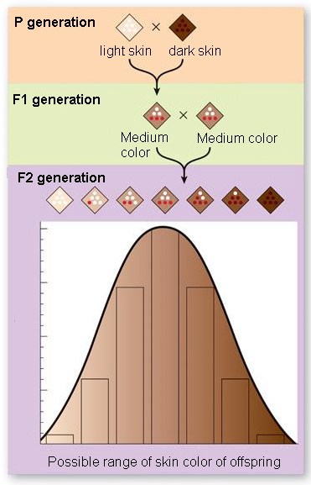
Can we use Mendel’s laws to explain continuous variation?
Polygenic inheritance: multiple genes affecting a single phenotype, explains the genetic component of continuous traits
Skin color: each dominant allele confers one “dose” of pigment
assume a cross between a very light skinned person and very dark skinned person:
a/a, b/b, c/c x A/A, B/B, C/C
F1 all heterozygous
F2 = 3³ = 27 possible genotypes
Doses of gene function:
a/a, B/b, c/c = 1 dose = light
A/A, B/b, c/c or A/a, B/b, C/c = 3 doses = medium
A/A, B/B, C/C = 6 doses = dark
Notes:
Imagine there are three genes that control skin color in humans (in reality, skin color has a significant environmental component and is likely controlled by more than 3 genes, but for the sake of an example we will ignore that). Imagine that each dominant allele for each gene confers one “dose” of pigment, such that A/A; B/B; C/C is a very dark skinned person (6 doses) and a/a; b/b; c/c is a very light skinned person (zero doses). The F1 generation in this case had medium skin (3 doses, AaBbCc). If you cross again the F1 generation with itself, you can achieve all possible genotypes conferring zero to 6 doses, however most individuals will have 2, 3 or 4 doses (remember there are 3^3 or 27 possible genotypes here, any only one is aabbcc and one is AABBCC and most in between will have some combination of dominant and recessive alleles). This will create a bell curve of possible phenotypes between two extremes, which is exactly our definition of continuous variation. Imagine if there are 6 or 10 or even more genes involved, this will create many more intermediate phenotypes between the two extremes. We call this polygenic inheritance - “poly” meaning many and “genic” for genes.

Slide 28
Why isn’t this considered a type of epistasis???
Doses of gene function:
a/a, B/b, c/c = 1 dose = light
A/A, B/b, c/c or A/a, B/b, C/c = 3 doses = medium
A/A, B/B, C/C = 6 doses = dark
Gene A
Pigment A
Gene B
Pigment B
Gene C
Pigment C

Slide 29
Are genes A, B and C Haplosufficient or Haploinsufficient?
Doses of gene function:
a/a, B/b, c/c = 1 dose = light
A/A, B/b, c/c or A/a, B/b, C/c = 3 doses = medium
A/A, B/B, C/C = 6 doses = dark
Haplosufficient
Haploinsufficient

Slide 30
Which of the following terms is the opposite of “polygenic”?
Co-dominant
Pleiotropic
Haploinsufficient
Recessive lethal
Heterozygous

Slide 31
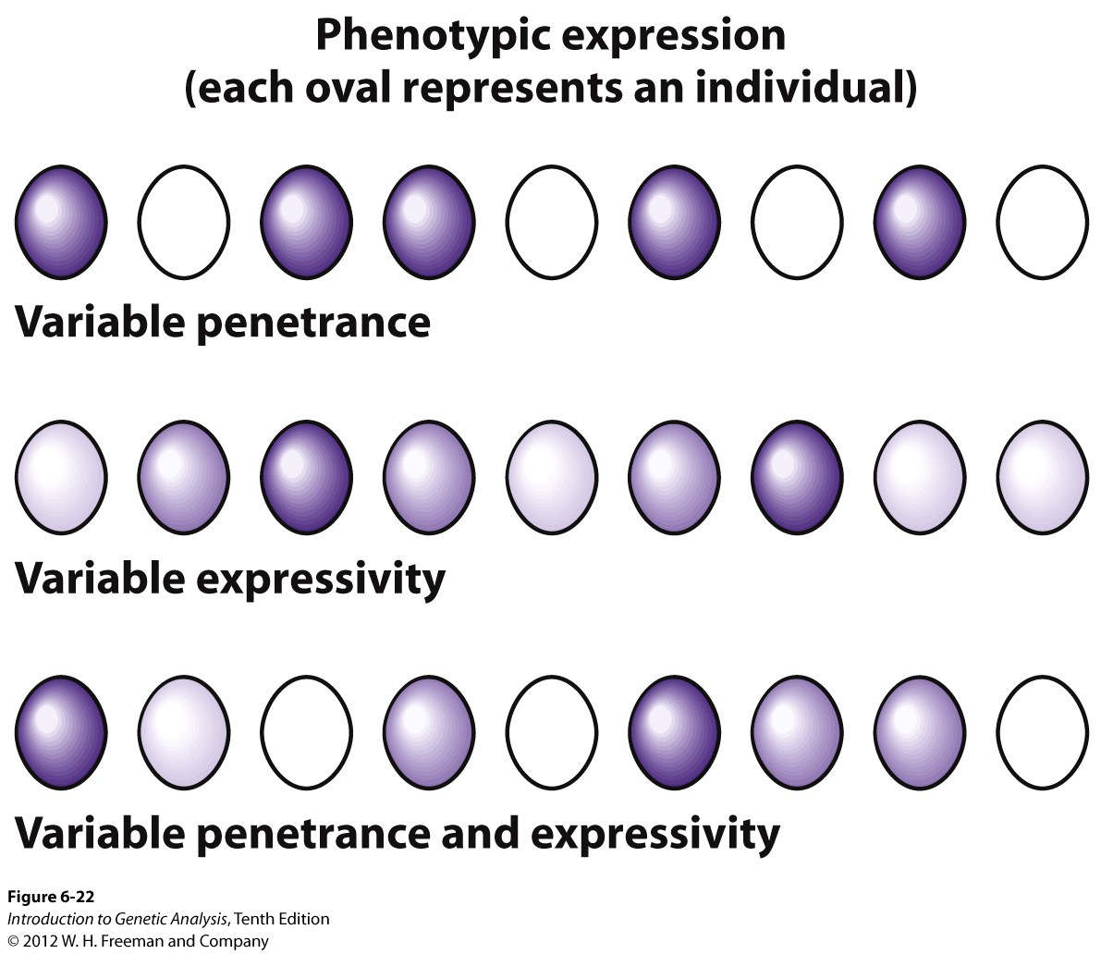
Expressivity and Penetrance
quick and easy way to remember the difference between the two:
Penetrance = present or absent
(P for presence and penetrance)
Expressivity = high vs. low (don’t have a good nmenomic for this one, but just remember it’s the other one)
Example of Rb with variable expressivity and incomplete penetrance?

Slide 32
In mice, the recessive mutation t/t causes tooth decay in about 75% of the t/t animals:
Incomplete penetrance
Variable expressivity
Incomplete penetrance and variable expressivity

Slide 33
The mutant allele vg/vg in fruit flies produces animals with vestigial wings. In a population of 100 vg/vg flies, 45 have very small wings and cannot fly at all, 45 have shortened wings but can fly over a very short distance, and 10 have full wings and can fly normally. This is an example of:
Incomplete penetrance
Variable expressivity
Incomplete penetrance and variable expressivity

