Slide 1
BB2920 Genetics
Prof. Farny
Lecture 10
2/3/17
Exam 1 returned Monday
RQ4 due Monday

Slide 2
Today’s Learning Objectives
Predict the outcome of single gene crosses when a gene is located on a sex chromosome (sex linked inheritance)
Examine the four basic modes of single gene inheritance
Use human pedigree analysis to infer the mode of inheritance of a gene
Use the product and sum rules to calculate the probability of obtaining a genotype or phenotype from a pedigree

Slide 3
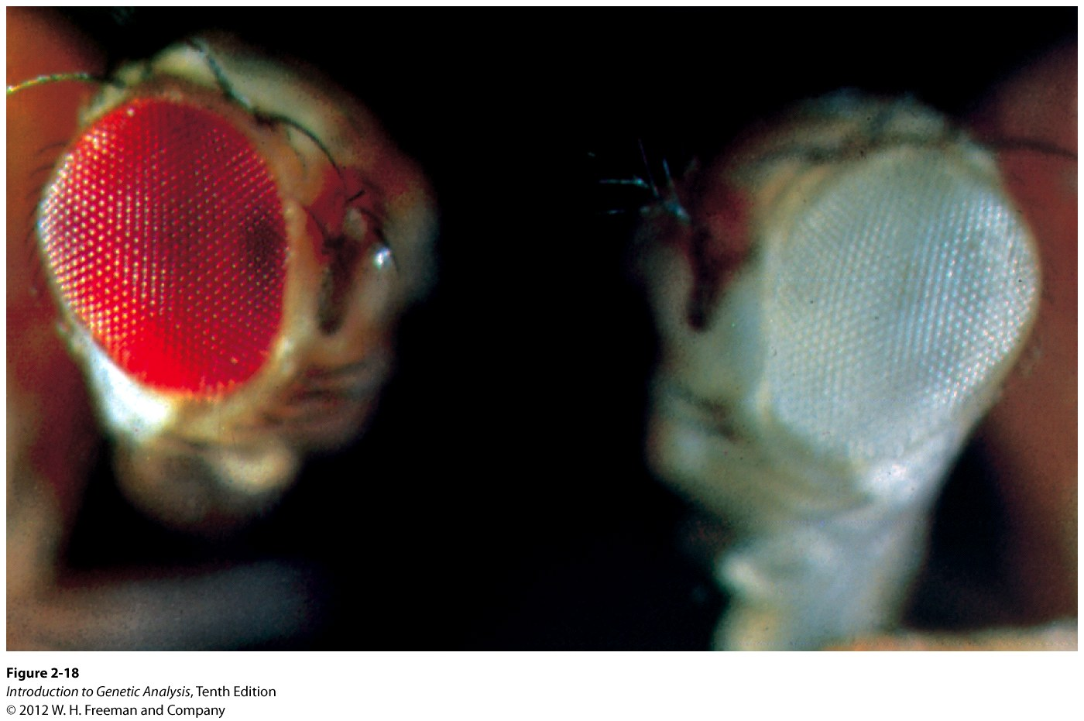
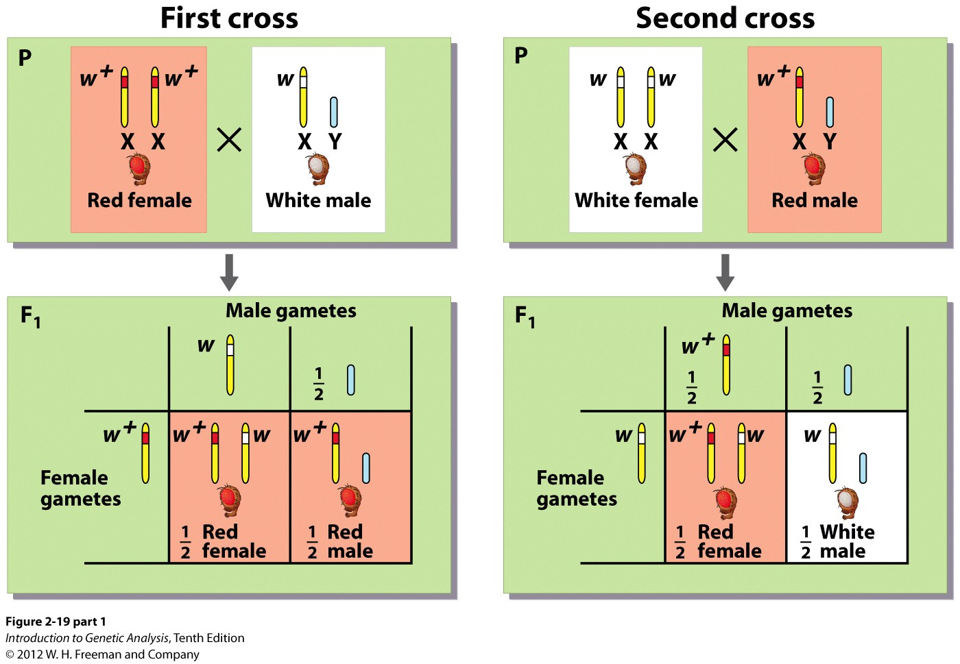
Inheritance patterns
What if the affected gene is on a sex chromosome?
Sex-linked inheritance
Drosophila can have white (w) or red (w+)eyes
Red is dominant over white
Fly males (like humans) are hemizygous for genes on the X chromosome, heterogametic for inheritance of sex chromosomes
does the phenotype of the parent matter to the phenotypic/genotypic ratios of the offspring?
Can you have a dominant gene in this case?
All individuals are red
same as Mendel’s F1 crosses
All females are red, all males are white

Slide 4
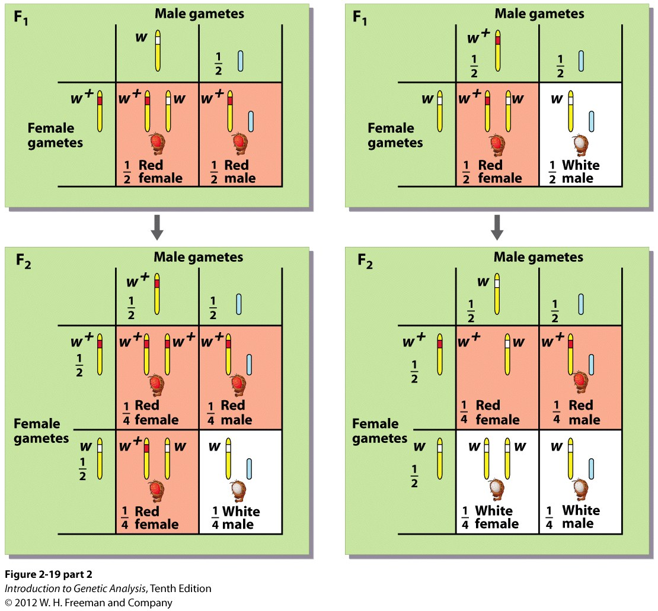
Inheritance patterns: Sex-linked inheritance
Predict the F2 offspring:
Cross A
Cross B
Which of these crosses will produce equal ratios of red eyed and white eyed offspring??

Slide 5
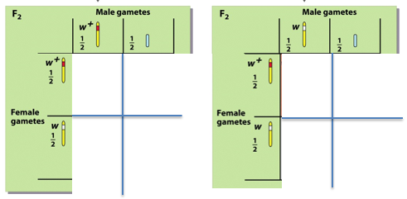
Which of these crosses will produce equal ratios of red eyed and white eyed offspring??
Cross A
Cross B

Slide 6
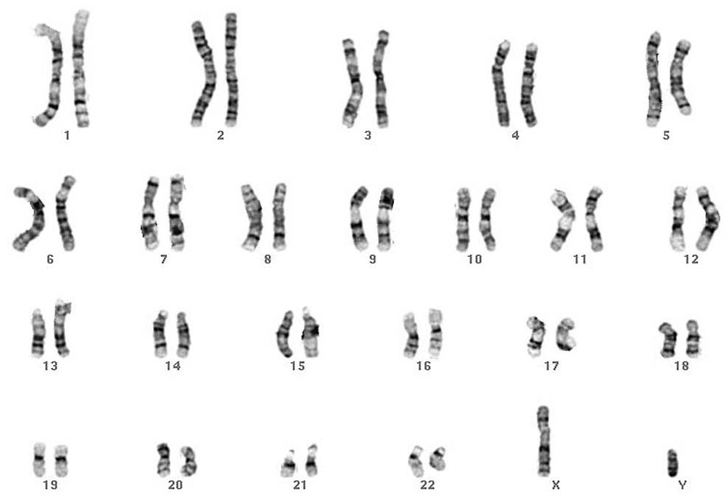
True or False: The X chromosome encodes all of the genes for female characteristics (estrogen receptors, oocyte development genes, etc)
True
False

Slide 7
What about Y? Does Y encode male characteristics (sperm development, etc)?
Yes
No

Slide 8
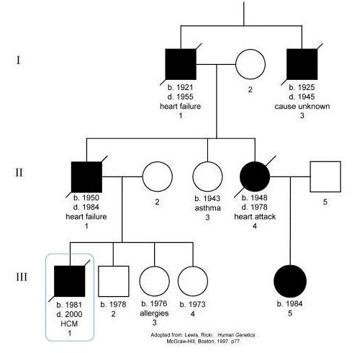
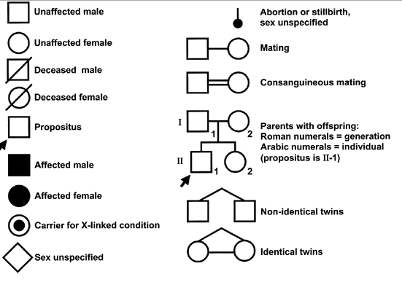
Single-gene Inheritance patterns
Human pedigree analysis can reveal inheritance patterns
Note that for rare genetic conditions, we assume individuals that “marry in” to a family are completely unaffected and not carriers (unless we observe otherwise, or until later in the term when we learn to account for population-level risk)

Slide 9
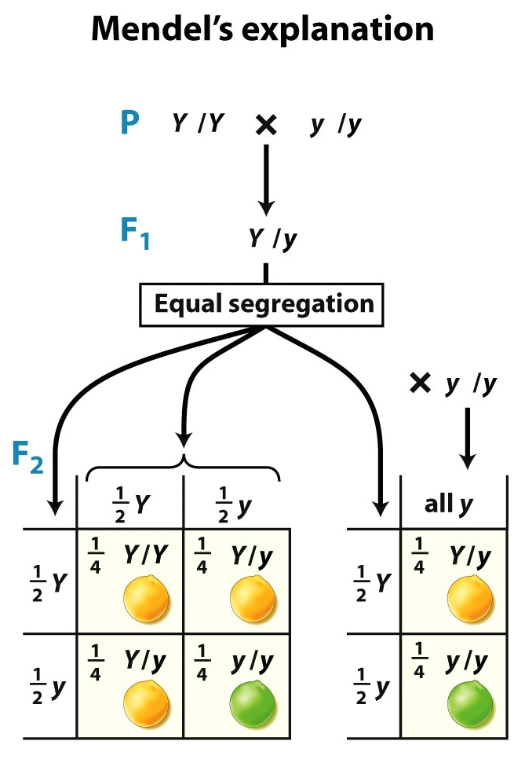
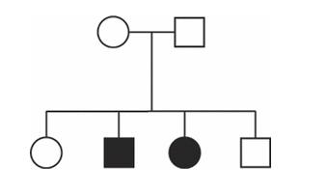
Inheritance patterns
Autosomal Recessive
3:1 pattern in monohybrid cross
parents are non-affected carriers, children are affected
male and female offspring equally affected (autosomal)
mutant phenotype requires two mutant gene copies
Many human genetic diseases, tend to be LOF mutations
Examples: Cystic Fibrosis, PKU
Affected gene is haplosufficient (half expression is enough for wildtype phenotype)

Slide 10
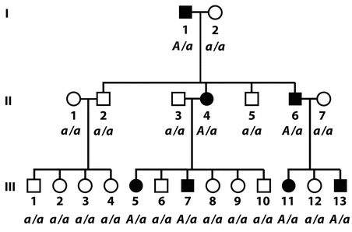
Single-gene Inheritance patterns
Autosomal Dominant
At least one parent affected
50% of offspring affected
Males and females equally affected
Examples: Pseudoacondroplasia (Dwarfism), Huntington’s Disease (late onset neurodegenerative disorder)
Affected gene is haploinsufficient (half expression is NOT enough for wild type phenotype)

Slide 11
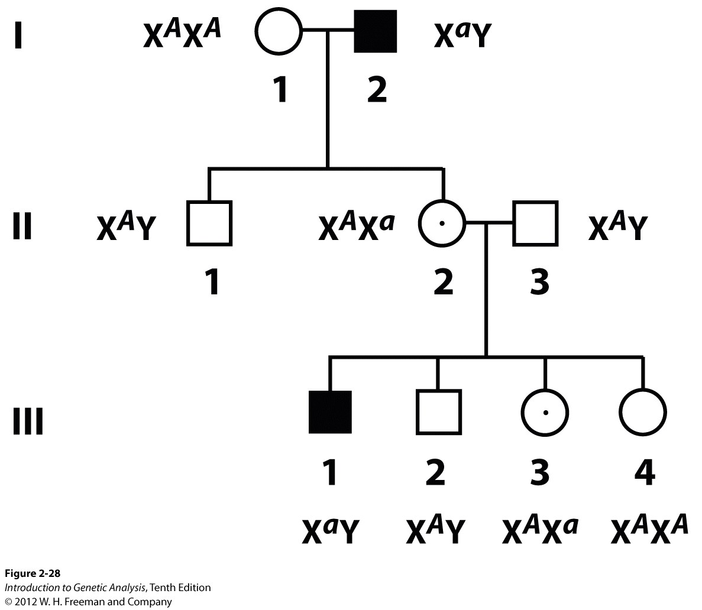
Single-gene Inheritance patterns
phenotype is more prevalent in males than females (due to hemizygosity)
Can affected male parent have affected children?
cannot pass on the allele to male children but female offspring of affected male parent are all carriers
Can affected female parent have affected children?
X linked recessive
Examples: color blindness, hemophilia, Fragile X Syndrome, DMD, etc

Slide 12
Single-gene Inheritance patterns
phenotype is more prevalent in males than females (due to hemizygosity)
Can affected male parent have affected children?
cannot pass on the allele to male children but female offspring of affected male parent are all carriers
Can affected female parent have affected children?
all male offspring will be affected; all female offspring will be carriers
Female carriers have a 50% chance of bearing an affected male child
X linked recessive
Examples: color blindness, hemophilia, Fragile X Syndrome, DMD, etc

Slide 13
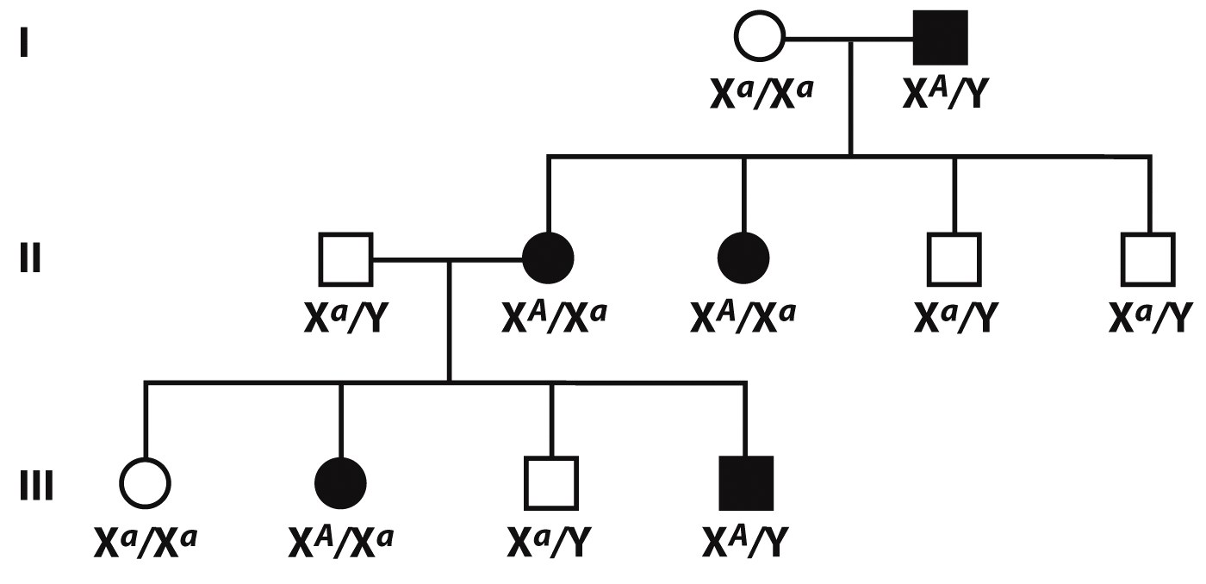
Single-gene Inheritance patterns
Parent must be affected in order to have affected children
Affected male parent:
all and only female progeny affected
Affected female parent:
50% of all progeny affected
**X linked dominant from female parent looks identical to autosomal dominant (need an affected male with offspring in the pedigree to see the difference)
X-linked Dominant
Very few examples of this type of inheritance
extremely rare

Slide 14
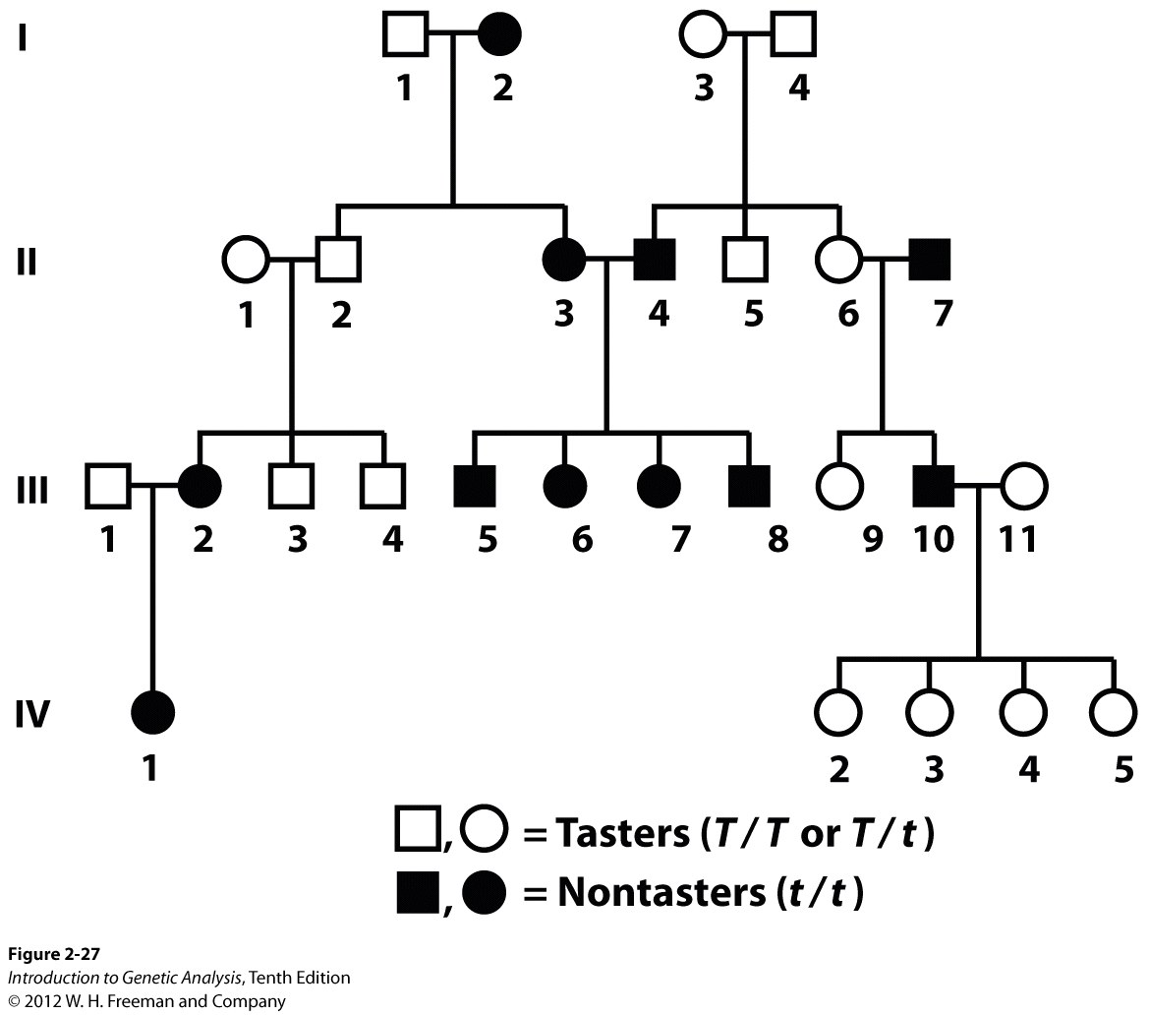
Single-gene Inheritance patterns
Polymorphisms – variation or mutation that is common
(unlike rare genetic disorders)
Unknown persons outside of the family cannot be assumed to be unaffected
Dominant trait listed first/capital by convention (not to imply a mutation)
Examples: eye color, PTC (phenylthiocarbamide) tasters
Dimorphism
2 phenotypes
autosomal recessive inheritance, however the trait is so common that the pedigree is not informative for determining inheritance

Slide 15
Break out!

Slide 16
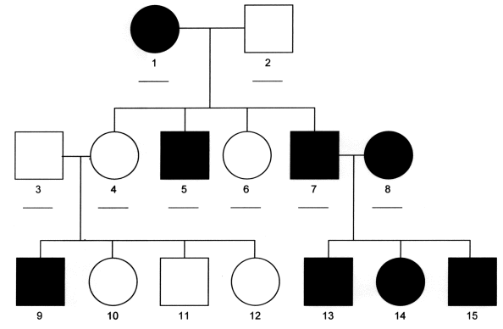
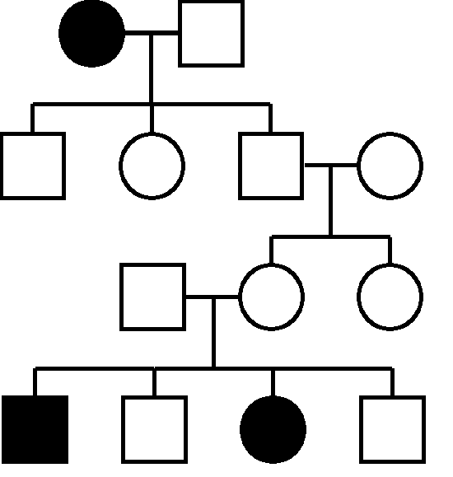
Single-gene Inheritance patterns
Consider these pedigrees for rare genetic conditions:
B
A
What is the inheritance pattern?

Slide 17
What is the inheritance pattern?
Autosomal Dominant
Autosomal recessive
X linked dominant
X linked recessive

Slide 18
What is the genotype of the circled person?
AA
Aa
aa

