Slide 1
BB2920-C16: Genetics
Prof. Farny
Lecture 15
2/20/17
Conference Wednesday (I will be there!)
Office hours Thursday 10-11am
PS5 due Thursday 3pm
JC3 Friday

Slide 2
Today’s Learning Objectives
Review negative regulation of the lac operon by lactose, including use of partial diploids to examine dominance of mutations
Understand positive regulation of the lac operon by glucose
Predict the transcriptional state of the operon under certain physiological conditions, or in response to particular mutations.

Slide 3
Lac operon video
https://youtu.be/oBwtxdI1zvk
They refer to the operator as a “regulatory region” but otherwise it’s a helpful visualization. Does not include positive regulation by glucose which we will discuss today.

Slide 4
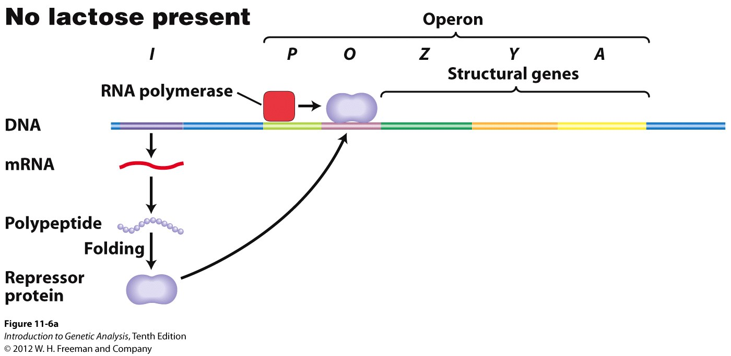
In the absence of lactose, the lacI repressor protein binds the operator, and the operon is “off” - no transcription of the lacZ lacY and lacA genes

Slide 5
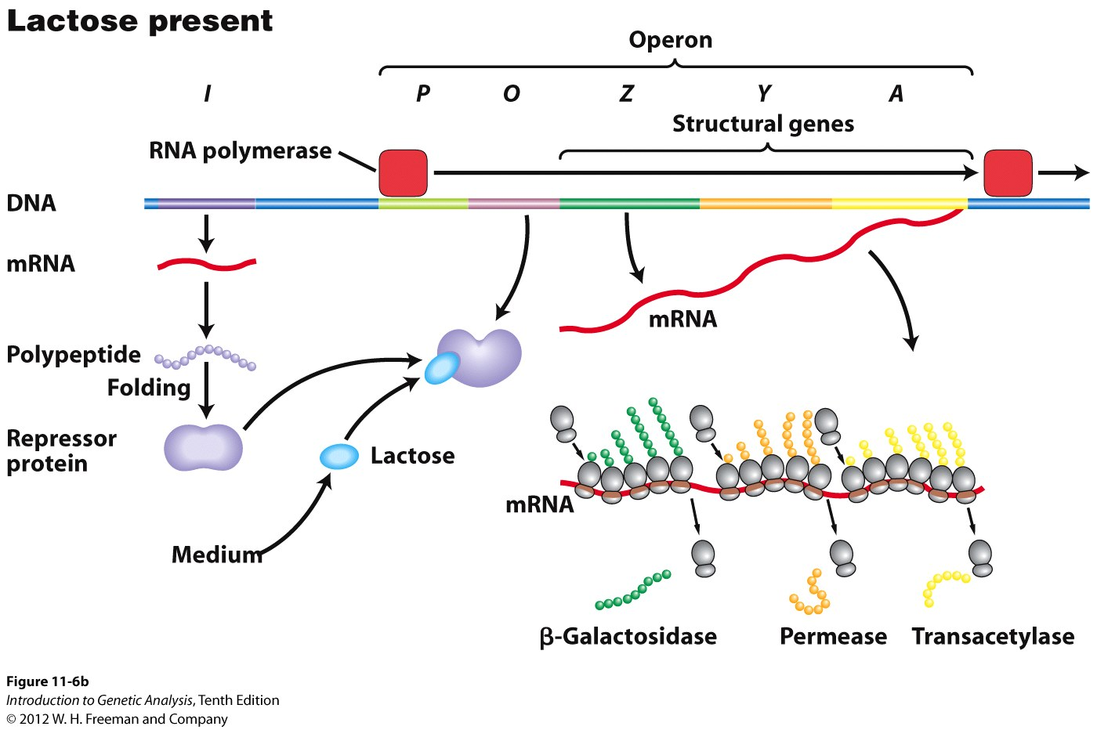
When lactose is present, the lactose binds to the lacI repressor, the repressor can no longer bind the operator, and the operon is “on” - transcription may begin, lacZ lacY and lacA are produced

Slide 6
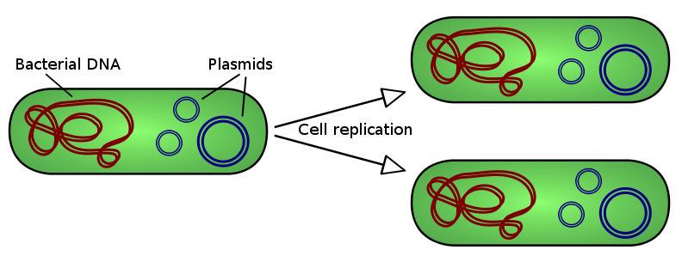
E. coli as a model for gene regulation
Haploid – one copy of each gene, single large circular chromosome, mutations will be expressed (no heterozygous state)
HOWEVER
Using plasmids, you can create a second copy of a gene if you wish (in order to examine dominance of different mutations) – a partial diploid
These plasmids are called “F’ plasmids”
Lactose metabolism: E coli can use lactose as a carbon source but only when galactose and glucose are not available, turns on lactose metabolizing genes only when necessary

Slide 7
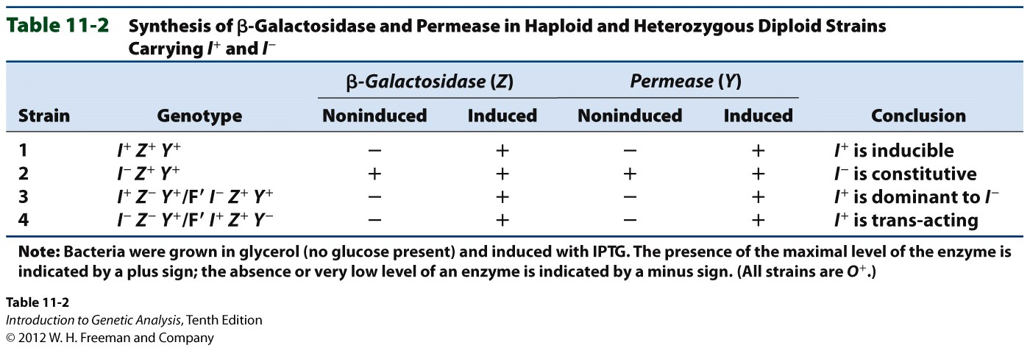
Consider the affects of the following partial diploids on the function of lacZ and lacY, as well as the result for the cell:
lacI
P
O
P O
+
F’
I
Z Y A
lacZ
lacY
O+ Z+ Y+/F’ O+ Z- Y+
O+ Z- Y+/ F’ O^{C} Z+ Y-
I+ Z- Y+/F’ I- Z+ Y+
I^{S} Z+ Y+/F’ I+ Z+ Y+

Slide 8
Here’s a tough one!
lacI
P
O
P O
+
F’
I
Z Y A
lacZ
lacY
I^{S} P+ O+ Z+ Y- / F’ I- P+ O^{C} Z- Y+
? ? ? ?

Slide 9
I^{S} P+ O+ Z+ Y- / F’ I- P+ O^{C} Z- Y+
lacI
P
O
P O
+
F’
I
Z Y A
lacZ
lacY
- + - +
- - - +
+ + + +
- - + +
- - - -

Slide 10
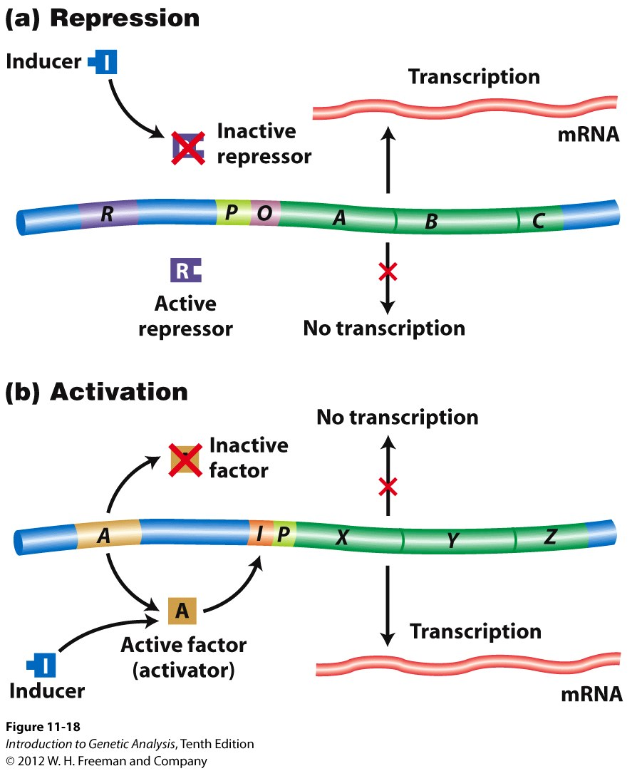
Genes can be regulated by repression (negative regulation)
or activation (positive regulation)

Slide 11
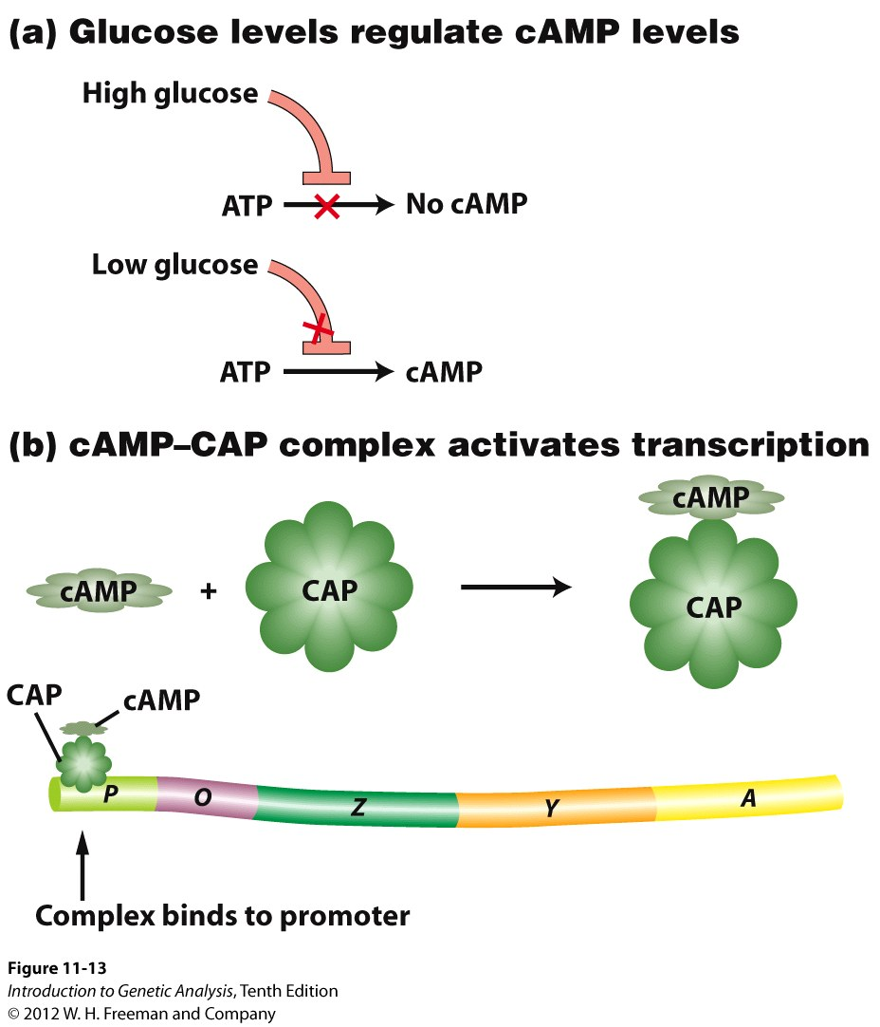
The lac operon is also positively regulated in response to glucose
AAHHHHH!!!
Why??!!
Why do we need this??
Remember the purpose of this operon! The cell will use energy to turn lactose into glucose ONLY if there is no glucose already around! The cell will not waste energy metabolizing lactose if it doesn’t have to! (It doesn’t need to carry around the ski boots in July!)

Slide 12
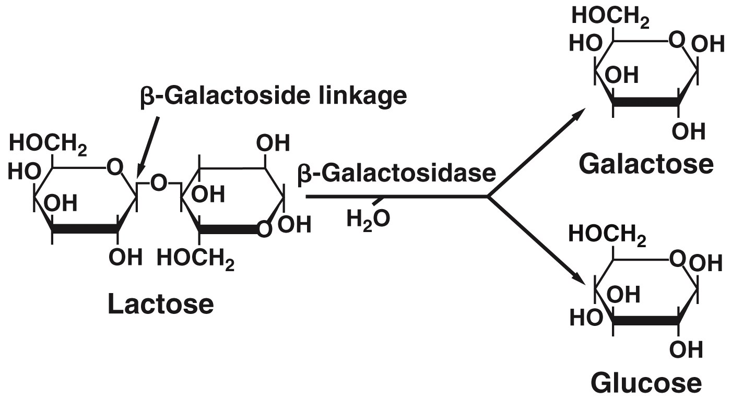
cAMP-CAP regulation is an example of Catabolite Repression
Glucose is a catabolite, or break down product, of lactose metabolism.
The presence of the catabolite represses expression of the operon

Slide 13
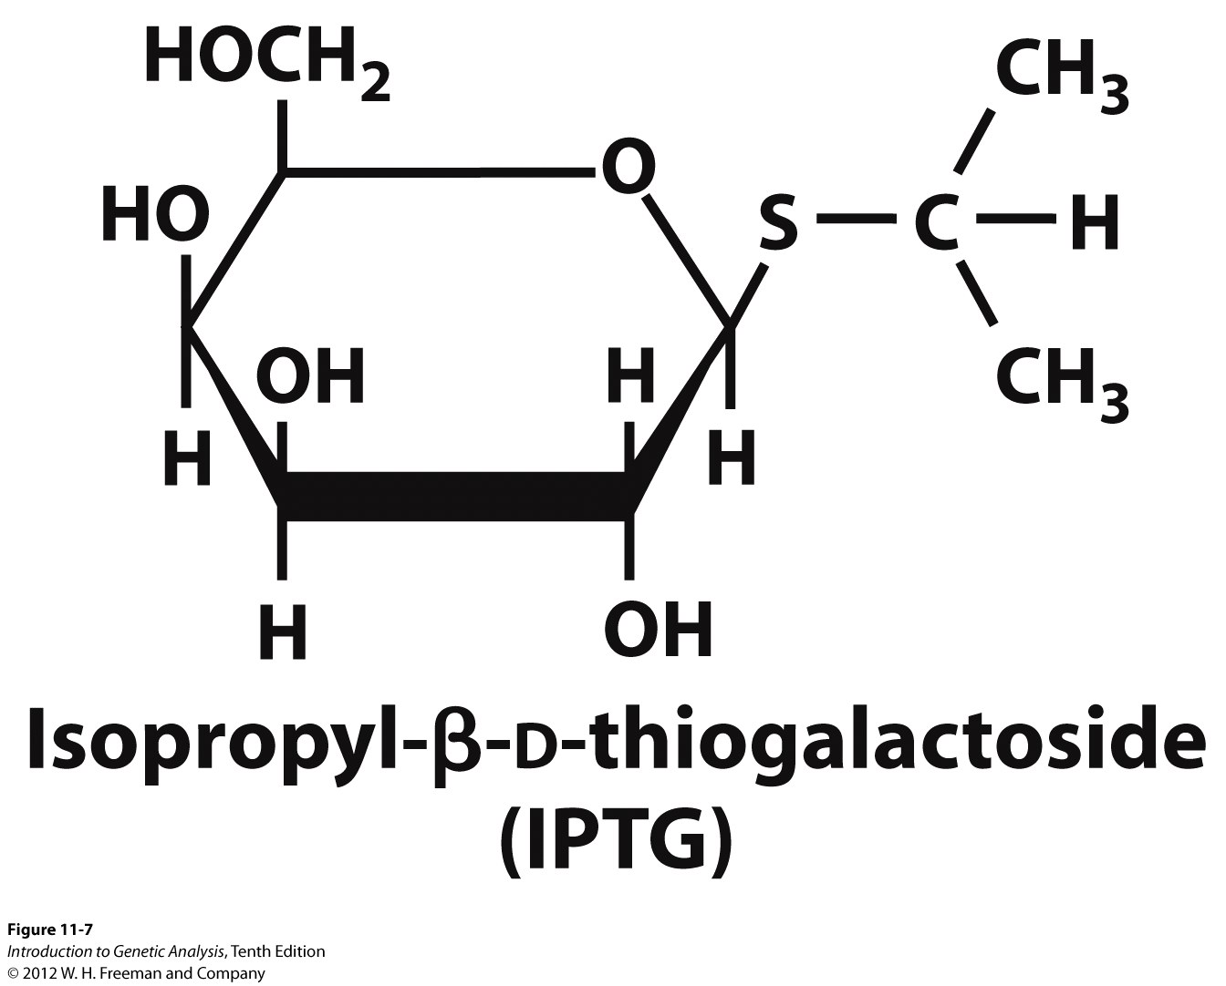
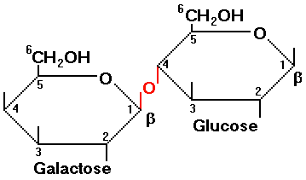
Think-Pair-Share: Why is it better to use IPTG as an effector in an experiment to test the lac operon than lactose?
lactose

Slide 14
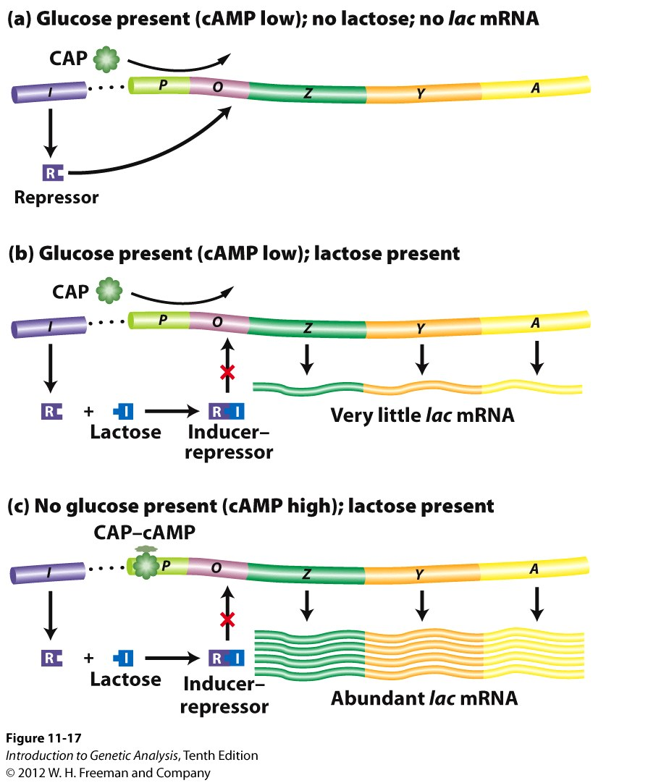
Dual positive and negative regulation of the lac operon ensures optimal gene expression under a variety of conditions

Slide 15
A mutation inhibits the allosteric site of CAP (so, not able to bind to cAMP). In the absence of glucose AND presence of lactose, the transcription of the lac operon would be:
OFF
ON low
ON high

Slide 16
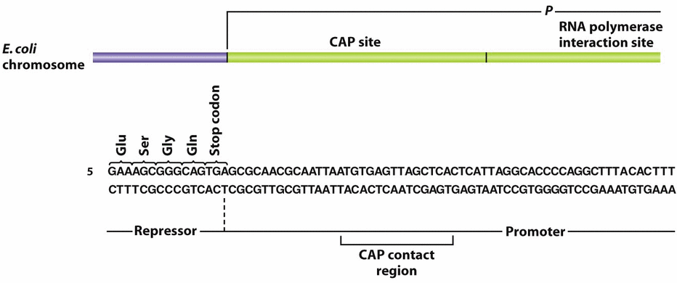
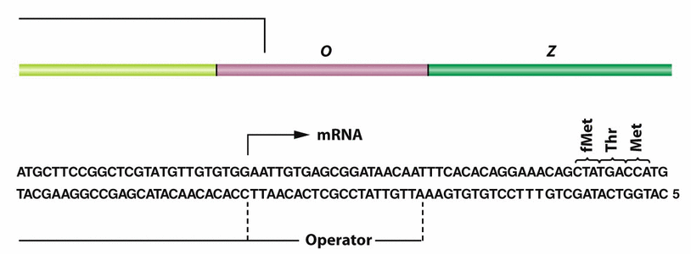
Consider the following mutations:
CAP-
CAP protein is inactive
Can be either allosteric site OR DNA-binding site (these aren’t considered as separate mutations as they are for I- and I^{S}. Why??)
P^{CAP}
Mutation in CAP-binding site in promoter

Slide 17
Z and Y transcription: Hi, Lo or Off???
Glu+ Lac- Glu+Lac+ Glu-Lac+
All +
CAP-
P^{CAP}
I-
I^{S}
O^{c}
P-

