Slide 1
BB2920: Genetics Prof. Farny Lecture 18 2/27/17
Please take alleles (little papers with E or e on them) in the cups on the front table! Take two!
Additional Office Hours GH203C: Wednesday Pet Therapy Day! Open door 10am-4pm!, Thursday 9:30-11
Conference Wednesday at 3pm, help for PS6
PLA help session Wednesday 7-9pm SL lounge
PS6 due Thursday for all (remember that you have one drop!)
Exam Thursday or Friday, as you wish (Thursday participants will sign a non-disclosure agreement)

Slide 2
Today’s Learning Objectives
Understand how to define a gene pool and predict the genotypes and phenotypes of a population using the Hardy-Weinberg equation
Discuss the factors that create deviations from H-W equilibrium in a population
Use H-W to calculate risks for rare genetic diseases

Slide 3
How comfortable are you at using the H-W equation?
Very comfortable, I’ve learned this several times
I’ve seen it once or twice but I’m rusty
Not at all, this is my first time learning it

Slide 4
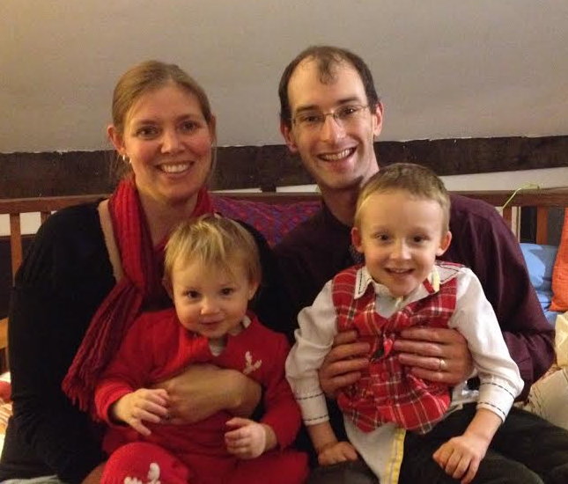
Population Genetics
Examines variation within a population
Predicts genotypes of future generation
Addresses forces that alter or influence the expected variation in a population
Today we will study the prevalence of Engineer-itis within a population
(alleles E and e)
EE = biologist
ee = engineer
Ee = bioengineers(?)

Slide 5
Defining a Gene Pool
Let’s define our gene pool: the total of all alleles of all breeding members of a population,
Based on the clicker responses:
population size: (N) = (# of people that click in/students that are here)
total alleles: (2N) = (total possible alleles)
allele frequency: E + e = 1.0 dominant allele = p recessive allele = q
p + q = 1.0
Assume I put equal numbers of E and e into the cups!
In theory, what are the allele frequencies?
p=
q=
Notes:
p = 0.5 and q = 0.5, in theory. Use only a few (~10) spare alleles in the cups so that its likely the first generation is close to HW equilibrium

Slide 6
The Hardy-Weinberg Law
Allele frequencies within a population remain constant from generation to generation in the absence of other evolutionary influences***
Therefore, H-W equation can be used to estimate genotype frequencies of subsequent generations once the gene pool has been defined.
Expected genotype frequency (f):
p²+2pq+q² = 1.0

Slide 7
Prediction of our Engineer/Biologist population
p²+2pq+q² = 1.0
p=0.5, q=0.5

Slide 8
What is your genotype? (Please enter the alleles in front of you) This gene is haploinsufficient! ☺
EE biologist
Ee bioengineer
ee engineer

Slide 9
Let’s see how we did:
population size: (N) =
Actual genotype frequency (f): f(EE) + f(Ee) + f(ee) = 1.0 (100%)
Actual allele frequency: (count from clicker responses…)
p =
q =
Reasons why this varied from the expected?
Notes:
COUNT ALLELES BASED ON CLICKER RESPONSES!!

Slide 10
Using H-W to predict the next generation
from clicker poll counts: p = q =
genotypes of the next generation are the probability of two alleles combining
(this is an application of the product rule!)
To predict next generation, use
Hardy-Weinberg Equation:
p²+2pq+q² = 1.0
probability of EE?
probability of Ee?
probability of ee?

Slide 11
Testing H-W: Let’s mate!
Choose a mate. There can be only one offspring per couple. Do not look at your alleles, just pick one at random to donate to your offspring.
ONE PERSON IN THE MATING PAIR: Ring in your genotypes (if you both ring in it will throw off our population!!!)

Slide 12
What is your offspring’s genotype? ONLY ONE MEMBER OF THE “MATING PAIR” SHOULD CLICK IN!
EE biologist
Ee bioengineer
ee engineer

Slide 13
Did the results of our mating match the H-W prediction?
p² = 2pq = q² =
p = q =
Have the allele frequencies changed?
Have the genotype frequencies changed?
Is our system at H-W equilibrium?

Slide 14
Assumptions required for the H-W equation:
random mating (no mate preference)
equal viability among genotypes (EE, Ee and ee are all equally likely to survive)
no isolation or formation of sub-populations
infinitely large population
When a population meets these criteria, the H-W equation can accurately predict genotype frequencies, the population is said to be at Hardy-Weinberg equilibrium
genetic variation is neither created nor destroyed, simply re-shuffled,
fluctuation in genotype frequencies are minor

Slide 15
What types of “evolutionary influences” or other phenomena affect the H-W equilibrium?
Assortative mating
positive: preferring to mate with one’s own kind
negative: preferring to mate with an opposite kind
Geographic distance - individuals have only a certain distance they are willing/able to travel in order to mate
Inbreeding - breeding with close relatives enriches the presence of recessive alleles
Mutation - randomly arising mutations become incorporated into the gene pool
Selection - one genotype has some sort of survival advantage over another
Genetic drift - in small populations, random sampling error can lead to allele bias due to chance, even is random mating is true (populations are not infinite!)

Slide 16
Applying H-W to rare genetic disease
For a rare disease in a very large population (like a country or an ethnic group) H-W allows you to calculate the allele frequencies with reasonable accuracy
Example: In the U.S. 1:4000 individuals are affected with cystic fibrosis. What percentage of the population are carriers for the disease allele?

Slide 17
In the U.S. 1:4000 individuals are affected with cystic fibrosis. “1:4000” represents:
p²
2pq
q²

Slide 18
In the U.S. 1:4000 individuals are affected with cystic fibrosis. What percentage of the population are carriers for the disease allele?
1/4000 = q²
q = 0.0158
p = 1-q = 0.9842
2pq = 2(0.0158)(0.9842) = 0.0311 or 3.11%

