Slide 1
BB2920: Genetics
Prof. Farny
Lecture 4
1/19/17
My office hours: Tomorrow (Friday) 11am-12:30
PLA office hours:
Tonight 7-9pm in SL lounge

Slide 2
Today’s Learning Objectives
Finish our discussion of the mechanism of DNA replication
Analyze a sequence and understand how replication will proceed for that sequence
Understand the process and the purpose of transcription
Explain the function of promoters
Apply your understanding of transcription to analysis of sequences and prediction of transcriptional products

Slide 3
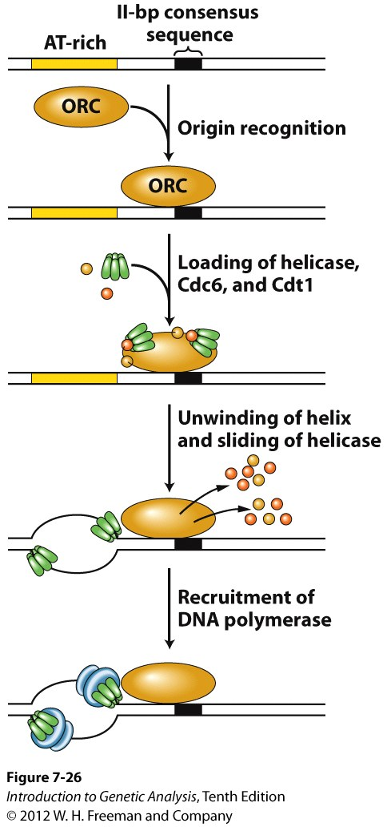
DNA replication
Challenge 1: where to begin?
Origin of Replication (or just “origin”)
a sequence element recognized by a protein complex, marks the place that DNA replication should start
Protein complex brings unwinding enzymes called helicases that begin to unwind the strands
E. coli – 1 origin
Yeast - ~400 origins
Humans – thousands and thousands
Notes:
In order to make a copy, you need to separate the strands. How is this done?

Slide 4
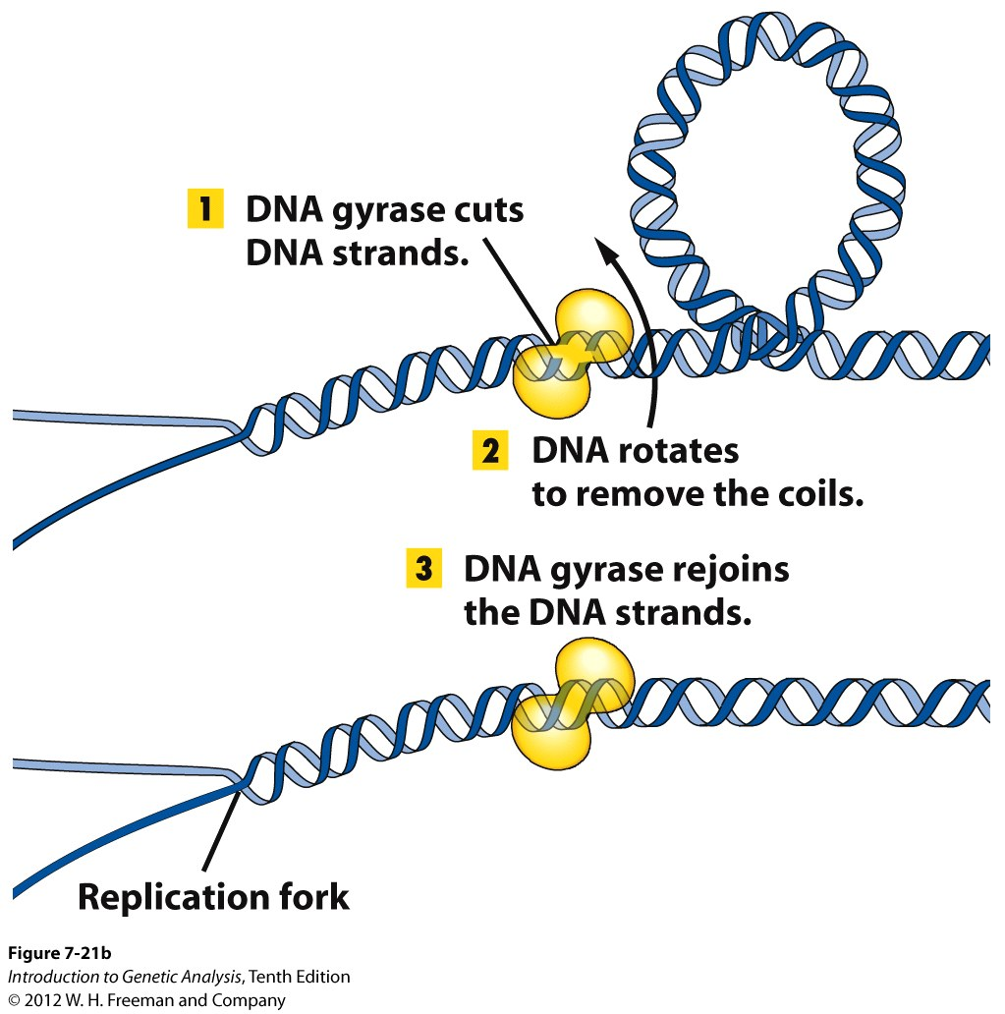
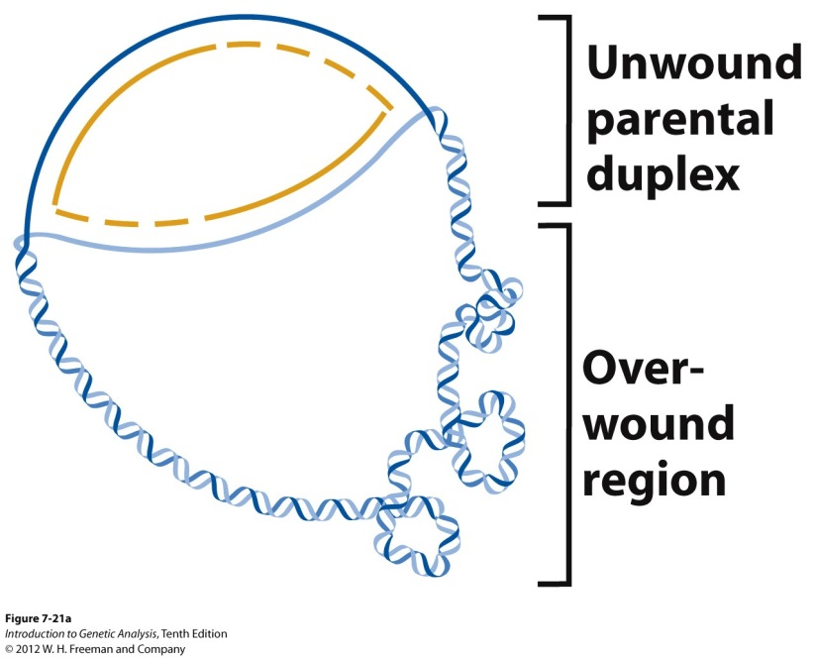
DNA replication
Challenge 2: Unwinding a double helix
Helicase
replication forks
Gyrase and topoisomerase are the same. Topoisomerase is a type of gyrase.
Gyrase and helicase are NOT the same. Gyrase relieves supercoiling, Helicase separates strands by disrupting hydrogen bonds.

Slide 5
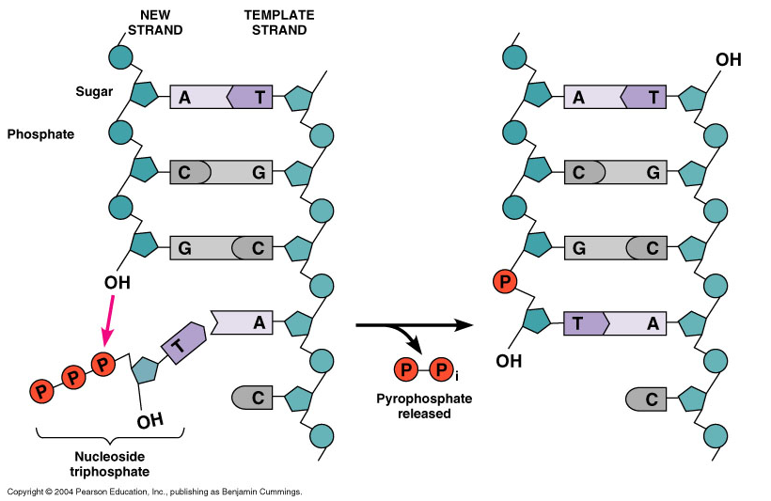
DNA replication
Challenge 3: what is the copying enzyme?
DNA polymerase III
creates a polymer (strand) of DNA by catalyzing the hydrolysis of nucleoside triphosphates (ATP, CTP, GTP, TTP) to form a phosphodiester bond
can only join to the 3’ end of an existing chain
3’ → 5’ exonuclease activity, “proofreading”
Problems?
what if there is not an existing chain?
how does it synthesize the other strand (away from the replication fork?)

Slide 6
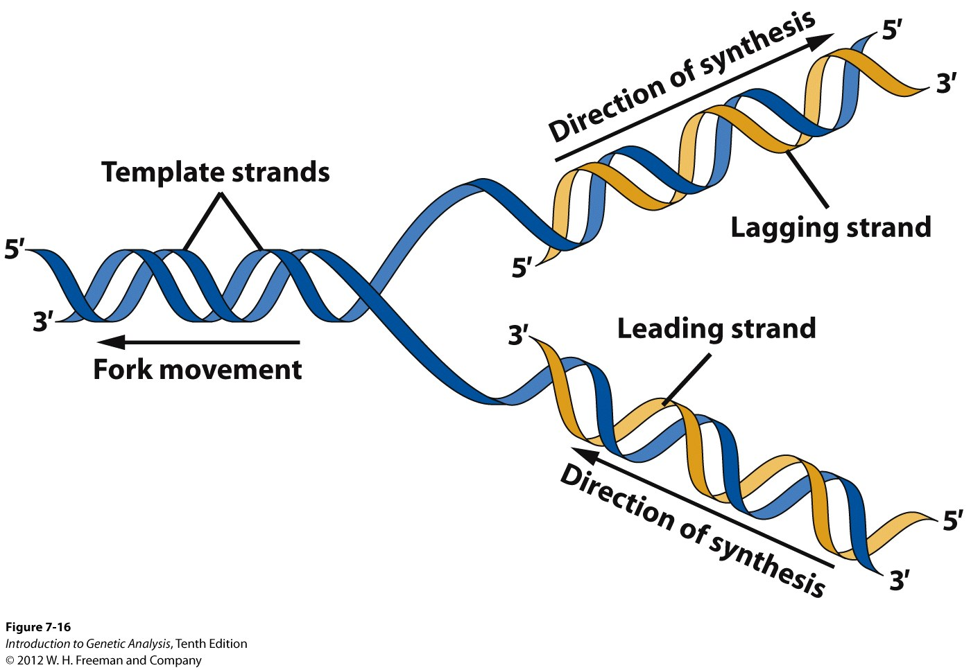
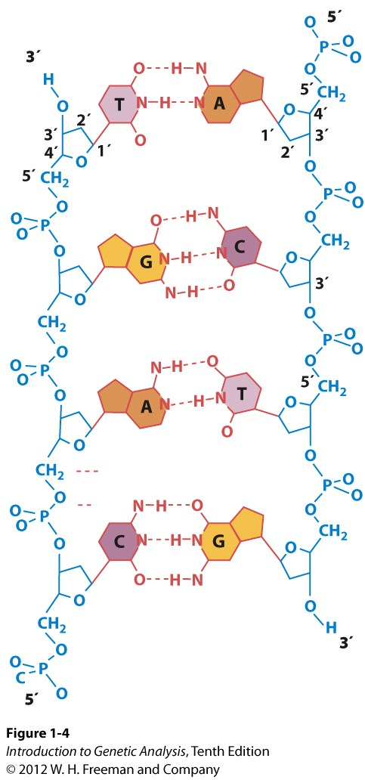
Challenge 4: how does the polymerase synthesize the other strand (away from the replication fork?)
Template strand is READ: 3’ → 5’
New DNA is SYNTHESIZED: 5’ → 3’
AGAIN: free nucleotides, RNA OR DNA, can only be joined to an open 3’ end!!
AND, base pairing is ALWAYS antiparallel. You’ll be able to figure it out if you remember that these rules must ALWAYS apply!

Slide 7
Break-out!!

Slide 8
Break-out: DNA Replication
In the direction of the red arrow:
Which strand (top or bottom) is the lagging strand?
What primer sequence will be created by the primase for replication of the leading strand?
(Remember: by convention, when discussing DNA or RNA sequences, they are always written from 5’ to 3’. Also RNA uses Uracil in place of Thymine)
ORI (begin here)
A
A
T
G
C
C
A
3’
5’
REPLICATION
FORK
G G C T A G G T A C A G A T C C T C A A
C C G A T C C A T G T C T A G G A C T T
3’
G
T
5’
C
G
T
T
A

Slide 9
Which strand is the lagging strand?
Top
Bottom

Slide 10
ORI (begin here)
A
A
T
G
C
C
A
3’
5’
REPLICATION
FORK
G G C T A G G T A C A G A T C C T C A A
C C G A T C C A T G T C T A G G A C T T
3’
G
T
5’
C
G
T
T
A

Slide 11
Enter the sequence of the first 6 nucleotides of the RNA primer on the leading strand (remember to enter 5’ to 3’!)
Rank | Responses
1 | AUCAGG
2 | GGACUA
3 | 1
4 | AUCAGGUA
5 | AGCAUC
6 | Other
Values: AUCAGG
Value Matches: 55

Slide 12
ORI (begin here)
A
A
T
G
C
C
A
3’
5’
REPLICATION
FORK
G G C T A G G T A C A G A T C C T C A A
C C G A T C C A T G T C T A G G A C T T
3’
G
T
5’
C
G
T
T
A

Slide 13
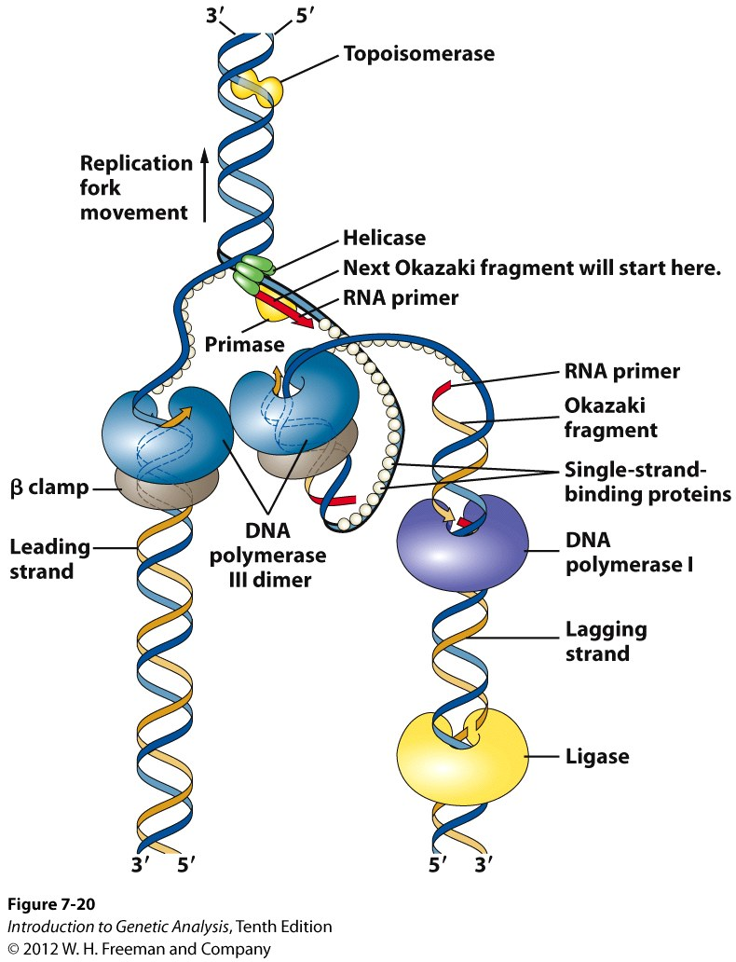
Proteins at work at the replication fork
(=gyrase)
Helicases: open and unwind DNA
Gyrases: relieve over-winding
Single-stranded binding proteins: coat the separated DNA to keep it separated
Primase: creates a short bit (8-12 nt) of complementary RNA “primer” which DNA Pol III can use to begin DNA synthesis
On the Leading strand: DNA Pol III immediately follows the replication fork
β clamp: holds the Pol III on the DNA
DNA polymerase I: removes the RNA primer, fills in the space with DNA
Ligase: glues the DNA ends together (where the primer used to be and the start of the Pol III strand, at the origin)

Slide 14
Proteins at work at the replication fork
On the Lagging strand:
Primase makes an RNA primer close to the replication fork
DNA Pol III: extends the primer until it hits the end of another new fragment of DNA. These short bits of new DNA are called Okazaki fragments.
DNA Pol I: removes the RNA primer and fills in the DNA between fragments.
Ligase: glues the two ends together.
DNA replication is:
Fast! 1000 nt/sec
Faithful! high fidelity, only 1 in 10¹⁰ errors

Slide 15
Differences in Eukaryotes
More enzymes: More types of DNA polymerase, helicase, etc BUT they have the same basic function
More origins with varying sequences
Must deal with nucleosomes (additional proteins help with this but you don’t need to know them specifically)
Linear chromosomes lead to telomere conundrum (more on this in part 2 of the course)

Slide 16
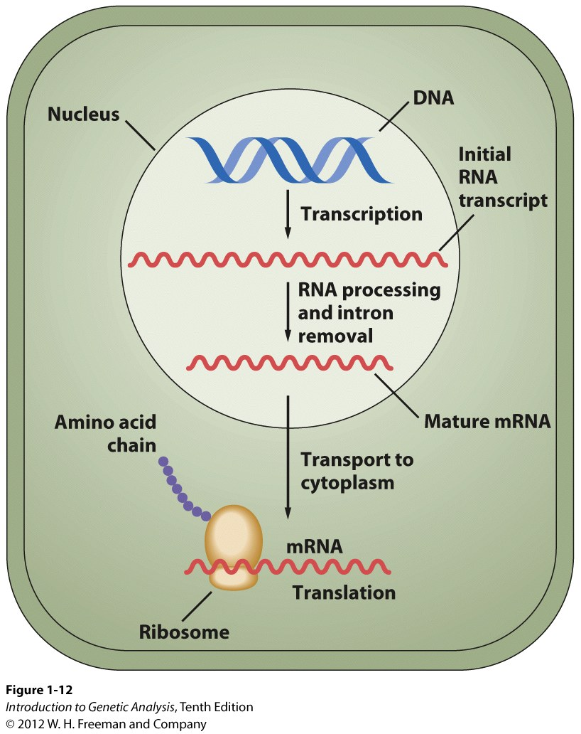
The Central Dogma of Molecular Biology
DNA
transcription
RNA
translation
Protein
replication
To transcribe (as in a text):
To make a very similar copy of some portion of the text, using the same language
Nucleic acid to nucleic acid (DNA to RNA)
To translate:
To convert from one language to another
Converts from nucleic acids to amino acids
(RNA to protein)

Slide 17
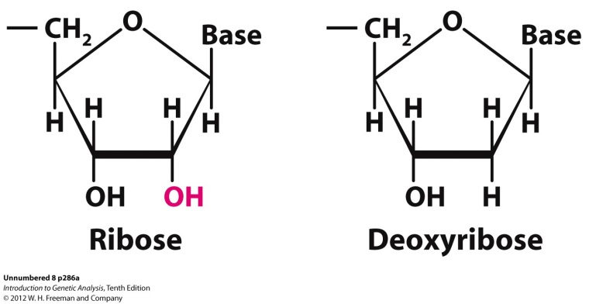
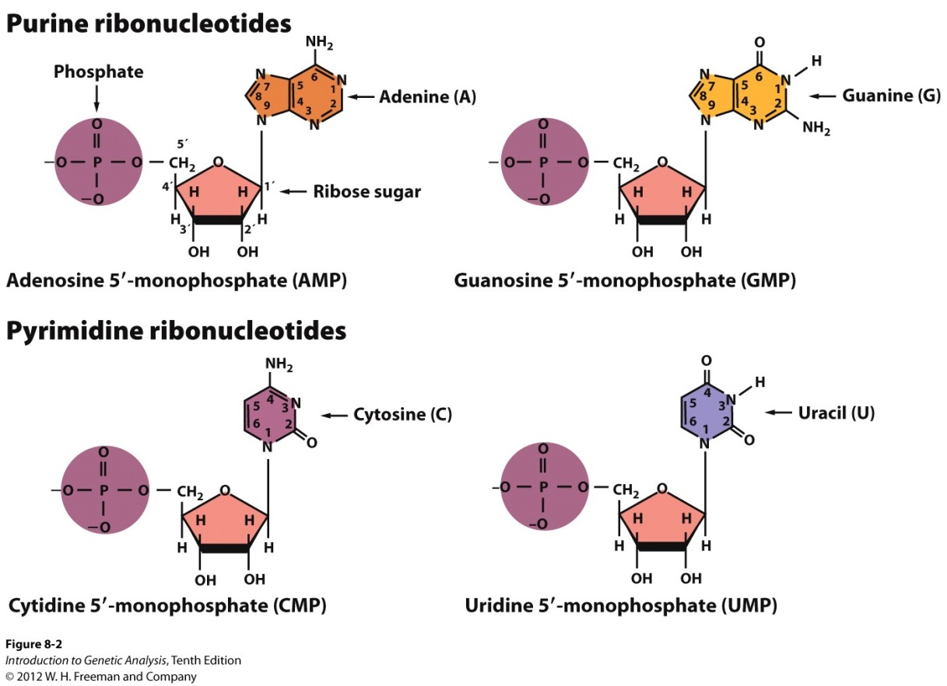
RNA: ribonucleic acid
Types of RNA
Informational:
messenger mRNA
(Pol II)
Functional:
transfer tRNA (Pol III)
ribosomal rRNA (Pol I)
small nuclear snRNA
many others....
Uracil replaces thymine in RNA

Slide 18
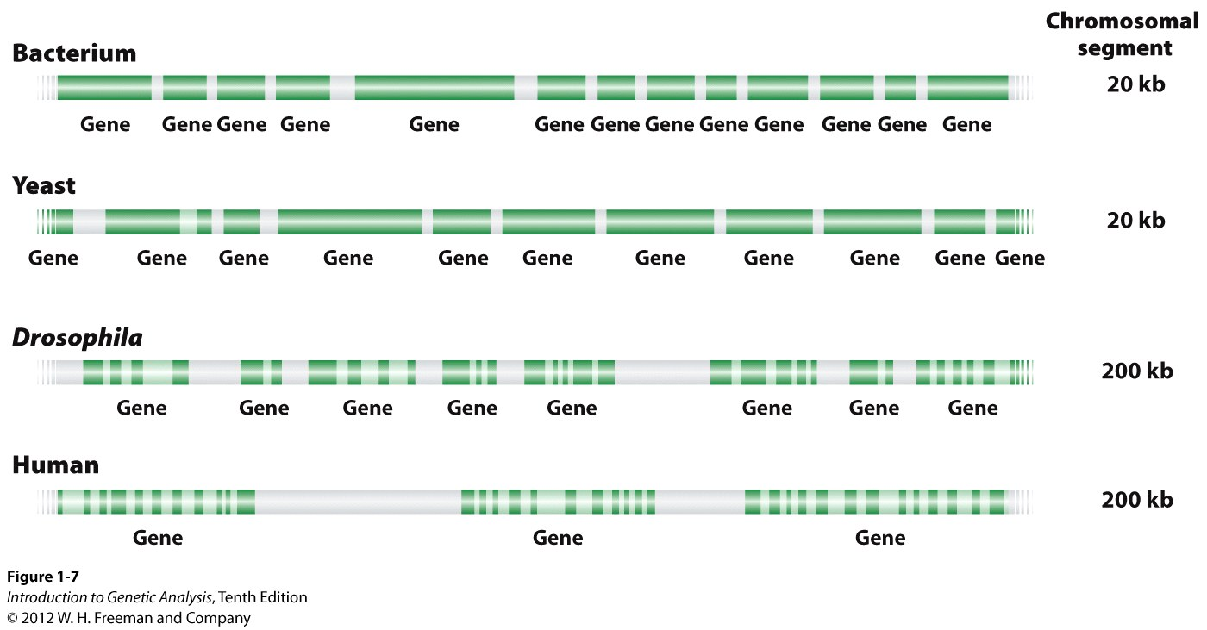
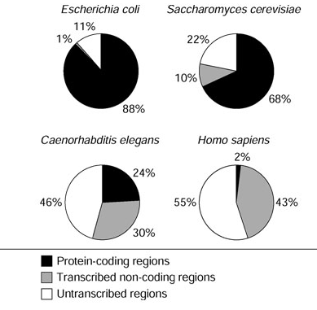
Organization of Genes within Genomes
DNA = gene
Genes are transcribed into mRNA in order to be made into proteins
transfer of informational content into a mobile, usable form

