Slide 1
BB2920: Genetics
Prof. Farny
Lecture 6
1/23/17

Slide 2
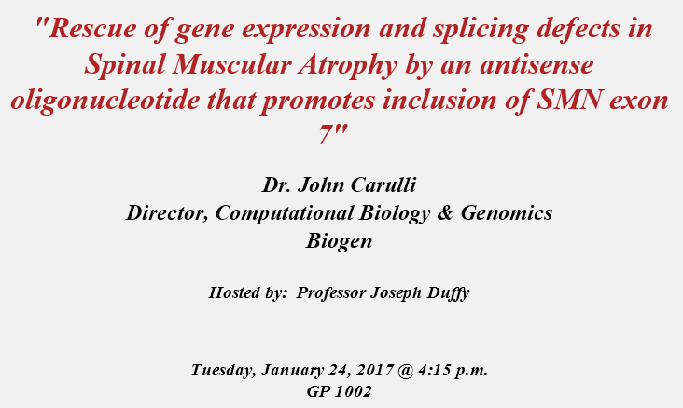
Extra Credit Opportunity
You will attend the seminar and/or read the research article, write a 1 page summary, and answer some questions online.
You will receive up to +3 points on the first exam for your participation and (quality) write-up.
Materials are posted under Modules. Brief write-ups due Monday Jan 30 11:59pm

Slide 3
Today’s Learning Objectives
Understand the process and the purpose of post-transcriptional RNA processing (capping, splicing, polyadenylation, alternative splicing) in eukaryotes
Understand the process of translation, and the features of the genetic code that make translation possible
Describe the types of mutations (both physical and functional) that can affect translation of proteins
Predict the functional consequences of a mutation on the activity of a protein, and the effects these mutations can have in human disease

Slide 4
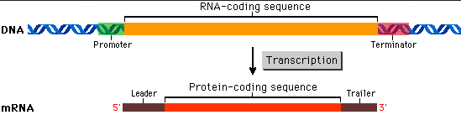
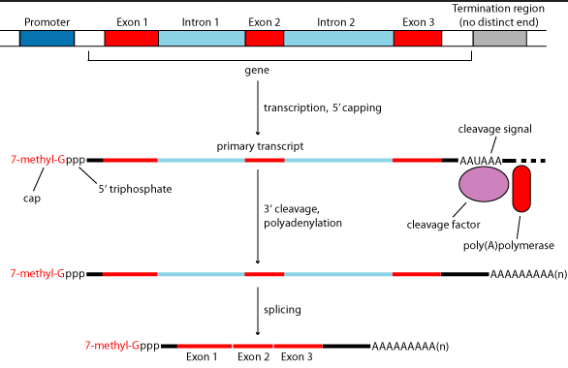
Prokaryotic mRNAs are ready-to-go; Eukaryotic mRNAs require processing
Prokaryote:
DNA
Eukaryote:
mRNA

Slide 5
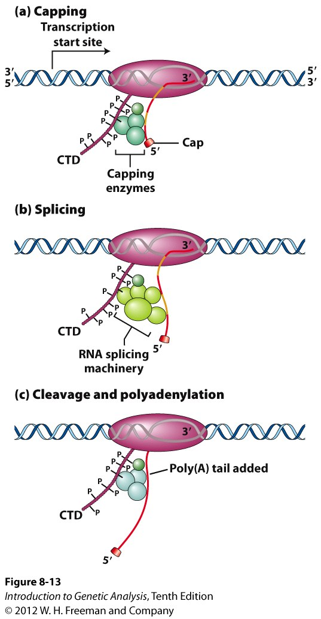
Eukaryotic mRNAs require processing
Processing is said to occur co-transcriptionally
RNA pol II CTD – C-terminal domain:
processing enzymes “ride along”
Capping:
7-methylguanosine, 5’-5’ linkage
(“backwards” G)
why? protects 5’ end
Splicing:
removal of introns
Cleavage and polyadenylation:
AAUAAA sequence
mRNA cut
poly-A tail added by poly A pol.
why? protects 3’ end
Notes:
in prokaryotes, the RNA is made and that’s it. In eukaryotes, the RNA is processed before it is ready for translation into protein

Slide 6
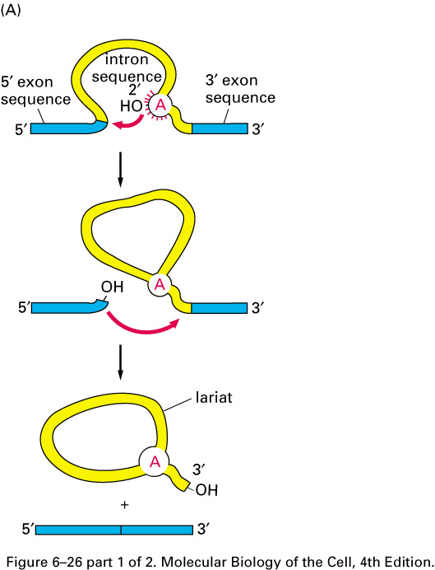
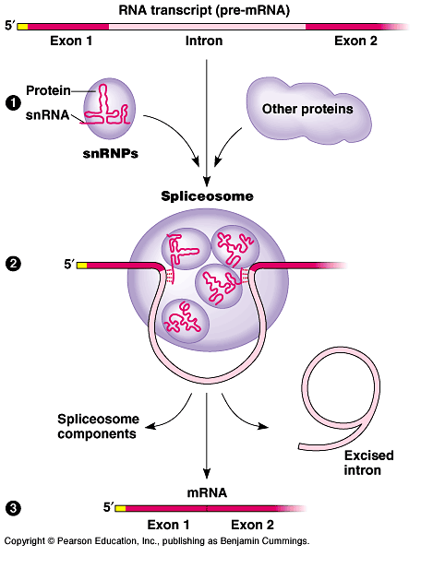
Splicing removes introns and joins exons together
This process does not require energy (the reaction is spontaneous under physiological conditions)
Protein complex called the spliceosome identifies the correct splice sites and brings the splice sites into proximity
Notes:
Esters are chemical compounds consisting of a carbonyl adjacent to an ether linkage. They are derived by reacting an oxoacid with a hydroxyl compound such as an alcohol or phenol. Esters are usually derived from an inorganic acid or organic acid in which at least one -OH (hydroxyl) group is replaced by an -O-alkyl (alkoxy) group, and most commonly from carboxylic acids and alcohols. That is, esters are formed by condensing an acid with an alcohol.

Slide 7
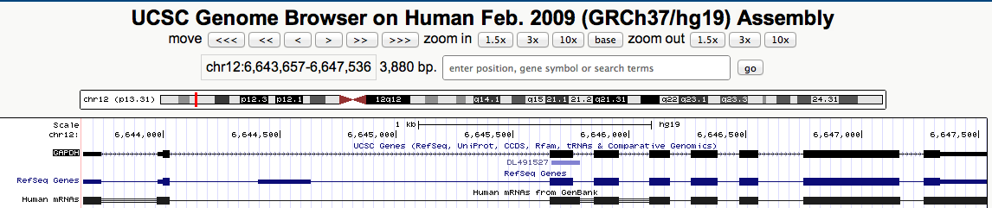
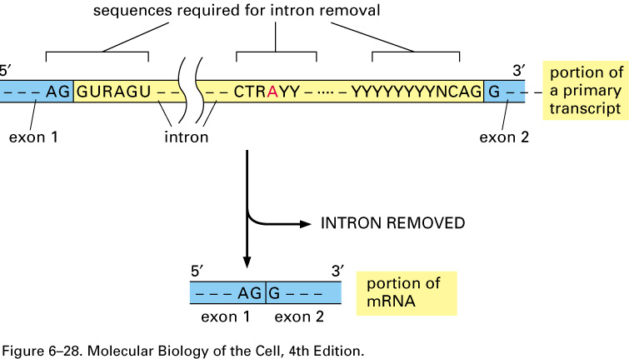
How is the correct splice site located among all that DNA??!!??
Specific sequences define the 5’ and 3’ splice sites, and the lariat branch point
3’ splice site
Y=pyrimidine (C, U)
R=purine (A, G)
5’ splice site
Branch site A

Slide 8
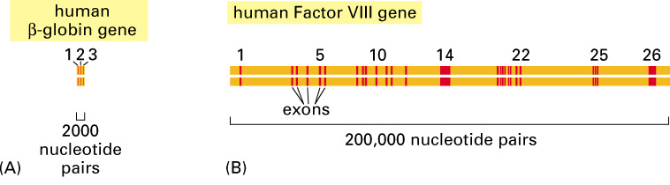
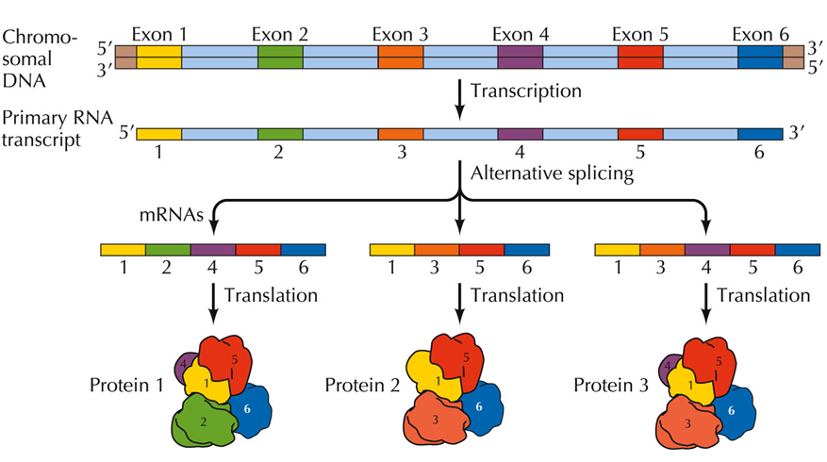
Why bother with splicing??
Alternative Splicing creates multiple coding regions from the same primary transcript
Up to 90% of human genes are estimated to be alternatively spliced
Remember: Prokaryotic genes do not contain introns so cannot be alternatively spliced!!

Slide 9
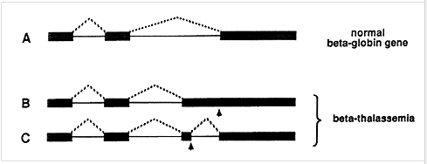
Below is a schematic of the primary transcript of the beta-globin gene, a component of hemoglobin. The normal beta-globin gene contains three exons and two introns. Mutations that affect beta-globin cause many blood diseases including sickle cell anemia and beta-thalassemia.
Exon 1
Exon 2
Exon 3
Where would the promoter be located in the corresponding DNA?
Which of the three primary transcripts shown above will be the longest?
Which of the resulting mRNAs will be the longest?

Slide 10
Where is the promoter?
Exon 1
Exon 2
Exon 3
Upstream of Exon 1
Downstream of Exon 1
Upstream of exon 3
Downstream of exon 3

Slide 11
Which of the primary transcripts is the longest?
Exon 1
Exon 2
Exon 3
Transcript A
Transcript B
Transcript C
They are all the same length

Slide 12
Which of the fully processed mRNAs is the longest?
Exon 1
Exon 2
Exon 3
Transcript A
Transcript B
Transcript C
They are all the same length

Slide 13
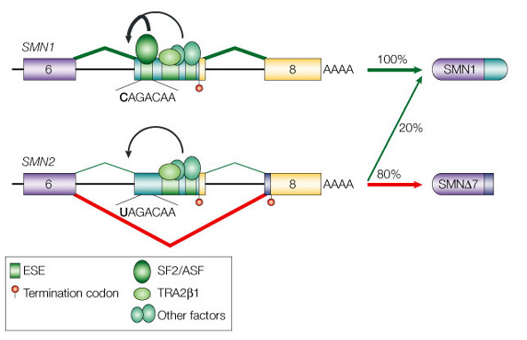
The Survival of Motor Neuron genes (SMN1/2) are regulated by alternative splicing
Deletion of SMN1 is causative for Spinal Muscular Atrophy (SMA), but could be treated by changing the alternative splicing of SMN2.
Cartegni, L., Chew, S. L. & Krainer, A. R. Listening to silence and understanding nonsense: exonic mutations that affect splicing. Nature Rev. Genet. 3, 285-298 (2002)

Slide 14
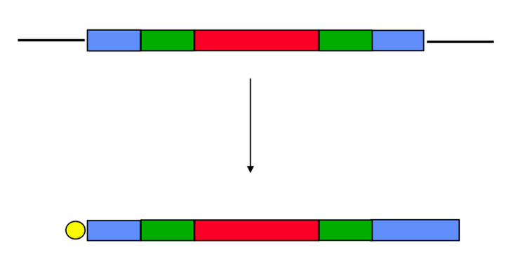
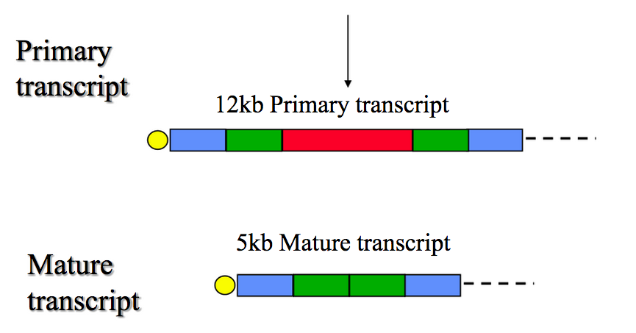
Eukaryotic mRNA processing Summary:
total length = 12kb
Primary
transcript
5’ UTR
Exon
1
intron
Exon
2
3’ UTR
Cap (capping enzyme)
Splice (spliceosome)
Intron (lariat)
Polyadenylate (poly A pol.)
AAAAAAAAA…..
ready to translate into protein

Slide 15
Anatomy of a mature eukaryotic mRNA
AUG (Met) = start codon
stop codon
AAAA....(150-200)
Cap
open reading frame (ORF)
translated into protein
poly-A
tail
5’ UTR
3’ UTR

Slide 16
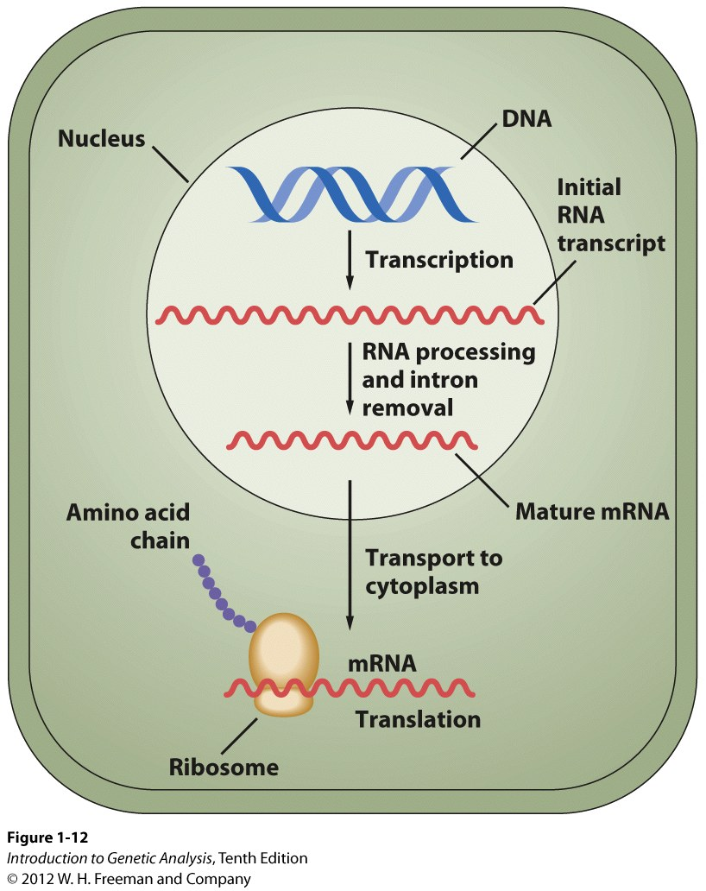
The Central Dogma of Molecular Biology
DNA
transcription
RNA
translation
Protein
replication

Slide 17
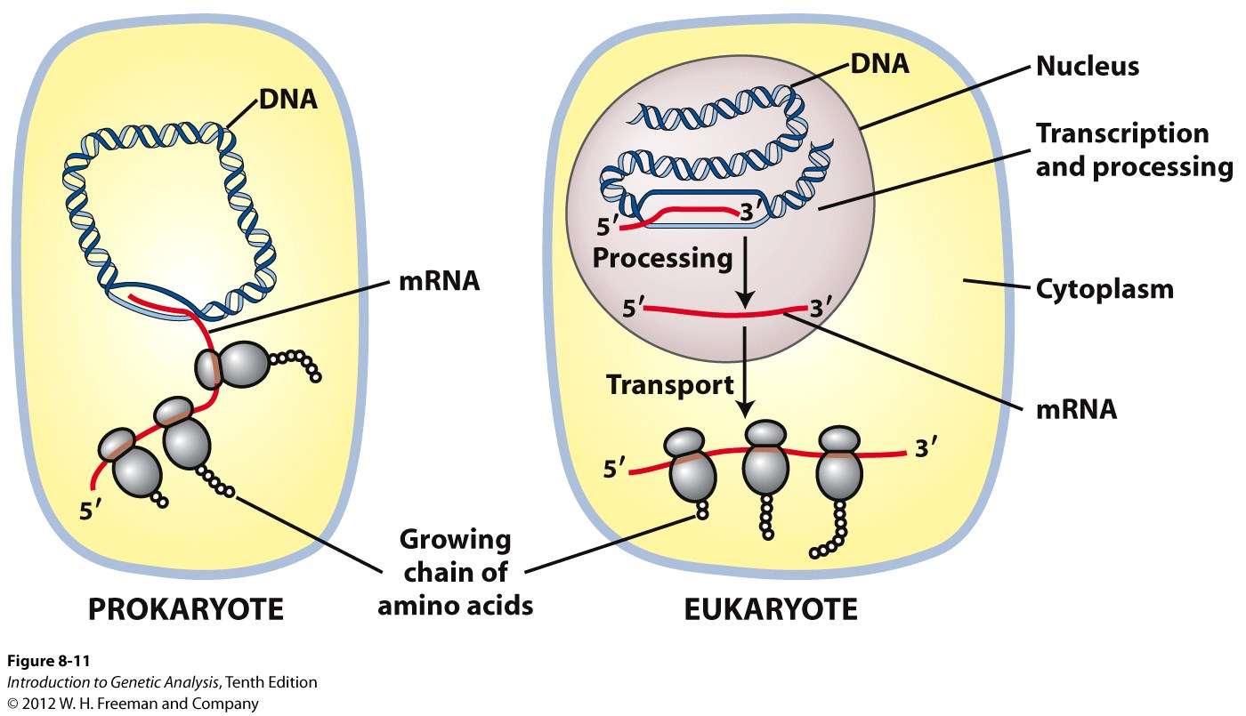
DNA
transcription
RNA
translation
Protein
replication
Ribosomes translate the information of the mRNA into proteins
Translation occurs ONLY in the cytoplasm!

Slide 18
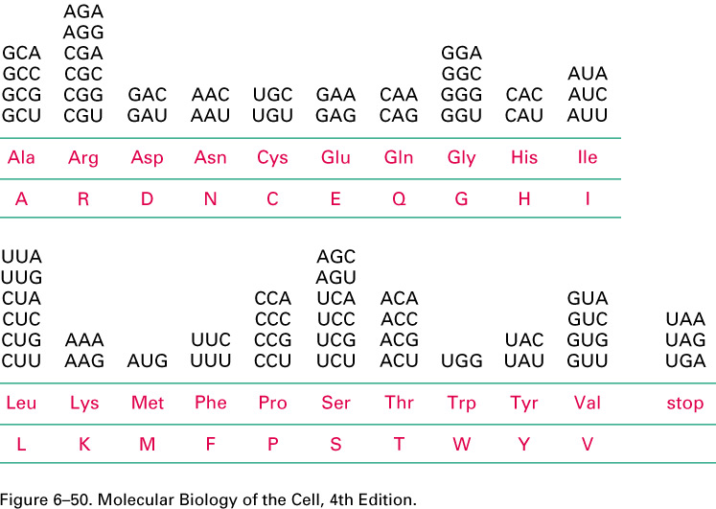
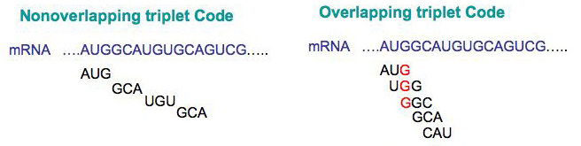
Cells use The Genetic Code to translate the
A-G-U-C nucleotides in an mRNA into the 20 different amino acids of proteins
3 nucleotides = 1 codon
The Genetic Code is:
Unambiguous – each codon ALWAYS and ONLY encodes the same amino acid
(E.g., CAA always and only = Q)
Degenerate – an amino acid can be represented by more than one codon
Non-overlapping – every 3 bases = one codon
Universal – ALL known organisms on Earth use the same genetic code

Slide 19
Translation
https://youtu.be/5bLEDd-PSTQ

Slide 20
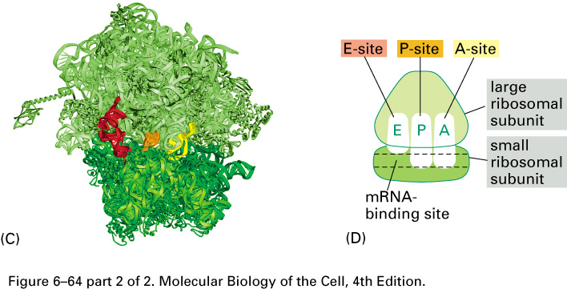
mRNAs are decoded by ribosomes
A site (aminoacyl tRNA entry)
P site (peptidyl transfer site)
E site (exit site)

Slide 21
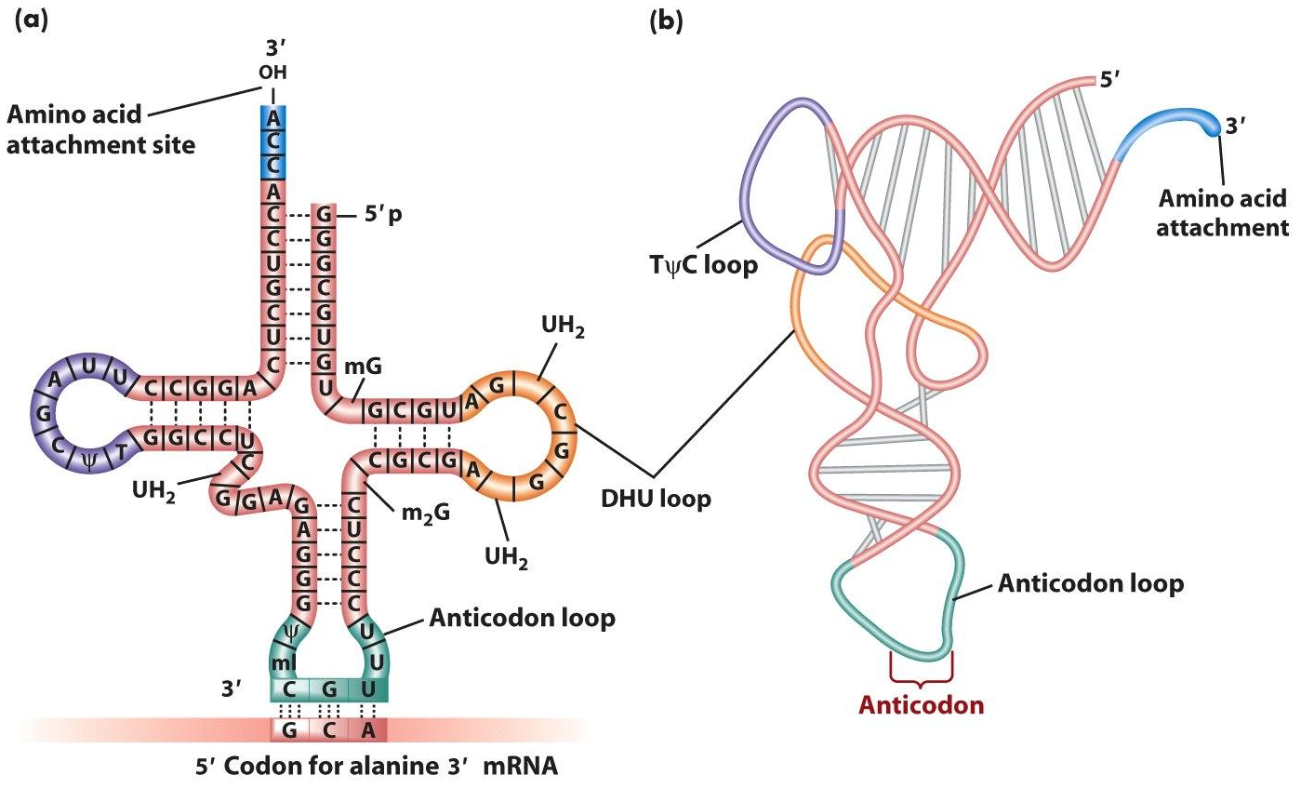
(transfer) tRNAs deliver the correct amino acid by pairing with the codon
How do tRNAs know which codon is right? They apply “The Rules”!! ☺
The codon and anticodon will base pair using complementarity
The tRNA and mRNA will be antiparallel as they base pair

Slide 22
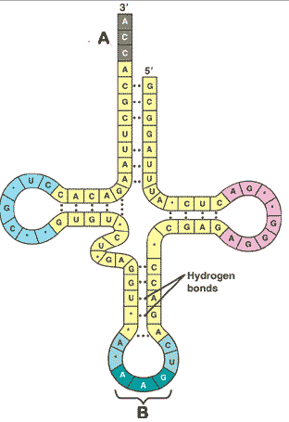
What is the codon that will be recognized by this tRNA?
AAG
TTC
UUC
CUU
CTT
GAA

Slide 23
What amino acid is encoded by this codon?
Leu
Ile
Glu
Lys
Phe

Slide 24
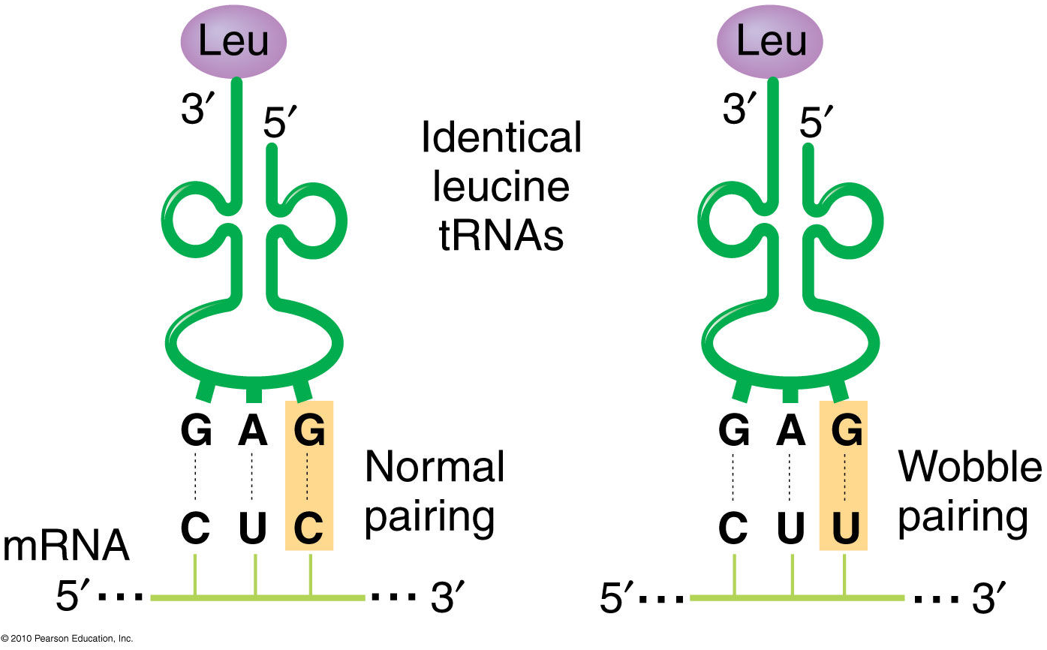
Wobble Bases
3rd position of the codon
Still favors a purine-pyrimidine base pairing, but allows pairing outside of conventional base pairs of A-T and C-G
One tRNA can identify two different codons
Why is it ok to have wobble pairing in this context, but NOT ok during a process like replication?

